Slide 1
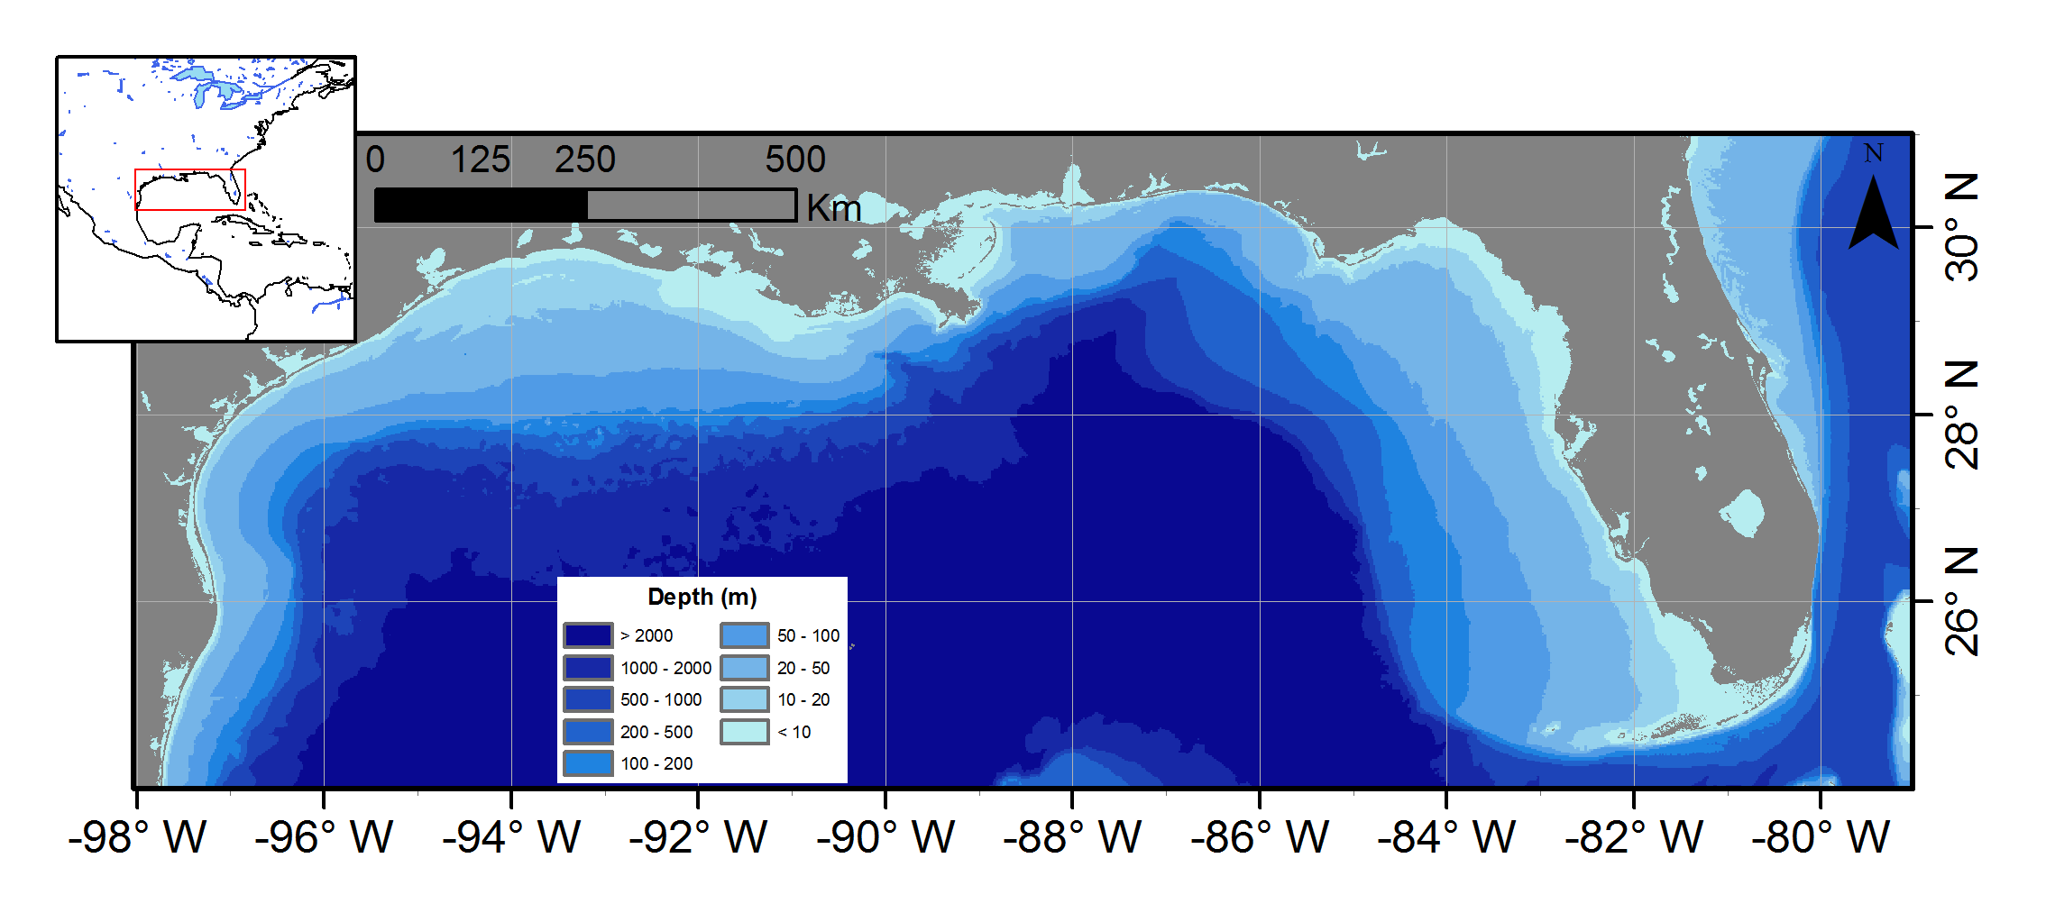

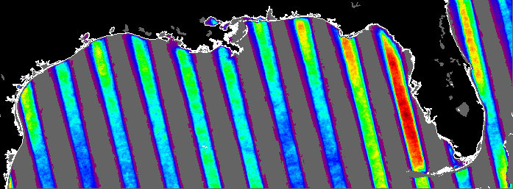
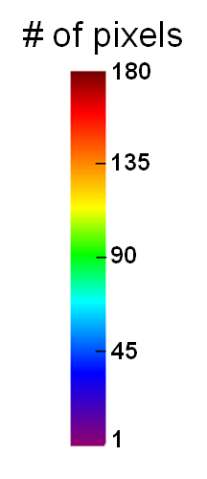
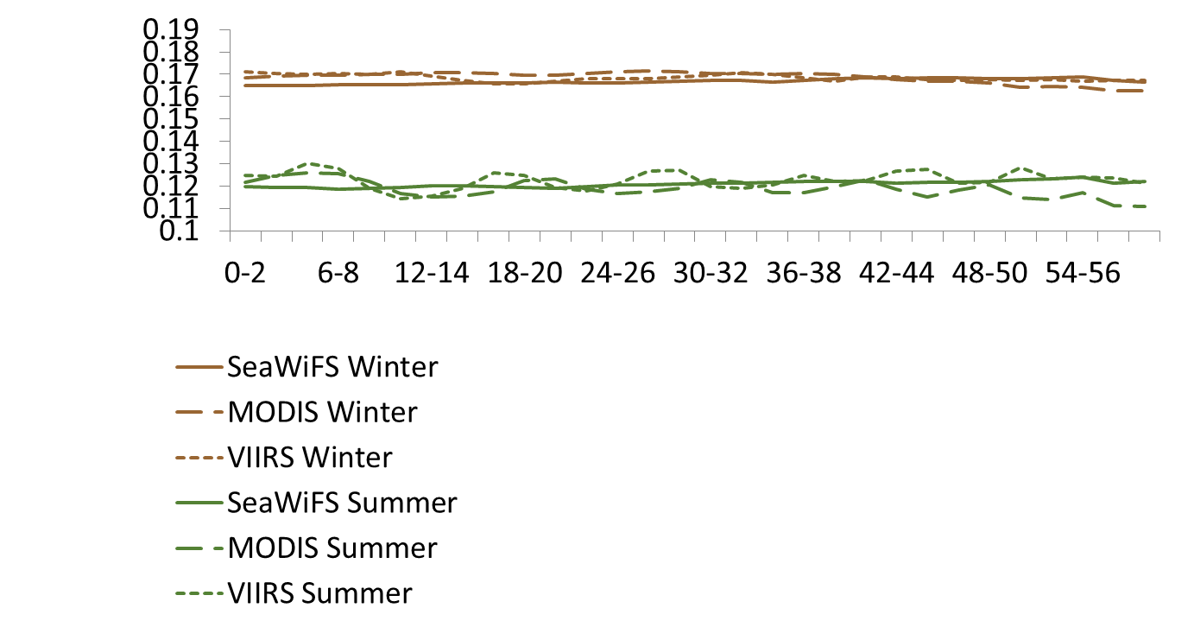
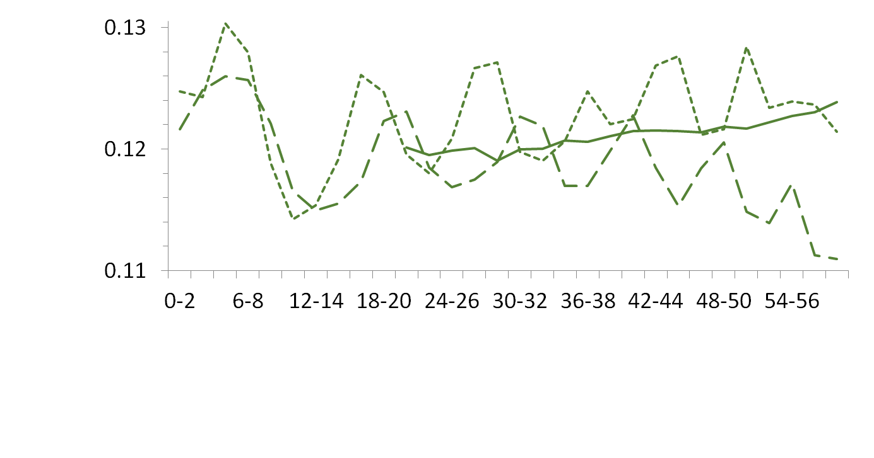
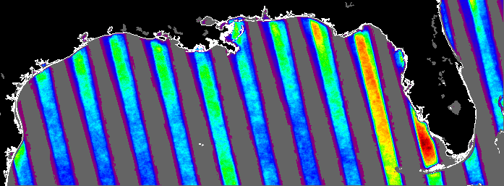
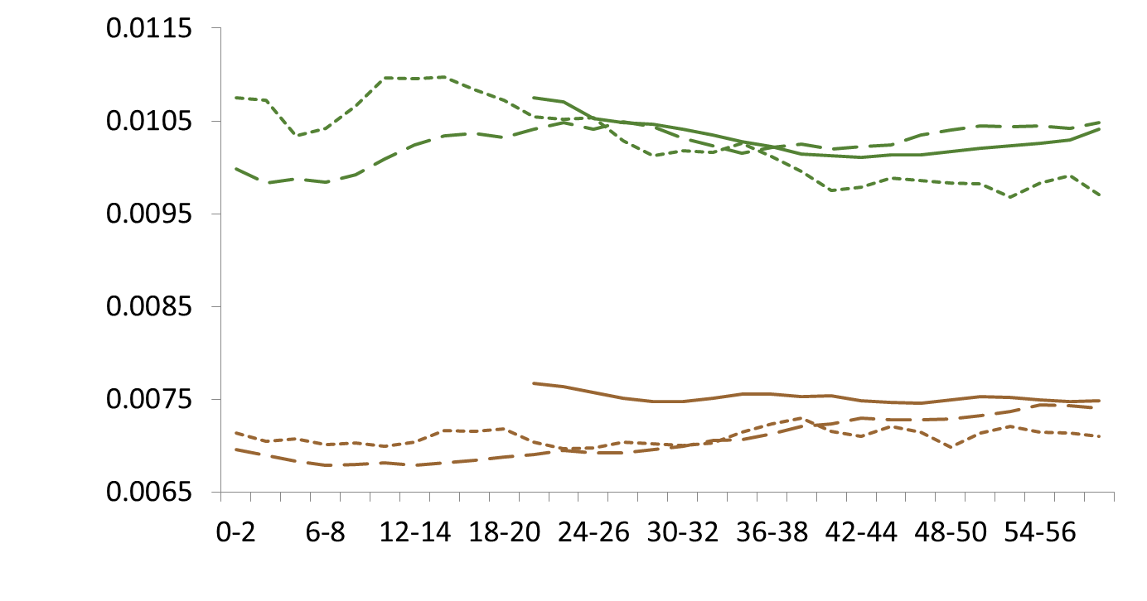
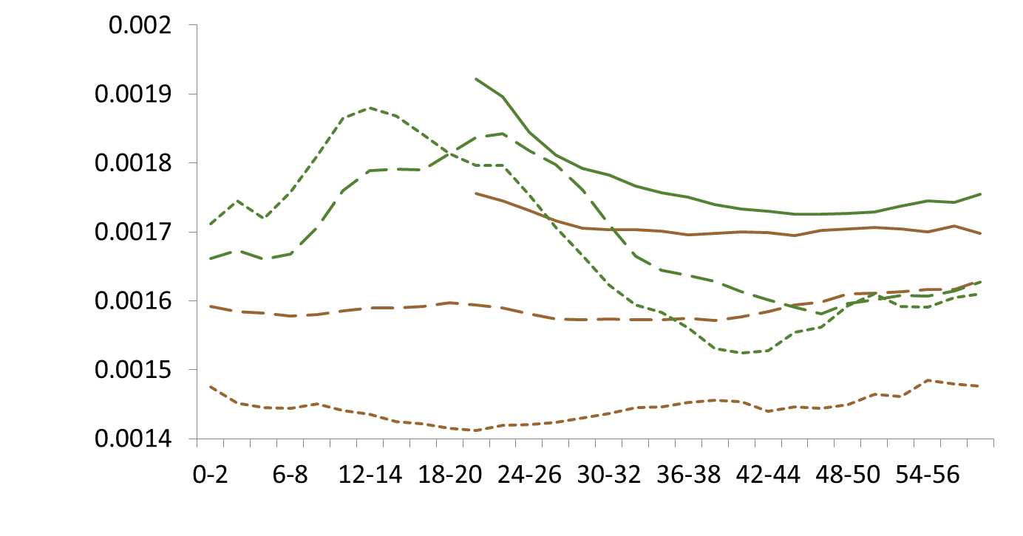
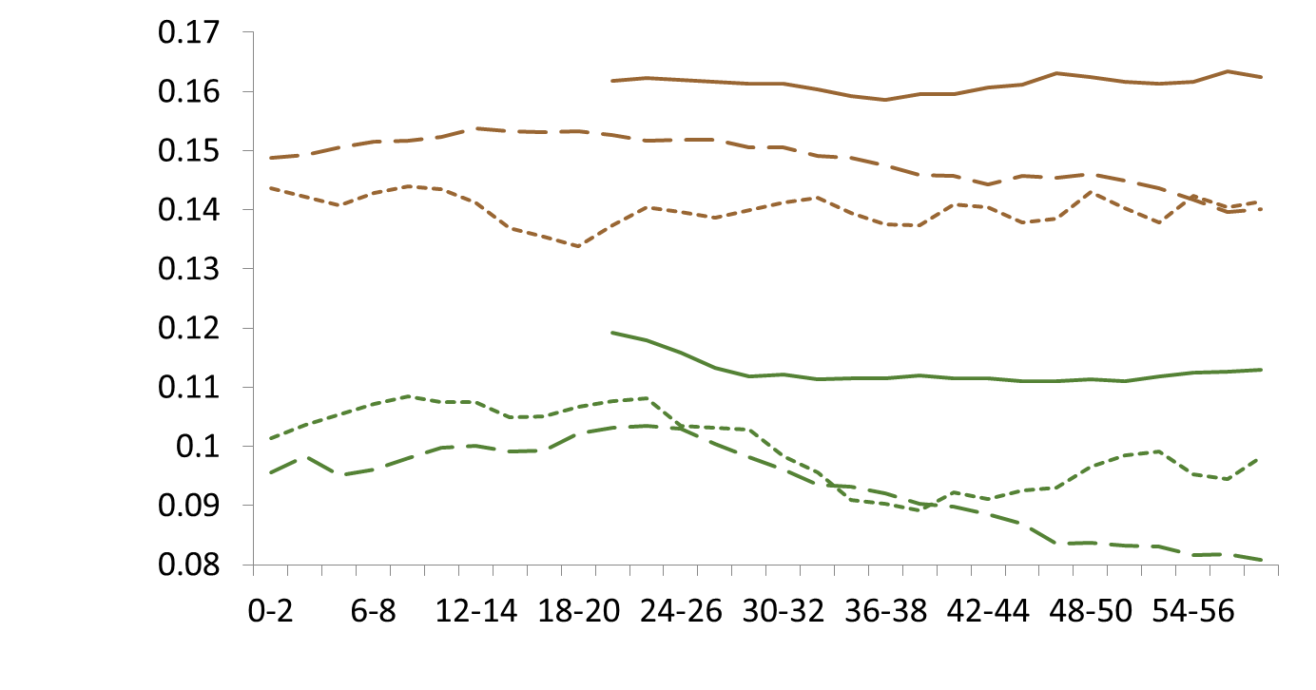

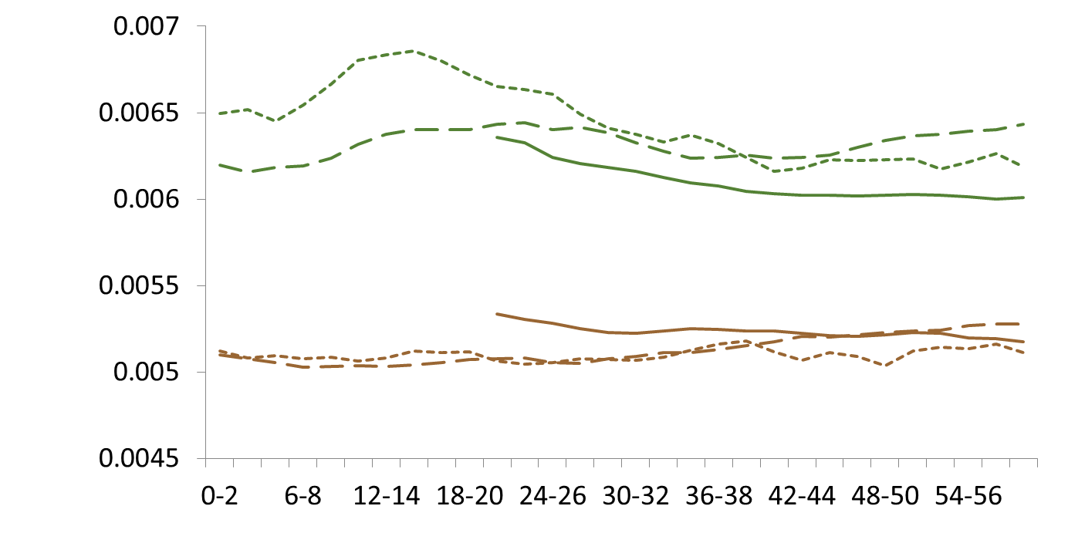
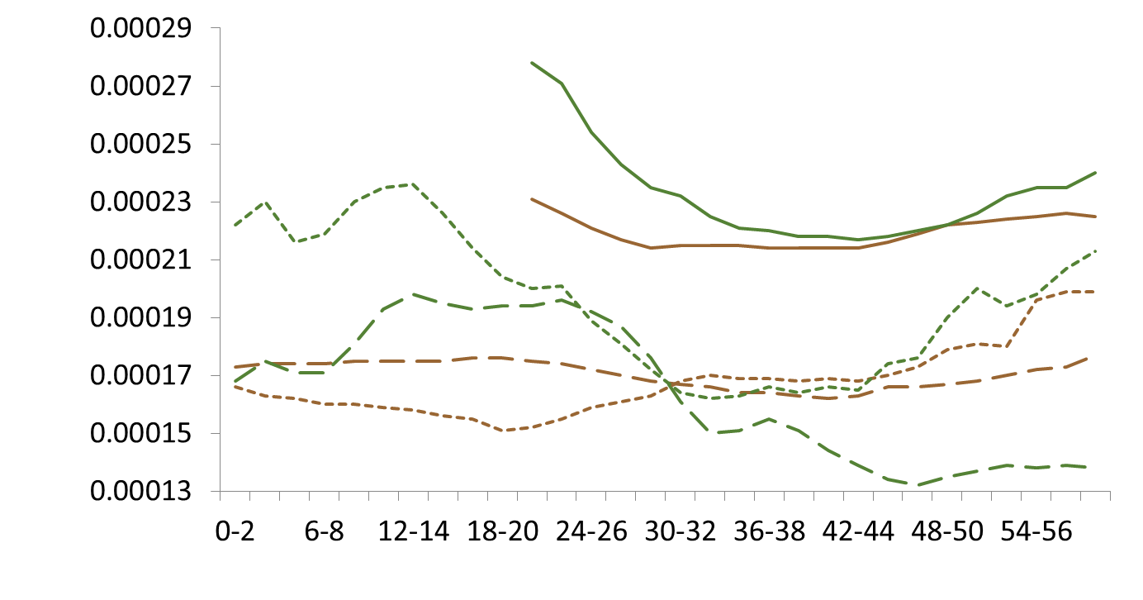
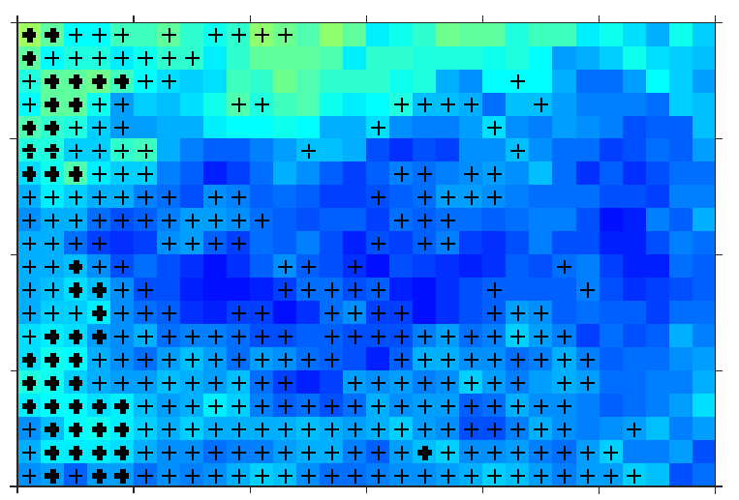
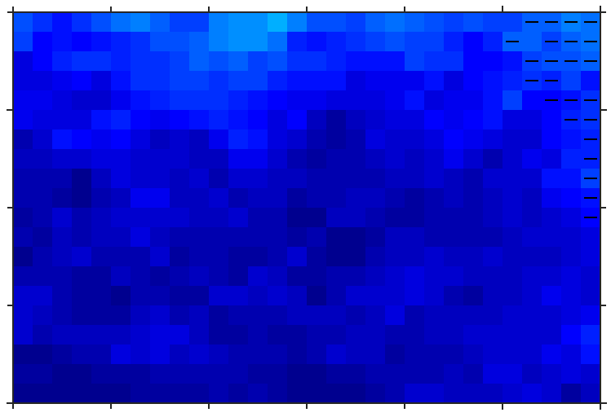
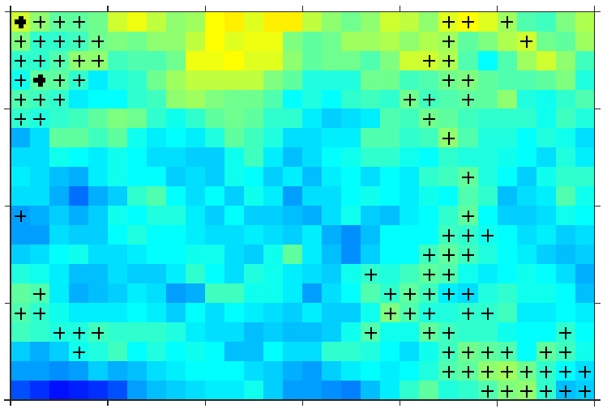
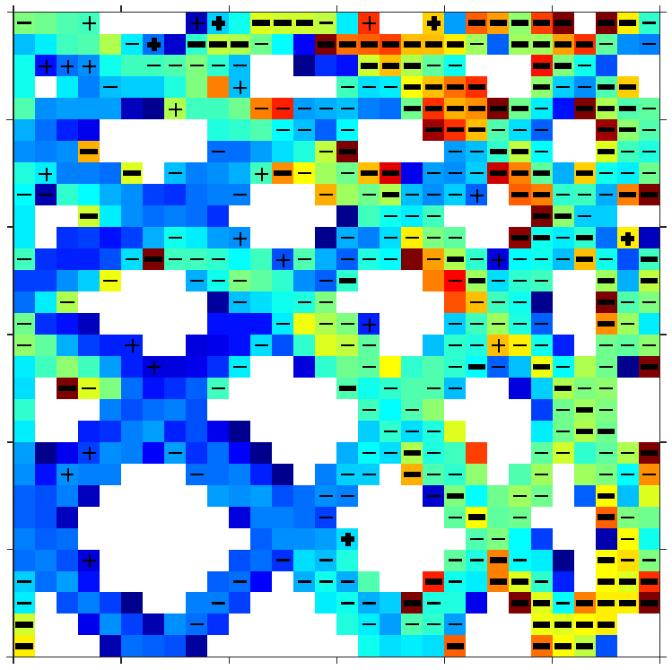
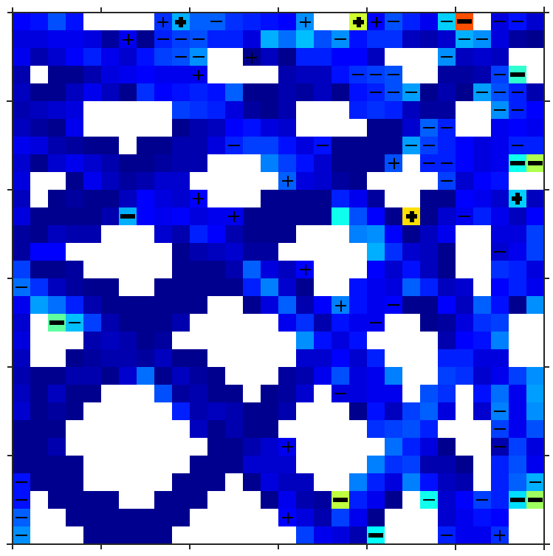
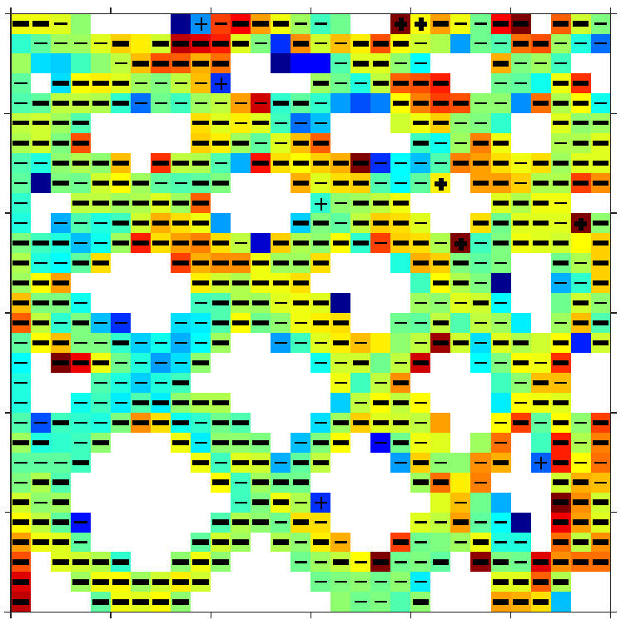
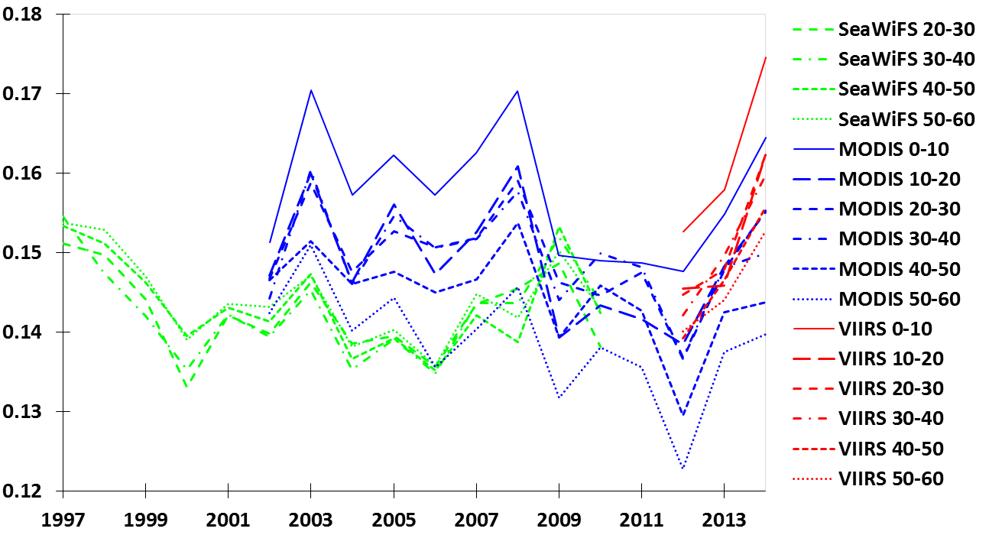
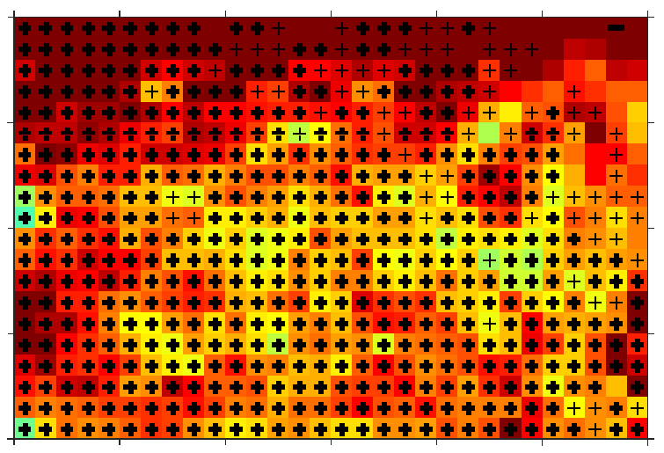
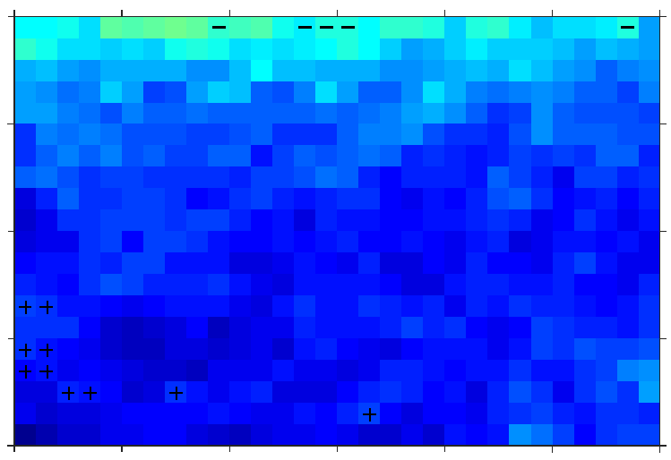
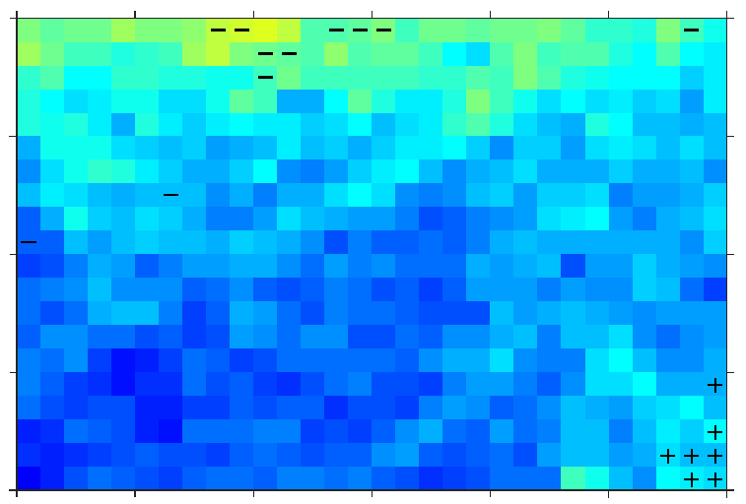
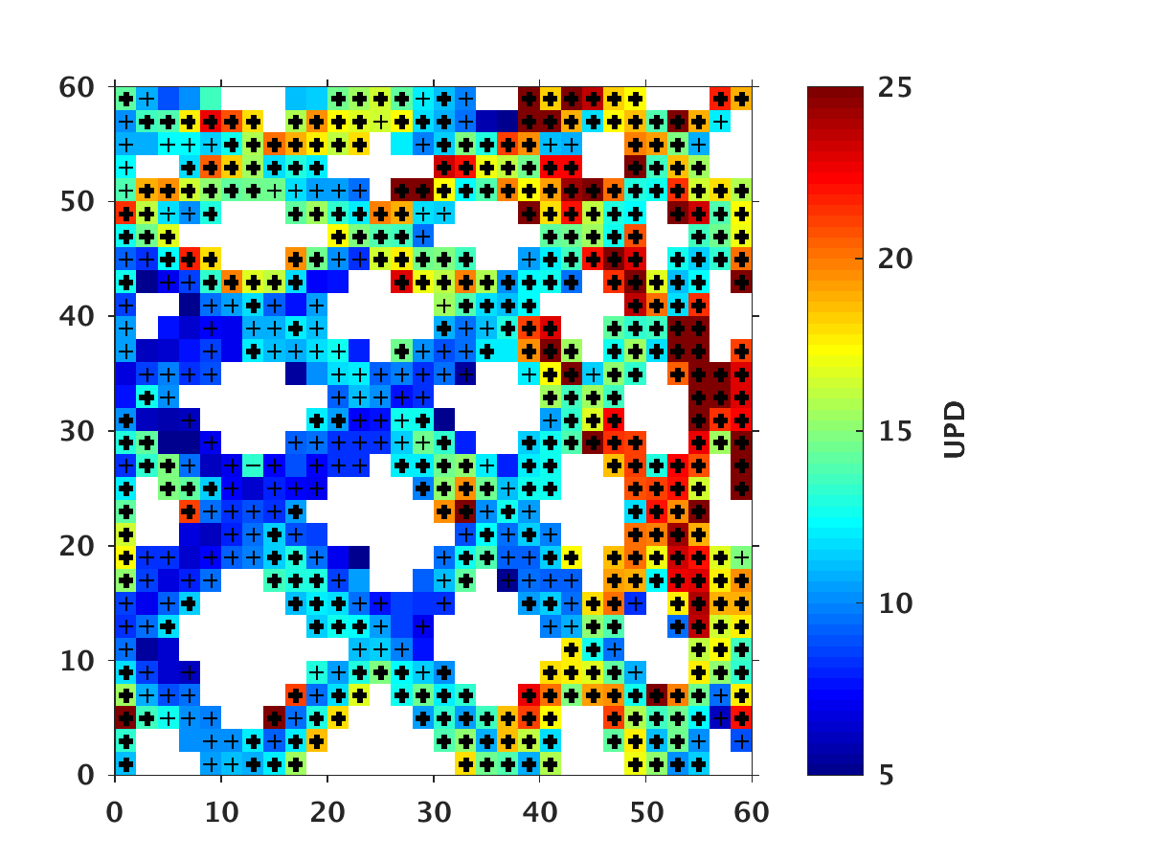
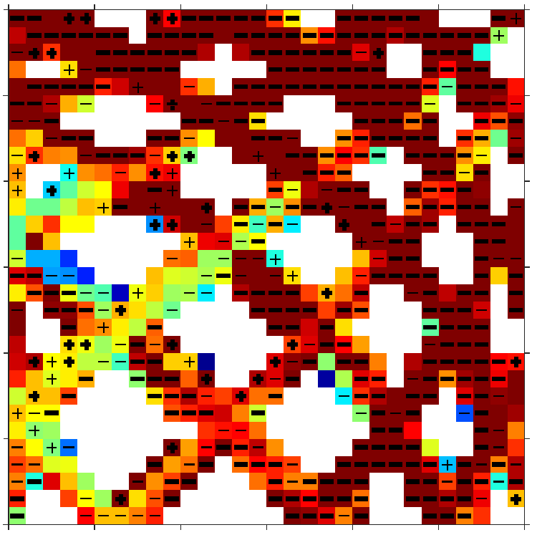
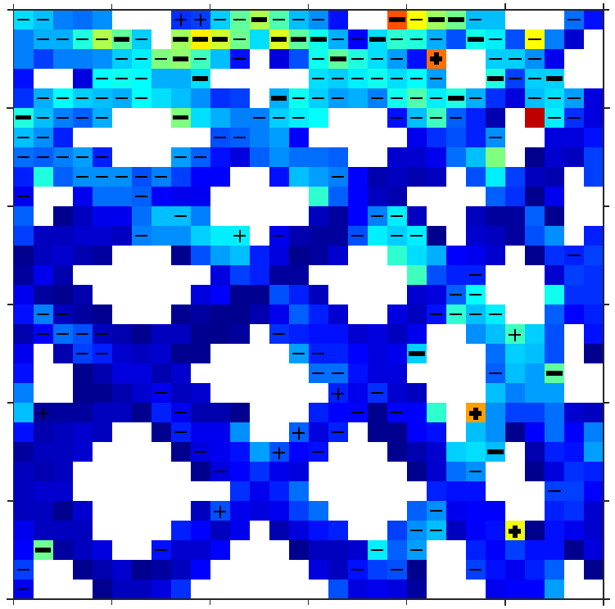
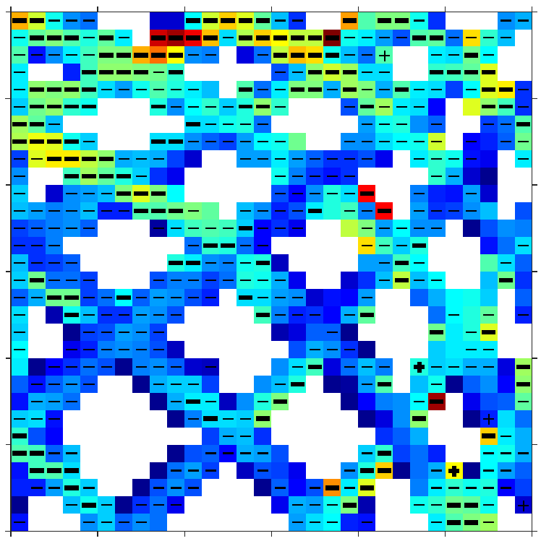
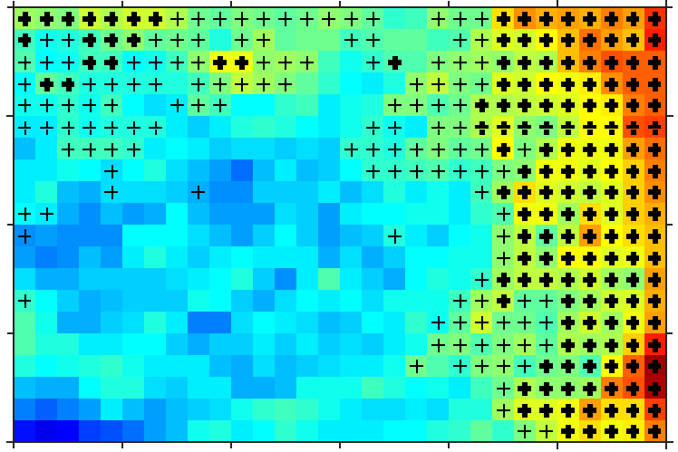
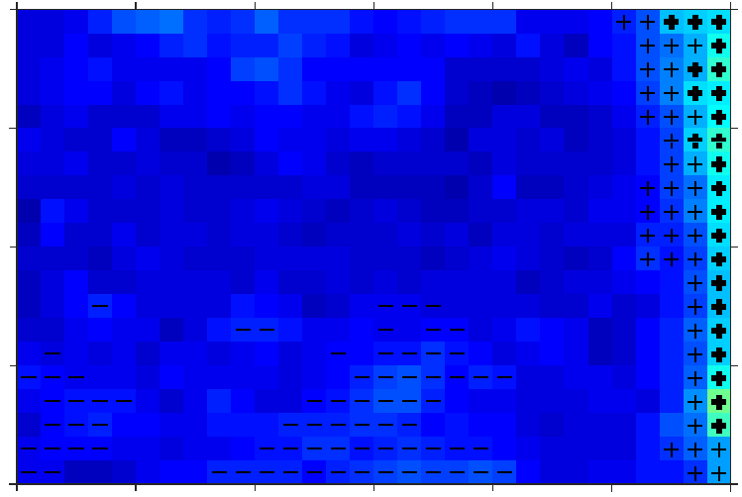
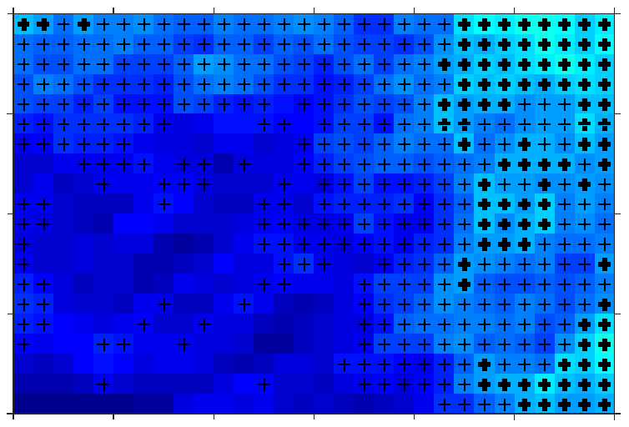
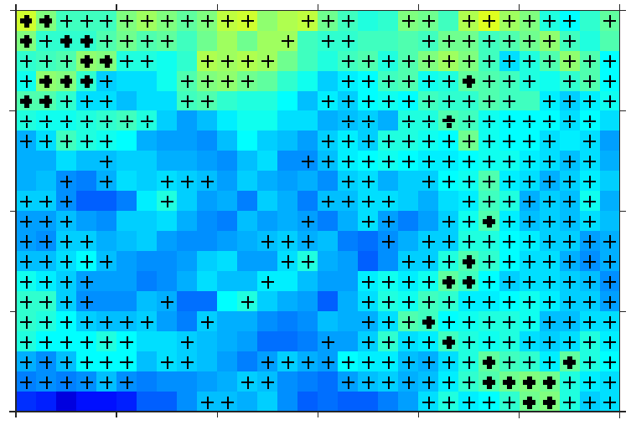

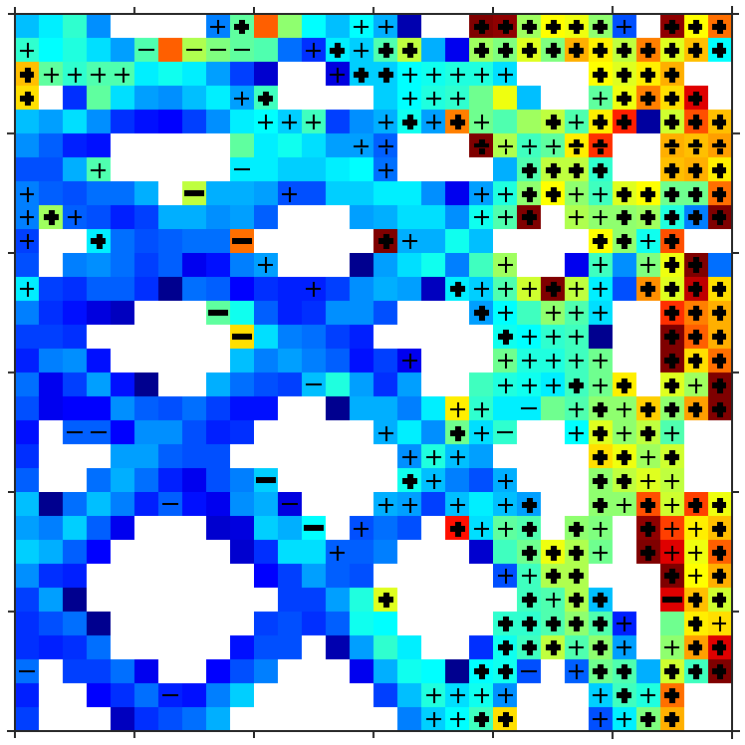
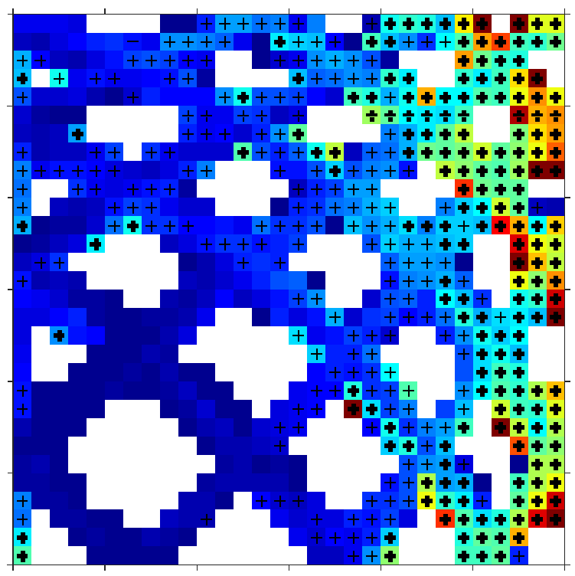
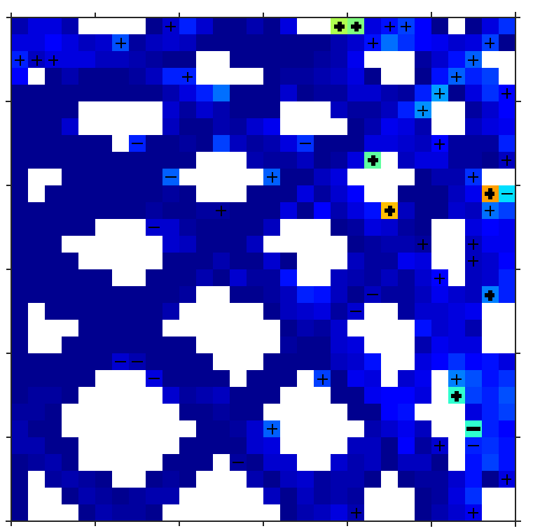
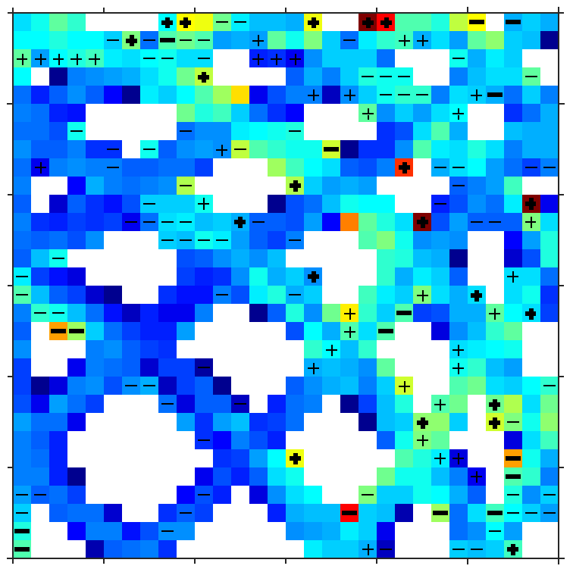
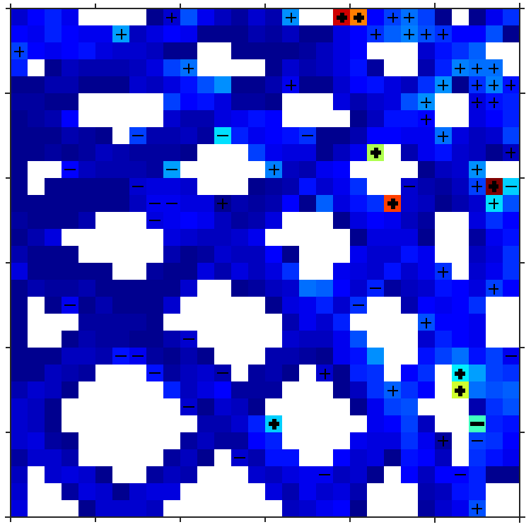
Dependence of satellite ocean color data products on viewing angles:
A comparison between SeaWiFS, MODIS, and VIIRS
Brian B Barnes and Chuanmin Hu
Optical Oceanography Lab, College of Marine Science, University of South Florida, 140 7th Avenue South, St Petersburg, Florida, 33701, USA
bbarnes4@mail.usf.edu, huc@usf.edu, www.optics.marine.usf.edu
Introduction & Objective
Study Area
Methods
Satellite-derived radiance and geophysical products may show errors according to sensor viewing geometry, causing variable uncertainties in derived time series as well as regional or global means. Angular dependence assessment is also necessary to inform future geostationary satellite design. Furthermore, assessment of continuity between various satellites is critical for production of continuous, multi-decadal datasets.
The objective of this study was to assess angular dependence of SeaWiFS, MODIS, and VIIRS using single- and merged-sensor datasets.
Download SeaWiFS (1997 – 2010), MODISA (2002 – 2014), and VIIRS (2012 – 2014) Level-2 HDFs covering study area from NASA GSFC
Map reflectance (R_{rs}), chlorophyll (CHL_{OCI} [1] and CHL_{OCx} [2]), water attenuation (K_{d}_lee [3]), QAA IOPs (a_{t} and b_{b} [4]), and sensor zenith (SZA) products to Level-3 at 1km resolution. Rescale green band R_{rs} to 555nm.
Remove questionable data, 3x3 median filter, subsample to 3km resolution
Subset Low Chla (CHL_{OCI} ≤ 0.25 mg m⁻³) and High Chla (CHL_{OCI} > 0.25 mg m⁻³)
Calculate regional means according to sensor zenith
Find cross-sensor matchups (collocated data measured within 1 hour)
Assess angular dependence using: variation in
UPD = Unbiased Percent Difference =
MRD = Mean Relative Difference =
Offshore water subset
Geographic component to angular dependence
Single sensor trends according to SZA - R_{rs}
MODIS 18 – 22°
For MODIS & VIIRS, most locations viewed from only ~6 SZAs. In this region, due to orientation of Florida, this causes oscillations in means according to sensor zenith
Using offshore waters removes geographic component to SZA dependence
Angular dependence still seen for all sensors, variable by product and season
Potential sun glint effects
MODIS & VIIRS summertime-only peaks in R_{rs}(555) and R_{rs}(667) at ~20° SZA
Potential residual BRDF uncertainties
SeaWiFS summer and winter Rrs( λ) highs at ~20° SZA
MODIS 24 – 28°
SeaWiFS
Mean CHL_{OCI} (mg m⁻³)
VIIRS
MODIS 18 – 22°
R_{rs}(555)
R_{rs}(412)
Summertime, full scene, Low Chla subset
MODIS
0
10
20
30
40
50
60
SZA (°)
Mean R_{rs} (sr⁻¹)
Single sensor trends according to SZA - Chla
MODIS 24 – 28°
Compared to CHL_{OCx} and R_{rs}(λ), CHL_{OCI} shows great agreement between sensors and little angular dependence
0
10
20
30
40
50
60
0
10
20
30
40
50
60
CHL_{OCx}
CHL_{OCI}
R_{rs}(488)
R_{rs}(667)
Mean Chla (mg m⁻³)
Mean R_{rs} (sr⁻¹)
0
10
20
30
40
50
60
0
10
20
30
40
50
60
0
10
20
30
40
50
60
0
10
20
30
40
50
60
SZA (°)
SZA (°)
SZA (°)
SZA (°)
Offshore only data, Low Chla subset
Offshore only data, Low Chla subset
Time Series of angular dependence
Cross-Sensor Agreement - R_{rs}
Low Chla
Low Chla
R_{rs}(412)
R_{rs}(488)
R_{rs}(555)
60
R_{rs}(412)
R_{rs}(488)
R_{rs}(555)
60
50
50
SeaWiFS SZA (°)
40
40
VIIRS SZA (°)
30
30
20
0
10
20
30
40
50
60
0
10
20
30
40
50
60
0
10
20
30
40
50
60
20
High Chla
10
Mean CHL_{OCI} (mg m⁻³)
60
0
0
10
20
30
40
50
60
0
10
20
30
40
50
60
0
10
20
30
40
50
60
50
High Chla
SeaWiFS SZA (°)
40
60
30
50
20
0
10
20
30
40
50
60
0
10
20
30
40
50
60
0
10
20
30
40
50
60
40
MODIS SZA (°)
VIIRS SZA (°)
No change in UPD with MODIS SZA,
except blue bands vs VIIRS
General Increase in UPD with SeaWIFS & VIIRS SZA
Blue band agreement better in Low Chla conditions
Red band agreement generally poor, better in High Chla
UPD (%)
30
Entire scene, Low Chla Subset
5
10
15
20
25
20
+ / - = MRD > 5%
+ / - = MRD > 10%
10
Year
0
0
10
20
30
40
50
60
0
10
20
30
40
50
60
0
10
20
30
40
50
60
MODIS angular dependence may be increasing with time
MODIS SZA (°)
Summary & Conclusions
Cross-Sensor Agreement – Chla, QAA, & K_{d}_lee
a_{t}(488)
b_{b}(488)
K_{d}_lee(488)
Angular dependence observed for all sensors
  Potentially due to sun glint (MODIS & VIIRS) and BRDF (SeaWiFS)
Impressive overall continuity for R_{rs}, with UPD generally < 10%
MRD for R_{rs} generally < 5%, with SeaWiFS > MODIS > VIIRS
Most angular dependence for SZA > 40°
CHL_{OCI} much more resilient to angular dependence than CHL_{OCx}
  Recent MODIS degradation may reduce continuity with VIIRS
  Consider validating MODIS Rrs with VIIRS
SZA dependence in R_{rs} does not propagate to QAA and K_{d}_lee products
a_{t}(488)
b_{b}(488)
UPD (%)
5
10
15
20
25
30
40
50
60
+ / - = MRD > 5%
+ / - = MRD > 10%
SeaWiFS SZA (°)
20
Severe CHL_{OCx} angular
dependence, not CHL_{OCI}
(circle) Due to recent
MODIS degradation?
K_{d}_lee and a_{t} errors less
than input R_{rs} (except
488nm) and more
resilient to SZA changes
b_{b} errors largest, but not
propagated to K_{d}_lee
0
10
20
30
40
50
60
0
10
20
30
40
50
60
0
10
20
30
40
50
60
0
10
20
30
40
50
60
0
10
20
30
40
50
60
10
20
30
40
50
60
Acknowledgment & References
VIIRS SZA (°)
0
This work was supported by the NASA OBB program and Water Quality program, and by the VIIRS cal/val program of NOAA NESDIS.
[1] Hu et al.(2012) J. Geophys. Res., 117:C01011
[2] O’Reilly et al (2000) NASA Technical Memorandum 2000-206892
[3] Z. Lee et al. (2005) J. Geophys. Res., 110:C02016
[4] Z. Lee et al. (2002) Appl. Optics, 41:5755-5772
0
10
20
30
40
50
60
0
10
20
30
40
50
60
0
10
20
30
40
50
60
0
10
20
30
40
50
60
0
10
20
30
40
50
60
MODIS SZA (°)
Low CHLA subset

