Slide 1
Status of International Air Quality Constellation Missions
Jay Al-Saadi, NASA
Jhoon Kim, Yonsei University
Ben Veihelmann, ESA
Pepijn Veefkind, KNMI
GEO-CAPE 2015 Open Community Workshop
US EPA, Research Triangle Park, NC
August 31 – September 2, 2015

Slide 2
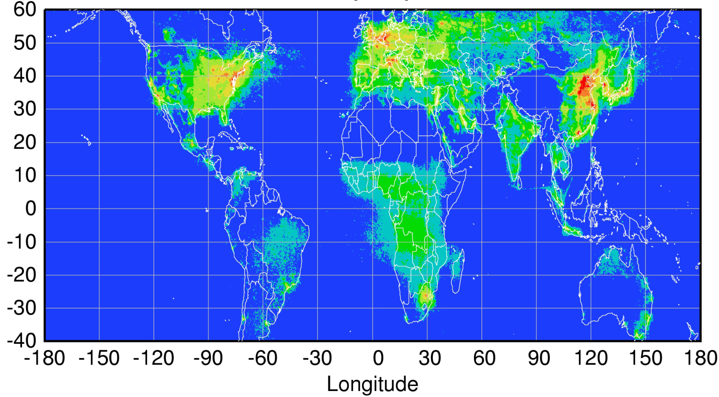
Global pollution monitoring constellation: Tropospheric chemistry missions funded for launch 2016-2021
Sentinel-4
(hourly)
TEMPO
(hourly)
GEMS
(hourly)
2021+ launch
2019-2021 launch
2019 launch
Sentinel-5P LEO
(once per day) 2016 launch
Courtesy Jhoon Kim,
Andreas Richter
Policy-relevant science and environmental services enabled by common observations
Improved emissions, at common confidence levels, over industrialized Northern Hemisphere
Improved air quality forecasts and assimilation systems
Improved assessment, e.g., observations to support United Nations Convention on Long Range Transboundary Air Pollution
2

Slide 3
Funded tropospheric chemistry mission parameters (as of 4/2015)
 | Europe Sentinel 4 | USA TEMPO | Korea GEMS | Europe Sentinel 5 Precursor TROPOMI
Orbit | Geostationary | Geostationary | Geostationary | Low-Earth
Domain | Europe and surrounding | North America | Asia-Pacific | Global
Revisit | 1 hour | 1 hour | 1 hour | 1 day
Status | Detailed Design, Phase C | Instrument CDR July 2015 | Instrument CDR complete | Instrument delivery 2015
Launch | 2021 (Flight Acceptance Review first instrument) | No later than 12/2021 | 2019 | 2016
Payload | UV-Vis-NIR 305-500, 750-775 nm | UV-Vis 290-490, 540-740 nm | UV-Vis 300-500 nm | UV-Vis-NIR-SWIR 270-500, 675-775, 2305-2385 nm
Products | O₃, trop. O₃, NO₂, SO₂, HCHO, AAI, AOD, height-resolved aerosol | O₃, trop. O₃, 0-2km O₃, NO₂, HCHO, SO₂, CHOCHO, AOD, AAI | O₃, NO₂, SO₂, HCHO, AOD | O₃, NO₂, SO₂, HCHO, AAI, AOD, height-resolved aerosol, CO, CH₄
Spatial Sampling | 8 km x 8 km at 45N | ≤ 2.22 km N/S x 5.15 km E/W @35N | 3.5 km N/S x 8 km E/W @38N | 7 km x 7 km nadir
Nominal product resolution | 8.9 km N/S x 11.7 km E/W @40N | ≤ 8.88 km N/S x 5.15 km E/W @35N | 7 km N/S x 8 km E/W @38N (gas), 3.5 km N/S x 8 km E/W @38N (aerosol) | 7 km x 7 km nadir
Notes | Two instruments in sequence on MTG-S; use TIR sounder on MTG-S (expected sensitivity to O3 and CO). Synergy with imager on MTG-I w.r.t. aerosol and clouds. | GEO-CAPE precursor or initial component of GEO-CAPE. Synergy with GOES-R/S ABI w.r.t. aerosol and clouds. | Synergy with AMI and GOCI-2 instruments w.r.t. aerosol and clouds. | In formation with S-NPP for synergy w.r.t. clouds and O₃.
3
Notes:
The limitation of GEO view is the lack of a global perspective
This can be mitigated through international cooperation to form a constellation from GEO
Timing and payloads demonstrate that threshold capability is ready
N. America-Europe-Asia covers the three primary economic/population/emissions regions

Slide 4
Air Quality Constellation Targets: Harmonization to improve data product quality and usage
CEOS* ACC** AQ Constellation leads developed recommendations for harmonization to mutually improve data quality and facilitate widespread use of the data products http://ceos.org/document_management/Virtual_Constellations/ACC/Documents/ACC_White-Paper-A-Geostationary-Satellite-Cx-for-Observing-Global-AQ_Apr2011.pdf
Includes LEO and GEO: LEO observations are a common transfer standard to link the GEO observations
Progress to date includes:
Sharing of instrument requirements influenced instrument specifications
Advocating open data policy (including L1B) with common formats
Agreed to use NetCDF format to easily exchange data (4/2015 ACC-11)
Establishment of new GSICS UV-Vis subgroup
AQ Constellation “Geophysical Validation Needs” document is in preparation
An AQ Constellation session will occur during Dec 2015 Fall AGU Meeting, to include preparatory field campaigns and all other aspects (Session A041)
*CEOS = Committee on Earth Observation Satellites **ACC = Atmospheric Composition Constellation

Slide 5
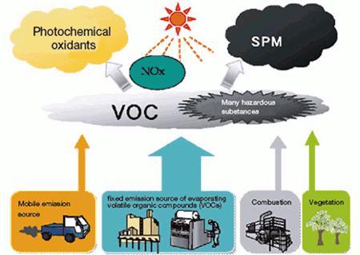
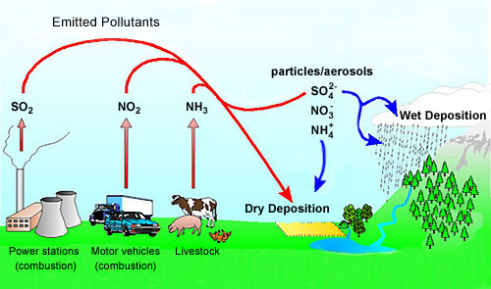
GEMS Objective: Measurements of O₃ & aerosol with precursors
hν (λ<345 nm)
O
O₃
HCHO
hν (<420 nm)
NO
NO₂
Oxidation
(OH, O₃, NO₃)
t~an hour
O₃, RO₂
AOD, type,
Height
Aerosol
5
Notes:
Formaldehyde (HCHO) is important as a tracer for HOx production,1 and has the potential to provide insight into the nature of convective events. It is one of the most abundant gas phase carbonyls in the atmosphere;2 tropospheric mixing ratios vary typically from 0.2 parts per billion by volume (ppbv) to 20 ppbv,3 depending on elevation and geography, and can reach as high as 60 ppbv.4 Stratospheric HCHO background concentrations are estimated to be much lower (~0.02 ppbv), but current methods lack sufficient sensitivity for a direct measurement. The dominant sources in urban areas include primary emissions from combustion and industrial processing and photochemical oxidation of numerous anthropogenic volatile organic compounds (AVOCs).2,5 Oxidation of biogenic VOCs (BVOCs) becomes important as a source in rural areas,2,5 while methane oxidation provides a source of HCHO (Fig. 1) in the remote troposphere and in the stratosphere.5
HCHO is fairly short-lived (τ ≈ 3 hours)6,7 and is removed from the atmosphere primarily by reaction with OH and by photolysis.2,3 Both of these processes produce HO2,3,6,8,9 and result in a net production of ozone (O3) in the presence of NOx (such as found in polluted urban areas).2 The interaction of HCHO in HOx chemistry has wide-reaching significance. HOx is a major oxidizer throughout the entire atmosphere and is central to catalytic cycles generating O3 in the troposphere and as well as those destroying O3 in the stratosphere, making accurate estimates of these species crucial to atmospheric modeling on both local and global scales.
Because of its implication in HOx cycling, as well as its role as an intermediate in the oxidation of numerous VOCs, HCHO is a useful tracer of the oxidative capacity of the atmosphere. HCHO may provide insight into oxidation processes in complex environments such as the atmosphere above snow-pack, where unexpectedly high OH concentrations have been observed,10 and that within forest canopies.11,12 For the second application, knowledge of HCHO fluxes would be especially useful. Fluxes can be approximated using Monin-Obukhov similarity theory,13 but because of the assumptions required for similarity theory direct HCHO flux measurement by eddy correlation is more desirable, leading to a more accurate closed budget of the species of interest.14–17

Slide 6
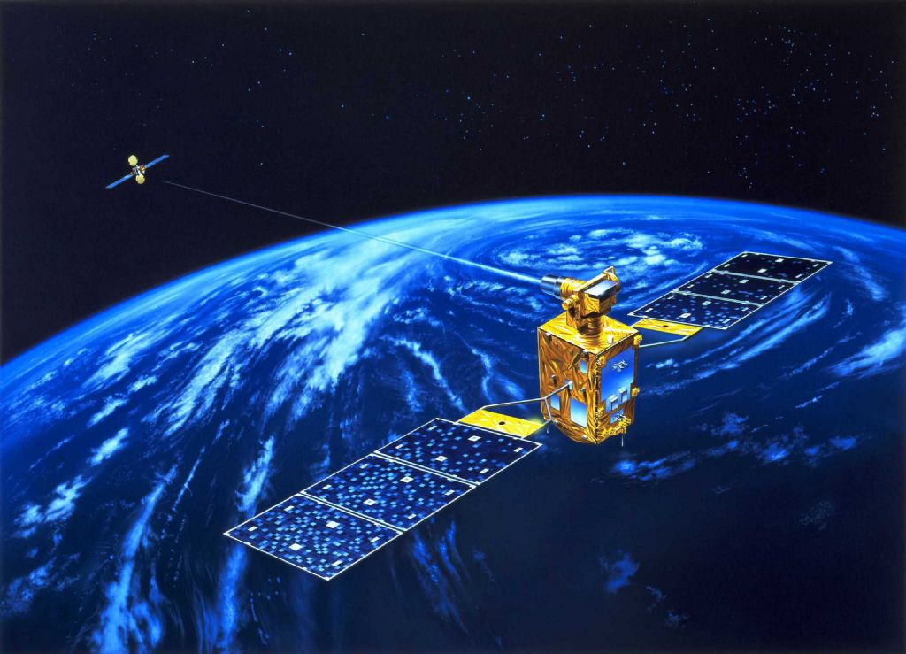
GEO-KOMPSAT 2
2A Sat. : AMI
2B Sat. : GEMS,
GOCI-2
Launch: May 2018(2A), Mar. 2019 (2B)
Specification
 | 2A | 2B
Payload | AMI | GOCI-2 | GEMS
Lifetime | 10 years
Channels | 16 | 13 | 1000
Wavelength range | 0.4 - 13 μm | 375 - 860 nm | 300-500 nm
Spatial resolution | 0.5 / 1 km (Vis) 2 km (IR) | 250 m@ eq 1 km (FD) | 7 x 8 km² @ Seoul 3.5x8 km² (aerosol)
Temporal resolution | 10 min (FD) | 1 hour | 1 hour
(Twin Satellite)
6

Slide 7
GEMS Summary
CDR of GEMS has been completed successfully and GEMS is now in manufacturing phase (Ball Aerospace) to be delivered to KARI by spring, 2017. The launch date for GEMS is now March, 2019.
GEMS onboard the Geo-KOMPSAT-2B is expected to provide information on aerosol and O₃ together with their precursors in high spatial and temporal resolution
O₃ NO₂ HCHO SO₂ AOD/AI/AEH, (possibly CHOCHO, BrO)
Clouds, surface reflectance, UV radiation.
The predicted performance of trace gases from the initial design of GEMS satisfies the product accuracy requirements of NO₂, HCHO, O₃. Meanwhile, the performance is expected to be poor in winter near Korea in particular.
Collaboration with Team of TROPOMI, Sentinel-4 & TEMPO is valuable in calibration, algorithm development and application.
7

Slide 8
Sentinel-4 Mission Objective
Sentinel-4 is designed to provide
Tropospheric composition measurements
With fast revisit time
At high spatial resolution over Europe
Operationally over 15 years
For the Copernicus Atmosphere Monitoring Services
Tropospheric NO₂ 2005-2007, Courtesy KNMI/OMI

Slide 9
The Atmospheric Sentinel Missions
GEOstationary (GEO)
Hourly revisit time over Europe
Mainly air quality
Diurnal cycle of tropospheric composition
Sentinel-4
Low Earth Orbit (LEO)
Daily revisit time global coverage
Climate, air quality, ozone & UV
Tropospheric & stratospheric composition
Sentinel-5
Sentinel-5 Precursor

Slide 10
Sentinel-4 Mission Implementation Status
S4/UVN instrument & Level-1b Prototype Processor developed by ESA with Airbus Defence & Space as prime
Preliminary Design Review completed
Intermediate Instrument Performance Review end 2015
Critical Design Review mid 2016
Flight Acceptance Review early 2021
Level-1b geometric processing (image navigation) developed on platform level
Level-2 Operational Processor developed by ESA
Kick-off expected June 2015
Prototype and Operational Processor
System Integration & Verification, support to Commissioning
EUMETSAT will operate the instrument and process the mission data up to Level-2

Slide 11
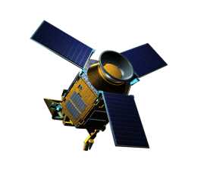
Sentinel 5 precursor COPERNICUS ATMOSPHERE MISSION IN POLAR ORBIT
The ESA Sentinel-5 Precursor (S-5P) is a pre-operational mission focussing on global observations of the atmospheric composition for air quality and climate.
The TROPOspheric Monitoring Instrument (TROPOMI) is the payload of the S-5P mission and is jointly developed by The Netherlands and ESA.
The planned launch date for S-5P is 2016 with a 7 year design lifetime.
TROPOMI
Contribution to Copernicus
UV-VIS-NIR-SWIR nadir view grating spectrometer.
Spectral range: 270-500, 675-775, 2305-2385 nm
Spectral Resolution: 0.25-1.1 nm
Spatial Resolution: 7x7km2
Global daily coverage at 13:30 local solar time.
Total column O₃, NO₂, CO, SO₂,CH₄, CH₂O,H₂O,BrO
Tropospheric column O₃, NO₂
O₃ profile
Aerosol absorbing index & layer height
11

Slide 12
TROPOMI in the CEOS AQ Constellation
Covering the spatial regions that are not covered by the GEO’s
Add products, e.g. CO, CH4, Aerosol layer height, aerosol profile.
Act as a “travelling standard” between the GEOs
S5P – SNPP constellation
12

Slide 13
Summary & Outlook
TROPOMI will be a major step forward for atmospheric composition observations due to improved spatial resolution & sensitivity.
TROPOMI will address important societal challenges: air quality, climate change, ozone layer.
The on-ground calibration has been finalized, analysis ongoing.
We are counting down for a launch in 2016!
veefkind@knmi.nl
www.tropomi.nl
www.tropomi.eu
sentinel.esa.int/s5p
13

Slide 14
Backup

Slide 15
Status of GEMS
GEO-KOMPSAT-2 Program
SRR in Apr., 2012; SDR in Feb. 2014, PDR in Jul., 2014,
CDR planned in Sep. 2015 for GK-2A, and Jan. 2016 for GK-2B
Budget
GEMS Program passed Mid-term review on Dec. 4, 2013, and now is in Main Phase till launch. (* Launch : Mar., 2019)
Prime Contractor
Ball Aerospace & Technologies Corp.( selected on May 13th, 2013)
* AMI contract with ITT; GOCI-2 contract with Astrium
GEMS Development
SDR in Oct., 2013, PDR in Mar., 2014, CDR in Feb., 2015
GEMS Telescope shall be assembled, aligned, and tested at KARI in 2015 (JDAK)
GEMS System integration and test shall be performed in 2016
GEMS shall be delivered to KARI from BATC spring of 2017
Changes in Environment
Air quality forecast in operation since 2013 by NIER/ME
→ GEMS to be an operational sat. (e.g. data assimilation of model with sat. data)
‘KORUS-AQ’ airborne campaign planned in 2016 (with GEOTASO)
15

Slide 16
The Atmospheric Sentinel Missions
Mission | Instrument | Utilization of data from
 |  | Imager | Infrared sounder | Other
Sentinel-4 | UVN spectrometer ⁽¹⁾ | FCI ⁽²⁾ | IRS ⁽¹⁾ | LI ^{(2,*)}
Sentinel-5 | UVNS spectrometer ⁽³⁾ | VII ⁽³⁾ | IAS ⁽³⁾ | 3MI ⁽³⁾
Sentinel-5 Precursor | UVNS spectrometer TROPOMI ⁽⁴⁾ | VIIRS ⁽⁵⁾ | CRIS ^{(5,*)} | OMPS ^{(5,*)}
⁽¹⁾ on MTG sounder (GEO)
⁽²⁾ on MTG imager (GEO)
⁽³⁾ on MetOp-SG (LEO)
⁽⁴⁾ on dedicated platform (LEO)
⁽⁵⁾ on SNPP/JPSS (LEO)
⁽*⁾ synergy on higher data level
UVN = Ultraviolet + Visible + Near infrared
FCI = Flexible Combined Imager
IRS = InfraRed Sounder
LI = Lightning Imager
UVNS = UVN + Short wave infrared
VII = Visible/Infrared Imager (MetImage)
IAS = Infrared Atmospheric Sounder (IASI-NG)
3MI = Multi-viewing, -channel, -polarisation Imager
TROPOMI = TROPOspheric Monitoring Instrument
VIIRS = Visible Infrared Imaging Radiometer Suite
CrIS = Cross-track Infrared Sounder
OMPS = Ozone Mapping Profiler Suite
MTG = Meteosat Third Generation
MetOp-SG = MetOp-Second Generation
SNPP = Suomi National Polar-orbiting Partnership
JPSS = Joint Polar Satellite System

Slide 17
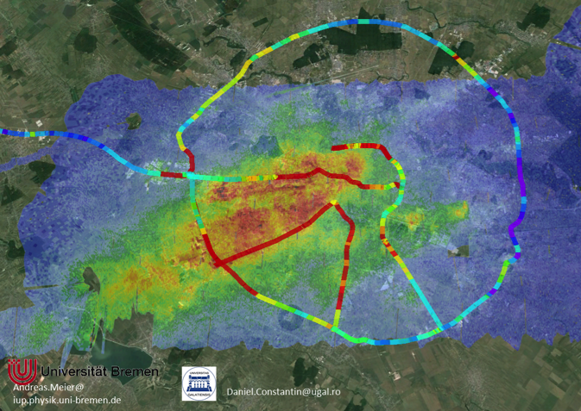
Geophysical Validation
2014: ESA AO
2015: ESA Validation Workshop
2014: AROMAT campaign, Romania
2015: AROMAT-II campaign, Romania
2016: Max-DOAS comparison campaign, NL
2017: ESA Campaign
2018: Cabauw Cloud campaign, NL
17

