Slide 1
Temporal resolution-focused studies including rate processes
Contributions from:
Chuanmin Hu, Univ South Florida
Maria Tzortziou, NASA
Bob Arnone, Univ Southern Mississippi
Antonio Mannino, NASA
Nick Tufillaro, Oregon State Univ
Joe Salisbury, Univ New Hampshire
Zhongping Lee, Univ Massachusetts Boston

Slide 2
Why we need high sampling frequency and what’s the impact?
Temporal variation vs sampling frequency:

Slide 3
Observing change
Wetipquin Marsh
18
35
16
30
14
25
[DOC]
12
[chl-a]
10
20
8
15
6
10
4
5
2
4
6
8
10
12
14
16
18
20
22
24
2
4
6
8
10
12
14
16
18
20
22
24
50
45
9
(300)
40
8
SF
35
7
CDOM
30
6
a
25
5
4
20
2
4
6
8
10
12
14
16
18
20
22
24
2
4
6
8
10
12
14
16
18
20
22
24
0.6
6
/[DOC]
SF / a
0.5
4
CDOM
0.4
a
2
4
6
8
10
12
14
16
18
20
22
24
2
4
6
8
10
12
14
16
18
20
22
24
2
0.018
Elapsed Time (h)
CDOM
0.016
Physics driven changes
S
0.014
Tzortziou et al. In Prep
2
4
6
8
10
12
14
16
18
20
22
24
Elapsed Time (h)
❖ Changes by a factor of 2-3 in CDOM within 6 hours.
❖ Changes by a factor of 2 in DOC concentrations.

Slide 4
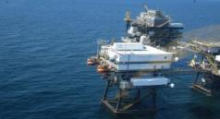
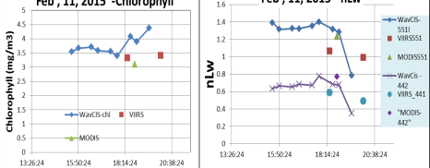
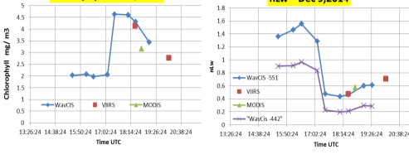
Characterizing the diurnal changes in bio-optical properties in coastal waters
Bob Arnone and Ryan Vandermeulen
WavCis
SeaPrism
How fast can Ocean Color change in ~ 100 minutes?
Synthetic Geostationary
Sensor - VIIRS Overlap
Physics driven changes

Slide 5
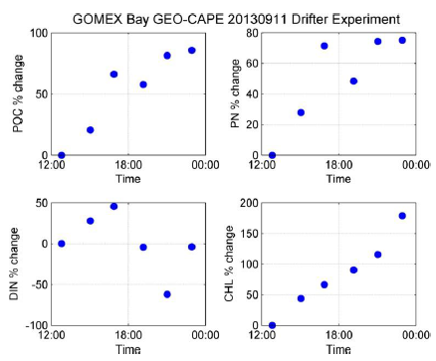
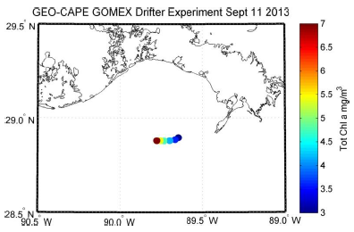
Gulf of Mexico Diurnal Variability in Biogeochemistry (drifters)
Small changes in DOC (<20%) and CDOM (15%; 40% offshore)
15% change in CDOM spectral slope offshore
Big changes in POC (up to 80%), chl-a (up to 175%), PN (40%), and DIN (180%); 1200% change in DIN offshore
Need GEO-CAPE temporal frequency of ~1 hour
Bio./chemo. driven changes
Mannino, Novak, Tzortziou, Mulholland

Slide 6
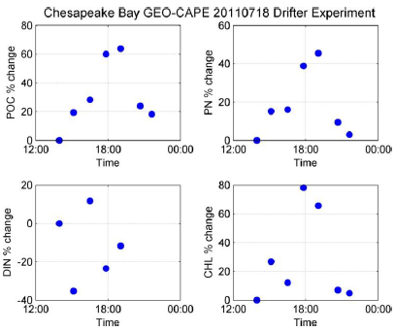
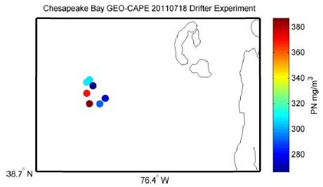
Chesapeake Bay Diurnal Variability in Biogeochemistry (drifters)
Little change in DOC and CDOM over time
Big changes in POC (up to 65%), chl-a (up to 80%), PN (45%), and DIN (55%)
Stationary site change over time: POC (30%), chl-a (25%), DIN (almost 60% drop in 3 hrs)
Need GEO-CAPE temporal frequency of ~1 hour
Bio./chemo. driven changes
Mannino, Novak, Tzortziou, Mulholland

Slide 7
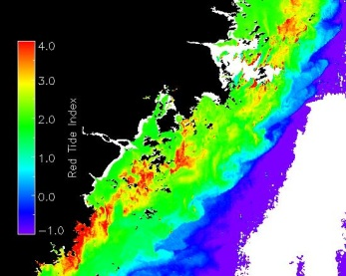
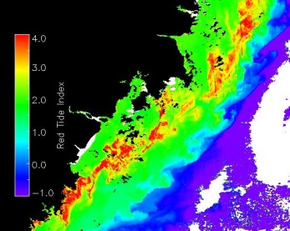
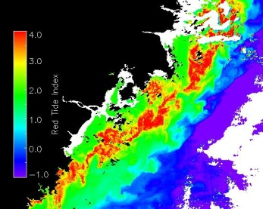
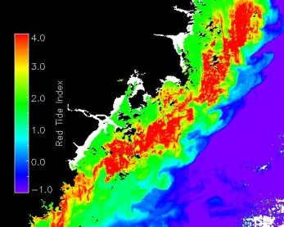
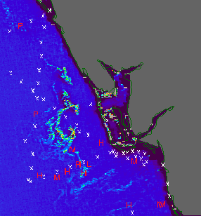
Diurnal changes of bloom size
GOCI-observed diurnal changes of a harmful algal bloom of Prorocentrum donghaiense along the East China’s coast. Annotated time is local time. Figure from Lou and Hu (2014).
Physics and bio./chemo. driven changes
08:30 29 May 2011
10:30 29 May 2011
12:30 29 May 2011
14:30 29 May 2011
GOES-observed diurnal changes of a Trichodesmium bloom off SW Florida (Hu and Feng, 2014)
5/22/2004
19:15
WFS
Bio./chemo. driven changes

Slide 8
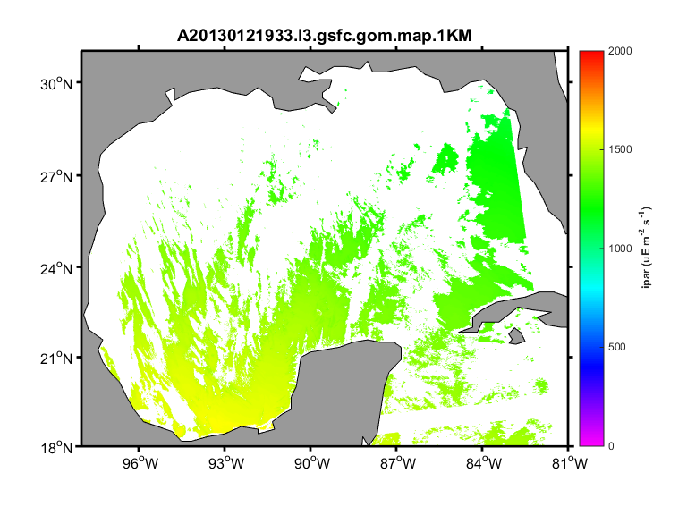
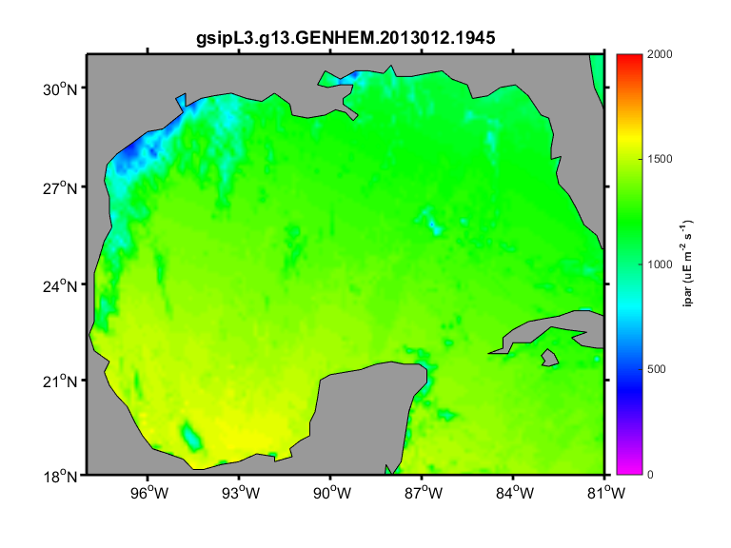
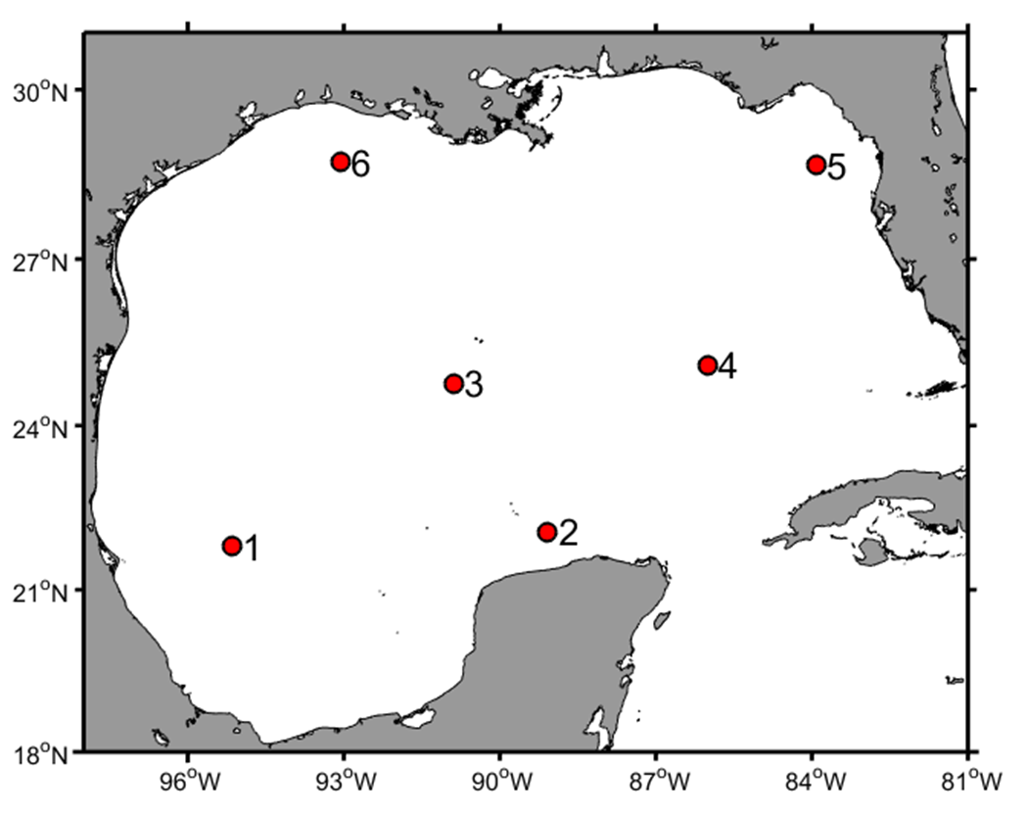
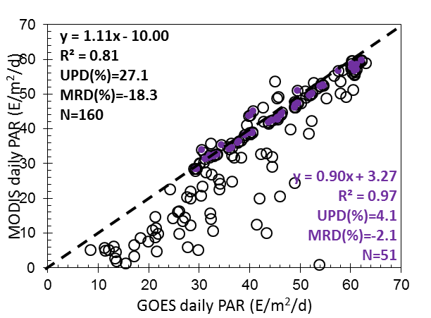
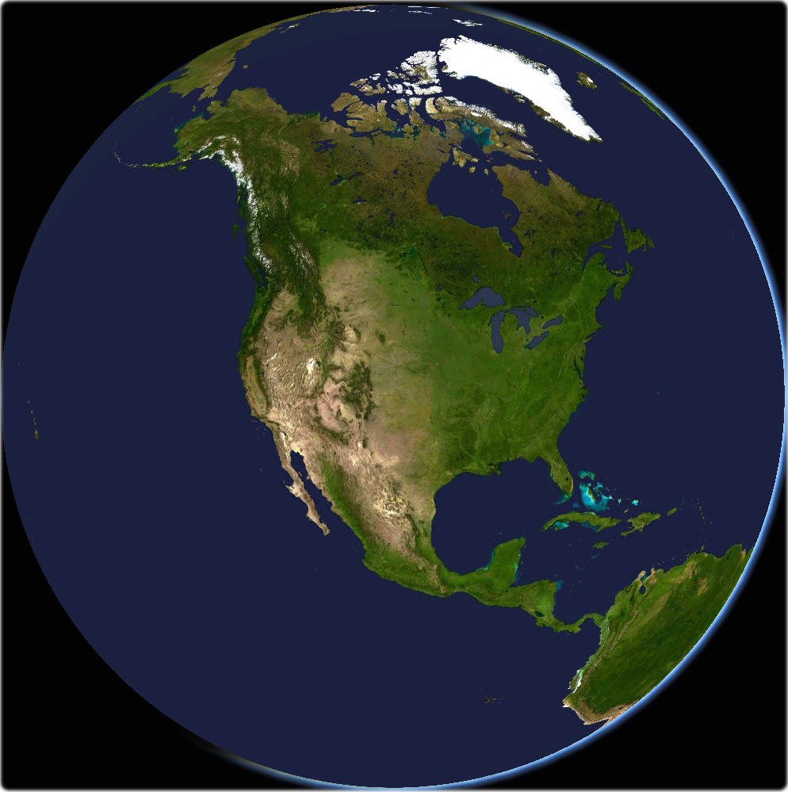
Solar radiation at Ocean Surface
Qi and Lee
Physics driven changes

Slide 9
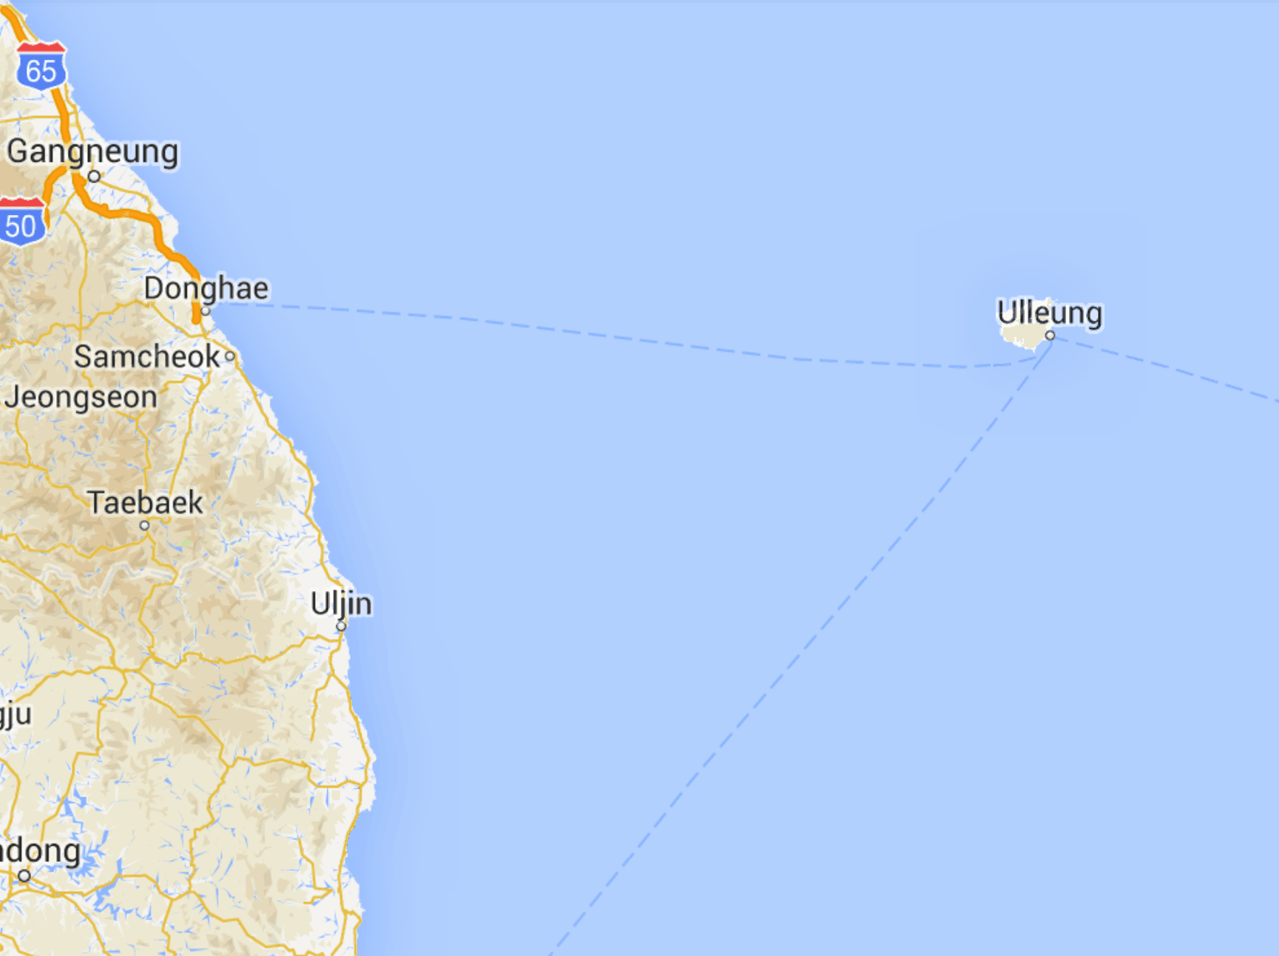
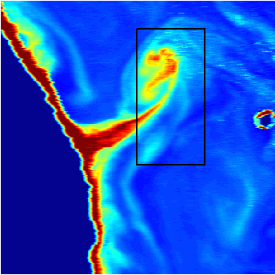
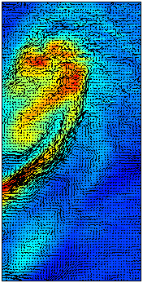
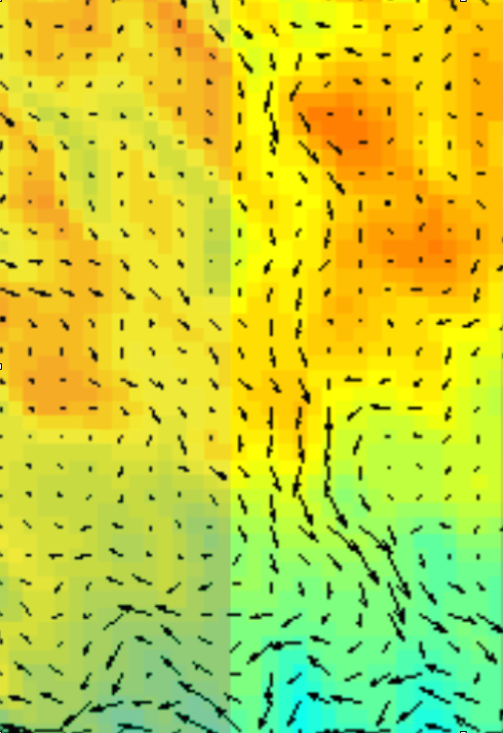
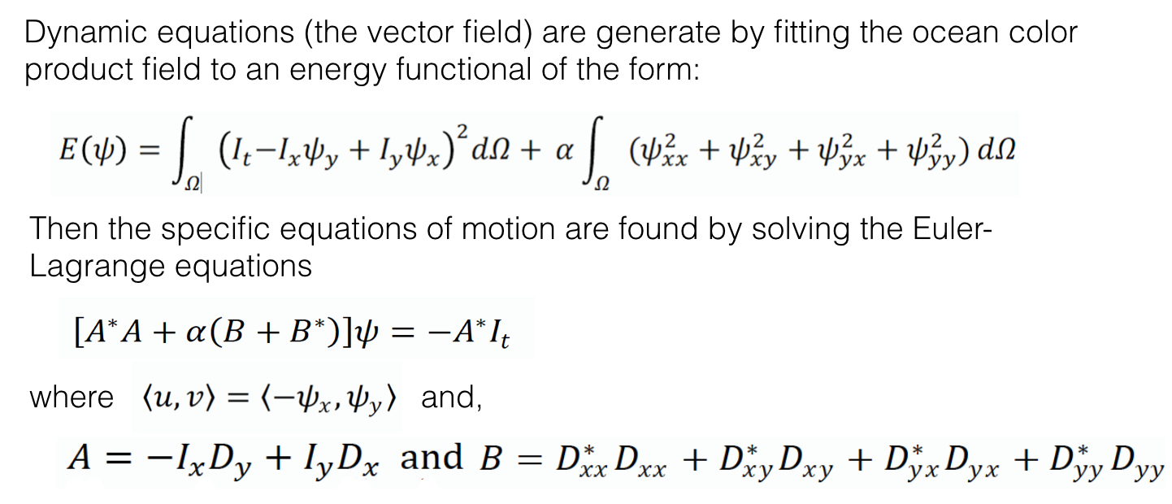
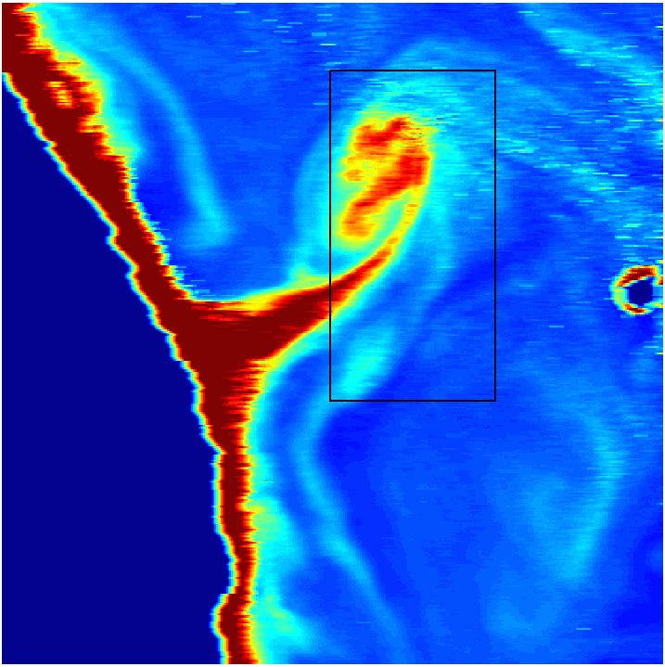
Applications: Derive physical/biogeochem. products
Nick Tufillaro
Optical Flow
➔ new dynamic ocean color products fields for tracking ocean color features such as coastal mesoscale plumes and blooms.
GOCI Example:
Region of Interest
Image Sequence
Vector Field
Flow Field (Zoom)
12:16 KST
13:16 KST

Slide 10
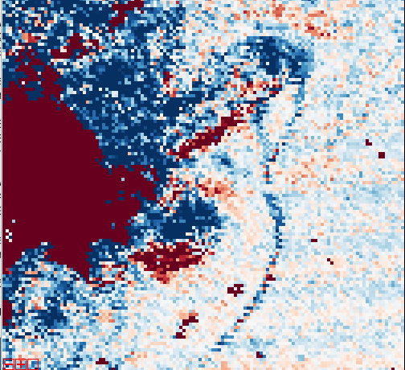
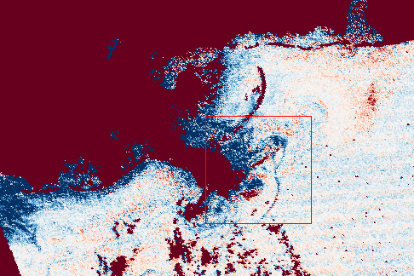
Characterizing the diurnal changes in bio-optical properties in coastal waters
Bob Arnone and Ryan Vandermeulen
WavCis
SeaPrism
Synthetic Geostationary
Sensor - VIIRS Overlap
Science Applications - Defining Temporal Changes
Chlorophyll
Difference
Frontal
Movement
Bloom
Second Pass Greater
-1 (mg/m3) +1
Surface Currents
Bloom Decay

Slide 11
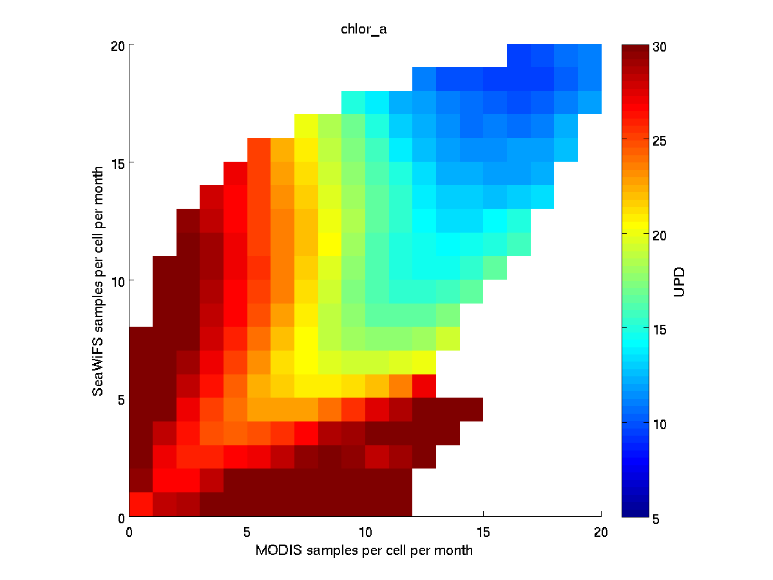
Applications:
Differences in monthly mean products for clear waters of the Gulf of Mexico
From Barnes and Hu (2015, IEEE TGRS)
Notes:
Chl Ocx comparison. Mean UPD (%) for monthly matchups as a function of the number of measurements from the two satellites per grid cell (0.25 by 0.25 degree) per month.

Slide 12
Applications:
Daily primary production
(Lee et al 2012)

Slide 13
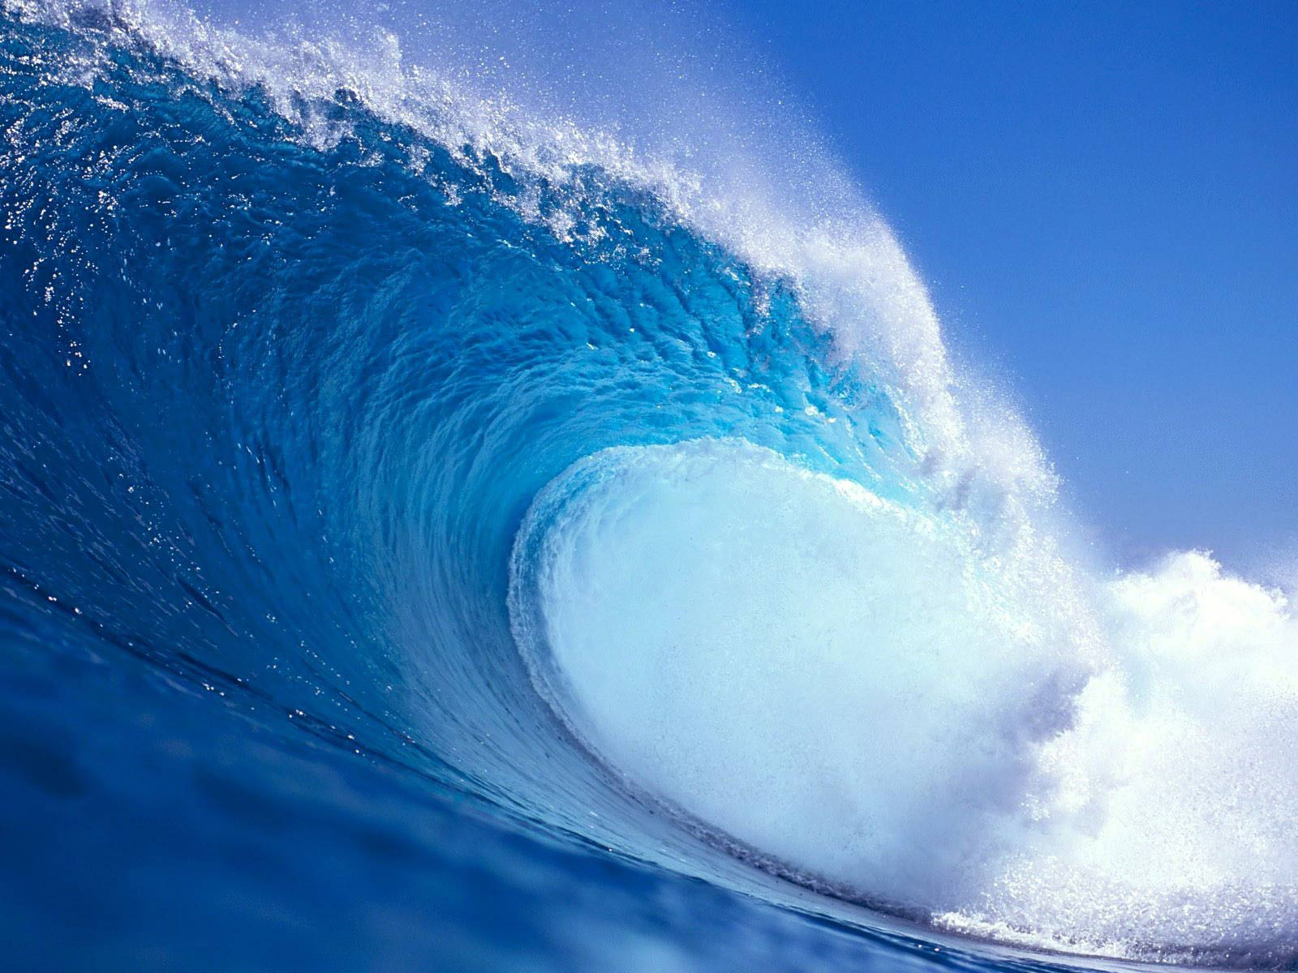
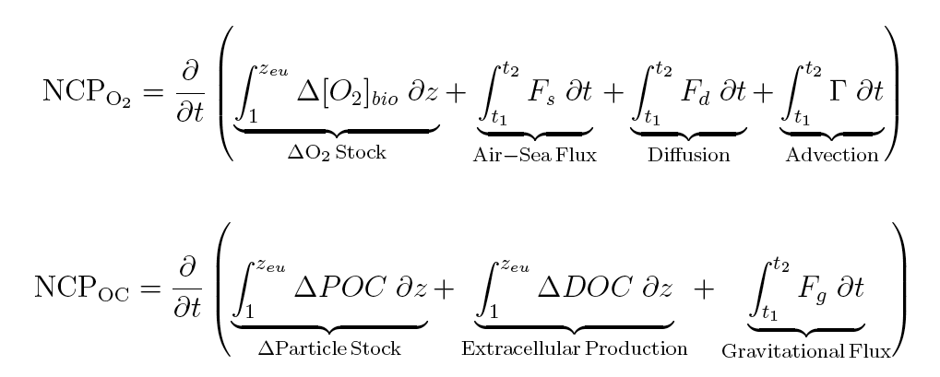
Applications:
Tracking Particle and Oxygen stocks during GOMEX
Get this term with GEO data
We assume these are equivalent (within the context of a homogenous water mass)

Slide 14
Estimating NCP by tracking sat particle inventories in a Lagrangian context
Jonsson, Salisbury, Mahadevan, Campbell (2009)
Jonsson, Salisbury, Mahadevan (2011)
Premise:
PC_{t1}
(PC_{t2} - PC_{t1})
= NCP proxy
(t2 - t1)
PC_{t2}
PC = satChl * Θ *z_{e}
z_{e} =log_{e}(0.01)=K490
Θ (Phytoplankton carbon) modified from Behrenfeld et al., 2005
***Movie examples shown w/ chl
Notes:
Premise is that the change in POC inventories over time and space is related to NCP

Slide 15
Start
End
From Mannino’s data

Slide 16
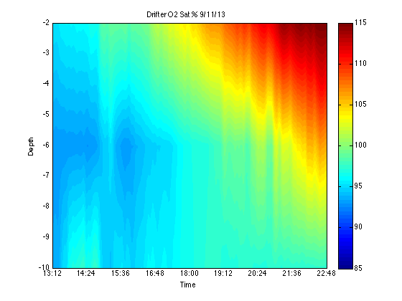
Increasing O₂ sat in Lagrangian time-space (8am – 6PM local)
Bio./chemo. driven changes
Need 1-2 Hourly data to track the bloom in Lagrangian time space
…. and 2-3 hourly to estimate the net production
Evidence of a strong bloom along the flow path!
Salisbury and Shellito

Slide 17
Conclusions:
Hourly sampling frequency is critical for studying coastal phy./biogeochem. processes!

