Slide 1
Spatial Variability of Trace Gases from P-3B in-situ Measurements and the WRF-Chem Model During DISCOVER-AQ
Melanie Follette-Cook
Ken Pickering
Jim Crawford
Thanks to A. Weinheimer, A. Fried, G. Diskin, R. Cohen, and A. Wisthaler for their data

Slide 2
Background
We want to quantify the variability that a geostationary instrument like TEMPO would observe.
Is the resolvable variability sufficient to answer the relevant air quality science questions for the geostationary instruments?
Follette-Cook et al. (2015) Atmos. Environ.
Quantified the variability seen in the Maryland/DC DISCOVER-AQ P-3B trace gas data and found it compared well with our WRF/Chem simulation
Questions addressed in that analysis:
How much does each species vary spatially and temporally throughout the campaign? (i.e. one month)
How much of that variability would a TEMPO-like instrument see?
Is the resolvable variability sufficient to answer the relevant science questions?
Notes:
Put satellite in motivation

Slide 3
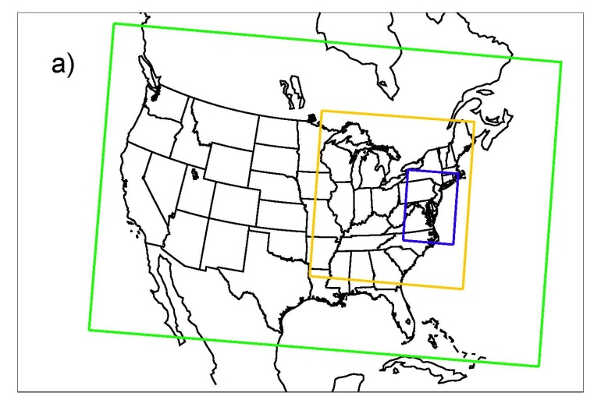
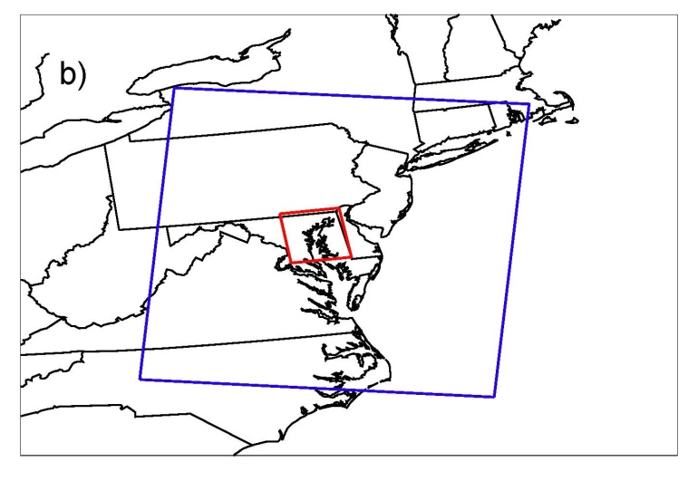
WRF/Chem simulation
4 km
4 km
12 km
36 km
Small sub-domain corresponding with DISCOVER-AQ region
(4 km horizontal resolution)
Simulation length: 6/27/2011 12Z – 8/2/2011 0Z
Meteorology was initialized every three days

Slide 4
Structure Functions
Structure functions are a useful way to quantify variability in both space and time. The equation for a spatial structure function will be as follows:
ƒ(Z, y)≡<⏐Z(x + y) - Z(x)⏐^{q}>
Where < > denotes the average of data pairs separated by distance y, Z is the variable of interest at a given location x, and q is a scaling exponent. In this case, q=1.
For structure functions using DISCOVER-AQ P-3B data:
- Both points must be below 2 km (AGL)
The points must be < 2 hrs apart (1.75 hrs for MD)
The 1 second merge data was used for this analysis
WRF/Chem output was sampled along the P-3B flight track

Slide 5
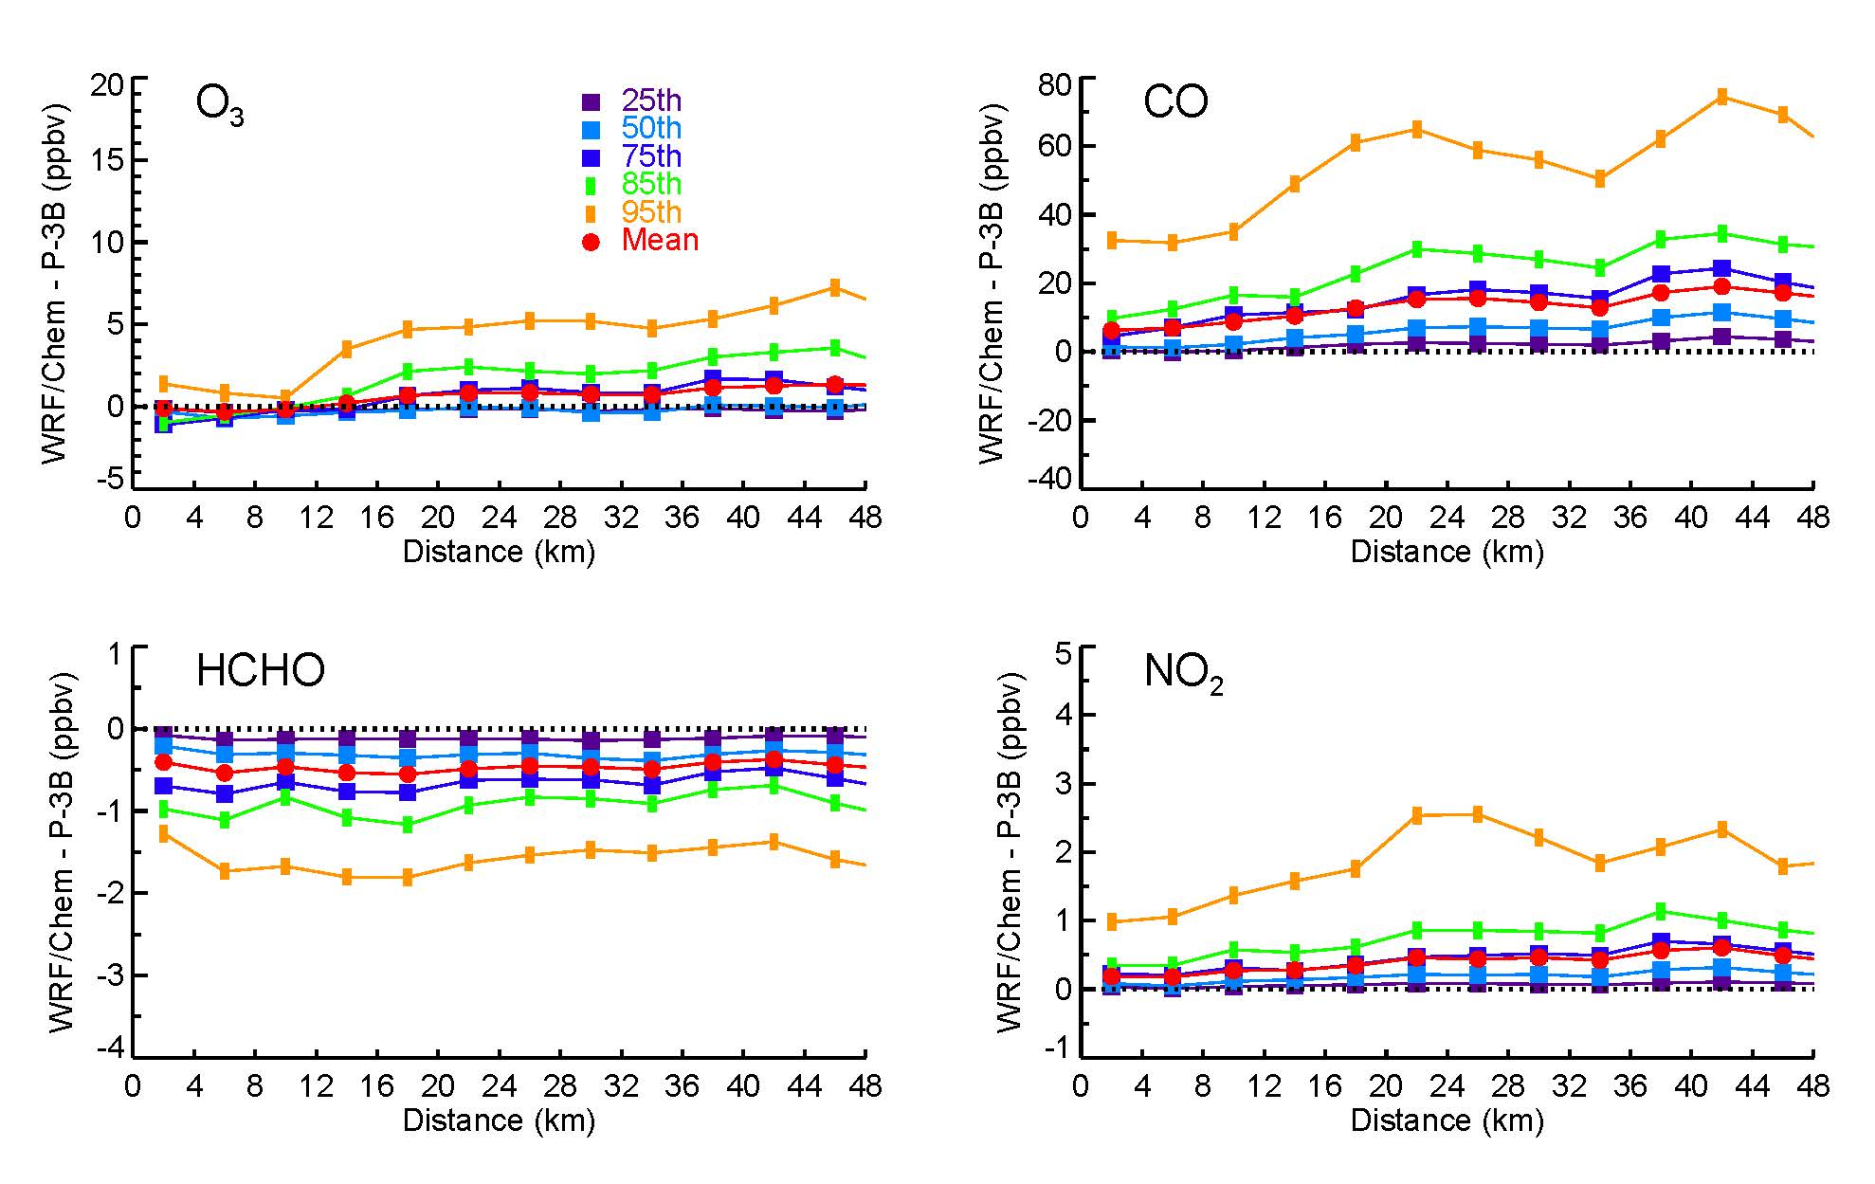
WRF/Chem vs. P-3B percentile differences
All MD flights included
Overall, the model captures the shapes of variability curves
Now let’s look at variability within WRF/Chem as it relates to a satellite like GEO-CAPE/TEMPO
Questions -
How much does each species vary spatially and temporally throughout the campaign? (i.e. one month)
How much of that variability would a GEO-CAPE/TEMPO like instrument see?

Slide 6
Precision Requirements (PR) for GEO-CAPE/TEMPO
Species | 0-2km |  | 2km-trop |  | Trop Column | Freq
O₃ | 10 ppbv | 1.7 DU | 10 ppbv | 4.3 DU | 6.2 DU | Hourly
CO | 20 ppbv | 0.91 x 10¹⁷ molec/cm² | 20 ppbv | 2.5 x 10¹⁷ molec/cm² | 3.4x10¹⁷ molec/cm² | Hourly
NO₂ | 0.5 ppbv** |  |  |  | 1x10¹⁵ molec/cm² | Hourly
HCHO |  |  |  |  | 1x10¹⁶ molec/cm² | 3x/day
SO₂ |  |  |  |  | 1x10¹⁶ molec/cm² | 3x/day
- Italics indicate a calculated quantity
** Lok Lamsal, personal communication
For proposed spatial resolutions of ~4-8 km
Notes:
Email Xiong

Slide 7
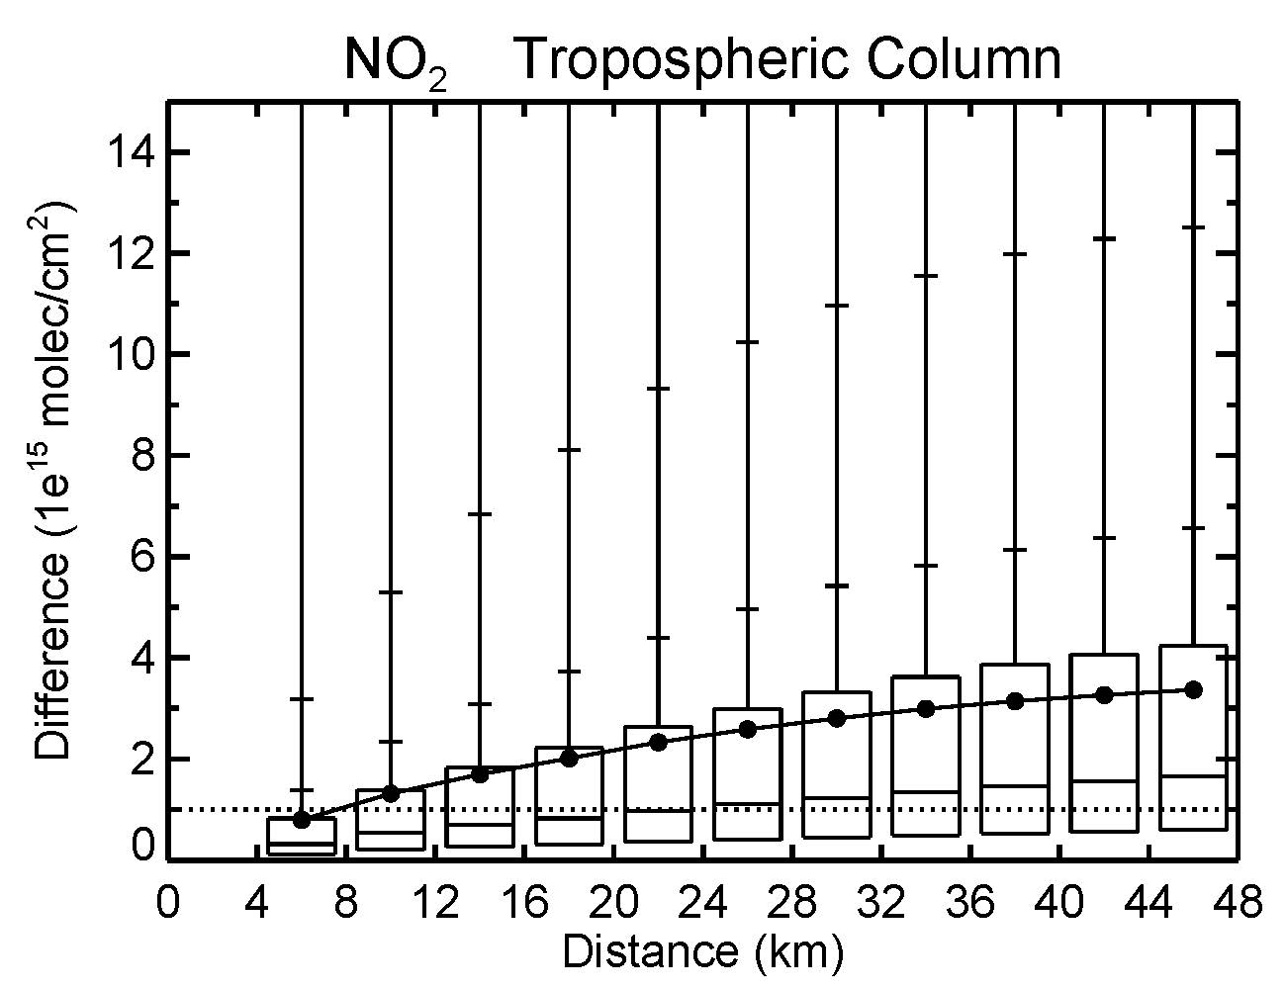
How did these species vary during July 2011?
Can we relate the prospective precisions from TEMPO to the variability in the WRF/Chem output?
At distances between 4 and 8 km, ~25% of the differences in NO2 are larger than the precision requirement (PR)
At distances between 8 and 12 km, ~38% of the differences in NO2 are above the PR
~50% of the differences are hypothetically visible to the instrument at distances between 16-20 km
Example – Tropospheric Column NO₂

Slide 8
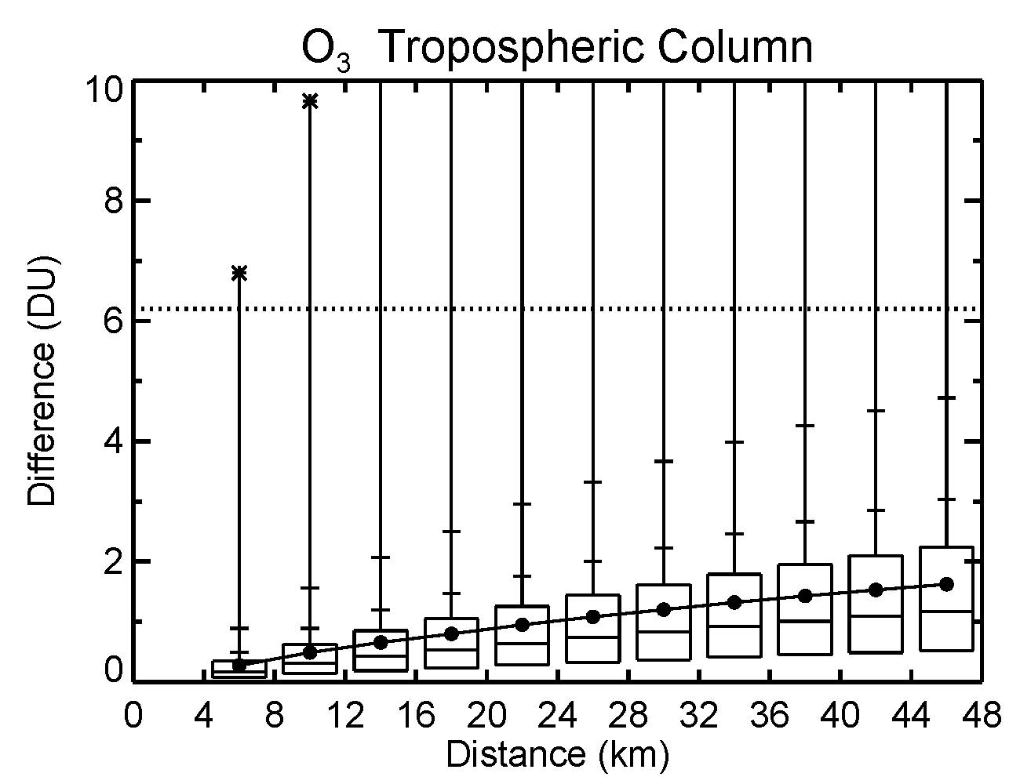
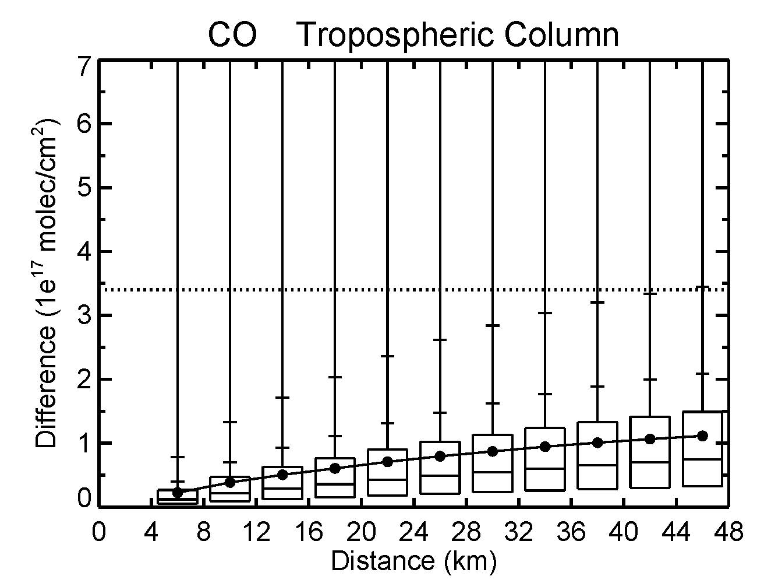
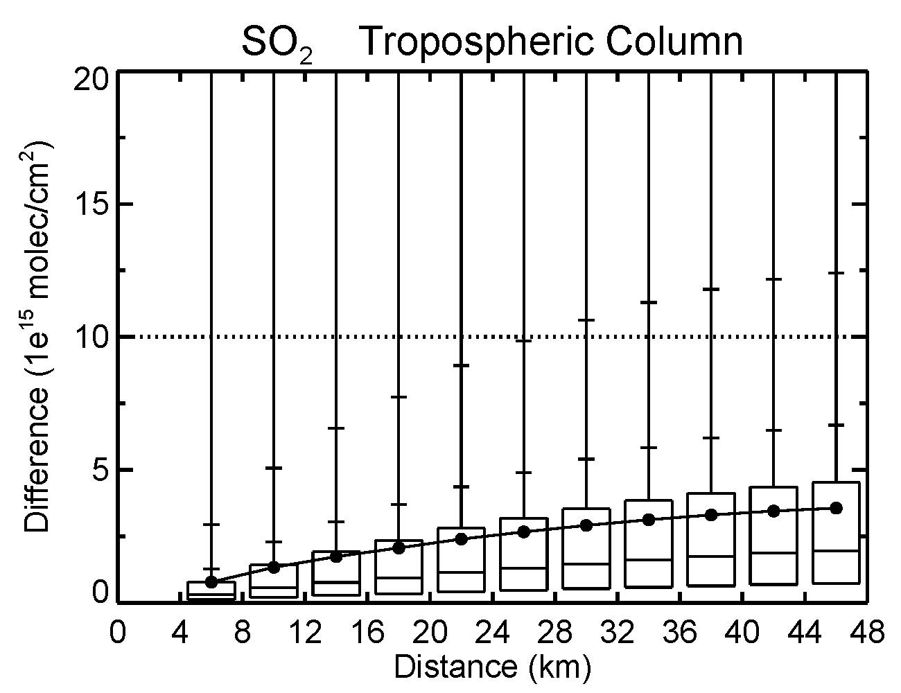
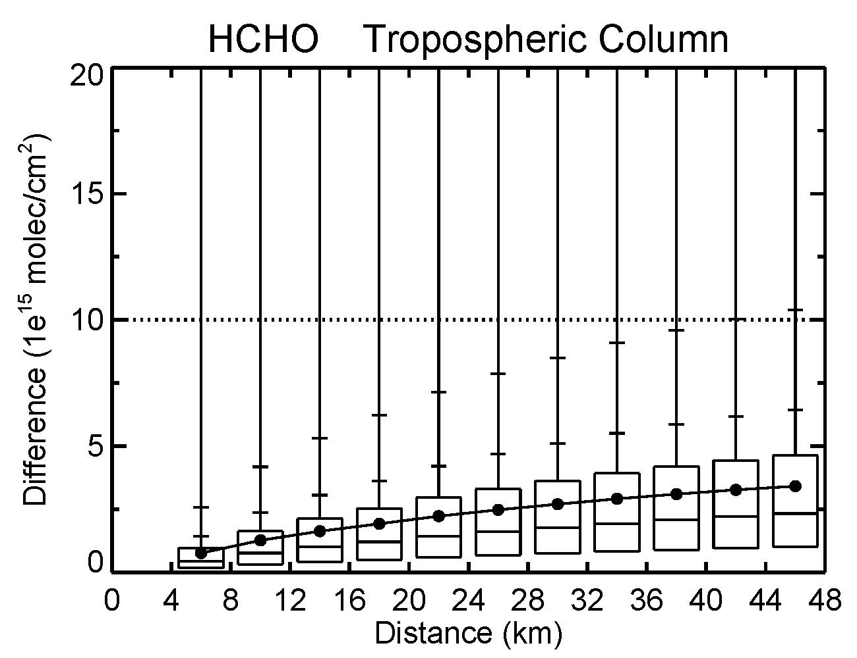
How did these species vary during July 2011? Tropospheric Column
Ozone
NO₂
CO
SO₂
HCHO
For most species, <15% of the differences lie above their PR

Slide 9
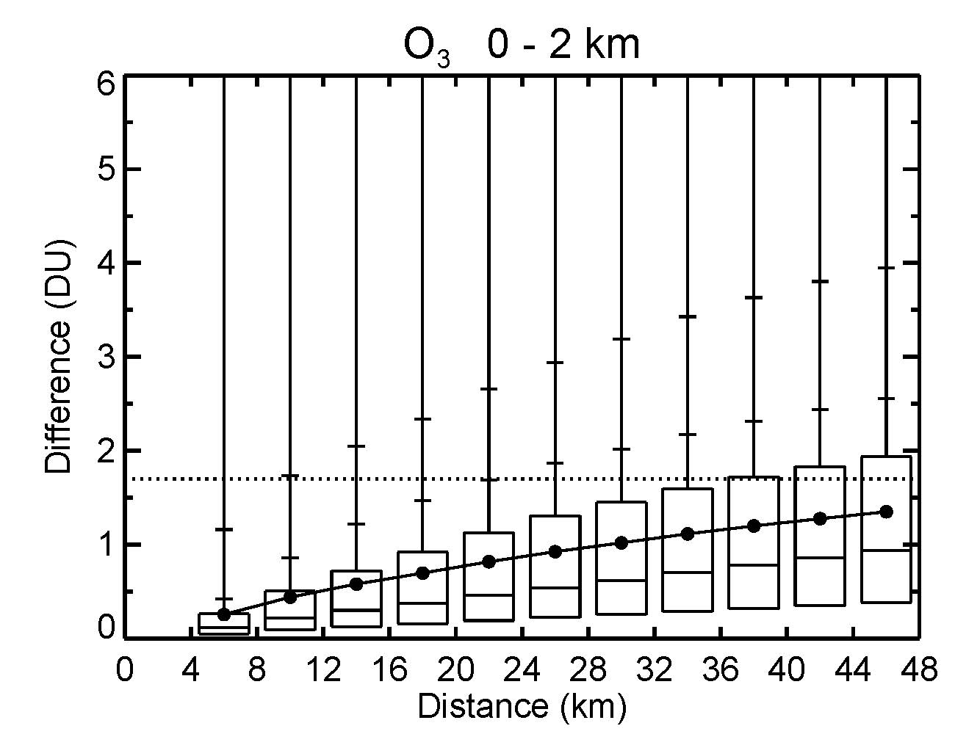
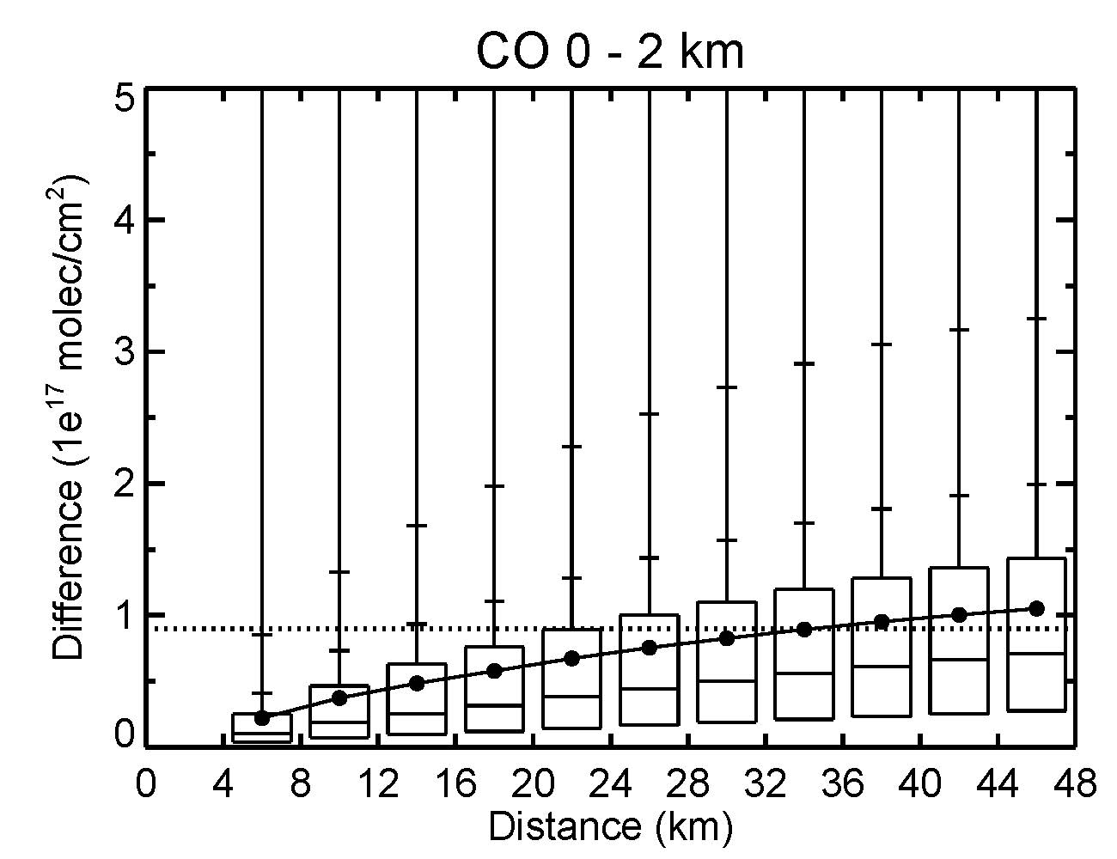
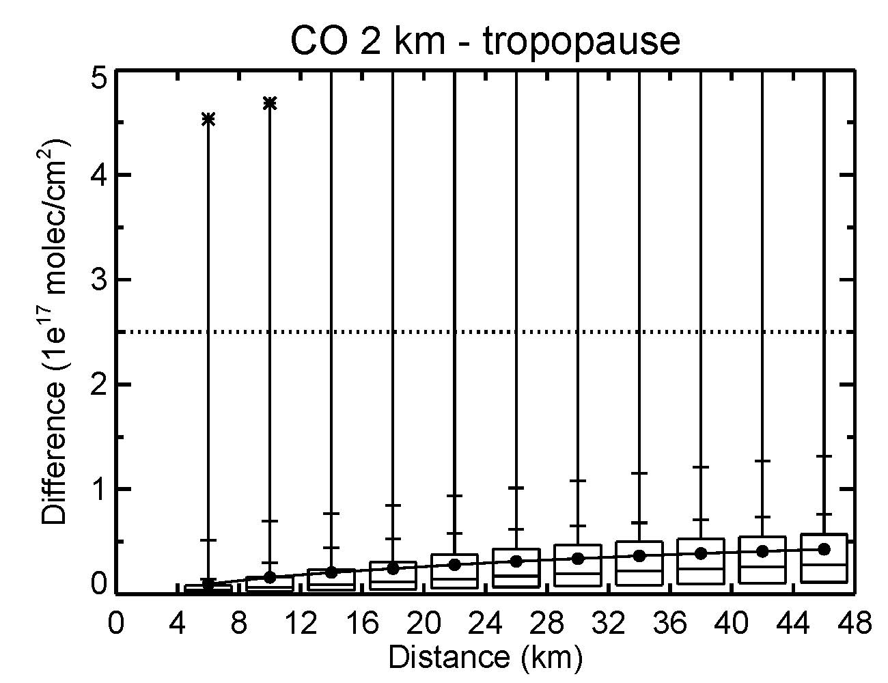
How did these species vary during July 2011? PBL / FT
Ozone
Trop Column
0 – 2 km
For PBL O3, < 5% of the differences are visible at distances < 12 km
At 12-24 km, 5-15% lie above the PR, increasing to 25% at 36 km
For PBL CO, < 5% are visible from 4-8 km distances
This increases to 15% at 20-24 km
CO

Slide 10
How does the spatial variability of each species change throughout the day?
Ozone : 0-2 km
< 5% of differences above PR from 4-12 km
<15% of differences above PR from 12-16 km
Differences increase throughout the day, with max mean/median differences in the early afternoon
10 am
2 pm
6 pm
NO₂
Increases and decreases in the NO₂ column differences follow emissions patterns, e.g. larger differences in the morning (largest at 10 am) and in the early evening (6 pm).
>25% from 4 -8 km
>25% from 8 - 12 km
~25% from 4 - 8 km
Notes:
Update numbers and text

Slide 11
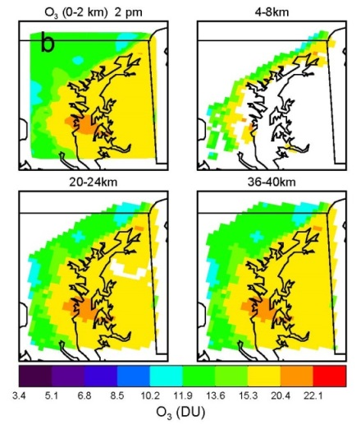
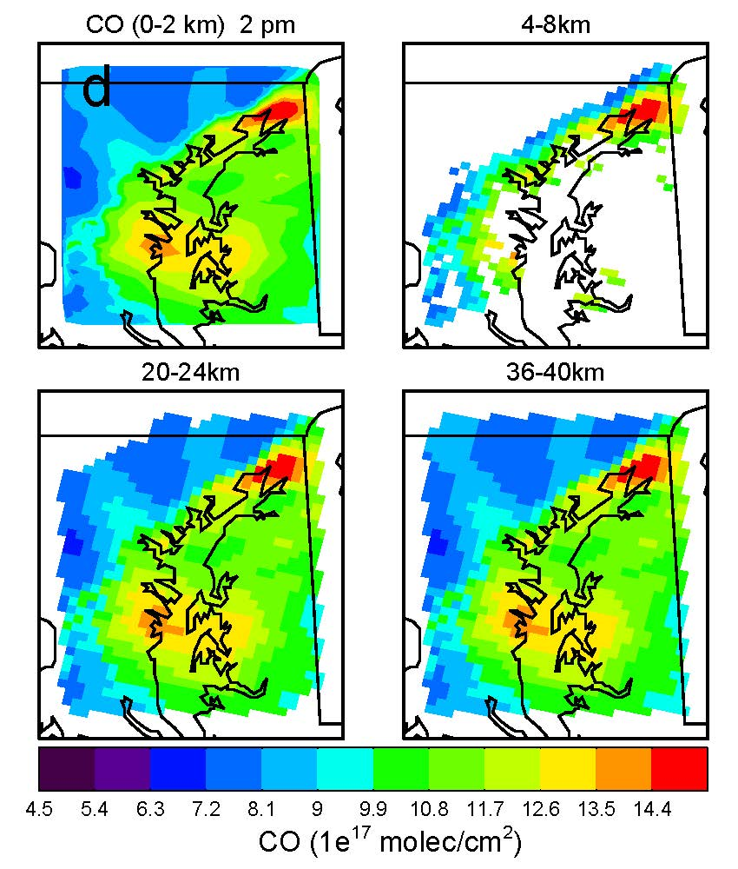
Geographic coverage of differences that fall above the PRs at several distances
O₃ – 0-2 km
CO - 0 – 2 km
These results indicate that the TEMPO instrument would be able to observe O₃ air quality events over the Mid-Atlantic area, even on days when the violations of the air quality standard are not widespread.
PR = 1.7 DU
PR = 0.91 e¹⁷ molec/cm²
7/29/2011 2 pm EDT

Slide 12
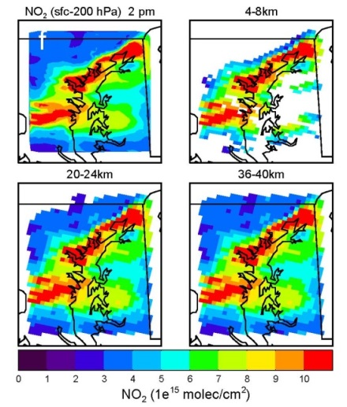
Geographic coverage of differences that fall above the PRs at several distances
NO₂ - Tropospheric column
The maximum differences in NO₂ are in the morning and early evening, so 2 pm could be considered a minimum in what would be observable
Despite that, the major features in the tropospheric column field can be seen in the plot of the visible differences at 4 – 8 km distances
The entire field is almost visible at distances greater than 20 km
This suggests that TEMPO will be able to satisfactorily observe the spatial variability of this species
PR = 1x10¹⁵ molec/cm²
7/29/2011 2 pm EDT

Slide 13
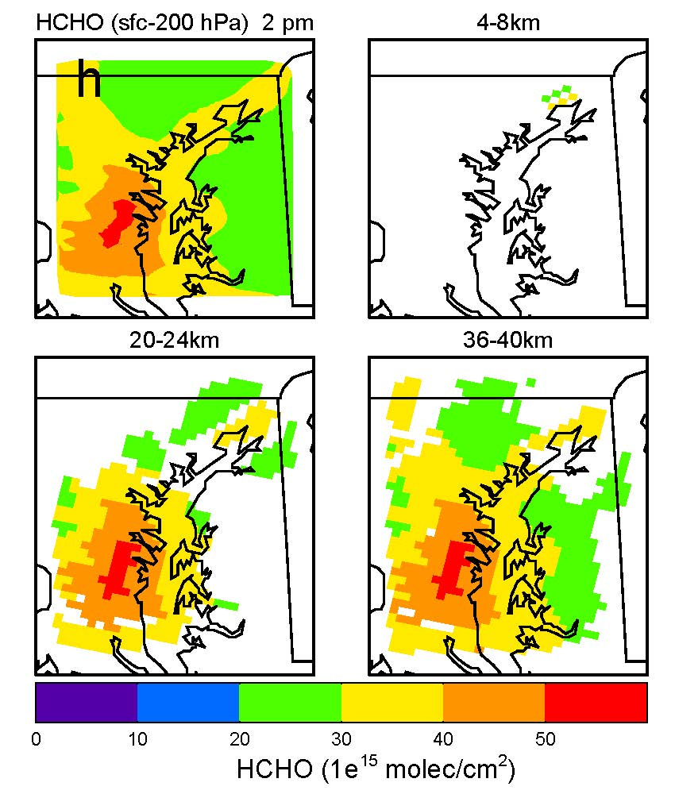
Geographic coverage of differences that fall above the PRs at several distances
HCHO - Tropospheric column
In MD, sources of HCHO include oxidation of hydrocarbons with both biogenic and anthropogenic sources. Thus, greater variability in HCHO is seen at longer distances, i.e. greater than 20 km, and would be hypothetically resolvable by TEMPO
PR = 1x10¹⁶ molec/cm²
7/29/2011 2 pm EDT

Slide 14
Inter-Campaign Variability
The results for the MD analysis suggest that the PR for TEMPO and GEO-CAPE are sufficient for addressing the science questions they are tasked to answer
How does the variability seen in the other three deployments compare to that seen in MD?

Slide 15
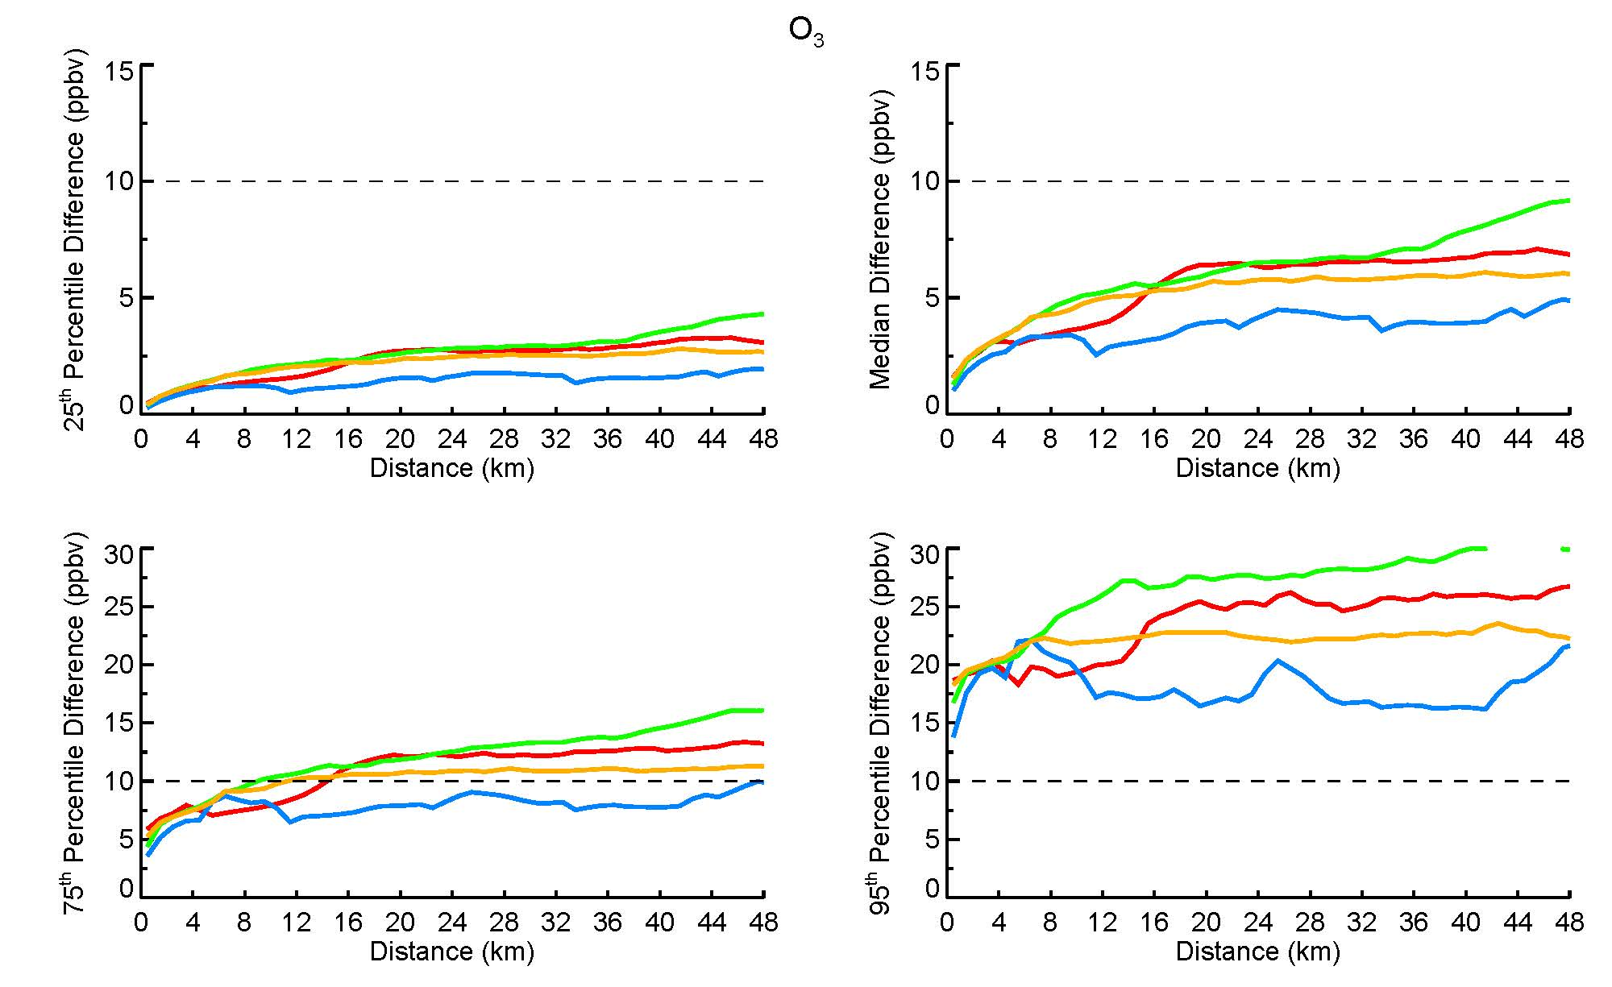
Percentiles – O₃
TEMPO PR
MD, TX, and CO 75th percentile curves above the PR at distances of 8 (TX), 12 (CO), and 16 km (MD)
All campaigns 95th percentile curves above the PR
MD CA TX CO

Slide 16
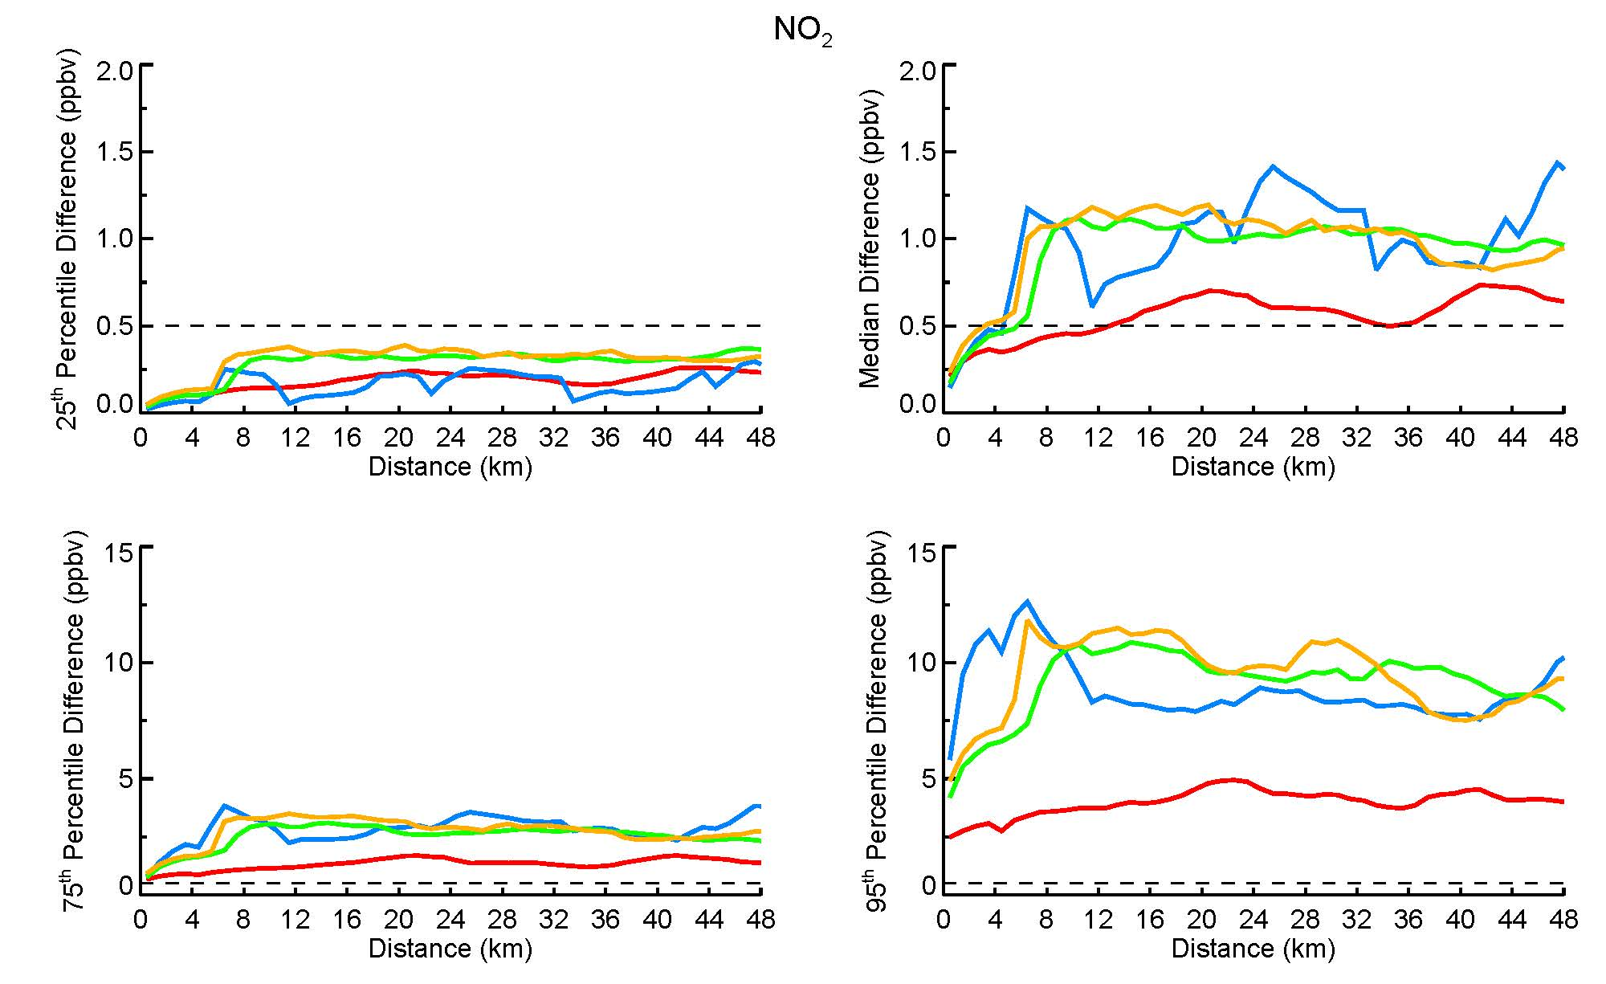
Percentiles – NO₂
MD shows the lowest NO₂ variability of any campaign
Follette-Cook et al. (2015) concluded that the variability during the MD campaign was large enough to be well-resolved by TEMPO
Therefore, with respect to variability, TEMPO’s NO₂ PR is more than sufficient for these other regions as well
MD CA TX CO

Slide 17
Summary and Conclusions
Follette-Cook et al. (2015) concluded that, with respect to the MD/DC region, the TEMPO PR are sufficient to address its AQ-relevant science questions
Ozone : Results from MD indicated that TEMPO would be able to resolve air quality events, even when the event was not widespread
TX and CO show comparable differences to MD
Air quality events in these regions will likely be observable by TEMPO
CO : Variability of all campaigns similar, except for CA
NO₂ : MD shows the lowest variability of any campaign
Therefore, with respect to variability, TEMPO’s NO₂ PR is more than sufficient for these other regions as well
HCHO : MD and TX show largest differences
In MD, larger differences in HCHO are seen at longer distances (> 20 km) and would be hypothetically resolvable by TEMPO
These results indicate that HCHO variability in the SJV and Denver, CO regions might be too small to be resolvable at < ~20 km distances

