Slide 1
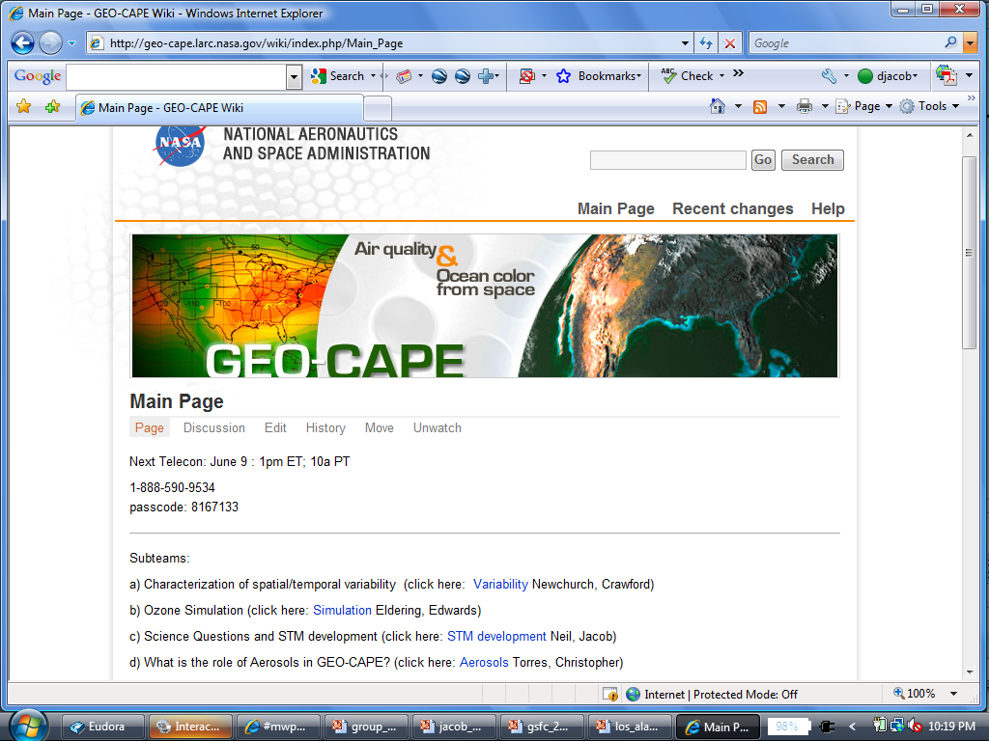
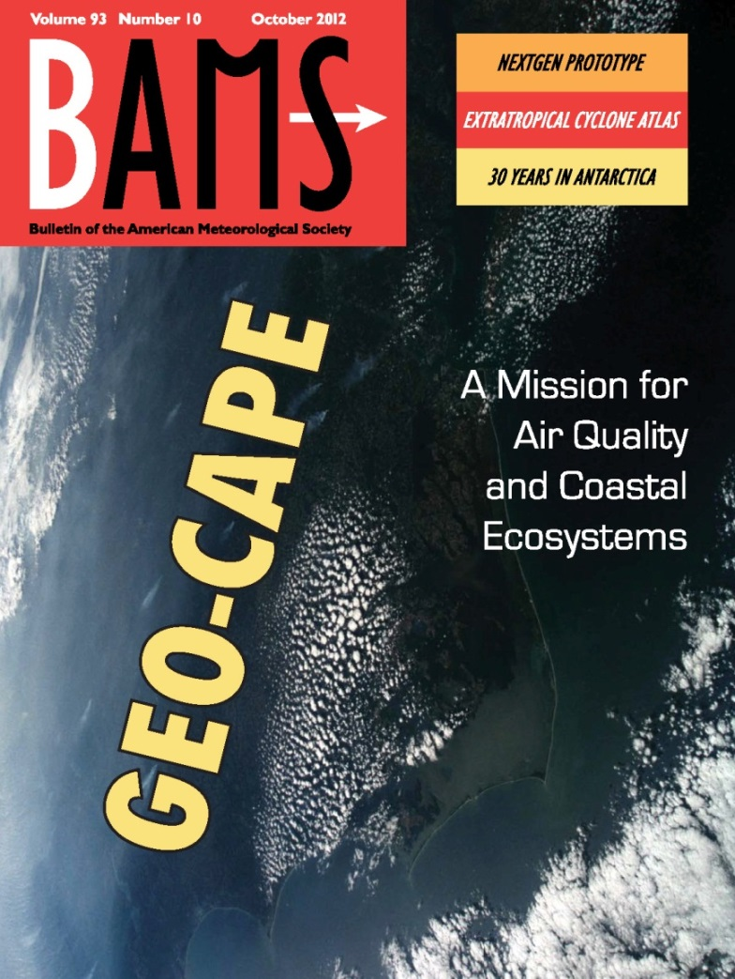
GEO-CAPE Atmospheric
Science Working Group highlights
Daniel J. Jacob and David P. Edwards
Co-Leads, GEO-CAPE Atmosphere SWG
Fishman et al.
[2012]

Slide 2
Early work of the ASWG defined mission requirements, implementation options
Science Traceability
Matrix (STM)
Science Value
Matrix (SVM)
GEO-CAPE also has an Applications Traceability Matrix (ATM)
and corresponding Applications Value Matrix (AVM)
STM leads: Doreen Neil. Daniel Jacob
SVM leads: Doreen Neil, David Edwards
ATM/AVM leads: Jessica Neu, Rob Pinder

Slide 3
Atmospheric Science Questions for GEO-CAPE
What are the temporal and spatial variations of emissions of gases and aerosols important for air quality and climate?
How do physical, chemical, and dynamical processes determine tropospheric composition and air quality over scales ranging from urban to continental, diurnal to seasonal?
3. How does air pollution drive climate forcing and how does climate change affect air quality on a continental scale?
4. How do we improve air quality forecasts and assessments for societal benefit?
5. How does intercontinental transport affect air quality?
6. How do episodic events such as wild fires, dust outbreaks, and volcanic eruptions affect atmospheric composition and air quality?

Slide 4
Measurement requirements for GEO-CAPE: spectral regions and precision
Species | Precision | Rationale
O₃ | Stratosphere: 5% 2 km-tropopause: 15 ppb 0-2 km: 10 ppb | Surface AQ, transport, climate forcing
CO | 2 km – tropopause: 20 ppb 0-2 km: 20 ppb | CO emission, transport
Aerosol | 0.05 (AOD) | Surface AQ, aerosol sources and transport, climate forcing
NO₂ | 1x10¹⁵ cm⁻² | NO_{x} emissions, chem.
HCHO | 1x10¹⁶ cm⁻² | VOC emissions, chem.
SO₂ | 1x10¹⁶ cm⁻² | SO_{x} emissions, chem.
CH₄ | Troposphere: 20 ppb | CH₄ emissions
NH₃ | 0-2 km: 2 ppb | NH₃ emissions
CHOCHO | 4x10¹⁴ cm⁻² | VOC emissions, chem., aerosol formation
Absorbing aerosol | 0.02 (AAOD) | Climate forcing
Aerosol index | 0.1 | Aerosol events
Aerosol centroid height | 1 km | Aerosol plume height, large-scale transport, AOD to PM conversion

Slide 5
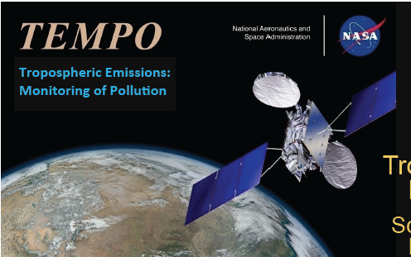
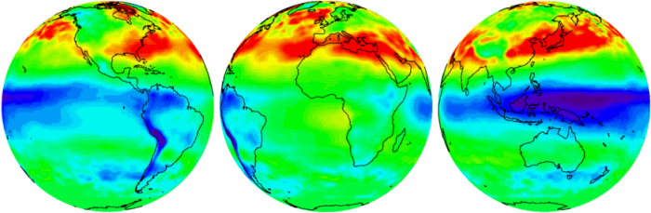
TEMPO: UV/Vis implementation of GEO-CAPE
TEMPO will observe tropospheric ozone (2 levels), aerosols, NO₂, SO₂, formaldehyde, glyoxal with hourly temporal resolution, 4x2 km² spatial resolution
TEMPO will be part of a geostationary constellation with other sensors observing Europe and East Asia
TEMPO delivers 70% of GEO-CAPE science as defined the SVM
A concurrent GEO-CAPE IR Instrument (GCIRI) would deliver the rest
Kelly Chance, PI
TEMPO Sentinel-4 GEMS

Slide 6
2015-2016 foci of GEO-CAPE ASWG
Prepare to exploit the TEMPO data for air quality over North America through improved retrieval algorithms and observation system simulation experiments (OSSEs)).
Define specific activities for exploiting data from the geostationary constellation to be launched in 2018-2019.
Define requirements/potential for GCIRI satellite mission to fly concurrently with TEMPO and complete the GEO-CAPE objectives.
Identify priorities for future geostationary observations of atmospheric composition to serve as input for the upcoming Decadal Survey.
Develop mechanisms for engaging air quality managers and other end-users to aid early adoption of TEMPO observation and the development of future geostationary missions.

Slide 7
Atmosphere SWG is organized along 5 Working Groups
Working Grouo | Chairs | Motivating question
Aerosols | Mian Chin, Jun Wang | How can TEMPO and GOES-R measurements be integrated to deliver maximum information on surface PM and aerosol radiative forcing?
Emissions and Processes | Daven Henze, Greg Frost | How can TEMPO and GCIRI improve understanding of the emissions and processes controlling air quality?
Urban/Regional OSSE | Brad Pierce, Vijay Natraj | How can TEMPO and GCIRI inform urban-scale and regional AQ through data assimilation and improved forecasts?
Global OSSE | David Edwards, Arlindo DaSilva | How can the geostationary constellation be exploited to better understand intercontinental transport and the factors controlling the air quality background?
Methane | Daniel Jacob, Jay Al-Saadi | How can geostationary observations of methane constrain emissions on the county scale?

Slide 8
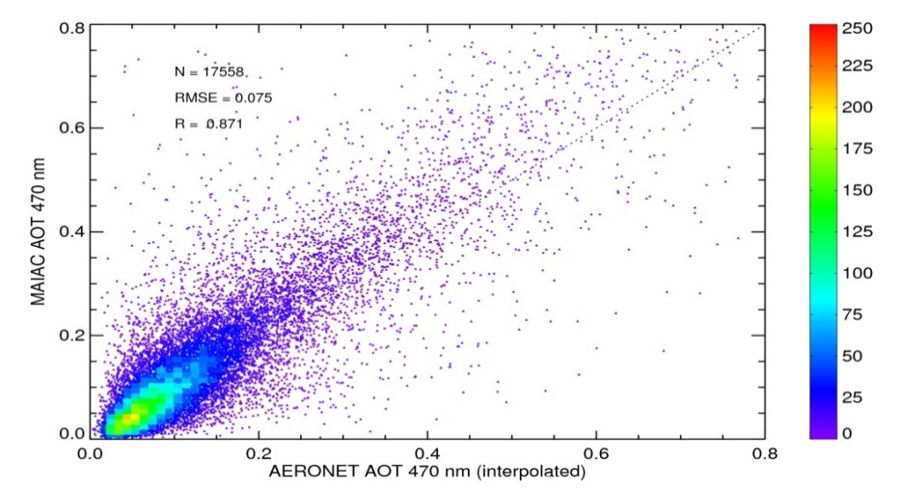
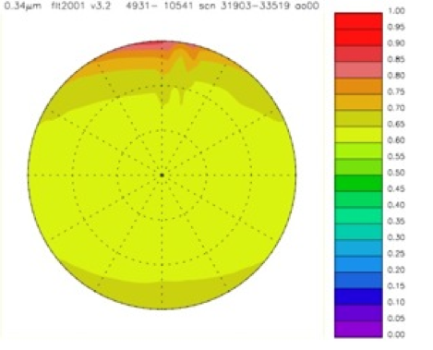
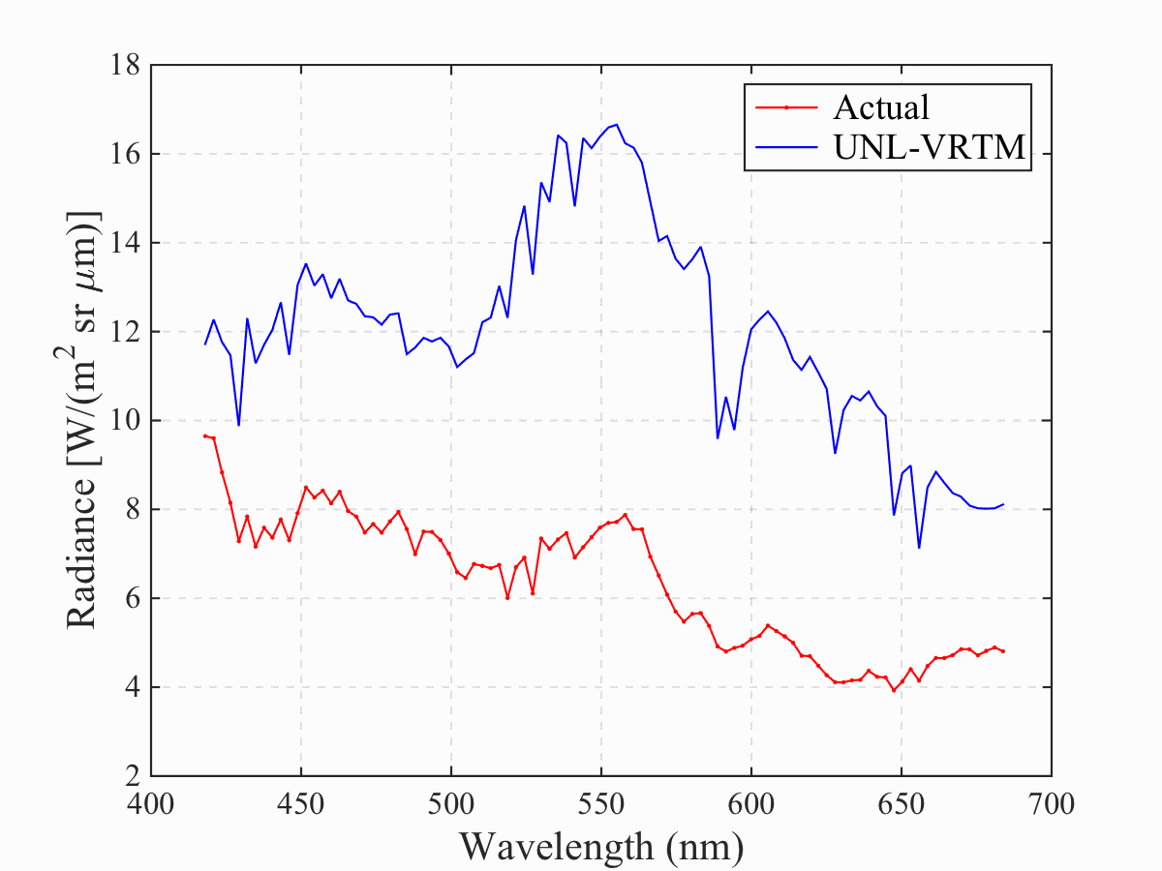
Aerosol WG highlights
1. Development of MAIAC algorithm to retrieve AODs for full range of solar zenith angles, surface reflectances (A. Lyapustin)
2. Development of bidirectional reflectance distribution function (BRDF) for different surfaces (C. Gatebe)
MAIAC AOT 470 nm
Eastern US
3. Development of hyperspectral algorithm to constrain AODs + size distributions (J. Wang)
4. Importance of full diurnal cycle observations to constrain aerosol radiative forcing (H. Yu)
A
% error from using 10 am AODs as measured from LEO
GeoTASO

Slide 9
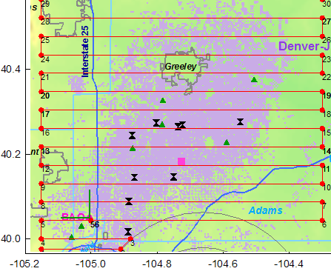
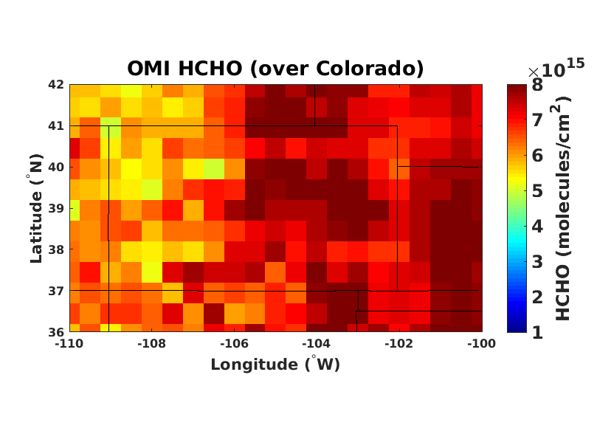
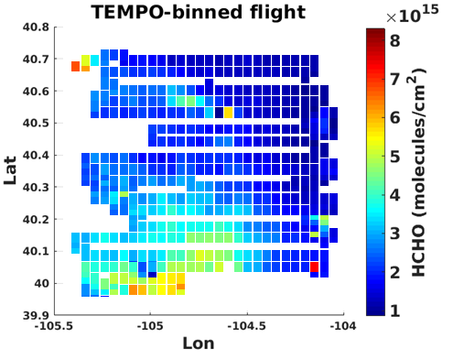
Using SONGNEX aircraft data to evaluate OMI and TEMPO HCHO
for observing VOC emissions from oil/gas fields
P3 flight over Denver-Julesburg basin (Right: Flight track in red, active wells in purple)
OMI data (below left) captures HCHO variability over state, but cannot resolve city-level sources.
Aircraft data (below right) averaged to TEMPO spatial resolution (2km/px N-S, 4km/px E-W) resolves multiple enhancements over the field.
TEMPO will greatly improve ability to localize emissions and pollution sources!
COLORADO
F. Keutsch, Harvard

Slide 10
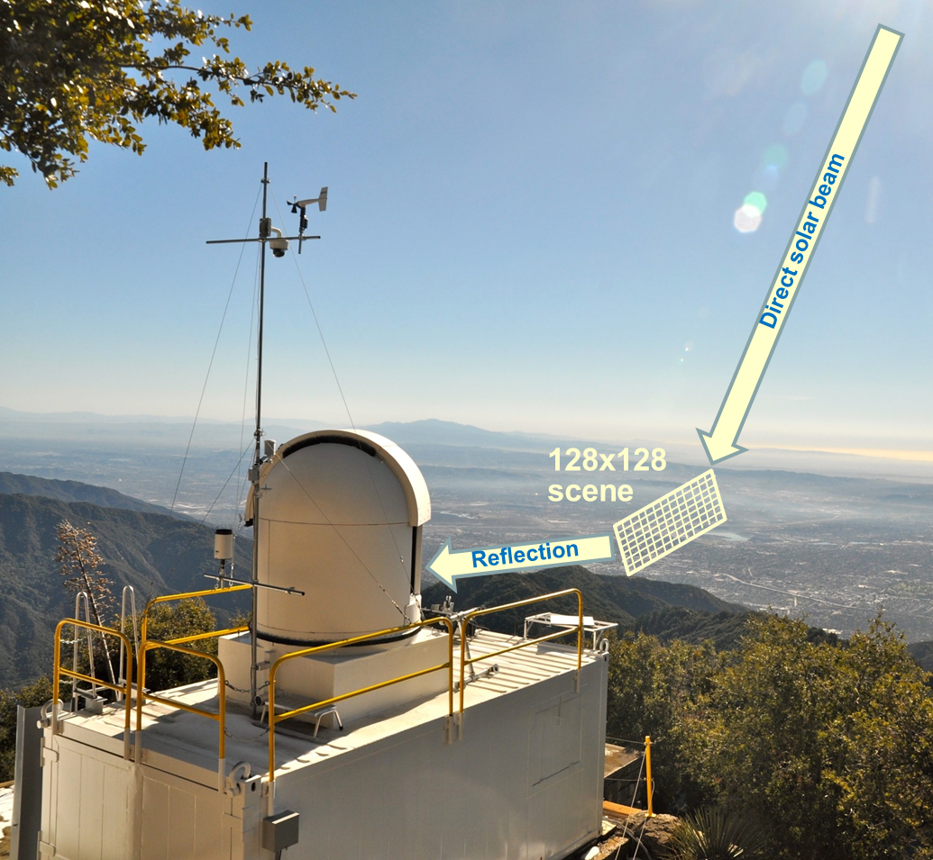
PanFTS Imaging FTS Studies in Support of
Simulated GEO-CAPE CH₄ Retrievals
S. Sander and the PanFTS Team, JPL
Objective:
Deploy and operate a version of the JPL IIP-10 PanFTS instrument for simulation of GEO-CAPE CH₄ retrievals with high (10 m.) spatial and temporal (1 hr.) resolution
Approach:
PanFTS was deployed at CLARS on Mt. Wilson overlooking the Los Angeles Basin in February, 2015
PanFTS measures XCO₂, XCH₄, XCO, vegetation solar-induced fluorescence (SIF) and AOD in a 128x128 pixel scene using sunlight reflected from the land surface.
O₂ A-band spectra provide path length verification and filtering for aerosol effects
PanFTS at CLARS simulates soundings from GEO
California Laboratory for Atmospheric Remote Sensing (CLARS) at 5700 ft. ASL overlooking the Los Angeles basin.

Slide 11
Map of Annual Average CH₄:CO₂
from CLARS-FTS measurements
Period: 09/2011-10/2013
Large landfill
Major natural gas pipeline
Large landfill
Oil fields
Wong et al., 2015
Dairy farms
Spatial averaging causes smearing of plumes, making attribution of point sources difficult without knowing atmospheric transport.
This can be improved in the further when the CLARS observations are integrated with in situ network observations and atmospheric transport model.

Slide 12
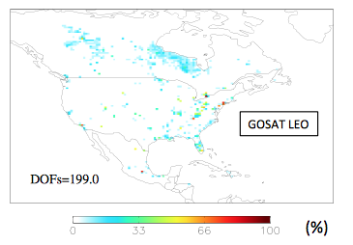
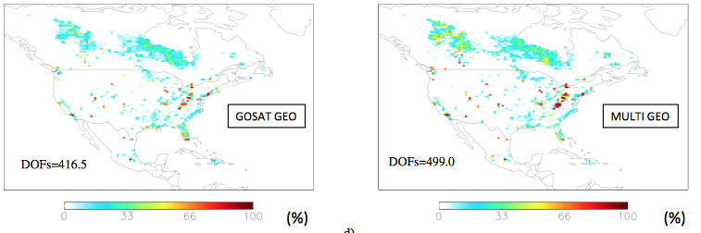
Assessing the capability of GEO-CAPE to constrain methane emissions in N America
Error reduction on prior and # of pieces of information (DOFS) from 1-month inversion of methane emissions at 0.5ºx0.625º resolution
Low earth orbit: Column (GOSAT)
Geostationary: Column
Geostationary: Multispectral
DOFs = 199
DOFs = 417
DOFs = 499
Error reduction
Geostationary column observations (near-IR) greatly improve hotspot detection relative to current LEO capability (GOSAT); multispectral observations (adding thermal IR) do even better
Bousserez et al. [2015]

Slide 13
Observation System Simulation Experiments (OSSEs) to assess value of GEO-CAPE as addition to observing system
Chemical Transport Model 1
Chemical Transport Model 2
assimilation
1. “True” atmosphere
(Nature Run)
Existing
observations
2. Analyzed atmosphere
without GEO-CAPE
(Control Run)
Compare 3 vs.1 and 2 vs. 1
for the metric of interest (concentrations, emisssions…)
How has the addition of GEO-CAPE improved Model 2’s abiiity to quantify this metric ?
GEO-CAPE
pseudo-observations
assimilation
3. Analyzed atmosphere
with GEO-CAPE
(Assimilation Run)

Slide 14
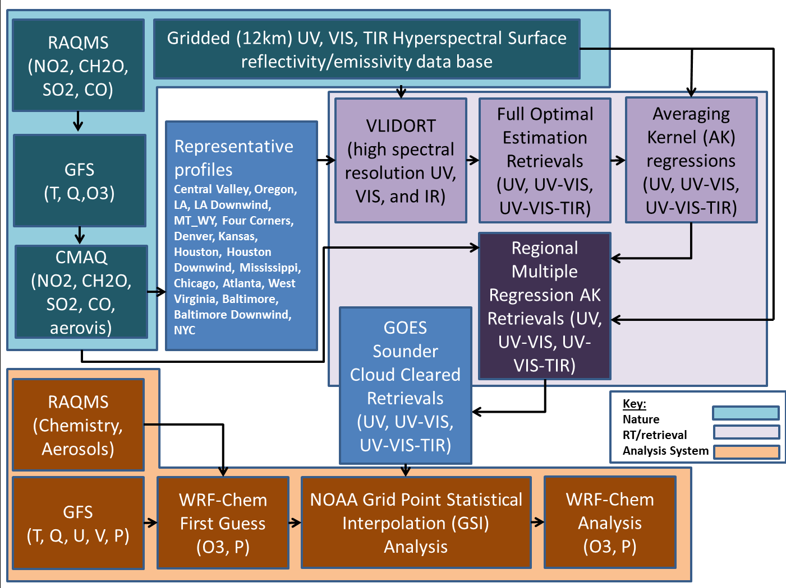
GEOCAPE Regional and Urban OSSE
“True”
Model
Pseudo GEO-CAPE
observations
“Analysis”
Model
Brad Pierce¹, Vijay Natraj², Helen Worden³, Susan Kulawik⁴
1- NOAA/NESDIS Center for Satellite Applications and Research, 1225 West Dayton Street, Madison, WI 53706
2- Jet Propulsion Laboratory, California Institute of Technology, 4800 Oak Grove Drive, Pasadena, CA 91109
3- National Center for Atmospheric Research, 3450 Mitchell Lane, Boulder, CO 80301
4- Bay Area Environmental Research Institute, Moffett Field, CA 94035
Notes:
There are three major components of the OSSE framework: Nature run (teal), Radiative Transfer/Retrieval System (purple), and Analysis System (orange).
We first used a set of representative profiles from 17 sites (hourly, every 3rd day of July 2011) and full radiative transfer/Optimal Estimation Retrievals (UV, UV-VIS, UV-VIS-TIR) to generate input data for developing a multiple regression estimate of the averaging kernels (AK).
We then use the AK regressions, the full Nature atmosphere (CONUS, hourly, every day of July 2011) to generate the Regional Multiple Regression AK retrievals (UV, UV-VIS, UV-VIS-TIR)
We then used observed GOES East and West Sounder cloud masks to identify clear retrievals, these are fed into the WRF-Chem/GSI regional assimilation system

Slide 15
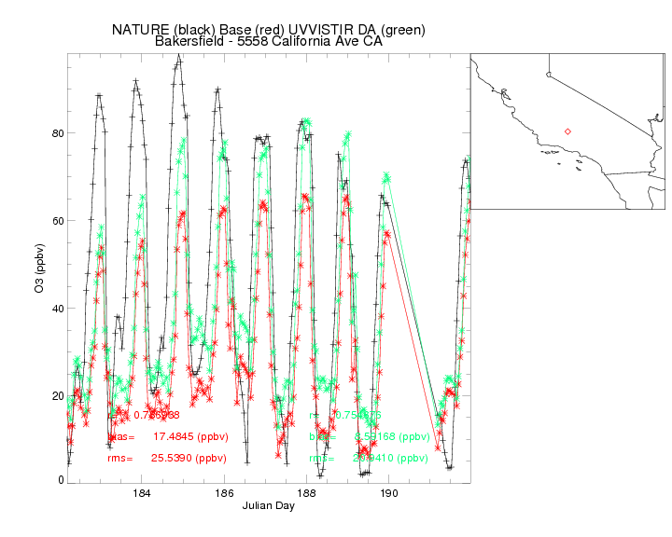
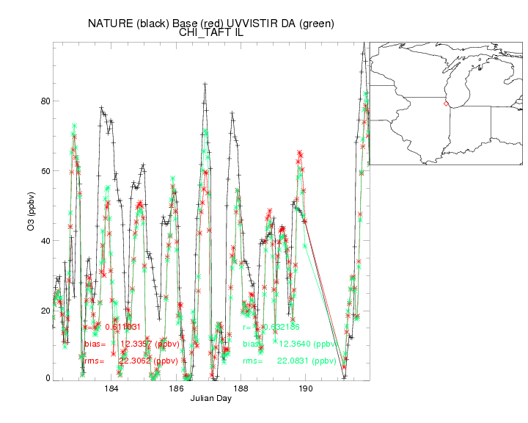
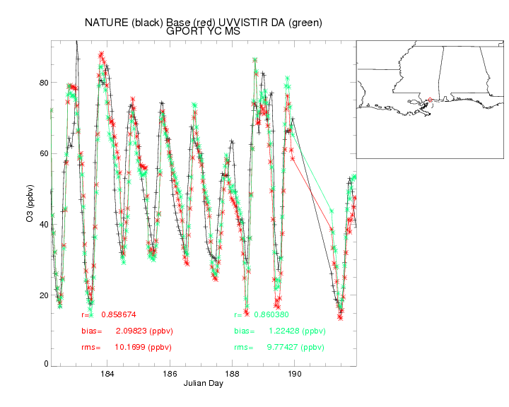
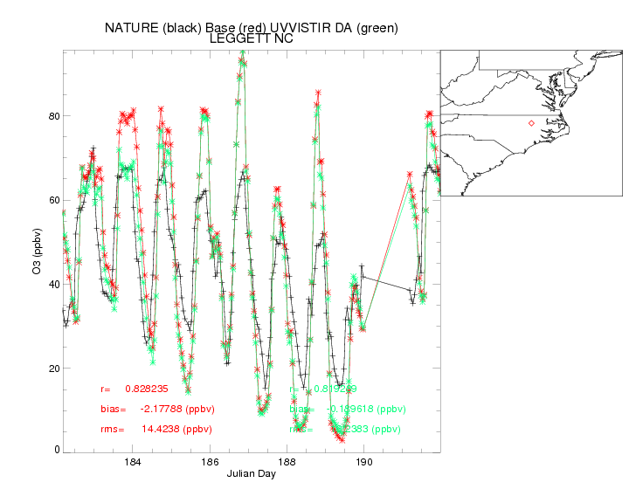
Continuous
Improvement
Improvement
at Day 5
Key
ASSIM
Control
Nature
Small changes
Improvement
at Day 2

Slide 16
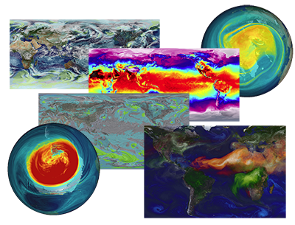
Global OSSE:
7 km GEOS-5 Nature Run for aerosols
Simulation details
Boundary Conditions
2-years : June 2005 – June 2007
7-km Global Resolution [72 vertical levels : 0.01mb top]
5-minute physics time step [5 seconds for dynamics]
Non-Hydrostatic Dynamics [Finite-Volume Cubed-Sphere]
Limited deep convection [RAS with stochastic Tokioka limiter]
Resolve mesoscale weather [storm-scale and cloud clusters]
High-resolution constituent transport [GOCART]
Executed on “Discover” at NCCS [7200 Cores : 11-days/day]
SST and Sea-Ice [1/4-degree Reynolds/OSTIA]
CO/CO₂ Fossil fuel emissions [10-km EDGAR inventory]
Land CO₂ fluxes [CASA-GFED at 10-km with MODIS EVI]
Biomass burning [daily QFED emissions]
Volcanic SO₂ [AEROCOM emissions and injection heights]
GOCART [mixing, chemistry, and deposition]
  Key aerosol types [sulfates, dust, black&organic carbon
  aerosols are radiatively coupled with the dynamics

Slide 17
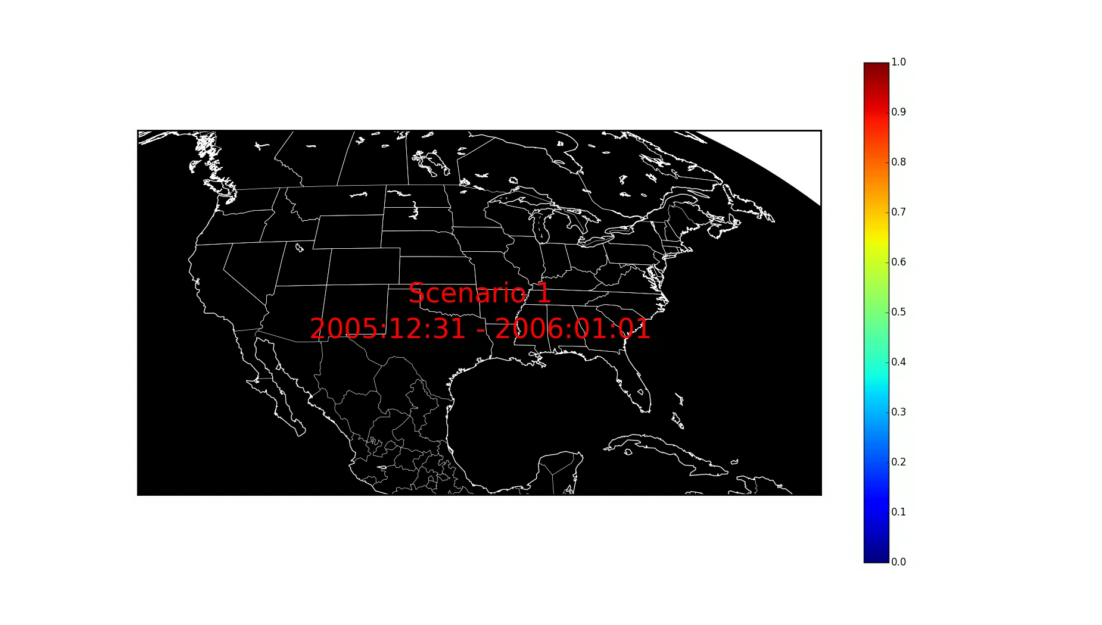
VLIDORT Simulator for GEOS-5 Nature Run
TEMPO “Level A” Simulator:
TOA Reflectances
In collaboration with GEO-CAPE aerosol Group
Calculations based on the Vector Linearized Discrete Ordinate RT code (VLIDORT)
4 Golden periods, 2-4 days each
Select aerosol channels
  UV: 354 & 388
  VIS: 412, 470, 550, 670
MAIAC derived BRDF
Cloud free conditions for now
  CF < 0.01
Aerosol and Rayleigh scattering atmosphere (gas corrected)

Slide 18
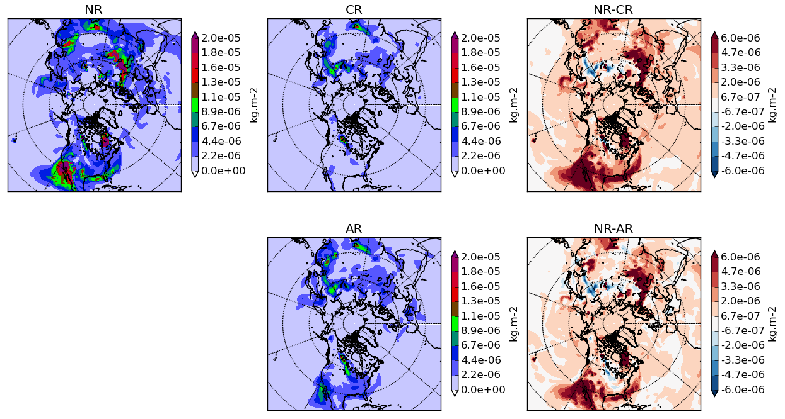
Constellation AOD OSSE: OC aerosol constraint
GMAO GEOS-5 Nature Run
NCAR CAM-Chem Control Run
Nature - Control
Assimilation Run
Nature - Assimilation
After assimilation of simulated AOD observations from the Nature Run, OC is constrained over the GEO regions bringing the Assimilation closer to the Nature Run compared to the Control Run
Total column results of June 17 00Z 2006 after 2 weeks assimilation of simulated AOD observations from GEOs over Europe, Asia and USA

Slide 19
Global OSSE: GEOS-5 Global 12.5 km
Nature Run w/ Chemistry
GEOS-5 NR-Chem
  Global, 12.5 km
  72 layers
  Pilot Year: 2013
  Validation: SEAC4RS
Availability:
  Q3 2015
Status
  25 km scout run about to start
  Pre-evaluation during SEAC4RS
  12.5 km code ready to go, pending 25 km run evaluation
Components
  Atmospheric GCM on cubed-sphere, non-hydrostatic
  Same framework as MERRA-2dd, but constituents run free
  Prescribed SST, sea-ice, Meteorology
  Constituents
    Radiatively coupled aerosols
    Carbon species
    GEOS-Chem Chemistry
Emissions
  Prescribed daily biomass-burning emissions (QFED)
  Anthropogenic inventories with ~ 10km resolution

Slide 21
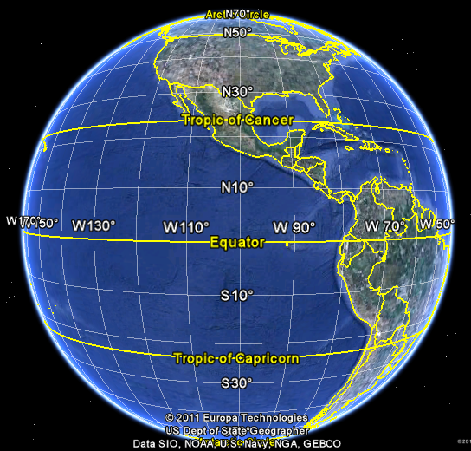
Measurement requirements for GEO-CAPE:
viewing geometry, resolution, frequency
Orbit centered over ~100º W, observing domain north of 10º N
Hourly data over land/coastlines
with pixel resolution of 1x1 km² (aerosols), 4x4 km² (gases), for SZA<70º (some species), <50º (others)
Daily data over open oceans (O_{3,} CO, aerosol) with pixel resolution of 16x16 km²
Observing
domain

