Slide 1
Discussion: Can we satisfy part of the GEO-CAPE mission requirements within the context of a NASA Earth Venture (EV) solicitation?

Slide 2
EV’s what are they?
EVM – complete space mission including instrument design, construction, launch, spacecraft operation, data processing and distribution, some science. ~$150 mil for entire mission
EVI - instrument design, construction, spacecraft operation, data processing and distribution, some science. ~$91 mil (FY 18$) mil
- NASA pays for the spacecraft integration and launch
EVS – Suborbital projects ~$30 mil (FY 13)

Slide 3
Present EVI and EVM grants
CYGNSS- Cyclone Global Navigation Satellite System (Surface winds) (EVM)
ECOSTRESS ECOsystem Spaceborne Thermal Radiometer Experiment on Space Station (Water Stress)
GEDI - Global Ecosystem Dynamics Investigation Lidar
TEMPO - Tropospheric Emissions: Monitoring of Pollution

Slide 4
EVS Goals (for most recent, 2013)
￼￼￼￼
1. Make use of, complement, and/or augment current NASA and non-NASA satellite observational capabilities,
2. Cover multiple objectives spanning the range from exploratory to more refined quantification of known processes,
3. Augment and/or complement current projects in the NASA Earth Science Research Program
4. Contribute to and/or provide data products useful to NASA’s Applied Sciences Program contribute to planning for future satellite observations and/or enhanced Earth system models.
http://nspires.nasaprs.com/external/viewrepositorydocument/cmdocumentid=349799/solicitationId=%7B8501AD49-0806-82C9-7F91-CF74AD5C66DA%7D/viewSolicitationDocument=1/A.30%20EVS2_Amend14_Corrected.pdf

Slide 5
For 2015 EVI (and past EVM)
Preference will be (was) given to investigations that:
￼￼
• advance scientific knowledge of Earth science processes and systems;
• add scientific data and other knowledge-based products to data archives for all to access;
• result in scientific progress and results published in the peer-reviewed literature to encourage, to the maximum extent possible, the fullest commercial use of the knowledge gained;
• provide opportunities to expand the pool of well-qualified Principal Investigators and Project Managers for implementation of future NASA missions;
• implement technology advancements accomplished through related programs; and
• communicate scientific progress and results through popular media, scholastic curricula, and outreach materials that can be used to inspire and motivate students to pursue careers in science, technology, engineering, and mathematics.

Slide 6
Can the GEO-CAPE Ocean Mission benefit from an EV project?
Some Pros
- Could likely produce a valuable proof of concept, risk reduction mission.
- Can answer an important subset of questions
- EVI on the cusp of affordability
Some Cons
-Funding is not nearly enough to answer all the science questions
-What do you sacrifice (time, space, spectral resolution, FOV, data rate)?

Slide 7
Our biggest obstacle: Cost

Slide 8
The Ocean Color Advanced Permanent Imager (OCAPI) may pursue a similar venue
Recent note from D. Anthoine:
A “Phase A” study has formally started, with the aim of submitting a proposal to the ESA 9th Earth Explorer call (likely mid 2016). Will be a simplified version of the “ideal OCAPI”, for being proposed as a hosted payload on a commercial platform.
Earth Explorer is the EU’s analogue to NASA EV

Slide 9
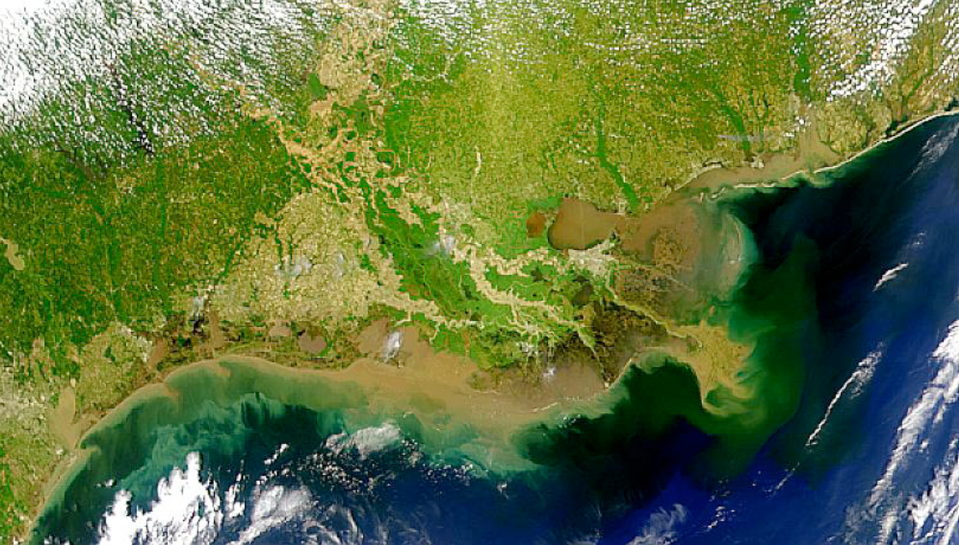
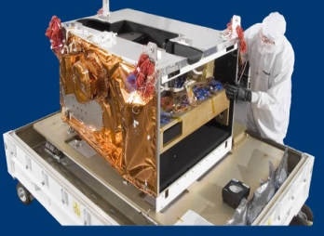
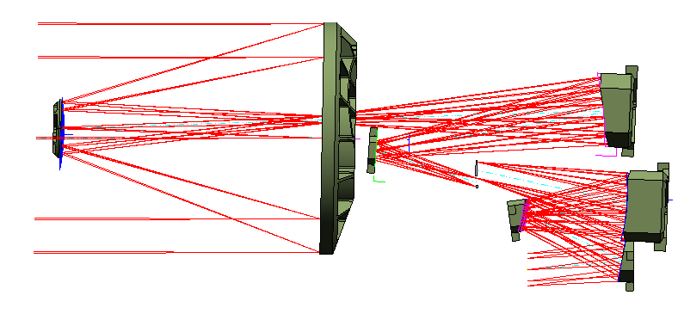
A group from UNH, Raytheon and Goddard started a proposal for submission to this year’s EVI-3
Coastal Ecosystem Measurement Concept for Earth Venture Instrument:
Geosynchronous Littoral Imaging and Monitoring Radiometer (GLIMR)
Dr. Jeff Puschell, Raytheon Space Systems
Joe Salisbury & John Macri (UNH)
Antonio Mannino, Bryan Franz et al (Goddard)
And many STM members

Slide 10
Geosynchronous Littoral Imaging and Monitoring Radiometer (GLIMR) for NASA Earth Venture Instrument-3 (EVI-3)
The proposed instrument addressed much of the Science in the GEOCAP STM for CONUS, and nearly all of threshold requirements in the Gulf of Mexico
Scanning Radiometer
Hyperspectral ~1000:1 SNR
~300m at NADIR
Min 3 looks/day for CONUS and 8/day for GOMEX
Given the ambitious goals……
We could not keep the mission within the price constraints

Slide 11
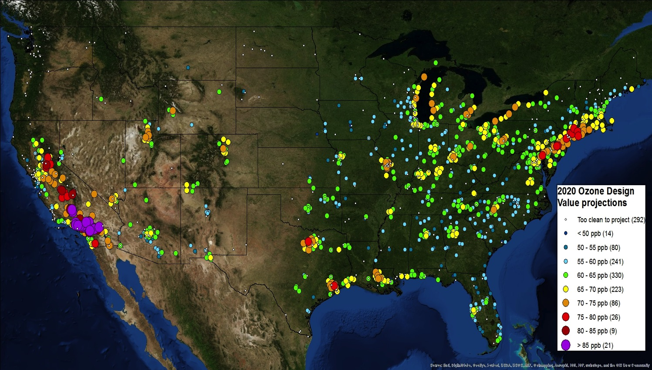
TEMPO
An EV success story

Slide 12
TEMPO news & summary
Currently on-schedule and on-budget
Passed PDR July, 2014
Converted instrument to firm fixed price March 2015
Independent cost estimates for cost plus are extremely challenging!
Now in Phase C: Passed KDP-C April, 2015
Ground systems development at SAO on schedule
Passed instrument CDR June 2015
Reassessing operational data product list
Separate Ground Systems CDR March 2016
Select satellite host probably in 2017
TEMPO operating longitude and launch date are not known until after host selection
Instrument delivery 05/2017 for launch 11/2018 or later
Could be as late as 2021 but we hope not

Slide 13
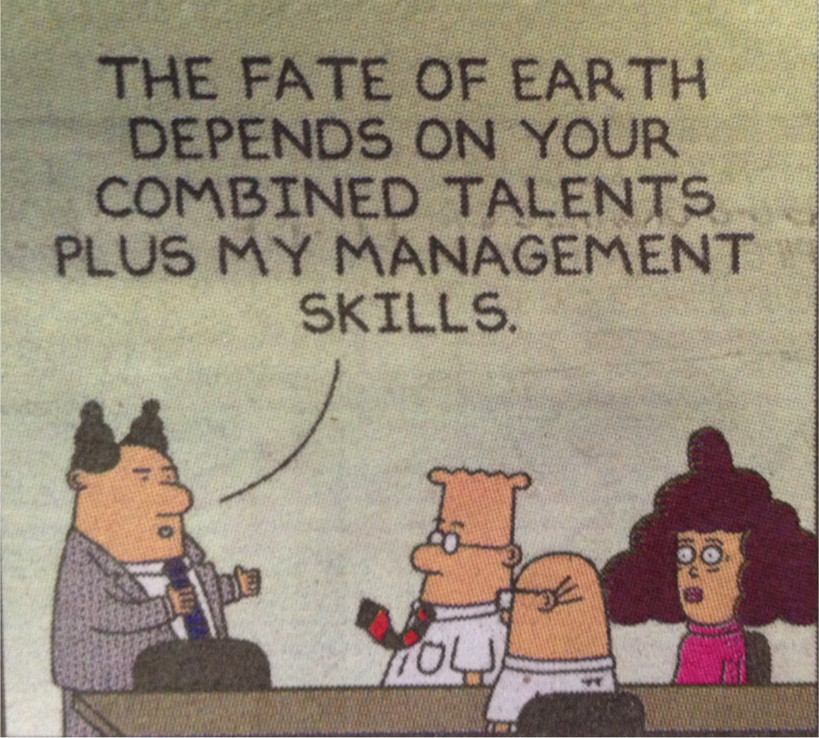
Team TEMPO!
Congratulations Kelley and Team
Kelley Chance
Notes:
One GEOCAPE success story should we emulate it?

Slide 14
DISCUSSION: Can the GEO-CAPE Ocean Mission benefit from an EV project?
EV-I, EV-M:
Appropriate? What science would you cut to keep it in the cost box? Which regions would give the best chance for success?
Other factors?
EV-S:
Ideas?

