Slide 1
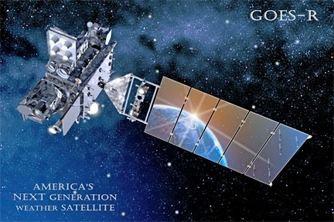
Lessons Learned from the NOAA
Satellite Air Quality Proving Ground
(AQPG)
Shobha Kondragunta
NOAA/NESDIS
Amy Huff
Penn State University
August 31, 2015
Notes:
This talk is partly based on the paper that Amy and I submitted to Environmental Health Insights with a similar title. And partly based on the new smoke and fire initiative proposal that Ivan and I plan to submit to the JPSS program office. Why are we calling out the exo-urban regions specifically? Smoke from fires get transported and affects human health over large regions but exo-urban regions that are in the vicinity of the fires get impacted a lot with loss of life and property.

Slide 2
Satellite Air Quality Proving Ground (AQPG)
Subset of the overall NOAA GOES-R/JPSS Proving Ground
Began in 2010 (GOES-R)
Preparing air quality community for new generation of aerosol satellite products from:
GOES-R Advanced Baseline Imager (ABI)
SNPP Visible Infrared Imaging Radiometer Suite (VIIRS)
Focus on operational users, but also includes users with research applications
Program goals:
Demonstrate VIIRS and simulated ABI products in NRT
Train user community on products
Work with user community to evaluate products and provide feedback to product developers
Achieving day 1 readiness

Slide 3
Satellite AQPG Activities
Advisory Group of 40 air quality forecasters and analysts from federal, state, and local agencies
Receiving hands-on training on aerosol products
Providing feedback to NOAA on VIIRS and ABI aerosol product development
Annual AQPG meetings for user community and product developers
Training videos on YouTube
Journal articles and conference presentations
Near real-time experiments with simulated GOES-R ABI. Delivery of aerosol products to users as if GOES-R is in orbit.

Slide 4
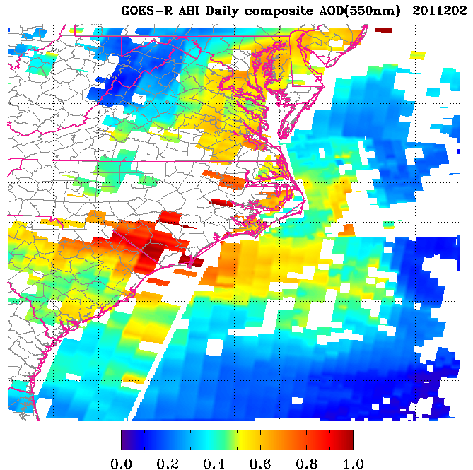
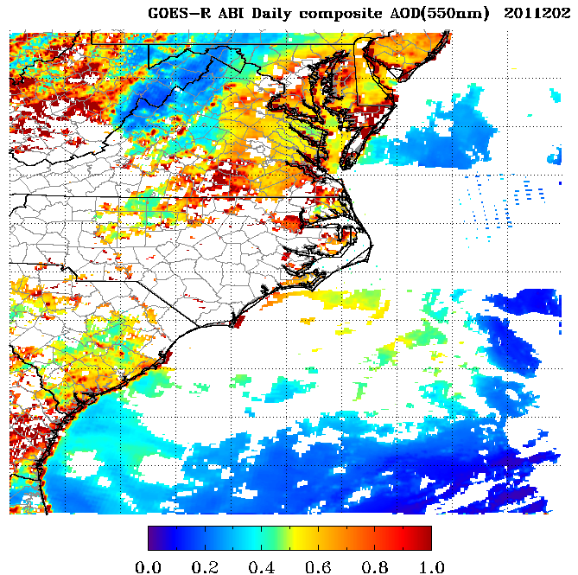
ABI NRT Testbed during 2011 DISCOVER-AQ
Simulated aerosol products included:
AOD, aerosol type, RGB
Domain: Southeastern U.S.
Streaming hourly images, 12:00 – 23:00 UTC daily, July 12-30, 2011
Experiment was conducted during the NASA DISCOVER-AQ field campaign
Availability of aerosol vertical profiles and other physical/chemical properties for ABI validation
10 km vs. 2 km

Slide 5
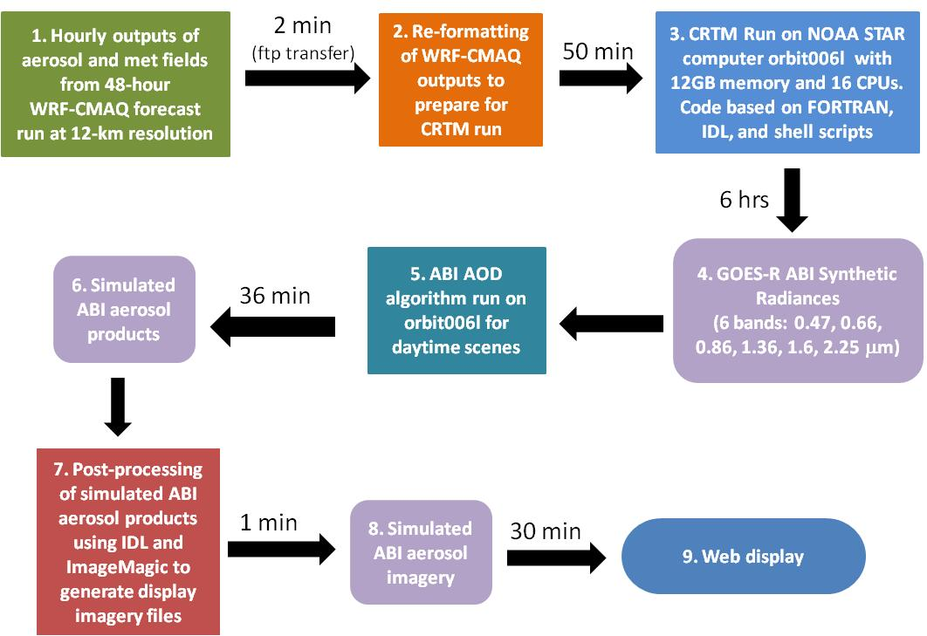
Process for Generating Simulated ABI Aerosol Imagery
http://www.star.nesdis.noaa.gov/smcd/spb/aq/aqpg_2014/index.php

Slide 6
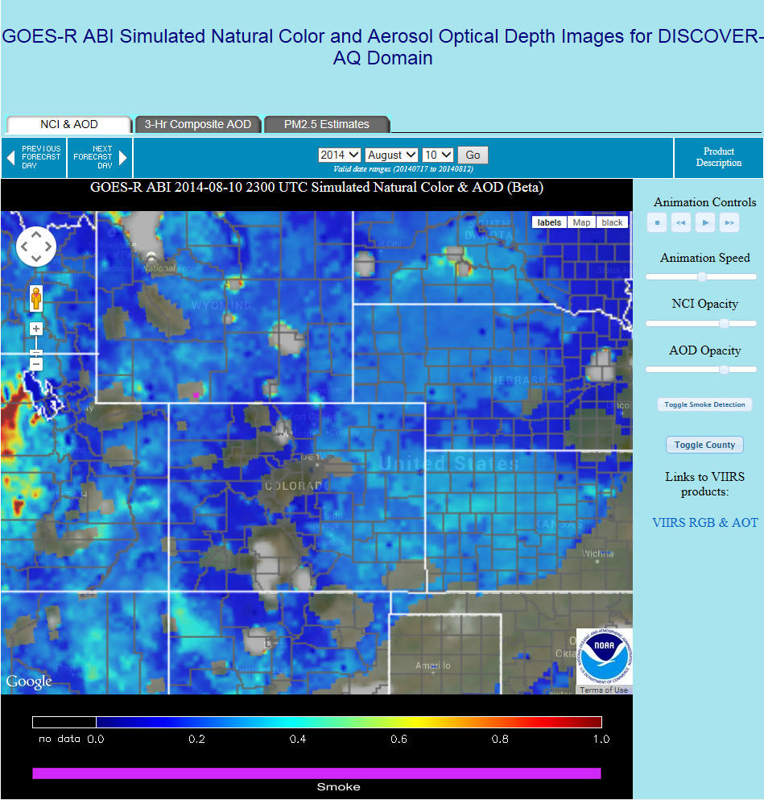
Example of Simulated ABI Products on IDEA
Select imagery:
AOD & NCI
3-hr AOD composite
Satellite-based estimate of PM_{2.5}
Control animation
Change opacity of AOD and NCI
Toggle overlays:
Smoke mask
County borders
Zoom In/Out

Slide 7
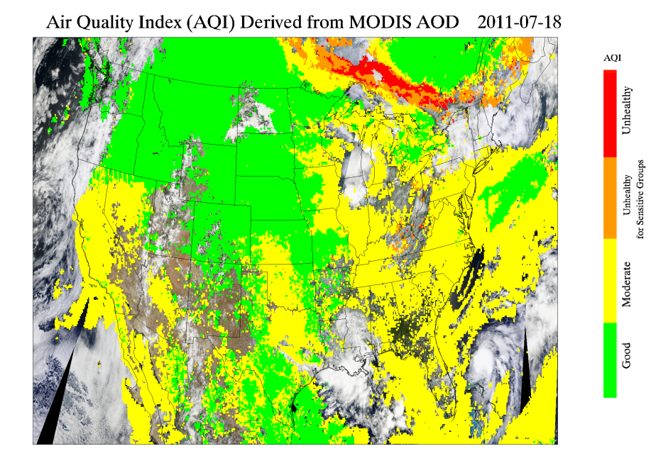
Examples of User Feedback on ABI AOD
Clarify in product description that white areas are clouds and gray areas are missing data
Use EPA Air Quality Index (AQI) colors to show estimated surface PM_{2.5} from AOD
Create 3-6 hour AOD composites and add a few contours corresponding to AQI breakpoints
Provide forward trajectories based on AOD
Add ability to zoom into city-level for in-depth analysis
Overlay satellite-derived wind speeds at different heights over AOD image

Slide 8
Lessons Learned: Product Developer
For near real time experiments, choose a model that simulates well…
Emissions for smoke and dust are included and fire information in the model is real time. Do not make this a model evaluation exercise.
Make sure model resolution matches resolution of satellite data to be delivered
Make sure model evaluation material is available off-line
If product development occurred based on a user feedback, demonstrate it

Slide 9
Lessons Learned: Process of Identifying Needs
The air quality community has different needs from the majority of NOAA satellite product users
Interact with users on a regular basis, to hear about needs from them directly
Provide in-person training on new products and obtain feedback in-person; ask questions about products, how users utilize them in daily activities
Take feedback seriously and make changes to products, to show users that you value their input
Providing training and updates through a variety of venues maximizes outreach to users
Scientific conferences (presentations, NOAA booth)
Journal articles
Project workshops

Slide 10
Lessons Learned: Delivering Data and Tools
Operational air quality user community has specific needs for data and tools:
No time to process data files, so products need to be available as imagery
Data need to be near real-time so users can access as soon as possible after observation
Also need archive of imagery for retrospective analysis
Can’t download commercial or proprietary software (e.g., AWIPS), so imagery needs to be available on a website
Best way we have found to understand user needs is to ask them
Annual workshops, conference trainings: show users data, have them fill out questionnaire about products, hold discussion to flesh out issues and needs

Slide 11
Lessons Learned: Looking Ahead to TEMPO
Be sure to really sample the user community
Make sure you include all aspects of user community in any advisory committee
Don’t forget the operational users!
Air quality forecasters and modelers
Smog Blog
Include at least one person on your program team from the user community(ies) you are targeting
In-person workshops are a great way to stay in touch with user needs
Brings users together with program managers, product developers, and gets them talking to each other
Obtain immediate feedback on products and user requirements
Need to budget for travel costs for some types of users (e.g., state, local, tribal agencies)

Slide 12
Backup Slides

Slide 13
WRF-CMAQ Model Configuration
Domain: Rocky Mountain States (centered on Colorado)
Horizontal grid: 12 x 12 km
Vertical layers: 21 (22 terrain following sigma-levels)
CMAQ options:
Carbon Bond 5 module
GOES AOD assimilation
Blue Sky fire emissions
48-hour forecast:
~4 hours computing time (e.g., 2 hours for WRF, 0.5 hours for SMOKE, 1.5 hours for CMAQ)
Input data delay of 2.5 hours for NAM and 4.5 hours for GBBEP
Based on 00 UTC model runs

Slide 14
Examples of User Feedback on VIIRS AOT
Request/Comment | Status
Change VIIRS AOT retrieval lower bound from 0 to -0.05 so it will match MODIS AOD coverage | Complete
Standardize the AOT quality flag names for EDR and IP (e.g., “high,” “medium,” “degraded”) | The quality flag names reflect the VIIRS AOT IP and EDR products. They are not consistent because IP AOT was not intended for release to the public.
Implement the interactive Google map style visualization for MODIS AOD on IDEA | Not currently possible due to the labor, computing time, storage increase needed
Keep the zoom-in area unchanged when switching from one day to another in the interactive Google map visualization | Complete
Add option to save zoomed-in images in the interactive Google map visualization | Complete
Overlay wind and in situ PM_{2.5} monitor observations in the interactive Google map visualization | We decided not to make this change at this time since users can open VIIRS AOT in Google Earth and add layers there
Fire hotspots are too large at the highest zoom level | We reduced the hotspots to half their original size

