Slide 1
Risk reduction measurements for GEO-CAPE:
A US-Korea joint field campaign (US-Korea JFC) in the East Sea and Yellow Sea
US Steering Group: GEO-CAPE Ocean Color Science Working Group (ZP Lee first author of Whitepaper)
Korean Steering Group: Youngje Park, Yu-Hwan Ahn
Goal of GEO-CAPE this field campaign:
Address the impact of short-term processes on longer and large scale biogeochemical dynamics
Obtain unique data for risk reduction analyses for GEO-CAPE

Slide 2
Justification/ Logic:
Processes/ Features: eddy fields, bloom dynamics, CDOM production and removal, big tides, dynamic particle features
Leverages financial support by the GOCI team for ship time, logistics and satellite data resources
GOCI is the only ocean color sensor in geosynchronous orbit
Atmospheric correction opportunities
KORUS-AQ Synergy: Plus legwork, infrastructure, interdisciplinary opportunities
When?
Tentatively Late Spring- Summer 2016 (??)

Slide 3
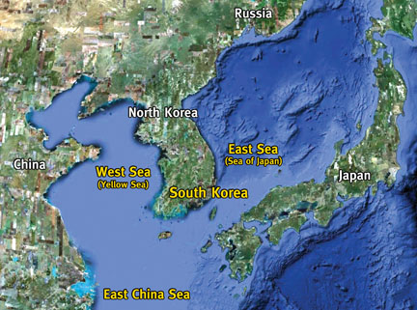
Where?

Slide 4
Motivating Questions
Can the diurnal changes in sediment resuspension and settling be resolved in the normalized-water leaving radiance (nLw)?
Can the diurnal dynamics in organic carbon (dissolved and particulate) due to tidal exchanges at land-ocean interfaces be resolved in nLw?
How do particle size, shape and composition impact the nLw signature at different view angles during a diurnal period?
Can diurnal change of CDOM photooxidation be detected from a geostationary satellite for all viewing geometries?
How accurate do the atmospheric properties need to be estimated in order to obtain reliable diurnal nLw from a geostationary satellite?
How does BRDF variation in water-leaving radiance (Lw, w/m²/nm/sr) affect the GOCI retrievals?
To what extent can the spatial and spectral specifications of GOCI address the diurnal variation of productivity and biogeochemical properties in the coastal oceans?
How do geostationary ocean color products compare with both polar-orbiting ocean color satellite products and with in situ measurements?

Slide 5
Example presented by Bob Arnone
Diurnal Changes in the
Yellow and
Japan East Sea
Korean Cruise Planning

Slide 6
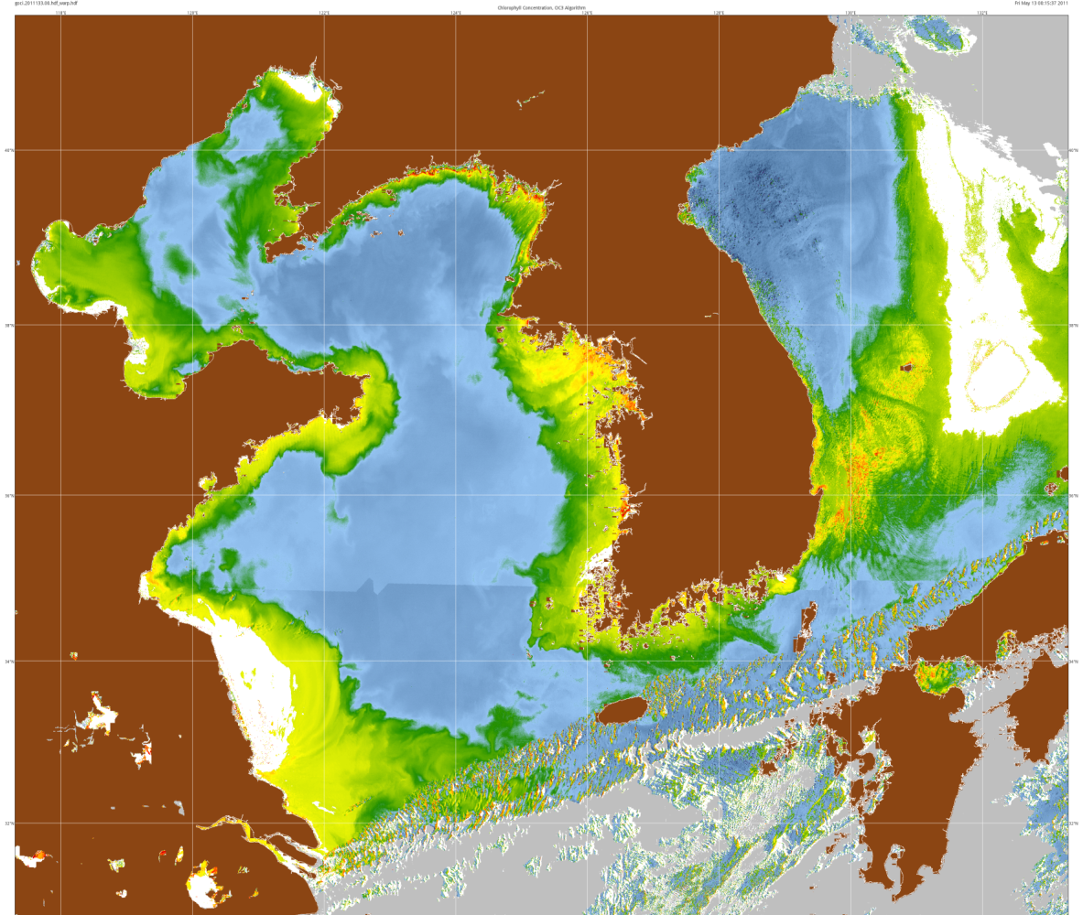
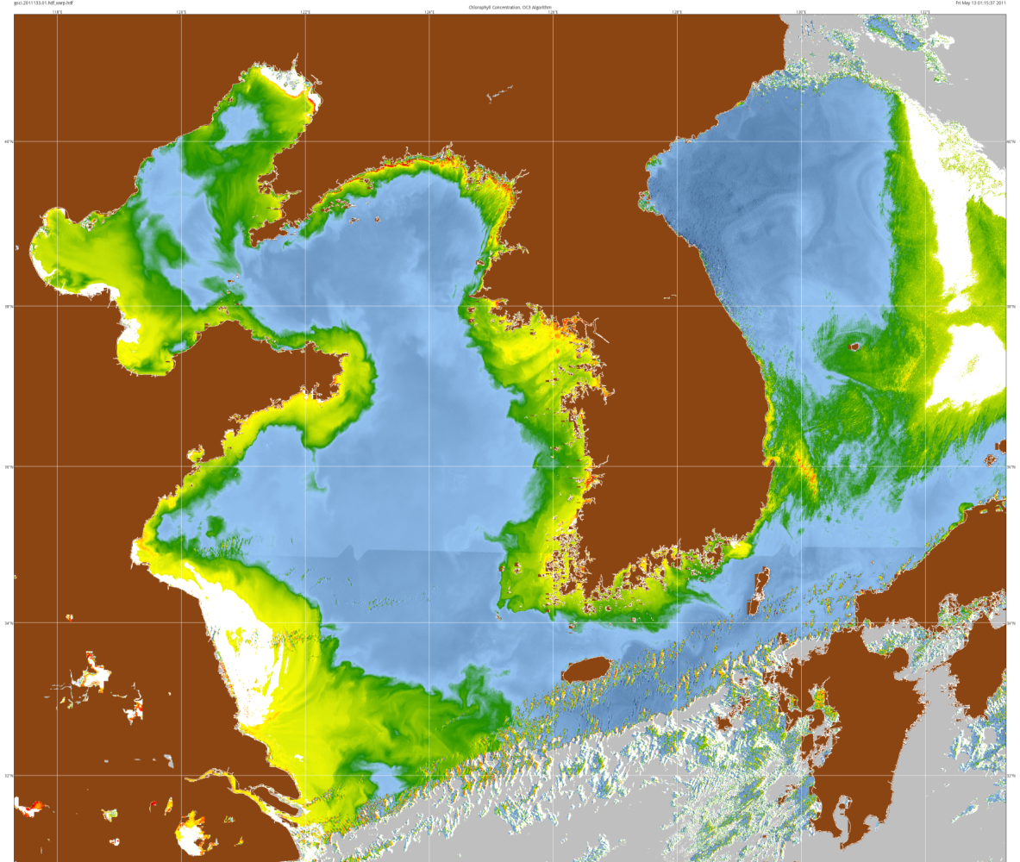
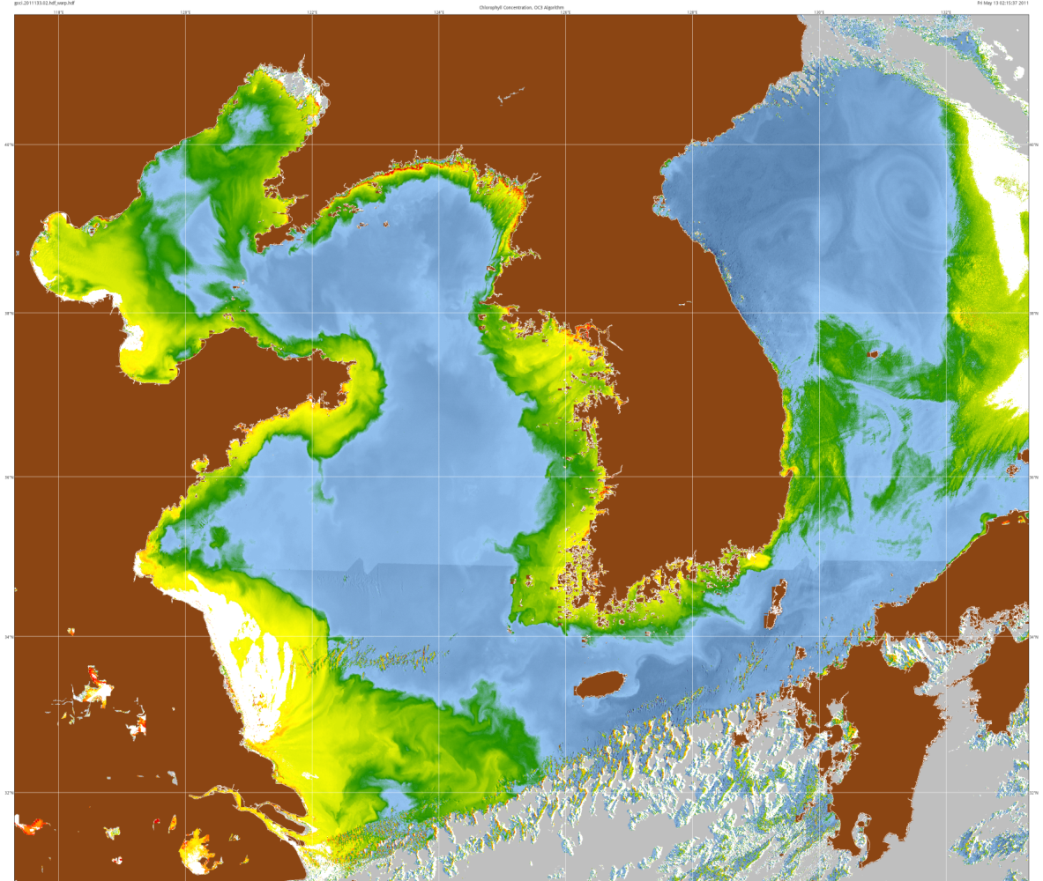
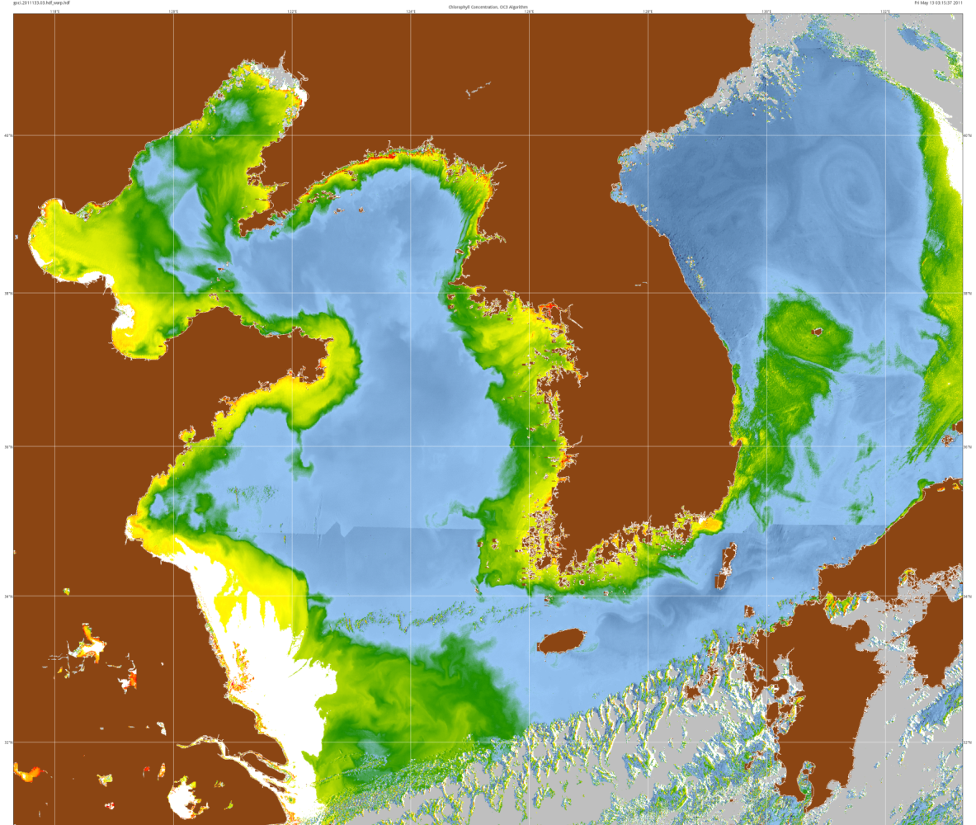
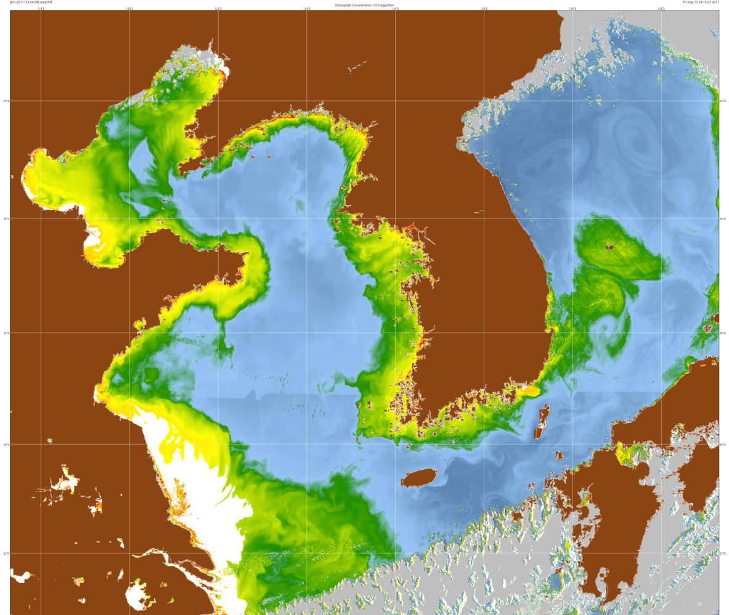
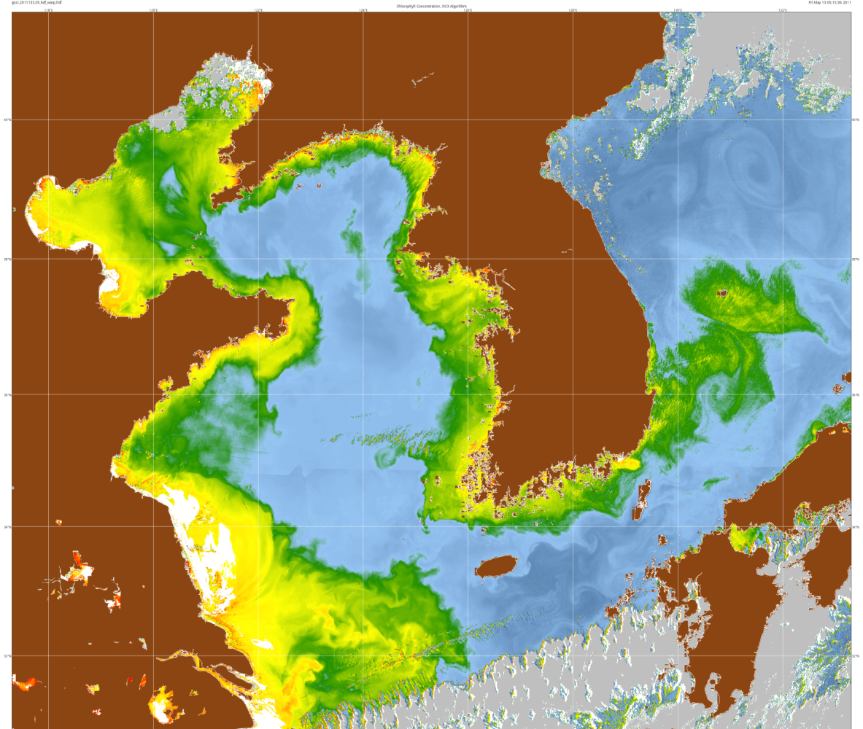
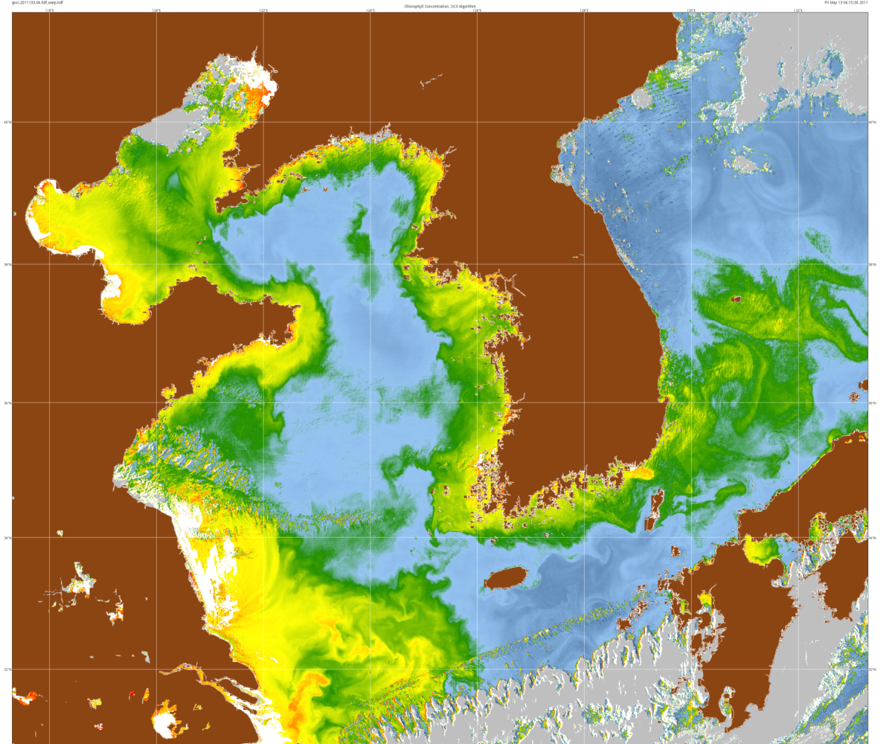
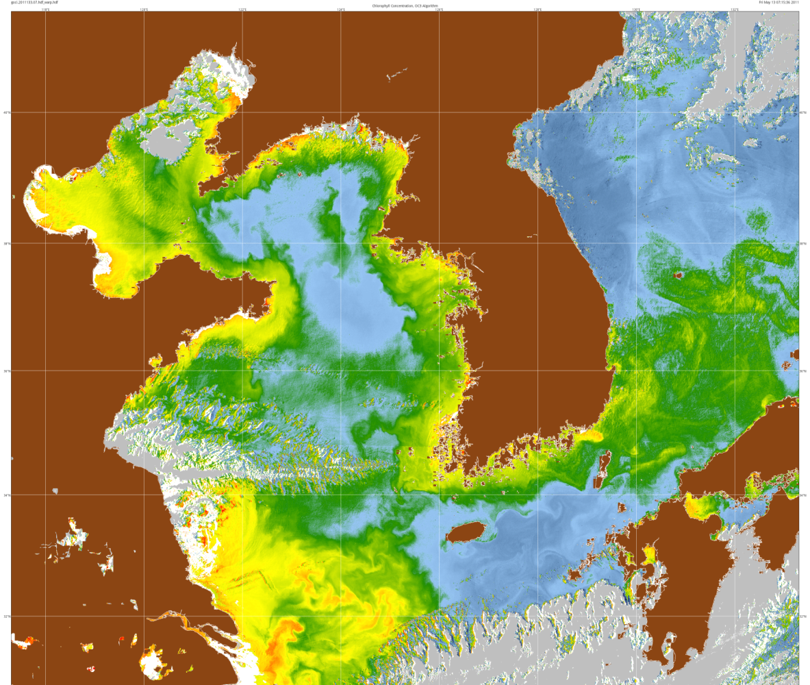
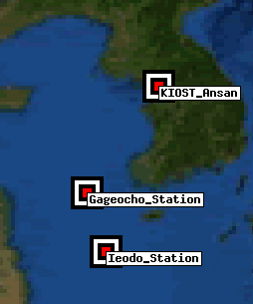
Geostationary Ocean Color Imager
Sequence
Chlorophyll
May 13, 2011
Flow fields
Sources and
Sinks
Japan
East Sea
Seoul
Ullung do
Island
South
Korea
Gageocho_
stations
AERONET
Korean
Strait
Cheju do
Island

Slide 7
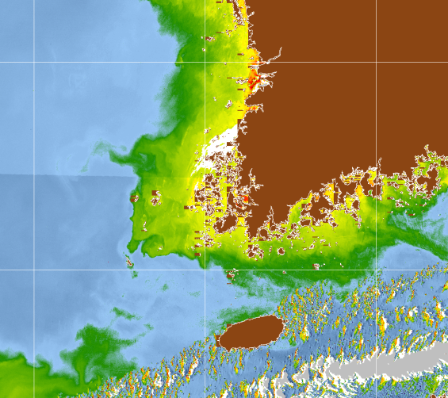
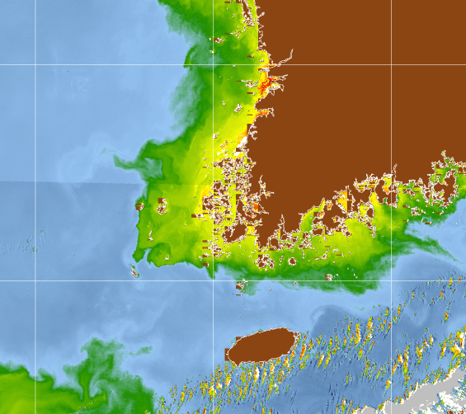
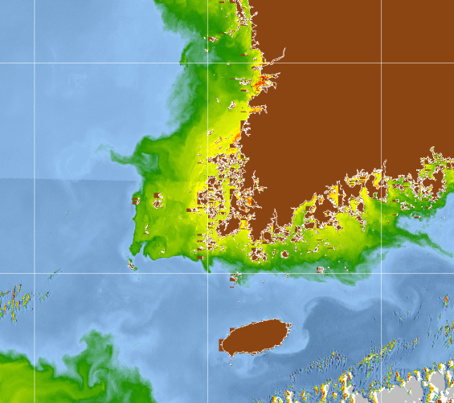
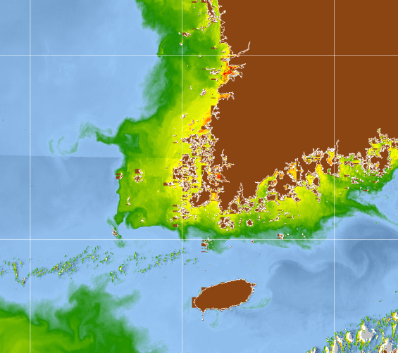
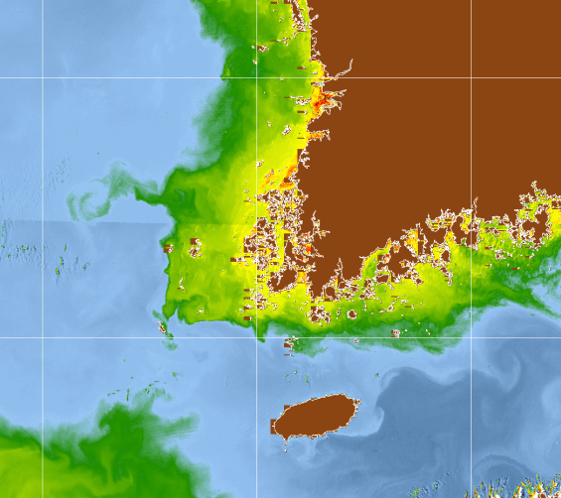
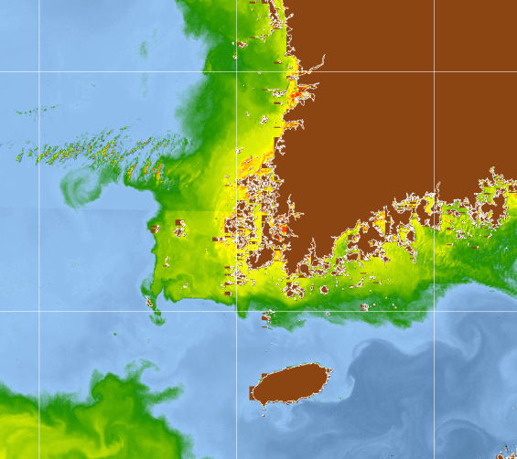
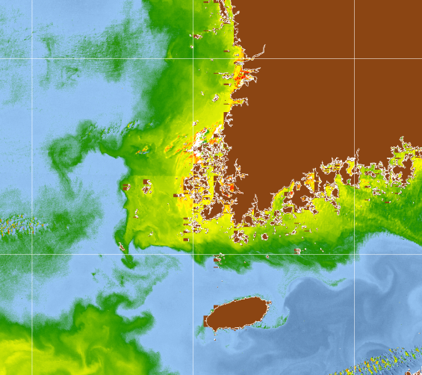
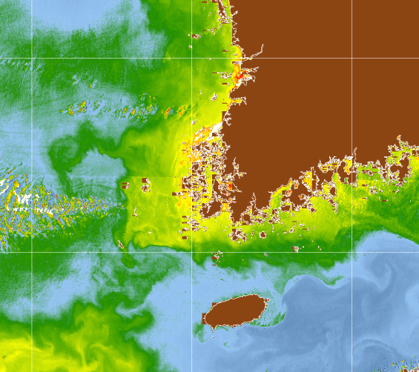
Geostationary Ocean Color Imager
8 Sequence
Chlorophyll
May 13, 2011
Tidal
Response
South
Korea
Korea Strait
Cheju do

Slide 8
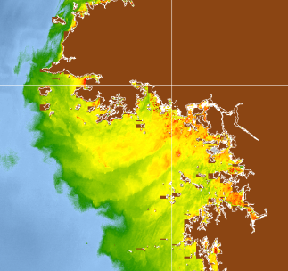
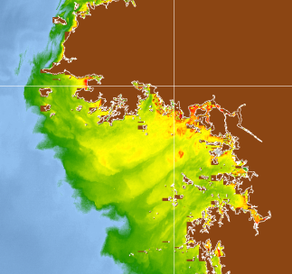
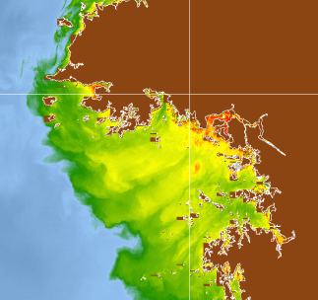
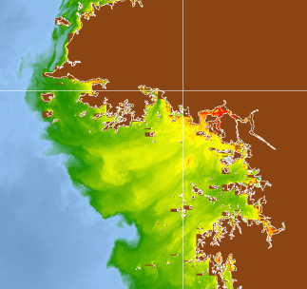
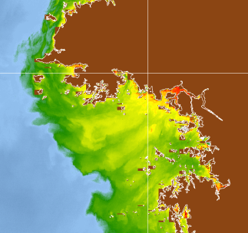
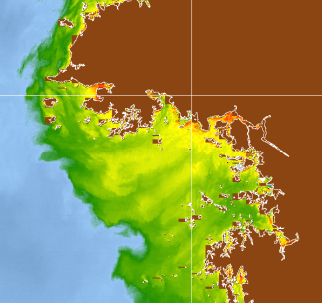
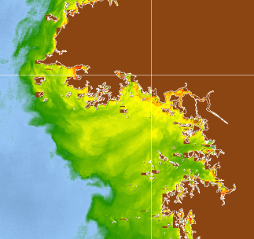
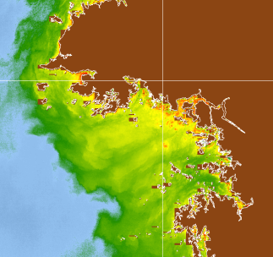
Geostationary Ocean Color Imager
Hourly Sequence
Chlorophyll
May 13, 2011
Tidal response
Along estuarine
channels
Seoul

Slide 9
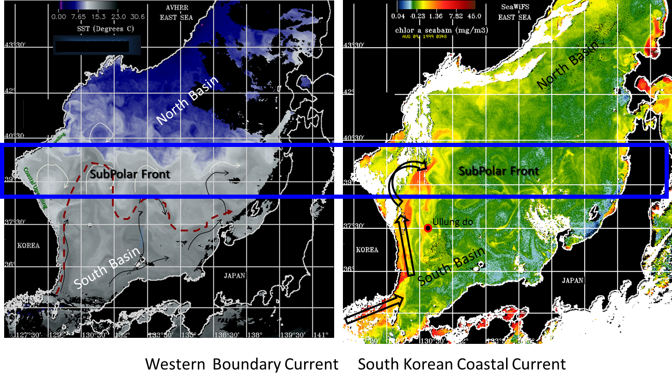
Japan East Sea Eddy Fields
Weekly Composites
Upwelling
Upwelling along the South Korean Coast

Slide 10
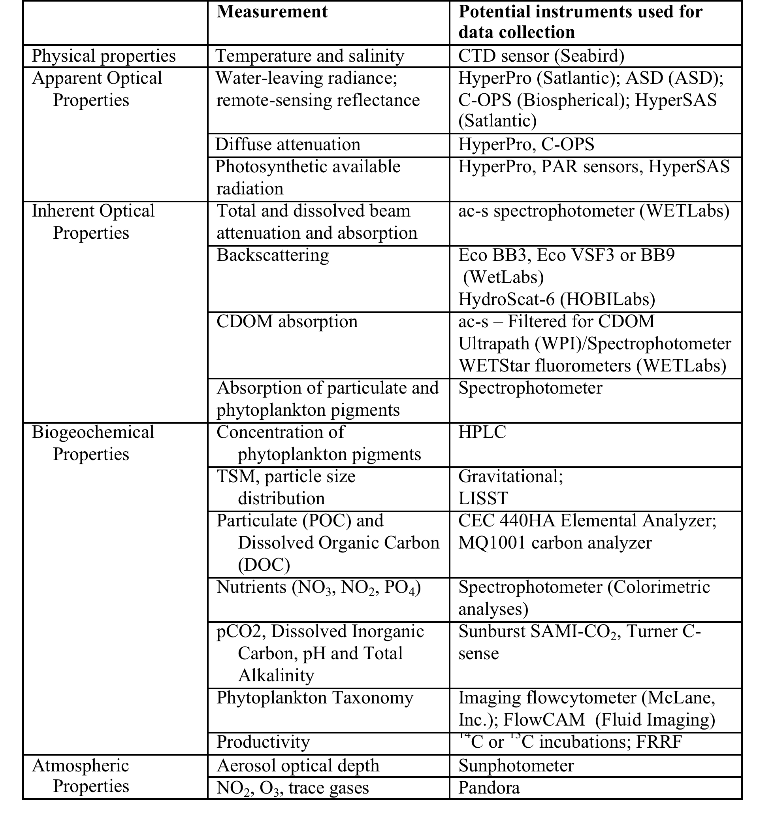

Slide 11
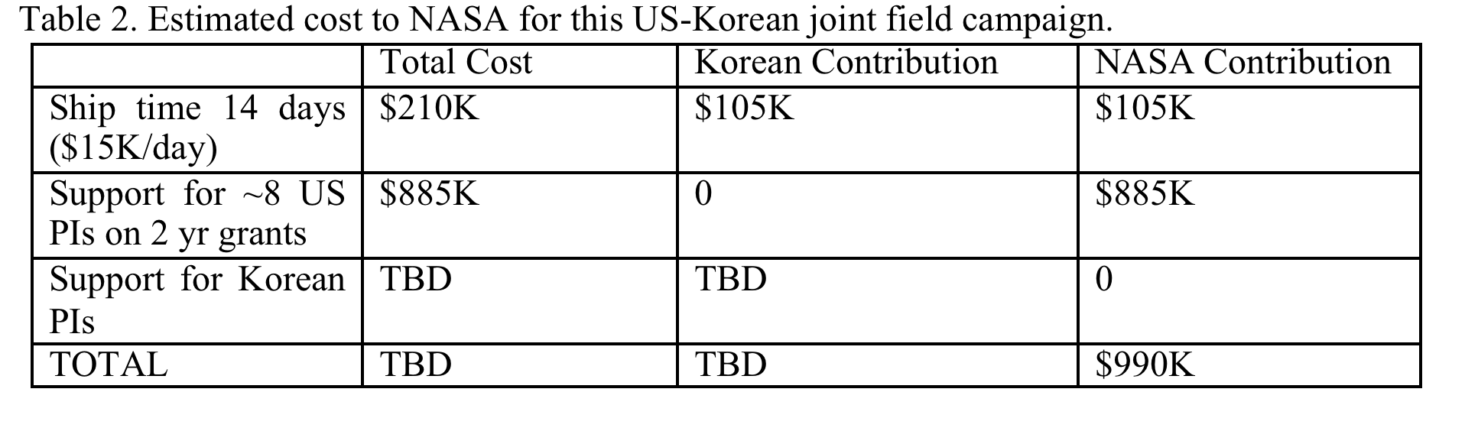
Tentative budget
Discussion……
- next steps?

