Slide 1
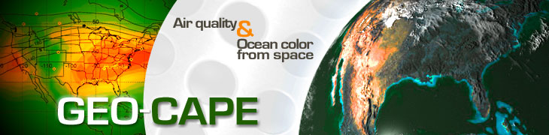

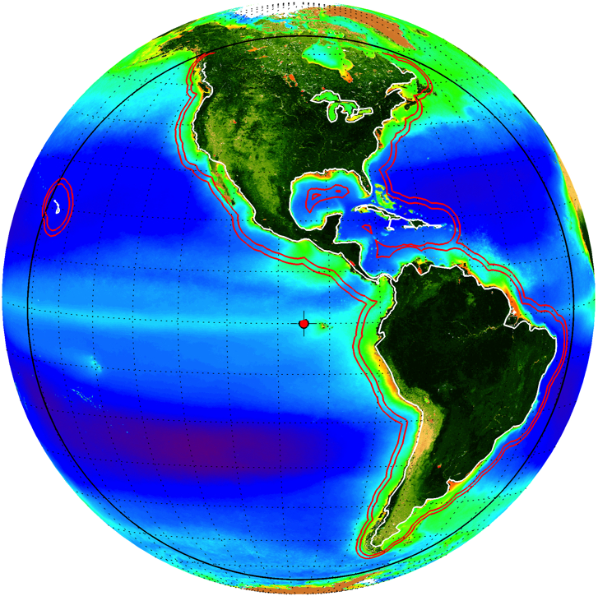
Ocean Color Science Working Group Highlights
Ocean Science Working Group
Antonio Mannino
NASA GSFC

Slide 2
GEO-CAPE Oceans Activities
Science Working Group Activities
  Science Traceability Matrix
  Applications Traceability Matrix
  Science Value Matrix Development
  White Papers
  PI-led scientific investigations
  Field Campaigns
    Chesapeake Bay - July 2011 (CBODAQ)
    Gulf of Mexico Experiment - September 2013 (GoMEX)
    Korean coastal waters - May-June 2016 (KORUS-OC) - joint w/ KIOST
Recent Engineering Studies
  2011 Pointing Study
  2014 Instrument Cost vs Capability study
  2015-2016 Functional 50-band filter wheel breadboard
  2015 Scheduling Study
Outreach

Slide 3
Outline
Activities to develop a Science Value Matrix
Recent updates to Science Traceability Matrix
Instrument capability vs cost study
Filter wheel mechanism breadboard study
Pointing study
Scheduling study
Gulf of Mexico field campaign
Other Science Studies
NASA Earth Science Applied Sciences Program discussion
Applications Science Matrix
Outreach: Ocean Optics Town Hall, update at OCRT, IOCS breakout session and poster, CERF 2015 town hall planned
Pre-Decadal Survey Activities
How to sell the mission?

Slide 4
Science Value Matrix
Science Application Priorities
Based on these Median scores it is recommended that the GEO-CAPE ocean color instrument be designed to address applications with a score of 8 or higher.
Applications that scored 7 should be adequately addressed by this same instrument.
Dust transport will also be measured for the areas sampled.
Open ocean OC requires additional area sampling and duplicates sampling with other instruments.
This instrument will not have adequate spatial resolution for small inland water bodies.

Slide 5
Science Value Activity Recommendations
Spatial resolution
  continue trade between 375 m (Threshold) and 250 m GSD (Baseline) at Nadir
Temporal resolution
  Hourly for Targets and US coastal waters (including Great Lakes)
UV Radiometry 340-400 nm
SWIR bands 1245 and 1640 nm
  Alternate SWIR bands are very low priority and no longer considered
Spectral capability - NO CONSENSUS YET
  Proposed: Hyperspectral 340-1050 nm (2-5 nm) (New Baseline) vs. 50 band Multispectral (5 nm bands) (New Threshold)
  Spectral sampling 2-5 nm plus 0.4 to 0.8 nm over 400-450 nm for NO2
Coastal coverage 375 km from inland to offshore for US coastal waters survey
SNR >1000:1 for 350- 800 nm binned to 10 nm FWHM (combines UV and visible)
Recommend updating STM to reflect these priorities and the remaining trades and then review current instrument designs in light of these new requirements.
SWG should discuss whether to update STM to reflect results and then review current instrument designs.

Slide 6
Modifications to STM
Survey Threshold: <2 hours
Geostationary orbit Threshold: 94°±2° W longitude; Baseline: 94°±1° W
Threshold pointing stability <25% of pixel
Threshold geolocation <50% of pixel
Scanning Priority
  Survey of U.S. Coastal Waters
  Other coastal and large inland bodies of water
  Open ocean waters within FOR
No consensus on spectral capability

Slide 7
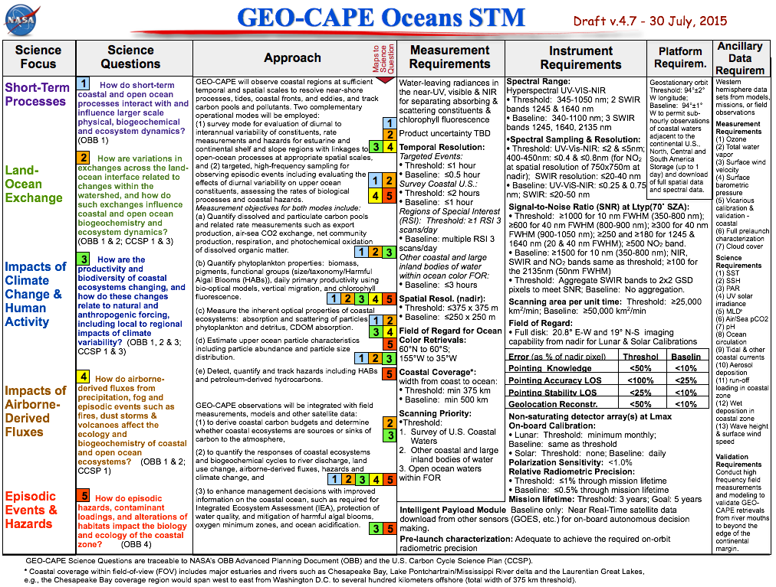

Slide 8
Measurement & Instrument Requirements
 | Threshold (minimum) | Baseline (goal)
Temporal Resolution Targeted Events | <1 hour | <0.5 hour
Survey Coastal U.S. | <2 hours | <1 hour
Spatial Resolution (nadir) | 375 m x 375 m | 250 m x 250 m
Spectral Range | 345-1050 nm; 2 SWIR bands 1245 & 1640 nm | 340-1100 nm; 3 SWIR bands 1245, 1640, 2135 nm
Scan Rate | >25,000 km²/min | >50,000 km²/min
Spectral Resolution | UV-VIS-NIR: ≤5 nm; 400-450nm: ≤0.8nm (NO₂); SWIR: ≤20-40 nm | UV-VIS: ≤0.75 nm; SWIR: ≤20-50 nm
Signal-to-Noise Ratio (SNR) @ Ltyp for 70° solar zenith angle | 1000:1 for 350-800 nm (10nm FWHM); 600:1 for NIR (40nm FWHM); 250:1 & 180:1 for 1245 & 1640 nm (20 & 40nm FWHM); ≥500:1 NO₂ | 1500:1 for 350-800 nm; 100:1 for 2135nm (50nm FWHM); NIR, SWIR and NO₂ same as threshold

Slide 9
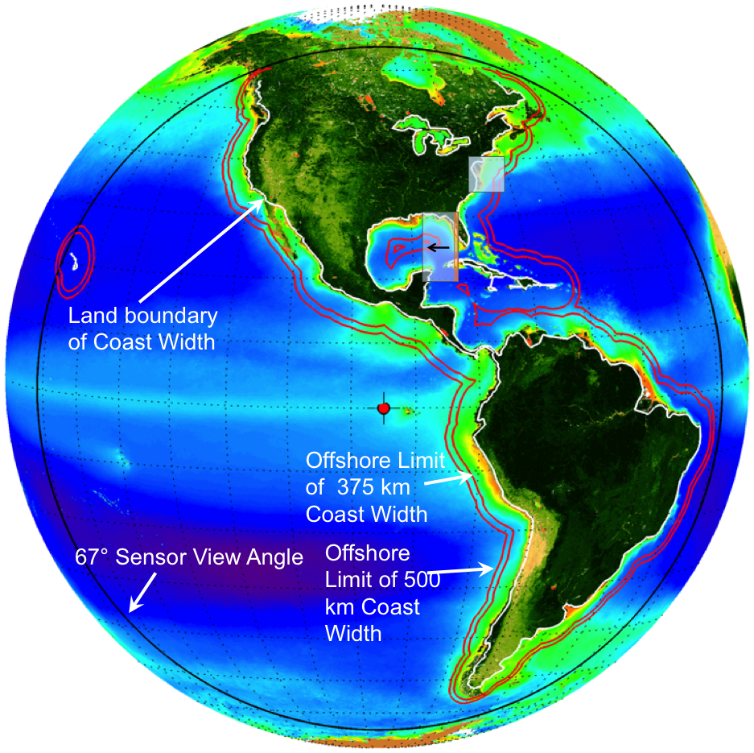
Competing Technical Challenges
Challenge: achieving an engineering solution for requirements that are in opposition to each other
Spatial resolution
Temporal resolution
Spectral resolution
Hyperspectral
Instrument concepts
Filter radiometer (GOCI)
Single slit spectrometer
Multi-slit spectrometer
Wide Field-of-View
spectrometer

Slide 10
2014 Instrument capability vs cost study
1) IDL pre-costing (using NICM - mass, power, telemetry) to narrow instrument design options
  Select most viable instrument types for optical design lab
2) Optical Design Lab (ODL)
  Develop optical designs for new sensor concepts with a limited set of capability permutations (GSD, etc.).
  Select most viable designs for IDL study
3) Extended IDL study on Wide-Angle Spectrometer (WAS)
4) IDL study on Filter-wheel Radiometer (FR)
5) IRAD supported 2-day IDL re-fresh of GSFC concept
6) Architecture Scaling Study
  Scale IDL designs by capability trade space and cost these alternate designs using NICM.

Slide 11
Input to Pre-costing - 2011 Informal RFI
Thanks to Jeff Puschell (Raytheon), Tim Valle & Paula Wamsley (Ball), Richard Key (JPL)

Slide 12
2014 Instrument capability vs cost study
 | Hyperspectral Spectrometers | Multi-spectral Filter Radiometer
Instrument Type | Single Slit, Multi-slit, Wide-Angle | Filter Wheel Instrument
Spatial Resolution | 250, 375 & 500 m | 250, 375 & 500 m
Spectral Resolution | 0.4 and 2 nm | 5 nm
Spectral Range | 340-1050 nm | 50 bands: 340-1050
SWIR Bands | 1245, 1640, 2135 nm | 1245, 1640, 2135 nm
SNR (UV-Vis; 10 nm bands) | 1000 | 1000

Slide 14
2014 Instrument Study Cost Assumptions
1 Flight Unit and Engineering Development Unit through PRICE-H
Engineering Test Units (ETUs) (10% of FU cost) and Component Spares covered by wrap factors
Class C Mission (selective redundancy)
  (Class B Parts – up-screening not included in cost estimate)
3 year design life (5-yr goal)
Costs reported in FY2016 constant year dollars
Instrument built by contractor
Flight Software (FSW) Estimated using GSFC in-House bid rates
SEER-H cost estimates for Detectors
Schedule used: ATP: 12/17, CDR: 12/18, PER: 5/21; Launch 12/2023
IDL study costs included HW and firmware to compensate for jitter and roll (star tracker, gyro, fast-steering mirror, passive struts, actuators and roll camera)
IDL provides instrument point design concepts with cost confidence level of 20-30% (rule of thumb to multiply by 1.5 to increase CL to 70%)
  NICM system and sub-system versions provide 50% CL

Slide 15
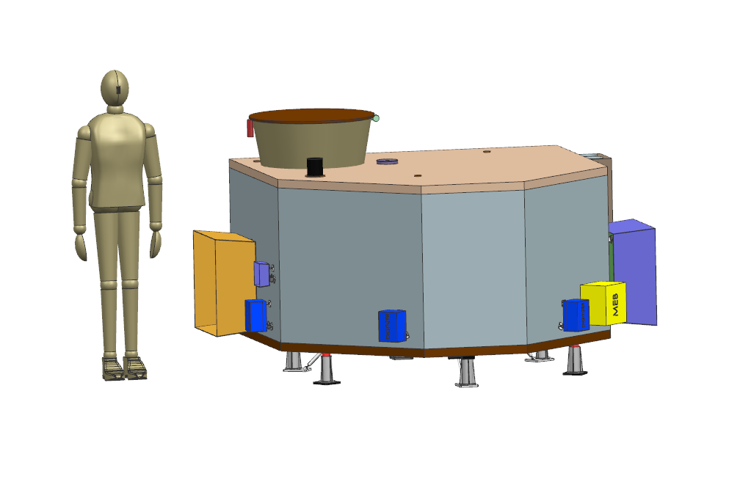
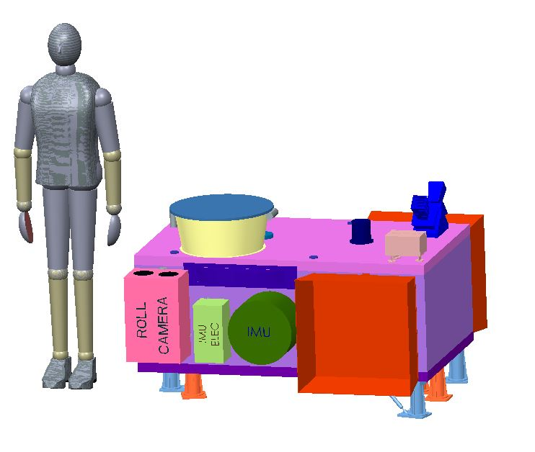
Instrument Relative Size
Wide-Angle Spectrometer (WAS) - 375m GSD
Filter Radiometer (FR) - 250m GSD
Coastal Ecosystems Dynamics Imager
(COEDI) - 375m GSD
GSFC
Proprietary

Slide 16
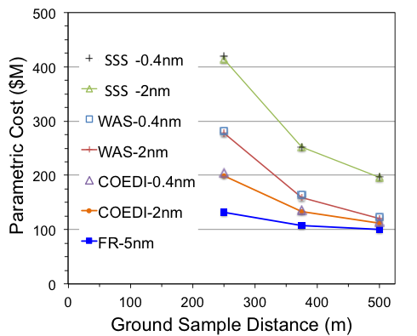
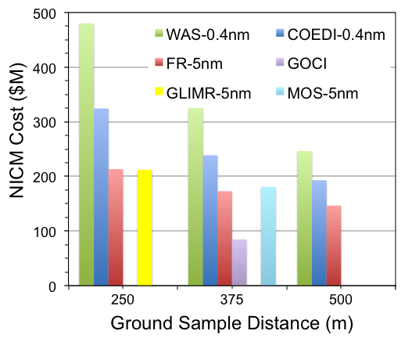
Instrument capability vs cost study
Spectral resolution: 0.4, 2, 5 nm
Nadir GSD: 250, 375, 500 m
SWIR: 3 bands
WAS = Wide Angle Spectrometer
FR = Filter Radiometer
SSS = single-slit spectrometer
COEDI = dual slit spectrometer (GSFC)
GLIMR = wide angle spectrometer (Raytheon)
MOS = 4-slit spectrometer (Ball)
GOCI = Korean/Astrium filter radiometer (360m)

Slide 17
Instrument Capability vs Cost
Instrument Type | Filter Radiometer FR |  | Wide Angle Spectrometer WAS | Multi-Slit Spectrometer COEDI
Spatial Resolution | 250 m | 375 m | 375 m | 375 m | 250 m
Spectral Resolution | 5 nm | 5 nm | 0.4 nm | 0.4 nm | 0.4 nm
Spectral Range (nm) (2135 not req) | Multispectral (50) 340-1050; 1245, 1640, 2135 | Multispectral (50) 340-1050; 1245, 1640, 2135 | 340-1050; 1245, 1640, 2135 nm | 340-1050 1245,1640 nm | 340-1050 1245,1640 nm
Scan Rate (km²/min) | 100,105 | 100,105 | 48,200 | 43,200 | 28,800
Mass CBE (kg) | 190.4 | 126.3 | 309.4 | 202.8 | 358.6
Power CBE (W) | 200.1 | 161.2 | 341.3 | 192.5 | 257.7
Volume (m x m x m) | 1.5 x 1.46 x 1.02 | 1.0 x 0.97 x 0.68 | 2.6 x 1.8 x 1.5 | 1.5 x 1.7 x 1.1 | 2.2 x 2.5 x 1.7
Telemetry CBE (kbps) | 15,900 | 10,600 | 23,832 | 23,854 | 35,765
NICM Cost ($M) | $213.4 | $172.9 | $325.2 | $238.8 | $308.0
Parametric Cost ($M) | $131.7 | $107.7 | $165.2 | $136.2 | $200.1
NICM Sub-System Cost ($M) | $128.7 |  | $179.3
Instrument: $200M
Project Mngmt, S&E, & SMA (10%) $45M
Ground Sys., Mission Ops (13%): $60M
Host fees (launch, I&T, data): $80M (TBD)
Science & Applications: $65M
- - - - - - - - - - - - - - - - - - - - - - - - - - - - - - - - - - - - - - - -
Reserves (10%): $45M _______________________________________________________________________________________________________
TOTAL: $495M

Slide 18
Cost Estimate for Ocean Color GEO-CAPE
WBS Element | Cost | Cost ($M)
Instrument | $133M * 1.5 | 200
Project Mngmt, Sys. Engr., & SMA* | 10%* | 60
Ground Sys. & Mission Ops.* | 13%* | 45
Host Fees (I&T, Launch, Data) | TBD | 80
Science |  | 65
Reserves | 10% | 45
TOTAL |  | $495M
* Cost % from recent LEO missions (should be lower for hosted mission)

Slide 19
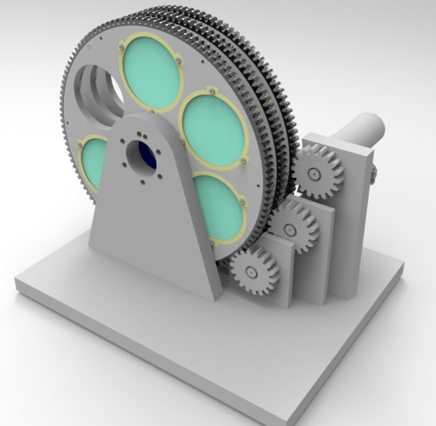
Filter Wheel Breadboard Mechanism
50 filters into 10 wheels with 5 filters each. Each wheel has an open spot
Each wheel is independently actuated but their positions are coordinated via computer
Design should be modular, expandable and use commercial solutions if practical
Not considered a high precision optical mechanism however the transition speed is fast
Filter replicas made of glass are preferred
Prototype “proof of concept” model is intended to operate in a shirt sleeve environment at STP conditions
Index: 60° in 0.2 seconds, still for 2.0 seconds
Life: 3 years operating 17 hours/24 hours
Courtesy of Walt Smith
Filter: 82 mm x 6 mm; 72 g;
94 mm radius
Wheel: 290 mm x 10 mm; 0.82 kg

Slide 20
Disturbance Rejection Apportioned by Frequency
Spacecraft attitude control rejects low-frequency disturbances (≤ 0.1 Hz)
Jitter suppression system on instrument mount rejects high-frequency disturbances (1.5 Hz and above)
    Active elements, plus passive rolloff due to inertia
Active “fast steering loop” rejects mid-frequency disturbances (0.1 to 1.5 Hz)
  Needs IMU sampled at >15 Hz
  Actuation by either:
    A fast steering mirror (baseline), or
    By steering the scanning mirror, or
    Active portion of the jitter suppression system
Courtesy of Eric Stoneking

Slide 21
FY15 Scheduling Study
Study Aims
Optimize Acquisition of “Cloud Free” Scenes at Lowest Cost
Scheduling of observations based on science priorities and cloud cover
NASA Ames Activities
Jeremy Frank et al.
Scene Layouts for FR and COEDI sensors (STK analysis)
  GSD determination across sensor view angles
Automated scheduler
  Requires cloudiness predictions, cloudiness thresholds, scenes
  Evaluation of automation technologies
  GSFC study Elements - http://geocape.herokuapp.com
  Karen Moe, Dan Mandl, Jacqueline LeMoigne, Stuart Fry & Pat Cappelaere
Smart cloud forecasting
On-board cloud detection
Ground/on-board scheduling with Robust Executive
21

Slide 22
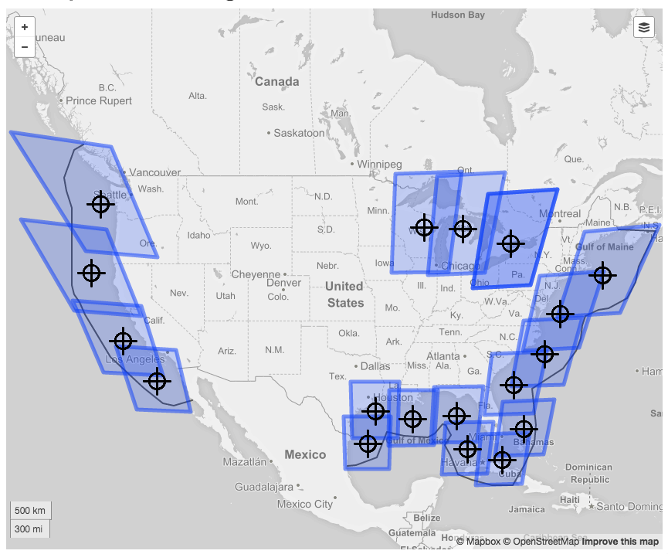
Strawman 18 Coastal/Lakes Survey Scenes Using FR
~45min to scan
CONUS coastal
waters
Source: GSFC analysis via GUI Editor, assuming spherical Earth – Satellite at 95W

Slide 23
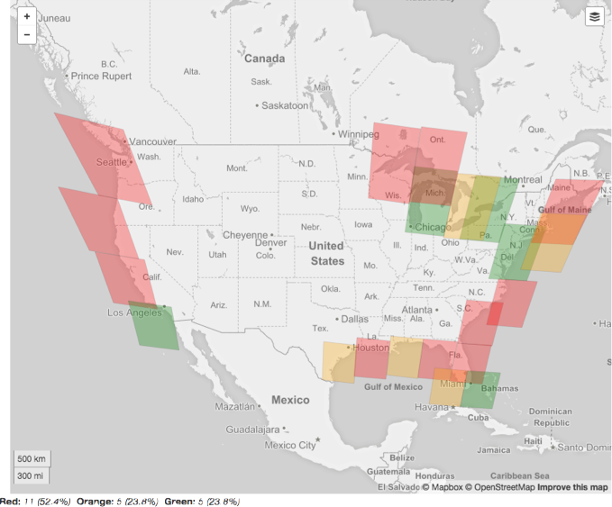
SURVEY SCENES & FORECAST
Example FR Scene
Forecast showing:
Red scenes fail cloud
threshold and are not
scheduled
Green scenes pass cloud threshold and are
scheduled
Orange scenes are
marginal and are
scheduled for more
evaluation onboard
Notes:
Red scenes will not be scheduled
Orange scenes will be scheduled
They will need to be green when acquired onboard (see discussion later)

Slide 24
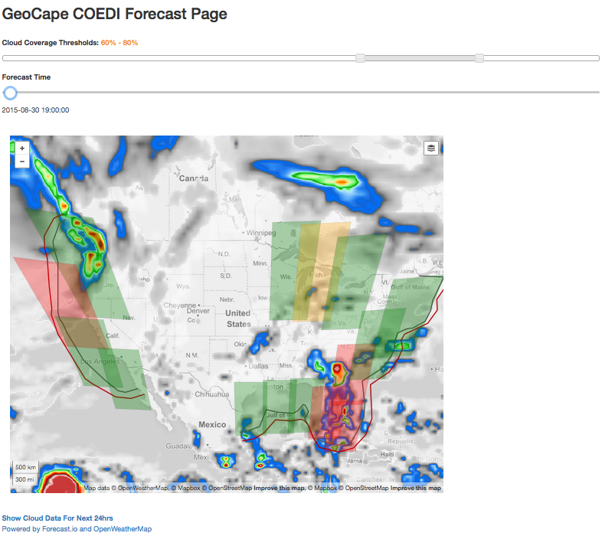
GSFC Scheduling Website - COEDI scene forecast
Cloud coverage thresholds at 60% and 80%
  http://geocape.herokuapp.com

Slide 25
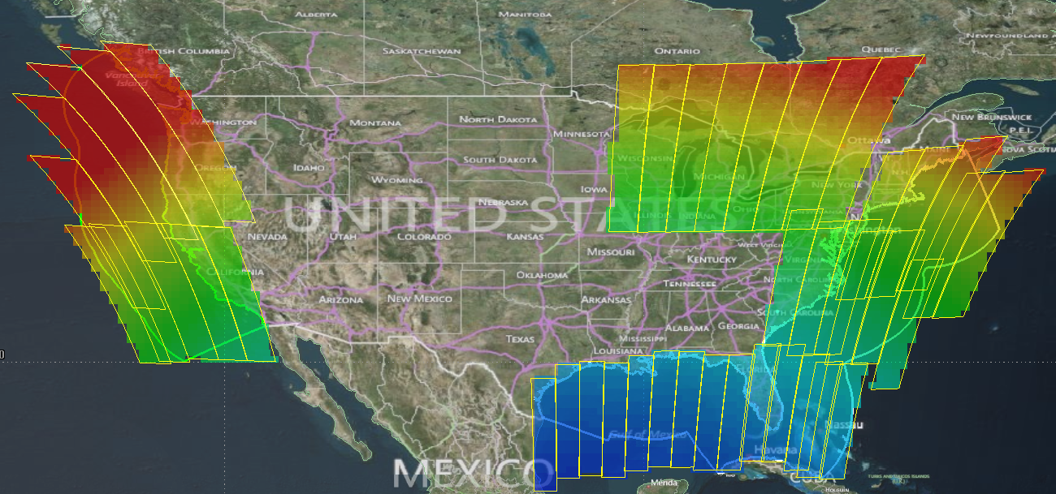
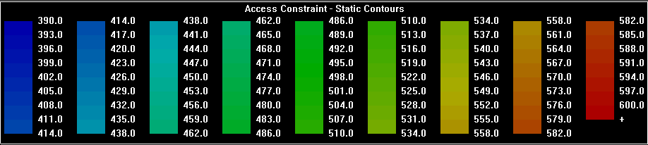
COEDI - 375m GSD, 500km coverage
# Scenes: 43
Min. GSD: 399 m
Max GSD: 687 m
Courtesy of Jeremy Frank et al.
25

Slide 26
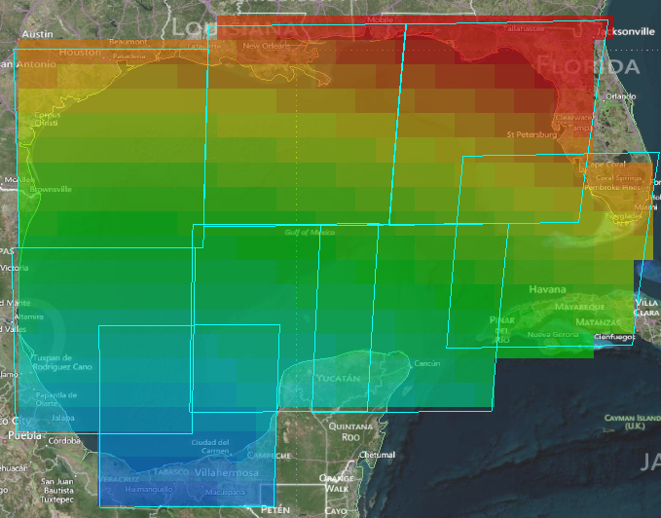
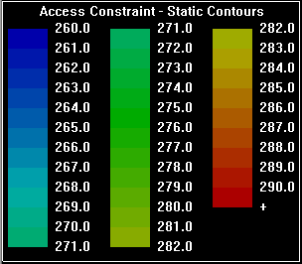
FR - 250 m GSD
# Scenes: 38
Min. GSD: 399 m
Max GSD: 701 m
Min. GSD: 262 m
Max GSD: 295 m
Courtesy of Jeremy Frank et al.
26

Slide 27
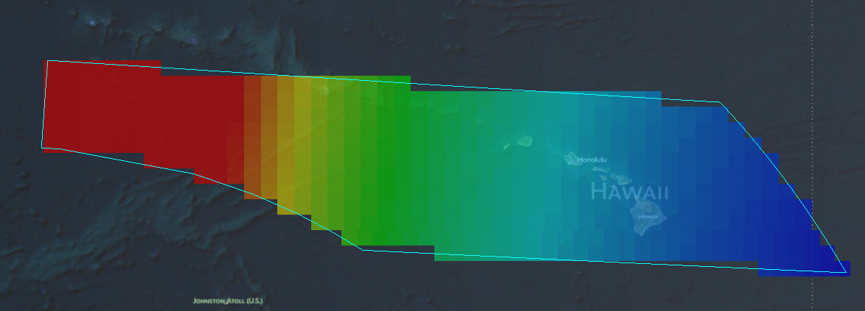
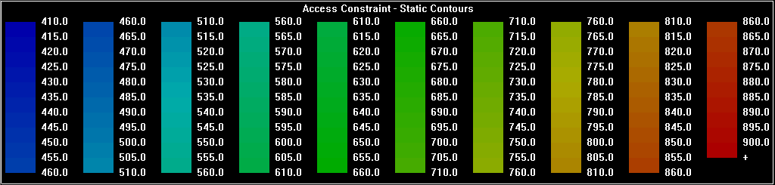
FR Scenes over Hawaii
Min. GSD: 413 m
Max GSD: 5885 m
Air Mass of 4 to 5; OC retrievals feasible from 95W
Courtesy of Jeremy Frank et al.

Slide 28
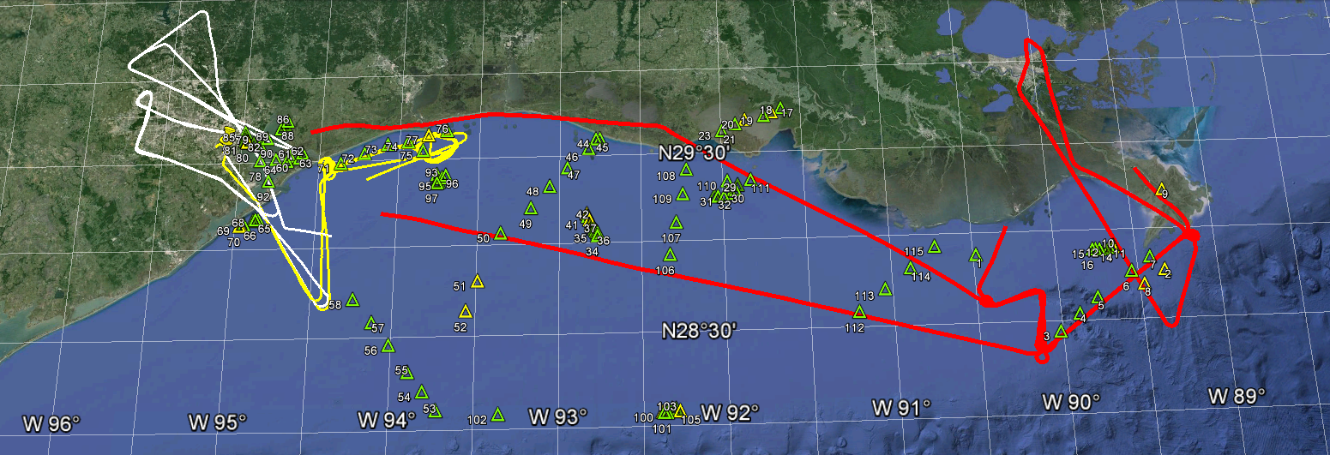
Gulf of Mexico Experiment - Sept. 2013
14-day oceanographic & atmospheric properties
Transects along gradients
  nearshore to offshore, river plumes, algal bloom patches
  addresses aquatic & atmospheric spatial variability
Tracking water masses (follow instrumented drogue)
  diurnal evolution of biology & biogeochemistry
Small boat operations (more optically complex waters)
  Marsh Island area; Galveston & Trinity Bay

Slide 29

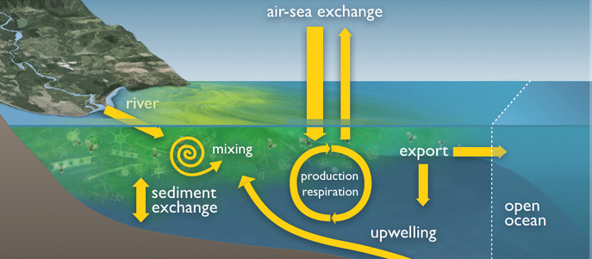
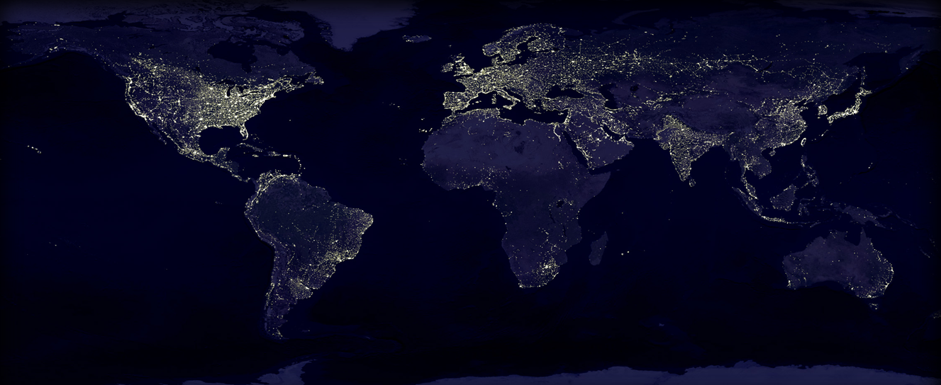
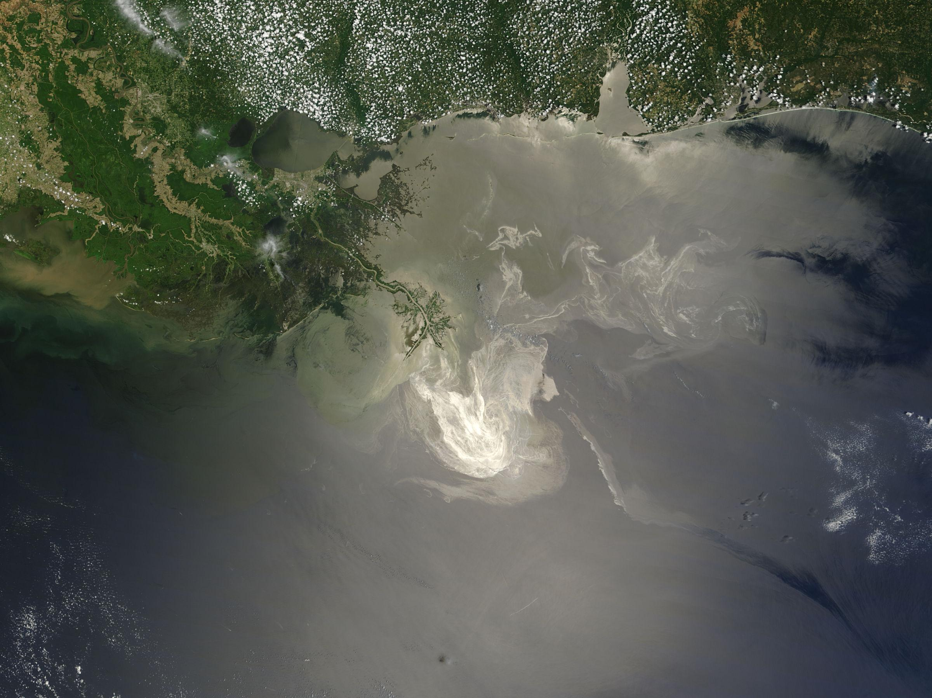
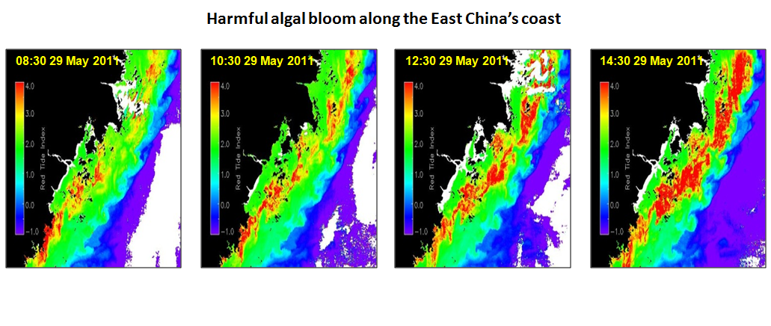
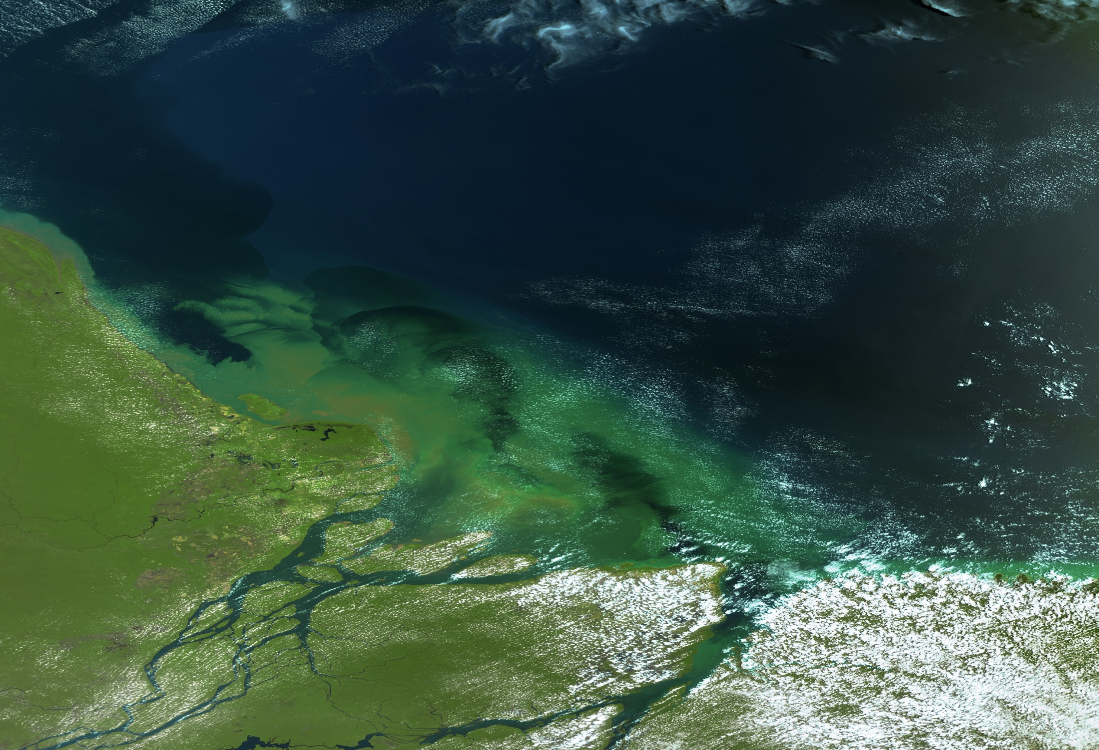
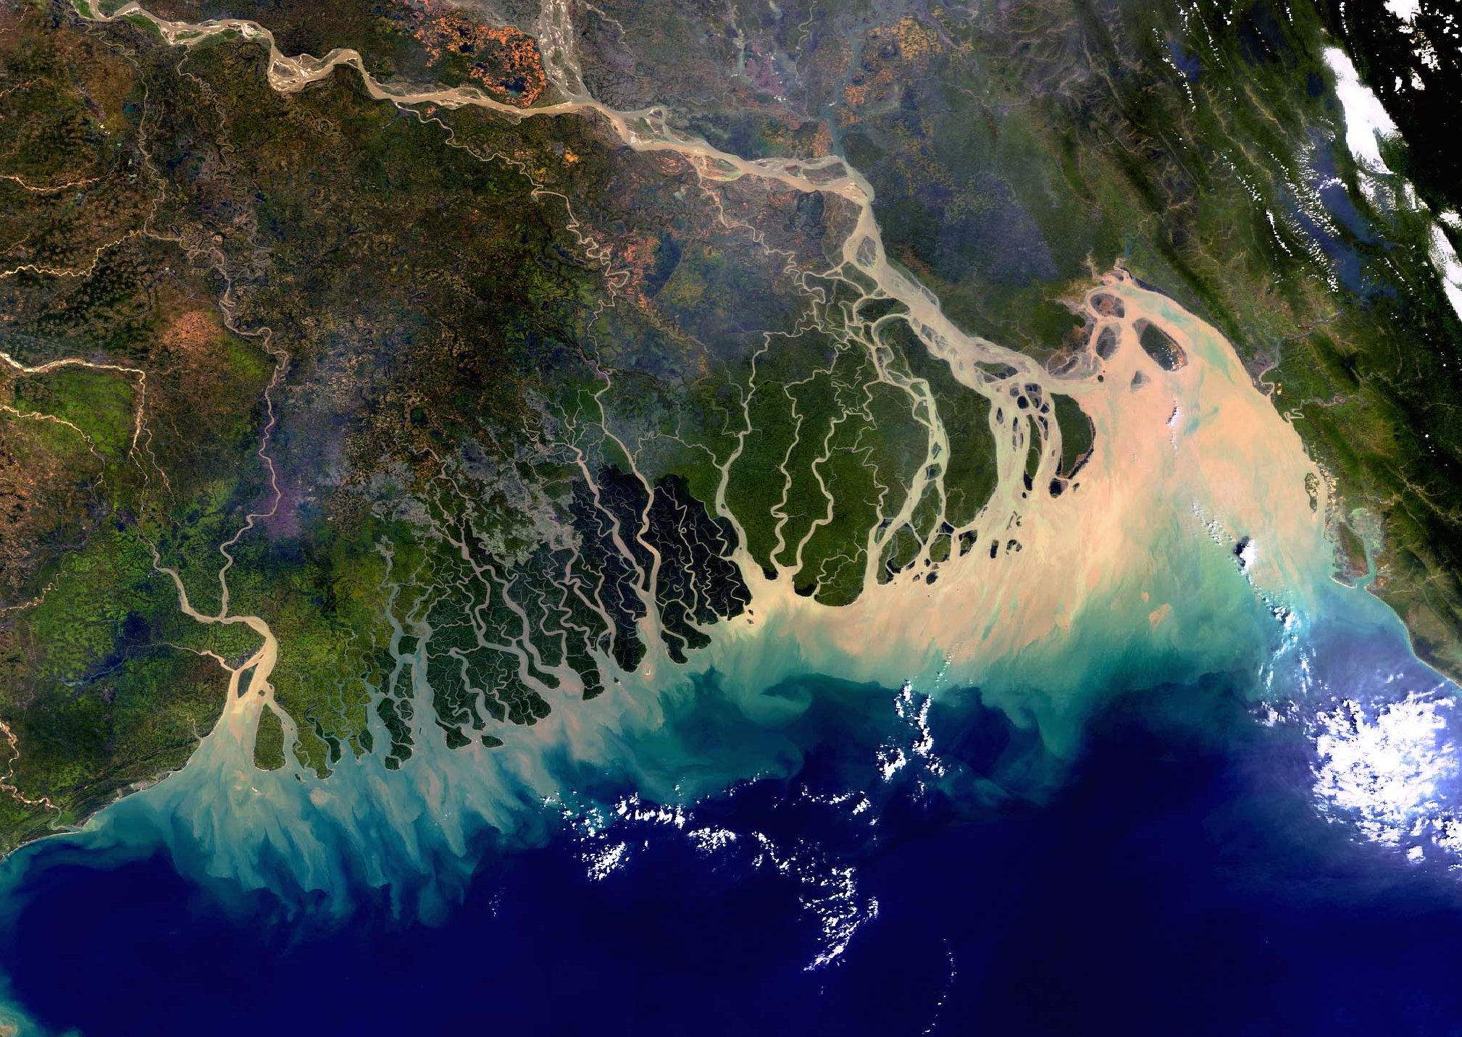
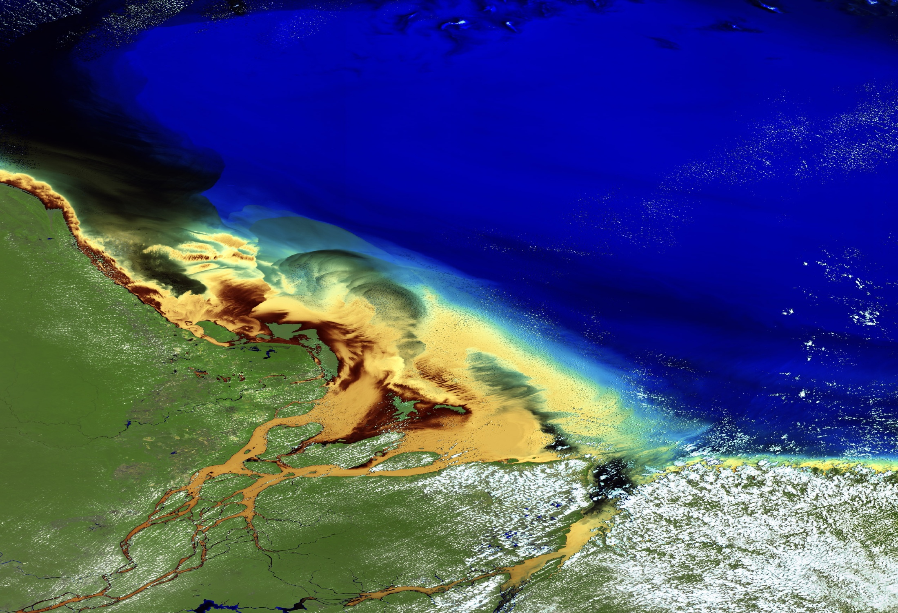
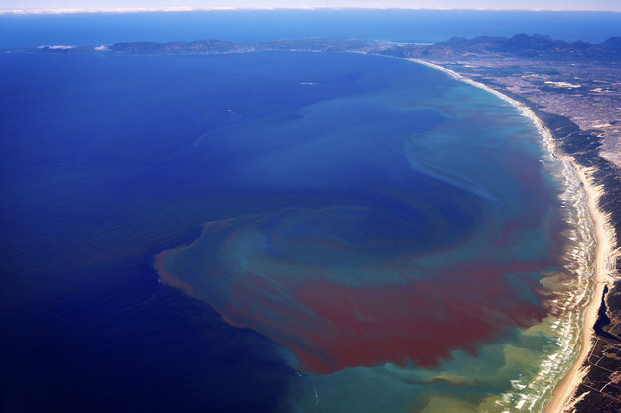
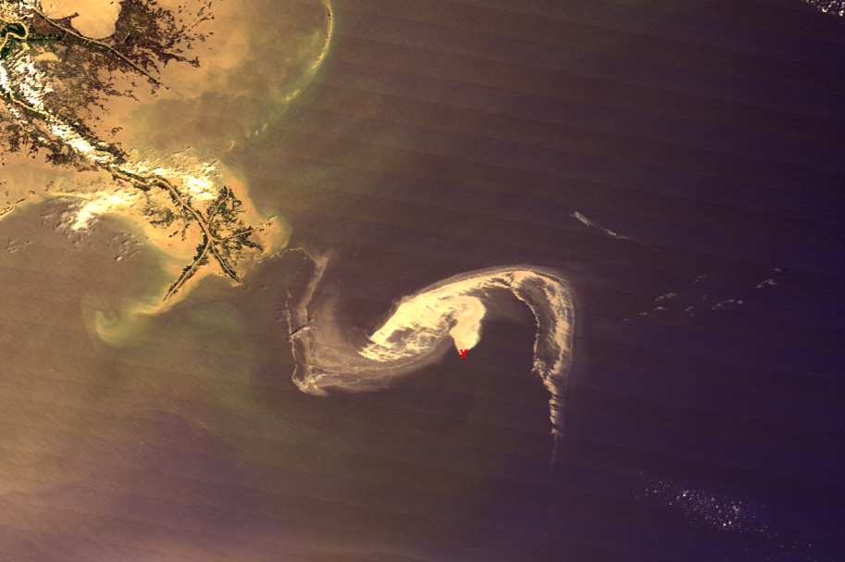
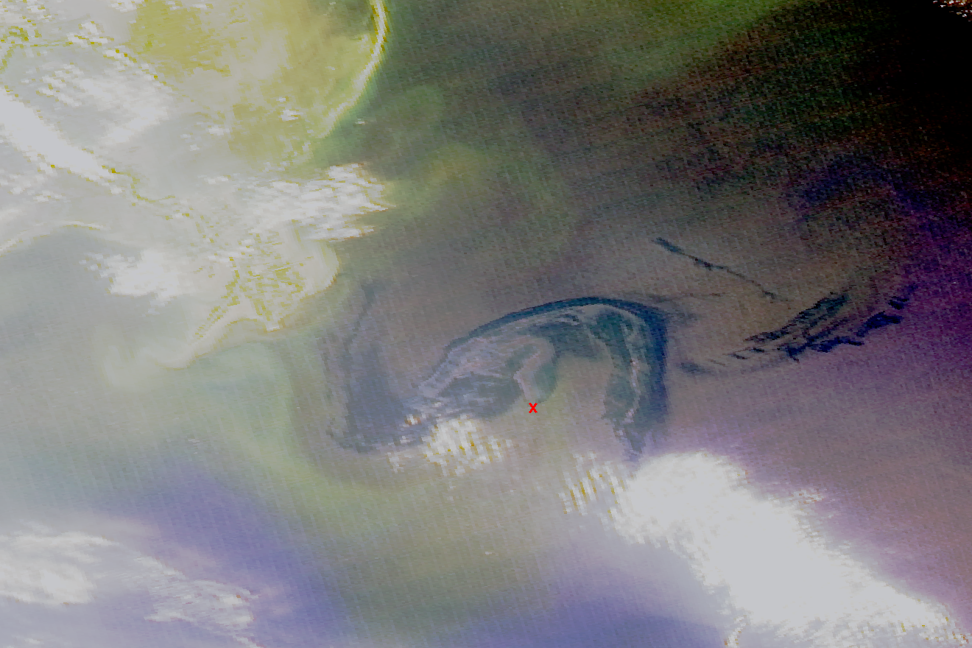
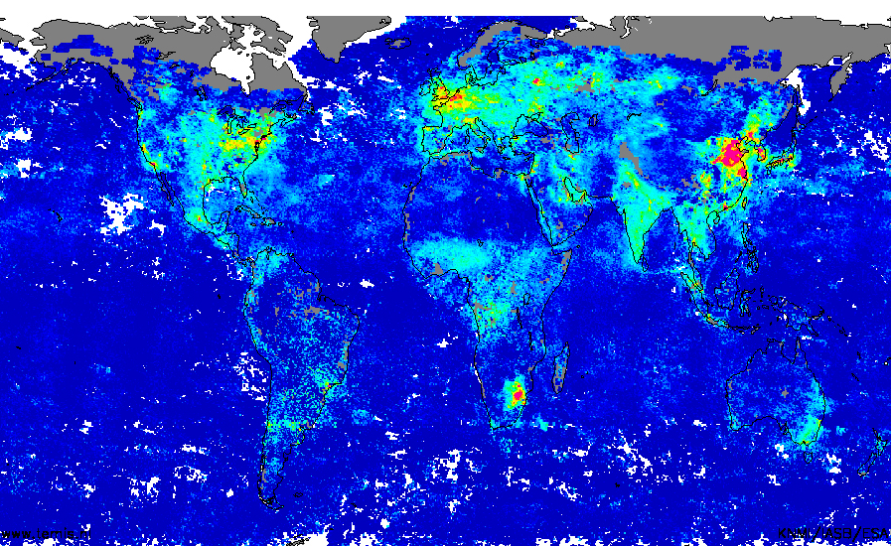
GEO-CAPE APPLICATIONS Objectives in Coastal Areas
GEOCAPE Applied Sciences
February 2015, NASA HQs
MODIS/Terra,
4/29/2010, 16:55 GMT
MODIS/Aqua,
4/29/2010, 18:30 GMT
M. River
M. River
GOCI-observed diurnal changes of a harmful algal bloom of Prorocentrum donghaiense along the East China’s coast. From Lou and Hu (2014).
Bangladesh coastline, flooding-Ganges transports sediments, MERIS, March 2005
MERIS: Amazon Delta, Northern Brazil 01. October 2005, orbit: 18758
Algae in Lake Erie, MODIS-Terra, Rapid Response, March 21, 2012
MODIS images just 1.5 hours apart, yet showing changes in the oil appearance and location (from Fishman et al. (2012).
MERIS: Sediments , Amazon Delta, Northern Brazil 01. October 2005
Oil Spill, Mississippi Delta, MODIS-Terra, March 24, 2010
Red tides in Benguela upwelling, Aerial photo Pitcher et al., Oceanogr. 2008
Hazards/Disasters
Water Resources
Oceans/Lakes
Ecological Forecasting
Air Quality/Human Health
Climate
• Post-storm Assessments (e.g., flood detection); sediment transport (navigation)
• Detection and tracking of oil spills, and other disasters
• Water Quality Indicators and management of water resources in lakes and coastal waters
• Better monitoring, predictions and early-warnings for HABs ; fisheries management
• Air Quality in Coastal Cities, and impacts of anthropogenic air pollution on human health
• Mapping and assessment of carbon dynamics, sources and fluxes & integration into climate models
Overall: Improve assimilation of satellite data into operational models to (i) assess/improve management of coastal resources , and (ii) improve forecasting/predictions.

Slide 30
Applications Traceability Matrix
Agency | Applications | Satellite products | Spatial requirements | Temporal requirements
NOAA | Habitat assessment, fisheries management, water quality, HABS, ecological forecasting, pollution monitoring, coral health, acidification | Chlorophyll, Rrs(λ), abs(λ), HABs, K₄₉₀, K_{PAR} | 100m – 4km | 3hrs - daily
EPA | Sustainable coastal resources; air, climate and energy research; healthy and sustainable coastal communities | Chlorophyll, Rrs(λ), abs(λ), abs(cdom, phy, det), HABs, SPM, K₄₉₀, K_{PAR} and more | <250m to 500m | 0.5 hrs – 3hrs
US Navy | Surface currents, instrument assessments, bathymetry, visibility, coastal oceanography, navigation | Chlorophyll, Rrs(λ), abs(λ), abs(cdom, phy, det), bbp(λ), HABs, SPM, K₄₉₀, K_{PAR} currents, etc. | 250m – 1km | 1hr - daily
Gulf of Mexico Fishery Mgmt Council | Habitat quality, fisheries conservation, coral conservation | Chlorophyll, NPP, currents | Not specified | Not specified
BOEM | Ecological models, sediment transport, current trajectory, oil detection and thickness | Chlorophyll, NPP, currents, cdom, SPM | Not specified | Not specified
U.S. Army Corps of Engineers | Coastal & Inland Water Quality Monitoring and Forecasting (including HAB detection and monitoring), Nearshore Benthic Habitat Mapping to Support Coastal Operations and Planning | Chl-a, phycocyanin, CDOM, turbidity, CDOM, green laser reflectance, hyperspectral Rrs, bottom type characterization, habitat change detection | 5 to 50 m | daily (WQ), monthly-seasonal (mapping)
Applications Identified
Habitat Quality/Assessment/Mapping
Water Quality
Fisheries Management
Ecological Models
Ecological Forecasting
Sustainability
Research
Human Health
Pollution Tracking
HABs
Current Trajectory
Visibility
Sustainability

Slide 31
FY14 & FY15 Science Studies
22 unique funded studies (>$1.7M in science study grants)
  Temporal resolution
    Arnone, Lee, Hu, Laney/Sosik, Muller-Karger/Toro-Farmer, Salisbury, Sosik/Lohrenz, Tufillaro/Davis,
  Spatial resolution
    Arnone, Ackleson, Laney/Sosik, Mannino, Salisbury, Tufillaro/Davis
  Atmospheric correction, BRDF, Sun-sensor geometry, clouds
    Ahmad, Arnone, Gatebe, Hu, Lee, Muller-Karger/Toro-Farmer, Pahlevan, Tzortziou
  Algorithms using UV, hyperspectral and/or high spectral resolution
    Hu, Mannino/Tzortziou, Sosik/Lohrenz, Tufillaro/Davis,
  Interdisciplinary white paper
    Jordan/Tzortziou
  Airborne data analysis
    Davis, Hu

Slide 32
Beyond PACE: Future Measurements for Coastal and Applications Research
Detection and tracking of red tides in coastal waters
Coastal Phytoplankton Dynamics
Biogeochemical processes in coastal waters
Detection & Tracking of Oil Spill
Harmful Algal blooms & water quality in inland waters
Sediment transport
Link data to models and decision-support tools and processes (e.g., predict hypoxic regions, fisheries mngmt, ocean acidification, water-quality forecasting)

Slide 33
Outreach
Splinter session on geo ocean color & presentation on GEO-CAPE at International Ocean Color Science Meeting (May 2013)
NASA Ocean Color Research Team Meeting (May 2014)
Ocean Optics Conference Town Hall (Nov. 2014)
HyspIRI Meeting (June 2015)
NASA OCRT update (June 2015)
International Ocean Color Science Meeting (June 2015)
  Breakout session on geo ocean color & presentation on GEO-CAPE
Planned Town Hall at CERF (Nov. 2015)

Slide 34
How to sell the mission to stakeholders?
Ecosystem Health Index
Global constellation of Geo ocean color
Synergy with PACE and other OC missions
Synergy with TEMPO

Slide 35
Ocean Science Working Group
Leadership
Antonio Mannino, NASA GSFC
Joe Salisbury, U New Hampshire
Paula Bontempi, NASA HQ
Laura Iraci, NASA ARC
Members
* Steve Ackleson, Naval Res. Lab
Bob Arnone, U Southern Mississippi
Barney Balch, Bigelow Laboratory
Francisco Chavez, MBARI
Curt Davis, Oregon State U
Carlos Del Castillo, NASA GSFC
Paul DiGiacomo, NOAA
* Charles Gatebe, USRA/GSFC
Joachim Goes, LDEO/Columbia U
Jay Herman, U Maryland
Chuanmin Hu, U South Florida
Carolyn Jordan, U New Hampshire
Kirk Knobelpiesse, NASA ARC
Zhongping Lee, Umass Boston
Steve Lohrenz, Umass Darmouth
Ramon Lopez-Rosado, East Carolina U
Rick Miller, East Carolina U
John Moisan, NASA GSFC
Colleen Mouw, Michigan Tech U
Frank Muller-Karger, U South Florida
Chris Osburn, NC State U
* Nima Pahlevan, Sigma Space/GSFC
* Molly Reif, U.S. Army Corps. of Engineers
* Crystal Schaaf, UMass Boston
Blake Schaeffer, EPA
Heidi Sosik, WHOI
Rick Stumpf, NOAA
Ajit Subramaniam, Columbia U
Gerardo Toro-Farmer, U South Florida
Omar Torres, NASA GSFC
Maria Tzortziou, CCNY
* Nick Tufillaro, Oregon State U
Menghua Wang, NOAA
Jeremy Werdell, NASA GSFC
Cara Wilson, NOAA
* New Members since 2013

