Slide 1
GEO-CAPE/Oceans: Spectral, atmospheric correction, BRDF, interdisciplinary studies capability-focused studies
Z. Ahmad, R. Arnone, C. Davis, C. Gatebe, T. -F. Gerardo, J. Herman, C. Jordan, M. -K. Karger, Z. P. Lee, W. Li, K. Stamnes, N. Tullifaro & M. Tzortziou

Slide 2
Tasks – FY15
Characterizing the uncertainty of BRDF to support a GEOCAPE sensor design (Robert Arnone)
Analysis of spatial, spectral, and temporal scales of coastal biogeochemical product fields for the GEO-CAPE mission (Nick Tufillaro & Curt Davis)
Assessment of the need for corrections of remote sensing reflectances due to BRDF effects in coastal waters (Charles Gatebe, Knut Stamnes & Wei Li)
Towards addressing the interdisciplinary dimension of coastal oceans (Carolyn Jordan & Maria Tzortziou)

Slide 3
Tasks – FY14/13
Development of coastal aerosol models and generation of hyper- spectral lookup tables for atmospheric correction of GEO-CAPE ocean color data (Zia Ahmad, FY14)
Improve understanding of remote sensing reflectance in the coastal zone for the GEO-CAPE mission (Zhongping Lee, FY-14)
Effects of GEO-CAPE viewing geometry and solar zenith angle on pigment concentration retrievals: calibration with international time series programs and analyses of uncertainty at different latitudes, times of day, and season (Frank Muller-Karger & Gerardo Toro-Farmer, FY14)
Refining requirements for aerosol and trace gas retrievals necessary for ocean color atmospheric corrections from GEO-CAPE(Maria Tzortziou & Jay Herman, FY13)

Slide 4
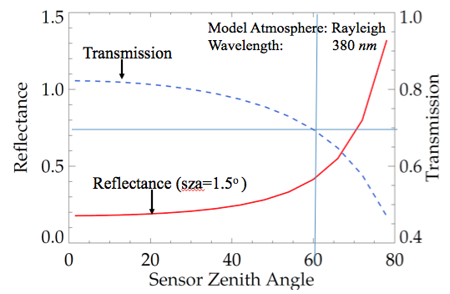
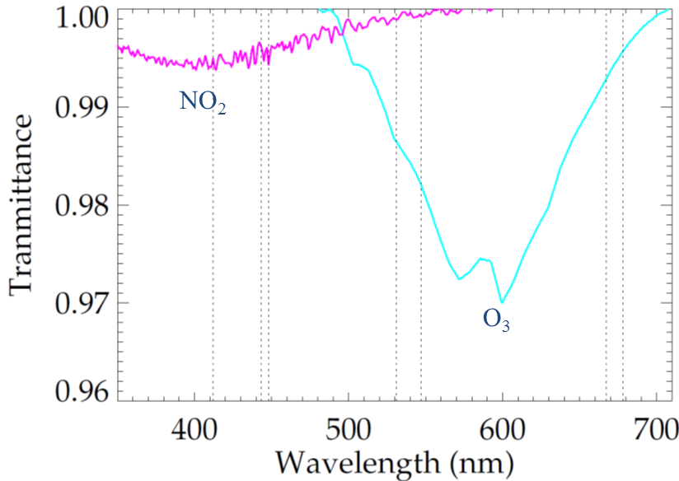
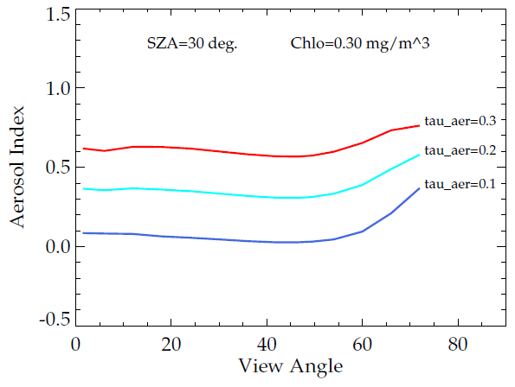
Development of coastal aerosol models and generation of hyper-spectral lookup tables for atmospheric correction of GEO-CAPE ocean color data
GEO-CAPE Atmospheric Correction issues
1. Effect of large view angle on TOA Reflectance
Large solar and sensor zenith angles (compare plane parallel vs spherical atmosphere)
Trace gases (NO2, O3, O2, H20)
Absorbing aerosols
Atmospheric correction algorithms (heritage vs. spectral matching and Bayesian methods)
2. Trace gases
Future Directions
Perform sensitivity studies to examine the accuracy of retrievals at large sensor and solar zenith angles.
Optimize OBPG aerosol models for coastal regions.
Develop methods to detect different types of absorbing aerosols: Saharan dust, Black Carbon, Industrial pollution (Brown Carbon, Continental aerosols).
Explore the possibility of using transport models like GOCART to identify and correct for different types of aerosols.
3. Absorbing aerosols
(Zia Ahmad)

Slide 5
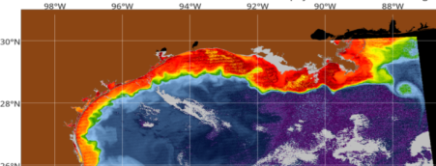
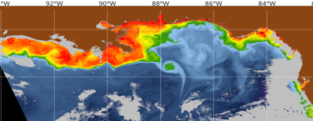
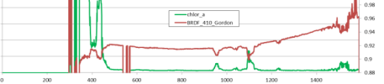
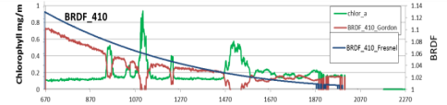
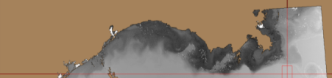

Characterizing the uncertainty of BRDF to support a GEOCAPE sensor design
Elevated chlorophyll – decreases BRDF response
Low Chl has less effect on BRDF response
Blue water case
Green water case
Apply VIIRS orbital overlaps for BRDF calculation
Changing Sensor and Solar angles within 100 minutes
Current processing uses Chlorophyll for BRDF response
Coastal IOPS significantly influences the BRDF
Orbit 2
T 19000
Orbit 1 1800
Orbit 2 1900
30º
35º
Edge of Swath
70º
Standard BRDF -
Response to Chlorophyll
Solar zenith Changes across scene and
From orbit to orbit. 15 – 20 degrees
BRDF
0.8 1.0
Requires validation of BRDF processing
adjustment for Coastal IOP’s
(Robert Arnone)

Slide 6
Improve understanding of remote sensing reflectance in the coastal zone for the GEO-CAPE mission
Developed a new IOP-centered system to correct biases in water leaving radiances due to BRDF effects.
Compared measured and Rrs-derived angular variation of water-leaving radiance of the blue/green water.
The Chl-based system is not applicable to the green water.
scatter plot of all remote-sensing angles
Two extreme waters
L_{w}/L_{w}(0º):
Blue water case
Green water case
550 nm, θ_{v} = 60º
A(44)=0.025m-1
Zeu=108 m
Rrs [sr-1]
Model (from Rrs)
From Rrs
412 nm
440 nm
L_{w}/L_{w}(0º) from NuRADs
A(44)=0.9m-1
Zeu=7.2 m
Rrs [sr-1]
Model (from Rrs)
From Rrs
512 nm
550 nm
Wavelength [nm]
Wavelength [nm]
Wavelength [nm]
Measurements (from NURADs)
Measurements (from NURADs)
Correcting BRDF with an IOP-centered system
(Zhongping Lee)
Notes:
NURADS stands for Netted Universal Radar System (upwelling radiance distribution camera system)

Slide 7
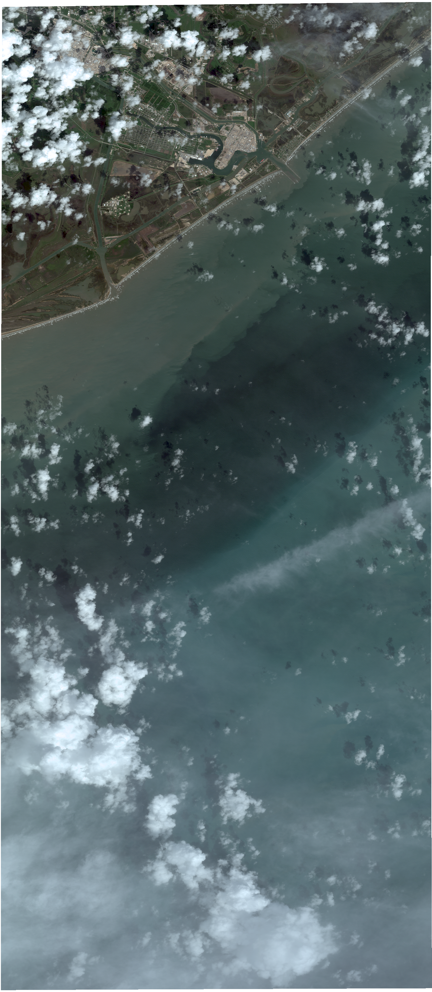
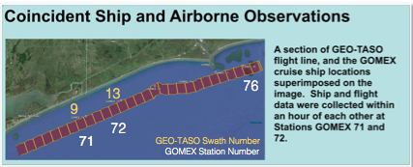
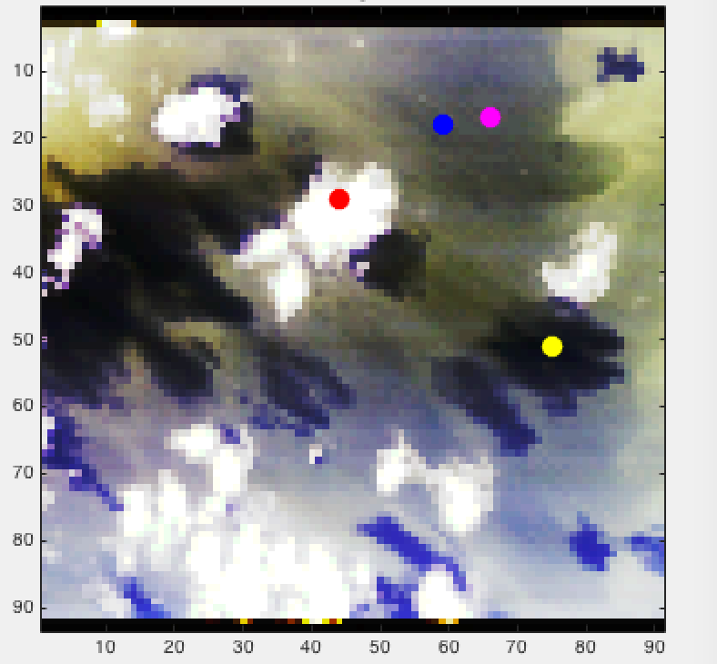
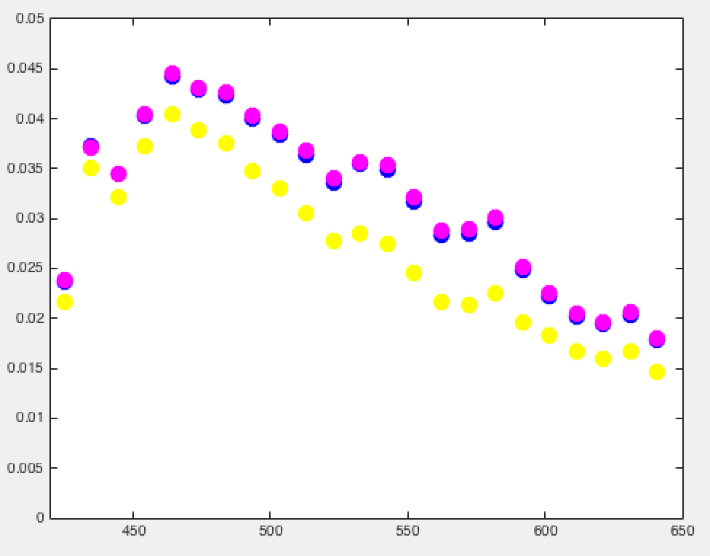
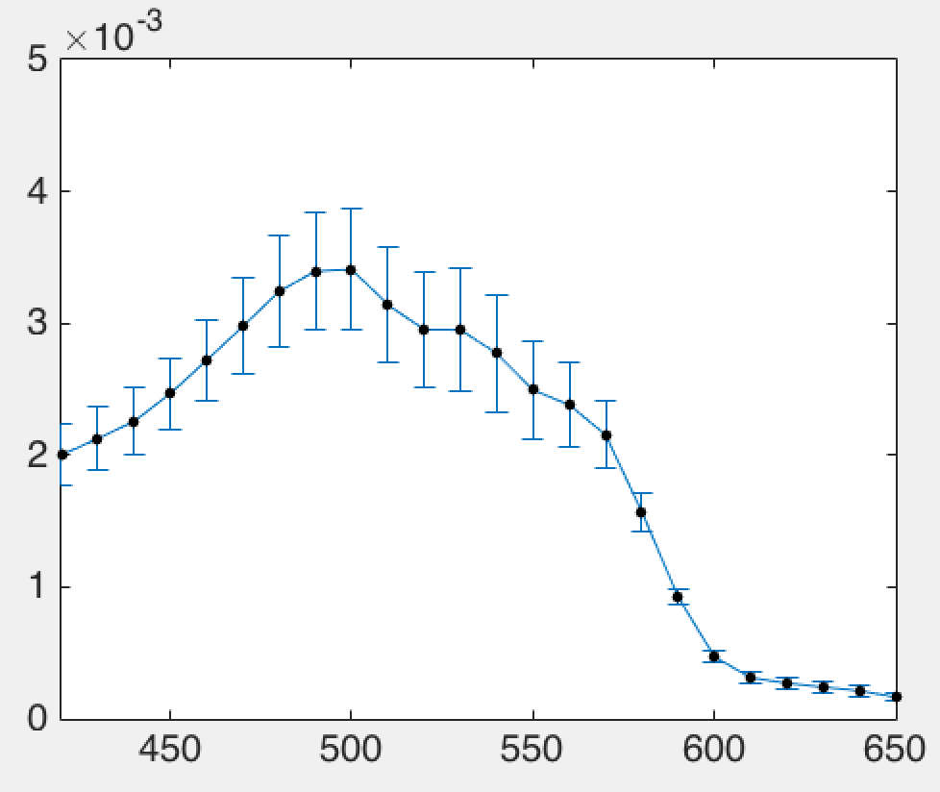
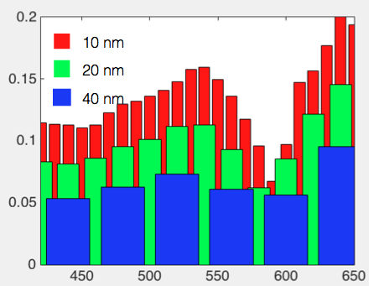
Effects of GEO-CAPE viewing geometry and solar zenith angle on pigment concentration retrievals: calibration with international time series programs and analyses of uncertainty at different latitudes, times of day, and season
GEO-CAPE assessment using GEO-TASO & in situ data
Approach: Analyzed coincident GEO-TASSO and GOMEX field data from the D-AQ Sept. 2013/Gulf of Mexico.
Build a ‘library’ of typical ‘patches’ for product uncertainty estimations: different spectral resolutions: GEO-TASO RGB ~ 100 m.
Good SNR for GEO-TASSO ocean measurements when binned to 10 nm spectral sampling and 100-500 m spatial sampling.
Spatial Rrs variability/cloudy scene
Spectral binning/uncertainty
Mean ‘clear’ water , Rrs
Fractional % Uncertainty
Wavelength [nm]
Wavelength [nm]
Wavelength [nm]
Issues:
  1. Identification of “homogenous” patches in a turbid/complex water is challenging. So this probably lowers the estimate of product SNR.
  2. working on automating scene identification for SNR estimations. But can we modify clear water ‘methodology' to handle complex coastal waters? The coastal waters on average is ‘bright’; how can we account/correct for this in estimation of product SNR?
Future: Incorporate all in situ data for product regressions. Produce L3 georectified images.
Coastal ocean and cloud conditions near Galveston, TX on 17 September 2013. Note both the ‘turbidity’ of the coastal waters as well as the high clouds casting shadows.
Nicholas Tufillaro and Curtiss Davis

Slide 8
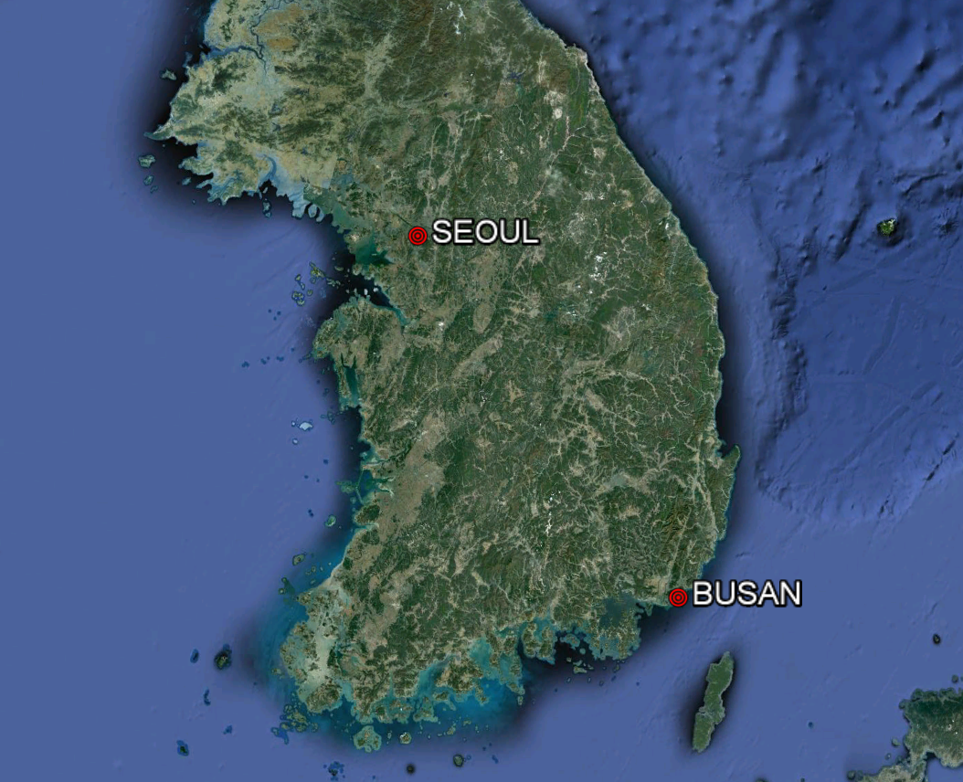

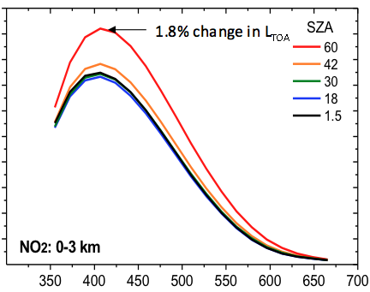

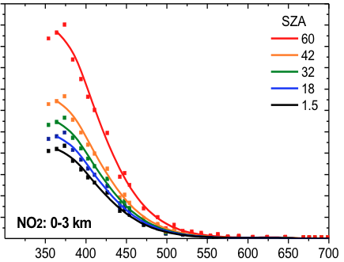
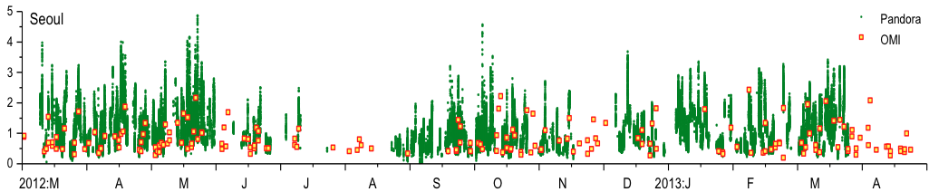
Refining requirements for aerosol and trace gas retrievals necessary for Ocean Color atmospheric corrections from GEO-CAPE
GEO-CAPE Atmospheric Correction issues
TOA spectral radiance is sensitive to NO2 total column amount, vertical distribution, and solar zenith and viewing angles.
OMI unable to detect NO2 peaks from industrial and rush hour traffic activities (due to coarse resolution and overpass timing).
Sensitivity of TOA reflectance to 1DU NO2
%error in Rrs due to 1DU error in NO2
%change TOA Refl.
%error in Rrs
NO2 diurnal variation
Wavelength [nm]
Wavelength [nm]
TCNO2 (DU)
(Maria Tzortziou & Jay Herman)

Slide 9
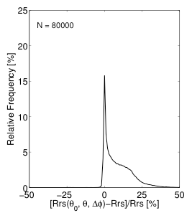
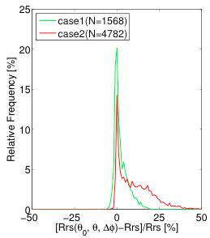
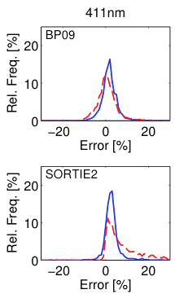
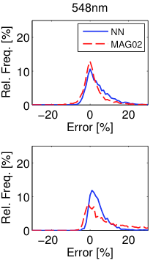
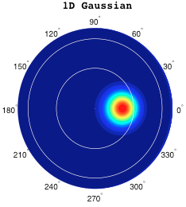
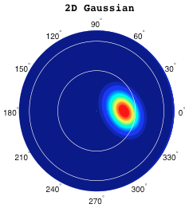
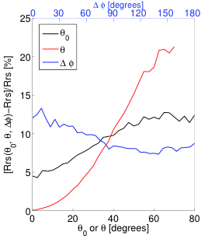
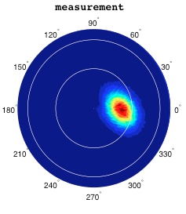
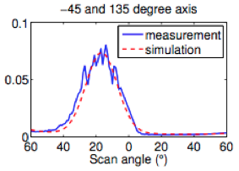
Assessment of the need for corrections of remote sensing reflectances due to BRDF effects in coastal waters
Developed a new neural network method for BRDF correction in Case 2 waters. Validated with NuRADS measurements. The new method is superior to the standard MAG02 for Case-2 waters.
Developed a 2D Gaussian distribution sun-glint algorithm, which was validated with CAR airborne BRDF measurements.
Anisotropy of Case-1 Vs Case-2
Neural Network method
2D Gaussian distribution sun-glint model
Case-1
Case-2
Measurements v. model – good agreement
Charles Gatebe, Knut Stamnes & Wei Li

Slide 10
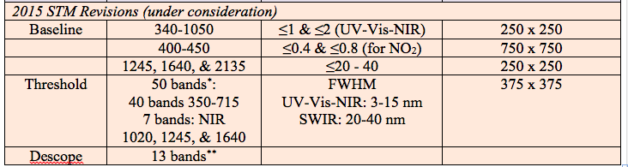
Interdisciplinary Science:
Implications of Spectral Range and Resolution Choices
Draft white paper is available for comments from the OC SWG
Examines the trade-offs among the current STM baseline and threshold spectral range and resolution choices on
  Atmospheric correction
  Interdisciplinary contributions to the broader scientific, applications, management, & policy communities
Key trade-off involves NO₂ correction (baseline) v. threshold or descope that might afford launch opportunities on shorter time horizons
Leveraging other NASA assets and resources from other agencies and international resources will be important to maximize interdisciplinary scientific benefit
Carolyn Jordan, Charles Gatebe, & Maria Tzortziou

Slide 11
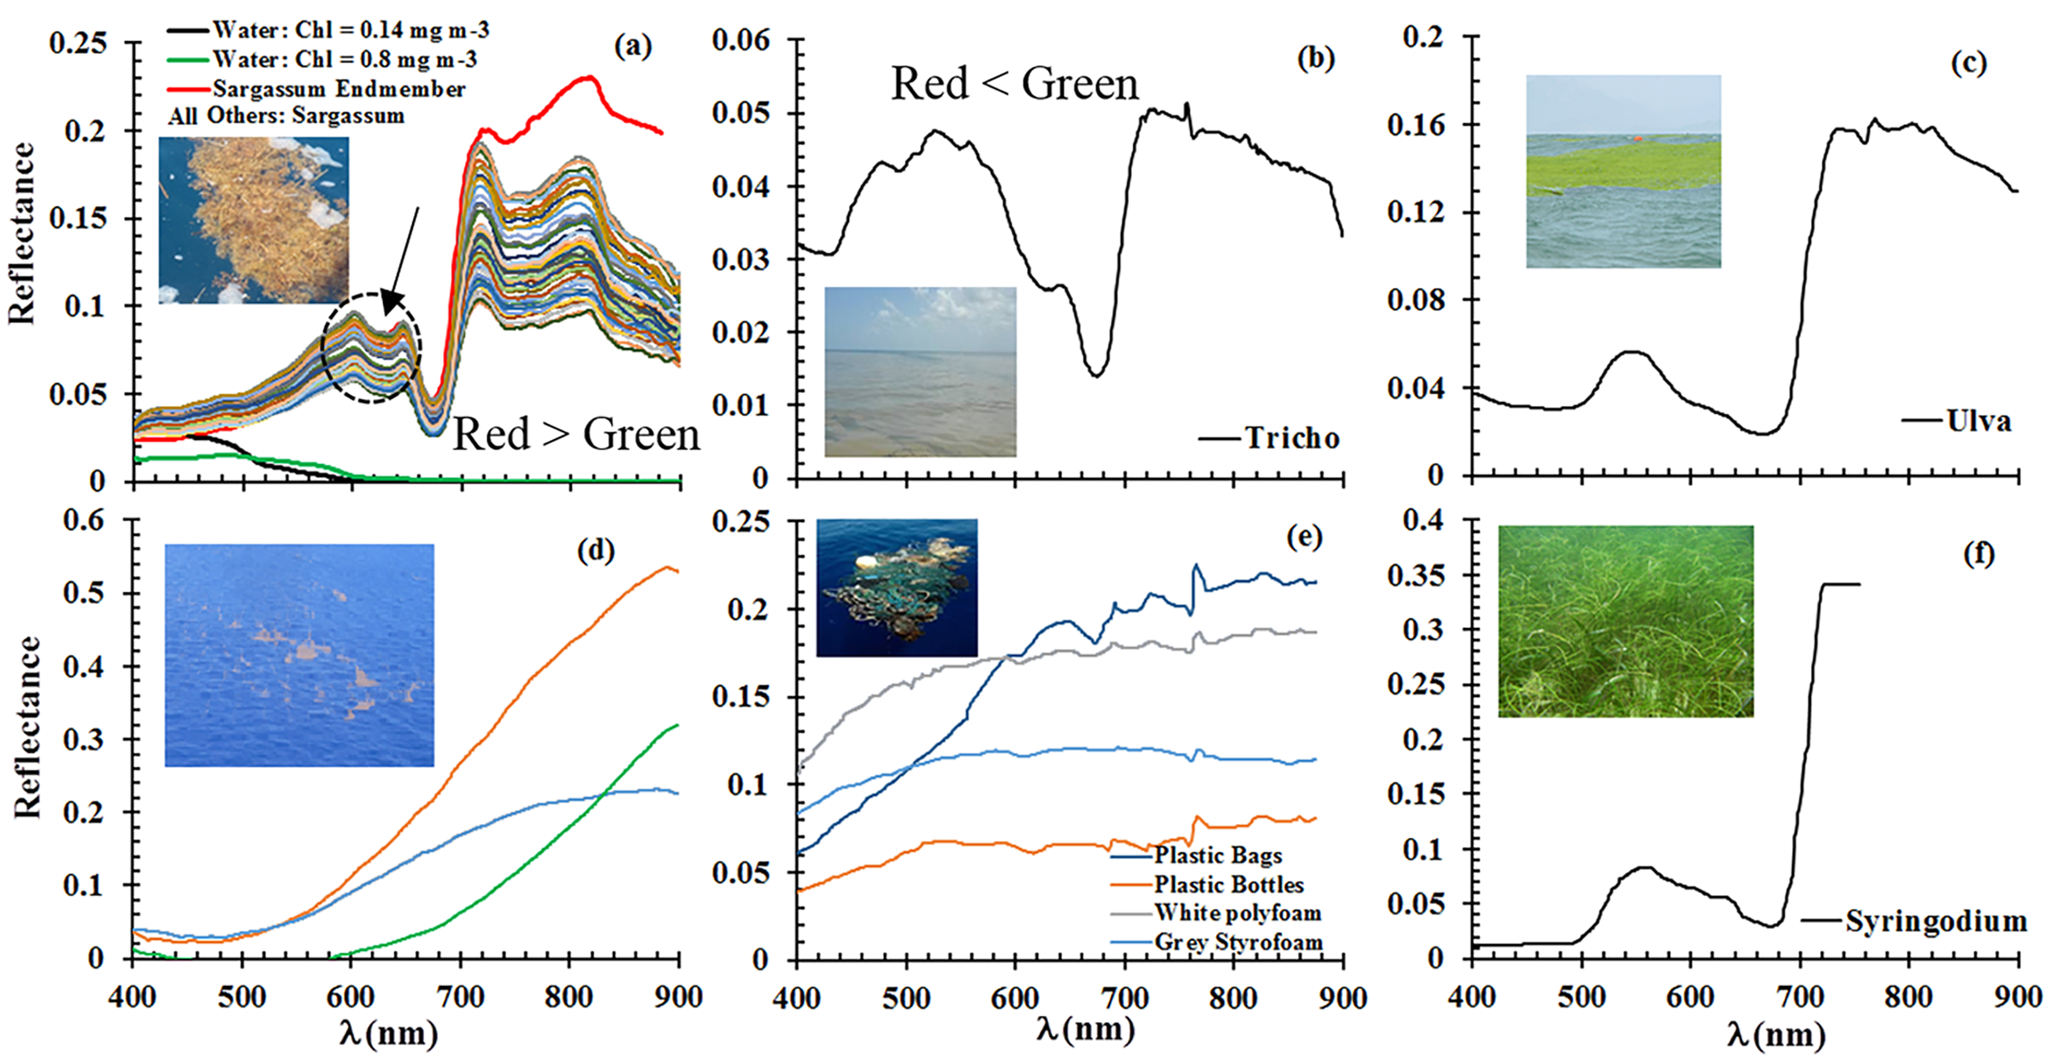
Spectral shapes of various floating materials
Due to chl-c pigment and red-edge reflectance, Sargassum can be distinguished from others using the following 10-nm bands: 555, 605, 625, 645, 685, 755 nm.
From Hu et al. (2015, RSE, Spectral and spatial requirements of remote measurements of pelagic Sargassum macroalgae)

Slide 12
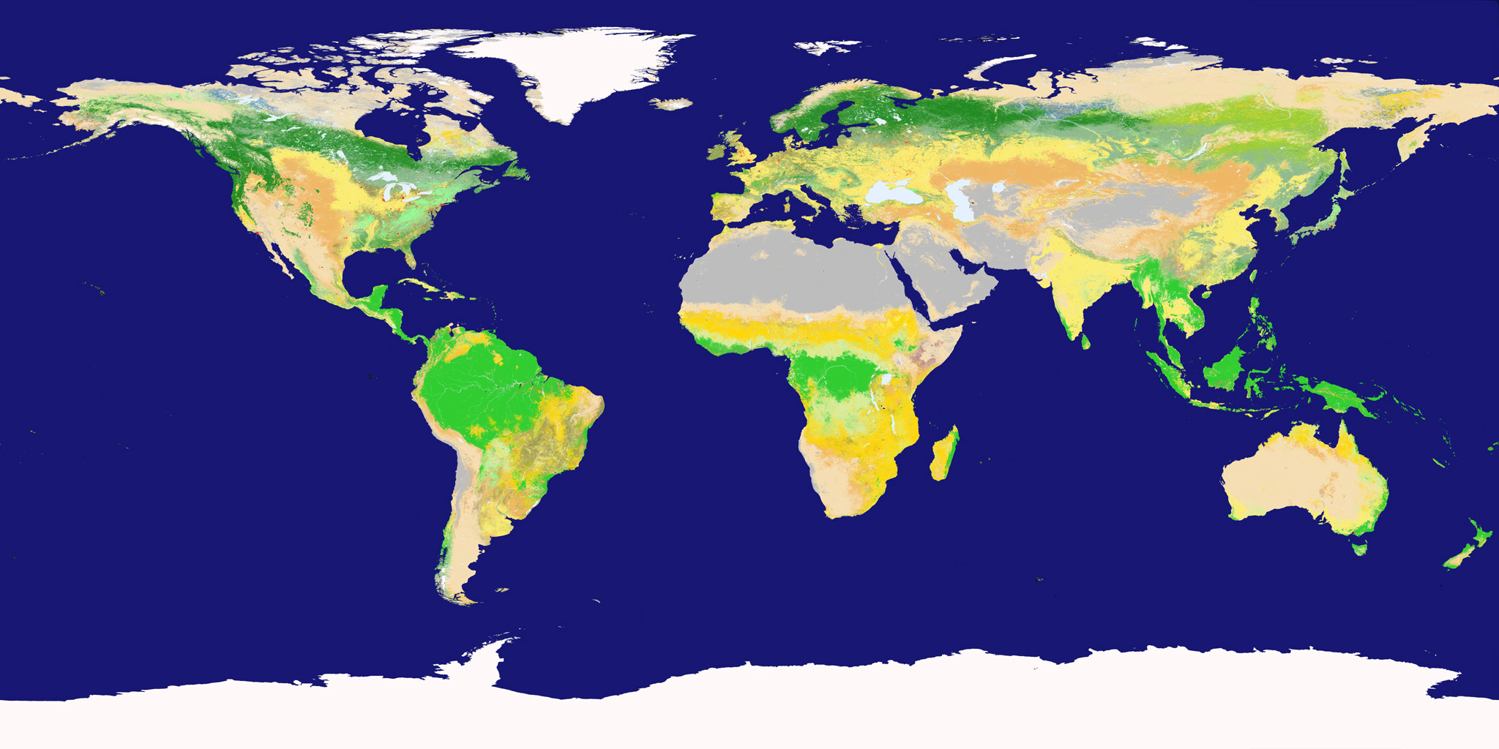
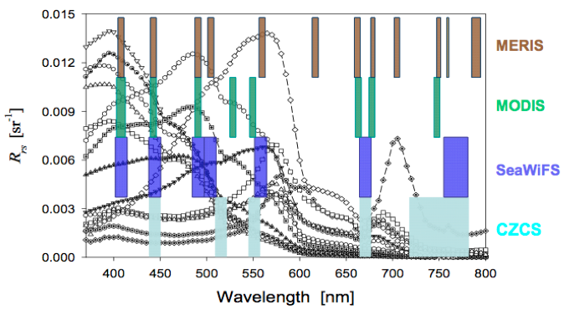
Critical number of spectral bands for independent information?
xx
xx
Locations of field measurement of in situ
hyperspectral Rrs
Hyperspectral Rrs (from a total of ~900)
Rrs(λ) [sr⁻¹]
Correlation coefficient between neighboring Rrs
r_{Δλ}(λ_{k}, λ_{l})
Wavelength [nm]
(Zhongping Lee)

