Slide 1

Adoption of TEMPO/GEO-CAPE by air quality managers: lessons learned from AQAST
Daniel J. Jacob
AQAST Leader

Slide 2


19 team members appointed in May 2011 for 5-year terms
Pollution monitoring
Exposure assessment
AQ forecasting
Source attribution Quantifying emissions
External influences
AQ processes
Climate interactions
satellites
AQAST
suborbital platforms
models
Earth Science resources
AQAST
US air quality management

Slide 3

What makes AQAST unique?
All AQAST projects connect Earth Science and air quality management
  Involve active partnerships with air quality managers, have deliverable application outcomes
  Expand relationships through meetings, online tools, newsletters, surveys
AQAST has flexibility in how it allocates its resources
  Members adjust work plans to meet evolving air quality needs
  Multi-member “Tiger Teams” are organized each year in consultation with air quality management community to address pressing problems requiring coordinated activity
  AQAST is self-organizing and can respond quickly to demands
Quick, collaborative, flexible, responsive to the needs of the AQ community
www.aqast.org

Slide 4
AQAST projects cover wide range of themes,
Earth Science resources, AQ agency partners
AQ agency
SIP Modeling
AQ processes
Monitoring
AQ-Climate
Background
IC/BC for AQ models
Forecasting
Emissions
Future satellites
Local: RAQC, BAAQD, SJVAPCD, CDPHE
States: California, Colorado, Georgia, Iowa, Maryland, New Hampshire, New York, Oklahoma, Texas, Virginia, Wisconsin, Wyoming
Regional: LADCO, CenSARA, MARAMA
National: EPA, NOAA,
NPS, BLM
Theme
Satellites: MODIS, MISR, MOPITT, AIRS, OMI, TES, GOES, GOME-2
Suborbital: ARCTAS, DISCOVER-AQ, ozonesondes, PANDORA
Models: MOZART, CAM, AM-3, GEOS-Chem, RAQMS, STEM, GISS, CMIP
Earth Science resource

Slide 5
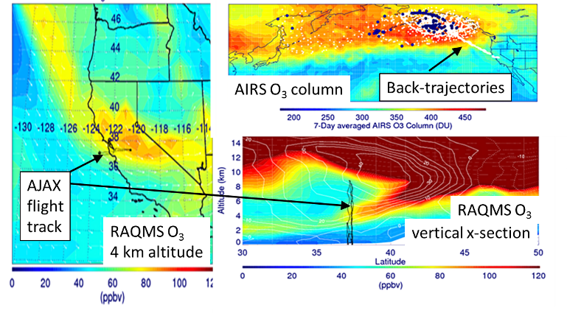
Wyoming Exceptional Event Demonstration
Wyoming DEQ/AQD used AQAST resources to issue an exceptional event demonstration package for an ozone exceedance at Thunder Basin, June 6, 2012
First-ever acceptance by EPA of an ozone
exceptional event!
AQAST PI: Pierce

Slide 6
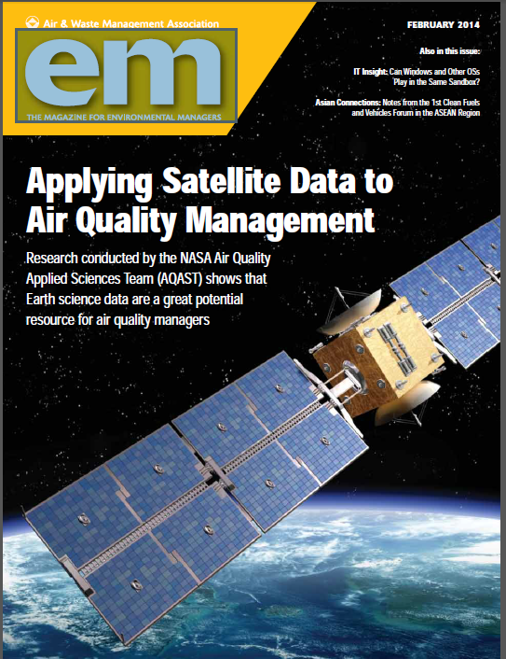
AQ managers’ interest in satellite data has greatly increased over past 5 years
Top applications of interest:
Documentation of exceptional events (fires, stratospheric intrusions…)
Constraining emissions for SIP modeling, reporting programs
Demonstration of interstate and international transport
Monitoring PM_{2.5} for health
Monitoring long-term trends

Slide 7
Engaging AQ managers through AQAST: a few things that worked
Engaging prior PI contacts in AQM community
2x/year AQAST meetings in different US regions with AQM sessions
Engaging local and state agencies
Participating/sponsoring/co-hosting meetings of AQM community
Consulting AQM community through surveys
Outreach to the public

Slide 8
Need to think of AQ management needs in the 2020s
Issues of interest to AQ managers have evolved greatly over past 5 years
UP: methane, background ozone, fires, microscales
Major issues in 2020s will evolve further
Increased management of climate forcing: CO₂, methane, N₂O, aerosols
Increased management of agricultural emissions: methane, ammonia, dust
Background ozone likely to become an increasing concern
Fires and their linkages to land management and climate change

Slide 10
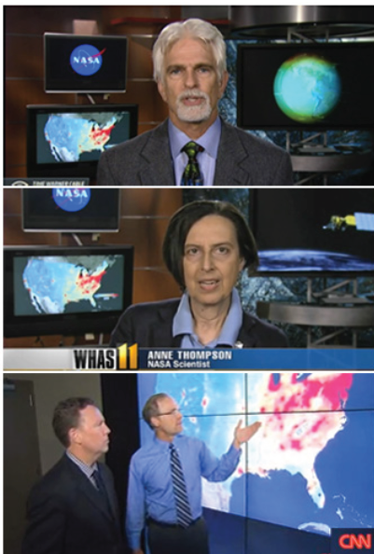
Aura 10th anniversary media day
(June 22, 2014, NASA/GSFC):
OMI NO₂ US trends go viral
AQAST members Russ Dickerson,
Anne Thompson, Bryan Duncan

