Slide 1
Ozone and NO₂ OSSEs on a Regional/Urban Scale for GEO-CAPE
Geo-cape OPEN COMMUNITY WORKSHOP
SEPTEMBER 1 2015
Vijay Natraj¹, Brad Pierce², Susan Kulawik³, Helen Worden⁴, Xiong Liu⁵, Mike Newchurch⁶, Konstantin Vinnikov⁷
1- Jet Propulsion Laboratory, California Institute of Technology, 4800 Oak Grove Drive, Pasadena, CA 91109
2- NOAA/NESDIS Center for Satellite Applications and Research, 1225 West Dayton Street, Madison, WI 53706
3- Bay Area Environmental Research Institute, Moffett Field, CA 94035
4- National Center for Atmospheric Research, 3450 Mitchell Lane, Boulder, CO 80301
5- Harvard-Smithsonian Center for Astrophysics, 60 Garden Street, Cambridge, MA 02138
6- University of Alabama and Huntsville, 320 Sparkman Drive, Huntsville, AL 35805
7- University of Maryland, College Park, MD 20742

Slide 2
Goals
Utilize independent modeling systems for generation of Nature atmosphere and conducting assimilation impact experiments
Account for realistic atmospheric variability, which requires evaluation of the nature runs with respect to observations
Include realistic variability in the synthetic radiances, which requires using realistic albedos and emissivities
Include realistic sensitivities, which requires generation of averaging kernels (AK) for each retrieval for use in assimilation studies
Notes:
These are the group’s goals, as they were in September.

Slide 3
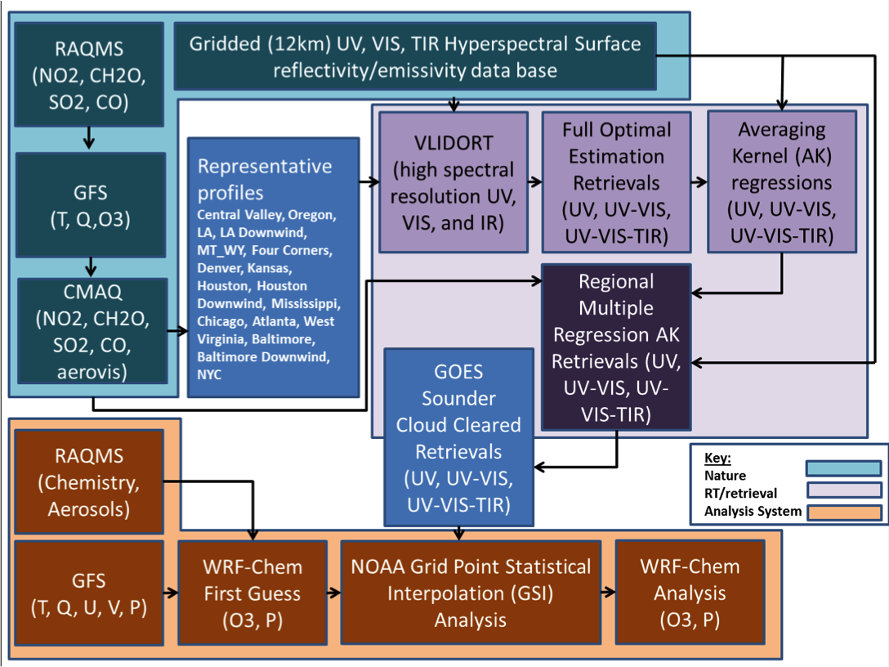
OSSE Flow Chart
Notes:
There are three major components of the OSSE framework: Nature run (teal), Radiative Transfer/Retrieval System (purple), and Analysis System (orange).
We first used a set of representative profiles from 17 sites (hourly, every 3rd day of July 2011) and full radiative transfer/Optimal Estimation Retrievals (UV, UV-VIS, UV-VIS-TIR) to generate input data for developing a multiple regression estimate of the averaging kernels (AK).
We then use the AK regressions, the full Nature atmosphere (CONUS, hourly, every day of July 2011) to generate the Regional Multiple Regression AK retrievals (UV, UV-VIS, UV-VIS-TIR)
We then used observed GOES East and West Sounder cloud masks to identify clear retrievals, these are fed into the WRF-Chem/GSI regional assimilation system

Slide 4
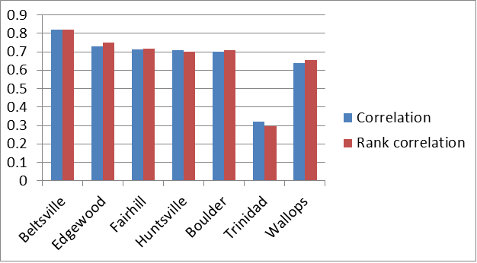
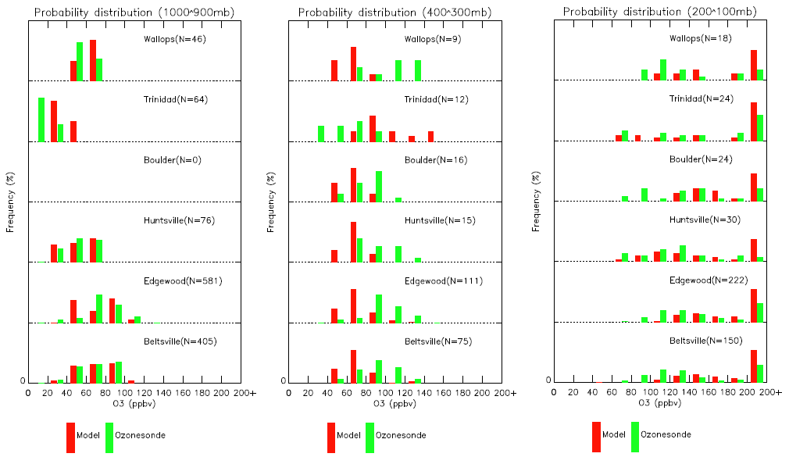
Quantifying Accuracy and Representativeness of Regional Nature Run
Correlation between model and EPA-monitored surface ozone (July 2011)
July 2011 Regional Nature run captures the variability of upper troposphere/lower stratosphere (200-100 mb) and boundary layer (1000-900 mb) ozone well but underestimates free tropospheric (400-300 mb) variance
Correlation between model and ozonesondes at Beltsville and Edgewood
Courtesy: M. Newchurch/L. Wang
Notes:
The CMAQ component of the nature run provides the ozone below 300mb and used lateral boundary conditions from GFS, which doesn't have tropospheric chemistry and therefore doesn't provide realistic variability in the free troposphere. The nature run is a linear blend of CMAQ and GFS above 300mb and GFS captures the dynamically driven variability in the UT/LS.
The surface o3 is low at Trinidad Head because this is a coastal site that is mostly influenced by clean maritime air near the surface.

Slide 5
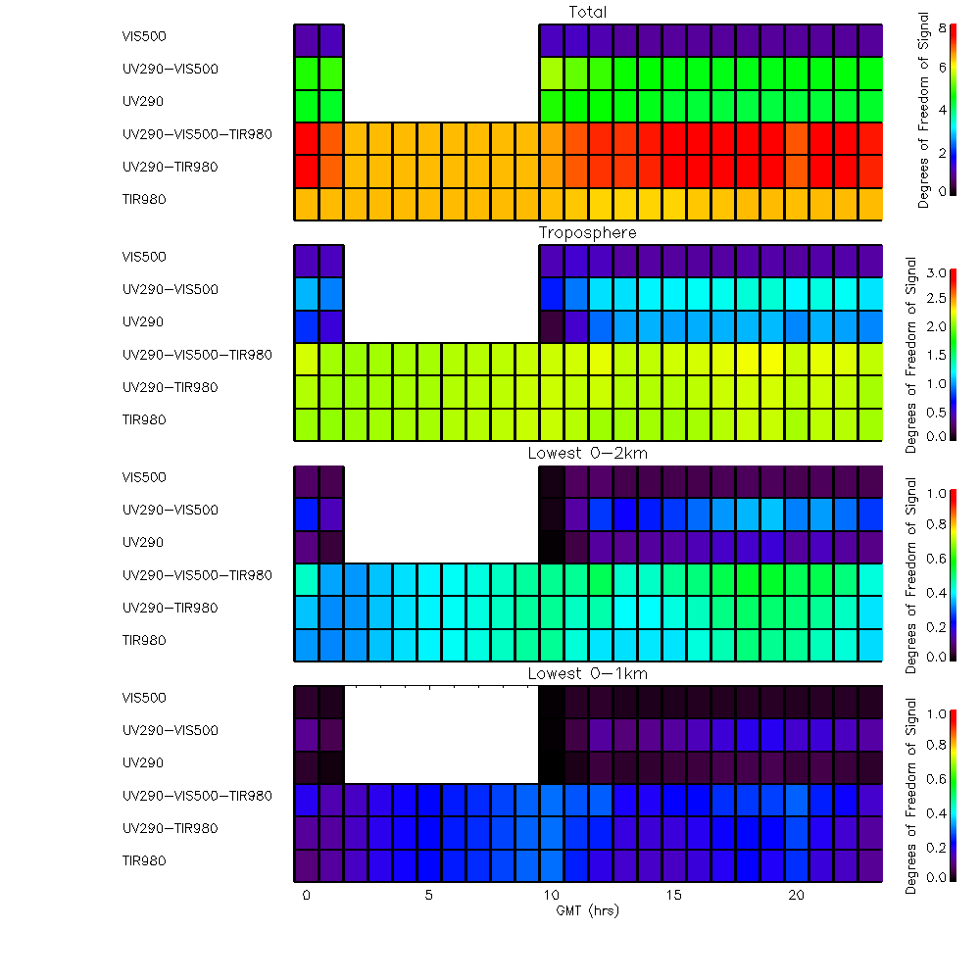
Multispectral O₃ Retrievals
VIS
UV-VIS
UV
UV-VIS-TIR
UV-TIR
TIR
Full Optimal Estimation Retrievals (UV, UV-VIS, UV-VIS-TIR)
(nighttime)
Total Troposphere 0-2 km 0-1 km
VIS
UV-VIS
UV
UV-VIS-TIR
UV-TIR
TIR
Diurnally resolved Degrees of Freedom for Signal (DOFS) for different pressure ranges and spectral combinations for all GEOCAPE Regional OSSE sites (no VIS, UV, or UV/VIS retrievals between 02-09Z)
Note UV/VIS has the same spectral range and noise as TEMPO.
VIS
UV-VIS
UV
UV-VIS-TIR
UV-TIR
TIR
VIS
UV-VIS
UV
UV-VIS-TIR
UV-TIR
TIR

Slide 6
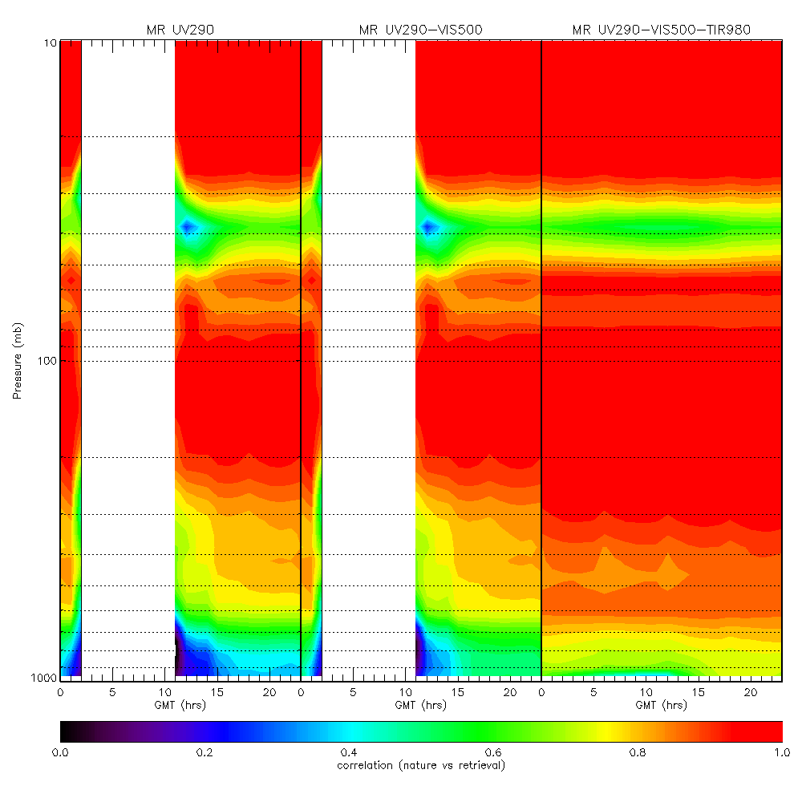
Nature/Retrieval Correlations
Regional Multiple Regression AK Retrievals (UV, UV-VIS, UV-VIS-TIR)
Diurnally resolved correlations between the Regional Nature Run and GEOCAPE O₃ retrievals for July 2011 show:
UV-VIS-TIR shows the highest correlations in the mid and lower troposphere
UV-VIS shows improvement over the UV only retrievals below 800mb
More details in H. Worden’s poster
Notes:
These statistics are based on direct comparisons between the Nature profiles (truth) and retrievals for all of CONUS for all of July 2011 and show the systematic improvement in retrieval sensitivity below 800mb as you go from UV to UV-VIS to UV-VIS-TIR. This is consistent with previous studies based on limited stations and provide a “real-world” context for how much information the retrievals have in the lower troposphere.
The reduced correlation at ~ 40mb is because of the low variability in ozone at these altitudes.

Slide 7
Data Assimilation I
WRF-Chem Analysis
(O3, P)
Initial RAQMS/WRF-CHEM/GSI GEOCAPE UV-VIS-TIR retrieval assimilation experiments have been conducted for early July, 2011
Currently assuming 30% observational errors and only assimilating retrievals below 100mb due to large initial adjustments in the lower stratosphere
Statistical analysis show positive impacts on surface ozone sampled at US EPA AIRNow sites
Notes:
The large initial adjustments in the lower stratosphere come about because we are simply adding the RAQMS ozone profile to the top of the WRF-Chem model top (50mb) to construct the full atmosphere profile before applying the AK. WRF-CHEM has coarse vertical resolution at the top and cannot resolve the sharp gradients in ozone in the UT/LS. The Nature run is influenced by GFS at these altitudes and so there are large differences.
We initially assumed 10% observational errors and assimilated the entire GEOCAPE profile. This resulted in propagation of the stratospheric adjustments into the lower troposphere (because of the AK coupling these layers in the analysis). We next tested a 30% observational error and the lower troposphere adjustments were reduced but not eliminated. Our final experiment only assimilated GEOCAPE profiles below 100mb, which largely eliminated the propagation into the lower troposphere although there were still large adjustments in the stratosphere due to the large vertical length scales in the background error estimates at these altitudes.

Slide 8
Data Assimilation II
WRF-Chem Analysis
(O3, P)
Future plans
Improve observation error estimate using error estimates from Full Optimal Estimation retrieval for select stations
Assess impact of restricting assimilation of retrievals to below local tropopause to mitigate impact of poor vertical resolution in WRF-Chem in the lower stratosphere
Conduct regional UV and UV-VIS O3 assimilation studies
Notes:
WRF-Chem has poor vertical resolution in the lower strat because no one in the regional AQ modeling community cares about the UT/LS. We've been dealing with this issue for a number of years and I thought that since WRF-Chem is online the resolution would be OK given the need to predict u, v, T, and wv. We may have to increase the vertical resolution and raise the model top to improve the assimilation results. We'll have to explore this with some sensitivity experiments.

Slide 9
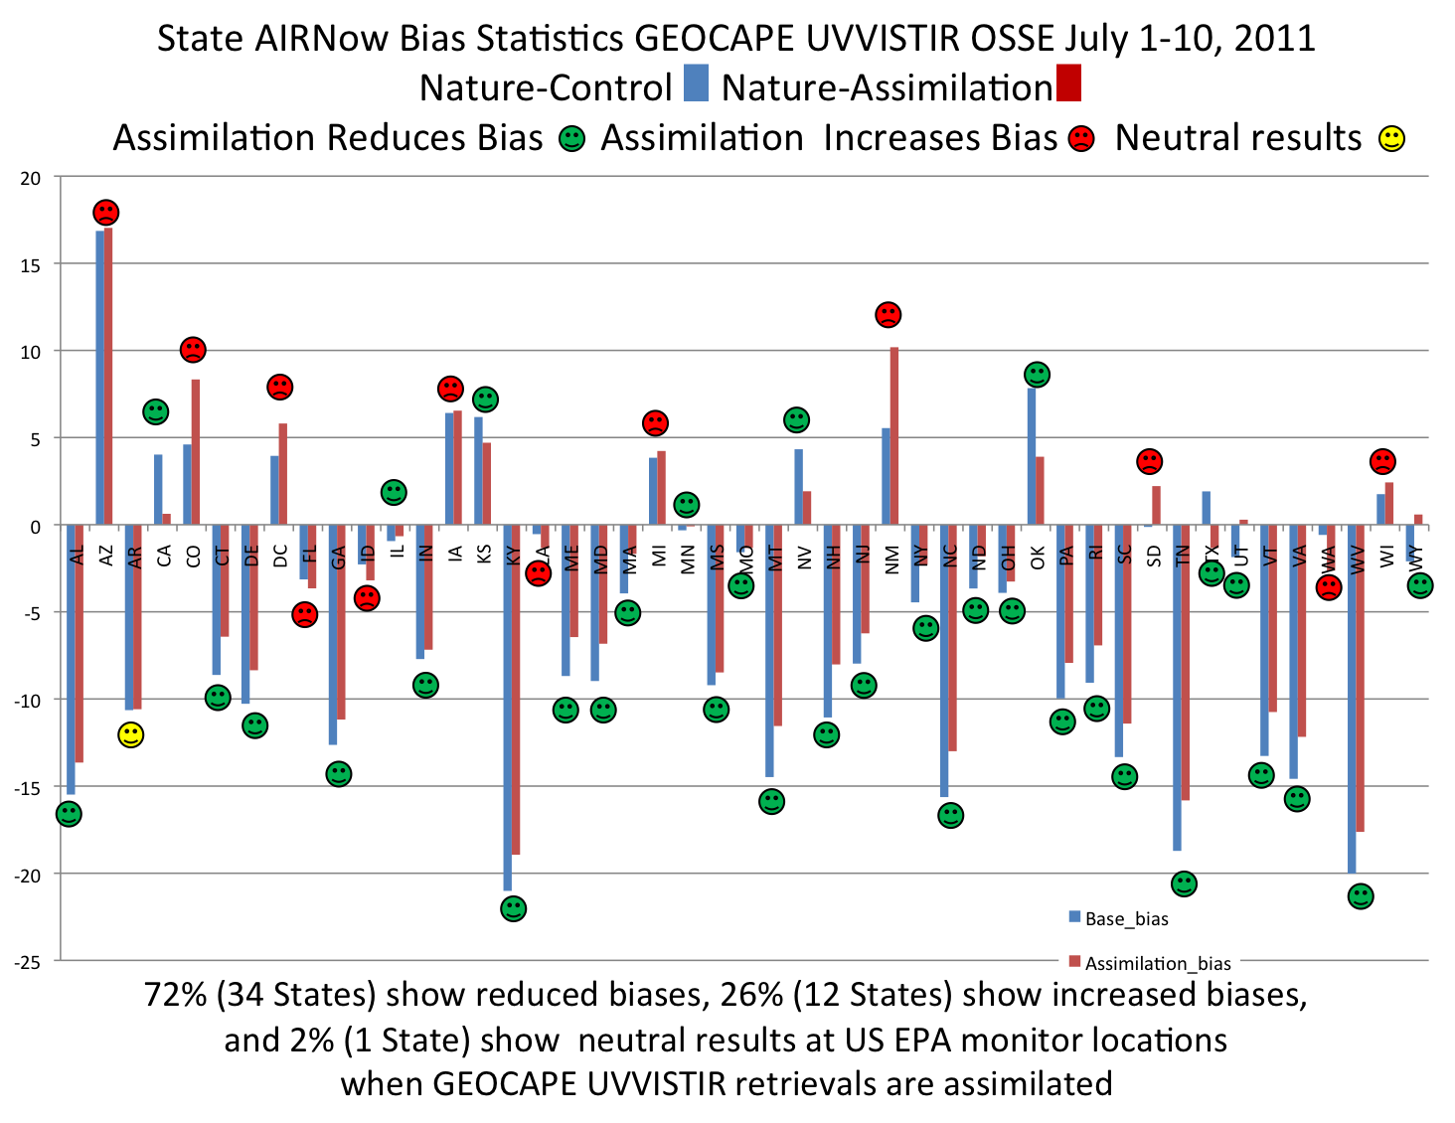
Impact of Assimilation: Overall Results

Slide 10
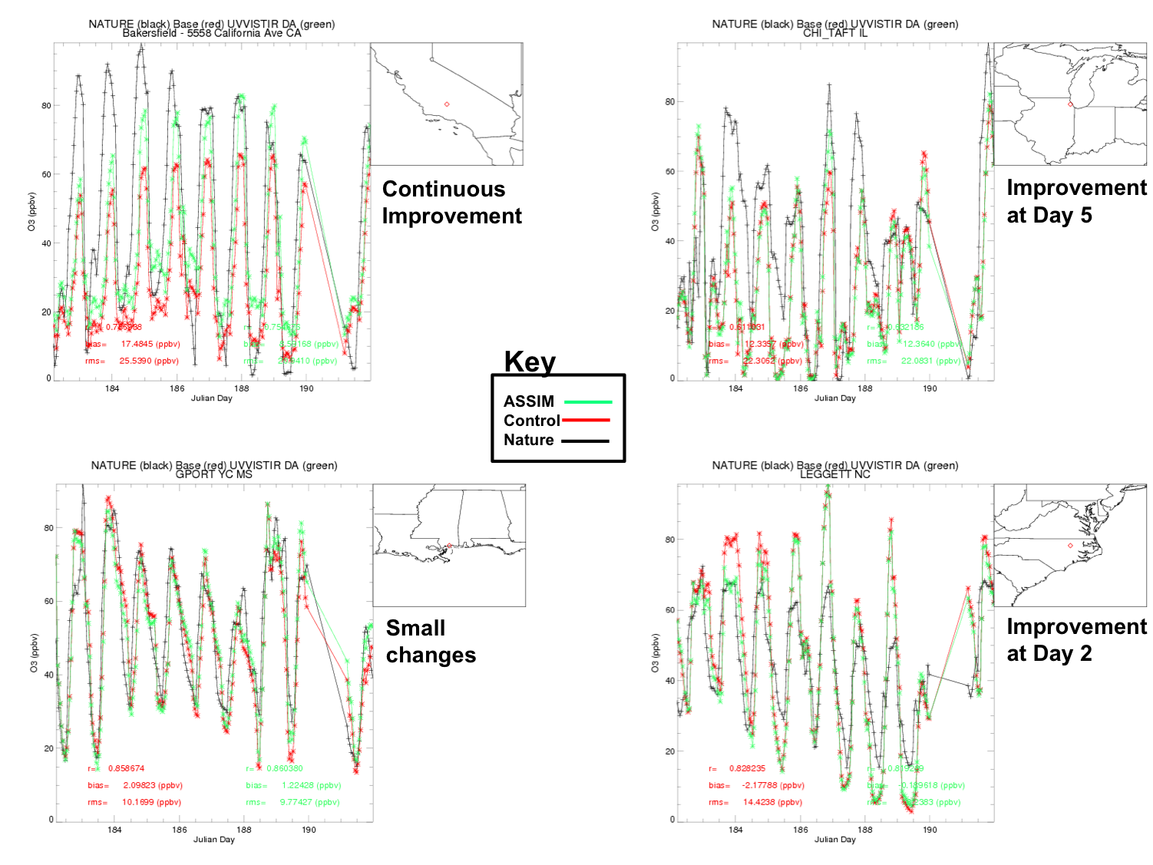
Impact of Assimilation: Selected Sites
Notes:
Examples of nature vs control and UV-VIS-TIR assimilation for selected sites (upper left: Bakersfield CA, upper right: Chicago, IL, lower left: Gulfport, MS, lower right Legget, NC) showing realistic complexity in OSSE system (independent Nature/Analysis models; systematic improvements for clear sky stations (Bakersfield, CA), episodic improvements for cloud impacted stations (Chicago, Legget), and very small changes for stations with good agreement between control and nature runs (Gulfport, MS)

Slide 11
NO₂ OSSE Developments I
Spectral region: 400−490 nm (TEMPO spectral range)
Forward modeling approaches
LIDORT
Exact single scattering + two-stream multiple scattering (2S-ESS)
2S-ESS + cross sections convolved to TEMPO spectral resolution (2S-ESS convolved)
Notes:
Our previous runs (which were over a wider wavelength region) required 8hrs per day (15hrs of daylight) per station for the O3 UV-VIS using 44 cpus. For NO2, which has significantly larger spatial variability than O3, AK regression is unlikely to produce good results. Therefore, computational efficiency is critical.

Slide 12
NO₂ OSSE Developments II
Computational time (one scenario):
LIDORT: 219 minutes
2S-ESS: 295 seconds
2S-ESS convolved: 78.5 seconds
Computational time (one day, full domain):
LIDORT: > 8 years!
2S-ESS: ~ 70 days
2S-ESS convolved: 18 days
With a 10x speed-up, we can perform calculations for one month for the entire domain in ~ two months

Slide 13
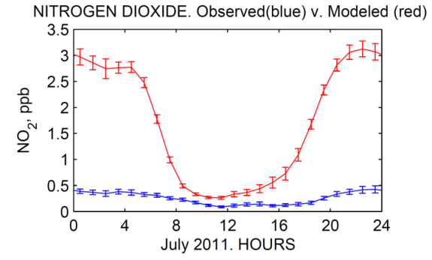
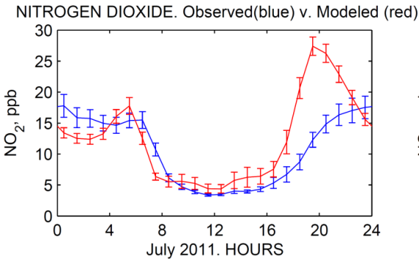
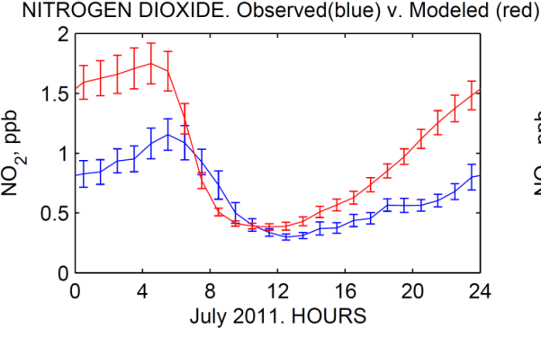
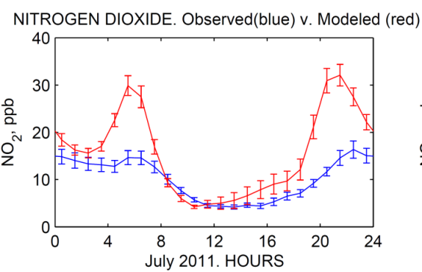
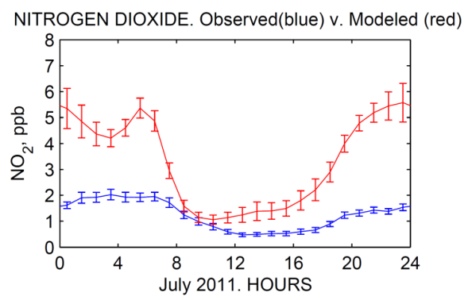
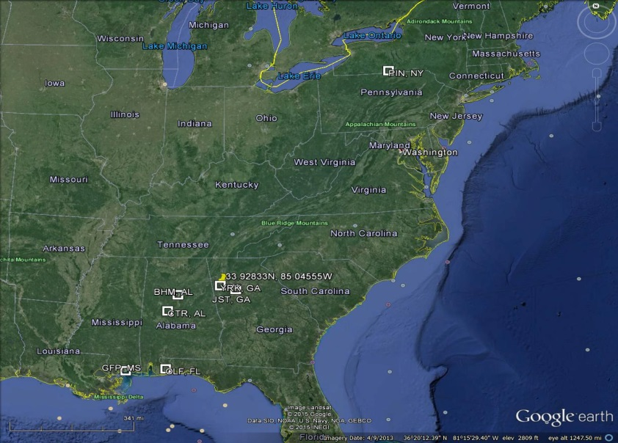
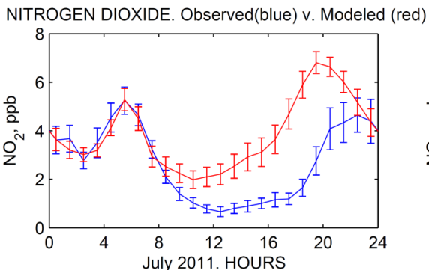
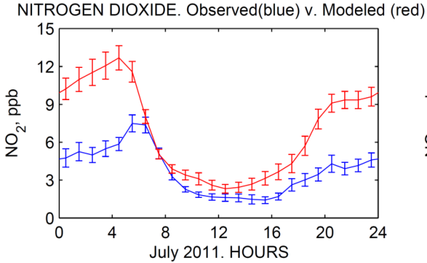
Quantifying Accuracy and Representativeness of Regional Nature Run
PINNACLE, NY. Park Forest
BIRMINGHAM, AL. Urban
CENTERVILLE, AL. Rural
Observed & Modeled (Nature run) diurnal cycle of NO₂
ATLANTA, GA. Urban
YORKVILLE, GA. Rural
STATIONS MAP
PENSACOLA (OLF), FL. Urban
GULFPORT, MS. Urban
The model systematically overestimates NO₂ concentrations but correctly reproduces shape of diurnal cycle and differences of NO₂ concentrations between rural and urban locations.
Modeled and observed daily variability in diurnal cycle of NO₂ concentrations are quite consistent.
Courtesy: K. Vinnikov/R. Dickerson/N. Krotkov

Slide 14
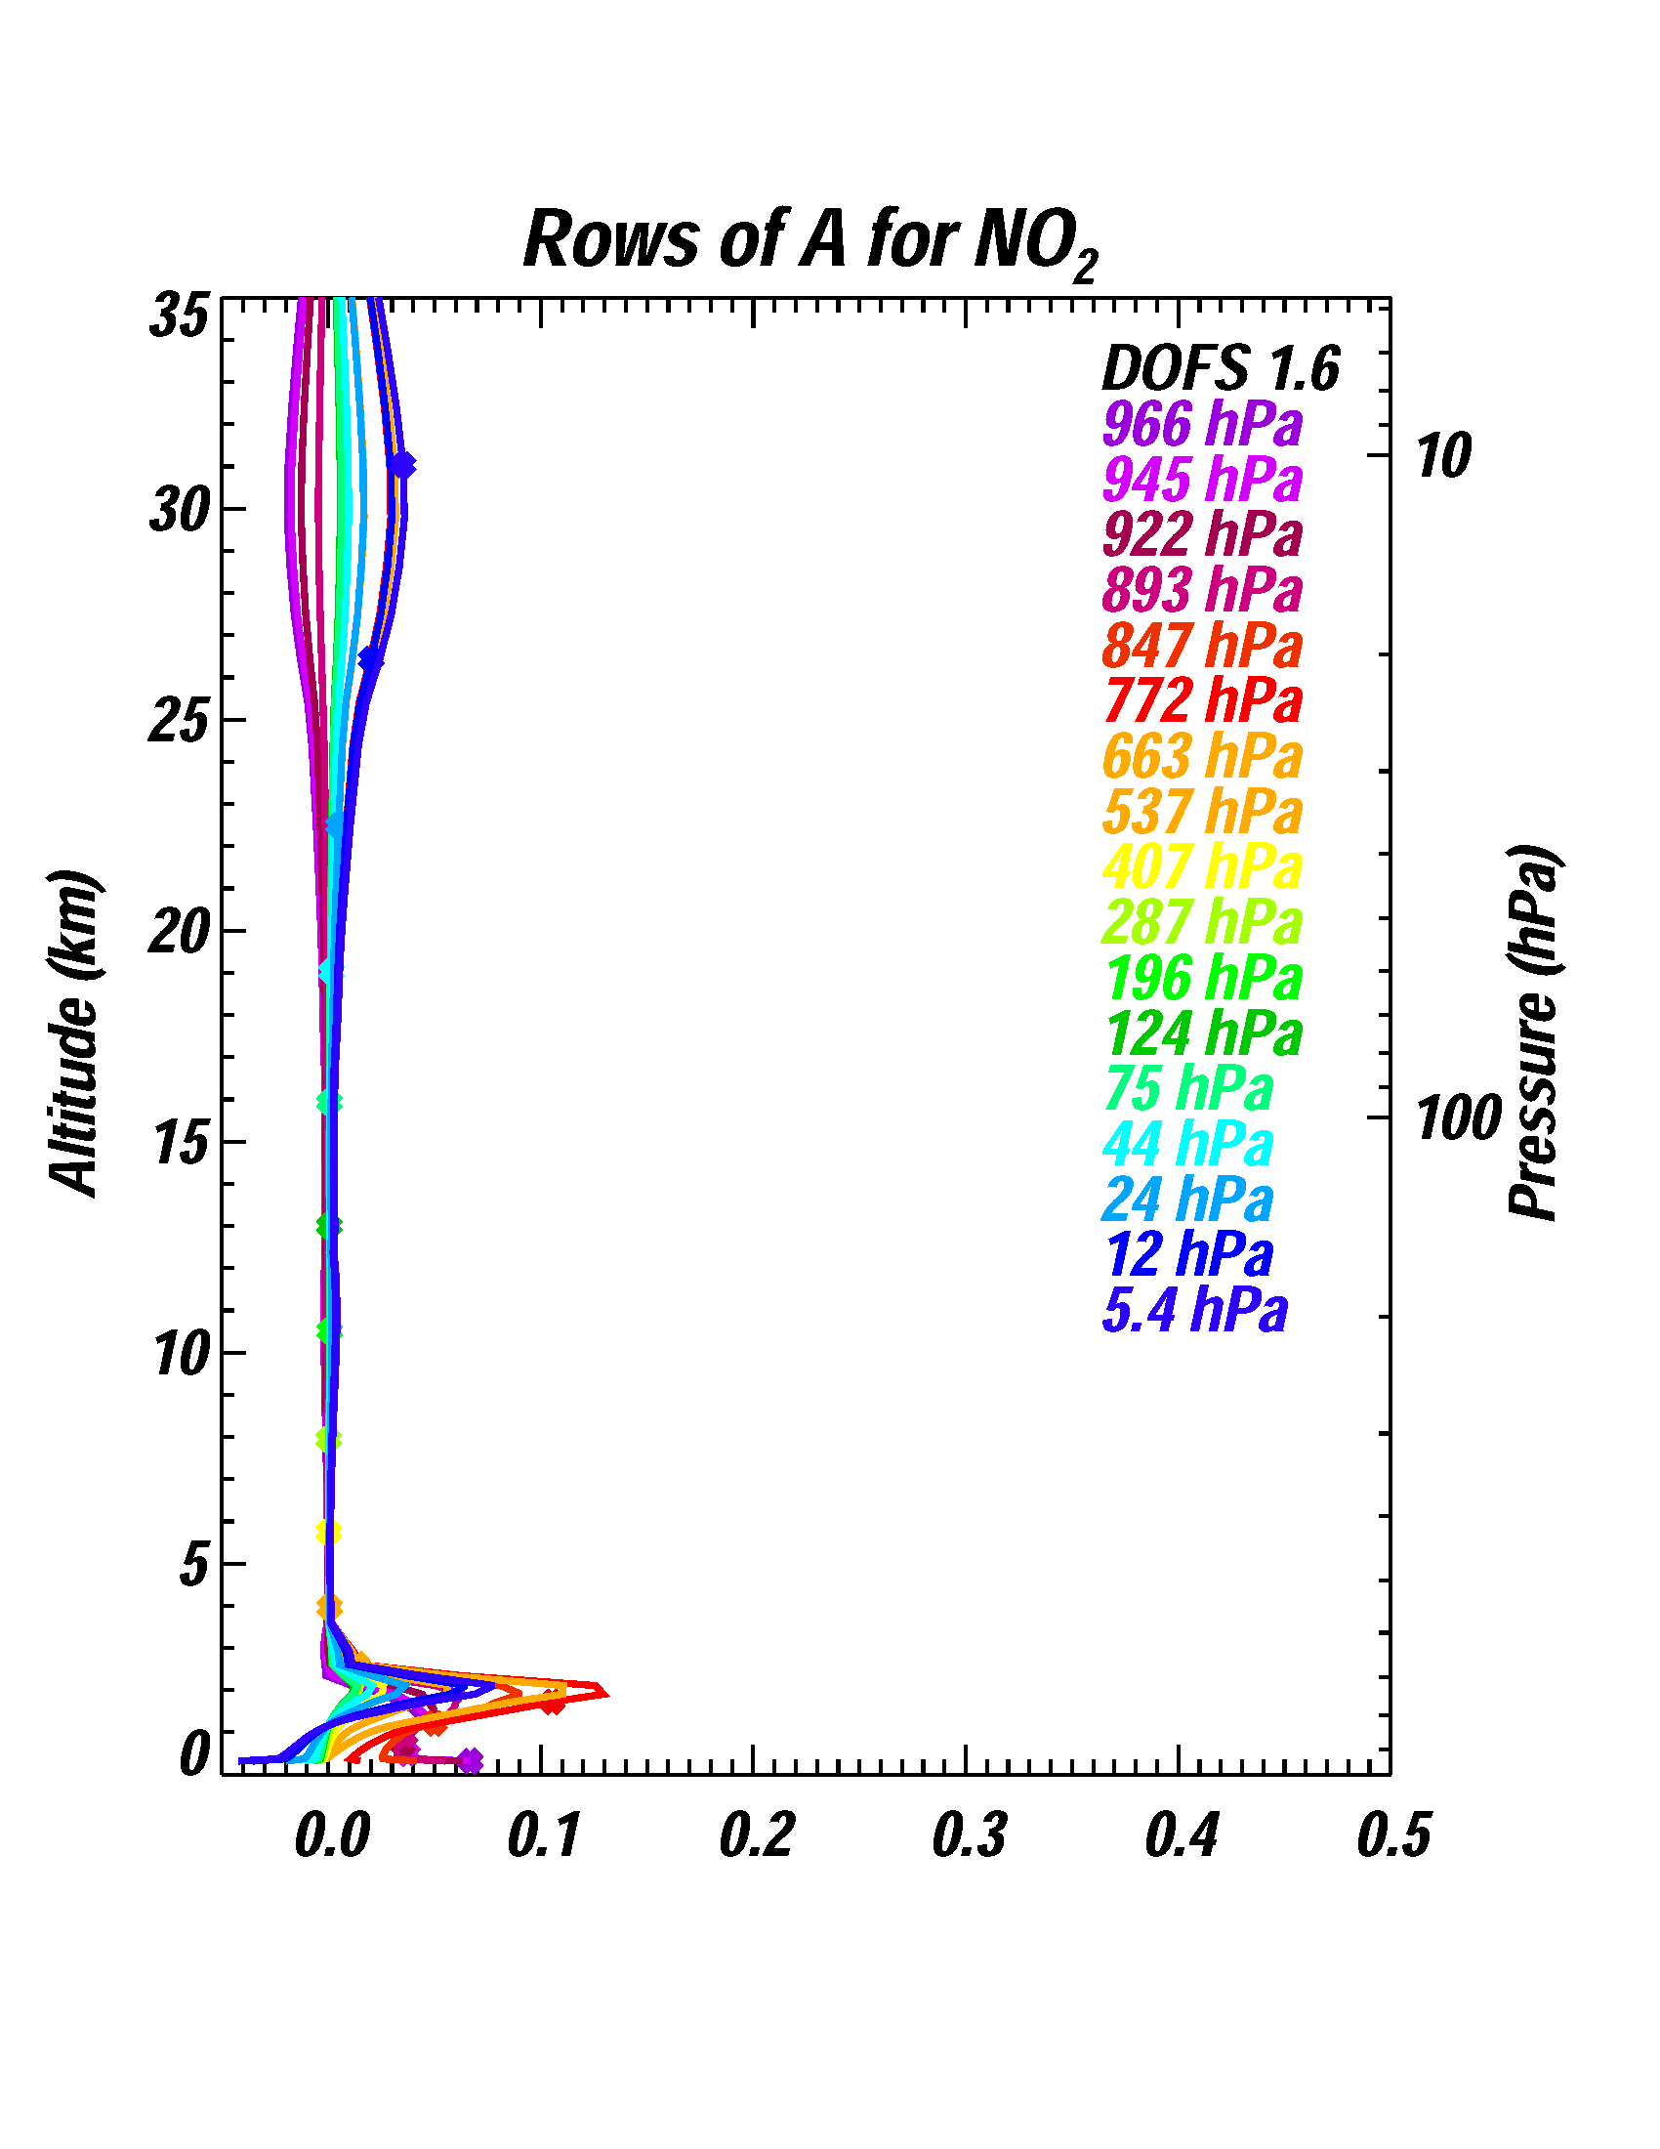
NO₂ Retrievals: First Results
Preliminary retrievals with TEMPO instrument characteristics meets GEOCAPE requirements for column precision
We retrieve a profile and collapse into a column
NO₂ has sensitivity in the lower troposphere and stratosphere
There is limited profile information for NO₂
Work underway on increasing computational efficiency to meet processing demands for full domain

Slide 15
Conclusions
O₃ Regional OSSE experiment underway
Work ongoing on tuning the analysis system
Initial results promising
Full UV-VIS-TIR retrievals showing positive impact on surface O₃
Regional OSSE system showing realistic complexity
NO₂ forward modeling simulations underway

Slide 16
Backup Slides

Slide 17
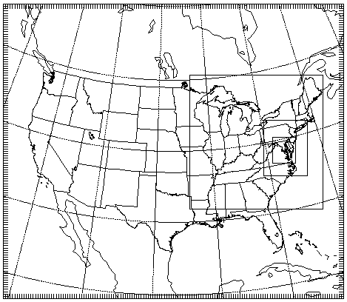
Nature Run
12 km
Regional Nature Run
4 km
down
scaling
1.33 km
Urban Nature Run
Courtesy: K. Pickering/C. Loughner
Notes:
These are the outputs – drop this

Slide 18
AK Prediction
Multiple regression works best for surface – 681 hPa
Combinations of fit AK in lower troposphere and average AK above allow simulated observations for different wavelength combinations
UV-VIS-TIR provides highest correlation between simulated observations and nature run
See Helen’s poster for more details
Notes:
Replace this with regional multiple regression retrievals slide from today. Dofs are reflected in actual correlation

Slide 19
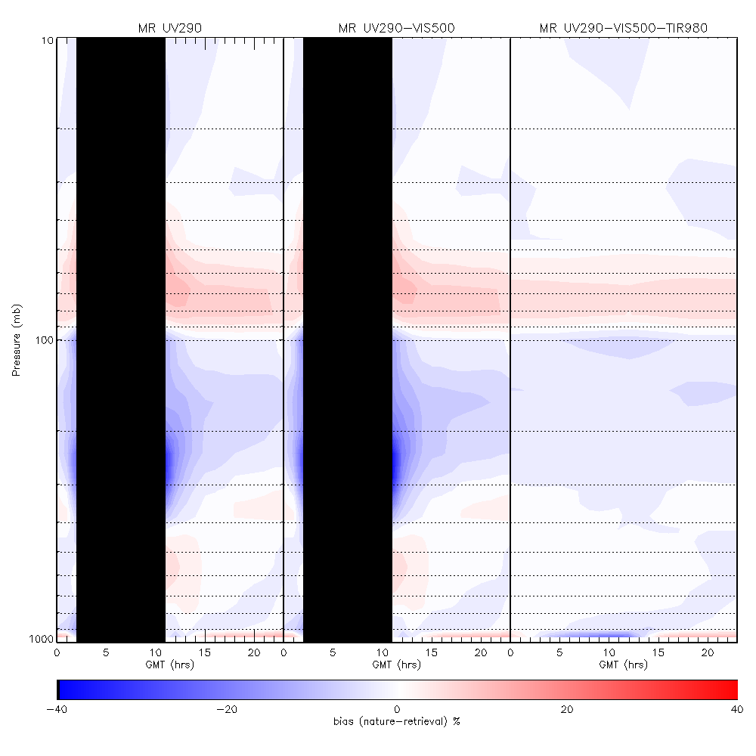
Retrieval Biases
Regional Multiple Regression AK Retrievals (UV, UV-VIS, UV-VIS-TIR)
Diurnally resolved biases between the Regional Nature Run and GEOCAPE O3 retrievals for July 2011 show generally low biases (<20%) except:
between 200-300mb at sunrise and sunset (UV and UV-VIS only)
at the surface (underestimate daytime and overestimate nighttime O3
Notes:
These statistics are based on direct comparisons between the Nature profiles (truth) and retrievals for all of CONUS for all of July 2011 and show the systematic improvement in retrieval sensitivity below 800mb as you go from UV to UV-VIS to UV-VIS-TIR. This is consistent with previous studies based on limited stations and provide a “real-world” context for how much information the retrievals have in the lower troposphere.

Slide 20
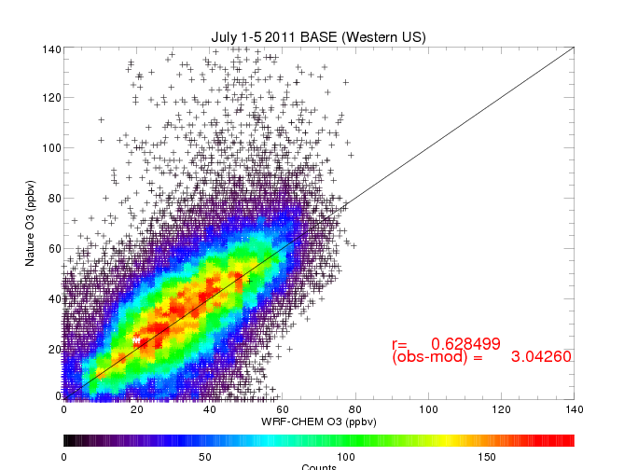
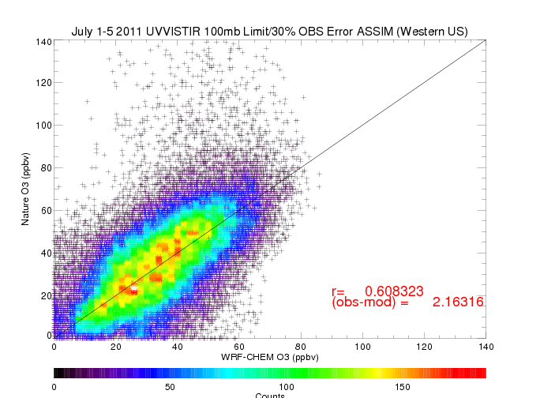
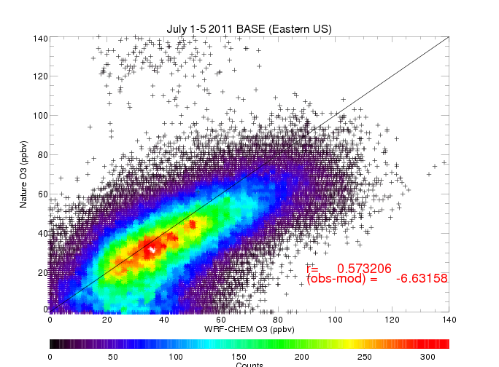
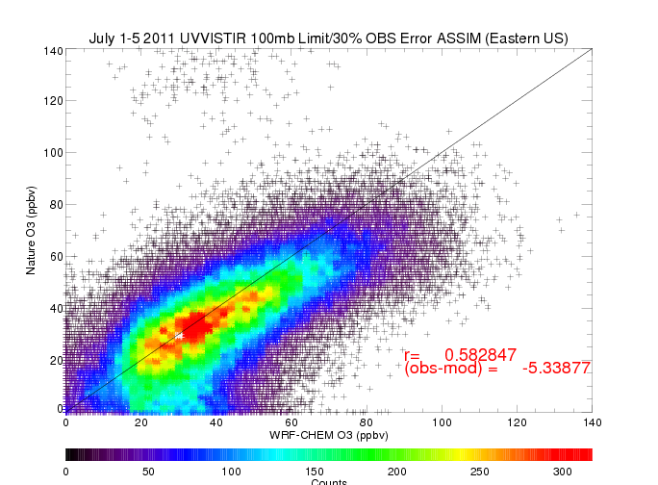
Impact of Assimilation: Overall Results
Nature vs Control (Western US)
Nature vs Assimilation (Western US)
Nature vs Control (Eastern US)
Nature vs Assimilation (Eastern US)
Notes:
Systematic reduction in surface ozone bias between nature run (obs) and UV-VIS-TIR analysis (mod) compared to control (mod) at US EPA AIRNow sites for July 1-5, 2011

Slide 21
Accomplishments for Ozone OSSE
12 km and 1 km Nature simulations were evaluated with respect to observations during the 2011 NASA DISCOVER-AQ campaign.
Diurnally resolved high spectral resolution UV/VIS/TIR forward modeling at 14 representative sites using ozone, NO₂, HCHO, SO₂, aerosol, water vapor, and temperature profiles from the Regional Nature run has been completed.
TIR, UV, VIS, UV/TIR, UV/VIS, and UV/VIS/TIR ozone retrievals have been generated and evaluated with respect to the Nature run profiles.
Notes:
Don’t need this slide

Slide 22
Accomplishments for Ozone OSSE
Averaging Kernel (AK) regression based on instrument and observing parameters has been developed using retrievals from 14 representative sites.
Data assimilation shows positive impacts on surface ozone sampled at US EPA AIRNow sites.
Notes:
Don’t need this slide

Slide 23
NO₂ OSSE Developments
Ways to get 10x speedup
Optimize optical property initialization (mainly, aerosol phase function moments)
Remove redundant copying of data between variables
Separate operations that are the same for each profile (e.g. reading in of large aerosol optical property tables) from those that are different between profiles so that former needs to be done only once

Slide 24
NO₂ Retrievals: First Results
NO₂ has sensitivity in the lower troposphere and stratosphere
We retrieve a profile and collapse into a column
There is limited profile information for NO₂
Preliminary retrievals with TEMPO instrument characteristics meets GEOCAPE requirements for column precision (OBServation error includes precision and error from aerosols, albedo)
Work underway on increasing computational efficiency to meet processing demands for full domain

