Slide 1
Identify and plan priority activities to prepare for the upcoming Decadal Survey
Curt Davis, Antonio Mannino and many Contributors

Slide 2
GEO-CAPE and the Decadal Survey
Decadal Survey to develop a prioritized list of top-level science and application objectives to guide space-based Earth observations over a 10-year period commencing approximately at the start of fiscal year 2018 (October 1, 2017).
“include reconsideration of the scientific priorities associated with the named missions from the 2007 decadal survey.”
The 2007 survey did not prioritize among the 15 missions for NASA; placement in 1 of 3 time periods (Tiers I, II, III: 2010-13, 2013-2016, 2016-2020) was based on factors including technical readiness; cost; synergy with existing, planned, or recommended missions; and consideration of int’l activities.
Continue and tout our progress to date
Work to move up priority from present tier to tier I

Slide 3
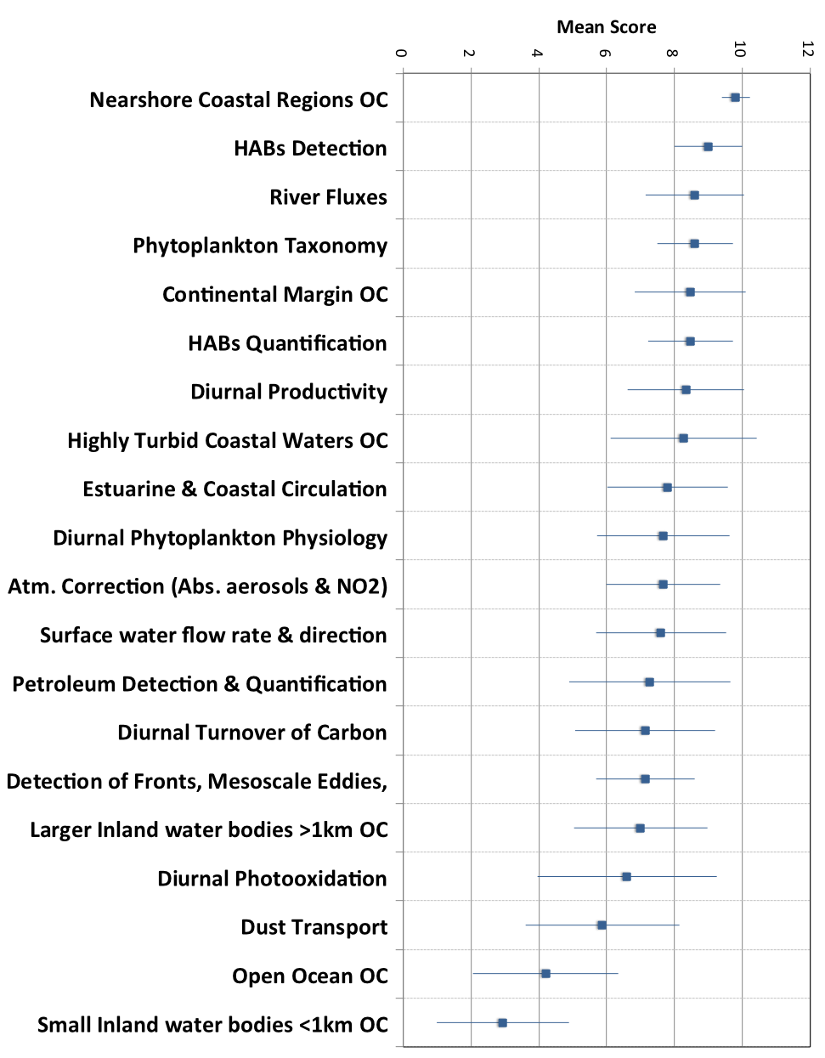
Science Application Priorities

Slide 4
Science Application Priorities
Based on these Median scores it is recommended that the GEO-CAPE ocean color instrument be designed to address applications with a score of 8 or higher.
Applications that scored 7 should be adequately addressed by this same instrument.
Dust transport will also be measured for the areas sampled.
Open ocean OC requires additional area sampling and duplicates sampling with other instruments.
This instrument will not have adequate spatial resolution for small inland water bodies.

Slide 5
GEO-CAPE and the Decadal Survey
Unique science based on
Hourly data of the coastal ocean
Event response (1/2 hour data)
Products (refine algorithms, demonstrate value)
RGB images
Water clarity
Chlorophyll
HABs
Water quality prediction
Coastal dynamics (response to tides, diurnal winds)
Diurnal Productivity

Slide 6
Comments from Frank Muller-Karger
Put all cards on the table and see what the science questions are, then figure how to address them - especially as input to the DS.
I agree that GEO and polar combination needs to be considered together. For weather observations in low to mid-latitudes, which operational weather forecasting agencies see as 'critical', it is OK to have the lower spatial resolution and limited geographic coverage from GEO orbit. These satellites are complemented by polar orbiters, so it is not just one or the other.
We just need to ensure clear specifications for high quality in so many respects, as this is where you get what you pay for... It depends on clearly defining the goals, perhaps levels of goals.

Slide 7
Suggestions from Bob Arnone
1. Define how the short temporal scales of bio-optics from GEO-CAPE can enhance understanding of longer temporal scales of coastal properties.
Our understanding of the long term trends of water quality from polar orbiting sensors, have biases and are limited by not accounting for the diurnal changes that GEOCAPE can resolve.
2. Monitor the response of the coastal water quality to hydrographic discharge and changes. New sensors are required for the hydrographic response from changing land discharge in coastal waters.
3. Establish how the diurnal changes in coastal ocean properties are coupled to the atmospheric diurnal changes.

Slide 8
Ocean and Atmosphere Interdisciplinary Science (please read the report by Jordan, et al.)
Themes:
1) greenhouse gases and the oceans
2) air-sea interface and fluxes of mass and energy
atmospheric deposition and ocean biogeochemistry
interconnections between aerosols, clouds, and ecosystems
ocean biogeochemical control on atmospheric chemistry
The hyperspectral choice will afford the greatest flexibility in investigations of AC and OC made simultaneously
Retrieve the same AOD over land and ocean
Retrieve NO₂, O₃, and aerosols
Transport of dust, smoke and particulates land to ocean
Keep 2130 nm band
100 km inland to cover megacities

Slide 9
Maria Tzortziou and Blake Schaeffer on needs for Applications
Hourly revisit
Ability to stare at or 30 min revisit of selected targets
300 m or better GSD. Prefer <100 m
Real time data is less than 30 min
Need SST - get it (500 m every 15 min) from GOES-R
Chlorophyll good but need HABs etc. more products:
Water clarity
HABs
Water quality predictions
RGB images
Other?

Slide 10
Things we might add for bigger user base?
Quality of water supply, LAI, fires, etc. on a targeted basis Nationally
Do we need a couple more SWIR bands?
1.38 micron and window band to do cirrus cloud detection and thin Cirrus removal (operational on MODIS)
2130 nm for aerosol correction
2 additional SWIR bands for fire detection (see through the smoke and give the temperature of the fires – demonstrated with AVIRIS data)

Slide 11
Preparation for the Decadal Survey
Finish the GEO-CAPE white paper and publish as a NASA tech memo
Ocean part as a separate publication, EOS or TOS?
Edit this version to submit to DS?
Finish STM and SVM
Standard GEO-CAPE ocean presentation for team members to present at multiple meetings
GEO-CAPE ocean team member(s) on the appropriate Panel for DS.
Sign up at bit.ly/ESASsignup
Key demonstration of the science value GEO-CAPE ocean
Key demonstration of the application value of GEO-CAPE ocean data
Water clarity, Chlorophyll, HABs, etc.
Work with local agencies on a regular basis

