Slide 1
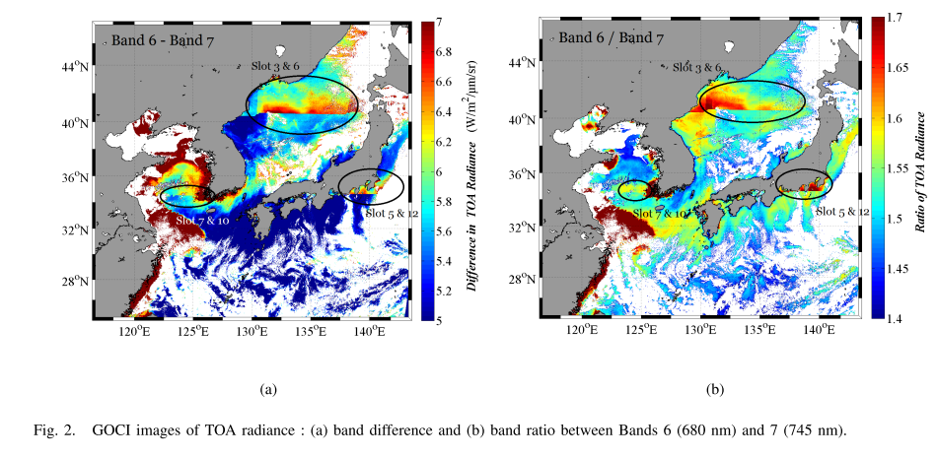
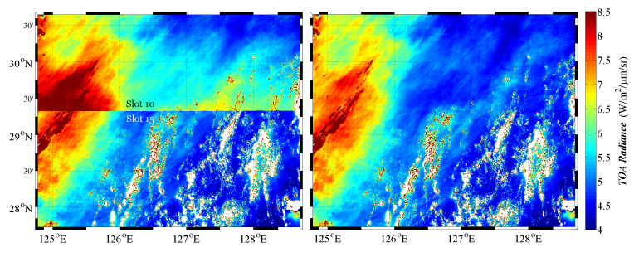
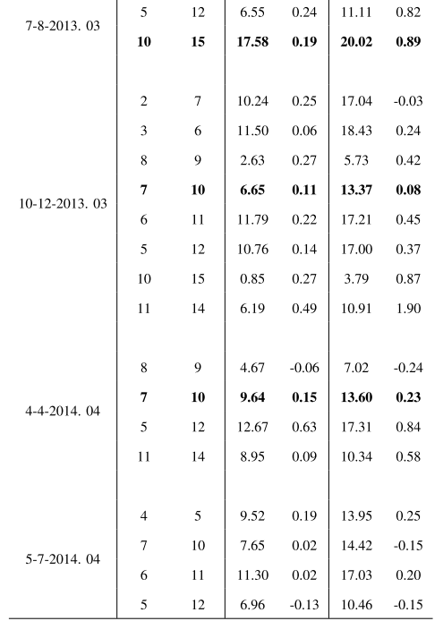
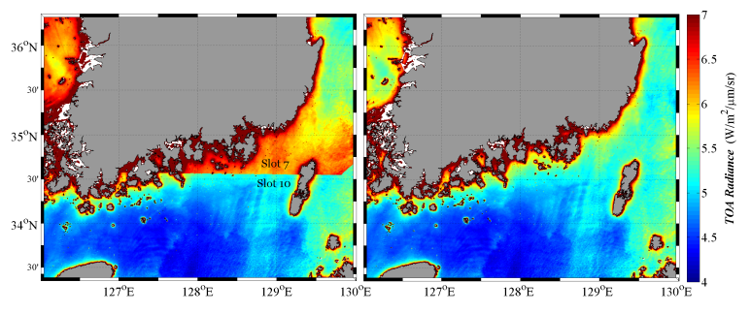
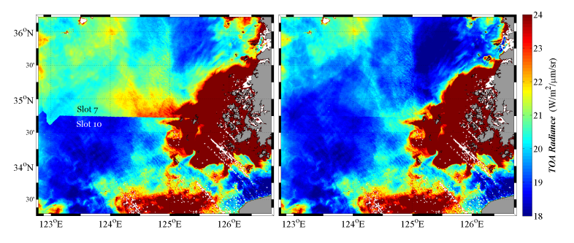
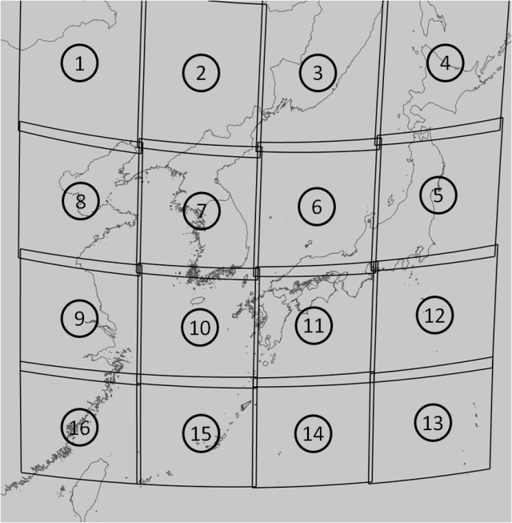
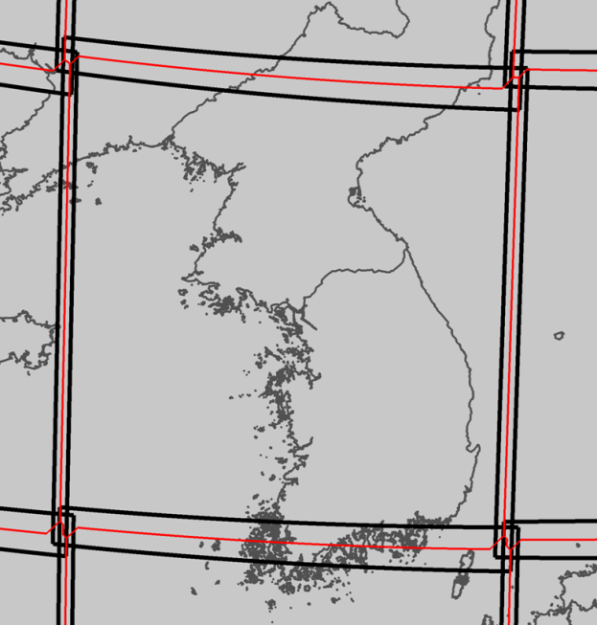
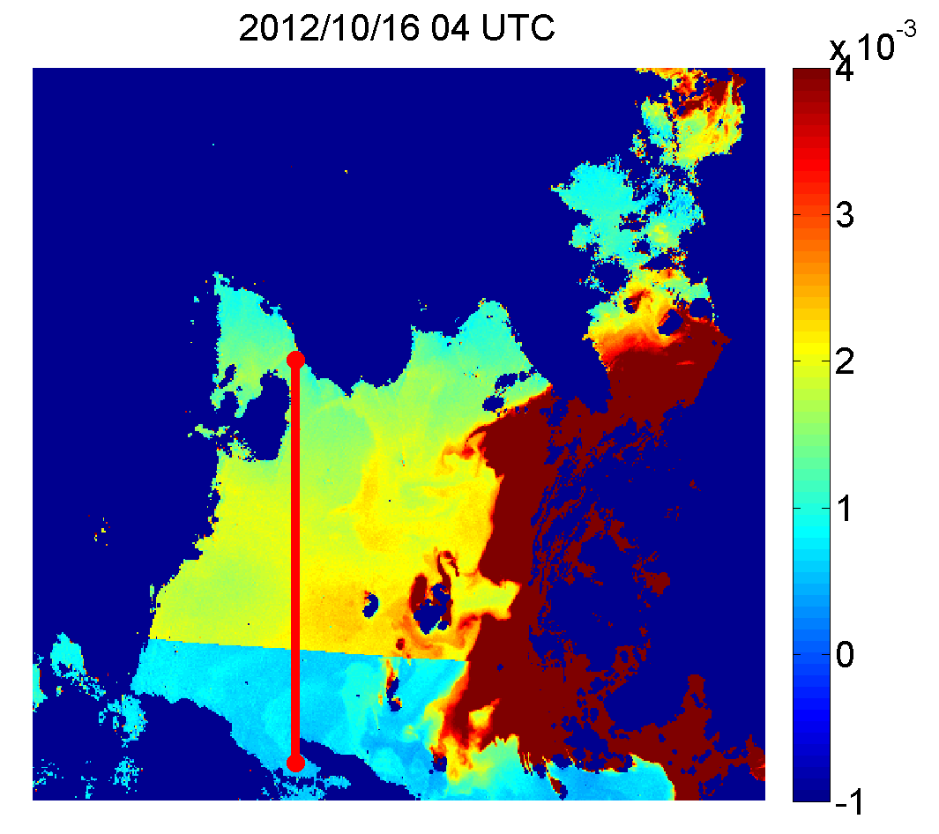
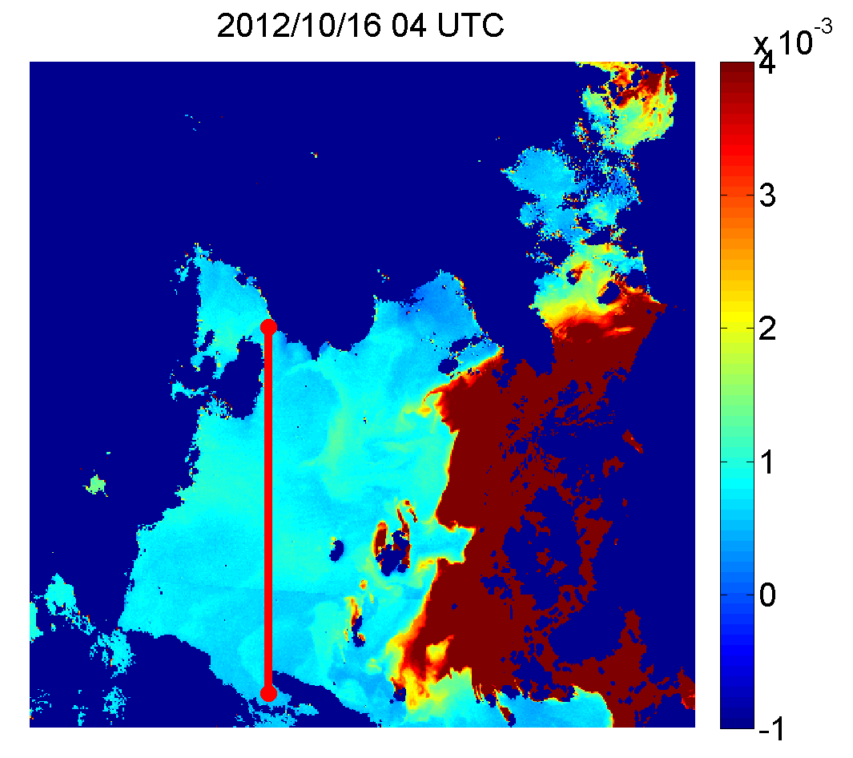
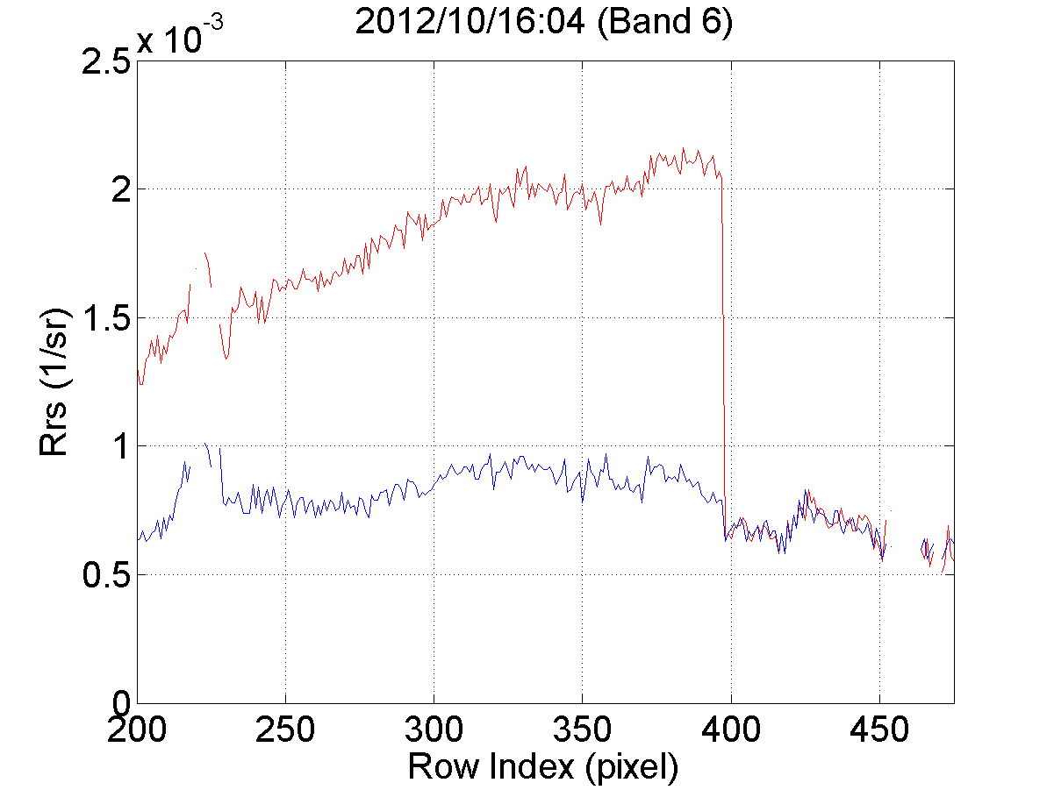
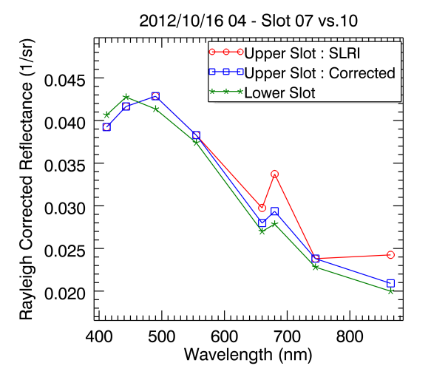
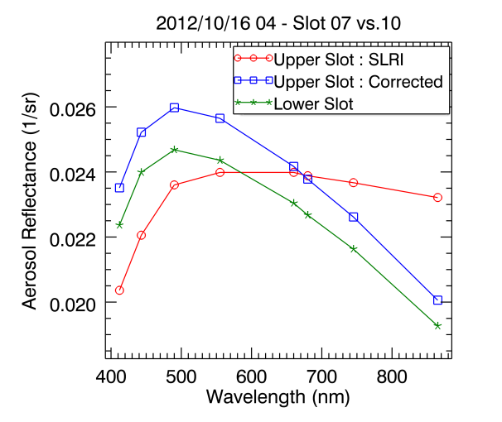
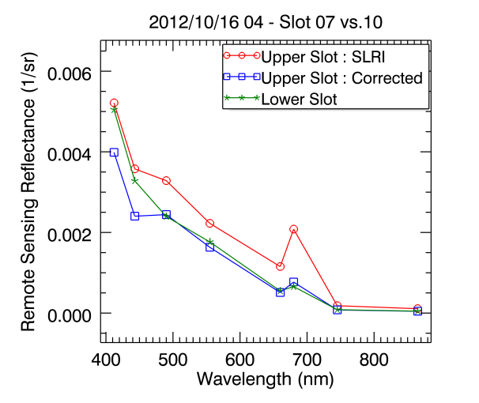
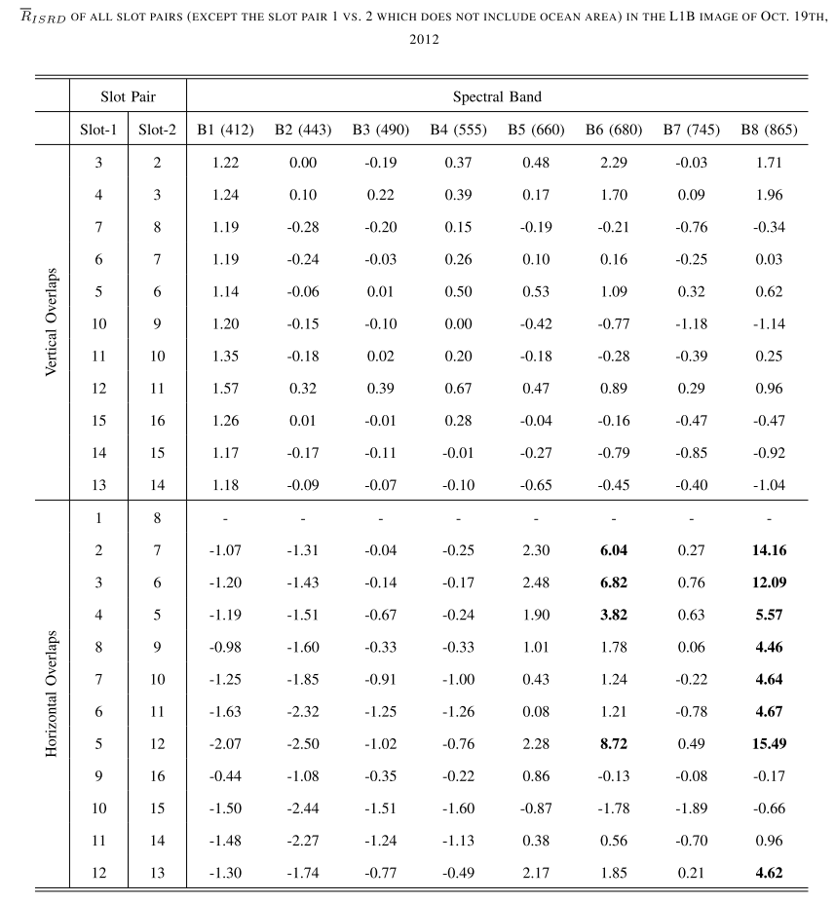
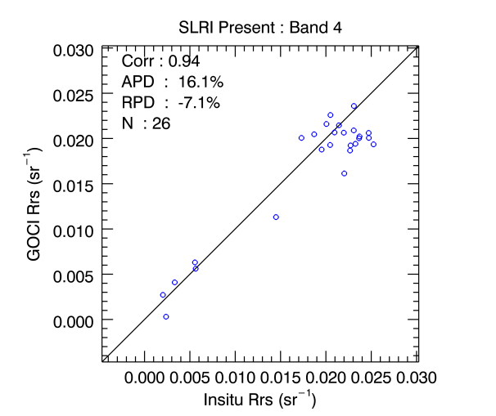
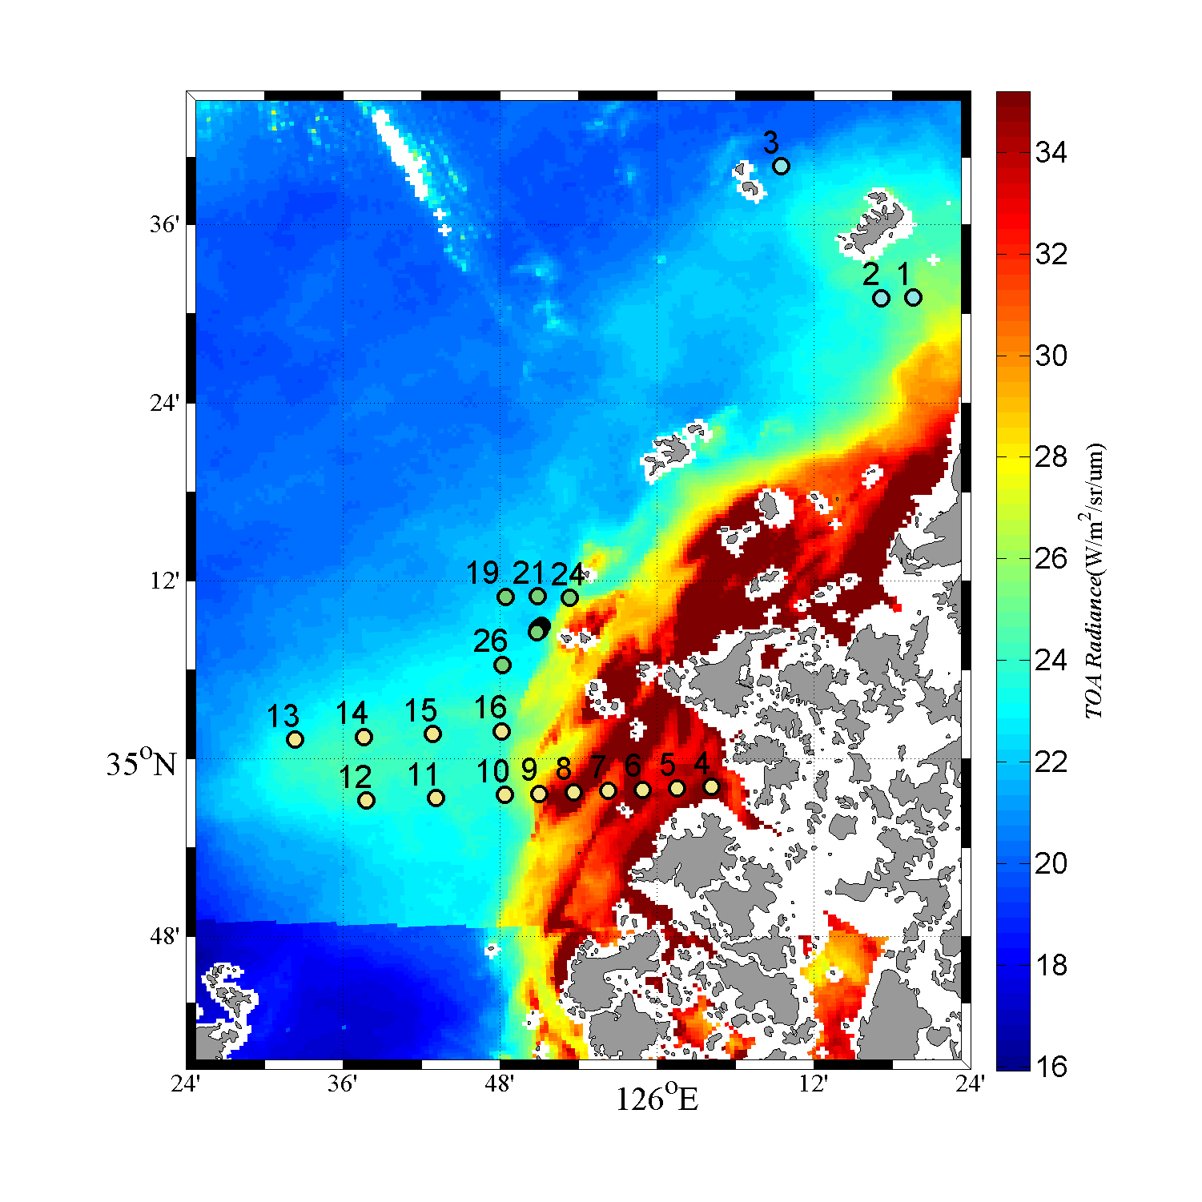
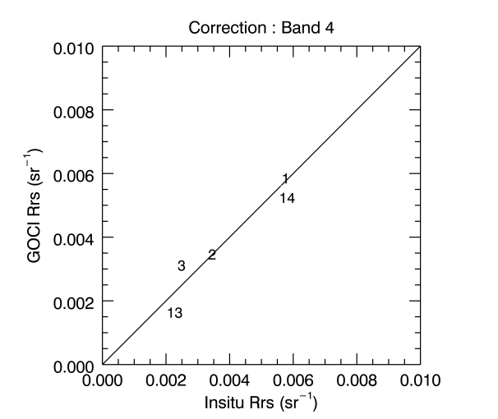
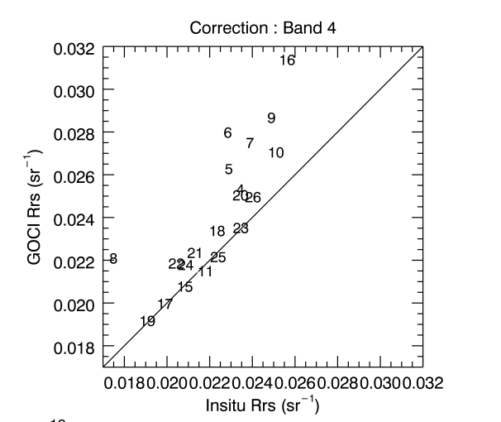
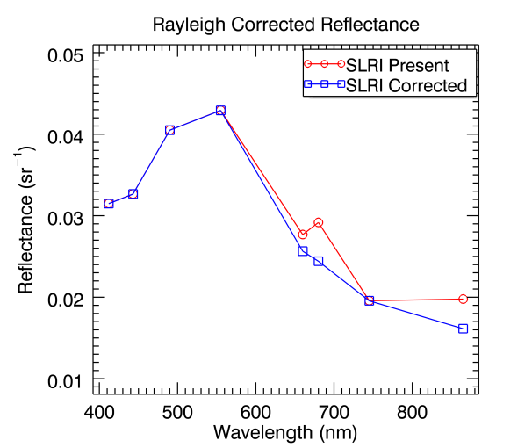
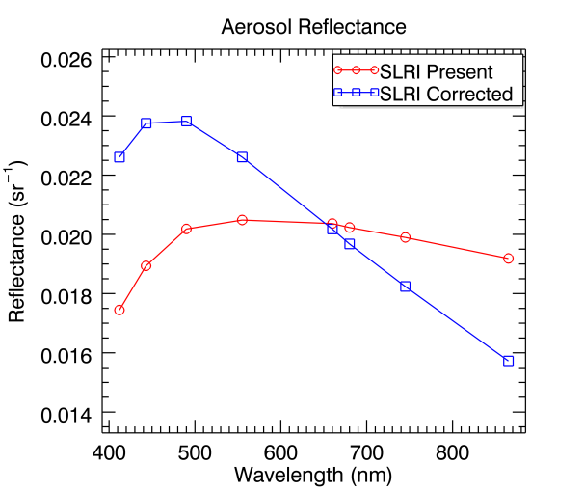
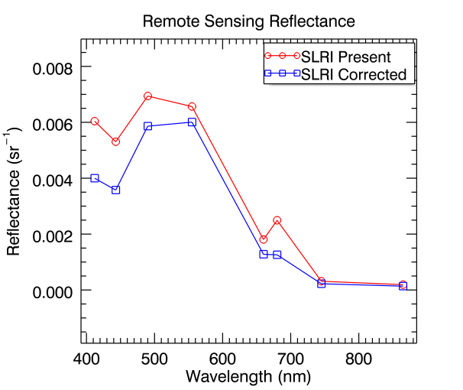
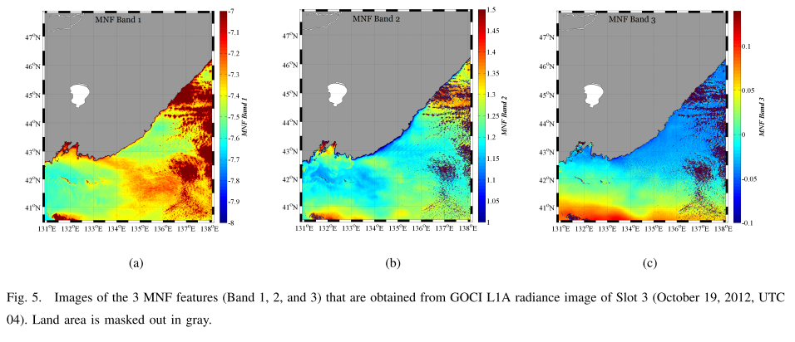
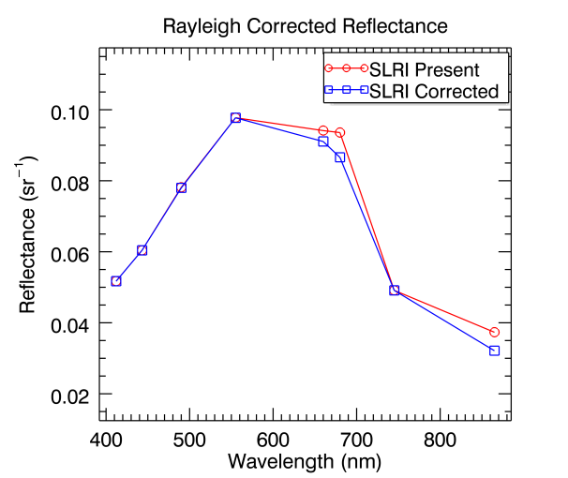
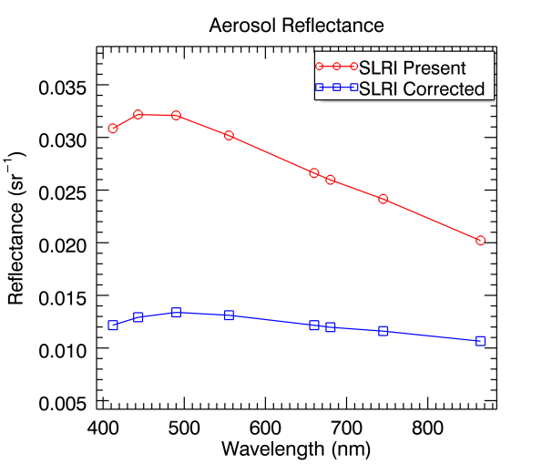
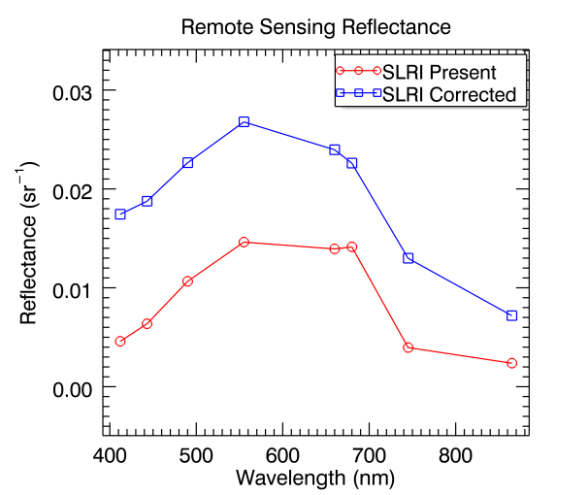
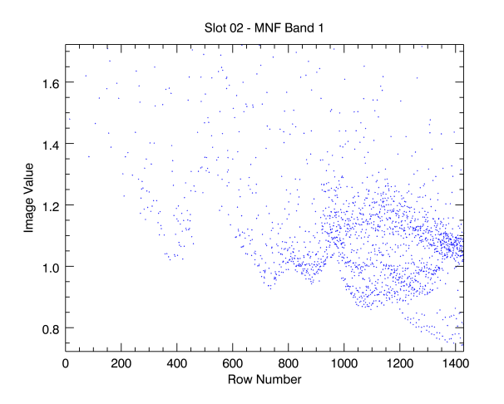
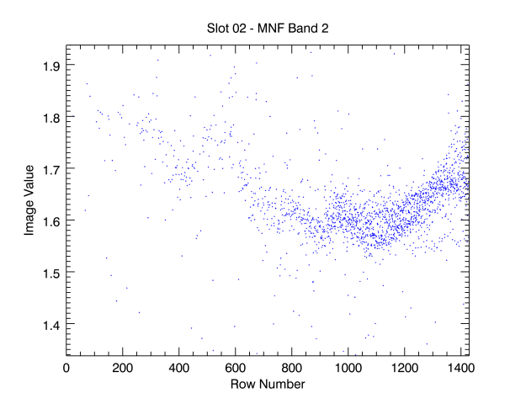
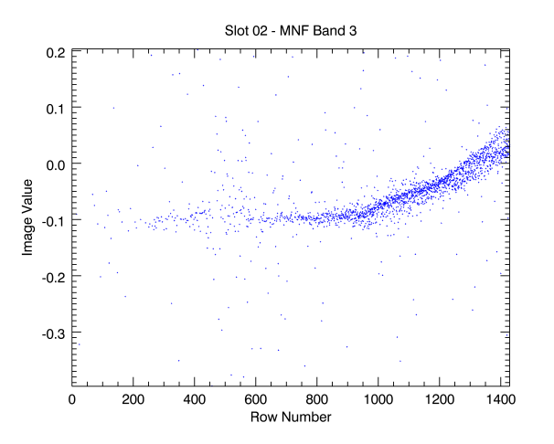
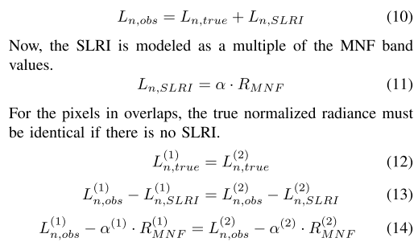
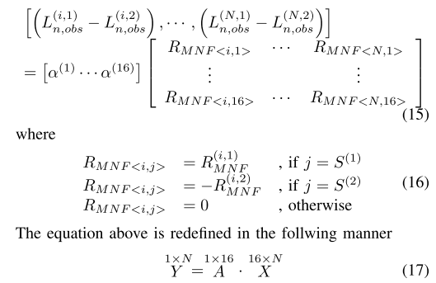
CIDUM : Correction of Inter-Slot Radiometric Discrepancy Using the MNF transform
Wonkook Kim, Jae-hyun Ahn, Young-Je Park
Korea Ocean Satellite Center, Korea Institute of Ocean Science and Technology
INTRODUCTION
Results
ISRD : Inter-Slot Radiometric Discrepancy
Radiometric artefact occurring in the slot boundary areas caused by the inconsistency of the radiometric response for locations
Source of ISRD
Natural sources : difference in image acquisition time between the slots (time interval between two adjacent slots varies from 103 second to 12 minutes)
Artificial sources
Pixel response non-uniformity : each pixel in the 2-dimensional sensor array has different sensitivity for photon
Stray-light inside the sensor optics : unwanted light from the outside of FOV
TOA Radiance (L1B data)
Remote Sensing Reflectance
Validation with in-situ measurements
A
A
A
B
B
B
Slot pairs with large ISRD exhibit TOA radiance difference greater than 3%
Those large ISRD for vertically aligned slot pairs are from the Stray-light driven radiometric inflation (SLRI) in the upper slots
SLRI Correction using CIDUM
Two-step correction scheme
Extraction of the SLRI pattern from each L1A image using the MNF transform
Calibration of the SLRI pattern by scaling the patterns through the optimization in all the slot overlaps (in such a way that the mean ISRD in all the 24 slot boundaries are minimized)
Band 1
Band 2
Band 3
Station 14
Station 16
REFERENCE
W. Kim, J. Ahn, and Y. Park, “Correction of stray-light driven interslot radiometric discrepancy (ISRD) present in radiometric products of Geostationary Ocean Color Imager (GOCI),” IEEE Transaction on Geoscience and Remote Sensing, vol. 53, no. 10, Oct. 2015.
J. Ahn, Y. Park, W. Kim, B. Lee, and I. Oh, “Vicarious calibration of the Geostationary Ocean Color Imager,”, Optics Express, vol. 23, no. 18, Aug. 2015.
CONTACT
Emails : wkkim@kiost.ac, +82 31 400 7794

