Slide 1
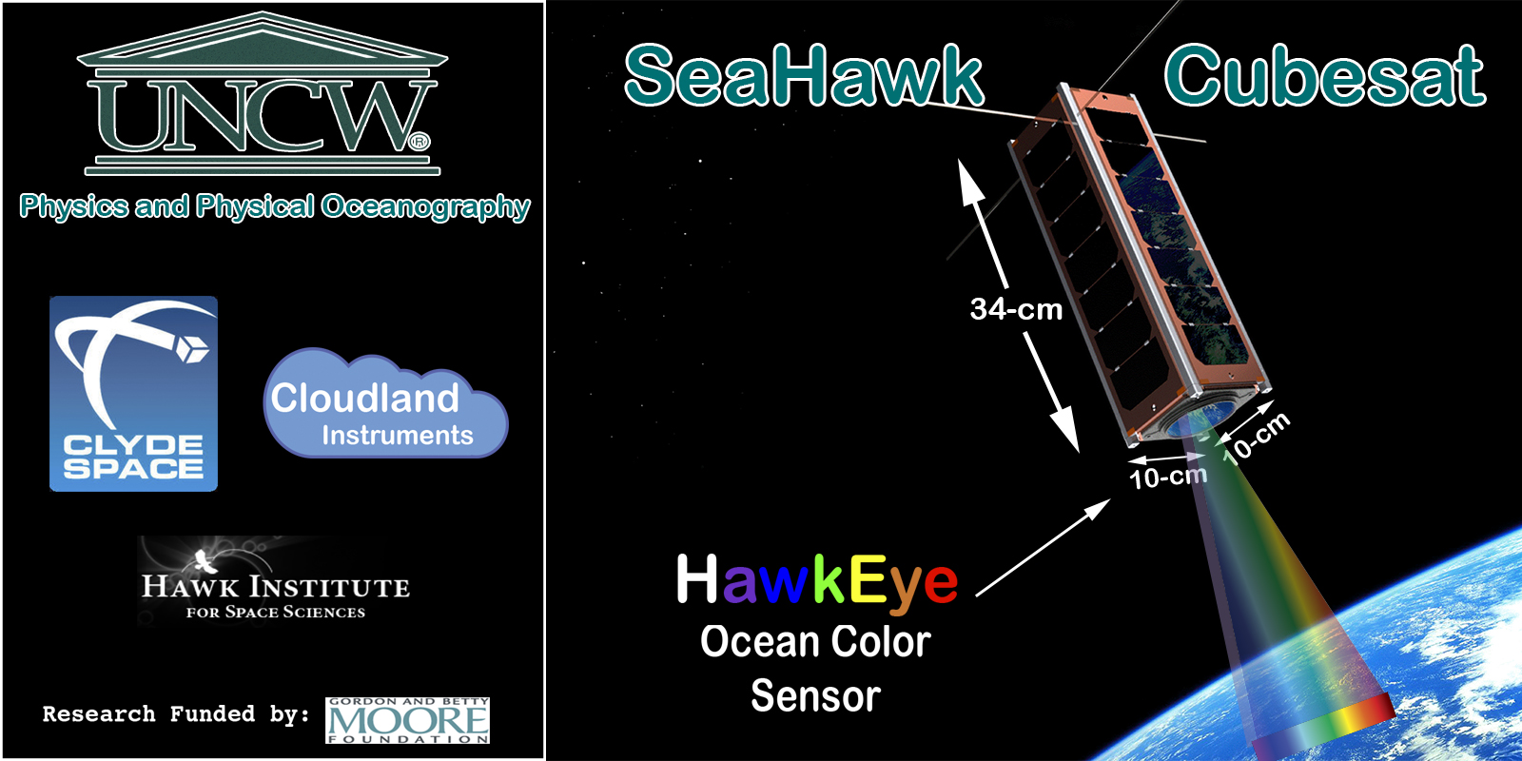
SOCON--Sustained Ocean Color Observation from Nanosatellites
Professor John M Morrison
Center for Marine Science & Dept. of Physics and Physical Oceanography

Slide 2
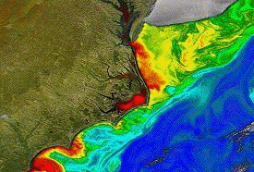
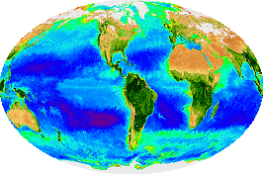
OCEAN
COLOR
2-year grant from Gordon and Betty Moore Foundation to team from University of North Carolina Wilmington, Cloudland Instruments, Clyde Space, NASA Goddard Space Flight Center & Hawk Institute for Space Sciences
“Game-changer, proof of concept” to demonstrate capability to construct 2 low-cost autonomous nanosatellites to provide sustained, high spatial and temporal resolution information about ocean surface processes.
$1,675M for 2 spacecraft, from paper design to ready to launch in 24 months.

Slide 3
Purpose of Grant:
CubeSat: nanosatellite with volumes in multiples of 3.0 liter (30cm³), and typically uses commercial off-the-shelf (COTS) components for its electronics. Stanford University’s Space Systems Development Laboratory (SSDL) and California Polytechnic State University developed the CubeSat concept to provide standardized, low-cost access to space (http://www.CubeSat.org/).
CubeSat Advantage: in terms of development cost and time, and low volume and mass, with respect to larger satellites opens the door for radically new earth observing missions (EO).
  EO missions traditionally involve large, complex spacecraft with multiple payloads leading to spacecraft having a large price tag
  A constellations of EO nanosatellites, by contrast, could provide daily or higher temporal resolution and increased spatial resolution while still being economically viable.

Slide 4
Proposed Mission Requirements
75 - 150 meter pixel footprint on ground
Nominal 525 Kilometer orbit, sun-synchronous orbit (approximate 5 day repeat orbit)
8 spectral bands – SeaWiFS bands
Sensitivity comparable to SeaWiFS
Unit should be designed for smaller targets, such as:
  Coastal Zone
  Islands
  Large lakes
  Bays and Estuaries
  Large Rivers

Slide 5
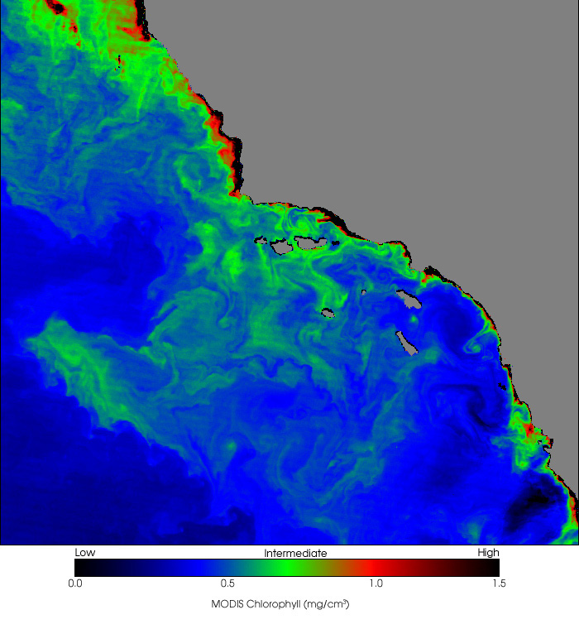
Field of View from 525 Km Orbit
-Santa Barbara Channel
MODIS
image

Slide 6
Project Team
Principle Investigator:
  John M. Morrison; University of North Carolina Wilmington
    Role: Team Leader; Project Manager & Science Lead
HawkEye Ocean Color Sensor Development Team Collaborators:
  Alan Holmes; Cloudland Instruments.
    Role: Team Lead; Sensor Design and Characterization
  Andy Vick; UK Astronomy Technology Center (ATC)
    Role: Sensor Design and Construction
  Gene Feldman; Ocean Color Program, NASA/GSFC/OCP
    Role: Data Collection, Processing and Algorithm Development
  Bryan Franz; Ocean Biology Processing Group, NASA/GSFC/OBPG
    Role: Algorithm development and atmospheric correction
  Gerhard Meister; Ocean Ecology Lab, NASA/GSFC/OEL
    Role: Instrument design and calibration
  Frederick Patt; SAIC Program Manager, NASA/GSFC/OEL
    Role: Spacecraft/Instrument Navigation
SeaHawk CubeSat Development Team:
  Craig Clark; CEO/CTO Clyde Space, Glasgow, Scotland
    Role: Team Leader; CubeSat Satellite Bus Construction
  Mary Cleave; Hawk Institute for Space Sciences (HISS)
    Role: Project Collaborator - Mission planning assistance and STEM.
  Dennis McCartney; CTO Hawk Institute for Space Sciences (HISS)
    Role: HawkEye Aircraft Flight Testing; CubeSat Development; Launch Operations

Slide 7
SeaHawk - Nominal Orbital Operation Parameters for Sun-Synchronous Orbit
Nominal Orbital: 525 km
  Ground speed is ~ 7600 meters per second
Data Nominally Collected: 10AM and 2PM local time
Latitudes: from +?? to –?? degrees will be surveyed
Orbital Lifetime: 1 - 2 year baseline
Lunar Calibration: rolling the spacecraft attitude
No Solar Calibrator

Slide 8
HawkEye Ocean Color Sensor
Cloudland Instruments
PI: Alan Holmes (alans@cloudlandinstruments.com)
Development Team:
  Alan Holmes (Optical/Systems Engineer)
  Craig Herrin (Senior Electronics Engineer)
  Linda Sasaki (Senior Mechanical Engineer)
  Carl Schueler (Calibration/Test Planning
Objectives and Benefits:
Develop a miniaturized multispectral ocean color imager of SeaWiFS caliber capable of flight on a CubeSat with significantly higher spatial resolution than standard satellite systems, providing observation of sub-mesoscale variability giving insights into mixing dynamics that are poorly understood. High spatial resolution imagery would improve our ability to monitor fjords, estuaries, coral reefs and other near-shore environments where anthropogenic stresses are often most acute and where there are considerable security and commercial interests.

Slide 9
HawkEye Practical Constraints
SeaHawk is defined to be a CubeSat
  Severe size limitations- 10X10X34 cm, 1.33 – 2.28 kgs
  Shorter lifetimes than larger satellites
Money was limited for initial effort
  “Off-The-Shelf” components had to be used
    Custom arrays would have been too expensive and time consuming to obtain
Guiding principle was to do the best we can in a small package with readily available parts!

Slide 10
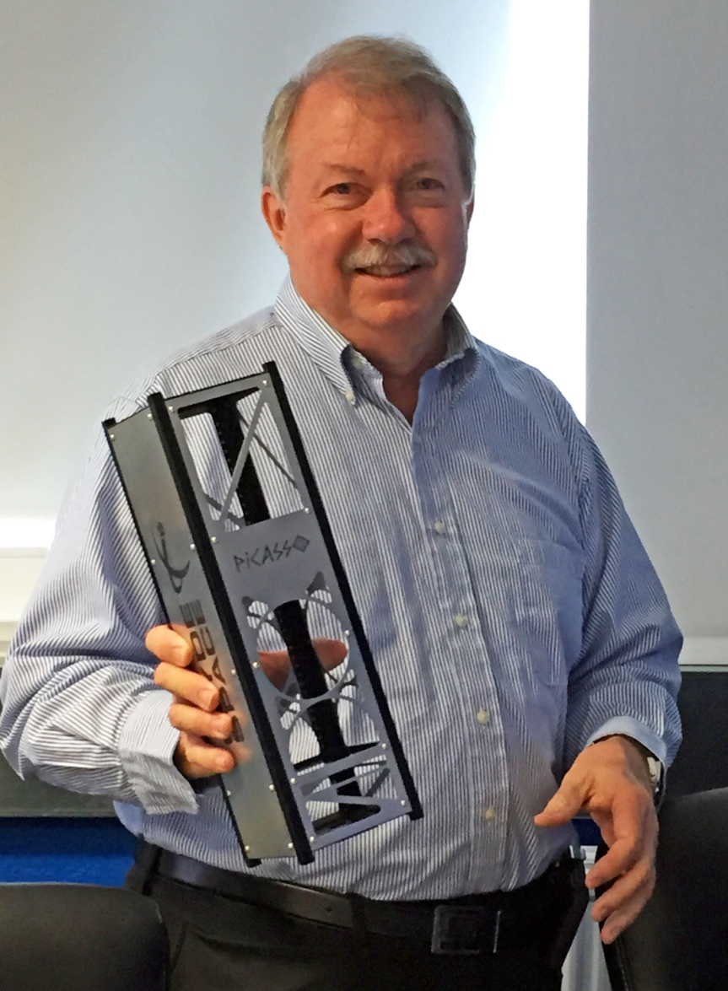
CubeSat with Prop! added for Scale
Initial Reaction!
You have got to be kidding?
Sensor Space
Actually, no 1/3 that size!
Satellite Bus

Slide 11
Original HawkEye Concept
8 linear array CCDs in individual packages, one for each channel
Optics set for 75 m ground resolution
Each CCD package has 4 linear CCD arrays, 3 with 4080 pixels and 1 with 8160 pixels
The camera will only use odd pixels in the Luma array
Therefore, a total of 4080 pixels from 4 channels, for a total of 16,320 pixels, will be read from each CCD for one line of data
On-board aggregation is planned to reduce this to 4080 pixels per CCD per line of data per band
For all 8 bands, a total of 130,560 pixels of raw data is collected approximately every 10 milliseconds
Power and Data Budgets extremely hard to make via 3U Cubsat!

Slide 12
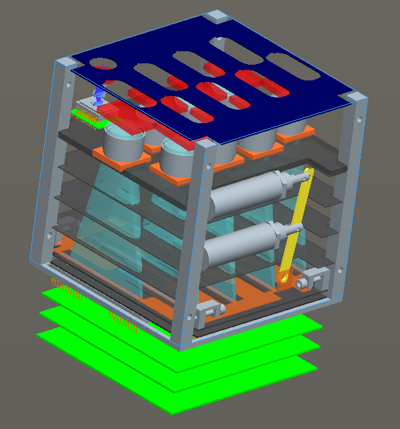
Planned Arrangement of Optical Package

Slide 13
An Immense Amount of Data is Captured in one 100 Second Frame
Number of pixels for complete raw image per channel = 16,320 x 10,000 = 163.3M Pixels
Number of pixels for aggregated image per channel = 163.3M / 4 = 40.8M Pixels
Total number of pixels for all channels in a raw image = 163.3M x 8 = 1.31G pixels
Total number of pixels for all channels in an aggregated image = 40.8M x 8 = 326.4M pixels
Plan to save all the raw data, and then perform the aggregation step, so we need 2.62 Gbytes of data memory
Aggregated image would require 71 minutes to downlink at 1 Mbit per second (for reference SeaWiFS LAC 662.4 kbps)
Typical CubeSat Problems: Space, Power, Data

Slide 14
Solution: Using Four Arrays, 2/Band
SPACE:
  Reduce baseline camera to 4 linear, CCD arrays
  Reduce focal length of optical array to better fit 10 cm X 10 cm X 10 cm
  smaller Package, space for GPS board and X-Band Radio
Power:
  Reduced Analog Power for CCD Arrays by 50%
  Computational capacity needed reduced from 4 microcomputers to a single microcomputer
Data Generation: more in line with Cubesat capability
  1800x4000 pixels (7.2 MPixels – 5.5X less)
  Still requires 13 minutes to downlink at 1 Mbit/sec(S-Band
  With 2x2 binning could be downlinked in single overpass
    900x2000 pixel image – still good resolution
Imagery:
  ~90 meter resolution (162 km swath) or 150 meter resolution (270 km swath) can still achieved with S/N comparable to SeaWiFS.
  More power, space for X-band radio >>More Images per pass

Slide 15
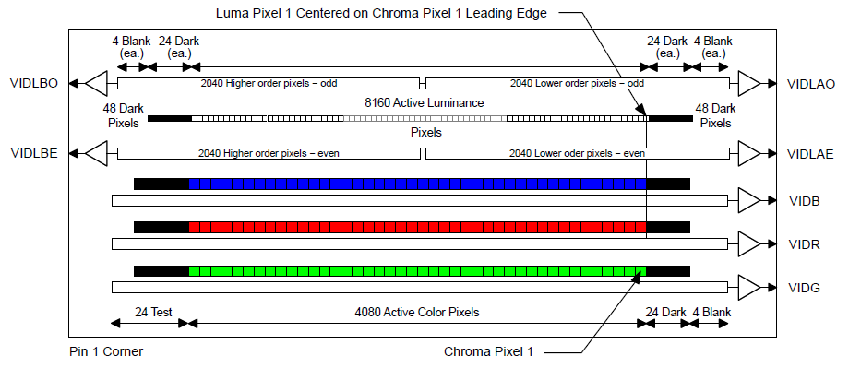
Overview of Linear Array Geometry
2000 pixels
80
pixels
2000 pixels
80
pixels
Bands 1, 3, 5, 7
Bands 2, 4, 6, 8

Slide 16
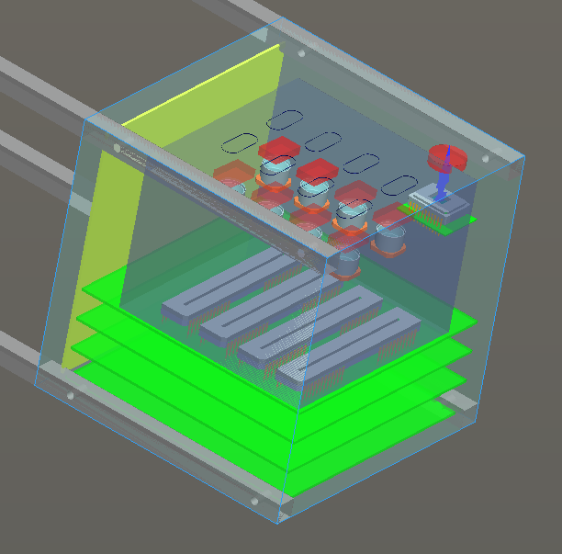
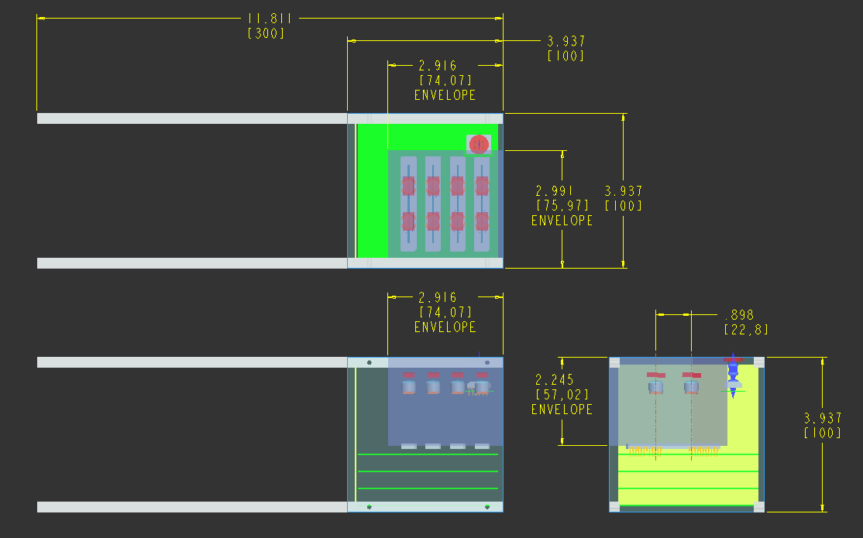
Reduced Resolution Design
4 Linear Arrays -2 Bands Per Array
Wide Field Version with 100-150 Meter Resolution. (17 August 2015 – GSFS Design Consultation)
Array
3.5” (89mm)
X
3.0”
(76mm)
Two bands
per CCD
(Baffles to separate bands not shown)

Slide 17
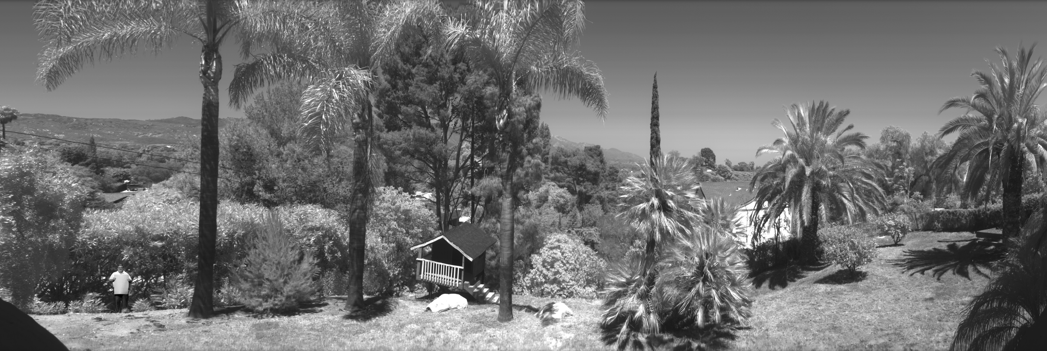
Array Testing – A Hand-Scanned Picture from my Backyard *
(4 Millisecond exposure time, F/22, 2000 x 6000 pixel crop)
* Legacy calibration target added for continuity

Slide 18
SeaHawk CubeSat Satellite Bus
Clyde Space Ltd
PI: Craig Clark (Craig.Clark@clyde-space.com)
Development Team:
Craig Clark (CEO/CTO)
Ross Marshall (Operations Manager)
John Charlick (Head of Projects)
Hessel Gorter (Project Manager)
Hazel Jeffrey (Systems Engineer)
Preliminary Design of SeaHawk CubeSat Architecture:
Current planning calls for a satellite bus similar to CubeSat UKube-1 (below) which is currently flying an 18 months mission, after being launched as a secondary payload on July 8, 2014 (15:58:28 UTC) on a Soyuz-2-1b launch vehicle with Fregat-M upper stage from the Baikonur Cosmodrome, Kazakhstan.
UKube-1 [UK universal bus experiment -1] was developed through a partnership linking Clyde Space (member of our science team) and University of Strathclyde with the UK Space Agency (UKSA), the UK Technology Strategy Board (UK-TSB) and UK Science and Technology Facilities Council (UK-STFC).

Slide 19
Overview of the SeaHawk Satellite Bus Components and Modular Architecture.

Slide 20
Concept of Operations
Launch:
  Launch date in 2017 or 2018.
Orbit:
  Baseline orbit sun-synchronous 525 km, 1200 LTAN, 9 day repeat
Imagery:
  Minimum Per Orbit
    1 – 6000 X 2000 pixel scene
    1 – 900 km x 300 km (150 km pixels)
    1 – 600 km x 200 km (100 km pixels) --- Most likely!!!!!
    1 – 540 km x 180 km (90 km pixels)
Mission
  duration minimum 12 months, aimed at 18-24 months

Slide 21
Platform design and Trade-Offs
Communications: High Speed Transmitter
Trade-off between transmission speed vs scene duration and resolution
Together with payload power consumption

Slide 22
Platform design and Trade-Offs
Communications: High Speed Transmitter
S-Band
Datarate max 2.0 Mbps, 0.8Mbps after block encoding and error correction
Requires around 17mm space
Power consumption of around 6W
High TRL
Lower cost
X-Band
Datarate 3 - 50 Mbps, excluding error correction and encoding
Requires around 27mm space
Power consumption of around 7-10W
Lower TRL
Higher cost

Slide 23


Slide 24
Current Design Plans: 8/17/2015
In comparison to the most successful ocean color satellite mission to date, NASA’s SeaWiFS, SeaHawk CubeSat with HawkEye Ocean Color Sensor will be:
130 times smaller (10 cm X10 cm X 30 cm),
45 times lighter (approximately 1 kg),
Ground resolution 7 - 11 times better (150 - 90 meters per pixel)
Signal/Noise Ratio > 50% that of SeaWiFs.
Development/construction cost of ~ 10% (HawkEye, $1.675M—SeaWifs, $14.1M)
The resulting imagery should be remarkable!

Slide 25
Gordon and Betty Moore Foundation Intellectual Property Terms
IP Ownership. The Gordon and Betty Moore Foundation (hereafter, The Foundation) and University of North Carolina Wilmington (hereafter, UNCW) agree that any intellectual property that UNCW, and any of its agents, employees, contractors, or subgrantees creates by the performance of this Grant Agreement (the "Grant Works"), shall be owned according to UNCW’s standard IP practices or policies.

Slide 26
IP and Knowledge Sharing Principles. Notwithstanding the foregoing, in order to maximize the impact of the Grant by enabling the production of multiple units of sensors and CubeSats with high quality ocean color sensors, UNC agrees to take all reasonable actions necessary to ensure the details of the sensor design (created by Alan Holmes, Cloudland Instruments) and the CubeSat bus design (created by Clyde Space) are made freely available in a manner that:
  is sufficient to enable another competent individual or organization to purchase commercial off-the-shelf components to build sensors and CubeSats with capabilities similar to the HawkEye Ocean Color Sensor and Seahawk CubeSat developed under this Grant; and
  enables such individual or organization to replicate the HawkEye Ocean Color Sensor and Seahawk CubeSat on a royalty-free, non-exclusive, worldwide, perpetual basis without restriction as to use.
These conditions are referred to collectively as the “IP and Knowledge Sharing Principles.”

Slide 27
HawkEye Ocean Color Sensor and Seahawk CubeSat
In furtherance of the foregoing, UNCW specially agrees to the following:
With respect to the HawkEye Ocean Color Sensor, UNCW agrees to ensure that Alan Holmes, Cloudland Instruments, provides a Complete Design Review (CDR) document for such sensor which UNCW can and does make freely downloadable from the principal investigator’s website for a period of three years (10/1/2015-9/30/2018) according to the IP and Knowledge Sharing Principles;
With respect to the Seahawk Cuesta, UNCW will ensure that Clyde Space provides a system level design document that outlines the standard commercial off-the-shelf components used and how they are interfaced electrically and mechanically, including the part numbers and user manuals for the commercial off-the-shelf component subsystems. UNCW will further ensure that Clyde Space provides full design information for any electronic, software or mechanical element that is developed specifically for the Seahawk CubeSat. UNCW will ensure the system level design document, part numbers, custom design information, and any other information or rights needed to satisfy the IP and Knowledge Sharing Principles will be made available via the principal investigator’s website for a period of three years (6/1/2016-5/30/2019).

