Slide 1


Updated GOCI atmospheric correction scheme
Jae-Hyun Ahn
Youngje Park
Wonkook Kim
Boram Lee
Korea Ocean Satellite Center (KOSC)
Korea Institute of Ocean Science & Technology (KIOST)
NASA GEO-CAPE community workshop 01/Sep./2015

Slide 2
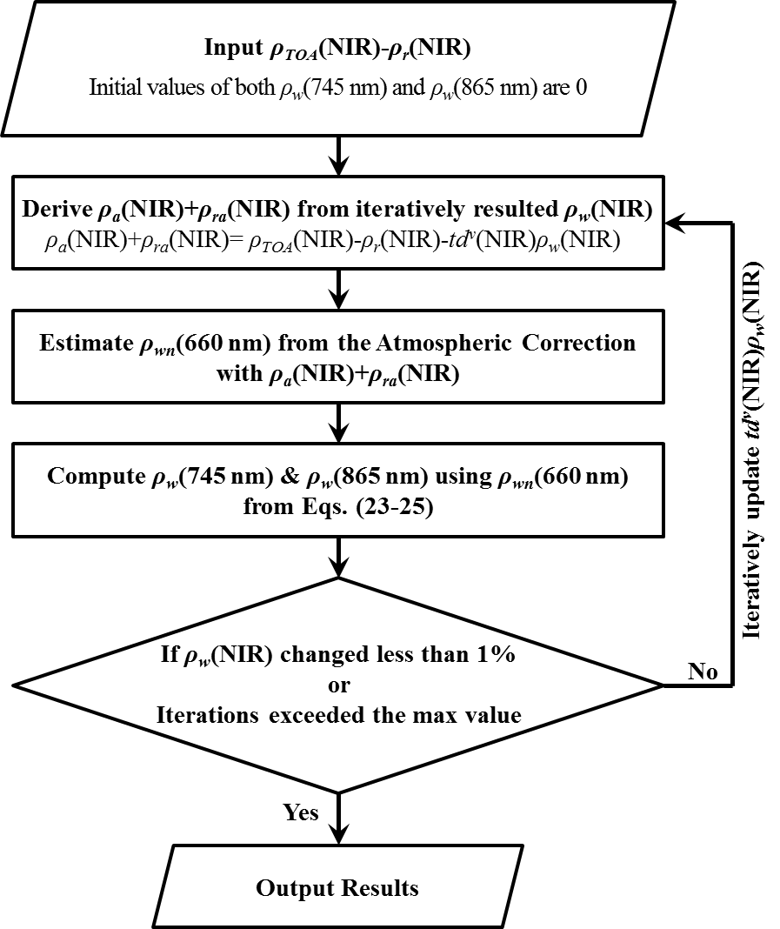
Atmospheric correction implemented in GDPS v.1.2
Differences compared to SeaWiFS & MODIS standard method
(Ahn et al., 2012)
Aerosol models
  Using 3-aerosol models: M99, M50, C50
NIR correction scheme for turbid water AC
  > Using relationship between ρ_{wn}(660 nm), ρ_{wn}(745 nm) and ρ_{wn}(865 nm)
Many missing parts…
  Near real-time meteorological data (wind field, O₃, air pressure)
  BRDF
  Vicarious calibration
  Sun-glint
  Flag
where

Slide 3
Atmospheric correction implemented in GDPS v.1.3
Updated features since GDPS v.1.2 (Ahn et al. 2015)
Vicarious calibration is applied
  Almost identical to Franz et al. (2007)
BRDF correction is implemented
  Air-sea interface
    Upward: Fresnel Eq. with assumption “wind speed = 0”
    Downward: Wang (2006) model with adjusted coefficients for spectral responses of GOCI bands
  f/Q correction
    LUT is generated by Morel (based on biogenic optical properties)
Support 32 bit flags for quality analysis
Turbid water NIR correction model is updated
    j_{n}={-0.00148, 0.4865, -22.93, 615.8,
    -6760.0 , 30210.0}
    k_{n}={0.5012, 4.0878}
v.1.2
v.1.3

Slide 4
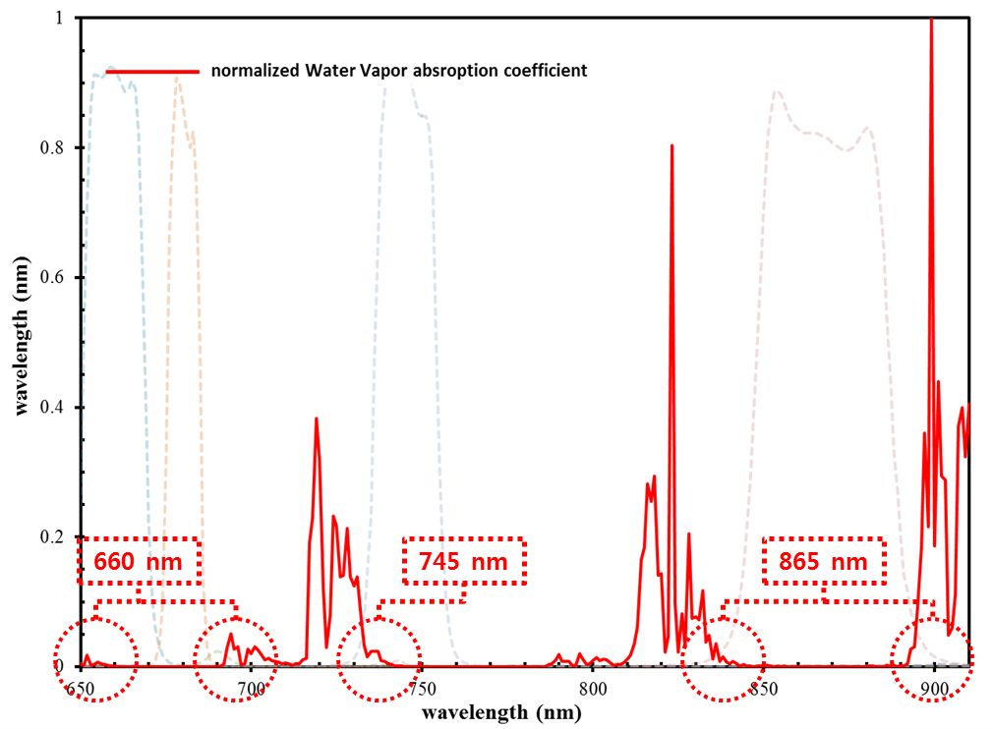
Atmospheric correction implemented in GDPS v.1.3.1
Updated features since GDPS v.1.3
Sun-glint correction is implemented
  Wind direction dependent Cox & Munk model
White-cap correction is modified
  GDPS v.1.3
    Gordon & Wang (1994), Frouin et al. (1996)
    Give weight factor, 0.4
  GDPS v.1.3.1
    Stramska & Petelski (2003), Frouin et al. (1996)
    Weight factor is removed
Water vapor correction is implemented
Turbid water NIR correction model is adjusted
Rayleigh correction is enhanced
  LUT resolution is increased
Vicarious calibration gains are adjusted after AC updates

Slide 5
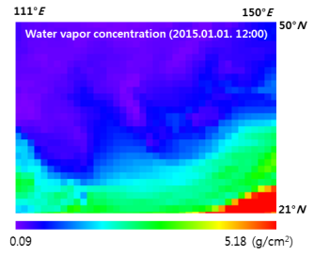
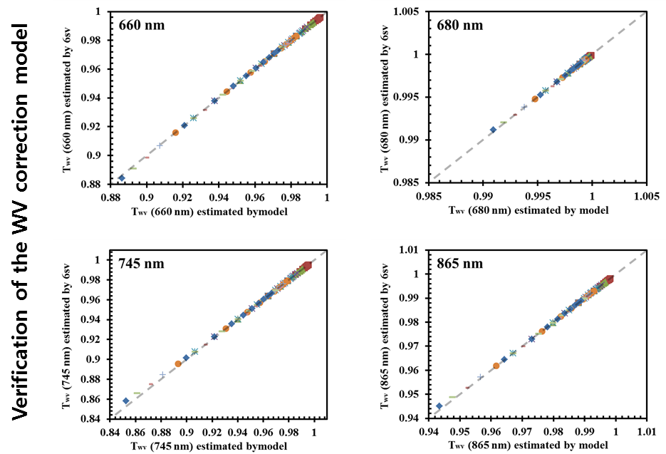
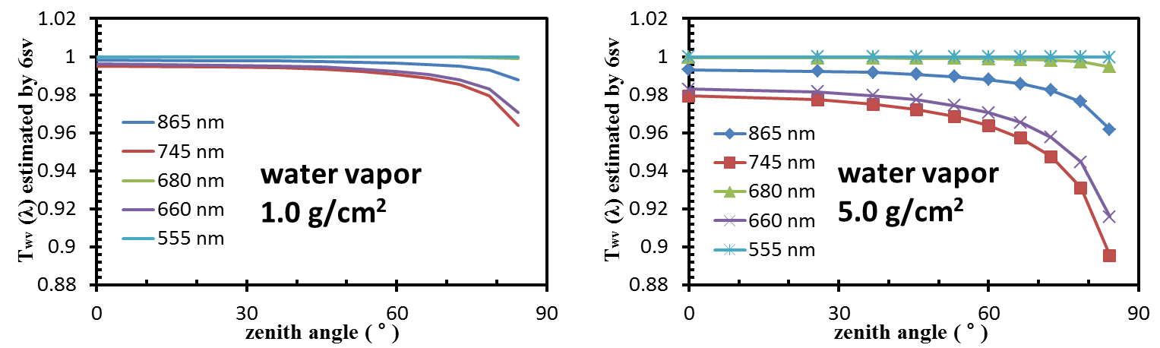
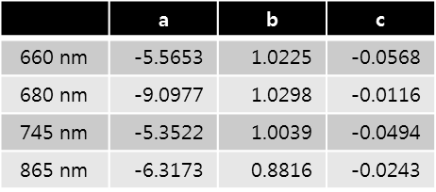
Atmospheric correction updates to GDPS v.1.3.1 (since v.1.3)
Water vapor correction
Revised Vermeulen’s simulation with extended water vapor concentration and total air mass
  Total airmass: 2~10
  Water vapor: 1~9 (g/cm²)
Statistical data were derived by radiative transfer model (6sv)
  Atmospheric composition and vertical profile were derived from US62 model
2nd order polynomial relationship between ln(airmass*water_vapor) and ln{-ln(T_{wv})}

Slide 6
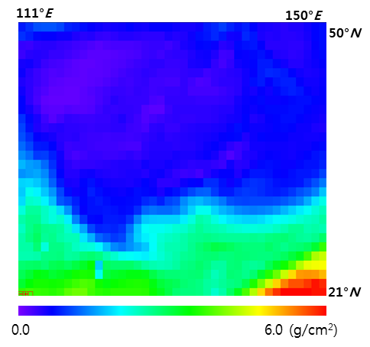
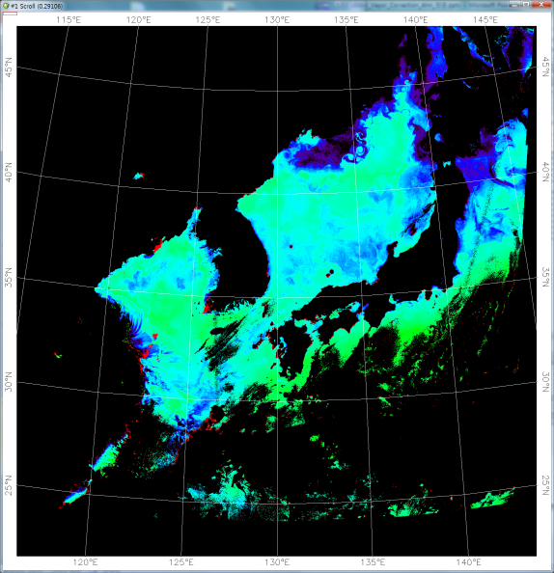
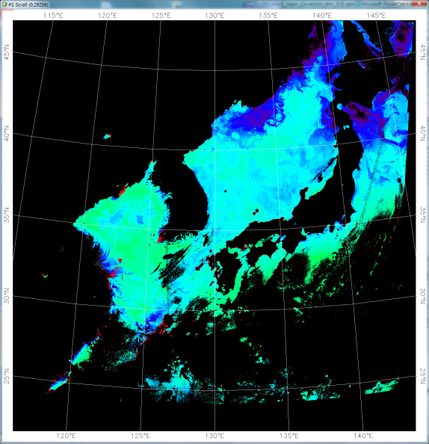
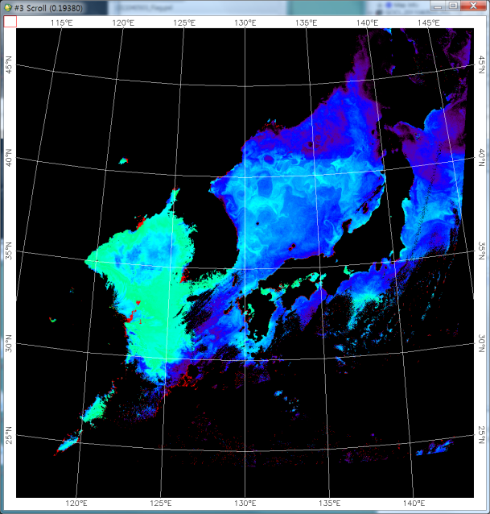
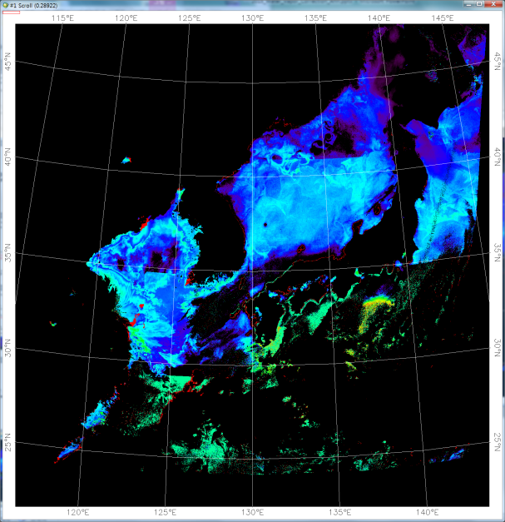
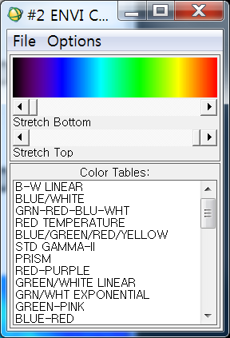
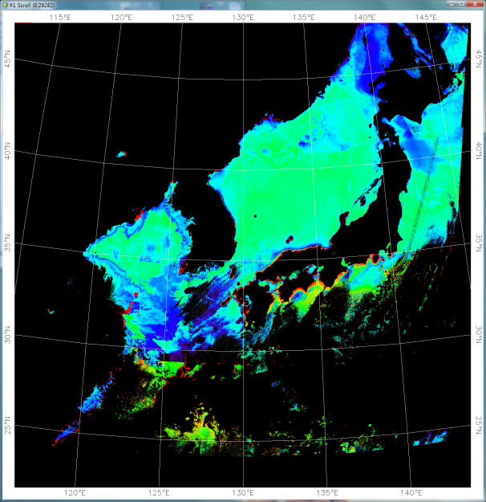

Atmospheric correction updates to GDPS v.1.3.1 (since v.1.3)
Water vapor correction (impact on R_{rs})
Rrs_{Diff} (%) = { (Rrs_{corr} - Rrs_{uncorr}) / Rrs_{corr} }*100
Rrs_{Diff} (443 nm) (2011/04/05 03:16)
Rrs_{Diff} (490 nm) (2011/04/05 03:16)
100 %
Water vapor concentration (g/cm²)
(2011/04/05 03:16)
0 %
Rrs_{Diff} (555 nm) (2011/04/05 03:16)
Rrs_{Diff} (660 nm) (2011/04/05 03:16)
Rrs_{Diff} (680 nm) (2011/04/05 03:16)
-100 %

Slide 7
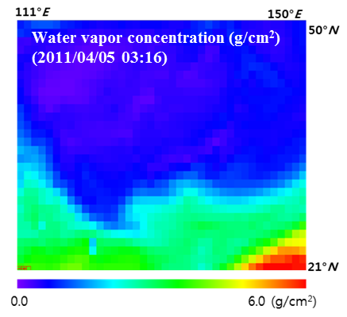
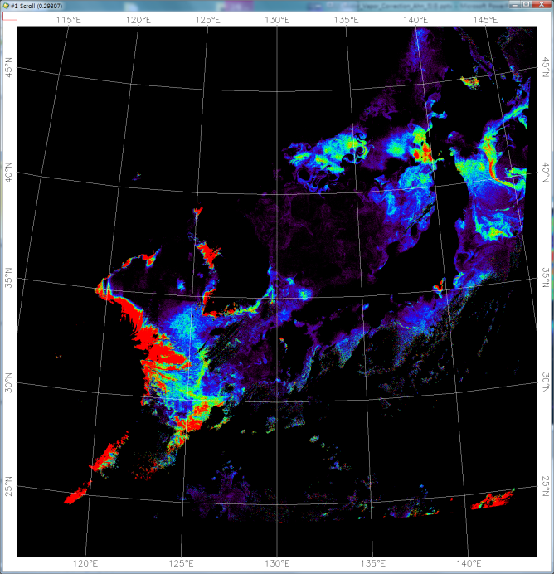
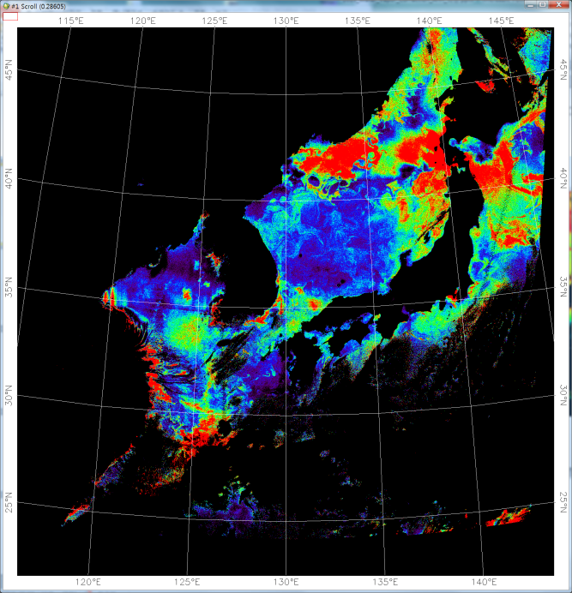
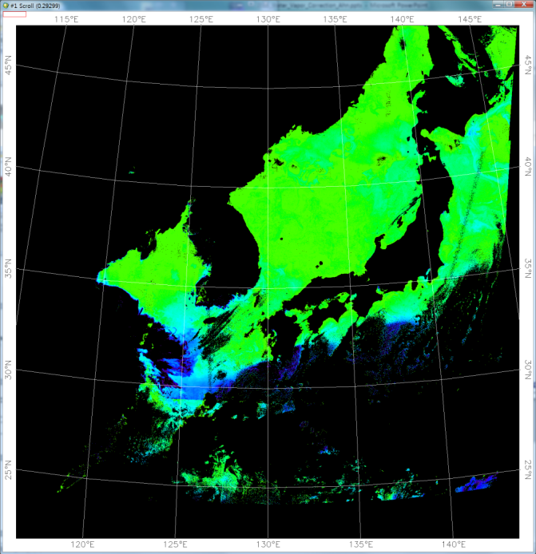
Atmospheric correction updates to GDPS v.1.3.1 (since v.1.3)
Water vapor correction (impact on Chl-a)
Chl-a_{Diff} (%) = { (Chl-a_{corr} - Chl-a_{uncorr}) / Chl-a_{corr} }*100
Chl-a_{uncorr} (2011/04/05 03:16)
Chl-a_{corr} (2011/04/05 03:16)
Chl-a_{Diff} (2011/04/05 03:16)
0.0
5.0
0.0
5.0
-100 %
0 %
100 %
200 %
unit: mg/m³
unit: mg/m³

Slide 8
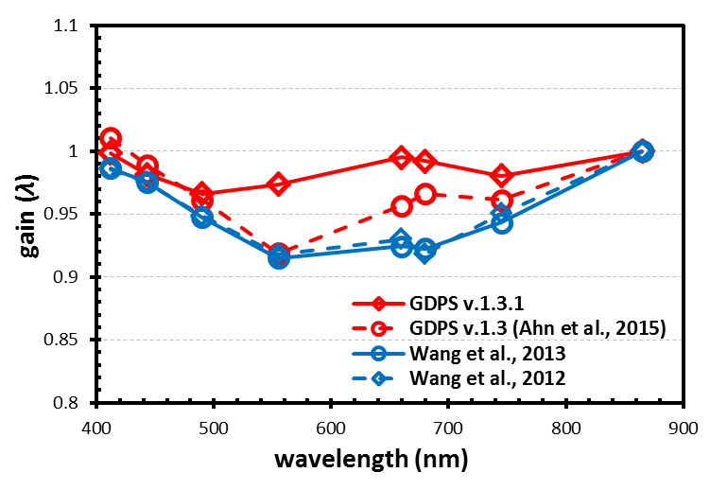
Atmospheric correction updates to GDPS v.1.3.1 (since v.1.3)
Vicarious calibration gain
 | 412 | 443 | 490 | 555 | 660 | 680 | 745 | 865
GDPS v.1.3.1 | 0.99849 | 0.98135 | 0.96605 | 0.97344 | 0.99491 | 0.99208 | 0.98031 | 1.0
GDPS v.1.3 (Ahn et al., 2015) | 1.0105 | 0.9891 | 0.9611 | 0.9186 | 0.9567 | 0.9659 | 0.9613 | 1.0
modified MSL-12 (Wang et al., 2013) | 0.9862 | 0.9753 | 0.9473 | 0.9149 | 0.9245 | 0.9223 | 0.943 | 1.0
modified MSL-12 (Wang et al., 2012) | 0.9857 | 0.9749 | 0.9484 | 0.9179 | 0.9299 | 0.9183 | 0.9502 | 1.0

Slide 9
Atmospheric correction updates to GDPS v.1.3.1 (since v.1.3)
Turbid water NIR correction model
Estimation of water reflectance in NIR bands
    j_{n}={-1.009046E-03, 5.158649E-01, -2.181632E+01, 5.509967E+02, -5.899103E+03, 2.726468E+04}
    k_{n}={0.468, 3.8204}

Slide 10
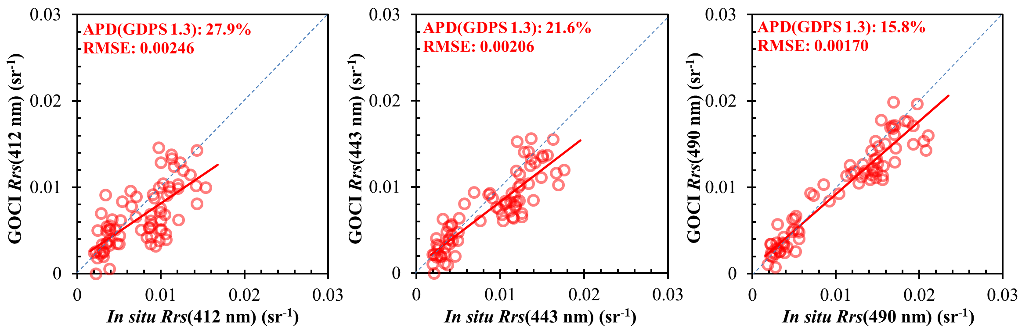
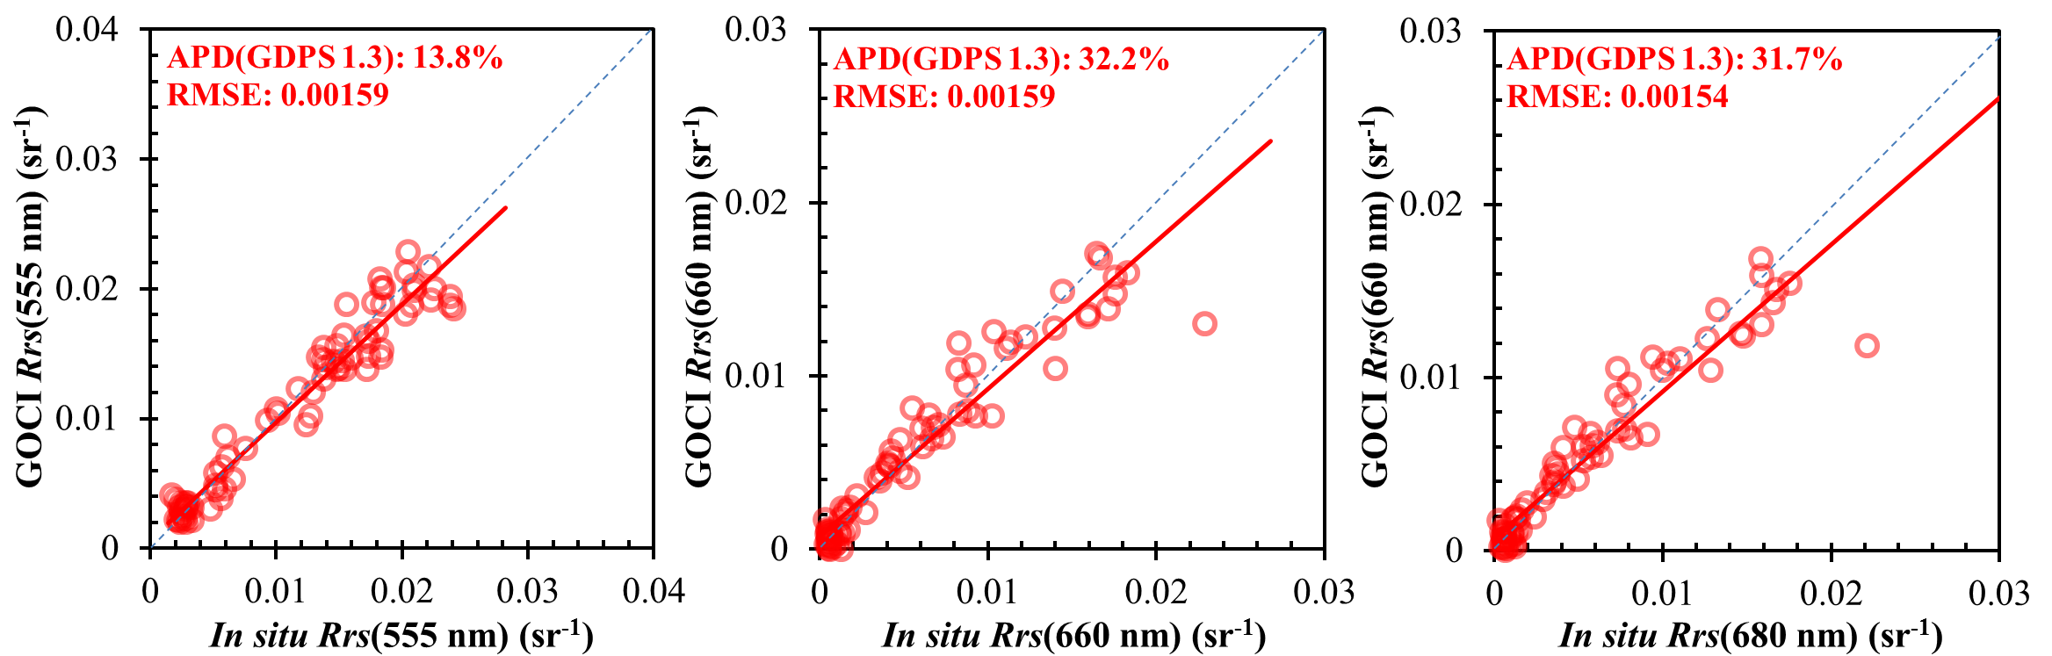
Atmospheric correction updates to GDPS v.1.3.1
Validation (in situ measurements)

Slide 11
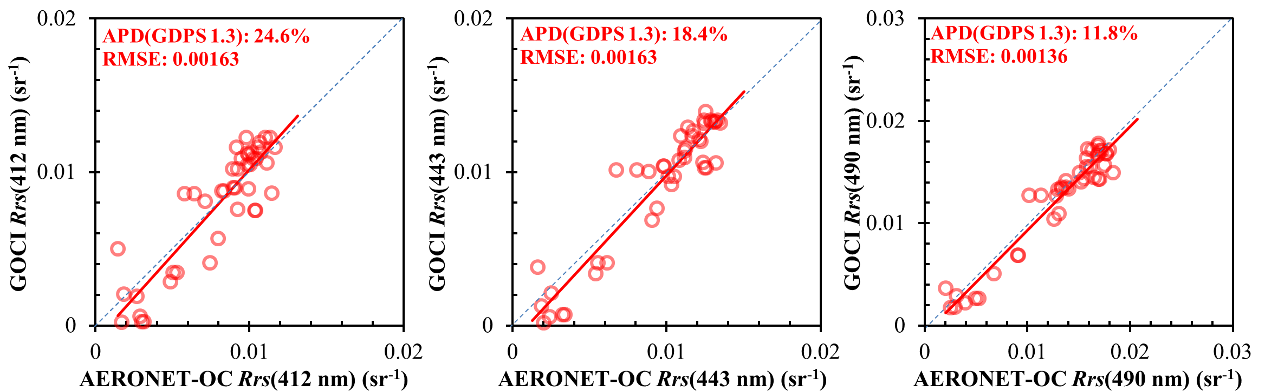
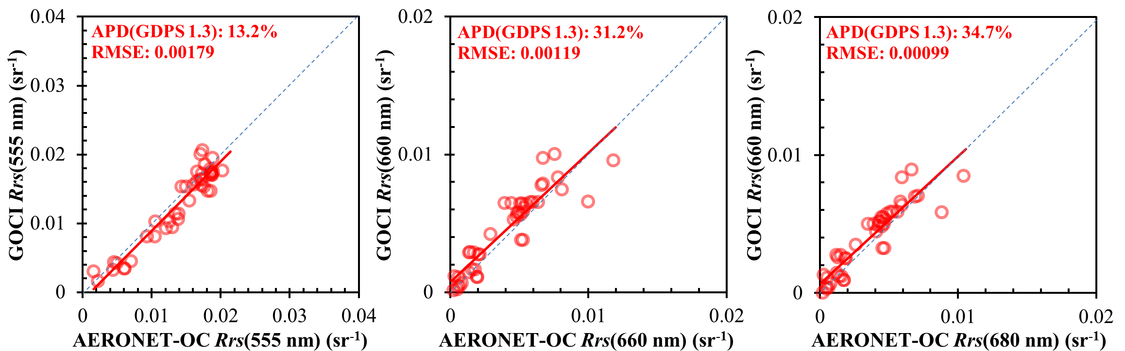
Atmospheric correction updates to GDPS v.1.3.1
Validation (AERONET_OC)

Slide 12
Summary & discussion
Summary of GOCI AC
  GOCI AC has developed based on NASA standard AC method
  Major differences
    Turbid water NIR correction
    Using 3-Aerosol models
    Estimation of Rayleigh reflectance
Discussion
  Remaining issues
    High SZA issue: R_{rs}(blue) is consistently lower for high SZA than normal angles
    BRDF correction based on case-1 waters
    745 nm calibration issue
  AC update plans
    Vicarious gain update
    BRDF correction model update
    Aerosol model update
    Build NIR correction model based on in situ data
    A new aerosol model selection scheme using the multiple-scattering epsilon
      The scheme is much simpler & faster
      The scheme produces less error with assumption that aerosol model is correct

Slide 13
Thank you
Jae-Hyun Ahn brtnt@kiost.ac
Youngje Park youngjepark@kiost.ac.kr

Slide 14
Appendix

Slide 15
A new ρ_{a}(λ)+ρ_{ra}(λ) estimation using multiple-scattering ε

Slide 16
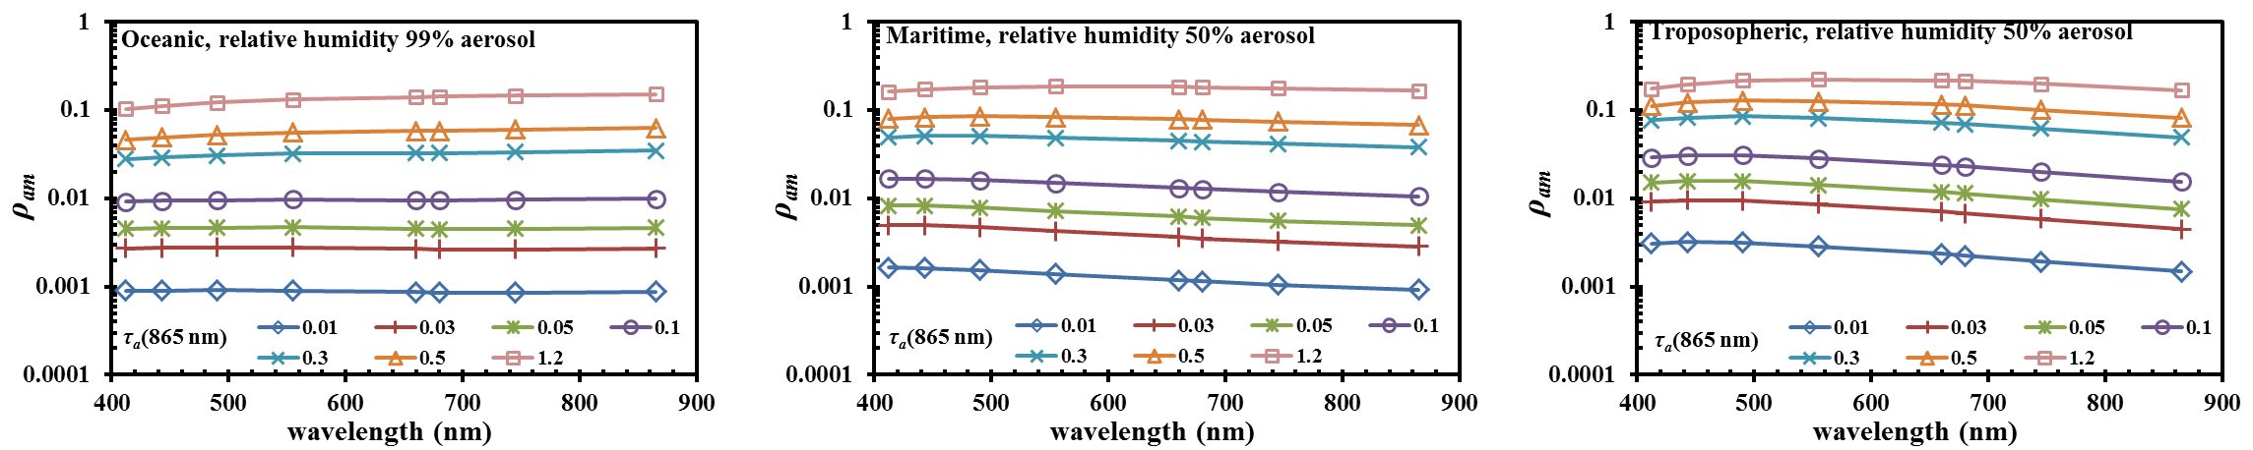
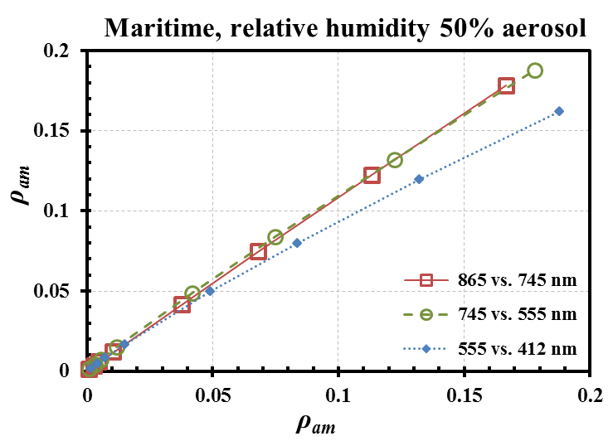
A new ρ_{a}(λ)+ρ_{ra}(λ) estimation using multiple-scattering ε
A new approach
Relationship example at θ_{s}: 60° , θ_{v}: 40°, ϕ: 40°

Slide 17
A new ρ_{a}(λ)+ρ_{ra}(λ) estimation using multiple-scattering ε
A new approach
Get mixture ratio of 2-selected aerosol models
LUT (θ_{s} , θ_{v} , ϕ_{s-v})
Solve quadric equation
w_{M1} : weighting factor for aerosol model 1 (unknown value to solve)
a_{n}^{M1}& a_{n}^{M2} : relationship coefficients (stored in LUT),
function of geometric angles and aerosol models

Slide 18
A new ρ_{a}(λ)+ρ_{ra}(λ) estimation using multiple-scattering ε
A new approach
    Get relationship between ρ_{a}(λ₁)+ρ_{ra}(λ₁) and ρ_{a}(λ₂)+ρ_{ra}(λ₂) from the LUT

Slide 19
A new ρ_{a}(λ)+ρ_{ra}(λ) estimation using multiple-scattering ε
A new approach
    Optical thickness & transmittance estimation

Slide 20
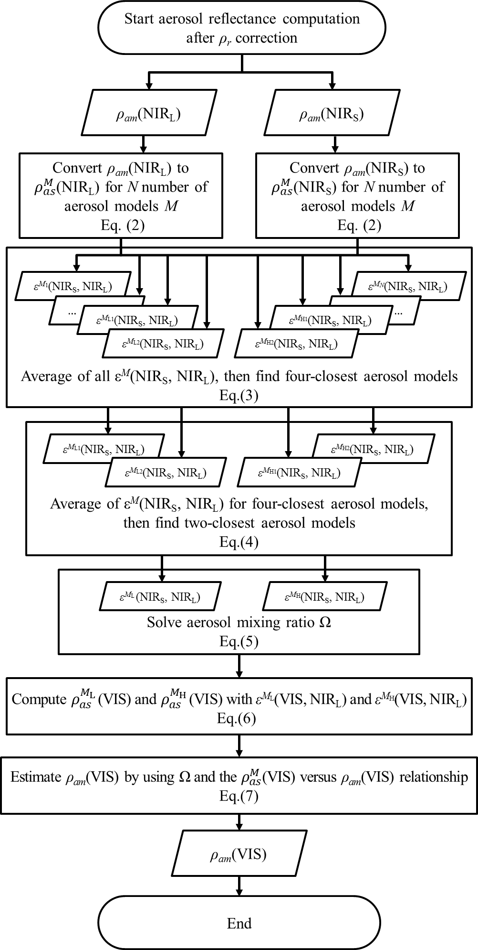
A new ρ_{a}(λ)+ρ_{ra}(λ) estimation using multiple-scattering ε
Comparison of each Algorithm (NASA standard)
(1)
(2)
(3)
(3-1)
(4)
(4-1)
(5)
(6)
(7)

Slide 21
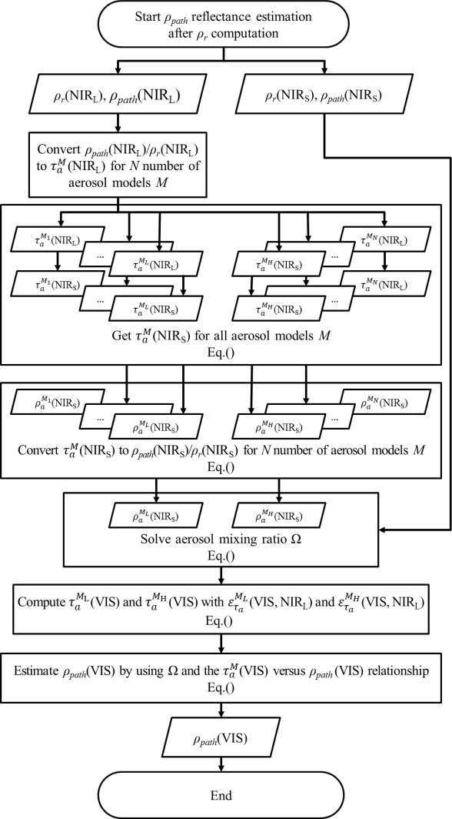
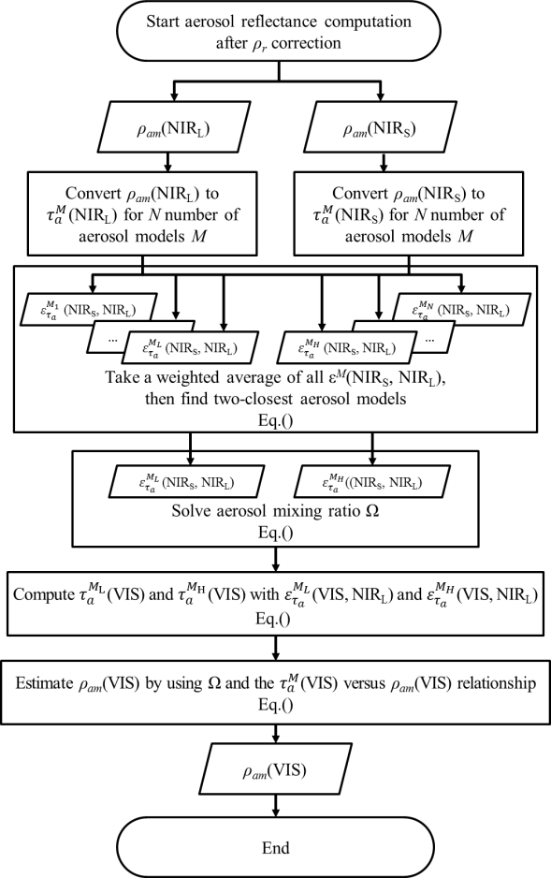
A new ρ_{a}(λ)+ρ_{ra}(λ) estimation using multiple-scattering ε
Comparison of each Algorithm (MERIS, OCTS)
OCTS
MERIS

Slide 22
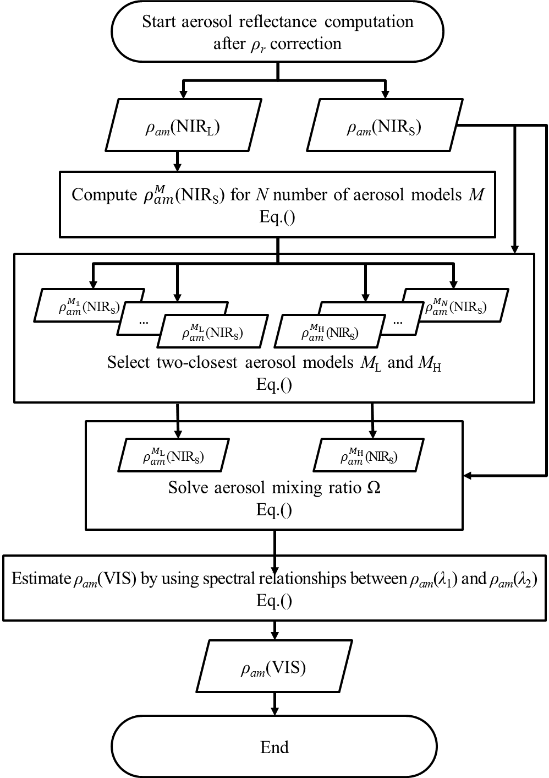
A new ρ_{a}(λ)+ρ_{ra}(λ) estimation using multiple-scattering ε
A new approach
(1)
(2)
(3)
(4)

