Slide 1
GOCI Level-2 Processing Improvements and Cloud Motion Analysis Wayne D. Robinson, Ocean Biology Processing Group, NASA/GSFC, SAIC GEO-CAPE Workshop, 31 Aug – 3 Sep, 2015

Slide 2
GOCI Level-2 processing at GSFC
- Metadata interpretation – The interpretation of the GOCI L1B metadata was incorrect and was repaired.
Slot times were used to generate solar geometry – this stabilized many ocean color parameters through the day.
- Residual gradients were seen and characterized in the GOCI ‘Slots’. KIOST is developing a correction for this gradient (Kim et. al., 2015).
- Cloud motion considerations for GOCI were examined (second half of talk).

Slide 3
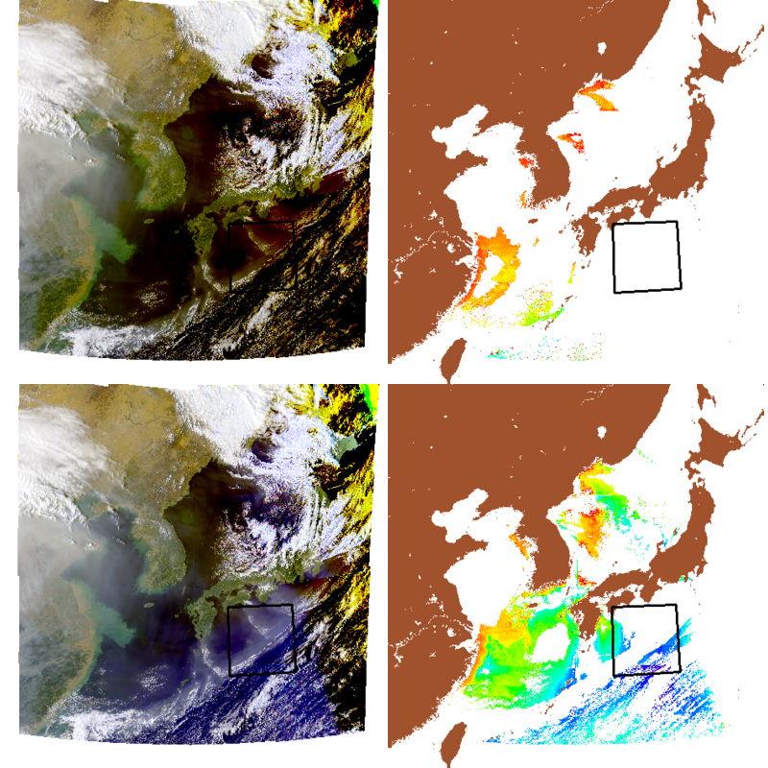
GOCI True Color (TC) and chlor_a, Slot Time Implementation
Initial times
Slot times
12 Oct 2013 at 1600 local time. This case has extreme solar zenith angles - > 70 degrees over ¾ of this scene. The red and yellow features in the South-East portion of the true color are reduced and more chlorophyll is retrieved when slot-based times are used

Slide 4
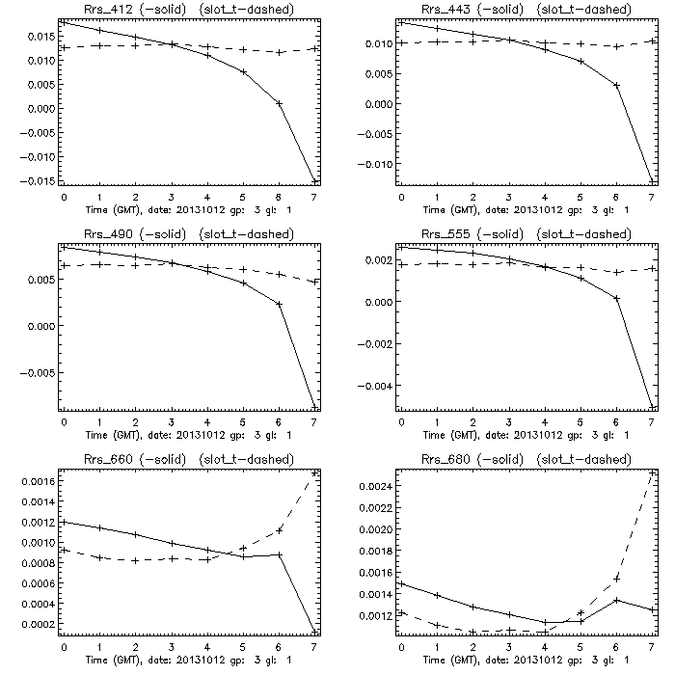
GOCI Slot time use: Rrs through the day
12 Oct 2013 – Rrs as a function of time of day for all visible bands. Solid line is with single time used, dashed is the slot time implementation. The use of the slot time assignment has helped stabilize the Rrs through the day.

Slide 5
GOCI Cloud Motion
Full description of GOCI instrument is in Faure et. al, 2008
Getting all 8 GOCI bands for one portion of the scene (the slot) takes about 52 seconds (490 nm to 660 nm bands).
Filter wheel use – each band is taken sequentially.
CCD detector array is exposed for each band for a portion of the scene (the slot).
S/N requires that each band needs to be exposed for 6 – 8 seconds.
With a nominal pixel size of 500 m, a cloud will move by 1 pixel between the 1st and last band if it had a speed of about 20 knots.
- The effect was noted by Fukushima et. al. 2015.
- This effect should be taken into consideration – essentially a cloud mask per-band.
- This effect could be used to determine cloud motion → wind vectors at cloud height.

Slide 6
GOCI Band relative acquisition times
Band | Wavelength (nm) | Time offset from 1st band (sec) | Approximate color | Comments
1 | 412 | 36 | Violet | TC-Blue
2 | 443 | 20 | Blue
3 | 490 | 52 | Blue | Largest shift
4 | 555 | 6 | Green | TC-Green
5 | 660 | 0 | Red | TC-Red
6 | 680 | 28 | Red
7 | 745 | 14 | NIR
8 | 865 | 44 | NIR
- data for this example is from 6 Jul 2015 03Z. Dwell times for bands will change through the mission to compensate for detector degradation.
- Order of band acquisition could change.

Slide 7
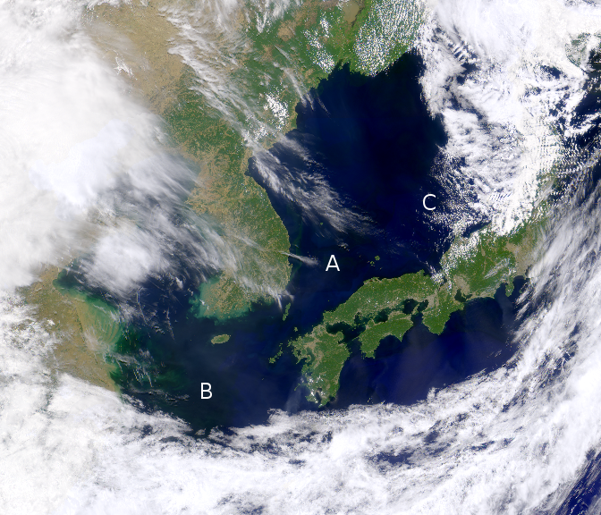
GOCI cloud shift – in true color
Figure 1. True color image of a portion of the GOCI scene on 4 June, 2015, 0300 GMT. 3 regions with cloud are indicated with the letters A, B, and C.

Slide 8
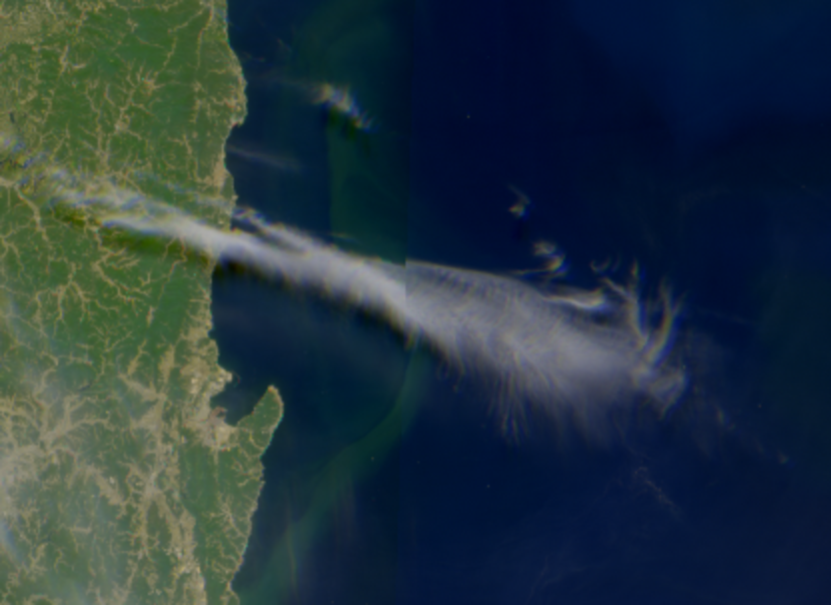
GOCI cloud shift – in true color
Figure 2. Close-up view of the region A in figure 1 showing a cirrus cloud coming off the Korean peninsula. The 36 second delay of the blue channel from the red is seen as a slight ghosting.

Slide 9
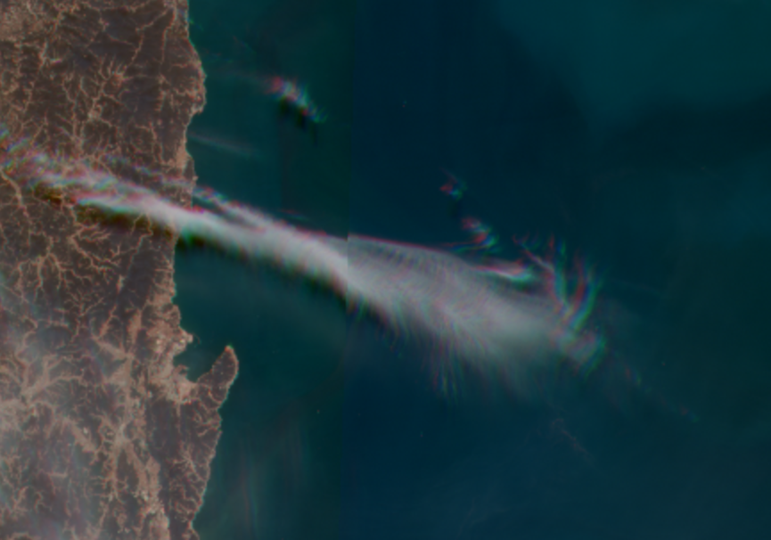
GOCI cloud shift – in true color
Figure 3. Same region as Fig 2, but the true color image in this case was made using GOCI bands with a 52 second time separation to more clearly show the effects of cloud motion.

Slide 10
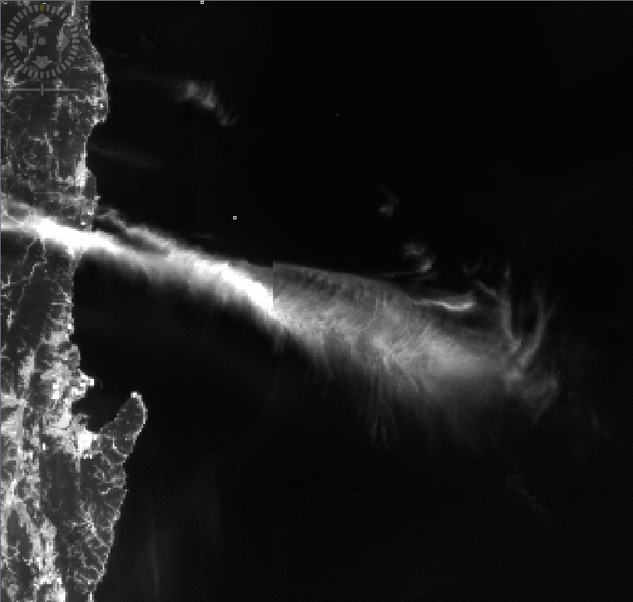
Cloud motion animation from one GOCI scene
Figure 4. Animation of all the GOCI bands in time-sequence for a cloud coming off the Korean coast at 0300 GMT, 4 Jun, 2015. This also shows the stability of the land.

Slide 11
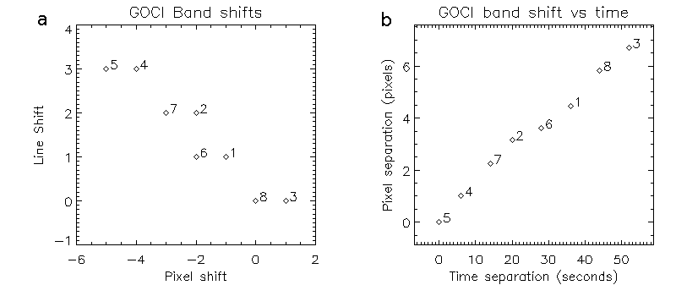
GOCI Cloud motion for point A in Fig 1
Figure 5. a) Analysis of the amount of image line and pixel shift needed to align each band so that the clouds are co-registered for a 30x30 region around point A in Fig 1, b) Shift amount from the band with the least time offset, band 5, as a function of the time delay for each GOCI band.

Slide 12
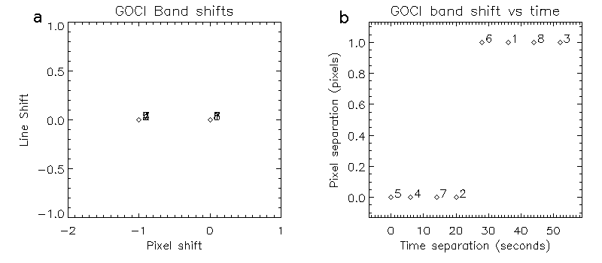
GOCI Cloud motion for point C in Fig 1
Figure 6. Same as for figure 4, but for point C in Figure 1. Although a shift of only 1 pixel occurred, the shift was monotonic in time. Very little much jitter between bands.

Slide 13
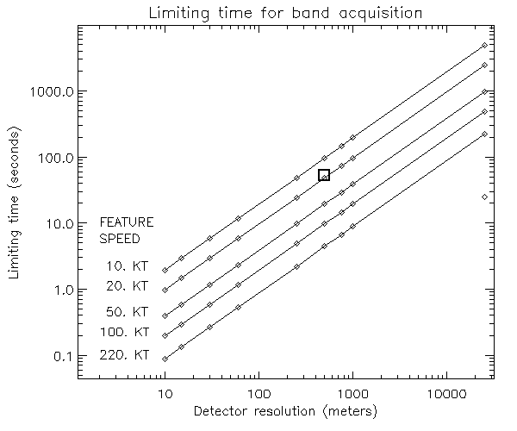
Is a feature’s motion large?
Plot of the longest amount of time to acquire all bands for a point without the feature moving by more than the detector size.
For GOCI (square in the plot), with a 500 m detector size, and about 50 seconds to take all the bands, features need to move at less than 20 kt to move less than the pixel size.
To get all bands for a cloud moving at the fastest observed upper-air speed (220 kt), GOCI would need to take all bands in under 4.5 seconds.

Slide 14
Summary
Metadata use in level-2 processing was improved.
Slot times were introduced into processing with greatly improved diurnal stability of ocean color parameters.
An uncorrected gradient in slots was found.
Cloud motion needs to be considered for GOCI and possibly other ocean color instruments.
Time to acquire all bands for a location needs to be short enough to avoid cloud motion between bands.
Determining cloud properties would be made more difficult.
If time is large, inter-band correlations and cloud mask shifting can be used to properly mask other bands.
Cloud wind speeds can be determined from band shifts if the time is large enough.
GOCI appears to have little jitter (detector motion) between bands.

Slide 15
References
F. Faure, P. Coste, and G. Kang, “The GOCI instrument on COMS mission—The first geostationary ocean color imager,” in Proc. ICSO, Oct. 2008, pp. 1–6.
H. Fukushima, K. Ogata, M. Toratani, J. Ahn, W. Kim, Y. Park, “Cloud-affected pixel identification on COMS/GOCI Ocean Color Imagery in Consideration to Fast-moving Cloud Fragments” in Proc. Int. Sym. Remote Sens. (ISRS), April, 2015.
W. Kim, J. Ahn, ad Y. Park, Correction of Stray-light Driven Interslot Radiometric Discrepancy (ISRD) Present in Radiometric Products of Geostationary Ocean Color Imager (GOCI), 2015, IEEE Trans Geo and Rem. Sens., 53, pp5458-5472.

Slide 16
Backup slides

Slide 17
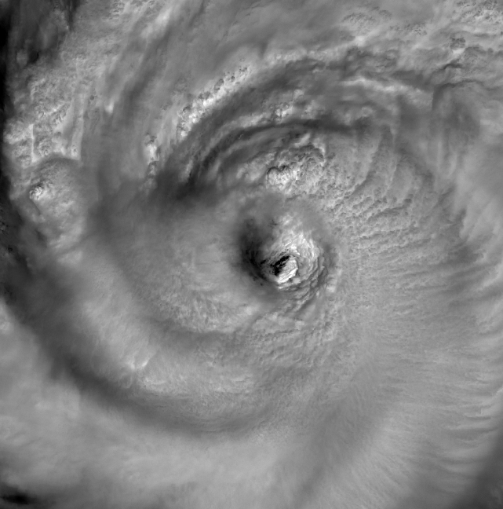
Cloud motion animation from one GOCI scene
This animation shows all the GOCI bands in time-sequence for Super Typhoon SANBA, South of the Korean peninsula at 16 Sep, 2012 at 0200 GMT.

Slide 18
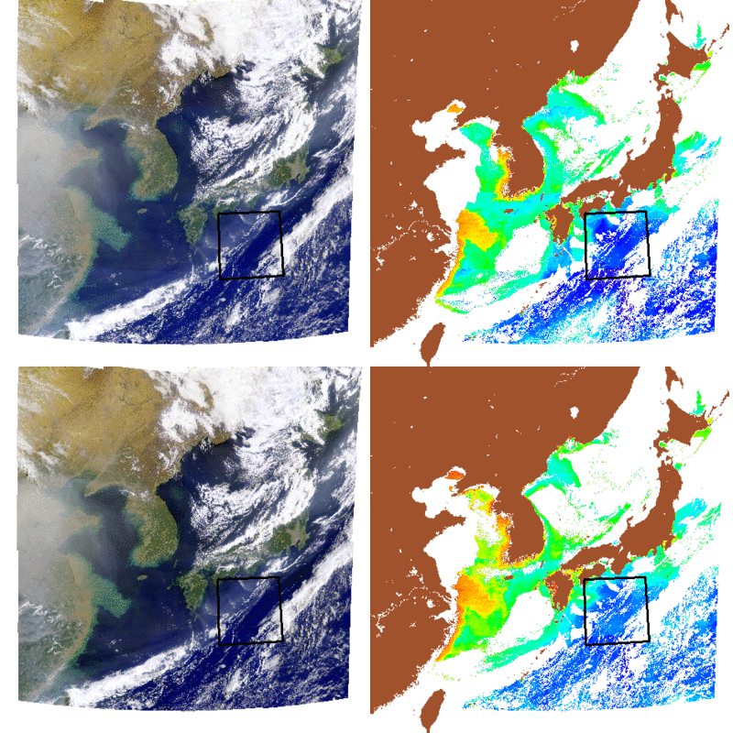
GOCI True Color and chlor_a, Constant time and slot times used
Initial times
Slot times
Animation of GOCI True Color and Chlorophyll-a for 12 Oct 2013 from 0900 to 1600 local time. The region in the black box was used to get the statistics seen in other plots

Slide 19
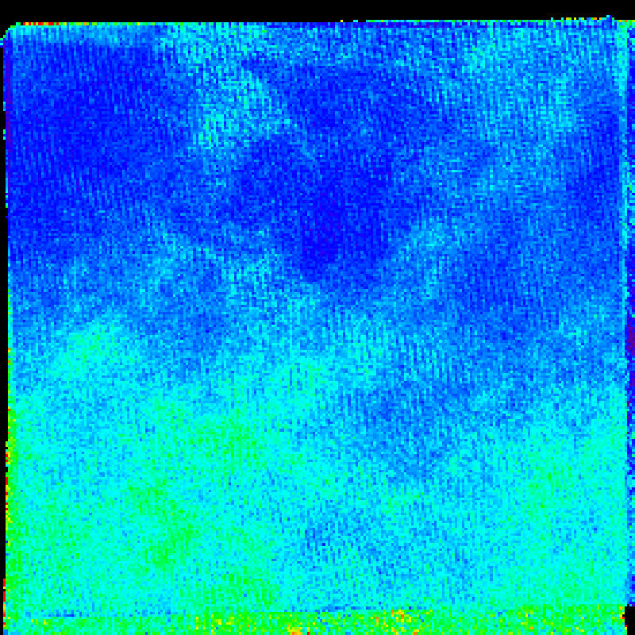
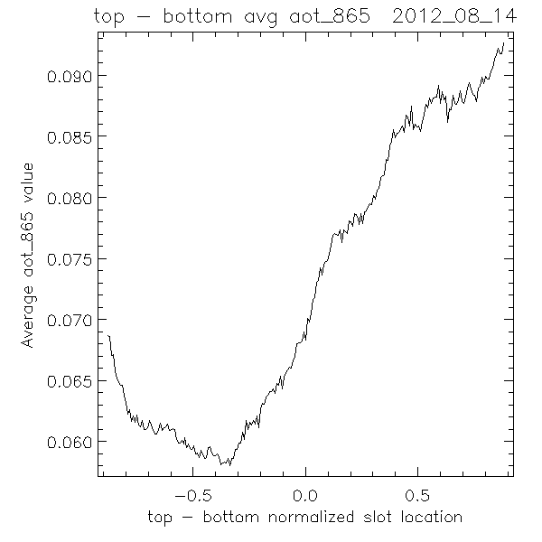
GOCI Slot-based Residual Gradient
- Image of aot_865 slot-binned for 14 Aug 2012 (left). Higher AOT is at the bottom of the slot (green colors). Average of all rows of aot_865 (right).
An uncorrected gradient present in each GOCI slot was found using the slot-binned data (slot seam discontinuities also pointed to this).
A correction is already being developed by Kim et. al., 2015

Slide 20
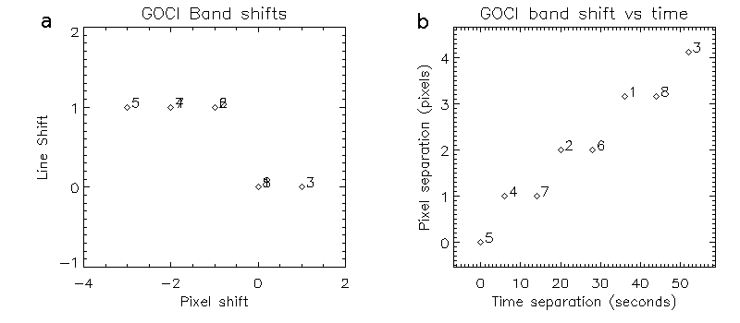
GOCI Cloud motion for point B in Fig 1
Cloud shift in pixel, line for point B in Figure 1 and distance moved vs. time delay for each GOCI band

Slide 21
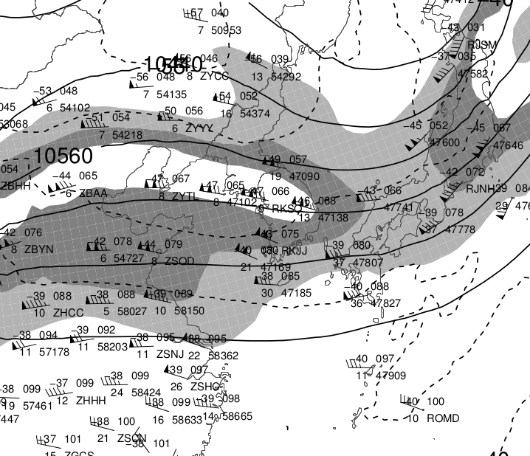
Upper air wind plot near the time of the GOCI scene in Fig 1
Upper air analysis at 250 mb, 4 June, 2015 at 1500 GMT. The cirrus clouds at point A in Figure 1 are very near the RKSQ upper air station near the center of the plot. The analysis was acquired from site http://weather.uwyo.edu/upperair/uamap.html

