Slide 1
Aerosol science opportunity from the GEO-CAPE ocean color measurements
GC aerosol working group members:
Mian Chin, Hongbin Yu, Omar Torres, Alexei Lyapustin, Lorraine Remer, Jun Wang

Slide 2
Aerosol science from OC measurements
The OC measurement and instrument requirements can provide an excellent opportunity for aerosol science focusing on the coastal area
The most fundamental requirement is quality retrieval of AOD and sufficient spatial (coastal water and inland), temporal (daytime resolved), and spectral coverage (UV to 2.1 μm)
Science focus: daytime variations of:
  Megacity air quality
  Emission and atmospheric process in the coastal environment
  Intercontinental transport fluxes
  Aerosol typing and absorption for BL and biomass burning aerosols

Slide 3
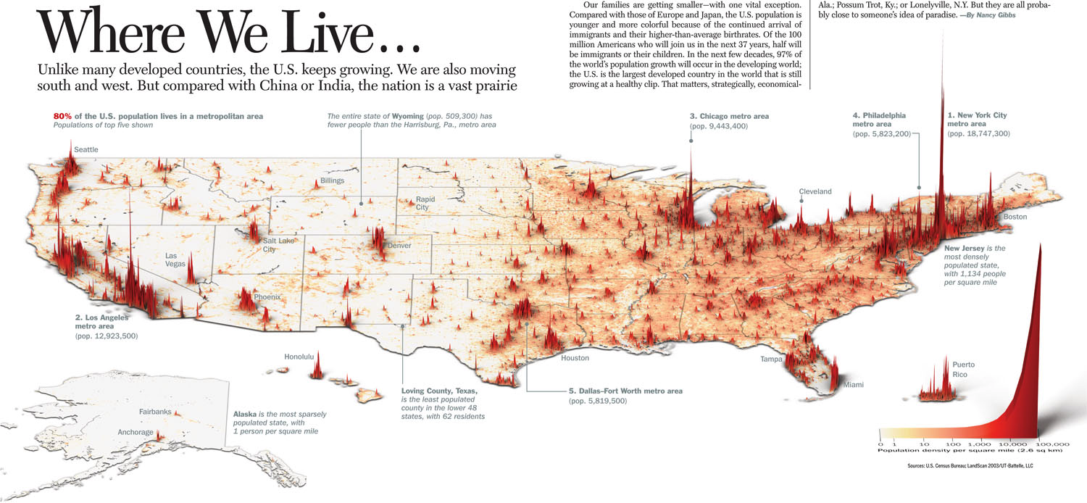
Megacity in the U.S.
Megacity air pollution is one of the greatest public interests
For the 10 largest (most populated) cities in the US: 6 within 1° and 7 within 2° from the coastal lines, including New York (NY), Los Angeles (CA), Chicago (IL), Houston (TX), San Diego (CA),and San Jose (CA)
For the 50 (100) largest cities, 17 (32) within 1° and 24 (47) within 2°

Slide 4
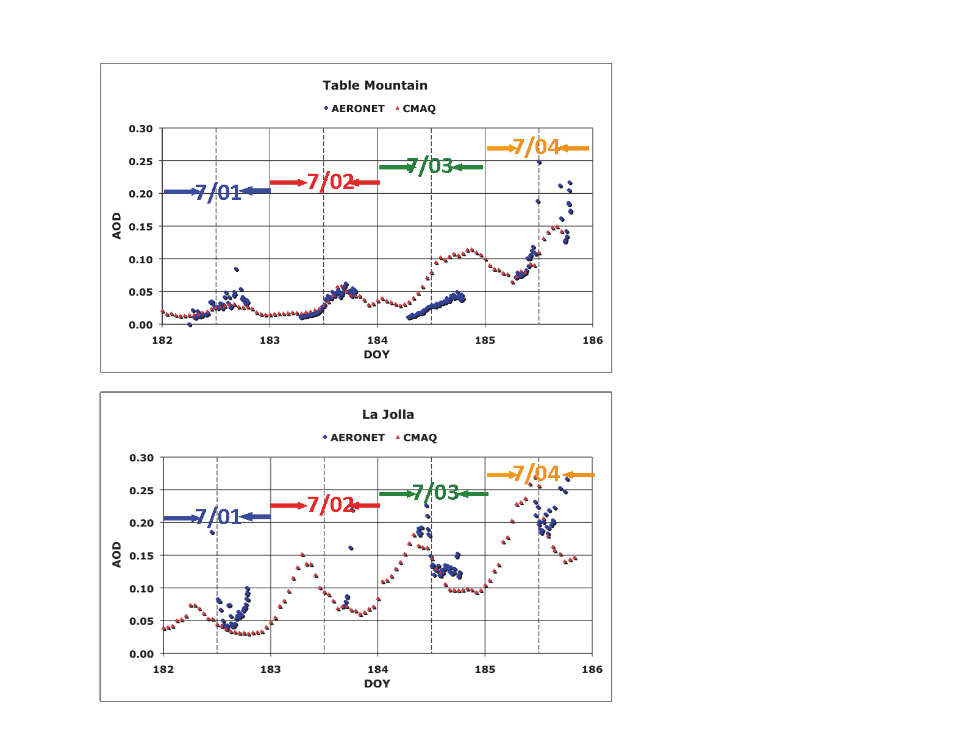
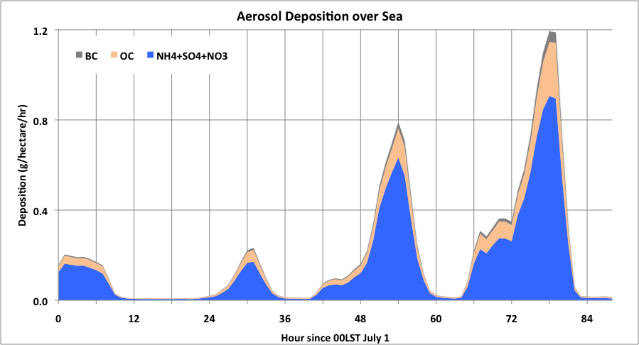
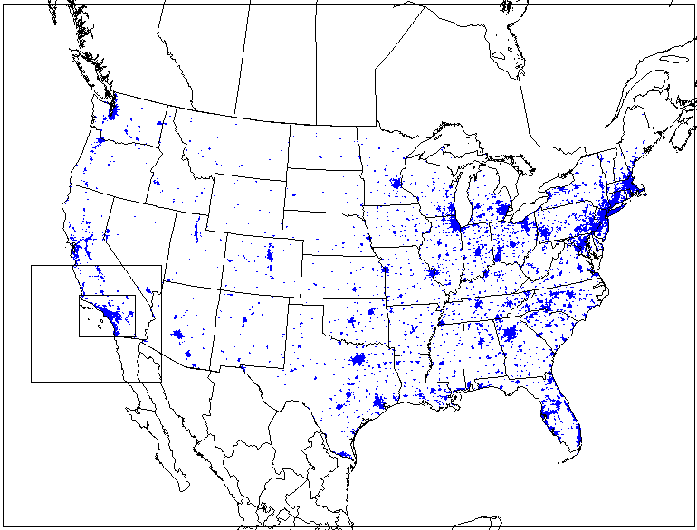
Coastal measurements of aerosols are most valuable for understanding the atmospheric processes
Coastal meso-scale circulations are often complex, such as land-sea breeze circulations interacting with mountain flows in the western North America, affecting air quality in coastal regions (e.g., recirculation of air pollutants)
Aerosols can influence the coastal meteorology through feedback processes
Deposition of urban pollution could have important implications for coastal ocean ecosystems and biogeochemistry
Variation of AOD from AERONET measurement and CMAQ simulation
CMAQ calculated aerosol deposition
BC
Table Mountain
La Jola
OC
SO4+NO3
+NH4
Aerosol accumulation from July 2 to July 4 2007 results mainly from recirculation (occurrence of return flow of sea breeze on July 3 & 4, due to weaker background wind).
(From Hongbin Yu)

Slide 5
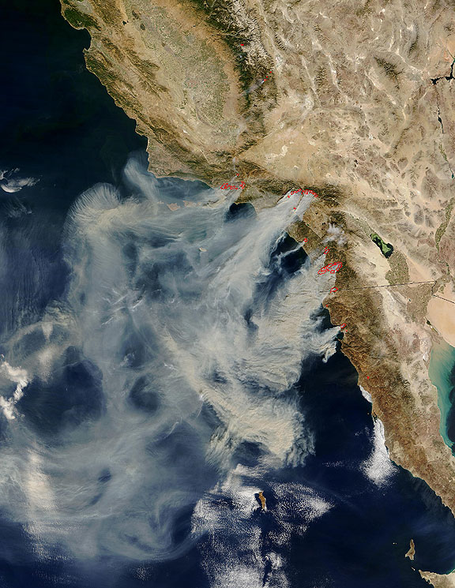
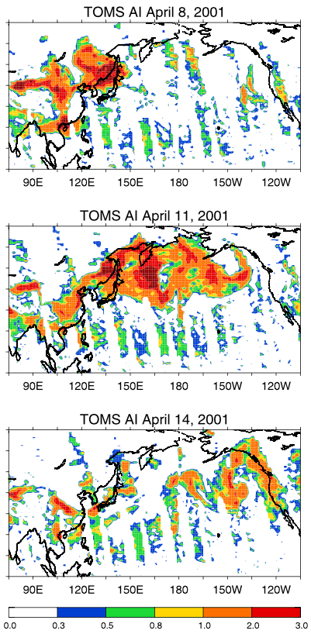
Quantify the transport fluxes and emissions near the coastal area
High temporal and accurate aerosol measurements can be most valuable to derive the intercontinental transport fluxes and the coastal land emissions
Transatlantic transport of African dust to Texas
Wildfire in Southern California and transport to the ocean
Transpacific transport of dust to North America
TOMS AI, 2001-04-14

Slide 6
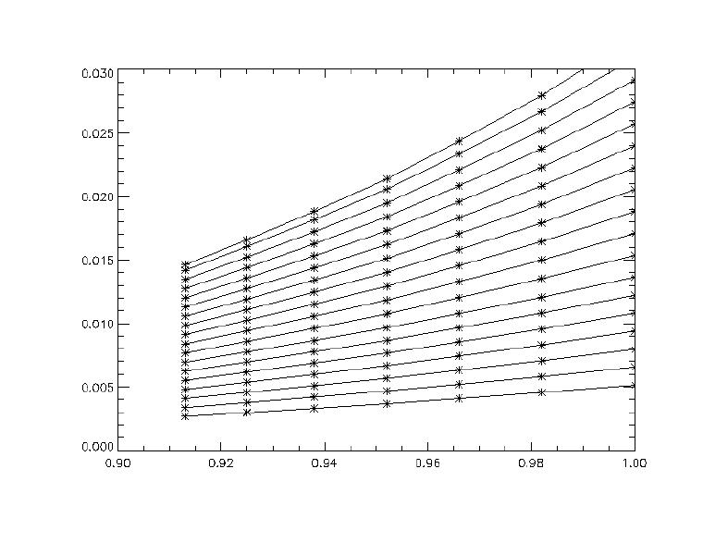
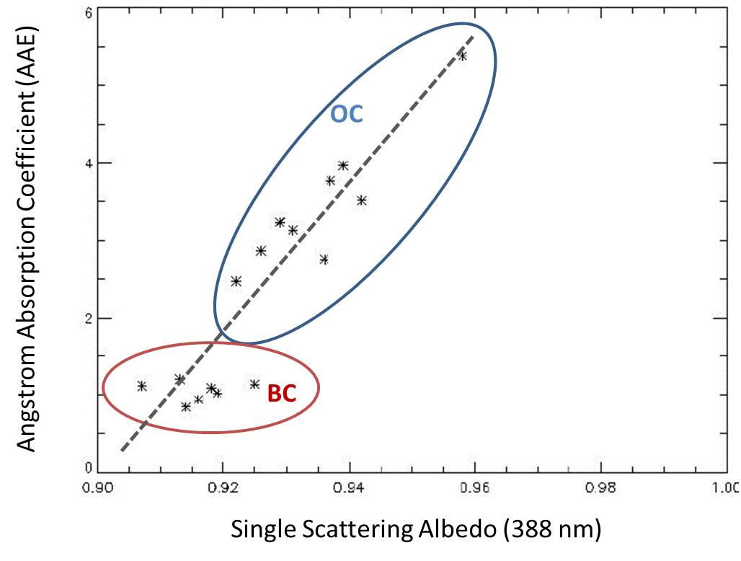
Aerosol type (separating BC and OC) in BL or biomass burning plumes with UV measurements
Observations in the 340-400 nm range can be used to measure spectral aerosol absorption
Accurate retrieval of AOD at blue channel is necessary to obtain the AOD in UV (two UV channels). Then the absorption angstrom exponent (AAE) can be obtained to separate BC and OC due to their differences in AAE
Aerosol from OC instrument can potentially resolve the aerosol absorption and BC/OC amount with daytime variations
Sample Retrieval
Using AERONET 380 nm AOD (>0.2) at GSFC as proxy of accurate satellite AOD and co-located OMI reflectance (354 and 388 nm)
Single Scattering Albedo Reflectance Function
OC has AAE above 2, increasing with higher SSA
Net Aerosol Reflectance (388nm)
1.0
AOD
0.2
BC has AAE about 1, independent of SSA
Single Scattering Albedo (388 nm)
(From Omar Torres)

Slide 7
Aerosol retrieval availability as a function of instrument resolution
High spatial resolution of OC measurements allows more aerosol retrieval opportunity due to better cloud screening to increase the spatial and time coverage (e.g., daytime variation of AOD) and data quality
OC-like
OC-like
TEMPO-like
TEMPO-like
1-km
2-km
4-km
8-km
Daytime variation of cloud-free fraction over a 1 deg box in Virginia on August 12, 2010 as a function of pixel resolution. (Figure from Remer et al., AMT 2012.)
l lines
Statistics of aerosol retrieval availability (cloud free fraction) at different locations and season as a function of instrument pixel resolution. Figure from Lorraine Remer (based on Remer et al., AMT 2012).
l lines

Slide 8
Measurement requirements
Spatial resolution: The OC threshold (375 m) and baseline (250 m) requirements are sufficient for significant reduction of cloud contamination and increase of retrieval availability compared to TEMPO (4.5 km x 2 km pixel resolution)
Spectral range: the baseline (hyperspectral 340-1100 nm; 3 SWIR bands 1245, 1640, 2130 nm) will assure the quality of AOD retrievals over land and water. Without the 2130 nm band in the threshold requirements, the land AOD retrieval would be more difficult with reduced accuracy
Spectral resolution: Hyperspectral resolution is not required for aerosol retrievals, although it may add more information
Inland coverage: ~100-km from coastal line is required to cover most of the megacities (i.e., population > 1 million). 200-km is desirable to cover nearly half of the 100 largest cities in the US
Temporal resolution: At least 3 times/day (morning, noon, afternoon) to characterize the daytime aerosol variations

