Slide 1
Tropospheric Emissions: Monitoring of Pollution (TEMPO)
Kelly Chance & the TEMPO Team
May 21, 2013

Slide 2
TEMPO Science Team
Team Member | Institution | Role | Responsibility
K. Chance | SAO | PI | Overall science development; Level 1b, H₂CO, C₂H₂O₂
X. Liu | SAO | Deputy PI | Science development, data processing; O₃ profile, tropospheric O₃
J. Carr | Carr Astronautics | Co-I | INR Modeling and algorithm
M. Chin | GDFC | Co-I | UV aerosol product, AI
R. Cohen | U.C. Berkeley | Co-I | NO₂ validation, atmospheric chemistry modeling, process studies
D. Edwards | NCAR | Co-I | VOC science, synergy with carbon monoxide measurements
J. Fishman | St. Louis U. | Co-I | AQ impact on agriculture and the biosphere
D. Flittner | LaRC | Project Scientist | Overall project development; STM; instrument cal./char.
J. Herman | UMBC | Co-I | Validation (PANDORA measurements)
D. Jacob | Harvard | Co-I | Science requirements, atmospheric modeling, process studies
S. Janz | GSFC | Co-I | Instrument calibration and characterization
J. Joiner | GSFC | Co-I | Cloud, total O₃, TOA shortwave flux research product
N. Krotkov | GSFC | Co-I | NO₂, SO₂, UVB
M. Newchurch | U. Alabama Huntsville | Co-I | Validation (O₃ sondes, O₃ lidar)
R.B. Pierce | NOAA/NESDIS | Co-I | AQ modeling, data assimilation
R. Spurr | RT Solutions, Inc. | Co-I | Radiative transfer modeling for algorithm development
R. Suleiman | SAO | Co-I, Data Mgr. | Managing science data processing, BrO, H₂O, and L3 products
J. Szykman | EPA | Co-I | AIRNow AQI development, validation (PANDORA measurements)
O. Torres | GSFC | Co-I | UV aerosol product, AI
J. Wang | U. Nebraska | Co-I | Synergy w/GOES-R ABI, aerosol research products
J. Leitch | Ball Aerospace | Collaborator | Aircraft validation, instrument calibration and characterization
R. Martin | Dalhousie U. | Collaborator | Atmospheric modeling, air mass factors, AQI development
D. Neil | LaRC | Collaborator | GEO-CAPE mission design team member
J. Kim | Yonsei U. | Collaborators, Science Advisory Panel | Korean GEMS, CEOS constellation of GEO pollution monitoring
J. McConnell | York U. Canada |  | CSA PHEOS, CEOS constellation of GEO pollution monitoring
B. Veihelmann | ESA |  | ESA Sentinel-4, CEOS constellation of GEO pollution monitoring

Slide 3
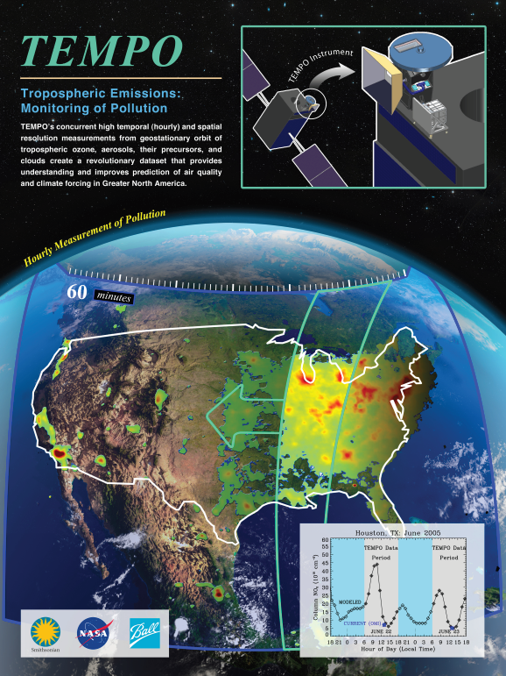
Hourly atmospheric pollution from geostationary Earth orbit
PI: Kelly Chance, Smithsonian Astrophysical Observatory
Deputy PI: Xiong Liu, Smithsonian Astrophysical Observatory
Instrument Development: Ball Aerospace
Project Manager: Wendy Pennington, NASA LaRC
Project Scientist: Dave Flittner, LaRC; Deputy PS: Jay Al-Saadi, LaRC
Other Institutions: NASA GSFC (led by Scott Janz), NOAA, EPA, NCAR, Harvard, UC Berkeley, St. Louis U, U Alabama Huntsville, U Nebraska
International collaboration: Korea, ESA, Canada
Selected Nov. 2012 through NASA’s first Earth Venture Instrument solicitation
Currently in Phase A, System Requirements Review 9/30/2013
Instrument delivery September 2017
NASA will arrange hosting on commercial geostationary communications satellite with expected ~2019 launch
Provides hourly daylight observations to capture rapidly varying emissions & chemistry important for air quality
  UV/visible grating spectrometer to measure key elements in tropospheric ozone and aerosol pollution
  Exploits extensive measurement heritage from LEO missions
  Distinguishes boundary layer from free tropospheric & stratospheric ozone
Aligned with Earth Science Decadal Survey recommendations
  Makes most of the GEO-CAPE atmosphere measurements
  Responds to the phased implementation recommendation of GEO-CAPE mission design team
  The North American geostationary component of an international constellation for air quality monitoring

Slide 4
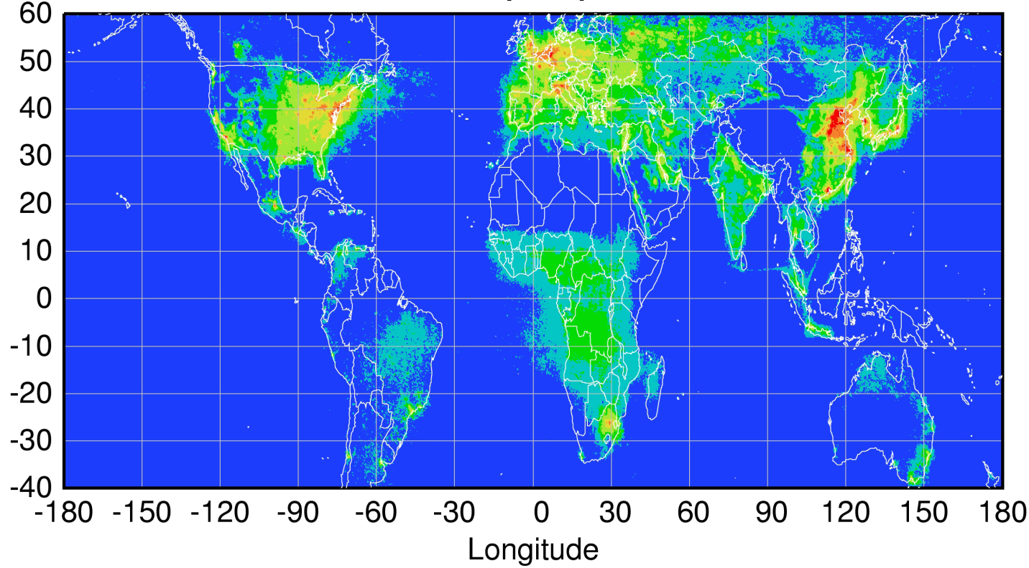
Geostationary constellation coverage
Sentinel-4
TEMPO
GEMS
Courtesy Jhoon Kim,
Andreas Richter
Policy-relevant science and environmental services enabled by common observations
Improved emissions, at common confidence levels, over industrialized Northern Hemisphere
Improved air quality forecasts and assimilation systems
Improved assessment, e.g., observations to support the United Nations Convention on Long Range Transboundary Air Pollution

Slide 5
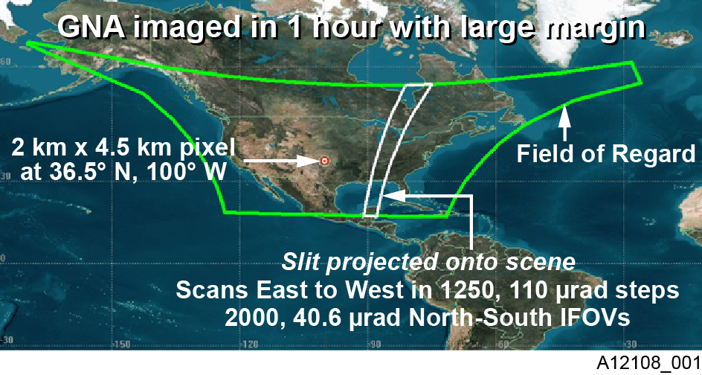
TEMPO footprint, ground sample distance and field of regard
Each 2 km × 4.5 km pixel is a 2K element spectrum from 290-690 nm
GEO platform selected by NASA for viewing Greater North America

Slide 6
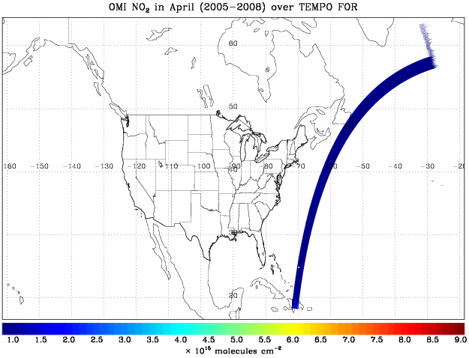
TEMPO hourly NO₂ sweep

Slide 7
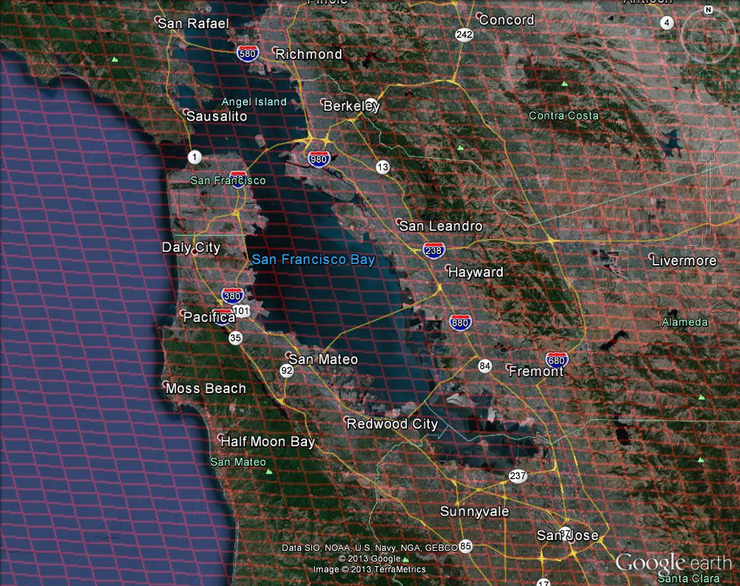
Bay area coverage

Slide 8
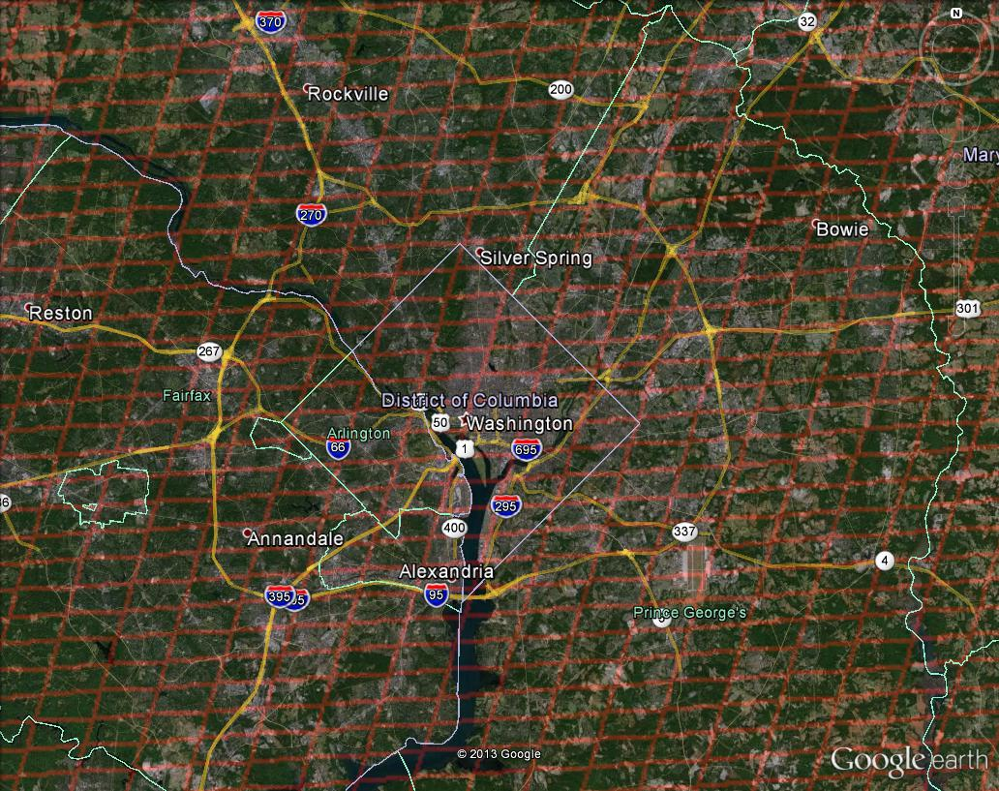
Washington, DC coverage

Slide 9
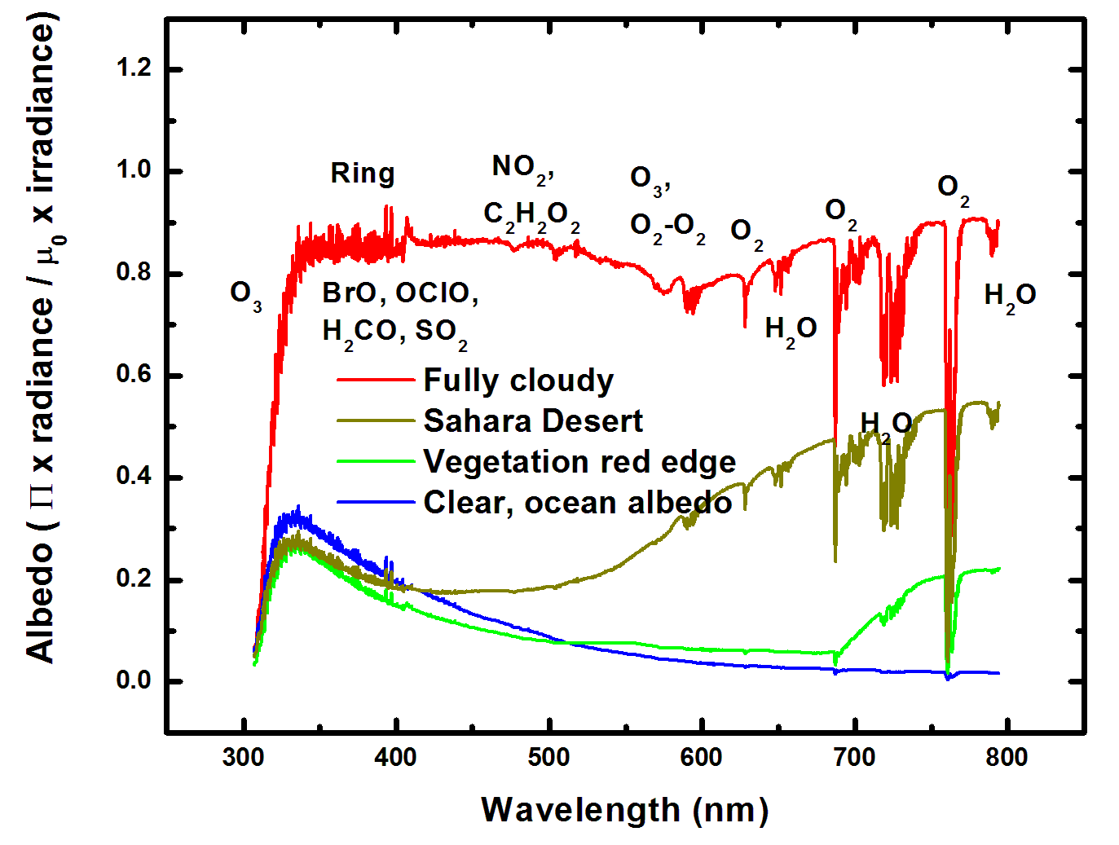
Typical TEMPO-range spectra (from ESA GOME-1)

Slide 10
TEMPO science questions
What are the temporal and spatial variations of emissions of gases and aerosols important for air quality and climate?
How do physical, chemical, and dynamical processes determine tropospheric composition and air quality over scales ranging from urban to continental, diurnally to seasonally?
How does air pollution drive climate forcing and how does climate change affect air quality on a continental scale?
How can observations from space improve air quality forecasts and assessments for societal benefit?
How does intercontinental transport affect air quality?
How do episodic events, such as wild fires, dust outbreaks, and volcanic eruptions, affect atmospheric composition and air quality?

Slide 11
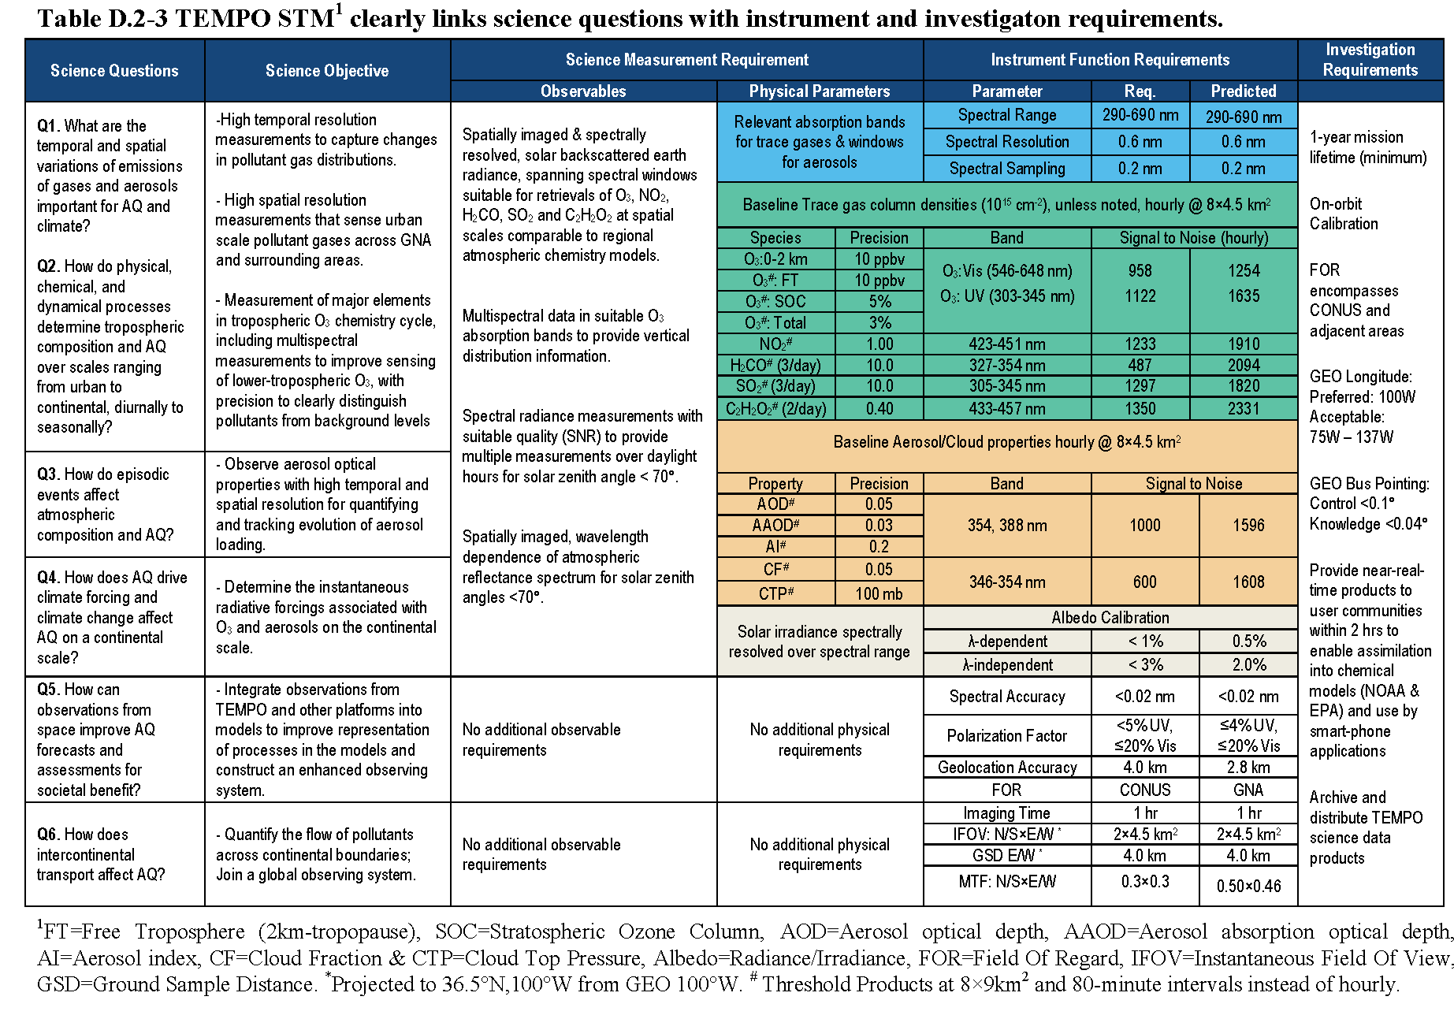
TEMPO Science Traceability Matrix

Slide 12
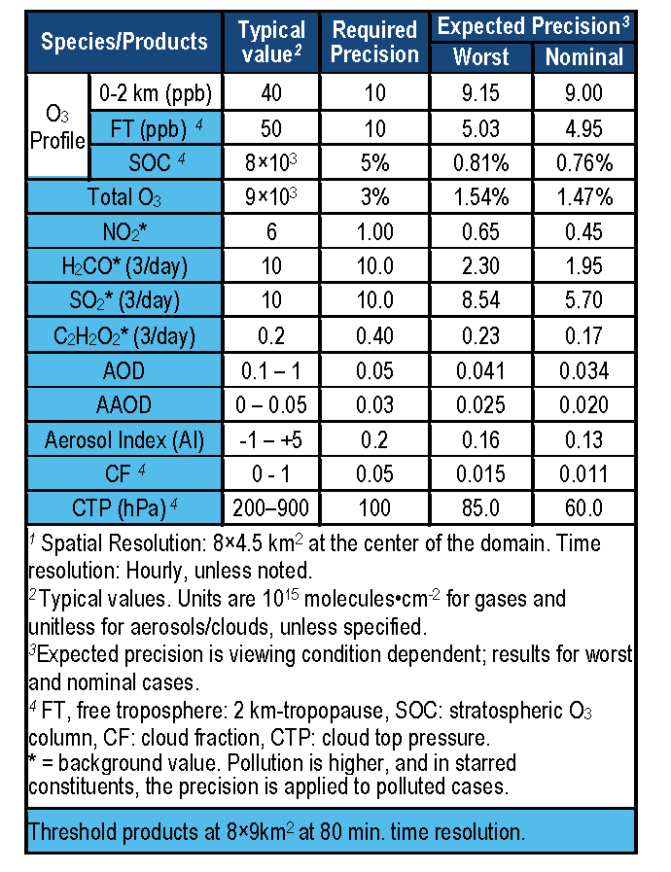
TEMPO baseline products

Slide 13
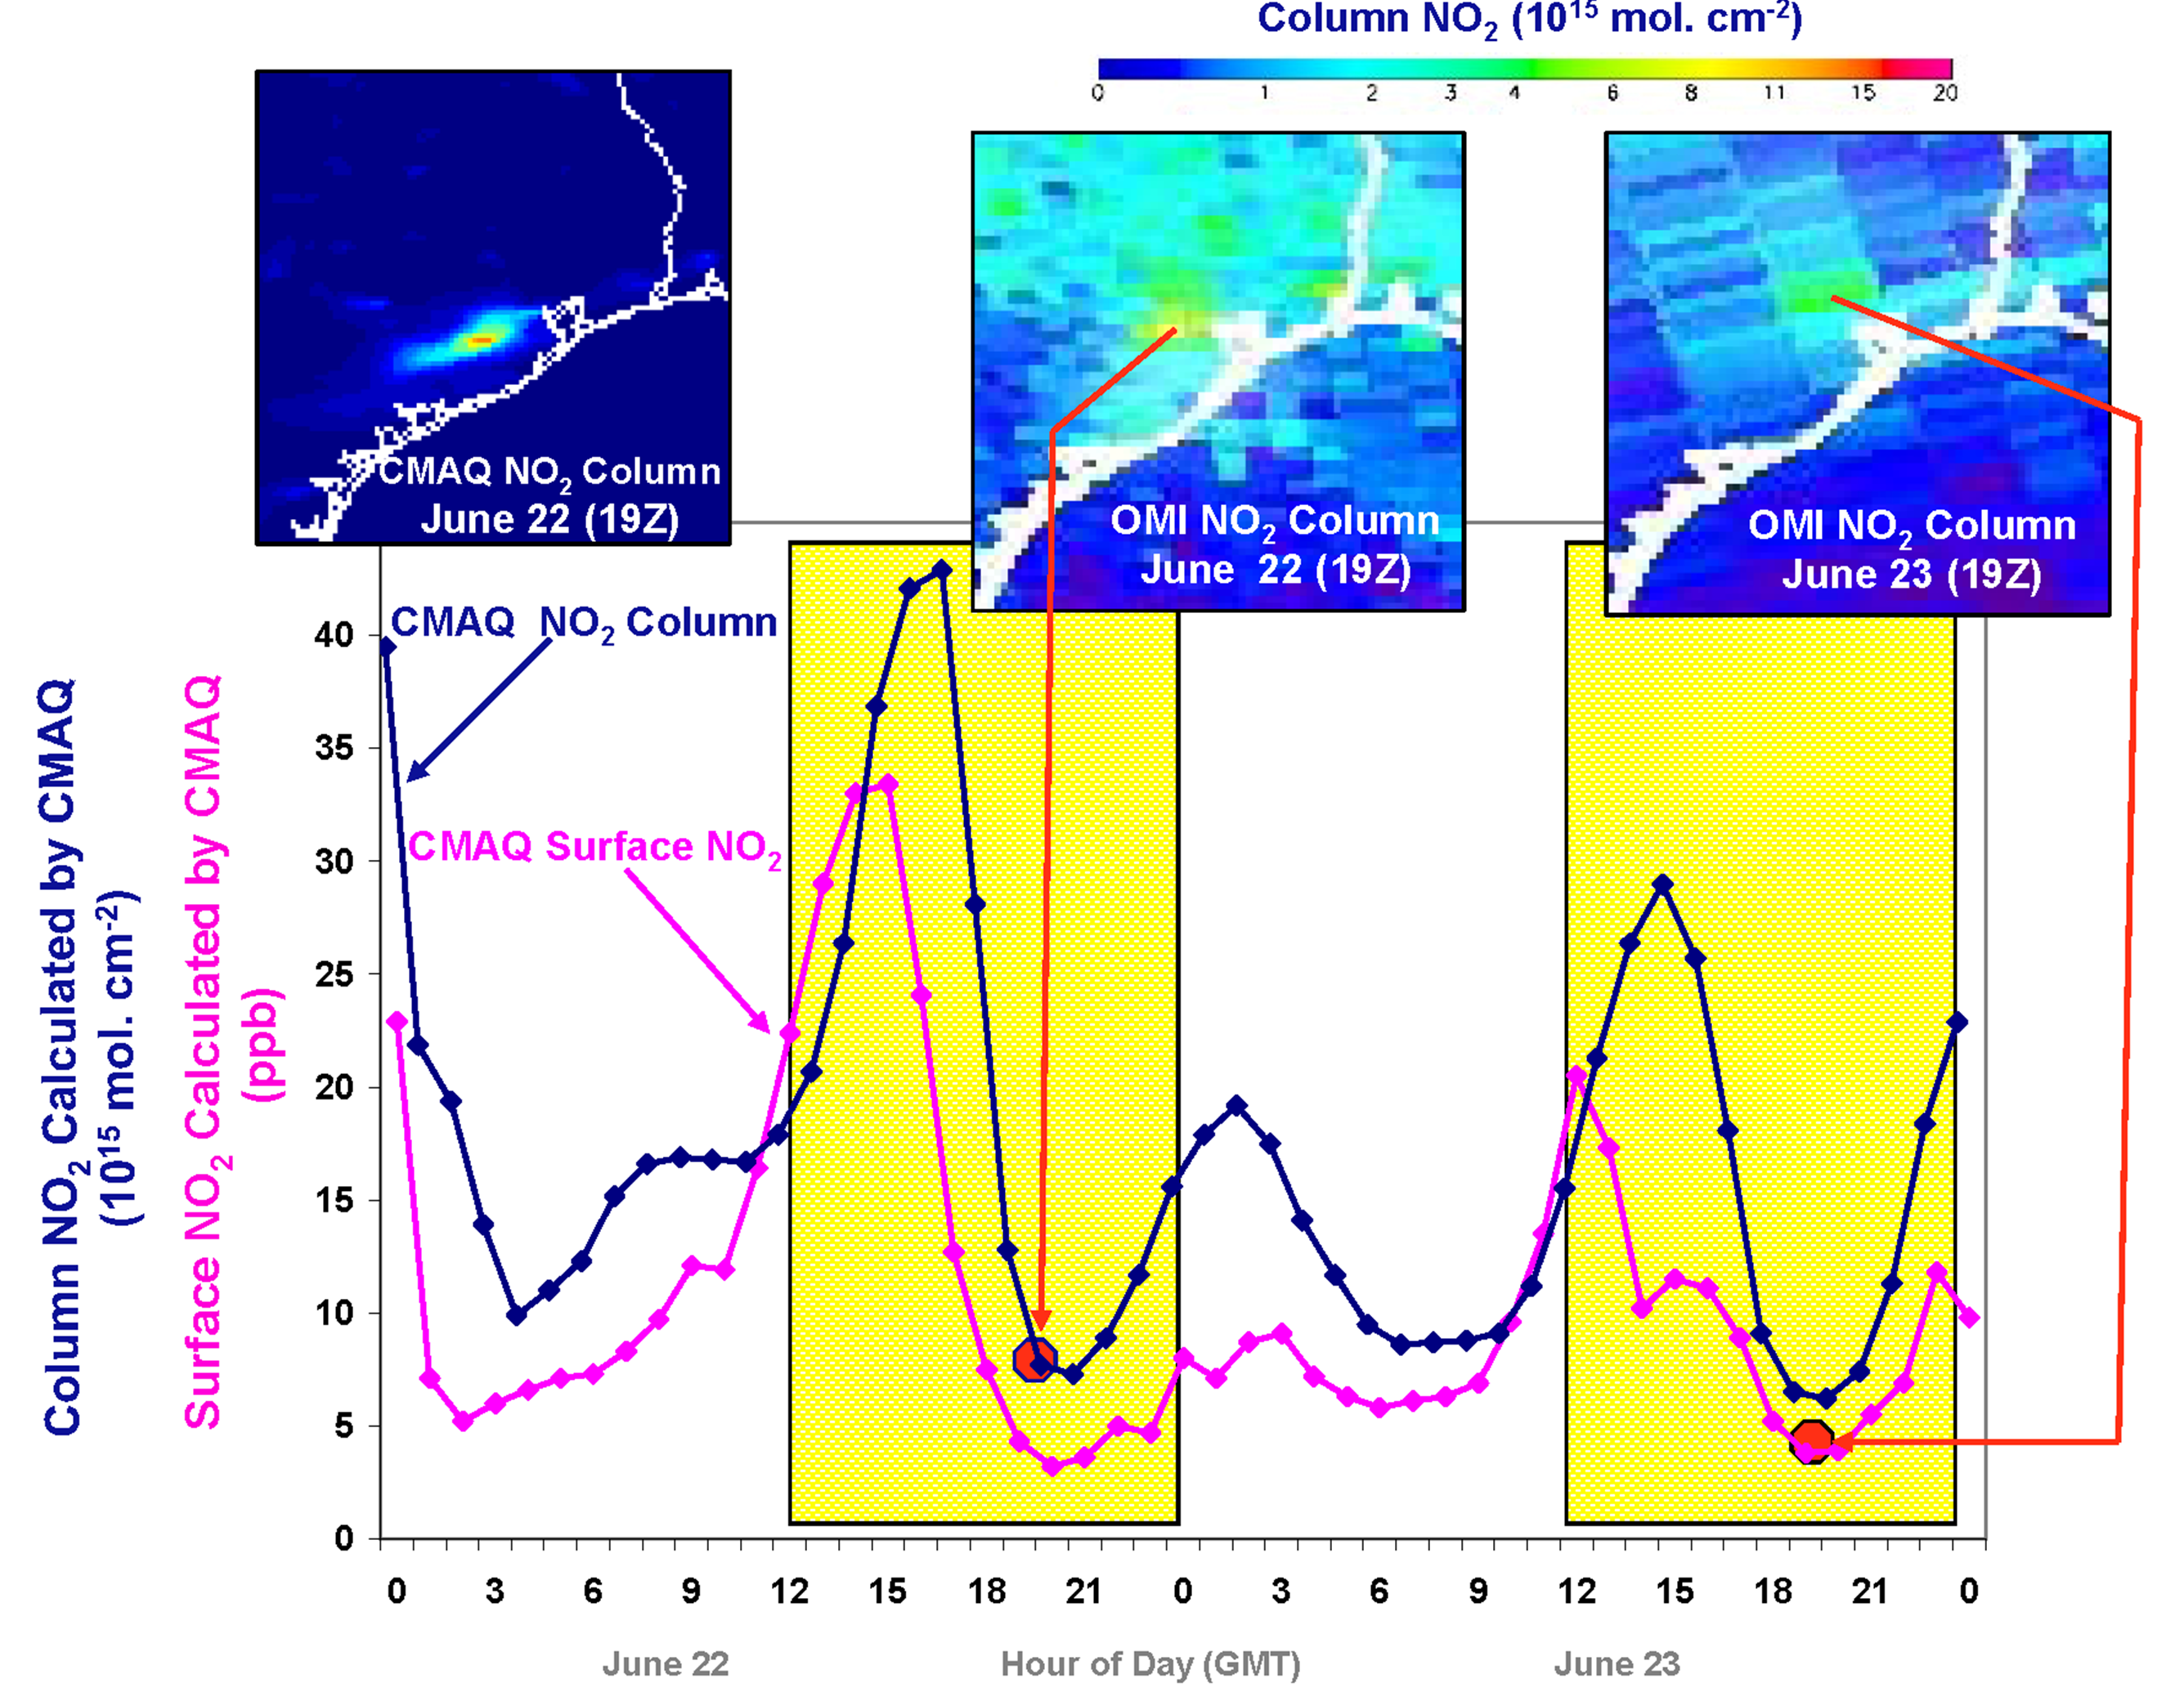
Why geostationary? High temporal and spatial resolution
Hourly NO₂ surface concentration and integrated column calculated by CMAQ air quality model: Houston, TX, June 22-23, 2005
June 22
Hour of Day (UTC)
June 23
LEO observations provide limited information on rapidly varying emissions, chemistry, & transport
GEO will provide observations at temporal and spatial scales highly relevant to air quality processes

Slide 14
TEMPO instrument concept
Measurement technique
  Imaging grating spectrometer measuring solar backscattered Earth radiance
  Spectral band & resolution: 290-690 nm @ 0.6 nm FWHM, 0.2 nm sampling
  2-D, 2k×2k, detector images the full spectral range for each geospatial scene
Field of Regard (FOR) and duty cycle
  Mexico City to the Canadian tar/oil sands, Atlantic to Pacific
  Instrument slit aligned N/S and swept across the FOR in the E/W direction, producing a radiance map of Greater North America in one hour
Spatial resolution
  2 km N/S × 4.5 km E/W native pixel resolution (9 km²)
  Co-add/cloud clear as needed for specific data products
Standard data products and sampling rates
  NO₂, O₃, aerosol, and cloud products sampled hourly, including eXceL O₃ for selected target areas
  H₂CO, C₂H₂O₂, SO₂ sampled 3 times/day (hourly samples averaged to get S/N)
  Product spatial resolution ≤ 8 km N/S × 4.5 km E/W at center of domain
  Measurement requirements met up to 70º SZA for NO₂, 50º for other standard products

Slide 15
TEMPO mission concept
Geostationary orbit, operating on a commercial telecom satellite
  NASA will arrange launch and hosting services (per Earth Venture Instrument scope)
    90-110º W preferred, 85-115º W acceptable
    Surveying COMSAT companies for specifications on satellite environment and launch manifests
  Hourly measurement and telemetry duty cycle for ≤70º SZA
    Hope to measure 20 hours/day
TEMPO is low risk with significant space heritage
  All proposed TEMPO measurements have been made from low Earth orbit satellite instruments to the required precisions
  All TEMPO launch algorithms are implementations of currently operational algorithms
    NASA TOMS-type O₃
    SO₂, NO₂, H₂CO, C₂H₂O₂ from AMF-normalized cross sections
    Absorbing Aerosol Index, UV aerosol, Rotational Raman scattering cloud, UV index
    eXceL profile O₃ for selected geographic targets
  Near-real-time products will be produced
TEMPO research products will greatly extend science and applications
  Example research products: profile O₃ for broad regions; BrO from AMF-normalized cross sections; height-resolved SO₂; additional cloud/aerosol products; vegetation products
  Example higher-level products: pollution/AQ indices from standard products, city light maps

Slide 16
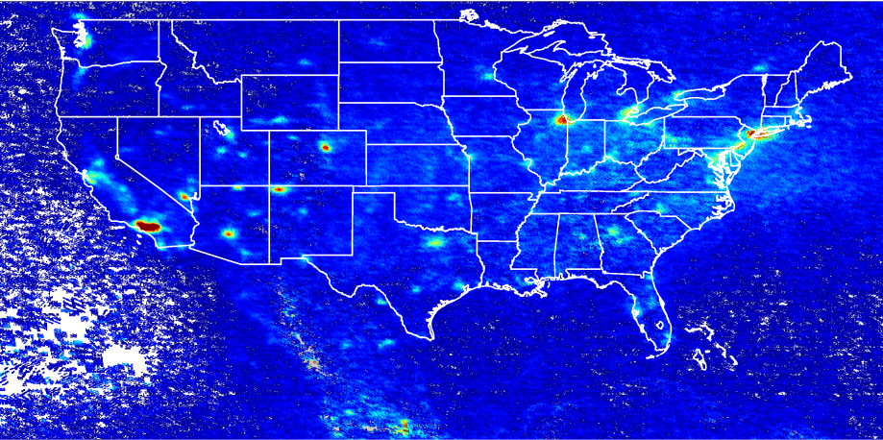
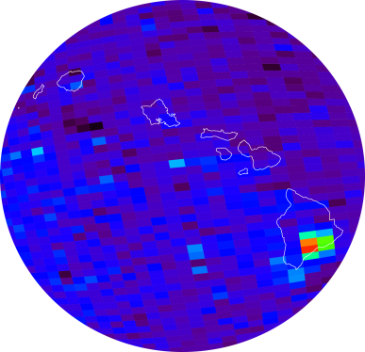
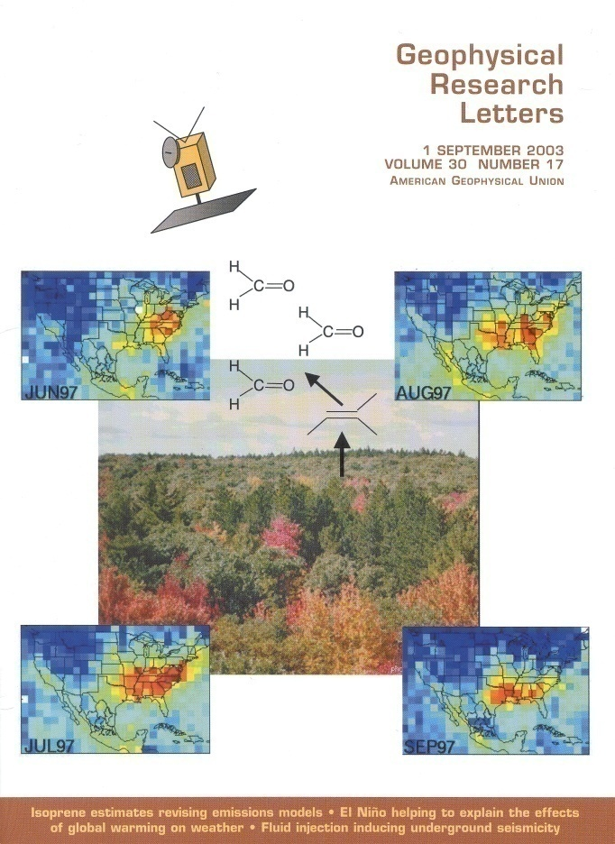
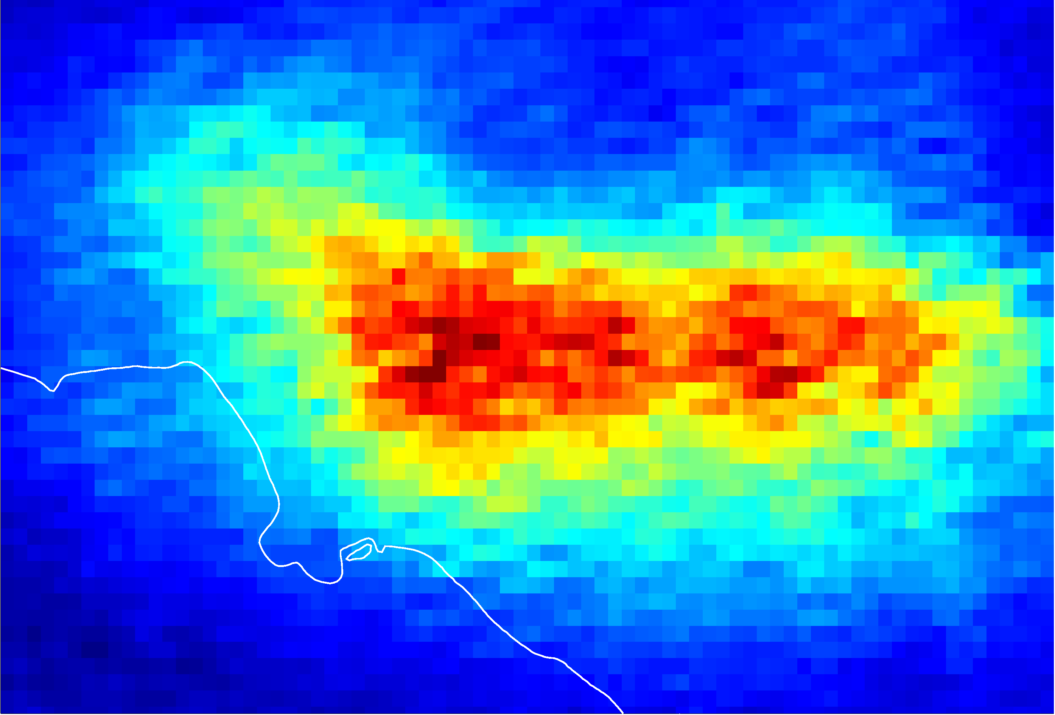
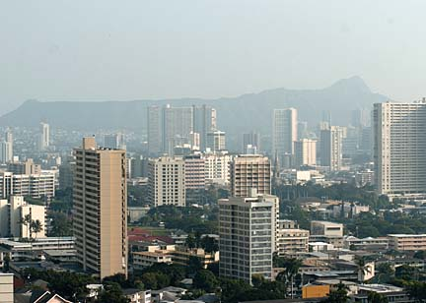
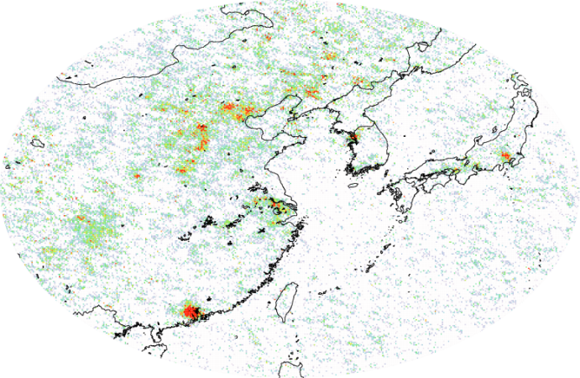
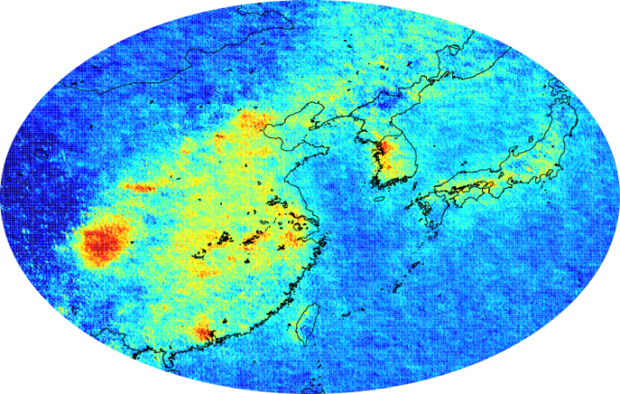
GOME, SCIA, OMI examples
NO₂
SO₂
Kilauea activity, source of the VOG event in Honolulu on 9 November 2004
O₃ strat
trop
H₂CO
C₂H₂O₂

Slide 17
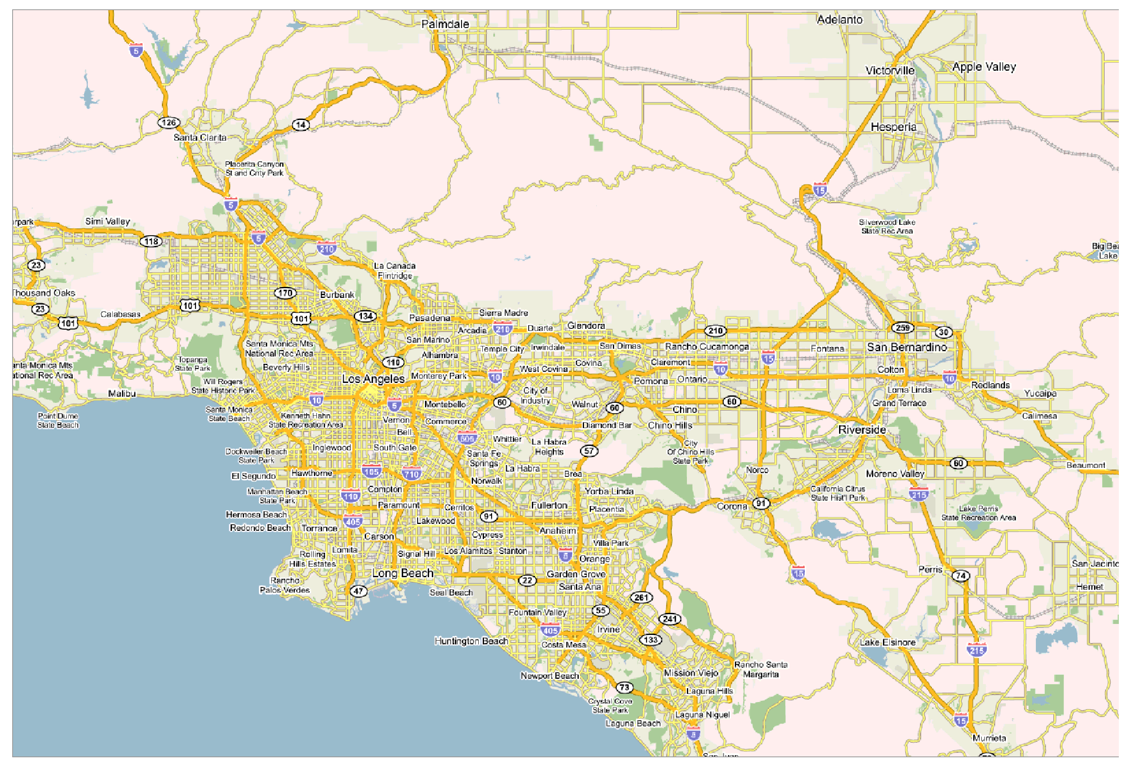
NO₂ over Los Angeles

Slide 18
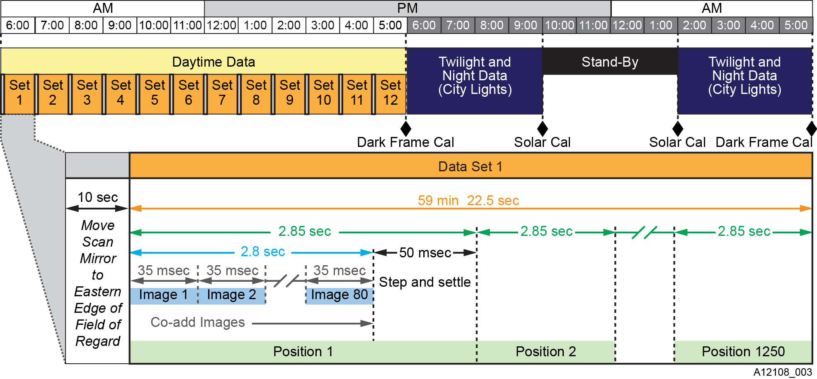
TEMPO Sensor Operations
Measurement modes for the TEMPO sensor operation change with the solar illumination of the Earth scene. Frame co-adding at a single position boosts sensitivity to atmospheric constituents. Special measurements are made by adjusting the dwell time and the scanning start and stop longitudes.

Slide 19




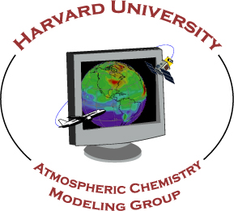


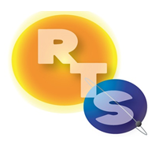


The End!

Slide 20
Current TEMPO schedule

Slide 21
TEMPO Phase A & B Schedule

Slide 22
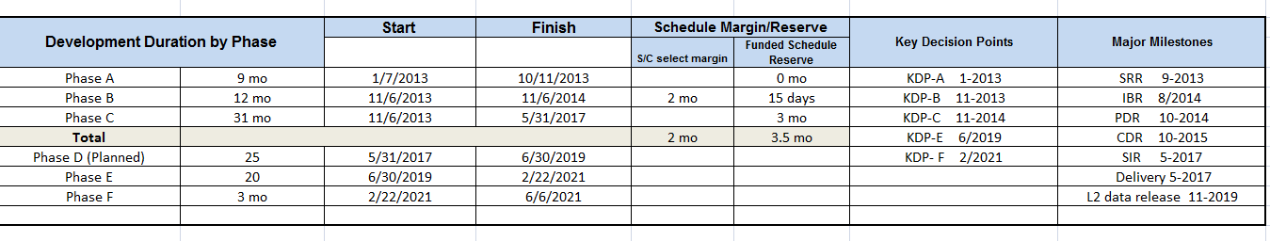
TEMPO major project milestones

Slide 23
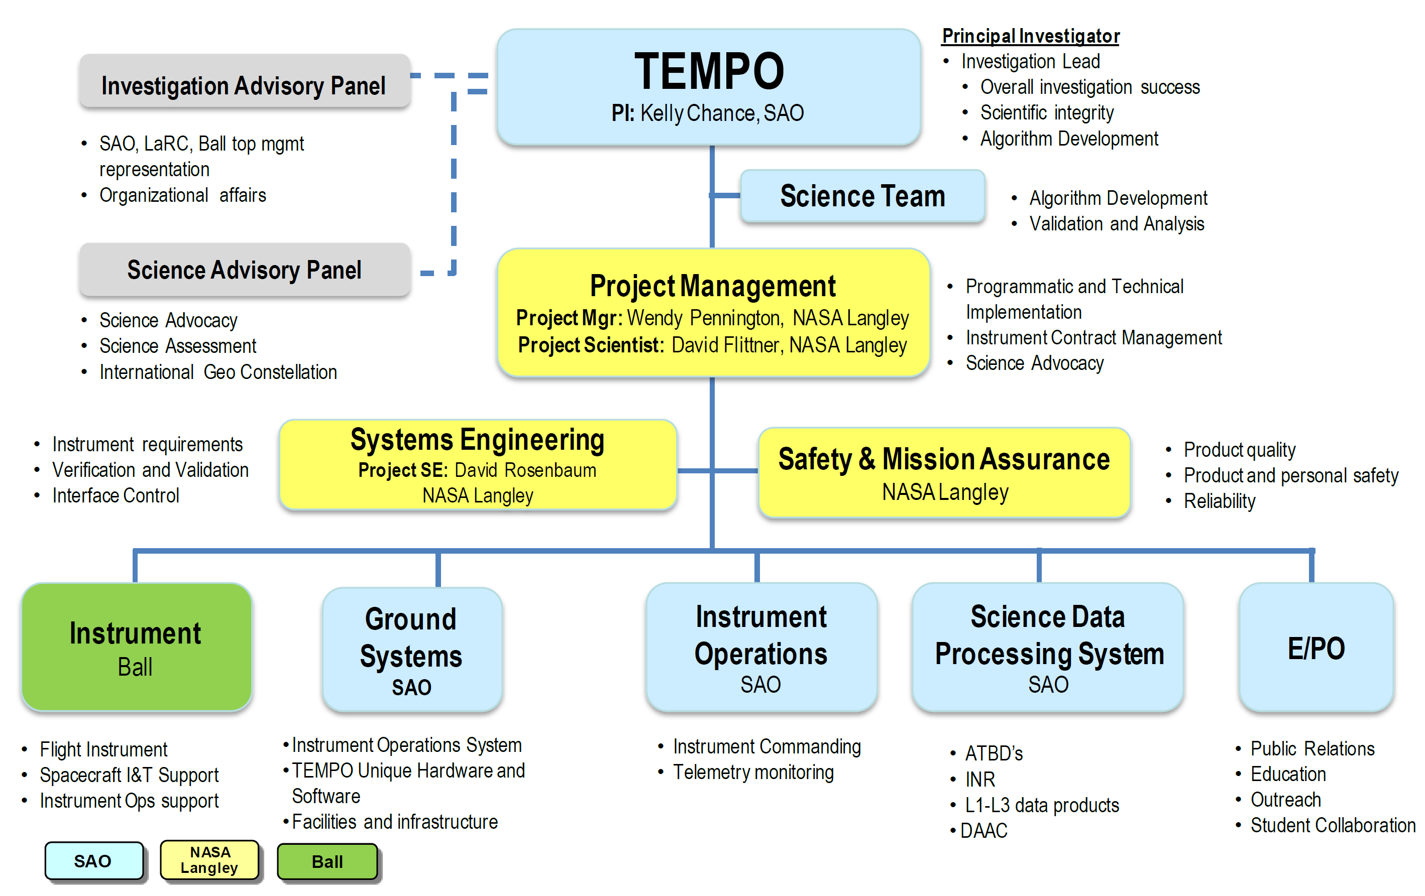
TEMPO Organization

Slide 24
Sun-synchronous nadir heritage
Instrument | Detectors | Spectral Coverage [nm] | Spectral Res. [nm] | Ground Pixel Size [km²] | Global Coverage
GOME-1 (1995-2011)‏ | Linear Arrays | 240-790 | 0.2-0.4 | 40×320 (40×80 zoom) | 3 days
SCIAMACHY (2002-2012)‏ | Linear Arrays | 240-2380 | 0.2-1.5 | 30×30/60/90 30×120/240 | 6 days
OMI (2004)‏ | 2-D CCD | 270-500 | 0.42-0.63 | 13×24 - 42×162 | daily
GOME-2a,b (2006, 2012)‏ | Linear Arrays | 240-790 | 0.24-0.53 | 40×80 (40×10 zoom) | near-daily
OMPS-1 (2011) | 2-D CCDs | 250-380 | 0.42-1.0 | 50×50 | daily
Previous experience (since 1985 at SAO and MPI)
Scientific and operational measurements of pollutants O₃, NO₂, SO₂, H₂CO, C₂H₂O₂ (& CO, CH₄, BrO, OClO, ClO, IO, H₂O, O₂-O₂, Raman, aerosol, ….)

Slide 25
LEO measurement capability
A full, minimally-redundant, set of polluting gases, plus aerosols and clouds is now measured to very high precision from satellites. Ultraviolet and visible spectroscopy of backscattered radiation provides O₃ (including profiles and tropospheric O₃), NO₂ (for NO_{x}), H₂CO and C₂H₂O₂ (for VOCs), SO₂, H₂O, O₂-O₂, N₂ and O₂ Raman scattering, and halogen oxides (BrO, ClO, IO, OClO). Satellite spectrometers planned since 1985 began making these measurements in 1995.

Slide 26

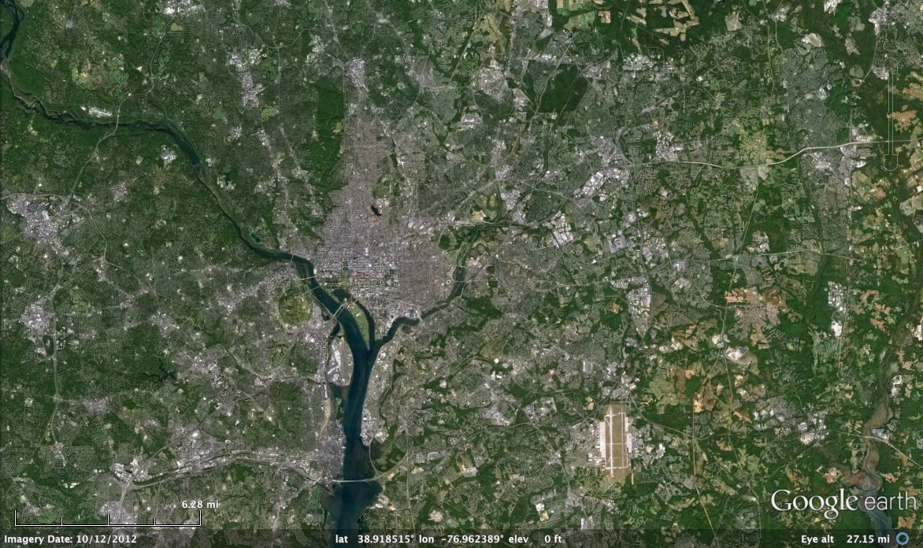
Washington, DC coverage
Hourly!

Slide 27

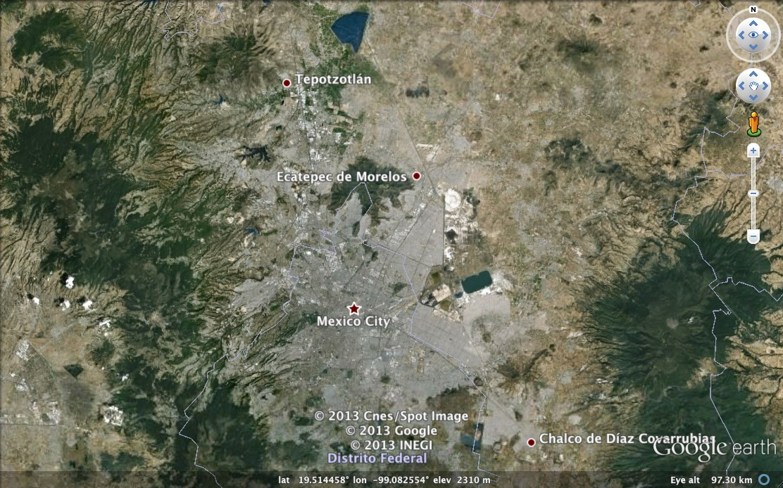
Mexico City coverage
¡Cada hora!

Slide 28
TEMPO launch algorithms
NO₂, SO₂, H₂CO, C₂H₂O₂ vertical columns
  Direct fitting to TEMPO radiances
    AMF-corrected reference spectra, Ring effect, etc.
    DOAS option available to trade more speed for less accuracy, if necessary
    Research products could include H₂O, BrO, OClO, IO
O₃ profiles, tropospheric O₃
eXceL optimal-estimation method developed @ SAO for GOME, OMI
May be extended to SO₂, especially volcanic SO₂
TOMS-type ozone retrieval included for heritage
Aerosol products from OMI heritage: AOD, AAOD, Aerosol Index
Advanced/improved products likely developed @ GSFC, U. Nebraska
Cloud Products from OMI heritage: CF, CTP
Advanced/improved products likely developed @ GSFC
UVB research product based on OMI heritage
Nighttime research products include city lights

