Slide 1
Highlights and key findings from the GEO-CAPE aerosol studies in the past decade
The GEO-CAPE Aerosol Working Group
GEO-CAPE workshop, College Park, MD
May 1, 2018

Slide 2
Science questions and measurement requirements of aerosols in the GEO-CAPE STM
Science questions (categories):
  Emissions
  Processes
  AQ-climate interactions
  AQ applications
  Transport and AQ
  Episodic events
Baseline measurements of aerosols (not including precursor gases):
Species | Time resolution | Typical value | Precision | Description
AOD | Hourly, SZA<70 | 0.1 – 1 | 0.05 | Observe total aerosol; aerosol sources and transport; climate forcing
AAOD | Hourly, SZA<70 | 0 – 0.05 | 0.02 | Distinguish smoke and dust from non-UV absorbing aerosols; climate forcing
AI | Hourly, SZA<70 | -1 – +5 | 0.1 | Detect aerosols near/above clouds and over snow/ice; aerosol events
AOCH | Hourly, SZA<70 | Variable | 1 km | Determine plume height; large scale transport, conversions from AOD to PM
Product spatial resolution: |  | 4 km x 4 km at the center of the domain
Spectral region: |  | Vis: AOD; UV-deep blue: AAOD, AI; Vis-NIR: AOCH
Cloud detection: |  | 1 km x 1 km cloud camera
Descope options: Product spatial resolution at 8 km x 8 km; eliminating cloud camera, AAOD, and AOCH.

Slide 3
Aerosol WG study in the past decade
The GEO-CAPE Aerosol Working Group was formed in late 2009 to work on the aerosol science questions, objectives, measurement requirements, and the Science Traceability Matrix
Our studies have been centered on how to meet the measurement requirements and how to answer the science questions in the following investigations:
  Daytime AOD variability (Zhang/Yu et al., JGR 2012) and retrieval opportunity of daytime AOD from geostationary satellite as a function of pixel spatial resolution (Remer/Mattoo et al.,AMT 2012; Jethva/Torres, in prep; Wang, Yu)
  Applications of geostationary observations for AQ assessments (Tan/Chin/Yu, Sorekhamer/Chatfield)
  Evaluation of available algorithms for aerosol retrieval over North America (Superczynski/Kondragunta et al., JGR 2017; Jethva/Torres, in preparation)
  TEMPO-GOES synergy for GEO-CAPE aerosol objectives (Ciren/Kondragunta, Lyapustin)
  Possibility to retrieve aerosol height information (Xu/Wang et al. GRL, Gasso/Torres, AMT 2016)
  [Aerosol retrieval from the airborne hyperspectral instrument over different surface types (Wang) – presented in airborne simulator session]

Slide 4
A. Retrieval opportunity of daytime AOD from geostationary satellite as a function of pixel spatial resolution
Lorraine Remer, Shana Mattoo, Hiren Jethva, Omar Torres, NASA GSFC

Slide 5
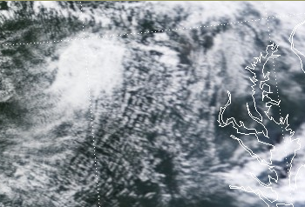
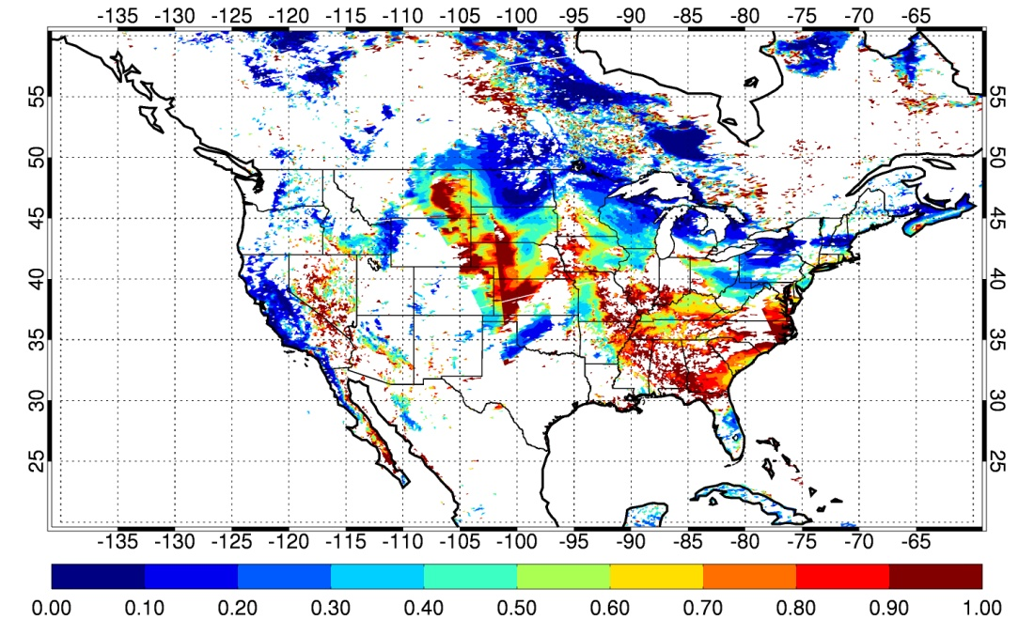
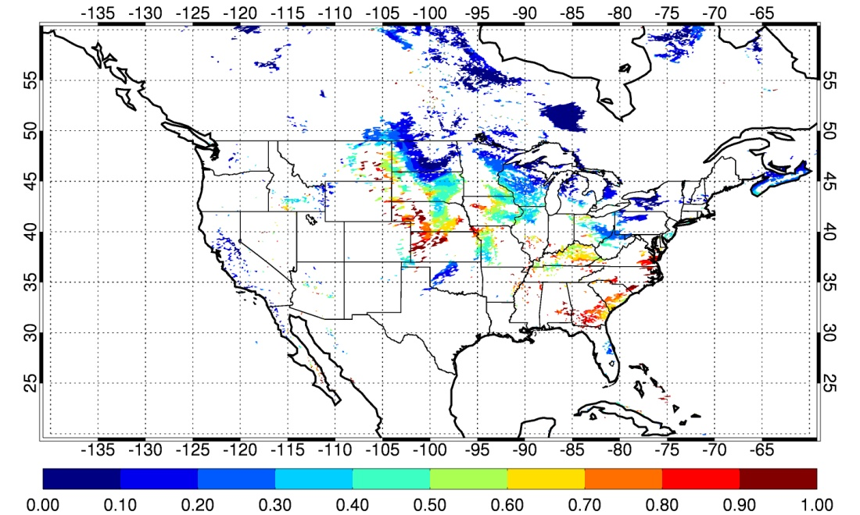
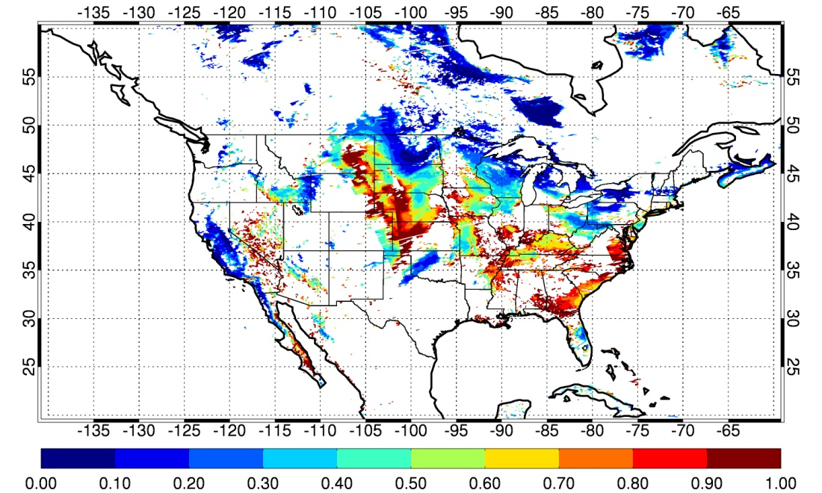
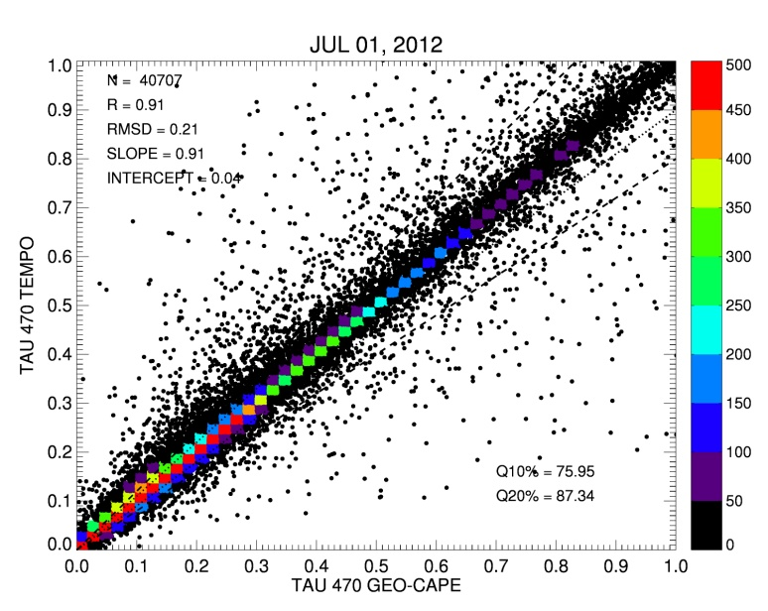
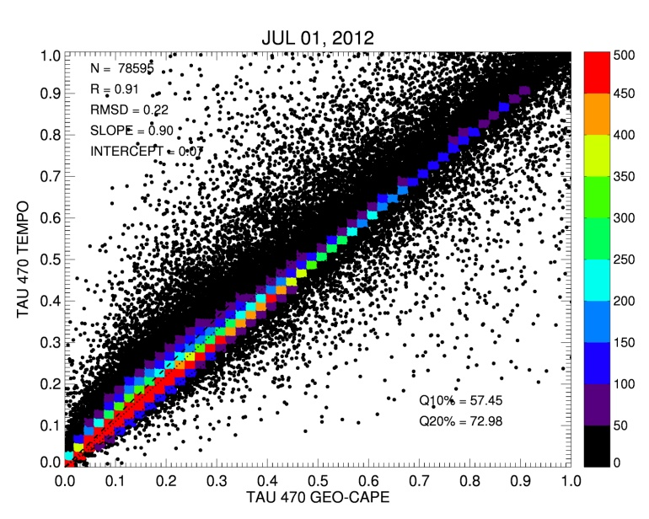
Temporal and spatial retrieval availability
Temporal retrieval availability - example in 1°x1° area in Virginia, August 12 2012
Spatial retrieval availability of AOD at GEO-CAPE-like (1x1 km) and TEMPO-like (4 km x 2 km) pixel resolution and different cloud detection criteria – study using MODIS Dark Target retrieval for July 1, 2012
1-km
2-km
GEO-CAPE (1x1km),
CM σ_{s} > 0.0025
TEMPO (4x2km),
CM σ_{s} > 0.0025
(1)
(2)
4-km
(2) vs. (1)
(3) vs. (1)
8-km
TEMPO (4x2km),
CM σ_{s} > 0.01
(3)
(Remer, L. A., S. Mattoo, R.C. Levy, A. Heidinger, R. B. Pierce, and M. Chin, AMT 2012)
(Jethva and Torres)

Slide 6
Key findings from A (aerosol retrievability):
Temporally, TEMPO will have reduced AOD retrieval availability in partial cloudy scene. The % reduction depends on the cloud amount
Spatially, TEMPO will have only about half coverage of GEO-CAPE on average for the same cloud variability criteria for cloud screening. The coverage increases with the relaxed criteria but the data quality might be affected

Slide 7
B. Applications of geostationary observations of AOD for AQ
Qian Tan, Alex Coy, Mian Chin, Hongbin Yu, NASA GSFC
Meytar Sorekhamer, Robert Chatfield, NASA Ames

Slide 8
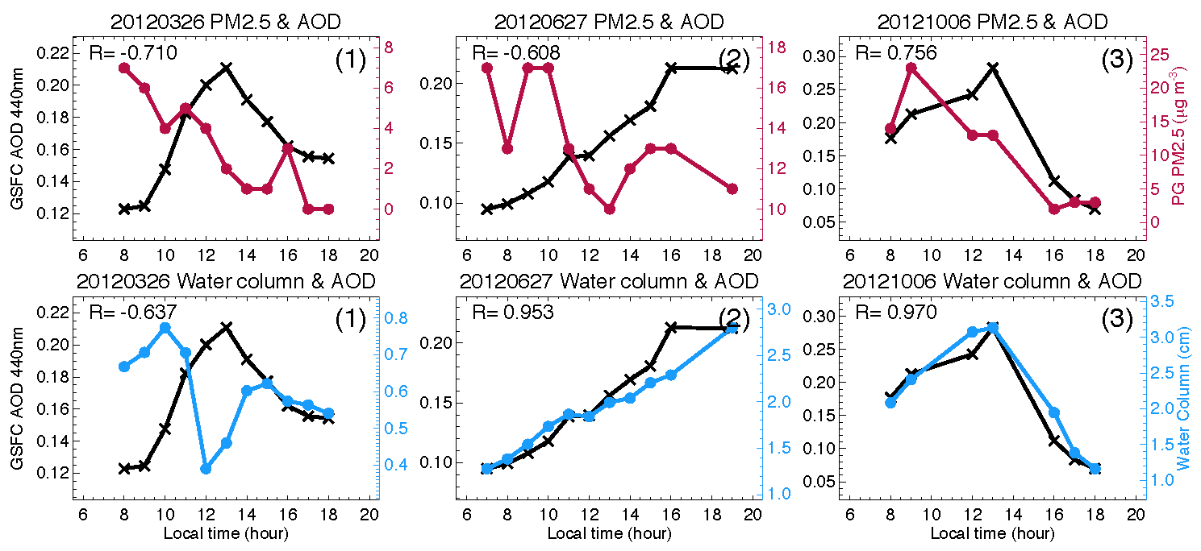
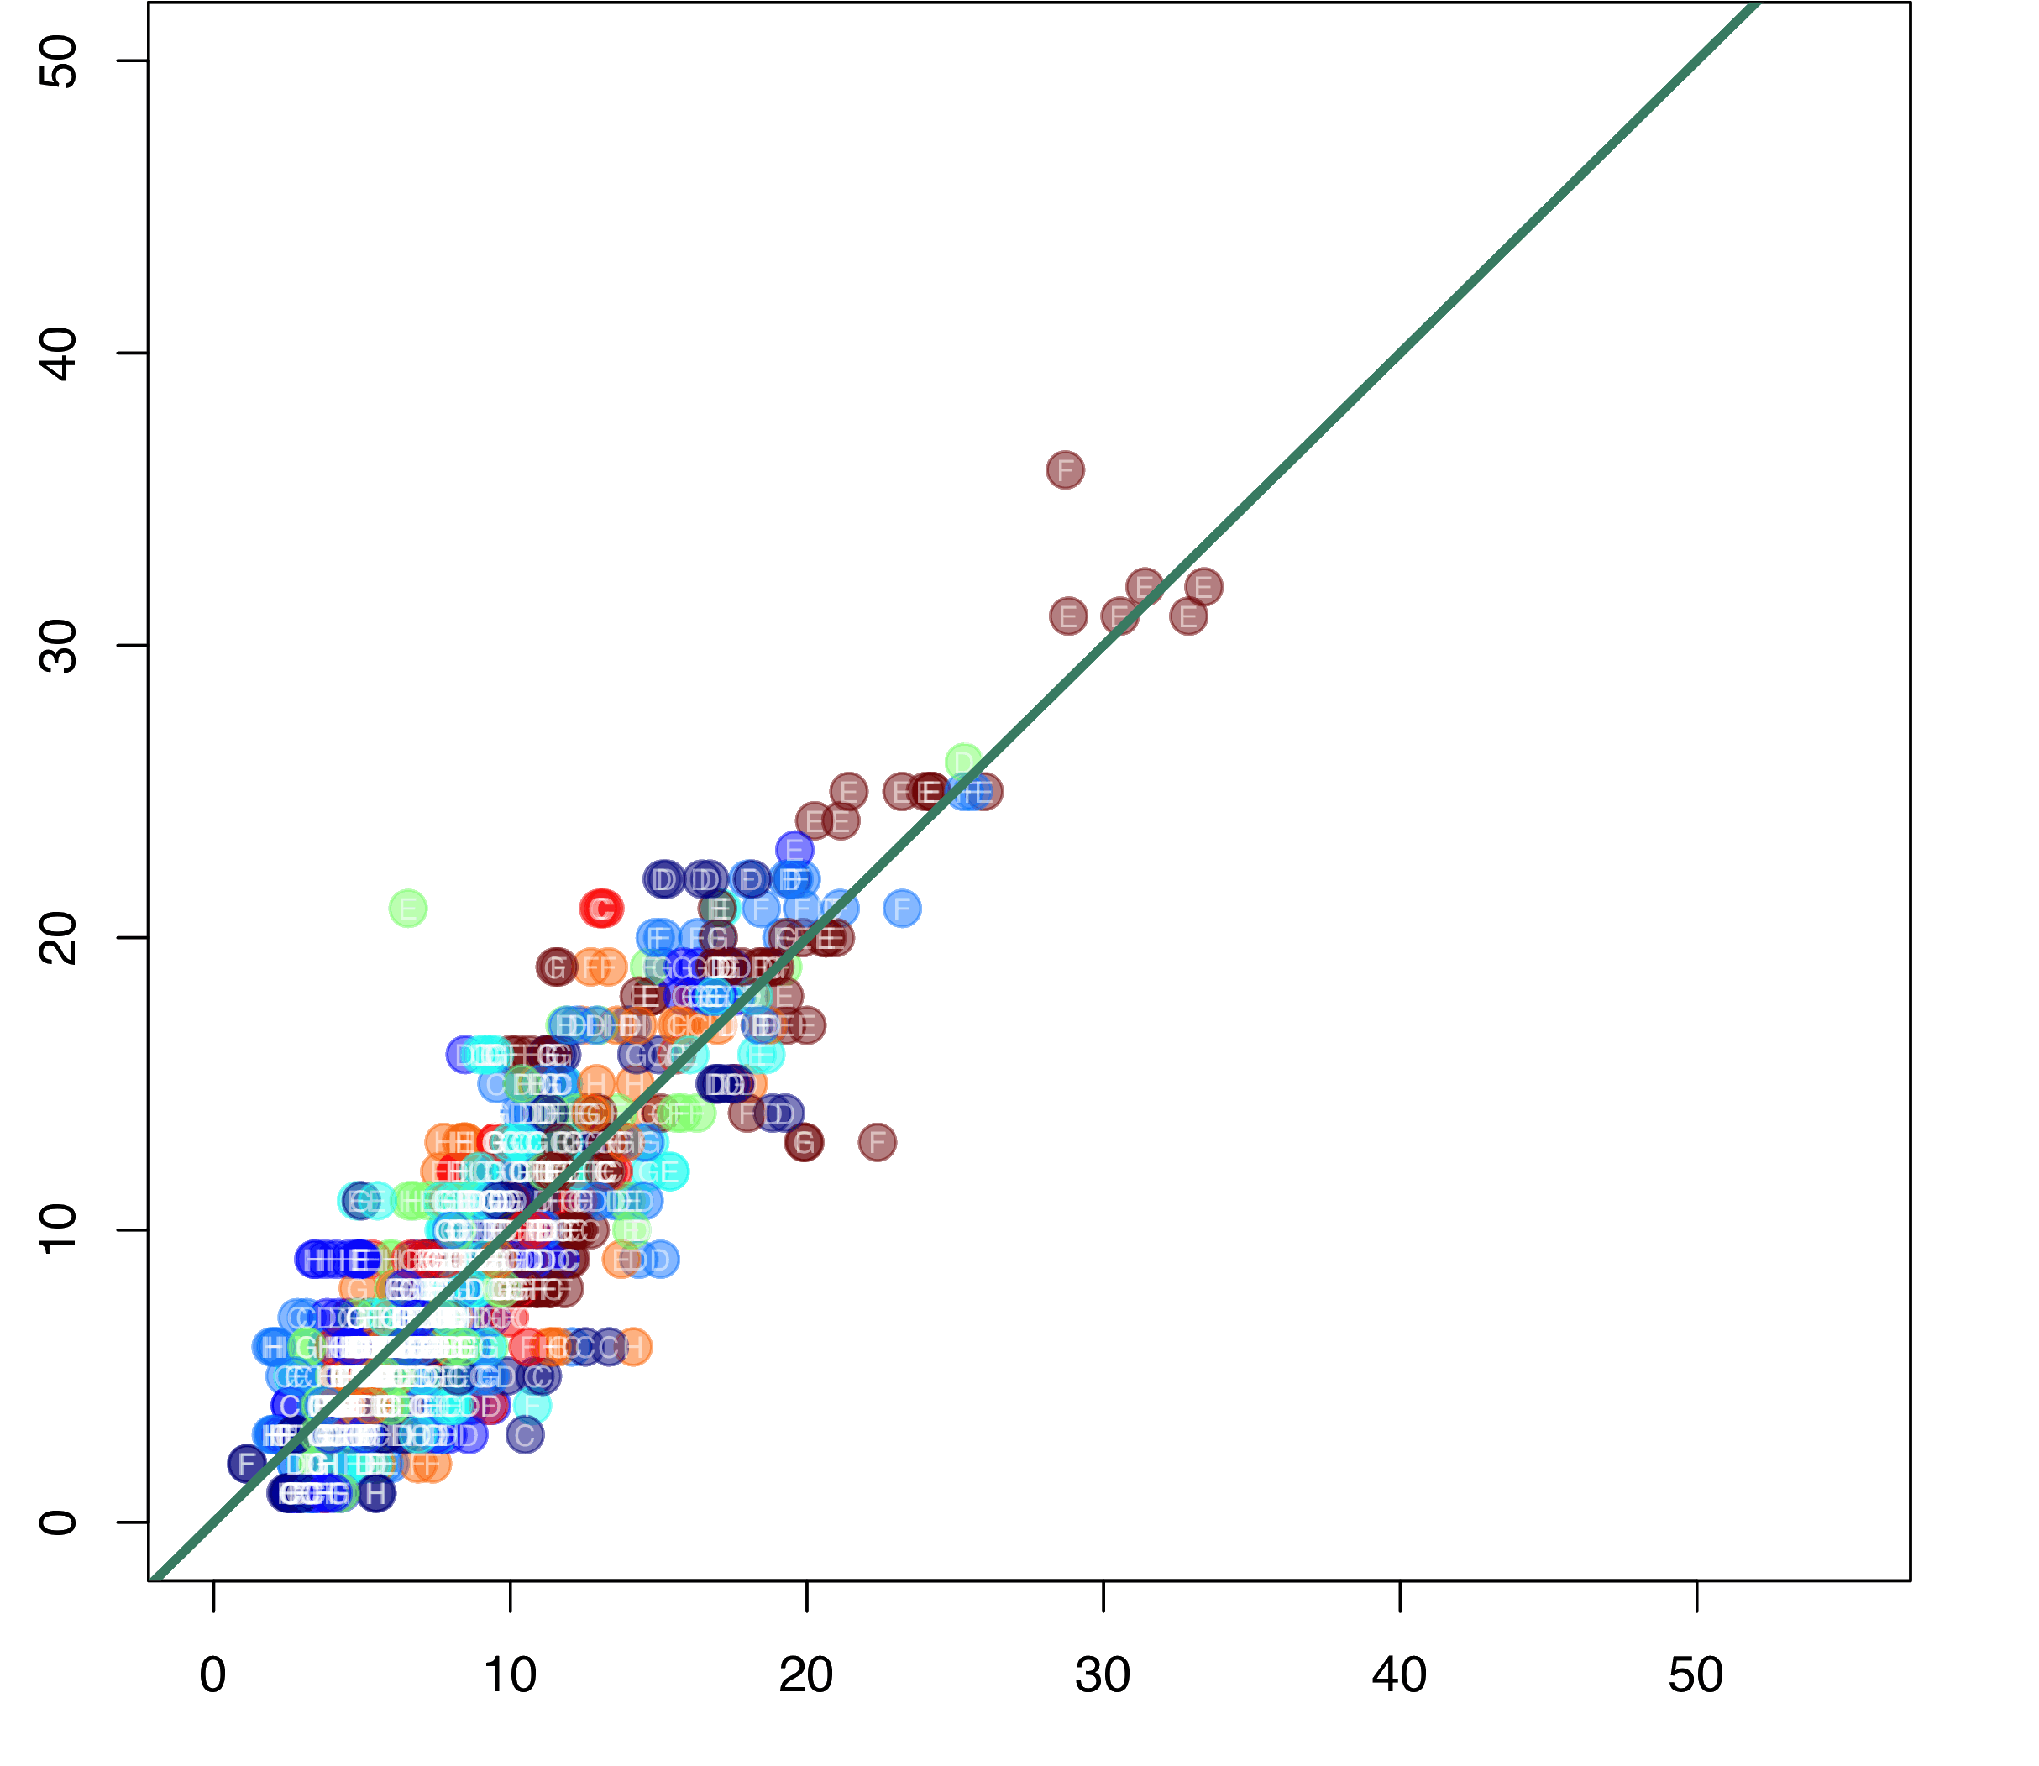
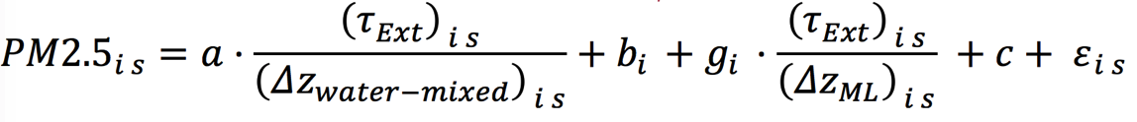
AOD-PM2.5 relationships in hourly and seasonal scales
How are AOD and PM2.5 correlated temporally in daytime?
Example of daytime AERONET AOD and EPA PM2.5 near GSFC
Can AOD adjusted by “mixed effects” on longer time scale help?
Example of daytime AERONET AOD and EPA PM2.5 near GSFC.
Spring season at local time 11-15 hours (well mixed PBL) for selected events
R=0.69
R=0.89, RMSE=2.53
Obs PM2.5
Obs PM2.5
Daily calibrated
Obs AOD
Fitted PM2.5
AOD negatively correlated with both PM2.5 and H₂O(g)
AOD negatively correlated with PM2.5 but positively with H₂O(g)
AOD positively correlated with both PM2.5 and H₂O(g)
i day, s obs within day
  In 2012 at four sites in the US (GSFC, Fresno, St. Louis, Houston), only 13-22% of all days when R (AOD-PM2.5) ≥ 0.7, but 30-57% of the days R < 0
  For the days R ≥ 0.7, the slopes and intercepts vary significantly
  By selecting data from certain season, time of the day, and with pollution events, the overall AOD-PM2.5 still shows large variability
  But with consideration of the AOD humidification effects, the fitted PM2.5 from daily calibration with column water vapor, and specific humidity captures the observed PM2.5 on that timescale
(Qian Tan, Alex Coy, Mian Chin, Hongbin Yu)
More see Qian Tan’s CEOS talk
(Meytar Sorekhamer, Robert Chatfield)

Slide 9
Key findings from B (AOD application for PM2.5):
On day-to-day basis, there is a large variability in daytime temporal relationships between AOD and PM2.5 such that direct scaling of AOD to estimate PM2.5 is not feasible, due to the effects of aerosol vertical profile, aerosol composition, and humidification
On longer time scales (e.g., seasonal) and considering multiple effects (column water vapor and specific humidity, PBLH, day-to-day variations, etc.), PM2.5 could be better predicted from AOD based on an empirical relationship for that scale. The concern is how practical the method can be applied on shorter time scale and the availability of the ancillary data for the fitting

Slide 10
C. Evaluation of available algorithms for land AOD retrieval over North America
Omar Torres, Hiren Jethva, Yasuko Yoshida, NASA GSFC

Slide 11
Introduction
High spatial resolution visible/near IR observations from the Advanced Base Imager (ABI) on NOAA’s GOES R and S satellites can be used to generate a Geo-CAPE-equivalent land AOD product.
ABI’s multi-spectral capability is similar to that of the EOS-MODIS (Terra and Aqua) sensors.
Three land AOD algorithms are currently applied to Aqua-MODIS observations: Dark Target (DT), Deep Blue (DB), and Multi-Angle Implementation of Atmospheric Correction (MAIAC).
The performance of each algorithm was evaluated using AERONET’s measurements over the continental United States over 15 years.

Slide 12
Dark Target Algorithm
Levy et al. [2013]
Surface characterization through a linear regression of surface reflectance in the 2.11 μm and visible channels (0.47 μm, 0.67 μm) accounting for the viewing geometry and “greenness” of land cover
Clouds, snow/ice, and inland water bodies (via NDVI test) not considered
The brightest 50% and darkest 20% are discarded; reflectance in each channel is averaged for AOD retrieval
Look-up table based approach; one fine-dominated and one coarse-dominated aerosol model combined with proper weightings to retrieve spectral AODs and fine/coarse mode weight
Diagnostic uncertainty ±(0.05+0.15τ_{A})

Slide 13
Deep-blue Algorithm
Hsu et al. [2013], Sayer et al. [2014]
Utilizes blue wavelength (412 nm) measurements from instruments such as SeaWiFS and MODIS, where the surface reflectance over land is much lower
Surface characterization through a hybrid approach--dynamical surface reflectance method (for urban built-up) and precalculated surface reflectance database (arid and semi-arid areas)
Cloud-screening by examining ρ_{0.412} spatial variation, 1.38 μm, and BT at 11 and 12 μm.
DB performs retrievals on cloud‐free and snow‐free pixels at nominal 1×1 km spatial resolution and then aggregates afterward to the 10×10 km retrieval box
Retrievals over bright desert and vegetated surfaces
Expected prognostic uncertainty ±([0.086+0.56τ_{DB}]/[1/μ₀+1/μ])

Slide 14
MAIAC Retrieval Approach
Lyapustin et al. [2012]
Grid TOA L1B data to 1km fixed grid
Observe the same grid cell over time. Slow change of surface helps detect “fast” variations from aerosols and clouds
Min refl. method to characterize spectral ratios (SR) for aerosol retrievals
Sliding window – store 4-16 last days of measurements in memory
Accumulate surface-related information for each grid cell (spectral BRDF; spatial variation from 500m bands; BT-contrasts etc.)

Slide 15
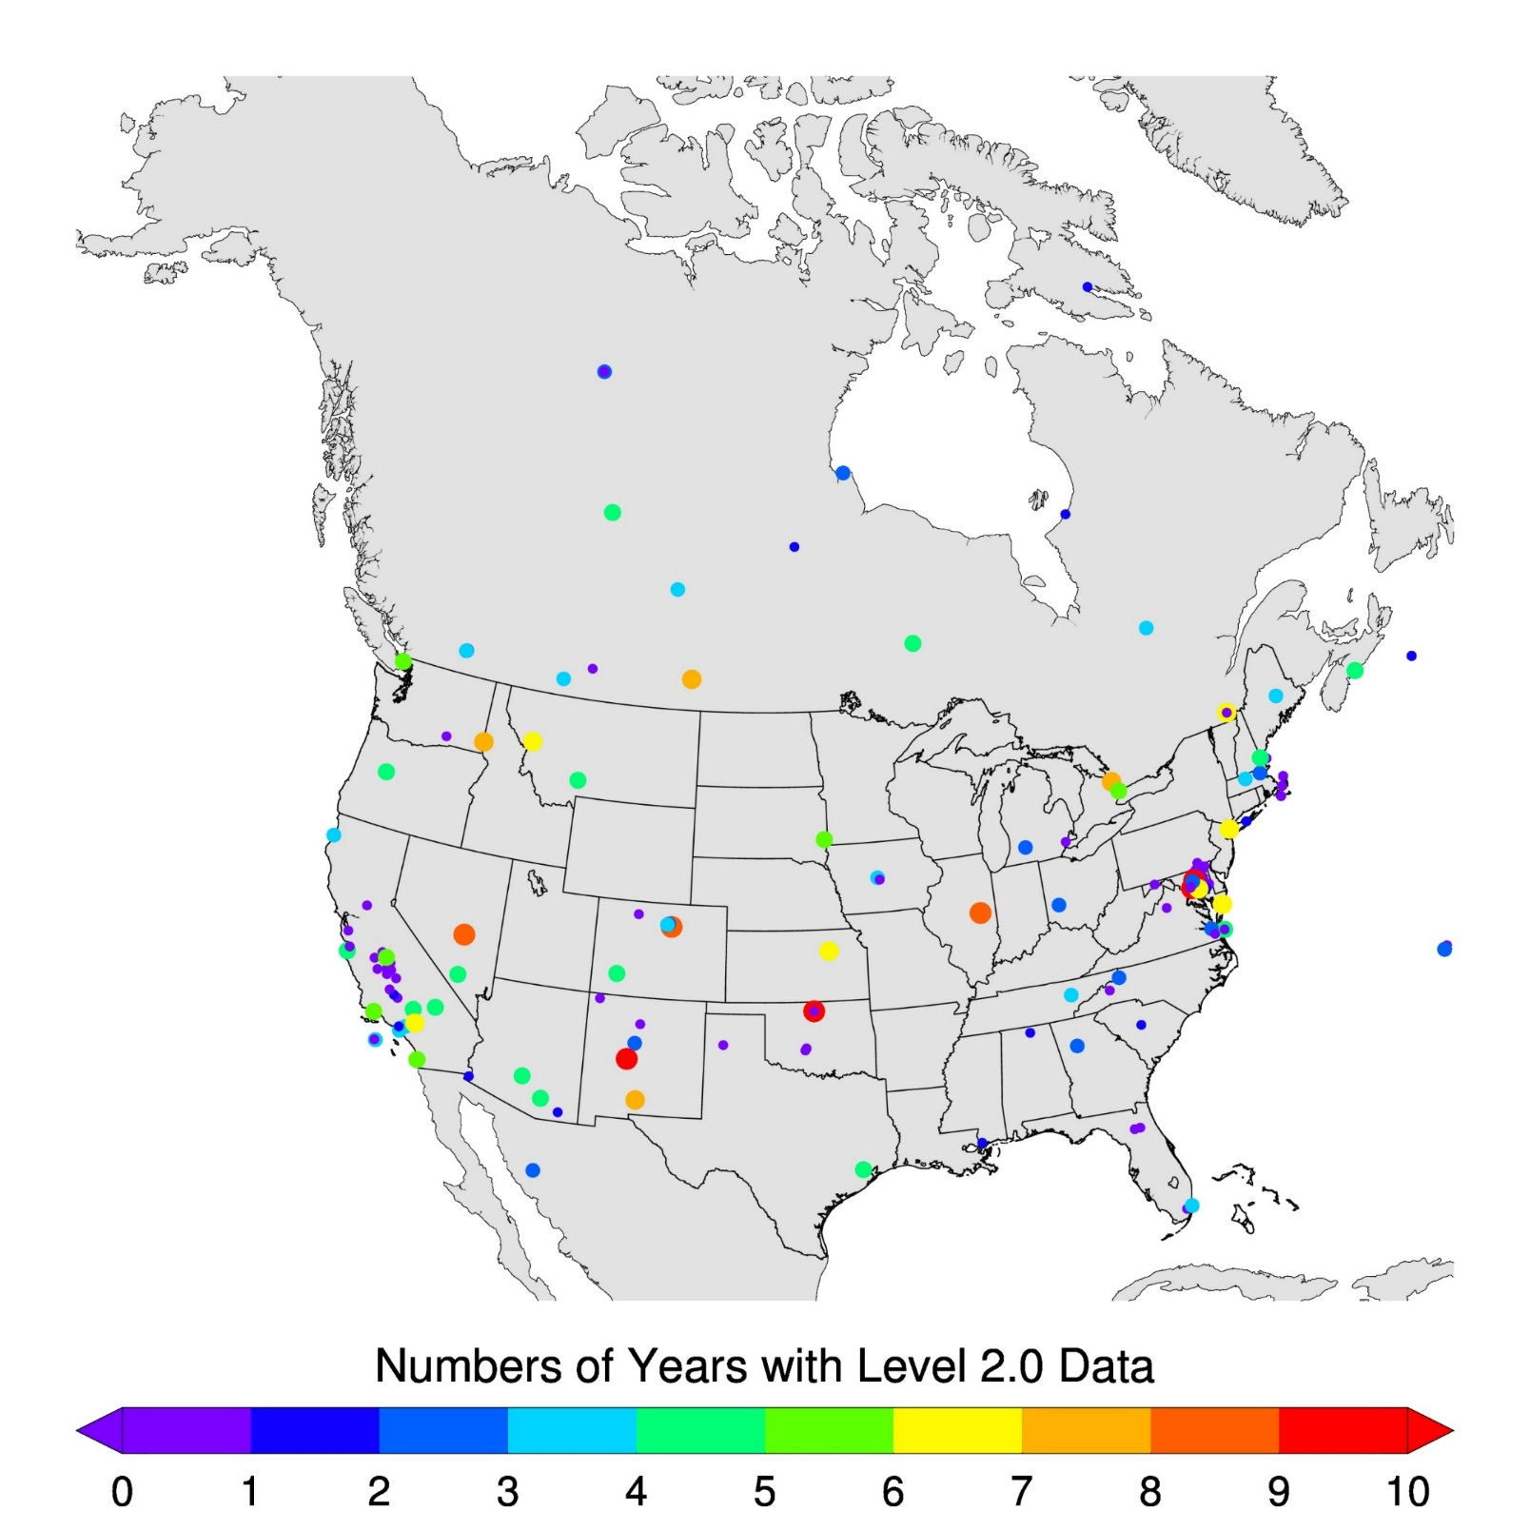
Evaluation of DT, DB, and MAIAC with AERONET data:
Ground-satellite collocation criteria
Geographical Distribution of AERONET Sites over North America
Spatio-Temporal Approach
+
40 km
40 km
N_{min}=160 ΔT =±30 mins.
Satellite overpass time
AERONET direct meas.
+
+
+
+
ΔT
Only best quality satellite AOD retrievals are considered in this analysis.

Slide 16
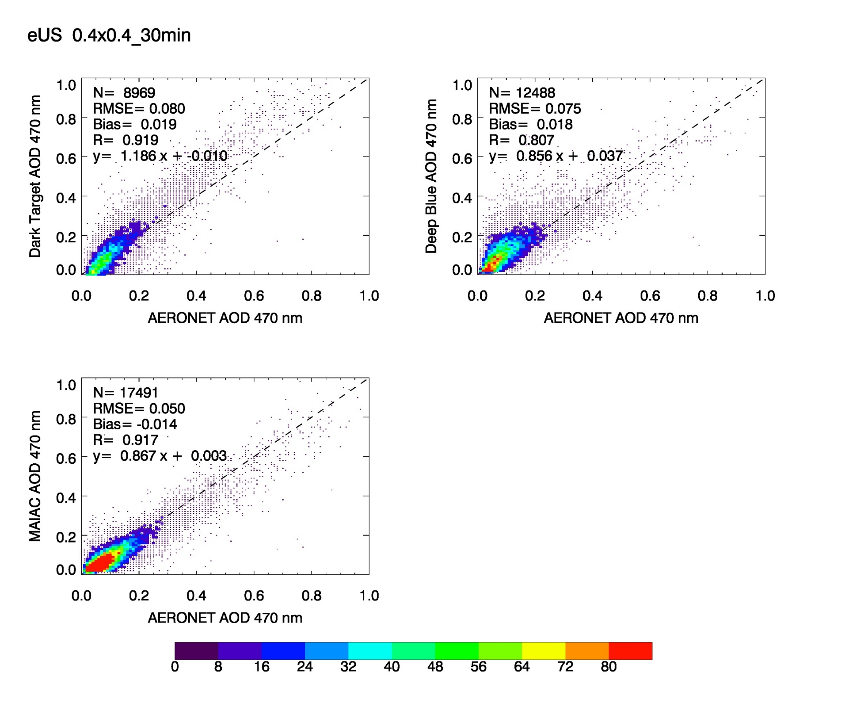
Eastern North America Composite: Independent comparison
 | DT | DB | MAIAC
N Corr. Slope Y-int RMSE Bias | 8969 0.919 1.186 -0.010 0.080 0.019 | 12488 0.807 0.856 0.037 0.075 0.018 | 17491 0.917 0.867 0.003 0.050 -0.014

Slide 17

Western North America Composite: Independent comparison
 | DT | DB | MAIAC
N Corr. Slope Y-int RMSE Bias | 9561 0.798 1.072 0.035 0.104 0.043 | 16785 0.733 0.835 0.027 0.073 0.010 | 26293 0.837 0.754 0.035 0.053 0.011

Slide 18
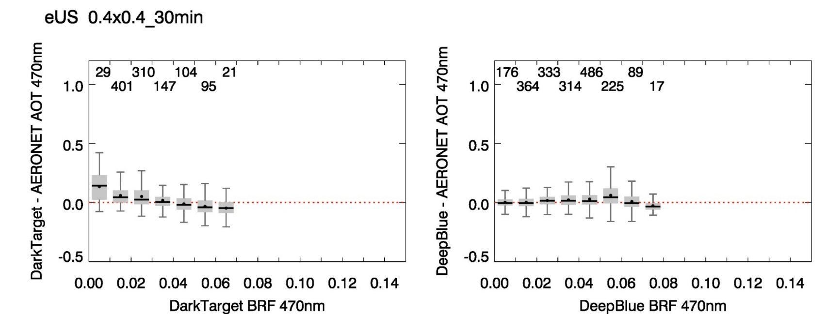
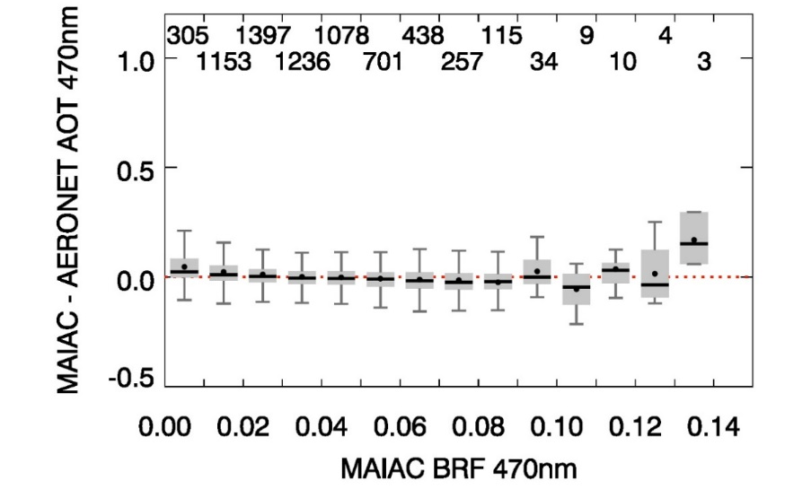
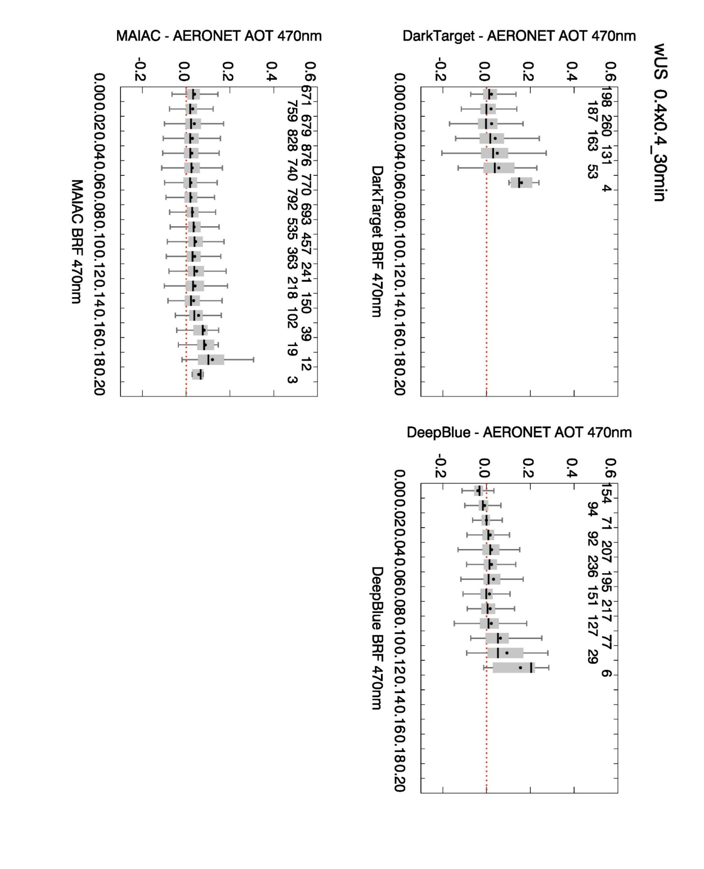
AOD Difference as a function of Surface Reflectance
Eastern N.A. Composite
Dark Target
Deep Blue
MAIAC
Western N.A. Composite
Dark Target
Deep Blue
MAIAC

Slide 19
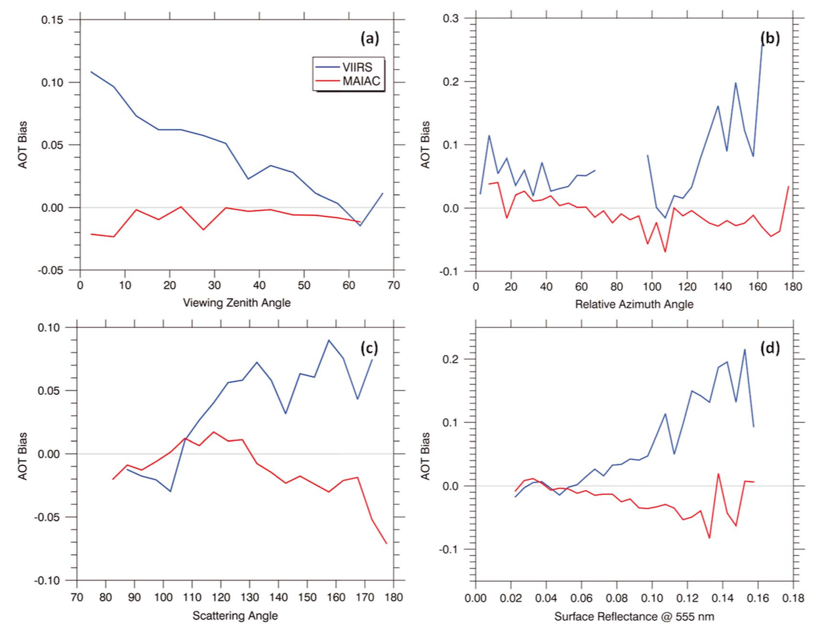
Evaluation of MAIAC and Dark Target Algorithm using VIIRS observations
Superczynki et al. [2017]
Dependence of AOT bias
Our reported results are consistent with recently published comparative analyses (Superczynski, et al, 2017)

Slide 20
Conclusions (C)
Overall, MAIAC retrievals compare better to AERONET observations
MAIAC’s accurate retrieval capability extends to bright arid/semi-arid surfaces
MAIAC retrieval frequency is significantly higher than those of the DT and DB algorithms

Slide 21
D1. MAIAC application for geostationary retrieval of Himawari aerosol and TEMPO-GOES synergy study using GLI as a testbed
Alexei Lyapustin, NASA GSFC
D2. Synergistic use of TEMPO and GOES-16 ABI observations to derive aerosol products
Pubu Ciren and Shobha Kondragunta, NOAA NESDIS

Slide 23
E. Coastal AOD and aerosol height
Jun Wang, University of Iowa

Slide 24
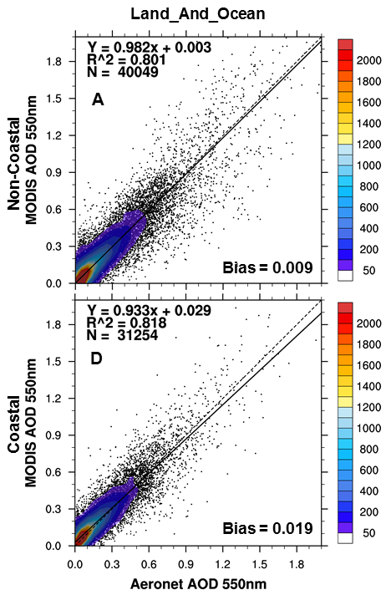
Coastal AOD retrieval, especially over turbid water
Global MOD C5
Non-coastal
No retrieval because of turbidity
Coastal
Anderson, Wang, et al., 2012

Slide 25
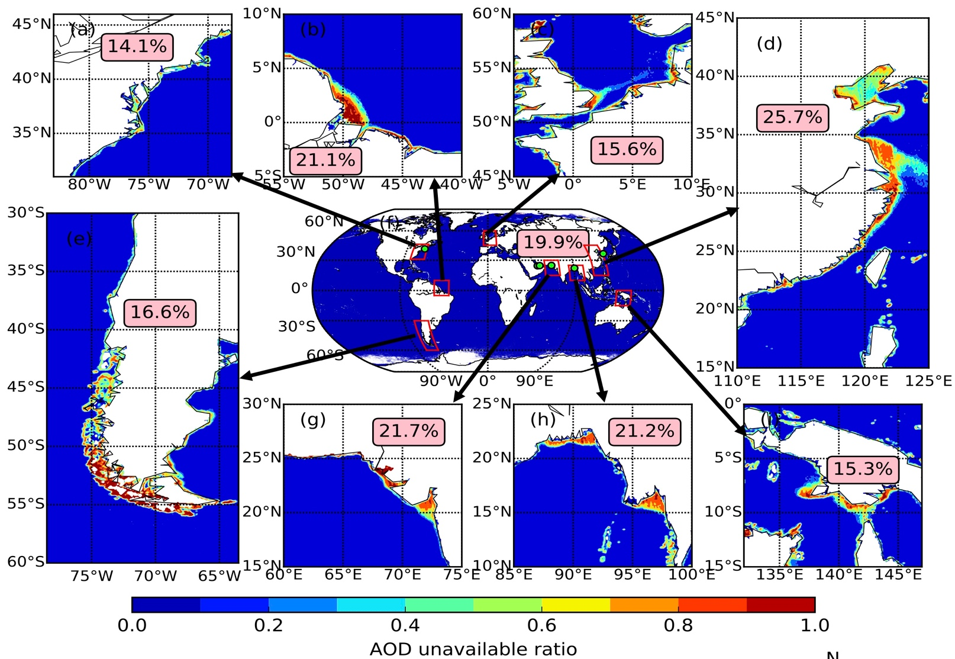
MODIS AOD Retrievals Not Valid solely due to Water
Florida

Slide 26
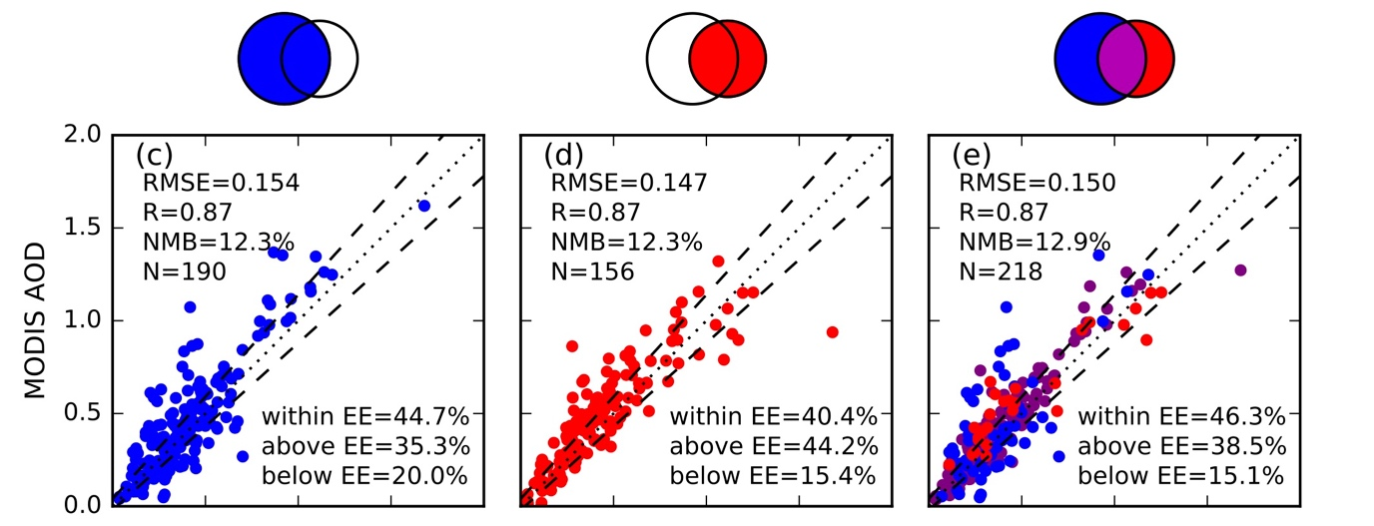
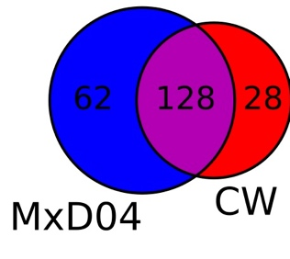
An algorithm is developed specifically for coastal AOD retrieval over turbid water using 2.1 um
Y. Wang, J. Wang, et al., 2017
Remote Sensing
The algorithm yields ~18% more MODIS-AERONET collocated pairs for six AERONET stations in the coastal water regions.
AOD
Notes:
The test algorithm yields ~18% more MODIS-AERONET collocated pairs for six AERONET stations in the coastal water regions.

Slide 27
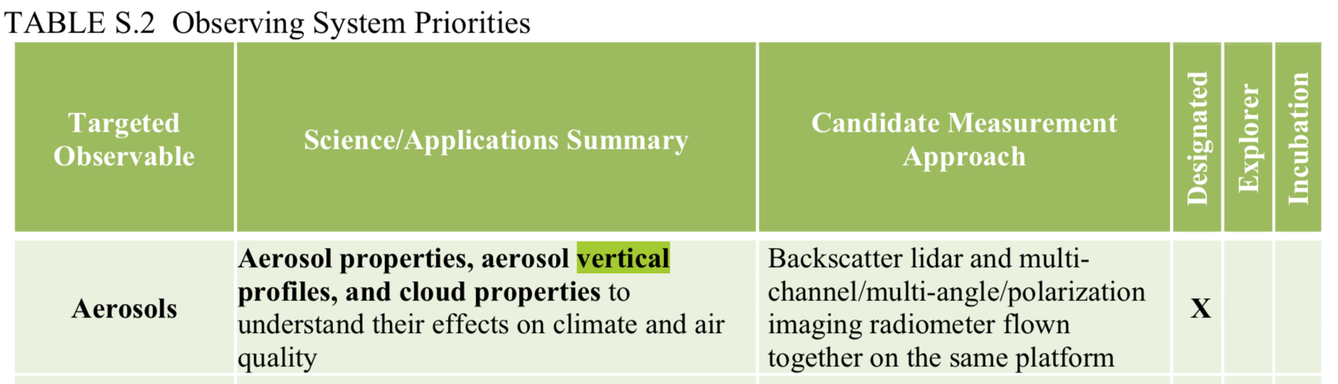
Aerosol plume height retrieval
AOD-PM_{2.5} relationship & aerosol semi-direct effect depends on aerosol profile, especially in the presence of aloft aerosol layer.
2017 Decadal Survey
Improve the understanding of the processes that determine air pollution distributions and aid estimation of global air pollution impacts on human health and ecosystems by reducing uncertainty to <10% of vertically‐resolved tropospheric fields (including surface concentrations) of speciated particulate matter (PM), ozone (O3), and nitrogen dioxide (NO2).

Slide 28
Dust plume height retrieval with O2 A and B band
Xu, Wang, et al., GRL

Slide 29
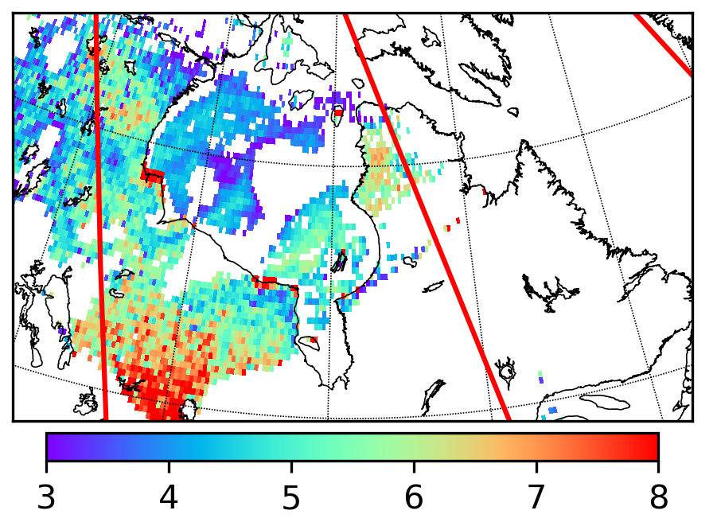
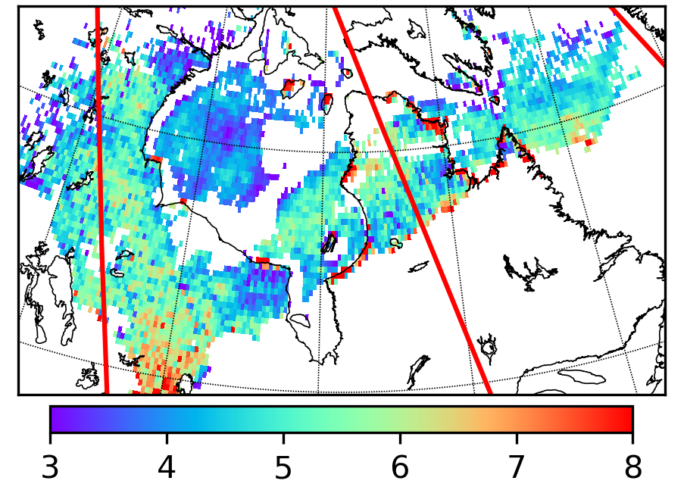

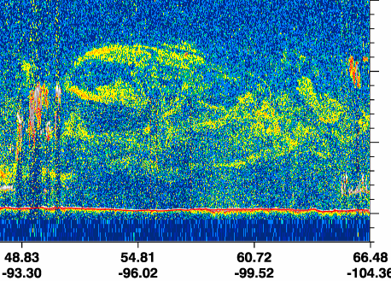
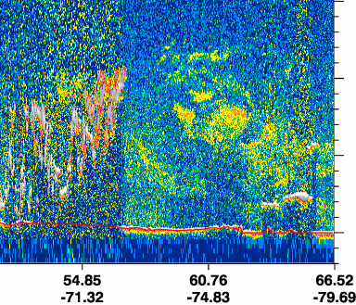
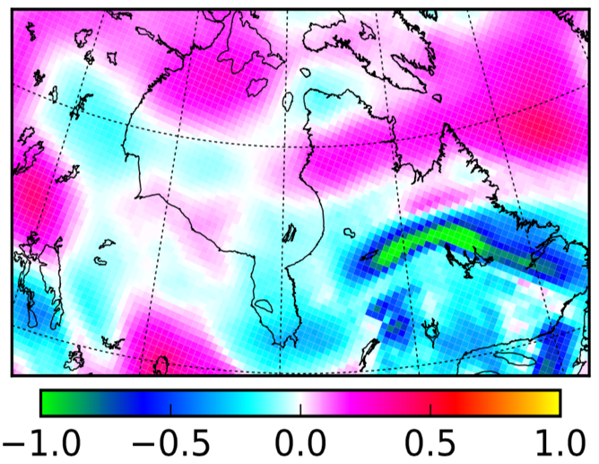
An algorithm of using O₂ A and B band to retrieve aerosol height is explored for vegetated surfaces
EPIC vs. CALIOP
23 August 2017
19:00 UTC
16:49 UTC
U
D
U
U
km
km
500 hPa level Omega (Pa/s)
18:44 UTC
North
17:05 UTC
North
D
U
Altitude (km)
U

Slide 30
Key findings and recommendations
Findings:
  Good progresses are made to advance GEO-CAPE STM in a) coastal AOD retrieval (using 2.1 um)
  Aerosol plume height retrieval (using O2 A and B bands)
Further advancement can be made by
  applying the algorithm to GOES-R (2.3 um) + TEMPO for coastal AOD
  applying O2 A+B bands with polarimetric and lidar measurements (likely through future missions, but starting with theoretic work)

