Slide 1
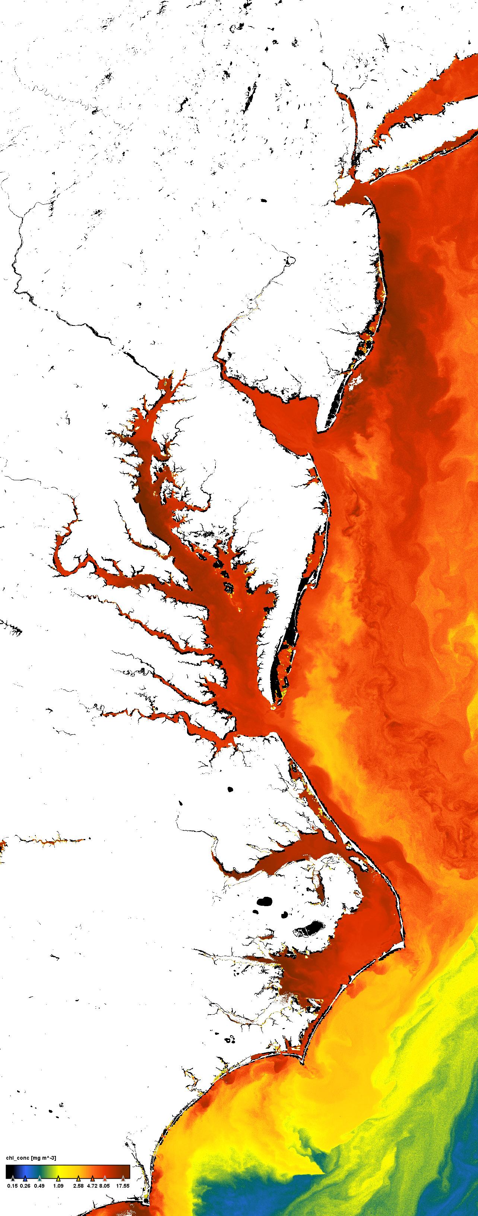
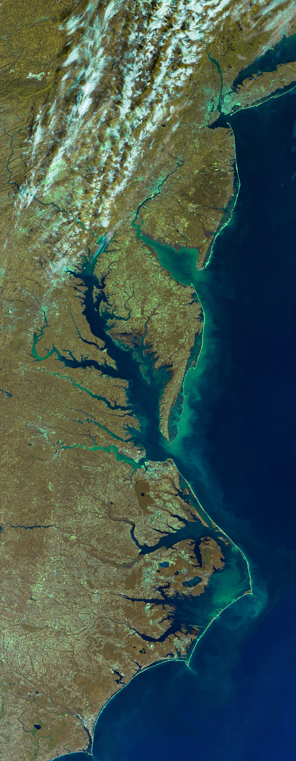
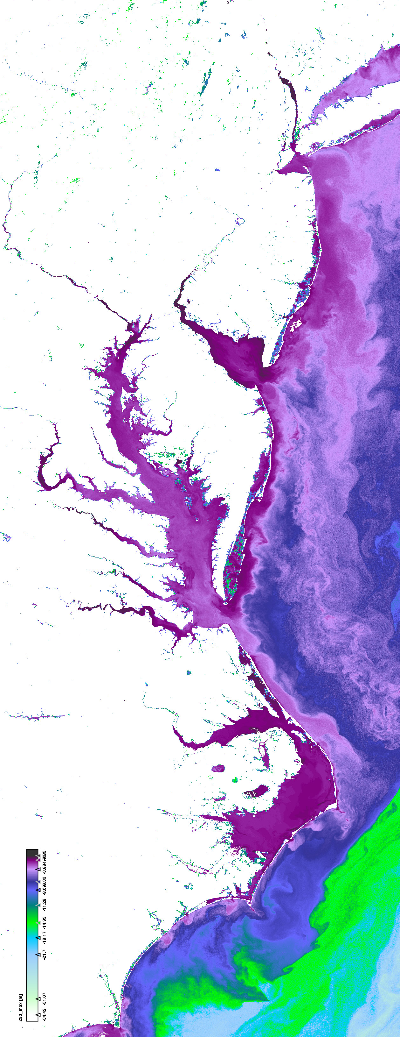
GEO-CAPE C B O D AQ Campaign
ay
hesapeake
ceanographic
iscover
11-20 July 2011
Maria Tzortziou
Associate Research Professor
University of Maryland College Park
maria.a.tzortziou@nasa.gov
On behalf of the GeoCAPE
Ocean Science Working Group
MERIS chlorophyll (http://www.coastcolour.org/site_6.html)

Slide 2
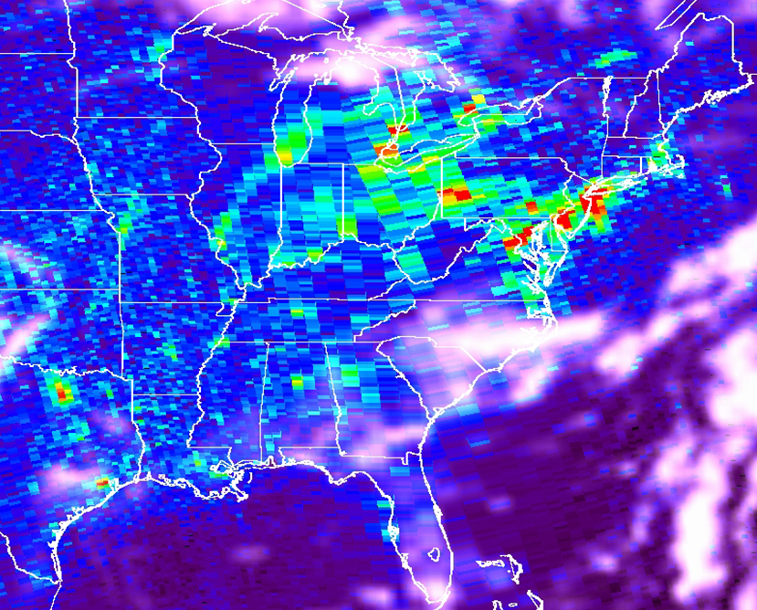
Evaluation of satellite products & derived spatial and temporal variability
OMI NO2 over the Eastern US
Wed Th Fr Sat Sun Mon Tues
“Weekly cycle of NO2 by GOME “ Beirle et al., 2003

Slide 3
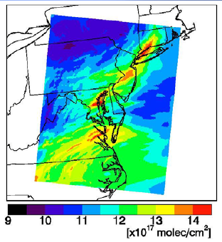
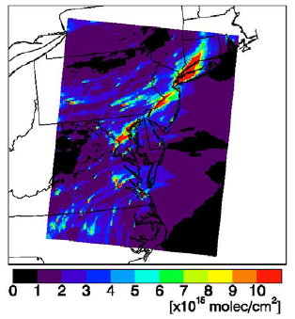
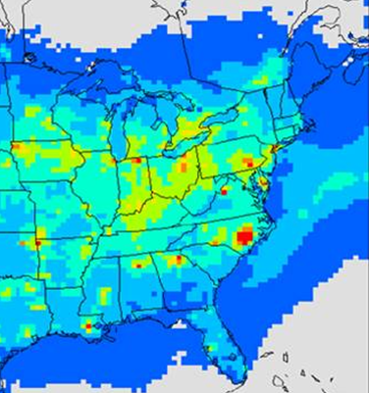
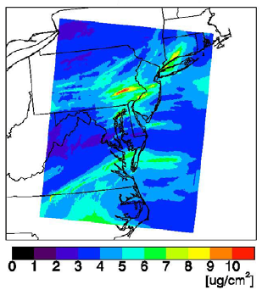
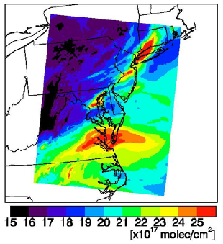
Air quality and impacts on coastal ecosystems
For improving modeling and prediction of sources, transport, chemical transformations, distribution, and deposition of atmospheric pollutants at the land-ocean interface …
Community Multiscale Air Quality (CMAQ) Model simulations
July 9, 2007 – 18 UTC
Trop Column (sfc-200 hPa
In the Chesapeake Bay, at least one third, and probably significantly more, of total nitrogen inputs comes from air deposition [STAC Publ. 09-001, 2009].
O₃
NO₂
PM₂
CO
Total Nitrogen Deposition (Kg-N/HA)– CMAQ Output (2001)

Slide 4
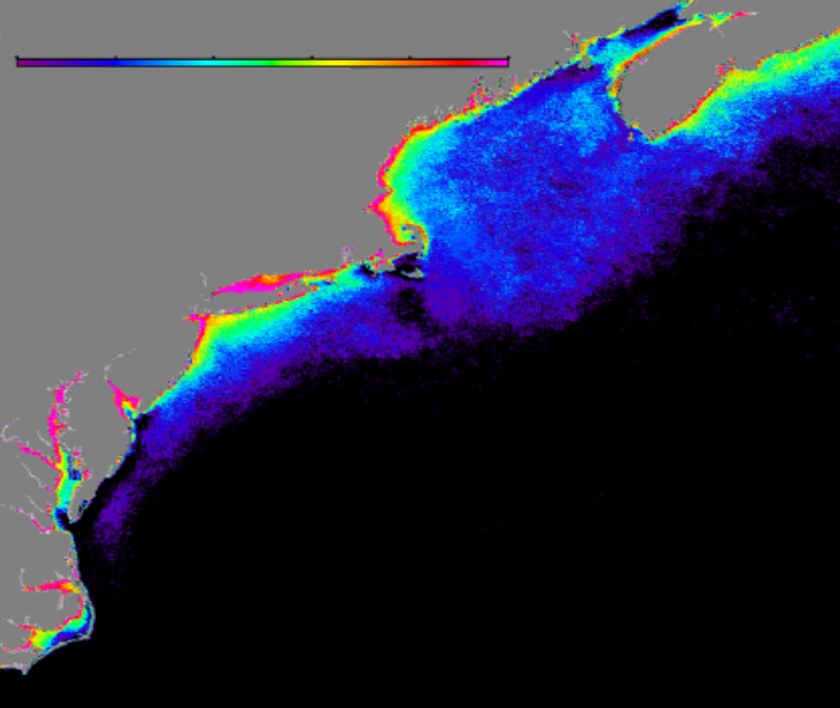
Improved Atmospheric Correction of Satellite Ocean Color
0.0 0.2 0.4 0.6 0.8 1.0
nLw - P_{neg} (probability)
by Jay O'Reilly; NOAA/NMFS, Narragansett, RI).
Probability of retrieving negative water-leaving radiances for the SeaWiFS 412nm band along the eastern seaboard of North America.

Slide 5
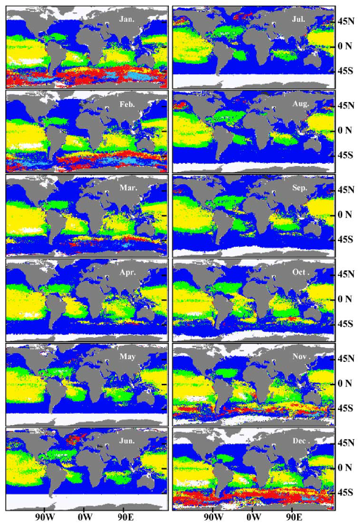
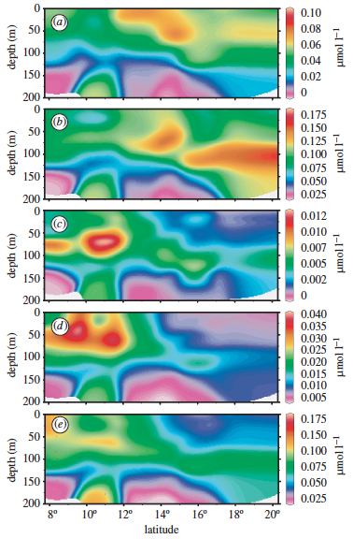
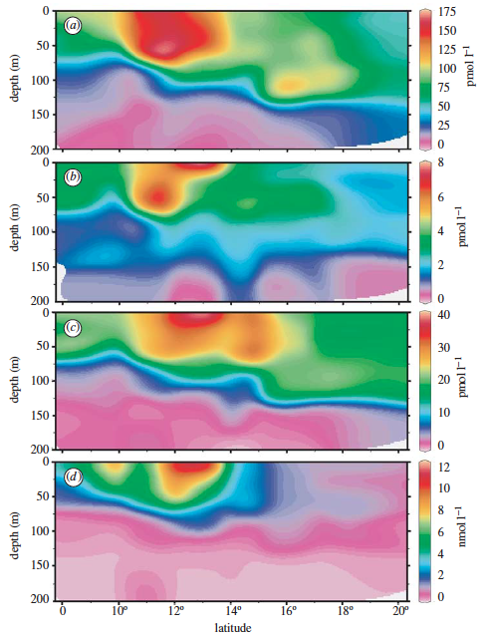
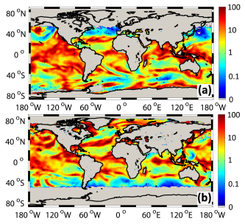
Land-Atmosphere-Ocean Interactions
by Jay O'Reilly; NOAA/NMFS, Narragansett, RI).
Influences of meteorology on coastal waters and vice versa
Bidirectional fluxes of chemical constituents between the atmosphere and coastal waters
Impacts of anthropogenic activities on coastal ocean biogeochemical cycles
(GEO-CAPE Interdisciplinary Science Group White Paper)

Slide 6
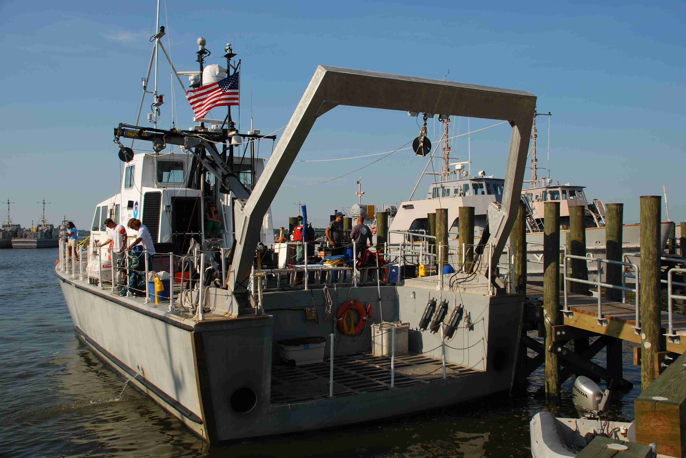
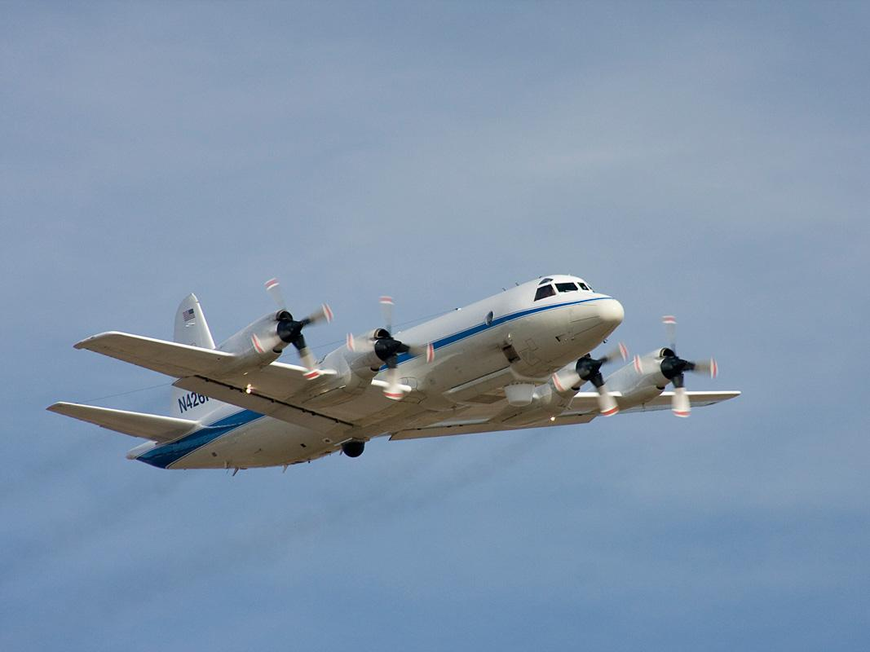
GEO-CAPE CBODAQ Campaign in the Chesapeake Bay ( 11-20 July 2011)
CBODAQ: Chesapeake Bay Oceanographic Campaign with Discover-AQ
More than 25 scientists and additional students from 10 research and academic institutions in the US participated with measurements on the ship, data processing, analysis, interpretation
NASA aircraft campaign DISCOVER-AQ (Deriving Information on Surface Conditions from COlumn and VERtically Resolved Observations Relevant to Air Quality
NOAA Vessel SRVx - National Marine Sanctuary Test and Evaluation Vessel R8501

Slide 7
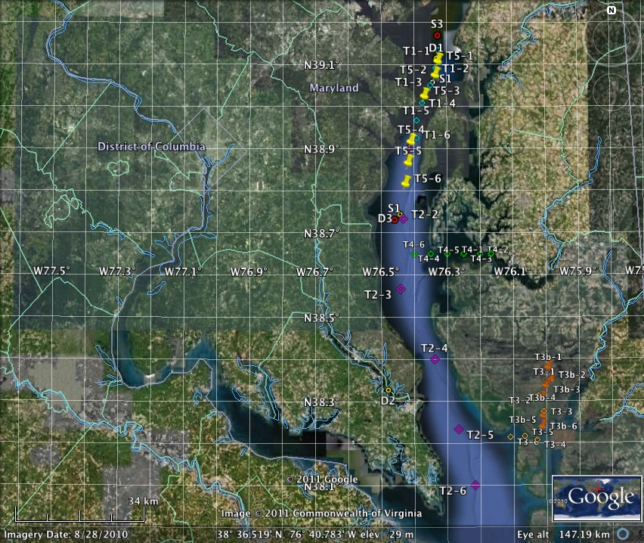
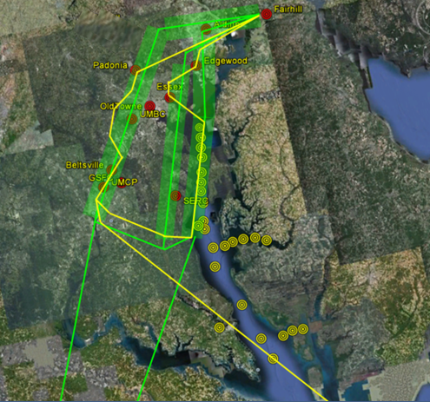
GEO-CAPE CBODAQ Campaign in the Chesapeake Bay ( 11-20 July 2011)
Spatial: | 2 days: stationary (S#)- measurements at one location - upper bay main stem (1 flight day) 3 days: follow water mass (drifter (D#) w/ GPS tracking) - upper bay main stem (2 flight days) - lower Patuxent river 5 days: transects (T#) - 2 transects in upper bay (2 flight days) - 1 transect in mid bay - Choptank River/estuary - Blackwater Wildlife Refuge marshes
Temporal: | 6 to 10 discrete stations during each day
Vertical: | 3 depths (surface, 10% and 1% light depth)
Aircraft flights during
DISCOVER-AQ campaign

Slide 8
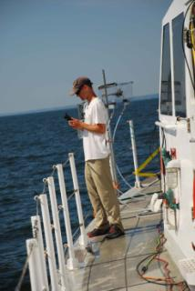
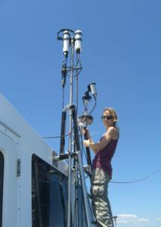
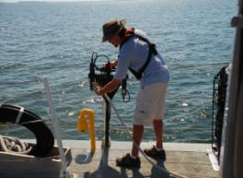
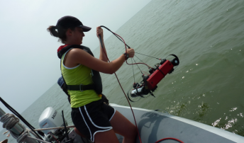
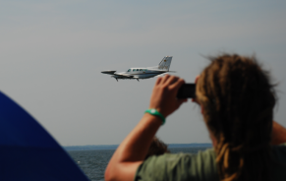
GEO-CAPE CBODAQ Campaign in the Chesapeake Bay ( 11-20 July 2011)
Objectives of oceanographic campaign:
❖ Study small scale and short-term dynamics in biogeochemical variables
❖ De-convolve spatial gradients with diurnal variability
❖ Examine and understand the causes of diurnal variability including tides, in situ production or transformations, river discharge, etc.
❖ Study dissipation/dispersion of phytoplankton communities, sediments, POM, DOM, and contaminants (incl. episodic events in rivers, estuaries and lakes).
❖ Look at diurnal phytoplankton physiological dynamics & implications for NPP models
❖ Algorithm development for coastal ocean products

Slide 9
GEO-CAPE CBODAQ Campaign in the Chesapeake Bay ( 11-20 July 2011)
Objectives of oceanographic campaign:
❖ Evaluate the spatial and temporal patterns in atmospheric variability and what this variability
represents in terms of uncertainties in GEO-CAPE ocean color data products
❖ Apply ACAM and HSRL (High Spectral Resolution Lidar) observations to ocean color studies
❖ Apply results from ocean and air-quality measurements to examine optical closure in the
ocean-atmosphere system
❖ Assess the role of Chesapeake as a net source/sink for certain aerosols and trace gases.
❖ Integrate results with air-quality model simulations, to study effects of meteorological
processes at the land-ocean interface on near-shore water quality and biogeochemistry

Slide 10
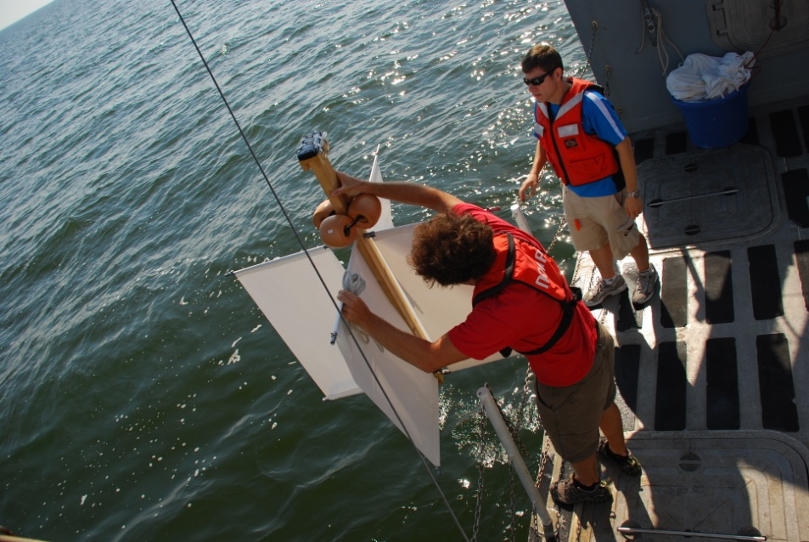
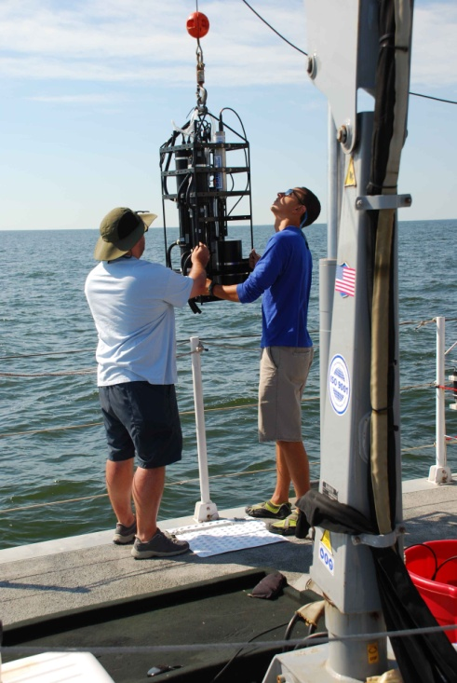
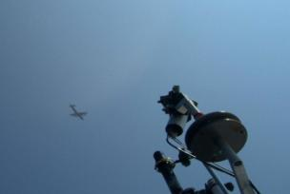
GEO-CAPE CBODAQ Campaign in the Chesapeake Bay ( 11-20 July 2011)
Measured Parameters
Water Inherent Optical Properties (IOPs): Total in-water absorption, a, scattering, b, attenuation, c, backscattering, bb, (ac-9, ac-s, VSF3, ECO triplet, CTD) – surface measurements and in-water profiles More Optical Parameters: Fluorometric Chlorophyll-a Chl-a, phytoplankton absorption spectra, aph, non-algal particulate absorption spectra, ad, colored dissolved organic matter absorption spectra, aCDOM, CDOM fluorescence Excitation Emission Matrices, EEMs
Radiometry: Surface Down-welling Irradiance, Es, Upwelling Radiance, Lu, Down-welling Irradiance, Ed, Water-leaving radiance, Lw, Remote Sensing Reflectance, Rrs, Normalized water leaving radiance, nLw, exact nLw, Q, Fo, %LL, Photosynthetically active radiation, PAR, Diffuse attenuation coefficient, Kd, KdPAR, KLu, Zeu, Kbio, OCnVn, etc. (C-Ops; 19-band UV-NIR sensor; 10nm FWHM) – profiles Ed, Lu, Es - HyperPro (UV-NIR; 3nm FWHM). NIR hand-held above-water radiometer/ 350 to 880 nm 512 channels (15 days).
Biogeochemical variables: Particulate Organic carbon and nitrogen, POC/PN, Dissolved Organic Carbon DOC, Total Dissolved Nitrogen, TDN, Suspended Particulate Matter, SPM; HPLC pigments (no cost); Phytoplankton cell count sample collection;
Primary Productivity incubations
Phytoplankton cell counts
O2 and partial pressure CO2 pCO2, Dissolved Inorganic Carbon DIC, Total Alkalinity TA, pH
Analysis for Vibrio species in collected water samples, including cholera
Measurements of aerosols/trace gases: AOD – Microtops instruments Total Column NO₂, O₃, SO₂, H₂O, HCHO, BrO - Pandora measurements Surface O₃, NO, NOy – In-situ sensors on the ship Boundary Layer Height and NRB – Micropulse Lidar (MPL) measurements In situ meas. of Aerosols and Trace Gases - Samples of CH4, Analysis for water-soluble inorganic ions; Organic analysis; Detailed information on submicron size distributions.

Slide 11
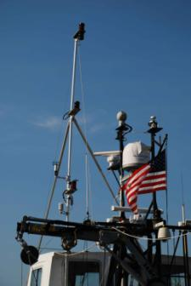
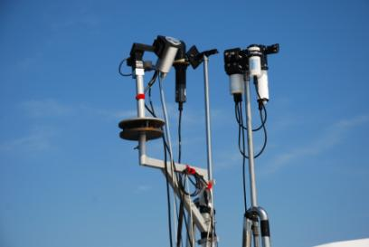
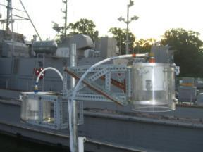
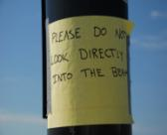
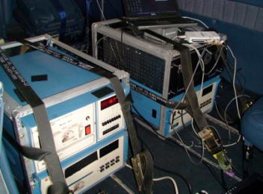
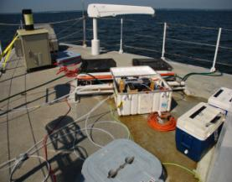
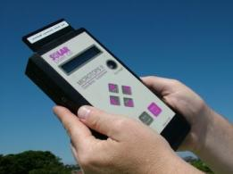
GEO-CAPE CBODAQ Campaign in the Chesapeake Bay ( 11-20 July 2011)
Instruments for measurements of atmospheric variability
Meteorological sensors
Pandora
Downwelling Irradiance
Sensors for Ocean Color
Wavelength | 280 to 525 nm
Spectral res | 0.5 nm
Detector | 2048 pixels CCD
Field of view | 2.5º FWHM
Camera FOV | 40.0º
Pointing Prec | 0.01º
ND Filter | ND1 to ND3
Filters for aerosol collection
MPL
O3, NO, NOy instruments (surface meas)
NRB
PBL
Microtops
(AOD at 340-880)

Slide 12
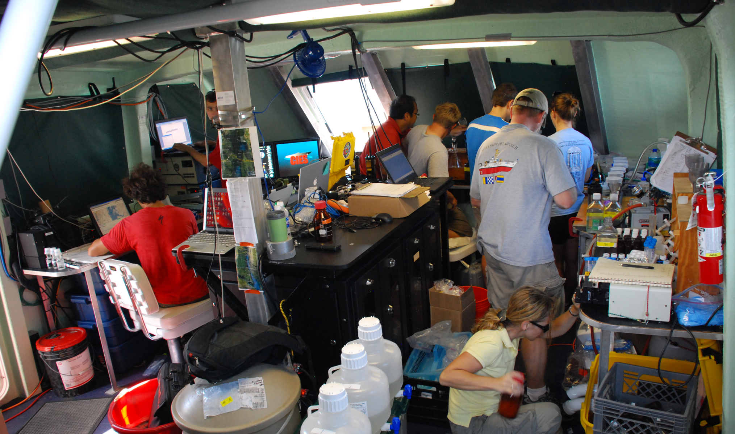
GEO-CAPE CBODAQ Campaign in the Chesapeake Bay ( 11-20 July 2011)
Lab on SRVx

Slide 13
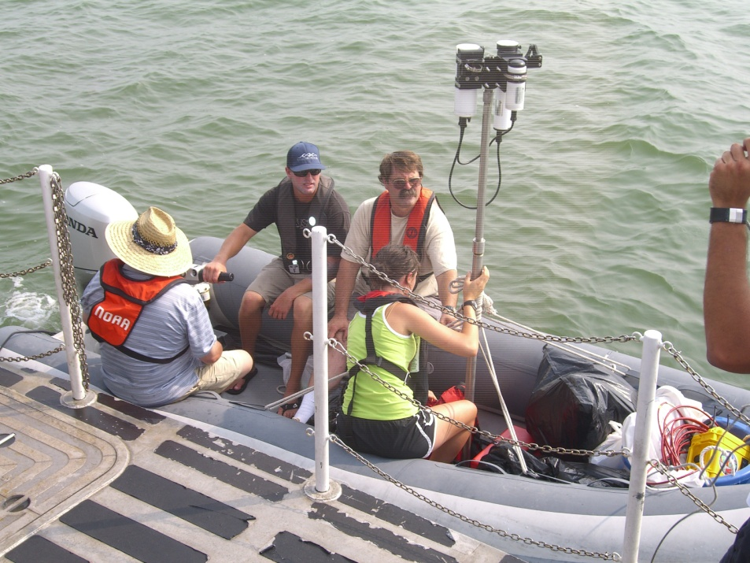
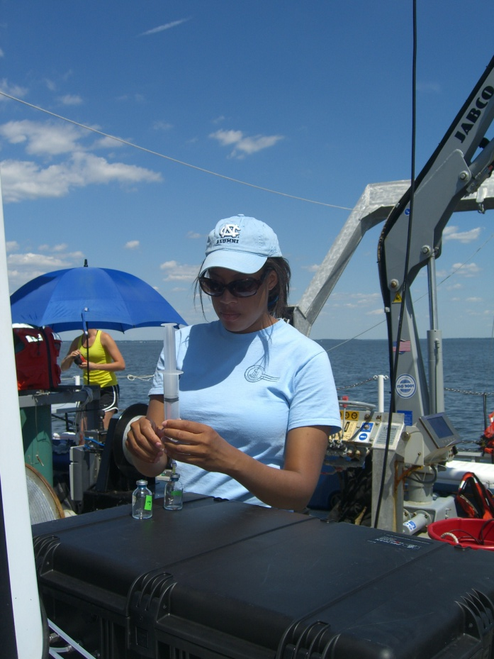
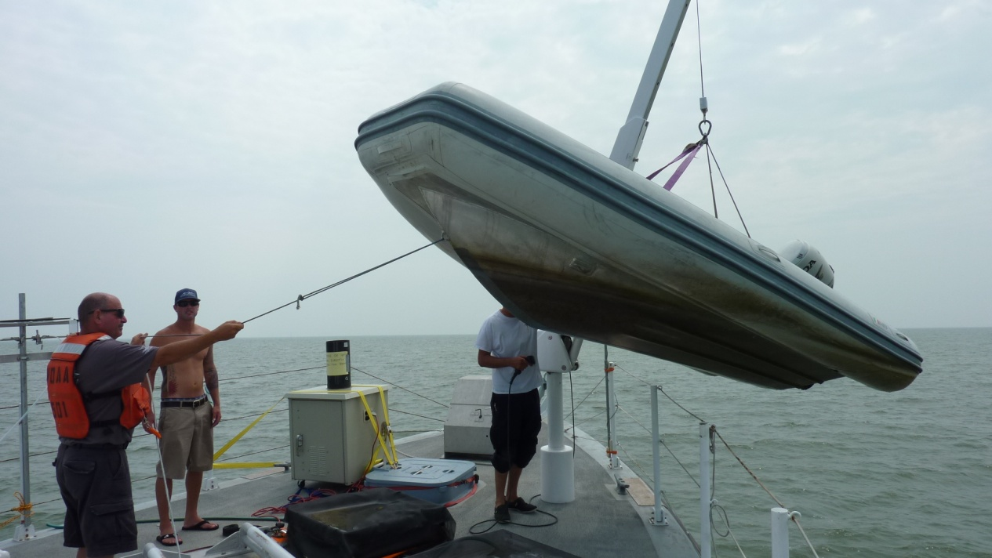
GEO-CAPE CBODAQ Campaign in the Chesapeake Bay ( 11-20 July 2011)
Zodiac for measurements in shallow waters
IOPs/AOPs
Experiments on deck
Deployment of drifter

Slide 14
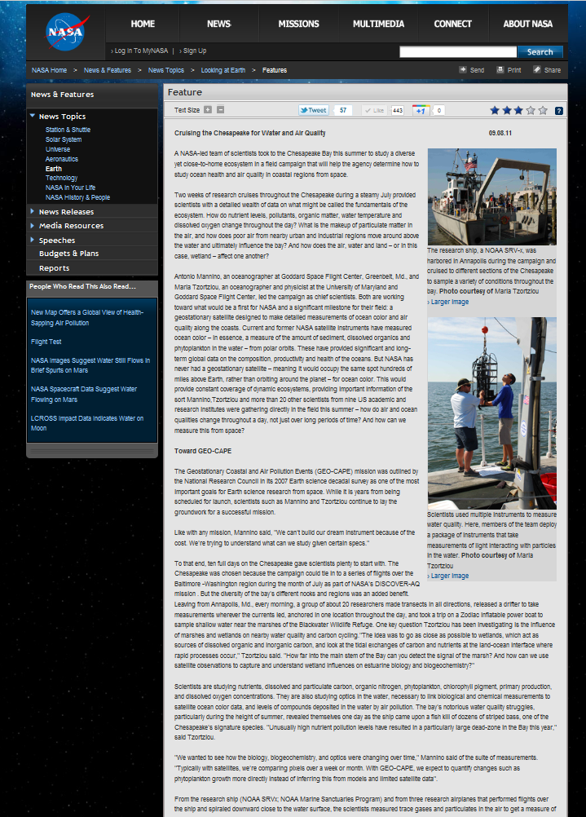
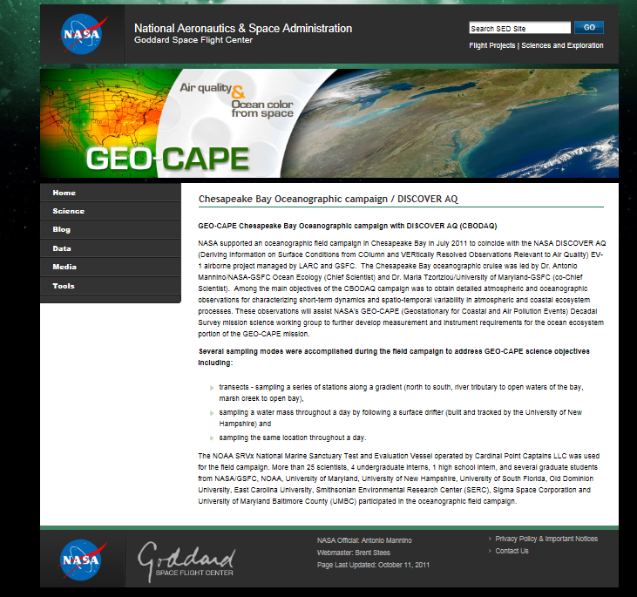
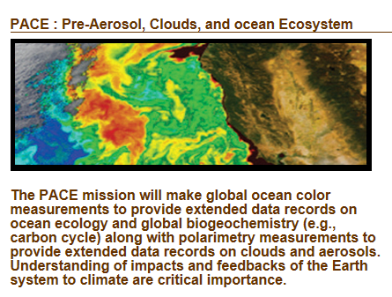
GEO-CAPE CBODAQ Campaign in the Chesapeake Bay ( 11-20 July 2011)
❖ Currently working on data analysis, interpretation of measurements from the ship, manuscripts.
❖ Several posters presented at this meeting discuss measurements related to CBDOAQ/GoMex campaigns
❖ The combined atmospheric and oceanographic data collected are relevant to both atmospheric and ocean components of GEO-CAPE, as well as other NASA future satellite missions, including PACE, ACE, HyspIRI.
❖ Collected data uploaded on NASA SeaBASS database and the DISCOVER-AQ archive. Aerosols data on the NASA AERONET Maritime Aerosol Network
❖ Feature article highlighting CBODAQ appeared on:
→ NASA Earth News & Features
http://www.nasa.gov/topics/earth/features/chesapeake-quality.html
→ the Smithsonian Institution News and Highlights
http://sercblog.si.edu/?p=1376
→ NASA's "Global Climate Change - Vital Signs of the Planet".
http://climate.nasa.gov/news/587
→ NASA's "Ocean Ecology Science Research Portal“
http://neptune.gsfc.nasa.gov/osb/index.php?section=250
❖ GEO-CAPE CBODAQ website:
https://geo-cape.gsfc.nasa.gov/osb/index.php?section=250

Slide 15
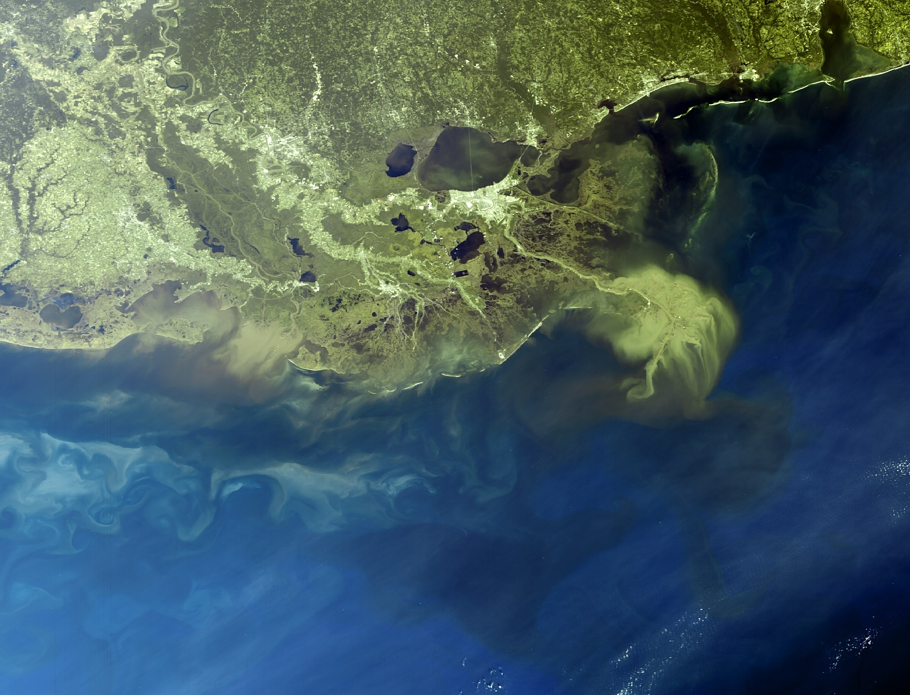
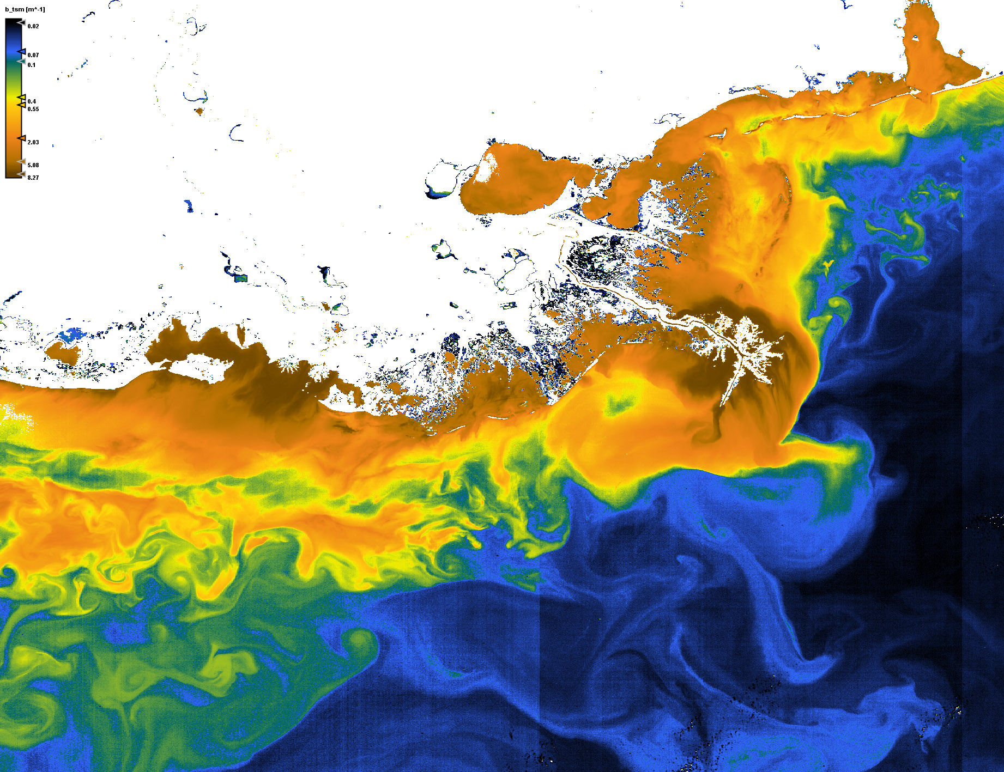
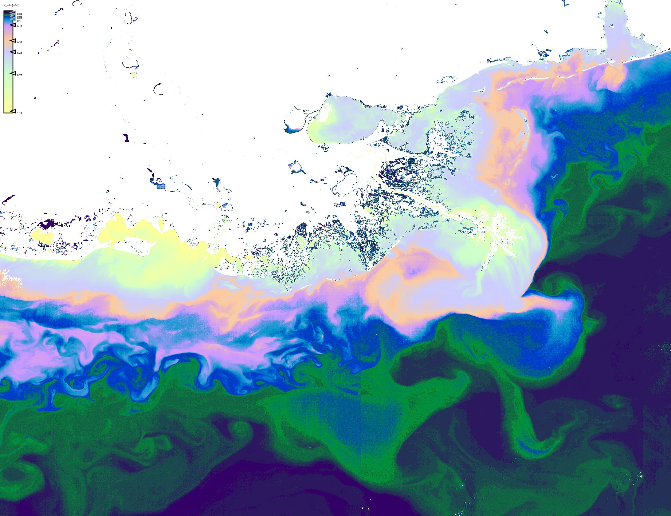
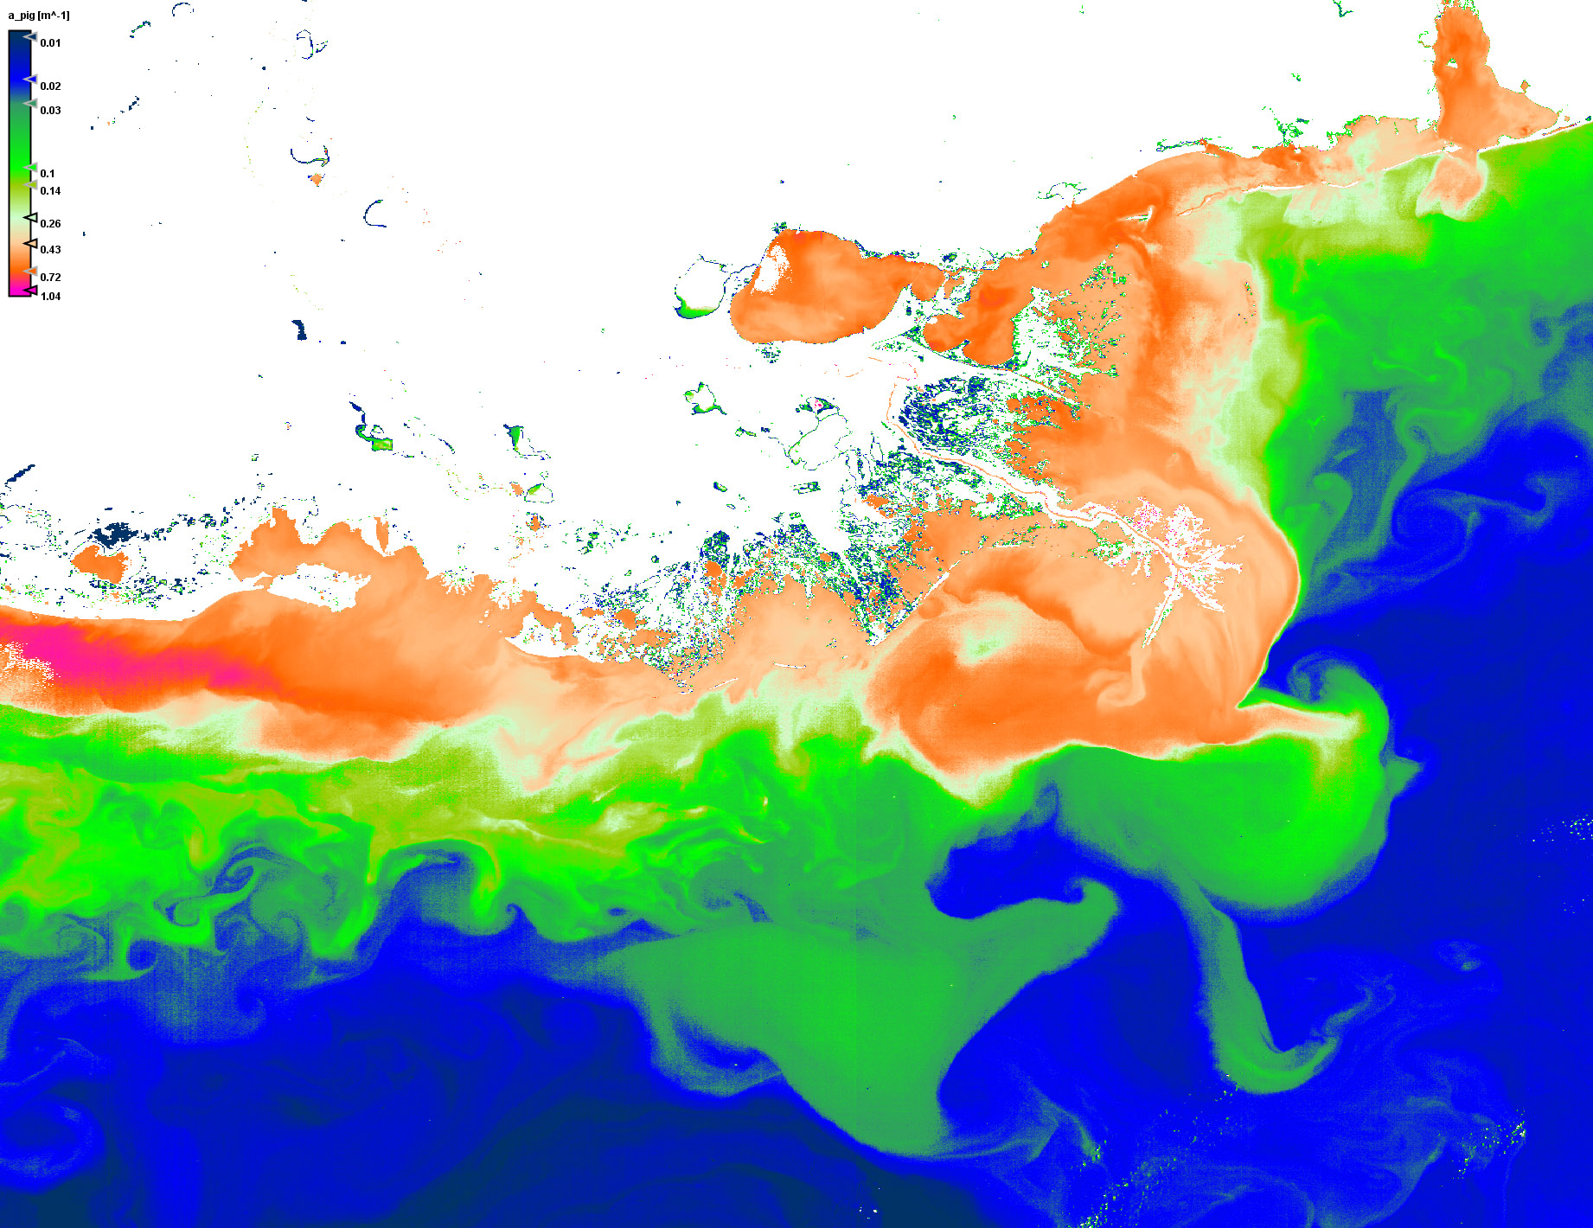
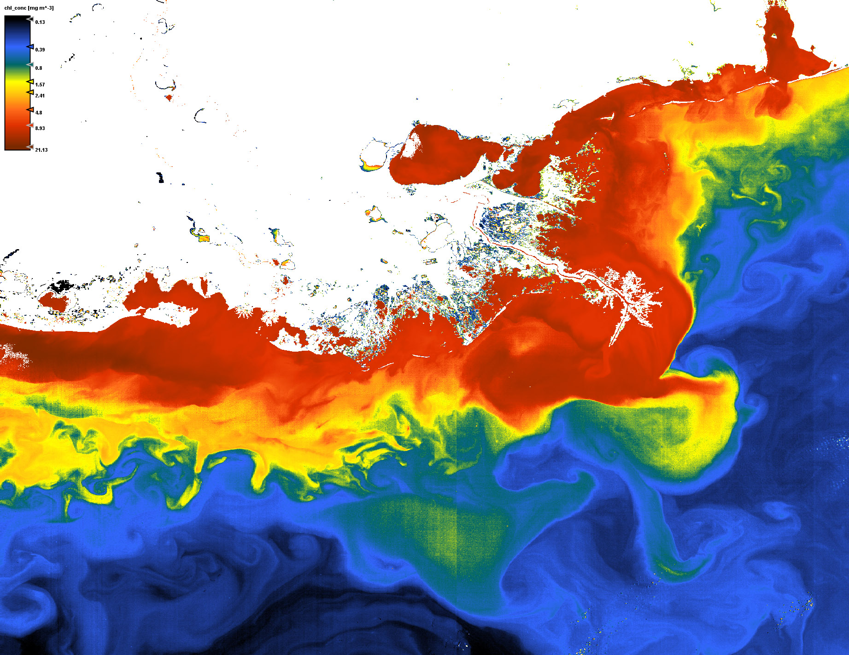
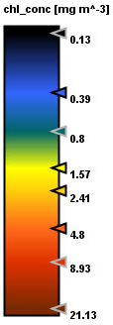
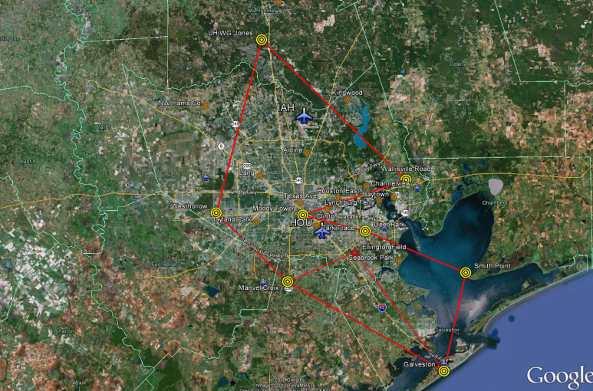
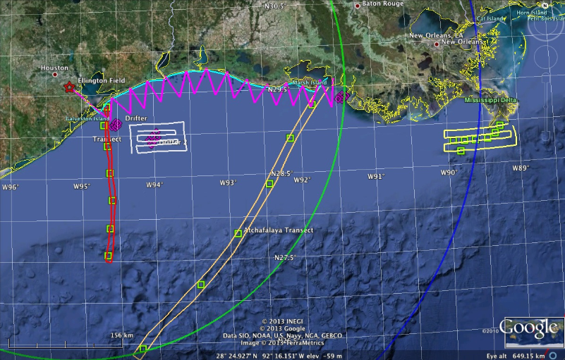
GEO-CAPE Campaign in the Gulf of Mexico – September 2013
Backscatter coefficient
of suspended matter
Next GEO-CAPE oceanographic campaign in September 2013
In the Gulf of Mexico, Mississippi/Atchafalaya river plume, extending along the coast into Galveston Bay
Water attenuation coefficient
at wavelength where this value
is at minimum
Pigment absorption coefficient
Chlorophyll concentration
King Air
RV Pelican
MERIS: Gulf Of Mexico 30. September 2008, orbit: 34434

Slide 17
GEO-CAPE CBODAQ Campaign in the Chesapeake Bay ( 11-20 July 2011)
Manuscripts related to CBODAQ measurements
Le, C., C. Hu, J. Cannizzaro, and H. Duan (2013). Long-term distribution patterns of remote sensed water quality parameters in Chesapeake Bay. Estuarine, Coastal and Shelf Science, accepted.
- Joe et al., “Estimation of aragonite saturation state in plume dominated coastal waters”, (In Prep)
-Tzortziou M., J. R Herman, *C. P Loughner, A.Cede, N. Abuhassan, S. Naik, 2013, " Spatial and temporal variability of ozone and nitrogen dioxide over a major urban estuarine ecosystem", Journal of Atmospheric Chemistry, Special Issue PINESAP, DISCOVER-AQ, DOI: 10.1007/s10874-013-9255-8.
-Reed A., A. M. Thompson, D. E. Kollonige, D. K. Martins, M. Tzortziou, J. R. Herman, T. A. Berkoff, N. K. Abuhassan, A. Cede, 2013, "Effects of Local Meteorology and Aerosols on Ozone and Nitrogen Dioxide Retrievals from OMI and Pandora Spectrometers in Maryland, USA during DISCOVER-AQ 2011", Journal of Atmospheric Chemistry, Special Issue PINESAP, DISCOVER-AQ, DOI: 10.1007/s10874-013-9254-9.
-Stauffer R, Thompson A, Martins D.K., Clark R.D., Loughner C.P., Delgado R., Berkoff T.A., Gluth E.C., Dickerson R.R., Stehr J.W., Tzortziou M., Weinheimer A.J., 2012, "Bay Breeze Influence on Surface Ozone at Edgewood, MD, during July 2011", Journal of Atmospheric Chemistry, DOI: 10.1007/s10874-012-9241-6
- Loughner C.P., M. Tzortziou, M. Follette-Cook, K. E. Pickering, D. Goldberg, C. Satam, A. Weinheimer, J. H. Crawford, A. Mannino, D. J. Knapp, D. D. Montzka, G. B. Diskin, L. T. Marufu, and R. R. Dickerson (In Review), "Impact of bay breeze circulations on surface air quality and boundary layer export", Atmospheric Environment
- Tzortziou M., J. R Herman, Z. Ahmad (In Review), "Variability in Atmospheric NO2 and Impact on Ocean Color Retrievals in Coastal Waters near Polluted Urban Areas", Journal of Geophysical Research.
Goldberg DL, CP Loughner, M Tzortziou, JW. Stehr, KE Pickering, L Tambaoga Marufua, JH Crawfordd, RC Cohene, and R Dickerson, (In Review), "Surface Ozone Concentrations over the Chesapeake Bay during DISCOVER-AQ", Atmospheric Environment
back

Slide 18
GEO-CAPE CBODAQ Campaign in the Chesapeake Bay ( 11-20 July 2011)
GEO-CAPE Poster Presentations
Aurin: Murky Waters: Atmospheric Correction and MODIS Ocean Color Uncertainty in Extreme Environments.
Aurin: Spatially resolving ocean color and sediment dispersion in river plumes, coastal systems, and continental shelf waters.
Davis: Using HICO and GOCI Data to Prepare for GEO-CAPE
Frost: Evaluating NOx emissions using satellite observations
Guild: NASA's Coastal and Ocean Airborne Science Testbed (COAST) Project
Jeong, U.: Preliminary result of the on-line Jacobian calculatio retrieval algorithm of AOD and SSA from OMI noramlized radiance data using VLIDORT
Jordan: Shipboard in situ aerosol measurements during CBODAQ, potential shipboard in situ aerosol measurements for GoMex, and developing a framework for interdisciplinary science studies
Kim, B. -R.: GEMS cloud algorithm development status
Kim, Si-Wan: Sensitivity of modeled vertical column NO2 , HCHO, CHOCHO, and O3 to emission inventories in the Los Angeles Basin
Kim, Y. J.: Status of NO2 and SO2 retrieval algorithm for GEMS
Kim, Y. J.: Retrieval of UV aerosol index using OMI observation data and VLIDORT during Dragon Campaign
Kulawik: Effect of surface albedo on ozone retrievals in the UV, VIS, and TIR
Kwon, H. -A.: Issue of development of formaldehyde retrieval for GEMS
Morrow and Hooker: Hybridspectral Instrument Technologies for Next Generation NASA missions: DISCOVER AQ Gulf of Mexico
Newchurch: Tropospheric ozone lidar network
Pickering: Ability of GEO-CAPE to detect lightning NOx and resulting upper tropospheric ozone enhancement
Tzortziou: Atmospheric trace-gas dynamics and impact on ocean color retrievals in urban estuarine and coastal ecosystems
Vassilkov and Joiner: Sensitivity of TOA radiance around the O2 γ and B bands to aerosol height
Worden: Averaging Kernel prediction from atmospheric and surface state parameters based on multiple regression with MOPITT CO and TES-OMI O3 multispectral observations
back

