Slide 1
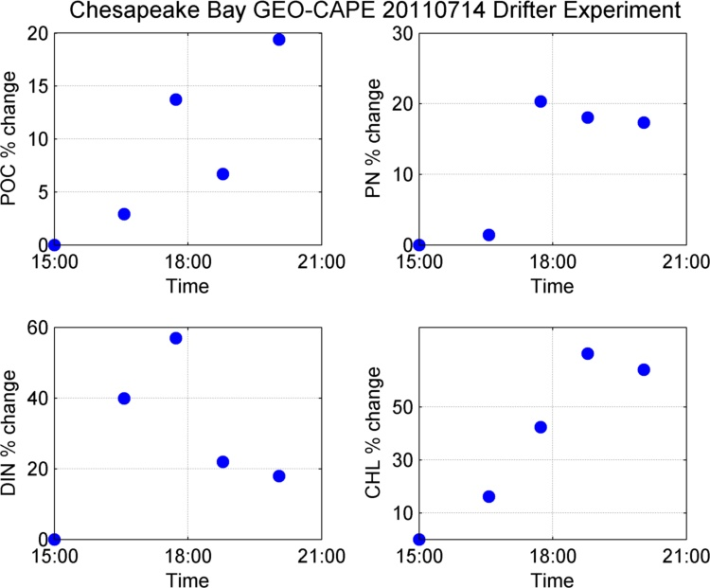
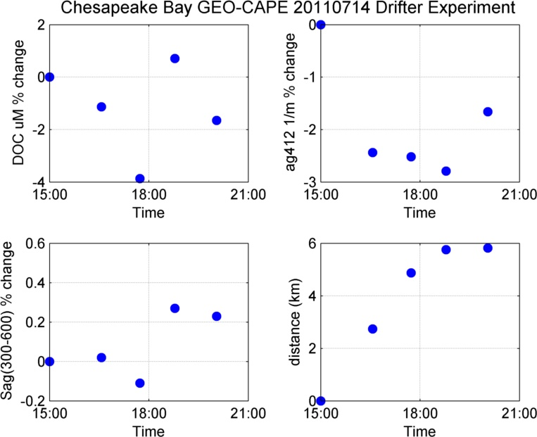
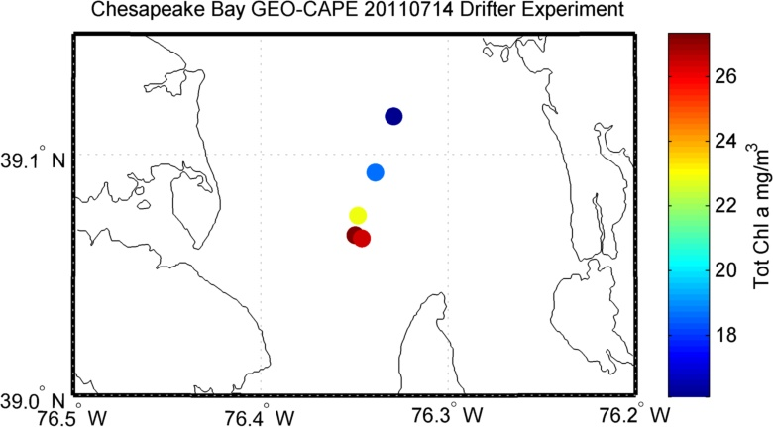
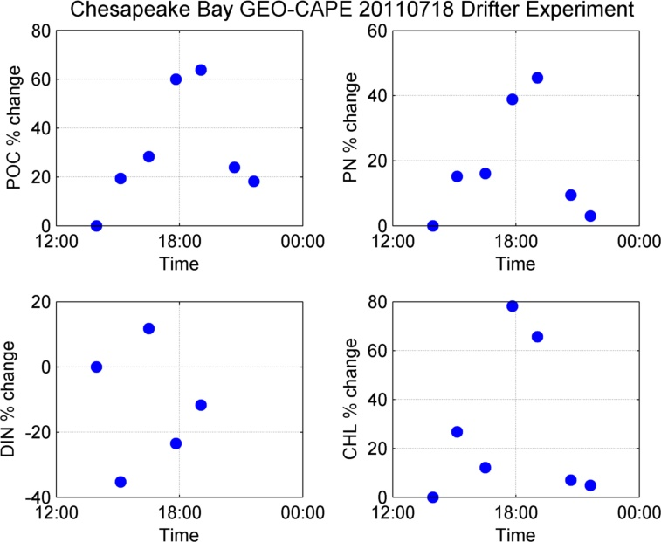
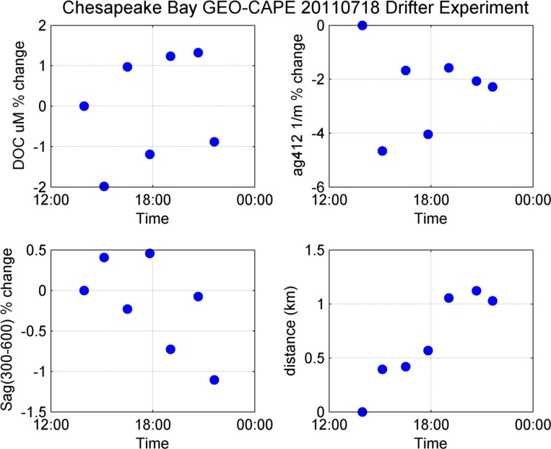
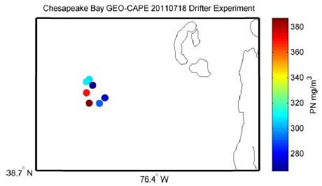
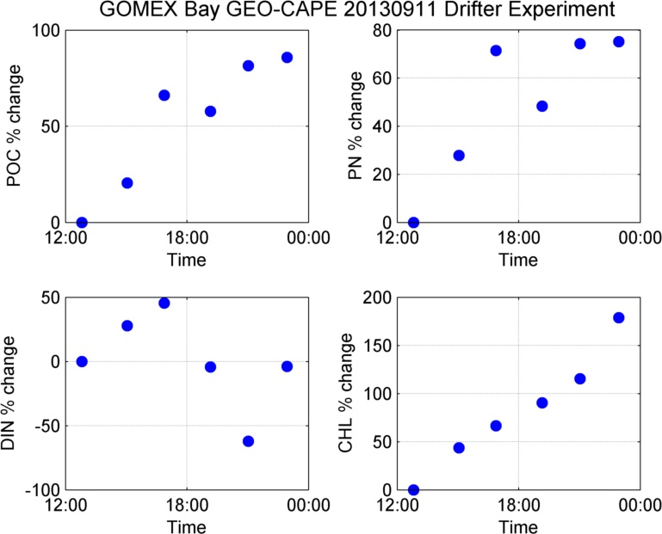
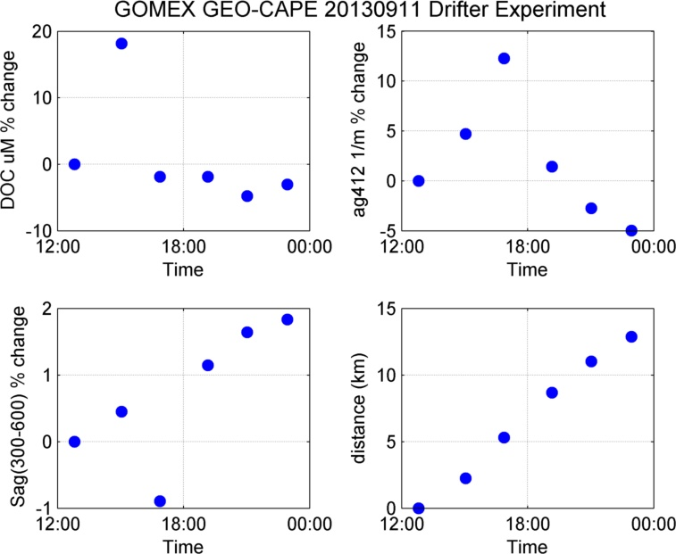
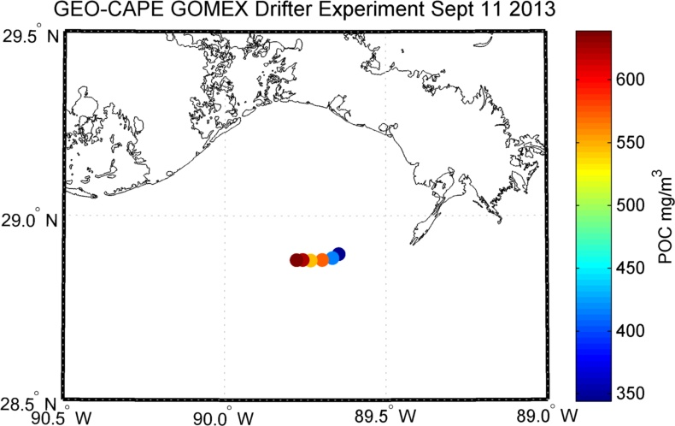
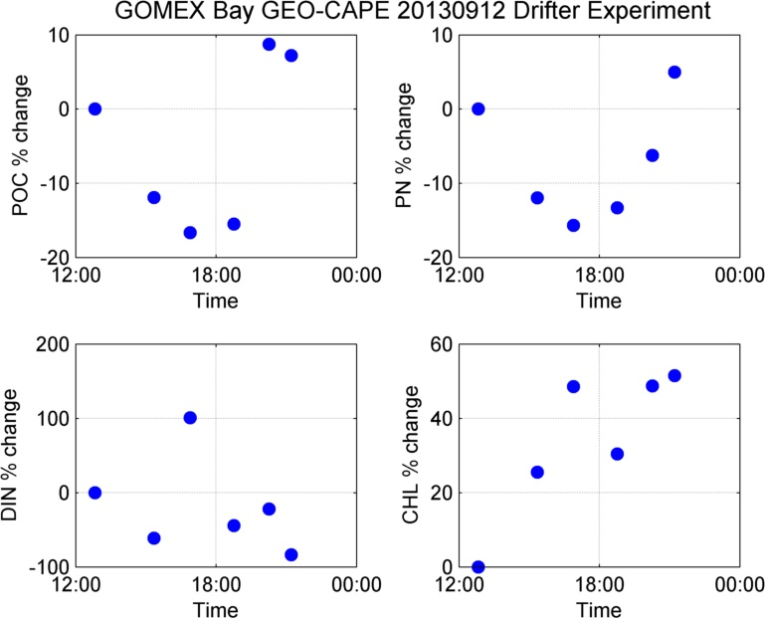
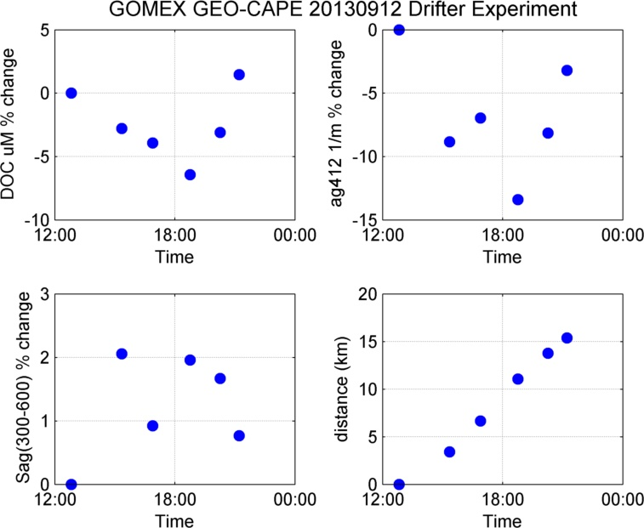
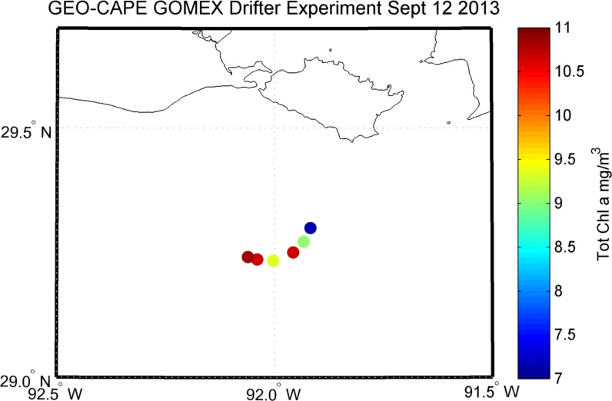
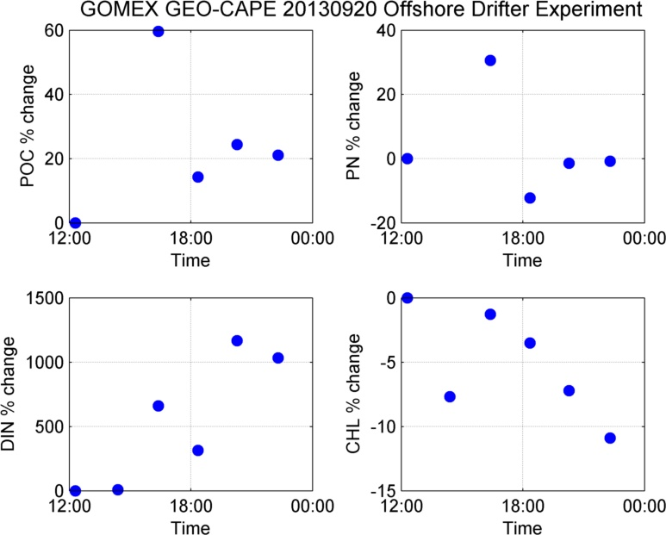
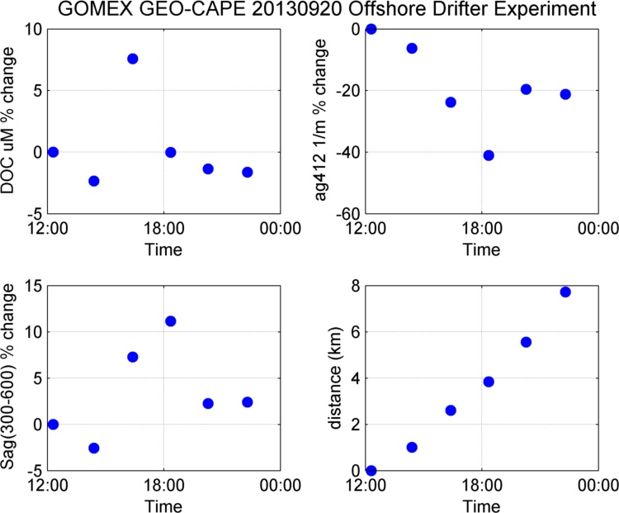
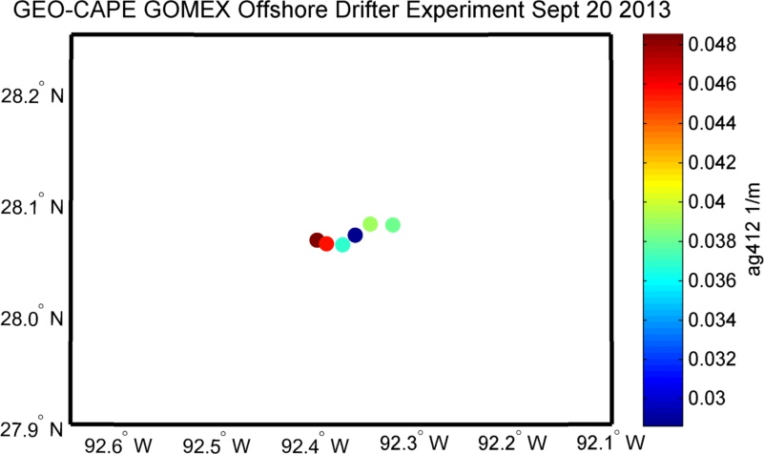
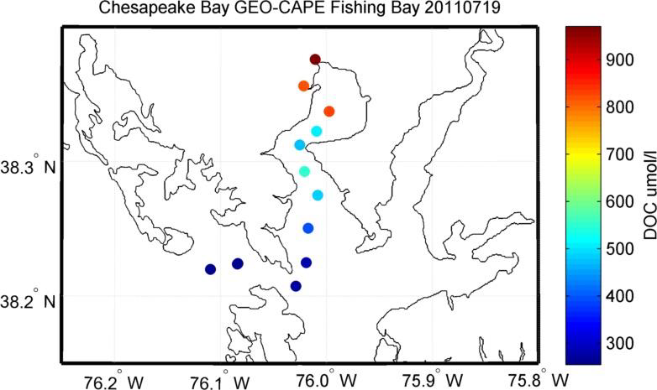
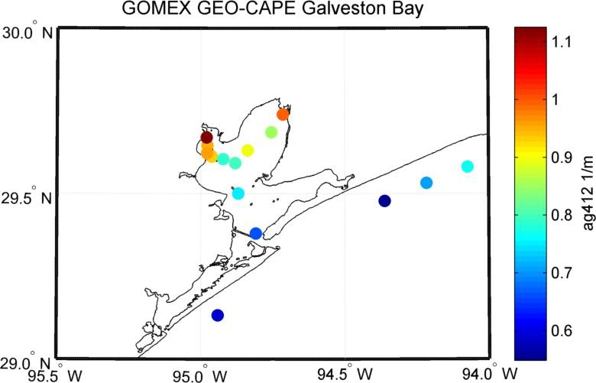
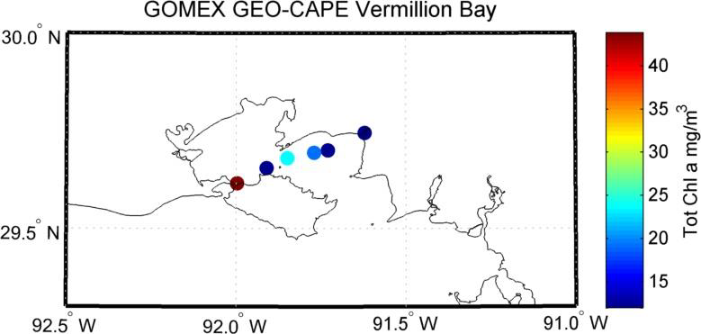
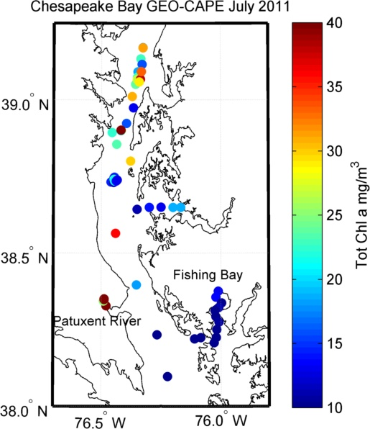
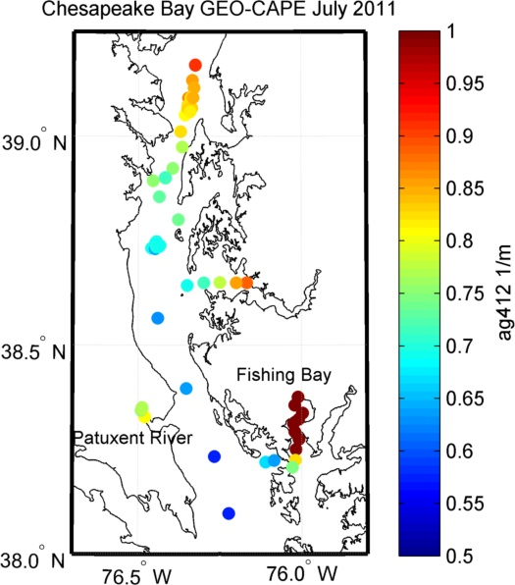
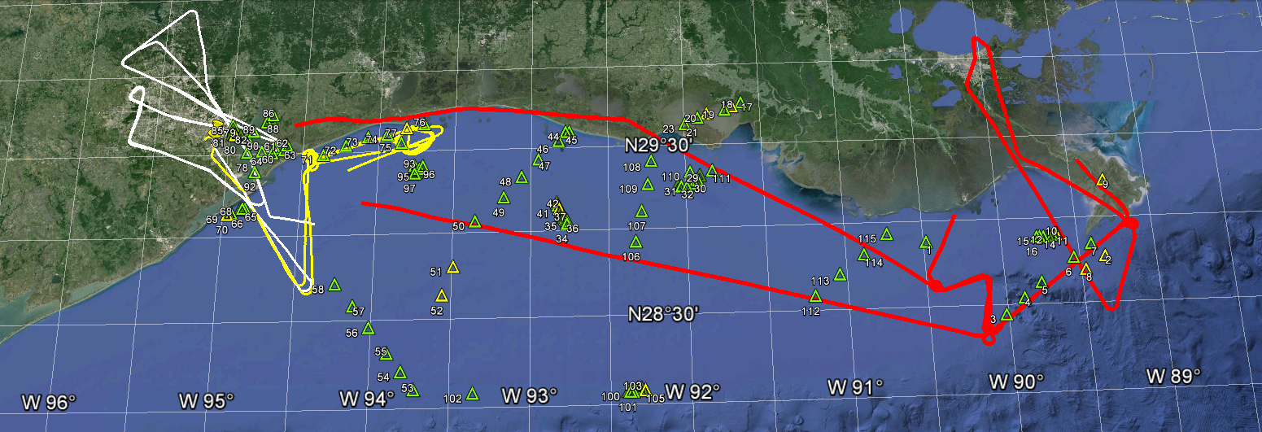
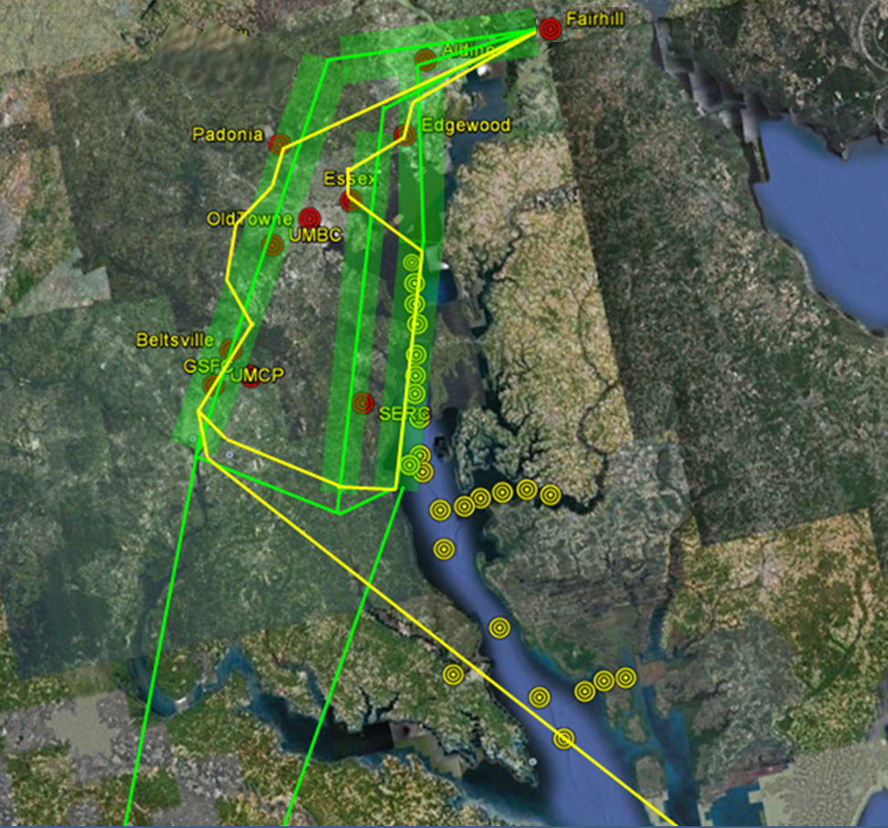
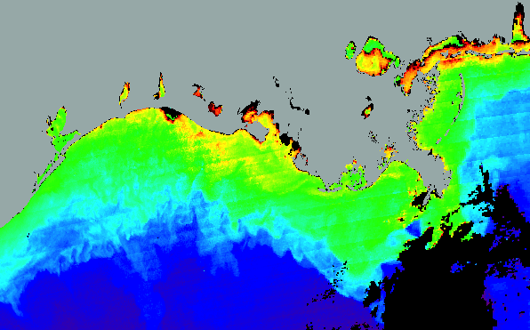
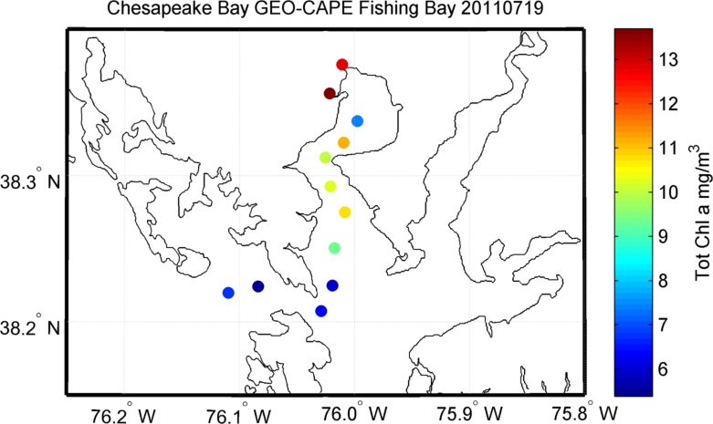
Coordinated Field Campaigns in Chesapeake Bay and Gulf of Mexico
Antonio Mannino, Michael Novak, Maria Tzortziou, GEO-CAPE Oceans SWG
Background
NASA’s GEOstationary Coastal and Air Pollution Events (GEO-CAPE) mission concept recommended by the U.S. National Research Council (2007) focuses on measurements of atmospheric trace gases and aerosols and aquatic coastal ecology and biogeochemistry from geostationary orbit (35,786 km altitude). Two GEO-CAPE-sponsored multi-investigator ship-based field campaigns were conducted to coincide with the NASA Earth Venture Suborbital project DISCOVER-AQ (Deriving Information on Surface conditions from Column and Vertically Resolved Observations Relevant to Air Quality) field campaigns:
(1) Chesapeake Bay in July 2011 and
(2) northwestern Gulf of Mexico in September 2013.
Goal: to evaluate whether GEO-CAPE coastal mission measurement and instrument requirements are optimized to address science objectives while minimizing ocean color satellite sensor complexity, size and cost - critical mission risk reduction activities.
NASA continues to support science studies related to the analysis of data collected as part of these coordinated field campaigns and smaller efforts.
Gulf of Mexico Experiment 2013 (GoMEX)
Overarching Objective: to obtain detailed oceanographic and atmospheric observations for characterizing short-term dynamics and spatio-temporal variability in coastal ecosystem processes.
Targeted Objectives:
Obtain ship- & airborne-based UV-Vis-NIR hyperspectral and SWIR data (1) to evaluate satellite sensor requirements and (2) algorithm development.
Measurements to improve aerosol retrievals including in near-UV for absorbing aerosols and trace gases (NO2, ozone, etc.) and determine their impact on ocean color retrievals.
Constrain sensor requirements for required temporal frequency and spatial resolution.
Obtain simulated GEO-CAPE datasets to refine algorithms for existing products and develop algorithms for new products.
Evaluate geo-unique issues to resolve (1) diurnal variability in atmospheric constituents, (2) product retrieval accuracy to quantify diurnal and day-to-day changes in ocean color
Dates: September 9-22, 2013
Ship: UNOLS R/V Pelican managed and operated by LUMCON; small boat ops. in West Cote Blanche Bay/Vermilion Bay, Trinity Bay and Galveston Bay.
Participants: 14 scientists were boarded on the ship
14 days of continuous measurement activities (limited nighttime operations).
Sampling Approaches:
1) Transects – sampling along gradients (nearshore to offshore, river plumes, algal blooms)
2) Diurnal sampling of a water mass by following a near-surface drifter
3) Sub-pixel spatial survey – examine spatial variability at sub-km scales (between stations 99-105)
4) Sampling same location throughout a day
Ship Measurements:
Radiometry: UV-Vis-NIR multi-/hyper-spectral in-water and above-water radiometry (Profiling HyperPros, Floating sky-blocked HyperPro, C-Ops, BioSors).
Inherent Optical Properties (IOPs):
Vertical profiles of hyperspectral visible absorption and attenuation, multi-spectral backscatter, multi-spectral/multi-angle scattering (VSF3);
continuous near-surface total and dissolved hyperspectral visible absorption and attenuation, multi-spectral backscatter, multi-spectral backscatter, chl-a and CDOM fluorometry;
discrete UV-ViS hyperspectral particle and CDOM absorption and CDOM fluorescence EEMs
Hydrographic: vertical profiles of temperature, salinity, density, dissolved oxygen (DO); continuous near-surface temperature, salinity, density, DO.
Biology and biogeochemistry:
Discrete vertical profiles of POC, PN, DOC, SPM, nutrients, phytoplankton enumeration and taxonomy, DIC, total & non-carbonate alkalinity, Winkler O2, pH, dissolved lignin and black carbon (select stations); short- and daily 13C carbon primary production incubations, nitrogen uptake incubations, triple O2 isotopes (GPP), N2 fixation
continuous near-surface pCO2, O2:Ar (NCP), 13C-CO2, phytoplankton enumeration and taxonomy
Atmospheric: aerosol spectral properties and composition, column (ozone, NO₂) and surface trace gases (ozone, NO, NO_{y}), meteorological data
Aircraft: UV-Vis water reflectances (GCAS) and profiling multi-wavelength lidar (HSRL)
Station locations shown below along with B-200 flight paths during 3 days of dedicated ocean color flights for over 3 regions: Mississippi River plume (red), Eastern Texas coast (yellow) and Galveston Bay (white).
Diurnal variability results from tracking individual water masses
Northern Chesapeake Bay:
Little change in DOC and CDOM over time
Significant change in POC, PN, Chl-a & DIN
Time in UTC
Mid-Chesapeake Bay:
Little change in DOC and CDOM over time
Significant change in POC, PN, Chl-a & DIN
Chesapeake Bay Oceanographic campaign with DISCOVER-AQ (CBODAQ)
Objective: to obtain detailed oceanographic and atmospheric observations for characterizing short-term dynamics and spatio-temporal variability in atmospheric and coastal ecosystem processes.
Dates: July 11-20, 2011
Ship: NOAA SRVx National Marine Sanctuary Test and Evaluation Vessel operated by Cardinal Point Captains LLC; small boat ops. in Fishing Bay
Participants: More than 25 scientists, 4 undergraduate interns, 1 high school intern, and several graduate students (see list at bottom)
10 days of daytime (~12hr) cruises
Sampling Approaches:
1) Transects – sampling along a gradient (north to south, river tributary to open waters of the bay, salt marsh creek to open waters of bay)
2) Diurnal sampling a water mass by following a near-surface drifter
3) Sampling same location throughout a day
Ship Measurements:
Radiometry: UV-Vis-NIR multi-/hyper-spectral in-water and above-water radiometry;
Inherent Optical Properties (IOPs): vertical profiles of hyperspectral and filtered multi-spectral visible absorption and attenuation, multi-spectral/multi-angle scattering (VSF3); discrete UV-ViS hyperspectral particle and CDOM absorption and CDOM excitation-emission matrices; continuous near-surface chl-a and CDOM fluorometry
Biology and biogeochemistry: discrete vertical profiles of POC, PN, DOC, SPM, nutrients, DIC, total alkalinity; short- and daily 13C carbon primary production incubations, nitrogen uptake incubations, continuous near-surface pCO2 and DO
Atmospheric: aerosol spectral properties and composition, aerosol and cloud layer height, column (ozone, NO₂) and surface trace gases (ozone, NO, NO_{y}), boundary layer height, meteorological data
Aircraft: UV-Vis water reflectances (ACAM), aerosol spectral properties and composition, column and profile trace gases (ozone, NO, NO_{y}), boundary layer height, meteorological data; http://www-air.larc.nasa.gov/missions/discover-aq/reports/
Station locations shown below with measurements of chlorophyll-a and CDOM absorption coefficient at 412nm (ag412) and B-200 aircraft flight paths.
Mississippi Plume:
Significant change in DOC and CDOM
Large change in PN, POC, Chl-a & DIN
South of Marsh Island
Small change in POC, PN, DOC and CDOM
Large change in DIN and Chl-a
Deep-water Gulf Mexico
Small change in DOC and Chl-a.
Large change in DIN, CDOM, POC, and PN.
Examples of Spatial Gradients from Chesapeake Bay & Gulf of Mexico
Summary & Preliminary Conclusions
Chesapeake Bay Diurnal Water Mass (Drifter) Experiments
Little change in DOC and CDOM over time
Large changes in POC (up to 65%), chl-a (up to 80%), PN (45%), and DIN (55%)
Gulf of Mexico Diurnal Water Mass (Drifter) Experiments
Small changes in DOC (<20%) and CDOM (15%; 40% offshore), 15% change in CDOM spectral slope offshore
Large changes in POC (up to 80%), chl-a (up to 175%), PN (40%), and DIN (180%); 1200% change in DIN at deep water site.
Spatial Gradients from Chesapeake Bay and Gulf of Mexico Cruises
Both coastal regions have high intense spatial gradients in DOC, CDOM, POC, Chl-a, PN, DIN, etc.
Spatial gradients strongest near shore (e.g., Fishing Bay (CB), Vermilion Bay, Trinity/Galveston Bay) and related to inputs of nutrients and carbon.
Biological processes (w/ physics) drive the diurnal variability
Need temporal frequency of ~1 hour or less from GEO-CAPE to capture diurnal variability in coastal water biogeochemistry and biological processes.
DIN data from M. Mulholland
Trinity
Bay
Galveston
Bay
Marsh
Island
Vermilion
Bay
West Cote
Blanche
Bay
Atchafalaya
R. outflow
Miss. Delta
5
Mississippi
Plume
1
0.1
0.01
CBODAQ Pis and Participants : Antonio Mannino & Maria Tzortziou (chief scientists), PIs: Jay Herman (GSFC), Stan Hooker (GSFC)*, Chuanmin Hu (USF), Carolyn Jordan (UNH), Rick Miller (ECU), John Morrow (BSI)*, Margaret Mulholland (ODU), Joe Salisbury (UNH), Maria Tzortziou (UMCP/GSFC)*; Cruise participants: includes PIs notated with * and Dirk Auriin (GSFC/SSAI), Peter Bernhardt (ODU), Chris Buonassissi (ECU), Ariel Degree (UNH), Carlos Del Castillo (JHU-APL), Marc Emond (UNH), Michael Novak (GSFC/SSAI), Mike Ondrusek (NOAA), Two participants from USF and several under/graduate students.
GoMEX-2013 Pis and Participants: Antonio Mannino (chief scientist), PIs: Stan Hooker (GSFC), Chuanmin Hu (USF), Bror Jonsson* (Princeton), Carolyn Jordan (UNH), Zhongping Lee (UMB)*, John Morrow (BSI)*, Margaret Mulholland (ODU), Frank Muller-Karger (USF), Mike Ondrusek (NOAA)*, Joe Salisbury*, Heidi Sosik, Gerardo Toro-Farmer*, Maria Tzortziou* (UMCP/GSFC), Cruise participants: PIs notated with * and Marc Emond, Michael Novak (GSFC/SSAI), Ian Sammler (UNH), Shawn Shellito (UNH), Sarah Schulenberg (UNH), Jianwei Wei (UMB); Other contributors: Alex Chekalyuk & Joachim Goes (LDEO).

