Slide 1
Topic #6:
Science & Applications Overview
Cara Wilson
NOAA/NMFS/SWFSC Environmental Research Division

Slide 2
Topic #6:
Science & Applications Overview
Cara Wilson
NOAA/NMFS/SWFSC Environmental Research Division

Slide 3
GEO-CAPE Science Questions
How do short-term coastal and open ocean processes interact with and influence larger scale physical, biogeochemical and ecosystem dynamics?
How are variations in exchanges across the land-ocean interface related to changes within the watershed, and how do such exchanges influence coastal and open ocean biogeochemistry and ecosystem dynamics?
How are the productivity and biodiversity of coastal ecosystems changing, and how do these changes relate to natural and anthropogenic forcing, including local to regional impacts of climate variability?
How do airborne-derived fluxes from precipitation, fog and episodic events such as fires, dust storms & volcanoes affect the ecology and biogeochemistry of coastal and open ocean ecosystems?
How do episodic hazards, contaminant loadings, and alterations of habitats impact the biology and ecology of the coastal zone?

Slide 4
“To meet all the needs of the ocean color research and operational community, a constellation of multiple sensor types in polar and geostationary orbits will be required.”
NRC Report on Assessing requirements for sustained ocean color research and operations, 2011

Slide 5
NOAA Application Requirements for GEO Ocean Color Measurements - 1
Application | Satellite Product | Requirements Spatial; temporal; coverage; etc. | Other Requirements | Citation
HABs detection, quantification, and prediction | Chl-a, HAB pigments, | Spatial: <300 m GSD Temporal: 3 hrs Coverage: coastal waters <100 nmi; 50°N-10°N, 160°W-60°W SNR: 1000 NIR & SWIR bands: 708, 720, 750, 865, 1000 | Uncertainty: 30% Range: 0.5-400 ug/L | Stumpf et al., 2009
Water clarity in coastal water, both optically shallow and optically deep | Kd, Kpar, NTU | Spatial: <300 m GSD Temporal: <3hrs Coverage: coastal waters <10 nmi; 50°N-10°N, 160°W-60°W SNR: 1000; NIR & SWIR bands: 865, 1245, 1640, 2135nm; 20-40 nm FWHM | Uncertainty: 15% Range: 0.0 | Bricker et al. 2007
Chlorophyll for water quality, eutrophication | Chl-a | Spatial: <300 m GSD Temporal: 3 hrs Coverage: coastal waters <100 nmi; 50°N-10°N, 160°W-60°W SNR: 1000 NIR & SWIR bands: 708, 720, 750, 765, 865, 1000 | Uncertainty: 30% Range: 0.1-100 ug/L | Bricker et al. 2007
Oil Spill monitoring | Visible/true color imagery | Spatial: < 300 m GSD Temporal: 1 hr Coverage: coastal waters <100 nmi; 50°N-10°N, 160°W-60°W | Uncertainty: n/a | Leifer et al. 2012
NOAA reps: Paul DiGiacomo, Rick Stumpf, Cara Wilson
Notes:
I don't think we are going to be able to sell it the way that NWS sells everything -- with specific numbers on improvements in forecast position and intensity of storms, providing the public with warning information x hours in advance. Putting numbers on fisheries can be counter productive.

Slide 6
NOAA Application Requirements for GEO Ocean Color Measurements - 2
Application | Satellite Product | Requirements Spatial; temporal; coverage; etc. | Other Requirements | Citation
Chlorophyll for habitat assessment (NMFS) | Chl-a | Spatial: 4 km Temporal: daily Coverage: full GEO-CAPE field (Global) | Need archived time-series of data | Polovina & Howell, 2005; Polovina et al, 2001, 2008; Wilson, 2011; Wilson & Qiu, 2008
Chlorophyll for detection of underwater volcanics (OAR) | Chl-a | Spatial: 1 km Temporal: daily Coverage: full GEO-CAPE field (Global) | Uncertainty: 30% Range: 0.5-3 ug/L | Haxel and Merle, OAR/PMEL,pers.comm.
Ocean color retrievals (CHL, DOC, TSM) in Great Lakes for water quality assessment | Rrs: 380- 750nm | Spatial: 100 - 250 m Temporal: 3 hrs Coverage: Great Lakes SNR; 1000 | Uncertainty :10-15% Range: Chl=0.1-100ug/L DOC=0.1-10 mg/L SM=0.1-10 mg/L | NOAA CORL
HABs detection & quantification | Chl-a, HAB pigments, SST | Spatial: 100 – 250 m Temporal: daily Coverage: Great Lakes | Uncertainty: 30% Range: 0.1-300 ug/L | NOAA CORL
Primary Productivity | Rrs: 380-750nmSST, Chl | Spatial: 100 - 250 m Temporal: daily Coverage: Great Lakes | Uncertainty: 20-30% Range: .001-10 g/c/m2/day | NOAA CORL
NOAA reps: Paul DiGiacomo, Rick Stumpf, Cara Wilson

Slide 7
NOAA Application Requirements for GEO Ocean Color Measurements - 3
Application | Satellite Product | Requirements Spatial; temporal; coverage; etc. | Other Requirements | Citation
Water turbidity in fresh inland lakes | Water turbidity in NTU | Spatial: <300 m GSD Temporal: 3 hrs Coverage: inland lakes SNR: 1000 NIR & SWIR bands: 865, 1240, 1640, 2130 nm | Uncertainty: 30% Range: 0.-500 NTU | Wang et al., 2012
Ecological forecasting | Rrs and derived products | Spatial: 100 - 300 m Temporal: daily Radiometric: Ocean Color (narrow bandwidth) Vis, NIR & SWIR bands Coverage: Coastal US waters |  | NOAA Ecological Forecasting Services Roadmap Meeting, 2012
Effect of land-based sources of pollution (LBSP) in coastal regions and on coral reefs | Chl-a, Turbidity, TSM | Spatial: 1 km or better Temporal: Daily or better Coverage: Coastal US waters |  | Lucas and Strong, In Press (NOAA-NESDIS Technical Report)
Coral reef bleaching events; HAB events; benthic habitat | (hyperspectral) water-leaving radiances, Chl, SST | Spatial: 100 m horizontal Temporal: Daily Coverage: full GEO-CAPE field (Global) |  | Ford, 2009
NOAA reps: Paul DiGiacomo, Rick Stumpf, Cara Wilson

Slide 8
NOAA Application Requirements for GEO Ocean Color Measurements - 4
Application | Satellite Product | Requirements Spatial; temporal; coverage; etc. | Other Requirements | Citation
Marine isoprene emission product | Chl-a, Kd, PAR | Spatial: <300 m GSD Temporal: <3hrs Coverage: All GEO-CAPE covered ocean/coastal/inland waters SNR: 1000; NIR & SWIR bands: 865, 1245, 1640, 2135 nm | Uncertainty: 30% Range: TBD | Arnold et al. 2009; Tony et al., 2012
Ocean acidification | Chl-a et al. | Threshold GEO-CAPE specs will satisfy their requirements | Science questions provided by Dwight Gledhill | NOAA, 2010
Primary Productivity for global carbon modeling | Rrs: 380-750nm, SST, Chl | Spatial: 0.1 degree Temporal: daily Coverage: full GEOCAPE field (Global) | Uncertainty: 10-20% Resolution. 0.1 millimol/m2/day | Bender et al. 2002
Chlorophyll for coastal carbon flux and ocean acidification algorithm development | Chl-a | Spatial: 4 km Temporal: sub-daily Coverage: Coastal US | Need archived time-series of data | NOAA, 2010 US Carbon Cycle Science plan
NOAA reps: Paul DiGiacomo, Rick Stumpf, Cara Wilson

Slide 9
NOAA Application Requirements for GEO Ocean Color Measurements - 5
Application | Satellite Product | Requirements Spatial; temporal; coverage; etc. | Other Requirements | Citation
Chlorophyll for operational seasonal-interannual modeling (Global Ocean Data Assimilation System / Coupled Forecast System (CFS)) | Chl-a | Spatial: 1 km Temporal: daily Coverage: full GEO-CAPE field (Global) |  | NWS / EMC / GCWMB operational User Request
Diffuse attenuation at 490 nm (K₄₉₀) for operational near-real-time modeling (Real-Time Ocean Forecast System (RTOFS)) | K₄₉₀ | Spatial: 1 km Temporal: daily Coverage: full GEO-CAPE field (Global) |  | NWS / EMC / MMAB operational User Request
Diffuse attenuation for photosynthetically active radiation (K_{PAR}) for operational near-real-time modeling (Real-Time Ocean Forecast System (RTOFS)) | K_{PAR} | Spatial: 1 km Temporal: daily Coverage: full GEO-CAPE field (Global) |  | NWS / EMC / MMAB operational User Request
NOAA reps: Paul DiGiacomo, Rick Stumpf, Cara Wilson

Slide 10
NAVY Application Requirements for GEO Ocean Color Measurements - 1
Application | Satellite Product | Requirements Spatial; temporal; coverage; etc.
Ocean surface currents forecast V&V To include Magnitude and direction and uncertainity | Chl-a, spectral nLw | Spatial: <300m Temporal: 1 hr Accuracy: 0.1 mg/m³
Diving operations for Mine Clearing, ASW Diving and Salvage | Diver visibility, Spectral Rrs, bb, a 380-750nm, SST | Spatial: <250m Temporal: 1 hr Accuracy: 0.1 W/m³-mm-sr
Assessing Performance of the Laser bathymetry systems. Determining where the SHOALS system can detect the bottom. | Laser penetration depth , Kd 532 | Spatial: <250m Temporal: 1 hr Accuracy: 0.1 W/m³-mm-sr
Assimilation of surface heat content in Ocean Circulation Models | Total Absorption Coefficient | Spatial: <250m Temporal: 1 hr Accuracy: 0.1 W/m³-mm-sr
Environmental monitoring; Ocean Fronts, Location and shape of Rings, eddies and fronts, Location of Coastal Jets and Plumes to track Tidal Impacts | Chl, backscattering , kd, SSt | Spatial: <=1km Temporal: 1 hrs Accuracy: <= 0.5 deg C
NAVY POC: Bob Arnone

Slide 11
NAVY Application Requirements for GEO Ocean Color Measurements - 2
Application | Satellite Product | Requirements Spatial; temporal; coverage; etc.
Assimilation of optical data into Ocean Ecological Forecasting: Models: Defining the dispersion and sources and sinks .“BIOCAST” | Surface Chl. Backscattering, absorption, CDOM, suspended sediments. | Spatial: <=1km Temporal: 1 hrs Accuracy: <= 0.5 deg C
Assimilation of Sea surface coastal Salinity into forecasting Ocean Circulation Coastal Models | Sea surface salinity from coastal optics | Spatial: <=1km Temporal: 1 hrs Accuracy: <= 0.5 deg C
Surface Contaminants Monitoring | Rrs 380-750nm; Imagery | Spatial: <300m Temporal: 1 hrs Accuracy: 0.1 W/m³-mm-sr
Monitoring Inland Waterway and Estuaries Analysis | Chlorophyll, Optical properties | Spatial: <100m Temporal: 1 hrs
Validation of Space LIDAR Bio - Optical Profiles | Chlorophyll, Optical properties | Spatial: <100m Temporal: 1 hrs
NAVY POC: Bob Arnone

Slide 12
EPA Application Requirements for GEO Ocean Color Measurements
Application | Satellite Product | Requirements | Citation | GEO-CAPE Science Focus & Questions | Req. not met by GEO-CAPE Threshold | Req. not met by GEO-CAPE Goal
Safe and Sustainable Water Resources Research Program (SSWR) | Chlorophyll a (chl-a); Photosynthetically available radiation (PAR); Diffuse attenuation (PAR); Colored dissolved organic matter (CDOM) absorption; Phytoplankton absorption; Detritus absorption; Primary production; Salinity proxy; Suspended particulate matter; Dissolved organic carbon; Coastal HAB detection (yes/no), chl-a, cell abundance and species identification; Lake cyanobacterial cell abundance, chl-a and identification; Pathogen detection; Petroleum detection, type and thickness; Effluent detection; Sea surface pCO2; Seagrass extent; Coral reef habitat mapping; UV attenuation; Nutrient proxies | Spatial (GSD nadir): Estuaries: ≤250m Coastal Waters: ≤500m Temporal: Estuary & Coastal Water Surveys: ≤3hrs Events: ≤0.5 hrs Event Real Time Data: ≤0.5 hrs Coverage (Width from coast to ocean): Minimum distance: 5.5 km (3 nmi) Maximum distance: 22 km (12 nmi) Field of Regard for Retrievals: 50°N to 14°N; 160°W to 60°W | SSWR 1.1 (Specifies the use of remotely sensed data); SSWR 1.4; SSWR 2.3; SSWR Science Question 3; SSWR 4.2; SSWR Science Question 6; Gulf Coast Ecosystem Restoration Task Force | Focus: Short-term Processes; Land-Ocean Exchange; Impacts of Climate Change & Human Activity; Episodic Events & Hazards; Questions: 1, 2, 3, & 5 | GSD for Estuaries; | None
 |  |  |  |  | Several products require algorithm development: Coastal HAB detection, chl-a, cell abundance & identification; Lake cyanobacterial abundance, chl-a and identification; Pathogen detection; Petroleum detection, type and thickness; Effluent detection; Sea surface pCO2; Seagrass extent; Coral reef habitat mapping; Nutrient proxies
Air, Climate, and Energy Research Program (ACE) |  |  | ACE Climate Mitigation & Adaptation Project MA-1, MA-2; ACE Research Theme 3; ACE Modeling & Decision Support Tools MDST-3; ACE NAAQS & Multipollutant NMP-8; | Focus: Impacts of Climate Change & Human Activity; Impacts of Airborne Derived Fluxes; Questions: 3 & 4
Sustainable and Healthy Communities Research Program |  |  | SHC Task 2.1.4.2; SHC Task 3.3.1.3; SHC Task 3.3.1.8; SHC Task 3.3.1.11; SHC Project 3.1.4; | Focus: Short-term Processes; Land-Ocean Exchange; Impacts of Climate Change & Human Activity; Episodic Events & Hazards; Questions: 1, 2, 3, & 5
EPA rep: Blake Schaeffer

Slide 13
From http://isccp.giss.nasa.gov/climanal2.html

Slide 14
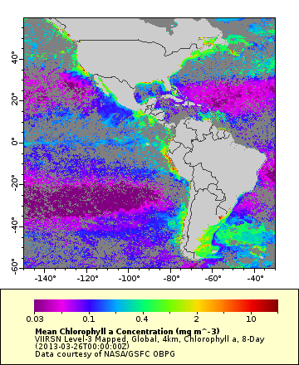
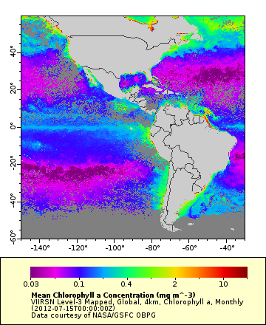
Generated from http://coastwatch.pfeg.noaa.gov/erddap
8-day composite monthly composite
VIIRS
March 22-30
2013
VIIRS
July
2012

Slide 15
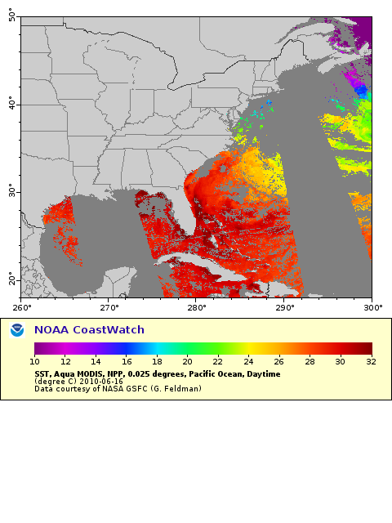
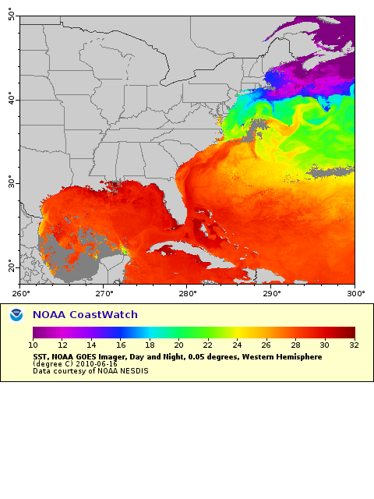
Polar vs Geo
MODIS SST- 1 day GOES SST- 1 day

Slide 16
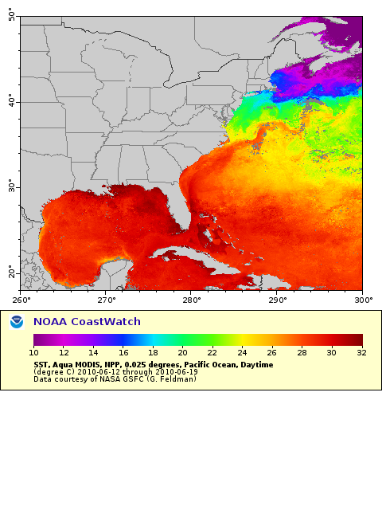
Polar vs Geo
MODIS SST- 8 day GOES SST- 1 day

Slide 17
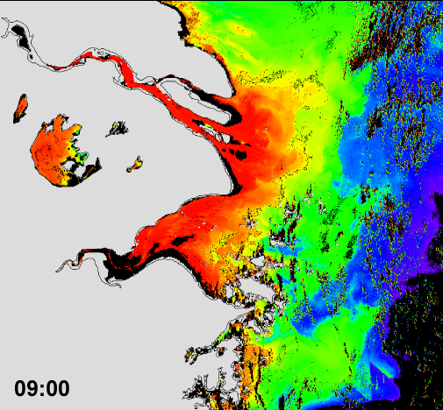
GOCI NOAA-MSL12 K_{d}(490) (2012-07-29)
More details in poster by Wang et al., “Ocean diurnal variations measured by the Korean Geostationary Ocean Color Imager”

Slide 18
“The Memo”
MEMORANDUM
FOR: Gregory Withee, Assistant Adminstrator for NESDIS
FROM: William Hogarth, Assistant Adminstrator for NMFS
DATE: April 20, 2006
SUBJECT: Advocacy for GOES-R in support of Operational Fisheries and Ecosystems Management Requirements
The purpose of this memo is to advocate the next generation of NOAA geostationary satellites (GOES-R), on behalf of NOAA Fisheries. In particular, the Hyperspectral Environmental Suite with Coastal Waters Imaging capability (HES-CW), to be flown on GOES-R, will help NOAA Fisheries fulfill its responsibility to monitor the health of our ecosystems, including commercial fisheries and protected species, such as marine mammals. NOAA Fisheries looks forward to the capabilities offered by GOES-R to provide accurate estimates of chlorophyll in U.S. coastal waters as a means to more accurately understand, monitor, and predict the health of our ecosystems. Chlorophyll is the only biological component of the marine ecosystem accessible to remote sensing, and as such provides a key metric for assessing the health and productivity of marine ecosystems on a global scale. For example, satellite derived primary productivity is one of the key indicators used in the assessment of Large Marine Ecosystems (LME). However, persistent cloudiness, on both coasts of the United States, can hamper the amount of usable data received from polar-orbiting satellites. The increased temporal resolution of ocean color data from a geostationary platform will greatly alleviate this issue. The increased spatial resolution from this sensor will allow us to characterize large estuaries and bays that are unresolved with current satellite data coverage. The key impacts and benefits are highlighted in more detail in the attached one-pager.
In summary, the increased spatial and temporal resolution of data from the HES-CW on GOES-R will greatly improve our ability to characterize and monitor coastal regions for better management of ecosystems and fisheries. This capability will greatly improve the use of satellite data in a wide variety of applications within NOAA Fisheries. Maximizing the usage and potential of this new satellite data will require user-friendly methods of data access and delivery. NOAA Fisheries is currently active in the GOES-R readiness process through participation in the GOES-R user conferences and the COAST working group. In closing, it is encouraging to see NOAA expanding the capabilities of the geostationary environmental satellites beyond their traditional role of serving the needs of the weather service, an example of one-NOAA in action.
“The increased spatial resolution from this sensor will allow us to characterize large estuaries and bays that are unresolved with current satellite data coverage”
“the HES-CW will help NOAA Fisheries fulfill its responsibility to monitor the health of our ecosystems, including commercial fisheries and protected species, such as marine mammals”
“Maximizing the usage and potential of this new satellite data will require user-friendly methods of data access and delivery.”

Slide 19
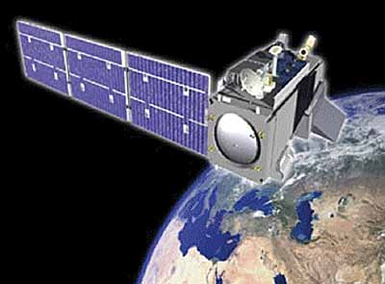
“Operational”
What does it mean?
relating to, or based on operations
ready for, or in a condition to undertake, a destined function
- Merriam-Webster’s Dictionary
Strict definition is vague at best…
• In the R2O context “operational” is often interpreted as “anything not research”.
Also rather ambiguous…
• In the world of (meteorological) satellite data, “operational” is often assumed to mean a near-real time (NRT) 24/7 application.
• For fisheries and marine resource managers, interannual and decadal timescales are often more relevant than NRT 24/7.
• It is likewise often assumed that “operational” means any quality of data will suffice – this is definitely not the case for ocean color data….

Slide 20
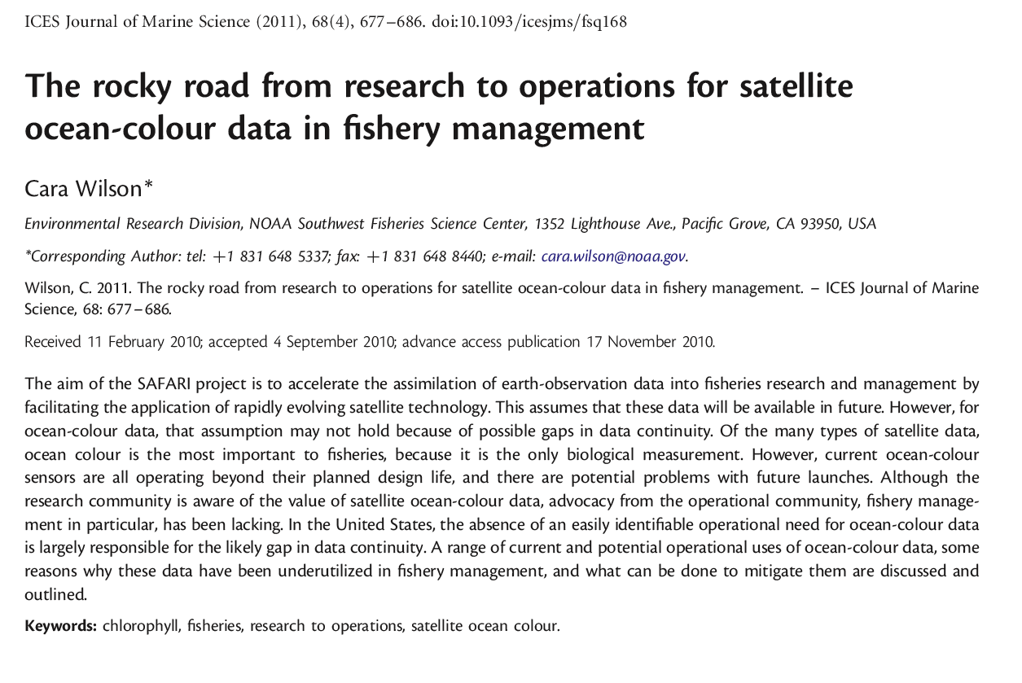
Reprints Available
Notes:
20

Slide 21
From earthobservatory.nasa.gov/GlobalMaps/view.php?d1=MODAL2_M_CLD_FR

Slide 22
From Michael Douglas, National Severe Laboratory/NOAA

