Slide 1
Evaluation of OMI total column ozone with four different algorithms SAO OE, NASA TOMS, KNMI OE/DOAS
Juseon Bak¹, Jae H. Kim¹, Xiong Liu²
¹ Pusan National University
² Harvard-Smithsonian Astrophysical Observatory (SAO)
NASA GEOCAPE-Korea GEMS joint meeting
March 21-24, 2013

Slide 2
Subject
Optimal Estimation (OE) based ozone profile algorithm developed at SAO (Xiong Liu), which will be adapted/modified for GEMS algorithm.
Evaluating the algorithm performance in retrieving total ozone column from OMI measurements through comparison with ground-based observation.
Qualities of SOE total column ozone estimates are compared with three kinds of OMI operational products from TOMS v8.5, DOAS and OE algorithms
algorithm | Principal | Fitting window | Developer | Version
SAO OE | OE | 270-330 | SAO
TOMS | TOMS | 317.5, 331.2 | NASA | 8.5
DOAS | DOAS | 331.1-336 | KNMI | 2.2.1
KNMI OE | OE | 270-330 | KNMI | 1.1.1
In principle, OE-based profile algorithms should be able to provide more accurate total ozone estimates than the two total ozone algorithms because of its use of a wider wavelength range (270-330 nm) than those that are used for total ozone [Bhartia, 2002]. However, the successful performance of hyperspectral profile retrieval algorithms can be accomplished with accurate calibration and simulation of measurements and gook knowledge of measurement errors and the a priori covariance matrix [Liu et al., 2005; Liu et al., 2010a]

Slide 3
Reference : Brewer Measurements
Brewer daily observation from WOUDC network
- Period : 2005-2008, 36 stations over North Hemisphere
Criteria for Brewer data
Only ‘DS (Direct Sun)’ observation mode
Criteria for OMI data
Solar zenith angle < 80°, cloud fraction < 0.8, AI < 2
Excluded pixels affected by row anomalies
Criteria for collocation between OMI and Brewer
Within 150 km in the radius between center of OMI and ground station
Same day (Note: Brewer data is given as daily averaged product)
We didn’t average OMI pixels within 150 km, but take one closest pixel

Slide 4
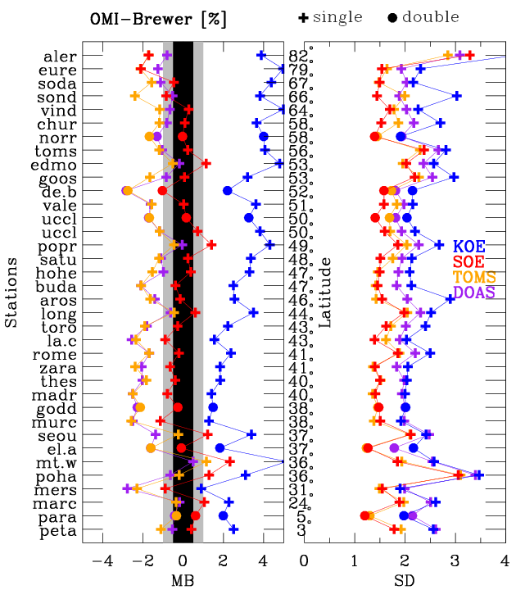
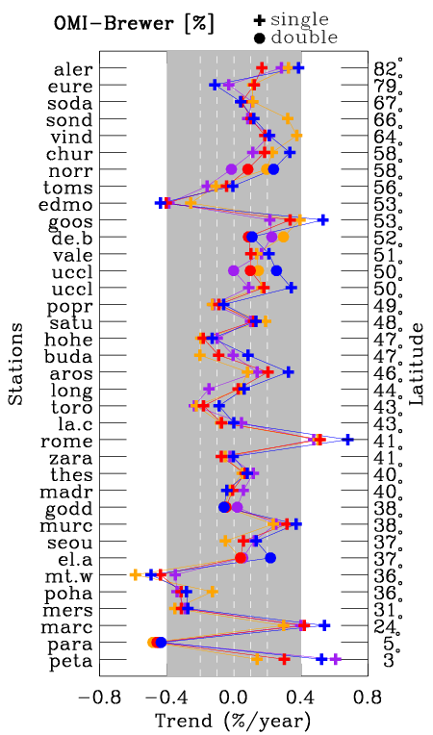
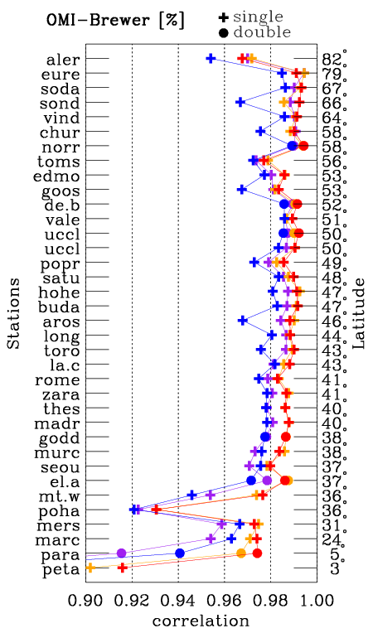
1. Station to station comparison
OMI – Brewer (%)
● double + Single
36 sites were initially selected from WOUDC, providing at least 100 days with DS measurements every year
29 sites were finally selected where OMI and Brewer comparison shows no noticeble deviations from
neighbouring stations through the similar selection procedure done in Balis et al. (2007)

Slide 5
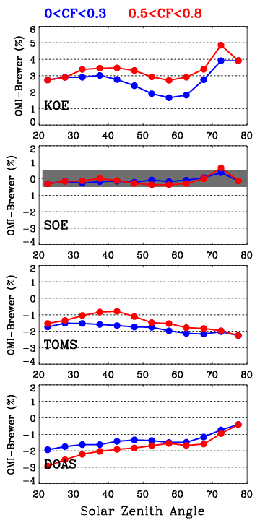
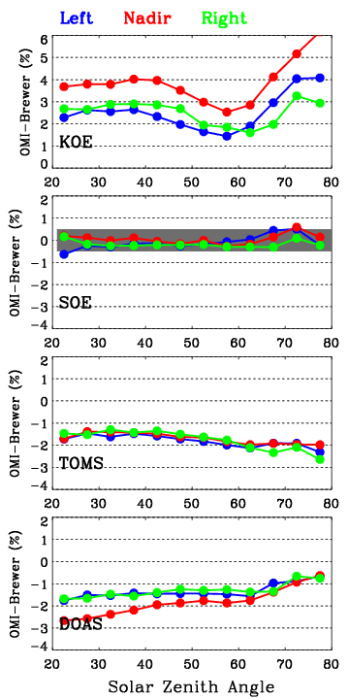
2. Solar Zenith Angle dependency
joint effect between cloudiness and OMI cross track position on SZA dependency
- Negative correlation between bias and SZA
at SZA < 60° and positive correlation at SZA > 60°
- SZA dependency increase for clear sky condition and is unchanged for different OMI cross track position groups but Large offset exists.
- No SZA dependency
- Typically, bias within ± 0.5 %
- Dependency is unchanged for any condition.
- Negative correlation between bias and SZA
- Dependency (SZA > 40 °) slightly increase
at high CF group
- Positive correlation between bias and SZA
- Dependency (SZA < 60 °) largely increase
at high CF group and nadir pixels (small VZA)

Slide 6
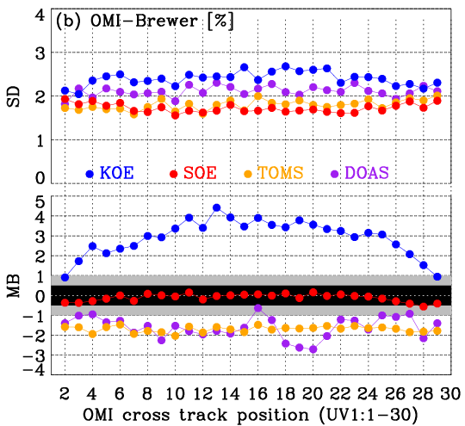
3. OMI Cross Track dependency
KNMI OE
- Strong cross track position dependency of mean biases : 4 % at nadir and 1 % at extreme nadir-off
- Apply no tuning for level1b
KNMI DOAS
- Large fluctuations at 4, 16, 20, 26 positions
- Apply no tuning for level1b
SAO OE
-Apply a Soft calibration to OMI level 1b radiances in order to correct possible all kinds of calibration errors including those causing cross-track/wavelength dependent biases as well as part of straylight error.
NASA TOMS
- Apply a Soft correction to take out across variability
Note : KOE and SOE is retrieved at UV1 spatial resolution and TOMS and DOAS at UV2.
1 and 2 for UV2 is defined as 1, 3 and 4 for UV2 is defined as 2.

Slide 7
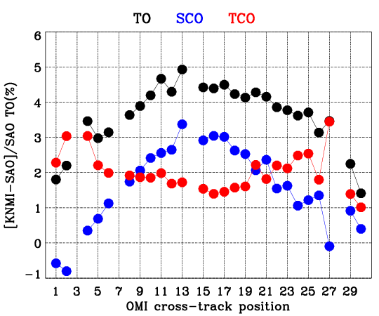
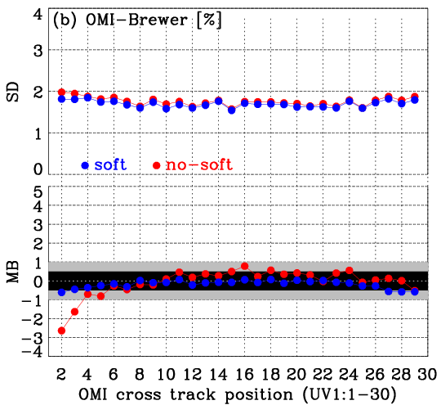
3. OMI Cross Track dependency
Direct comp between SOE and KOE
Soft calibration effect on SOE
The feature of cross track-position dependent biases shown in KOE TO - Brewer comparison is distinctly found in the SCO/TO difference between SOE and KOE. On the other hand, TCO differences typically increase from 1.5 % at nadir positions to 3 % or more toward nadir-off positions.
➔ the existence of cross-track dependent calibration problems in both UV1 and UV2 channels which
could affect the ozone retrievals in both stratosphere and troposphere.
the SOE soft calibration helps to remove the large negative biases at the extreme left side of cross-track positions, but could not explain the large differences in the cross-track position dependence between SOE and KOE algorithms. Probably, other implementations such as using different ozone cross section data set, a priori covariance matrix, and radiative transfer model could be secondary cause to the different cross-track position dependence.

Slide 8
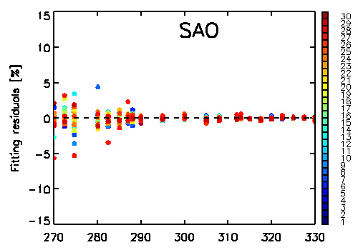
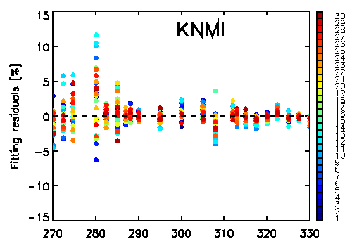
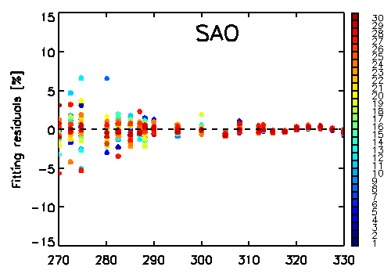
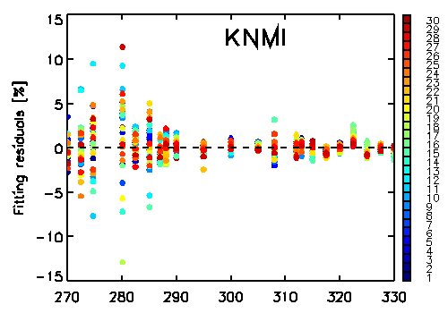
Direct comparison in fitting residuals between SOE and KOE
${\left(\frac{Y_{measured fromOMI}−Y_{calculated from RTM}}{Y_{measured fromOMI}}\right)}^{}$
Lat = 31.5 , SZA = 30.4
2007m0701t01
Lat = 82.8 , SZA = 74

Slide 9
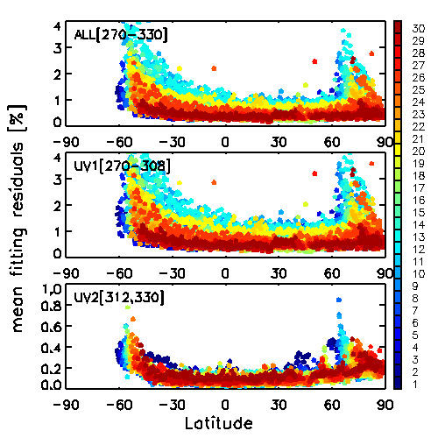
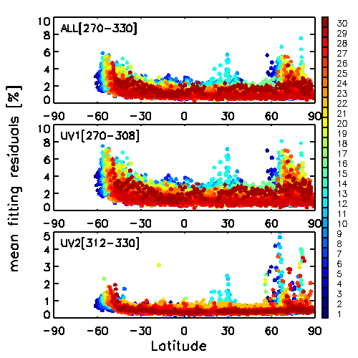
Direct comparison in fitting residuals between SOE and KOE
Note : retrievals of one orbit [15739, 2007m0701t01] are used for comparison (SZA < 85°)
SAO
KNMI
Glint effect

Slide 10
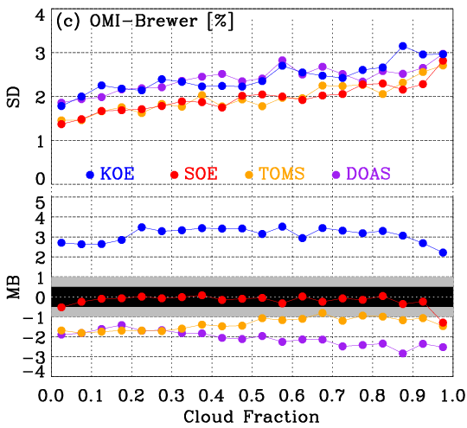
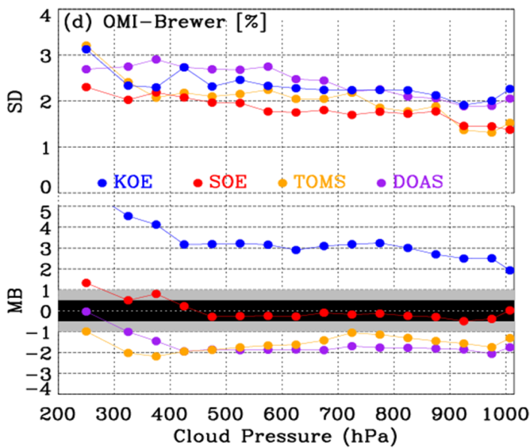
4. Cloud parameter dependency
Note : solar zenith angle < 45。 considered
Dependency on Cloud fraction
DOAS significant negative dependent bias
TOMS mild positive dependent bias
SOE remarkable stability for both clear/cloud conditions with
one exception at the bin of 0.95 – 1.0
KOE Larger bias under partly cloud (0.2<CF<0.8)
could be related to a switch point in the algorithm between
fitting the surface albedo and fitting the cloud albedo.
Commonly increasing scatter With increasing cloudiness
Dependency on CTP
A stable variability in total ozone relative differences for low
and middle clouds for all algorithm.
Large deviations for high cloud ( CTP < ~ 350 hPa), but
SOE produces the smallest deviations.

Slide 11
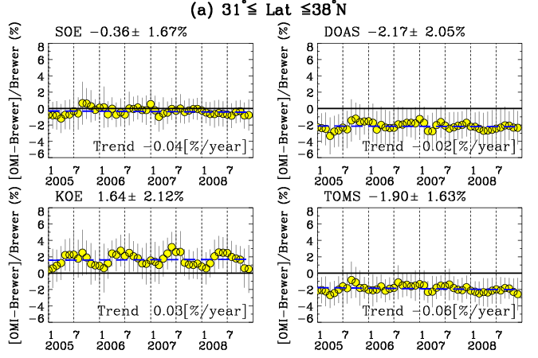
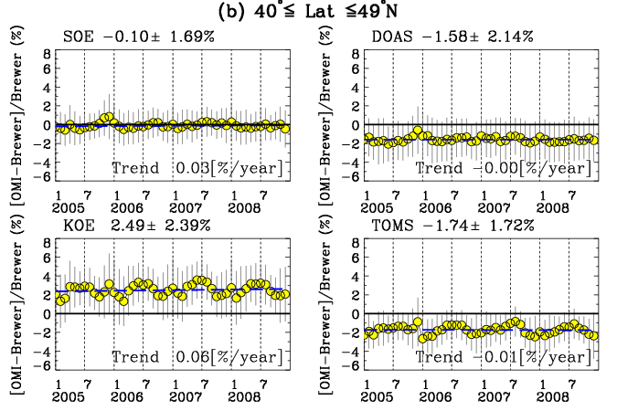
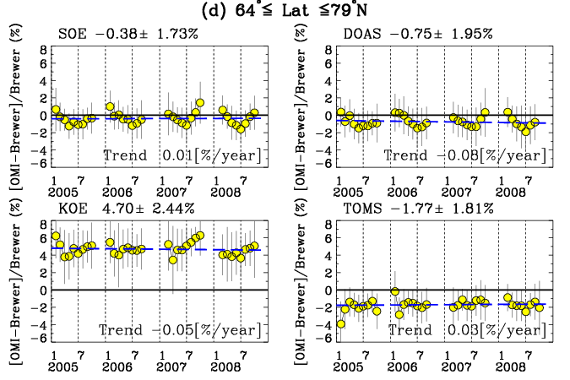
5. Monthly relative difference
 | SOE | DOAS | KOE | TOMS
SOE | 1
DOAS | 0.88 | 1
KOE | 0.16 | -0.04 | 1
TOMS | 0.79 | 0.72 | 0.43 | 1
SZA | 0.32 | 0.49 | -0.82 | -0.00
 | SOE | DOAS | KOE | TOMS
SOE | 1
DOAS | 0.71 | 1
KOE | 0.23 | 0.10 | 1
TOMS | 0.35 | 0.26 | 0.73 | 1
SZA | 0.30 | 0.35 | -0.68 | -0.62
 | SOE | DOAS | KOE | TOMS
SOE | 1
DOAS | 0.83 | 1
KOE | 0.57 | 0.26 | 1
TOMS | 0.17 | 0.09 | -0.05 | 1
SZA | 0.80 | 0.69 | 0.55 | -0.09
SOE and DOAS show similar seasonal variability likely due to the common o3 Cross section data
(BDM) : TOMS and KOE uses Bass and Paur (1984) and Maicet e al. (1995), respectively.
Seasonal dependency is a quite small for mid latitudes, but significant at high lat. with Winter maxi. & Summer min.
High correlation between the temporal changes between KOE biases and solar zenith angle
: Strong negative correlation at mid latitude and strong positive correlation at high latitude, which is consistent
with negative dependency on small SZAs and positive dependency on high SZAs.

Slide 12
Summary & Conclusion
Excellent performance of SOE algorithm is demonstrated by showing a remarkable stability w.r.t OMI geometries and cloud properties, long-term/seasonal stability
1
 | OMI-Brewer(%) | R
SOE | -0.12 ± 1.76 | 0.99
TOMS | -1.68 ± 1.82, | 0.99
DOAS | -1.55 ± 2.18 | 0.99
KOE | 2.76 ± 2.55 | 0.98
2
TOMS : mild negative and positive dependency on SZA and CF.
DOAS : stronger positive and negative dependency on SZA and CF.
3
KOE –Brewer shows large dependency on OMI geometries ( SZA, cross track position)
High correlation in monthly averages between KOE biases and SZA
4
Need a very hard understandings to GEMS radiometric/wavelength calibrations to apply the SAO algorithm.
5

