Slide 1
TEMPO Algorithms

Slide 2
Introduction
We will begin with the default launch data products, which are the gases O₃, H₂CO, C₂H₂O₂, NO₂, and SO₂, and aerosols, clouds, and UVB. By default, we will reproduce OMI products as fully as possible. We can then branch out into improved and additional products. For those algorithms with particularly strong OMI heritage, producing the DLPs may be a hybrid process, since operational OMI code can morph into operational TEMPO code. In the SAO case of least-squares fitting, to be applied to H₂CO, C₂H₂O₂, NO₂, and SO₂ (and probably some additional products) we will start with our OMI code, simplify it, and add the functionalities to, as options, (1) do DOAS fitting (in but never tested) and (2) to use wavelength-dependent AMFs. NO₂ adjustment for the stratosphere will be done in a collaboration among SAO, GSFC, and Dalhousie U.

Slide 3
Approach
Ground systems are at SAO in Cambridge:
Commanding
0-1 processing
1-2 processing
Higher level products (AQ maps)
Apps for NRT products
Archiving and distribution at SAO plus final archive at a NASA-specified DAAC

Slide 4
Default launch data products
TOMS-type O₃, in collaboration with GSFC
eXceL O₃ done by SAO in collaboration with RT Solutions, for scenes limited by computational power (but maybe the entire FOR at 8×9 km²)
NO₂ fitting by SAO, stratospheric correction in collaboration with GSFC, Dalhousie
SO₂ fitting by SAO in collaboration with GSFC
H₂CO fitting by SAO
C₂H₂O₂ fitting by SAO
Clouds as in GSFC OMI clouds
Aerosols as in GSFC OMI aerosols
UVB as in OMI GSFC/FMI
AQ indicators, from previous products, in collaboration with EPA and Dalhousie. Includes NRT products, apps

Slide 5
Improved data products
Height-resolved SO₂, in collaboration with GSFC
Improved cloud products by GSFC
Improved aerosol products by GSFC and U. Nebraska
Improved aerosol correction for gases, in collaboration with GSFC and Dalhousie

Slide 6
Additional data products
H₂O
BrO
IO?
OClO?
Outgoing SW radiation from GSFC
Vegetation products from GSFC
Your product here!

Slide 7




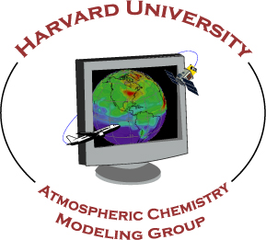


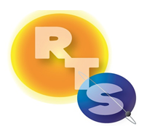


The End!

Slide 8
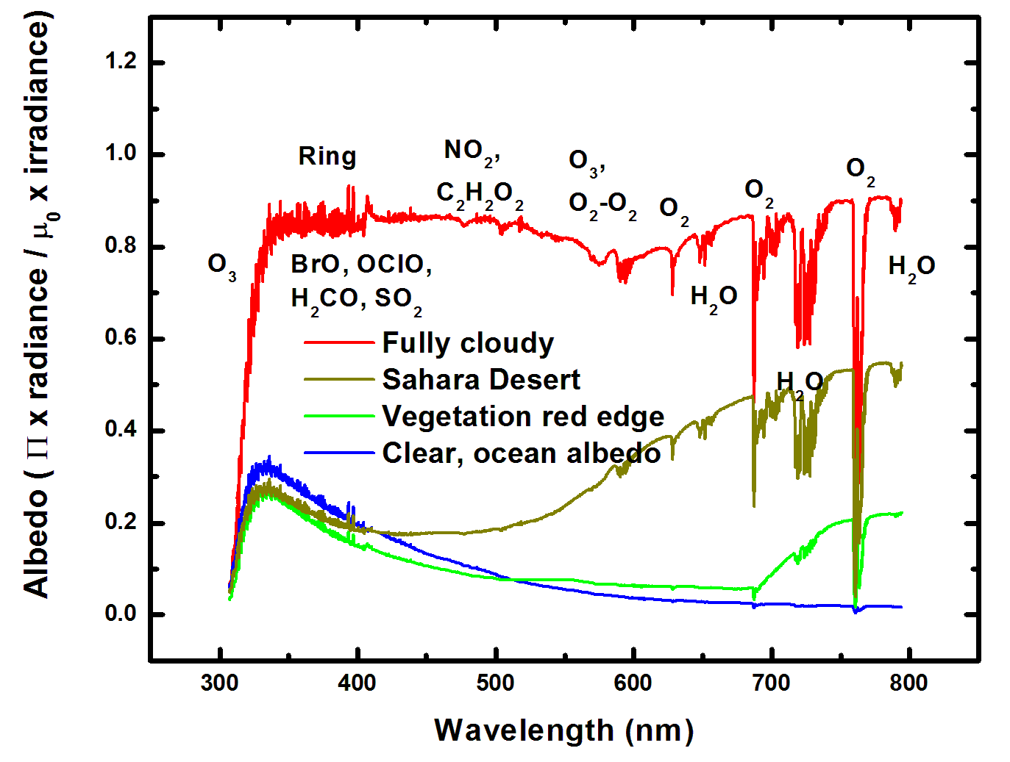
Typical TEMPO-range spectra (from ESA GOME-1)

Slide 9
Team TEMPO!

