Slide 1
New science enabled by the GEO-CAPE mission
1. Enhanced temporal resolution
  a) Sequencing over the day enables:
    Currents, (U-V estimates)
    Particle tracking
    Spatiotemporal bloom evolution (dSTOCK/dT)
    Diurnal biological and biogechemical processes
      Fluorescence
      Migration
b) Better cloud info, PAR estimates
c) Improved OC algorithms
2. Hyper spectral resolution will enable:
a) advancements in phytoplankton functional type (PFT) estimates
b) better estimates of harmful algae
c) water depth
d) provides more information on DOM and OM.
e) much more

Slide 2
New science enabled by the GEO-CAPE mission
3. 250-350m nadir spatial resolution will enable:
  a) Studies of many more mid- large sized estuaries (cf MODIS, MERIS)
  b) Key for comprehensive land – ocean studies
4. Geostationary atmospheric measurements will enable
a) better and more appropriate atmospheric corrections (?)
b) a better chance at fully exploring SQ #4
d) interdisciplinary science
5. Science enabled by the synergy of the above

Slide 3
To motivate discussion, we show work by:
Our GOCI colleagues including Yongje Park
G. Neukermans et al. (SEVIRI colleagues)
Bob Arnone et al.
Curt Davis et al.
Zhongping Lee et al.
John Moisan
Sosik et al.
S. Hooker

Slide 4
New science enabled by GOCI
Courtesy of Youngje Park, Korea Ocean Satellite Center(KOSC), Korea Institue of Ocean Science & Technology (KIOST)

Slide 5
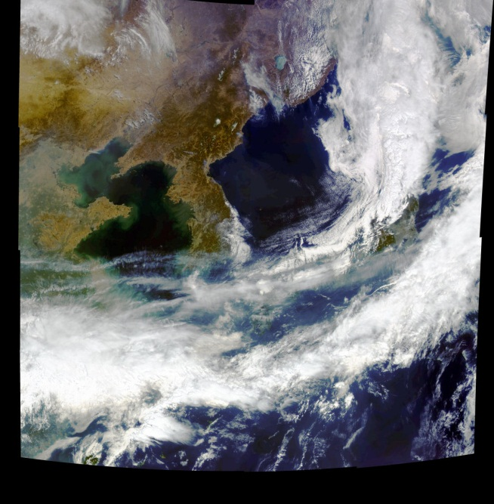
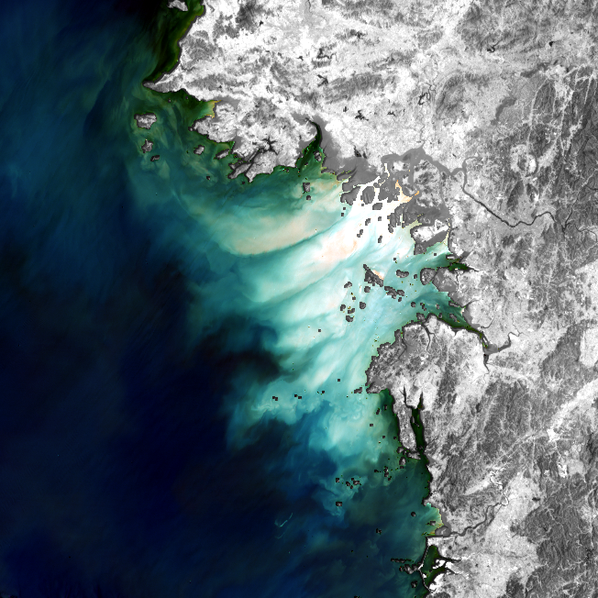
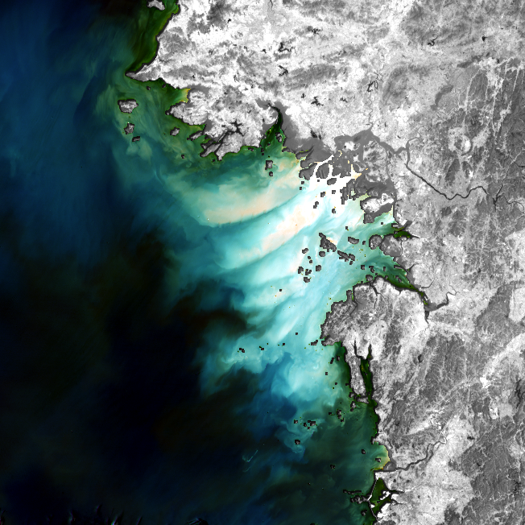
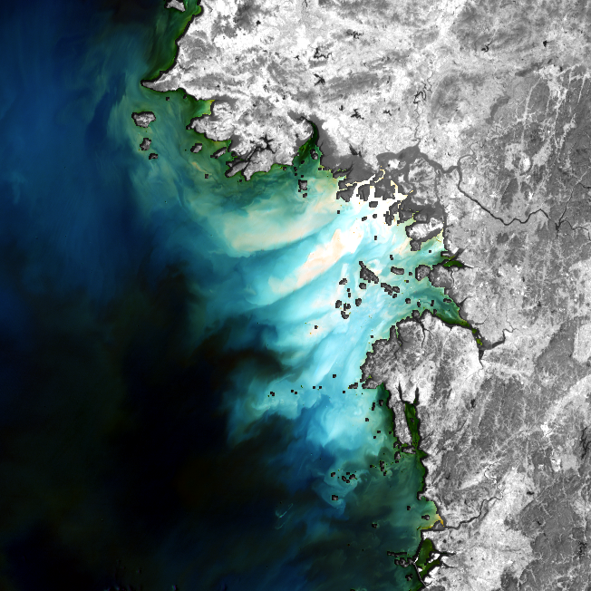

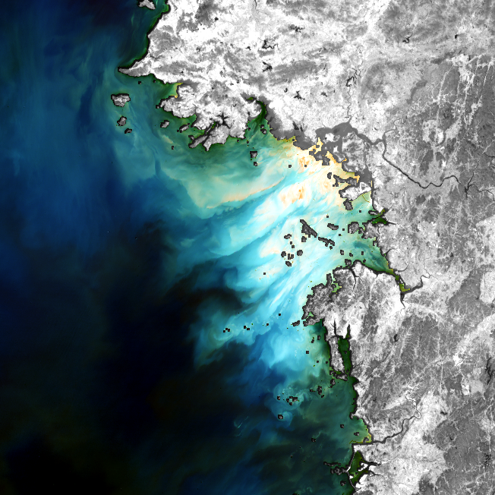
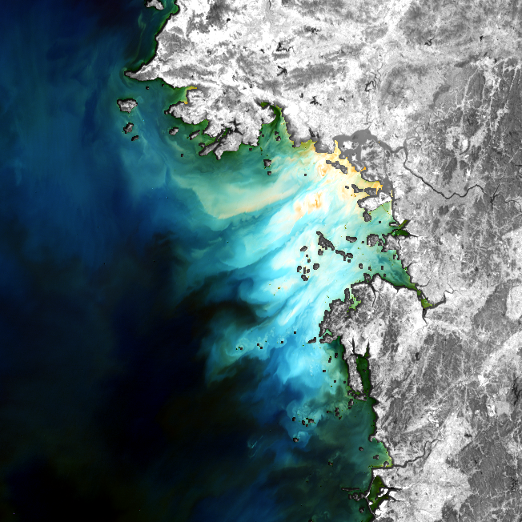
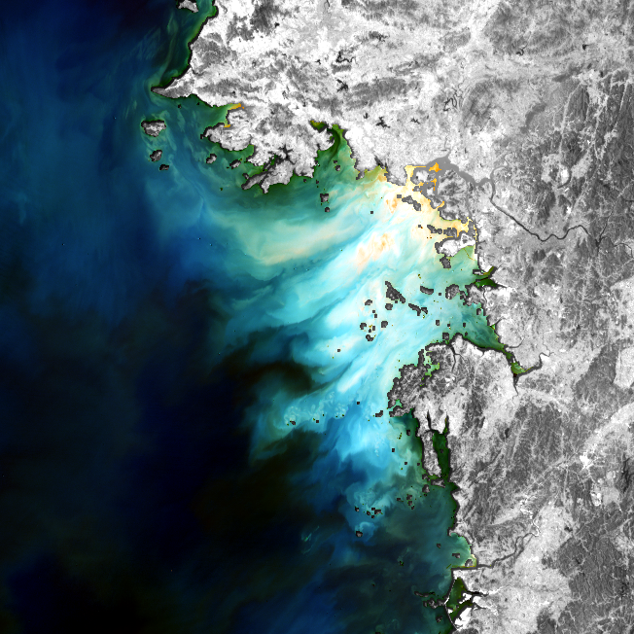
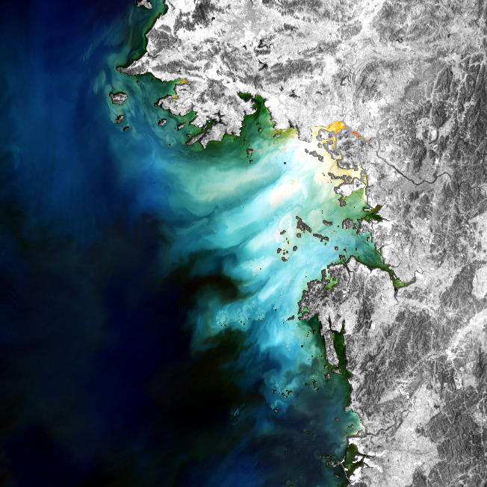
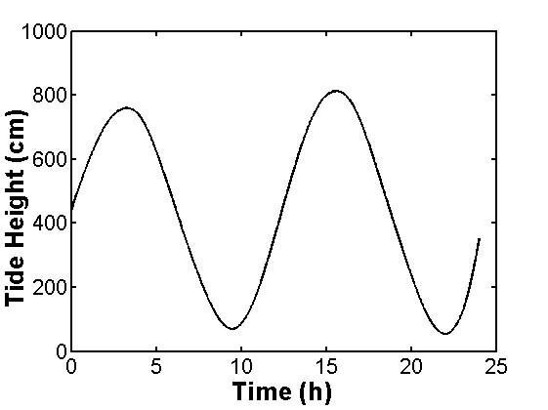
Tidal effects on the SS movement
GOCI
2011년 4월 16일
09시 30분 획득 영상
GOCI
2011년 4월 16일
10시 30분 획득 영상
GOCI
2011년 4월 16일
11시 30분 획득 영상
GOCI
2011년 4월 16일
12시 30분 획득 영상
GOCI
2011년 4월 16일
13시 30분 획득 영상
GOCI
2011년 4월 16일
14시 30분 획득 영상
GOCI
2011년 4월 16일
15시 30분 획득 영상
GOCI
2011년 4월 16일
16시 30분 획득 영상
R_{rs} RGB-642 composite image
(background : l1b band6)

Slide 6
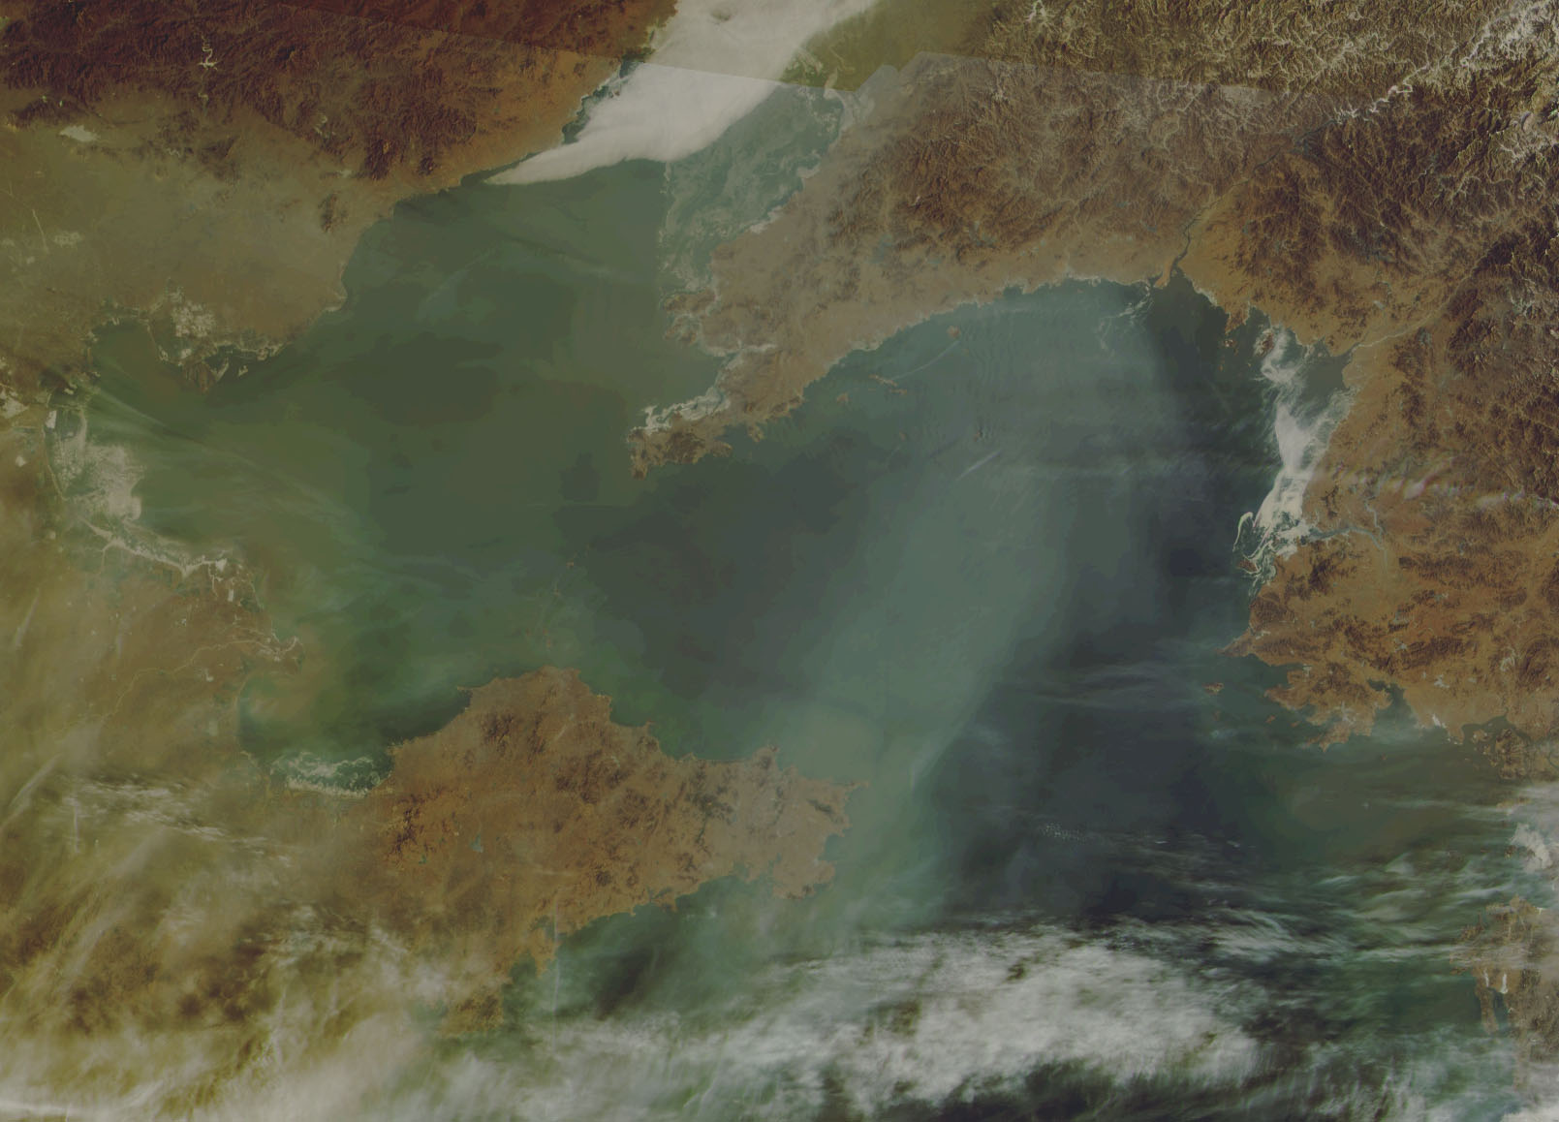
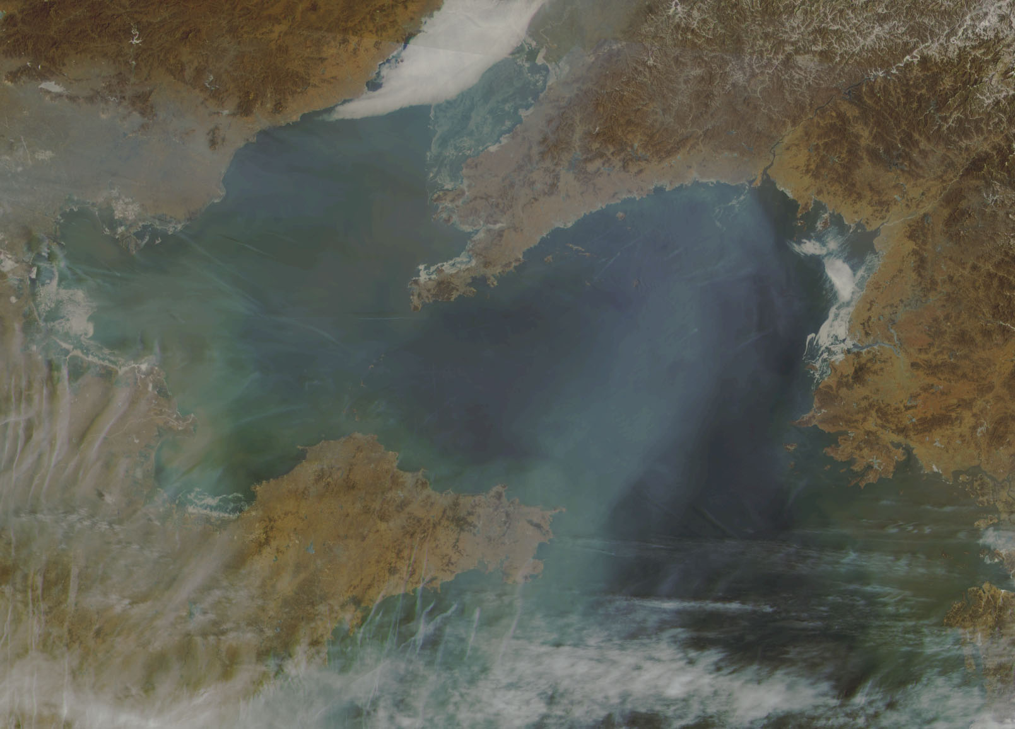
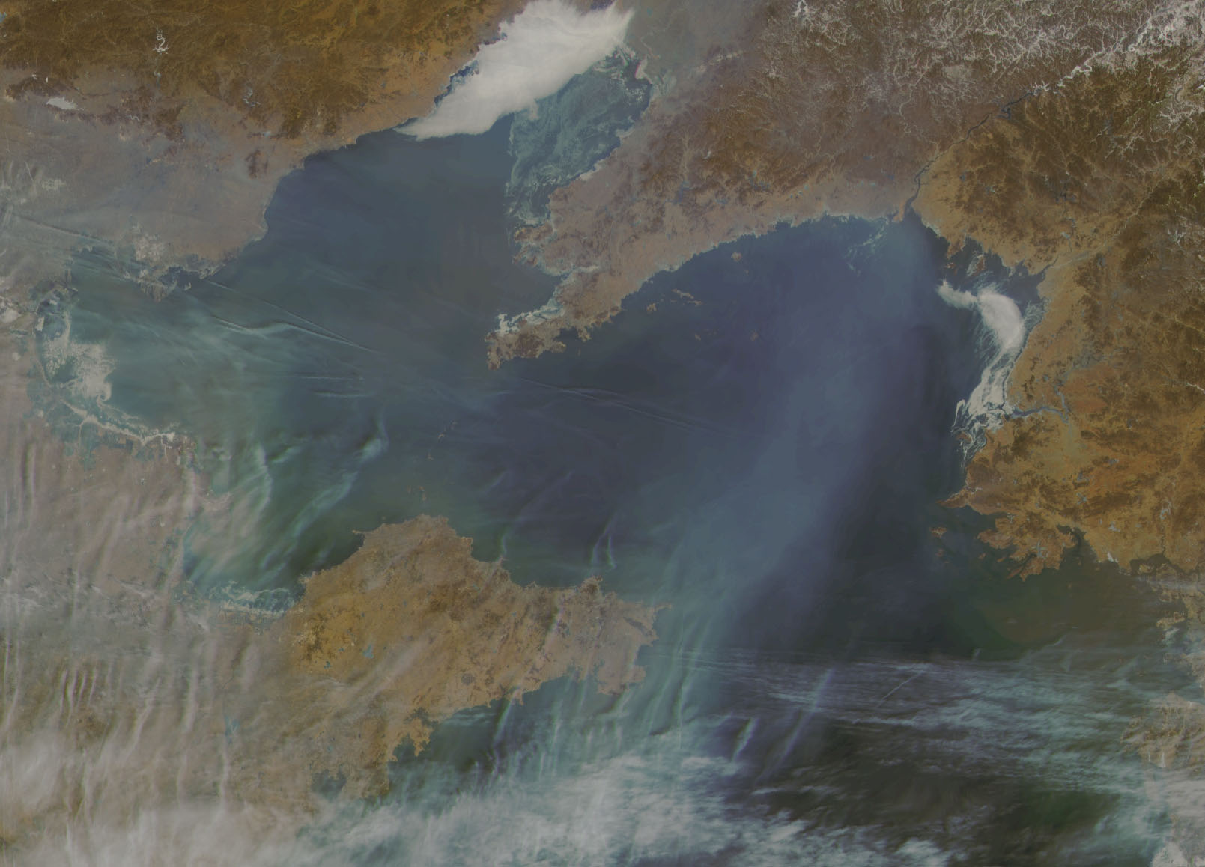
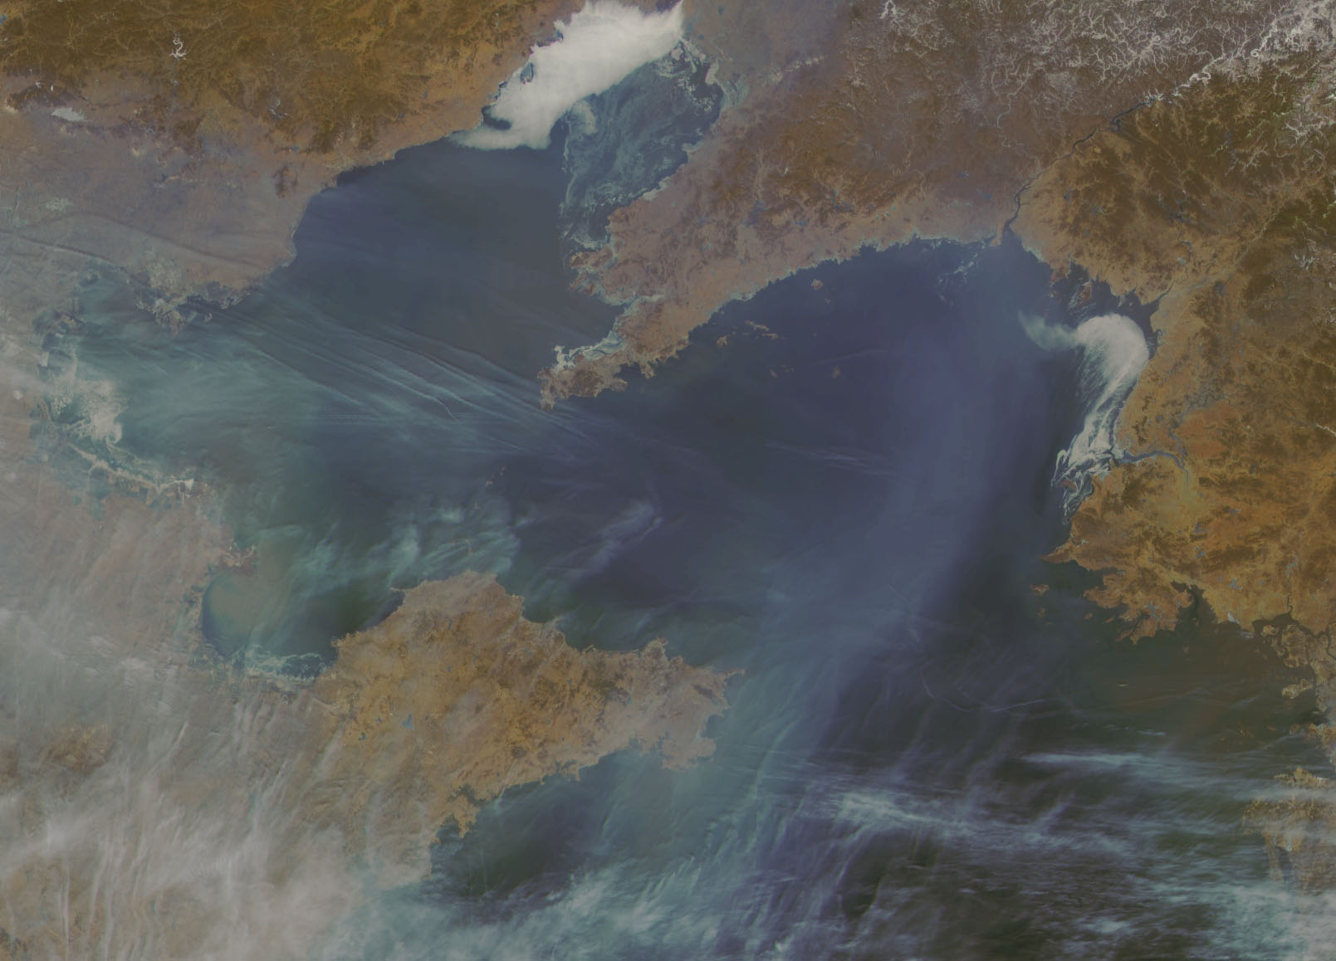
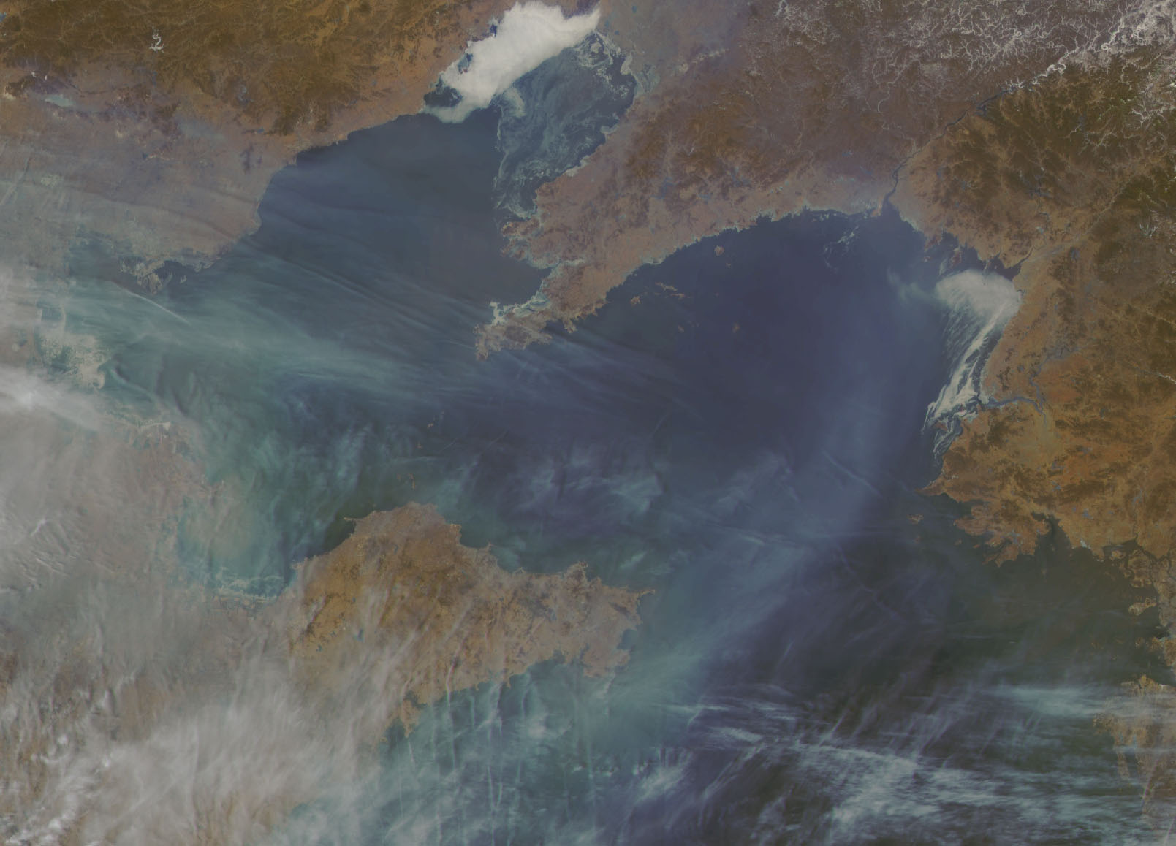
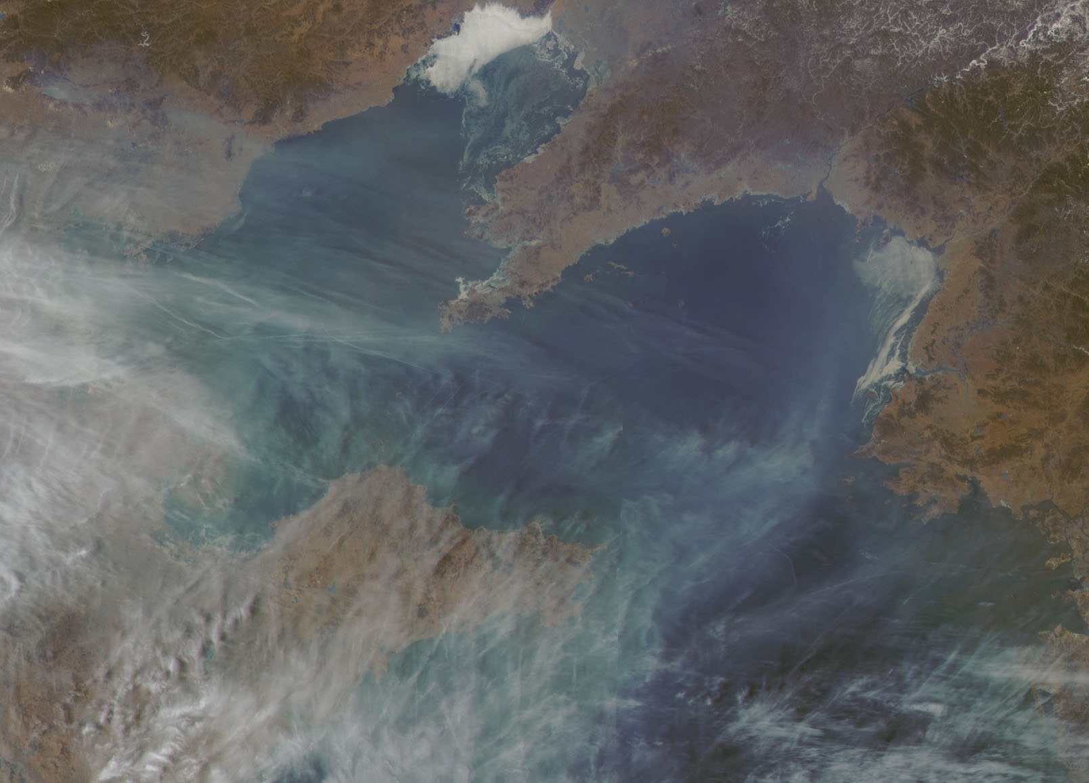
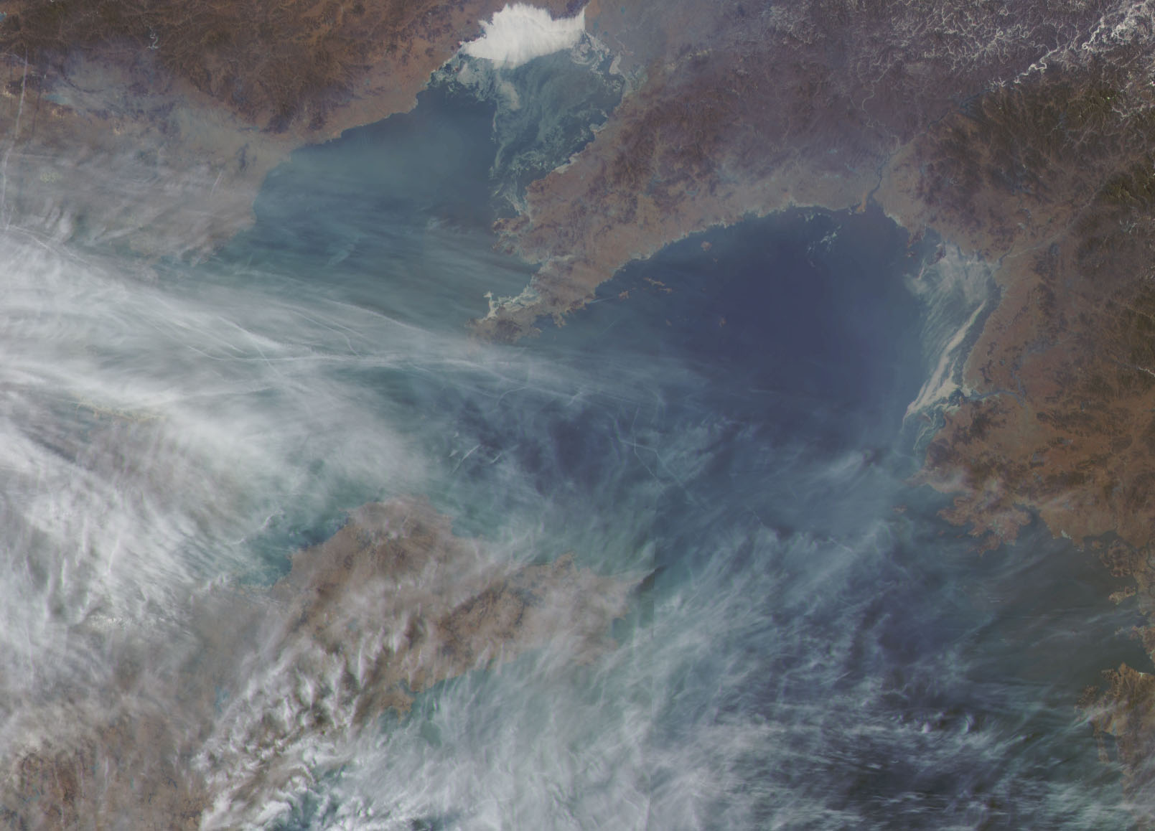
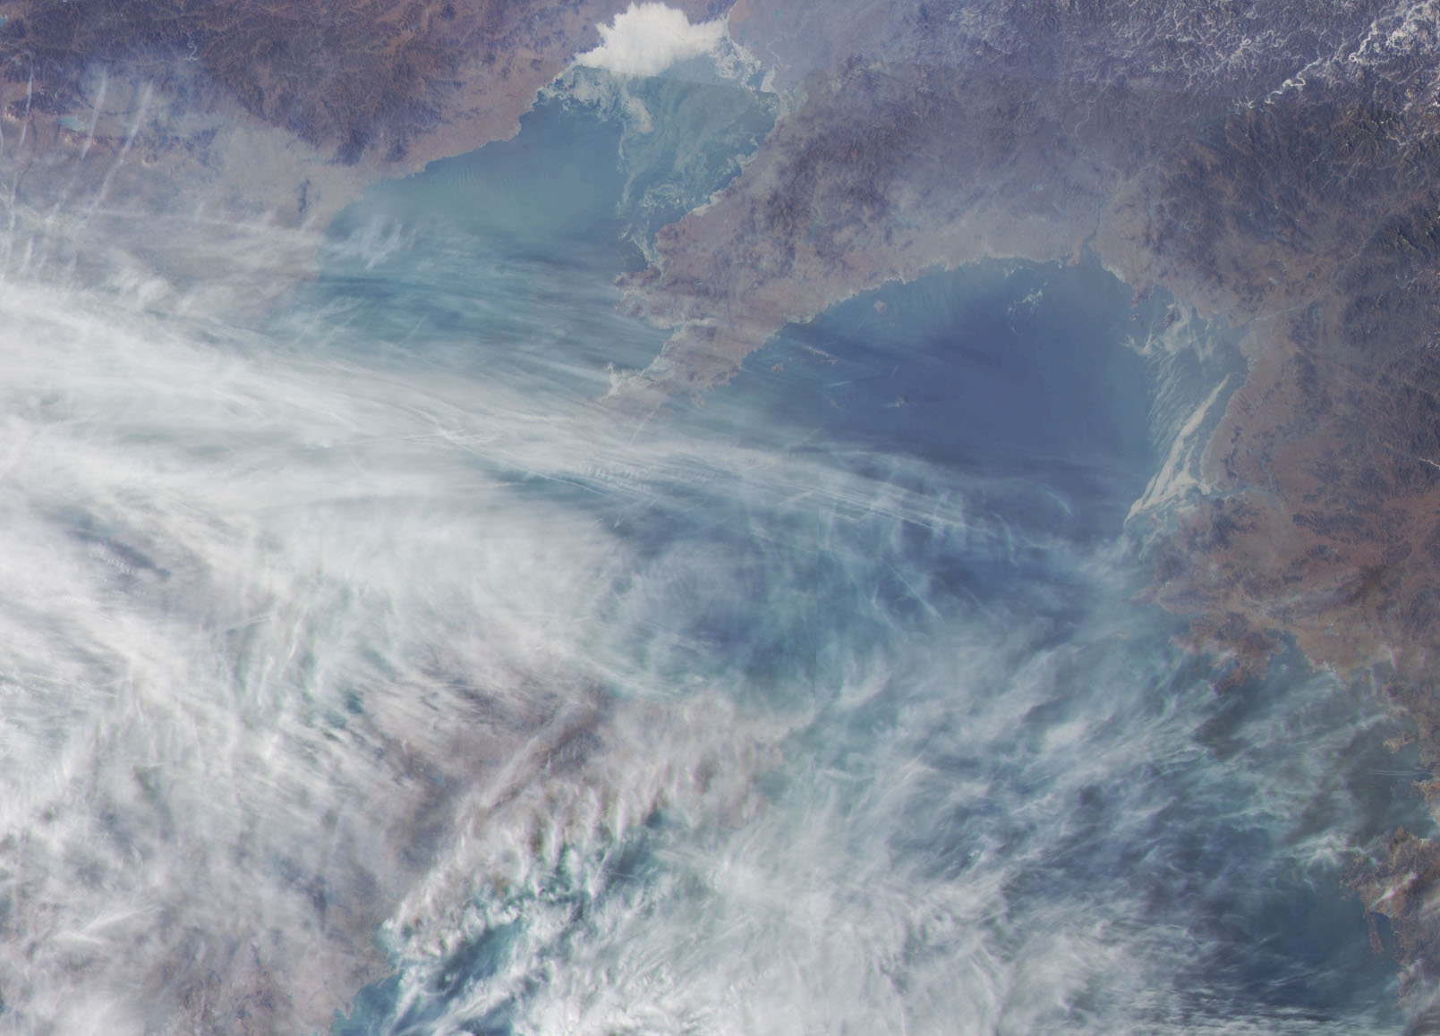
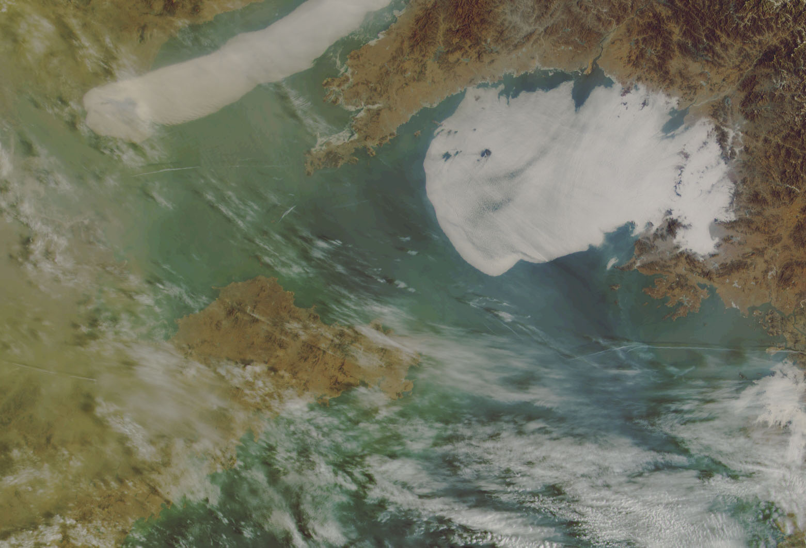
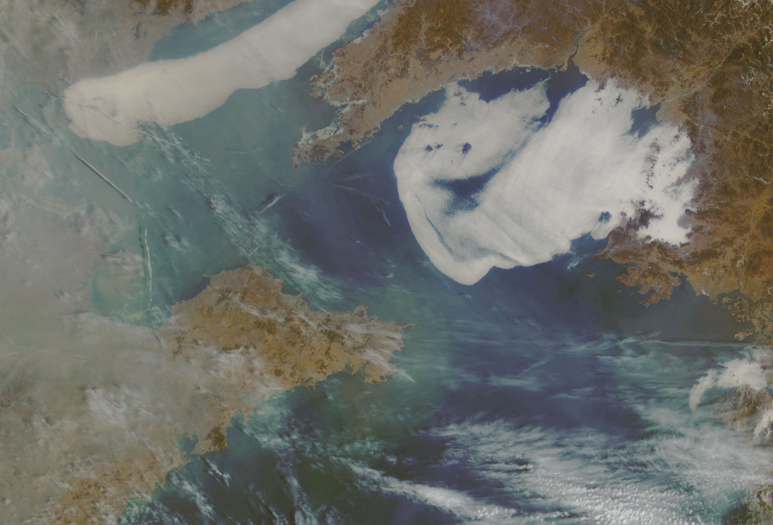
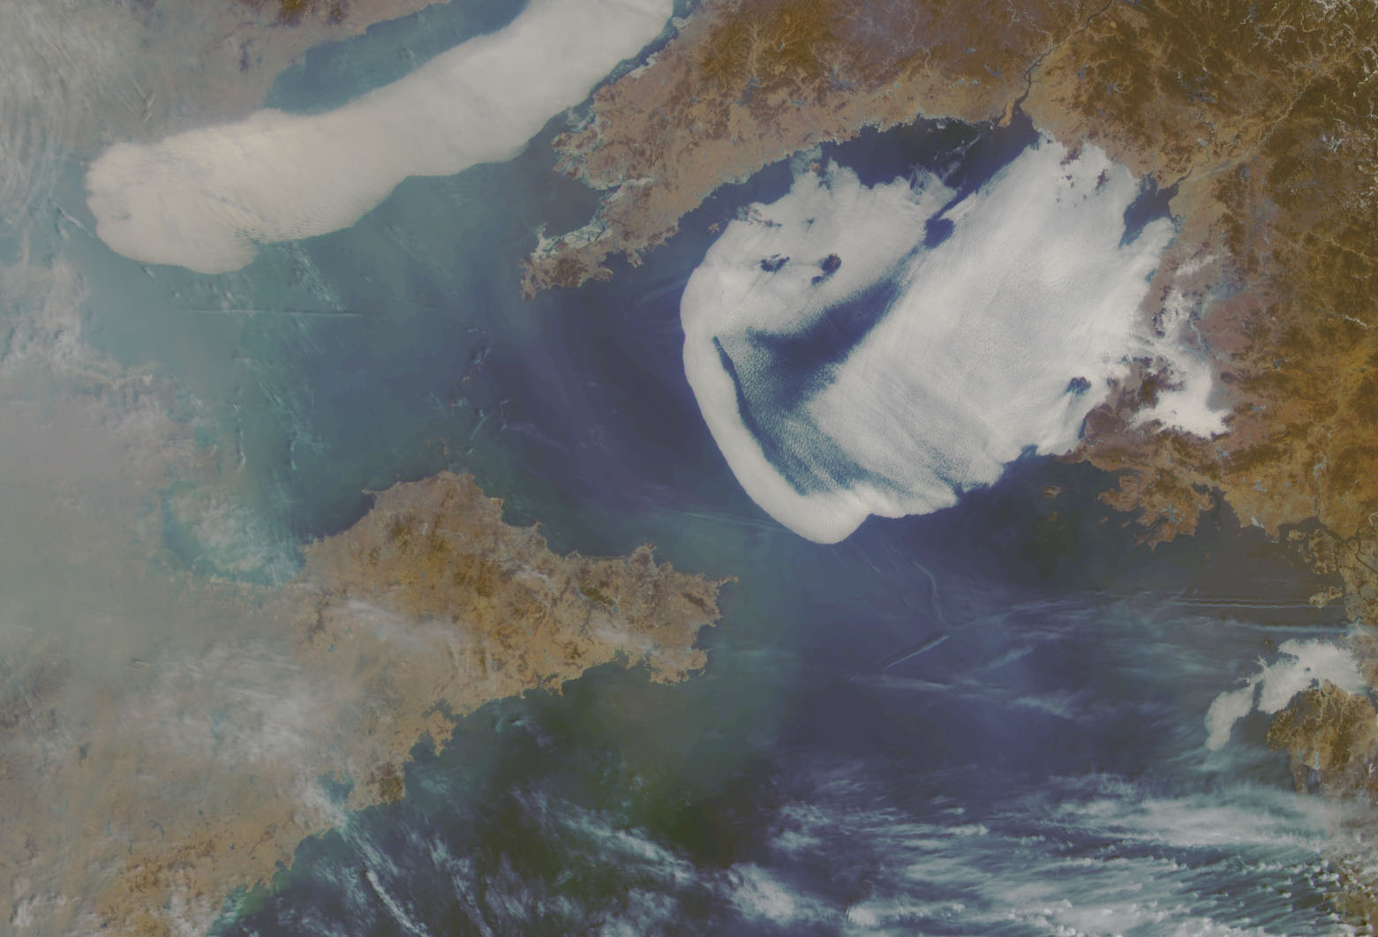
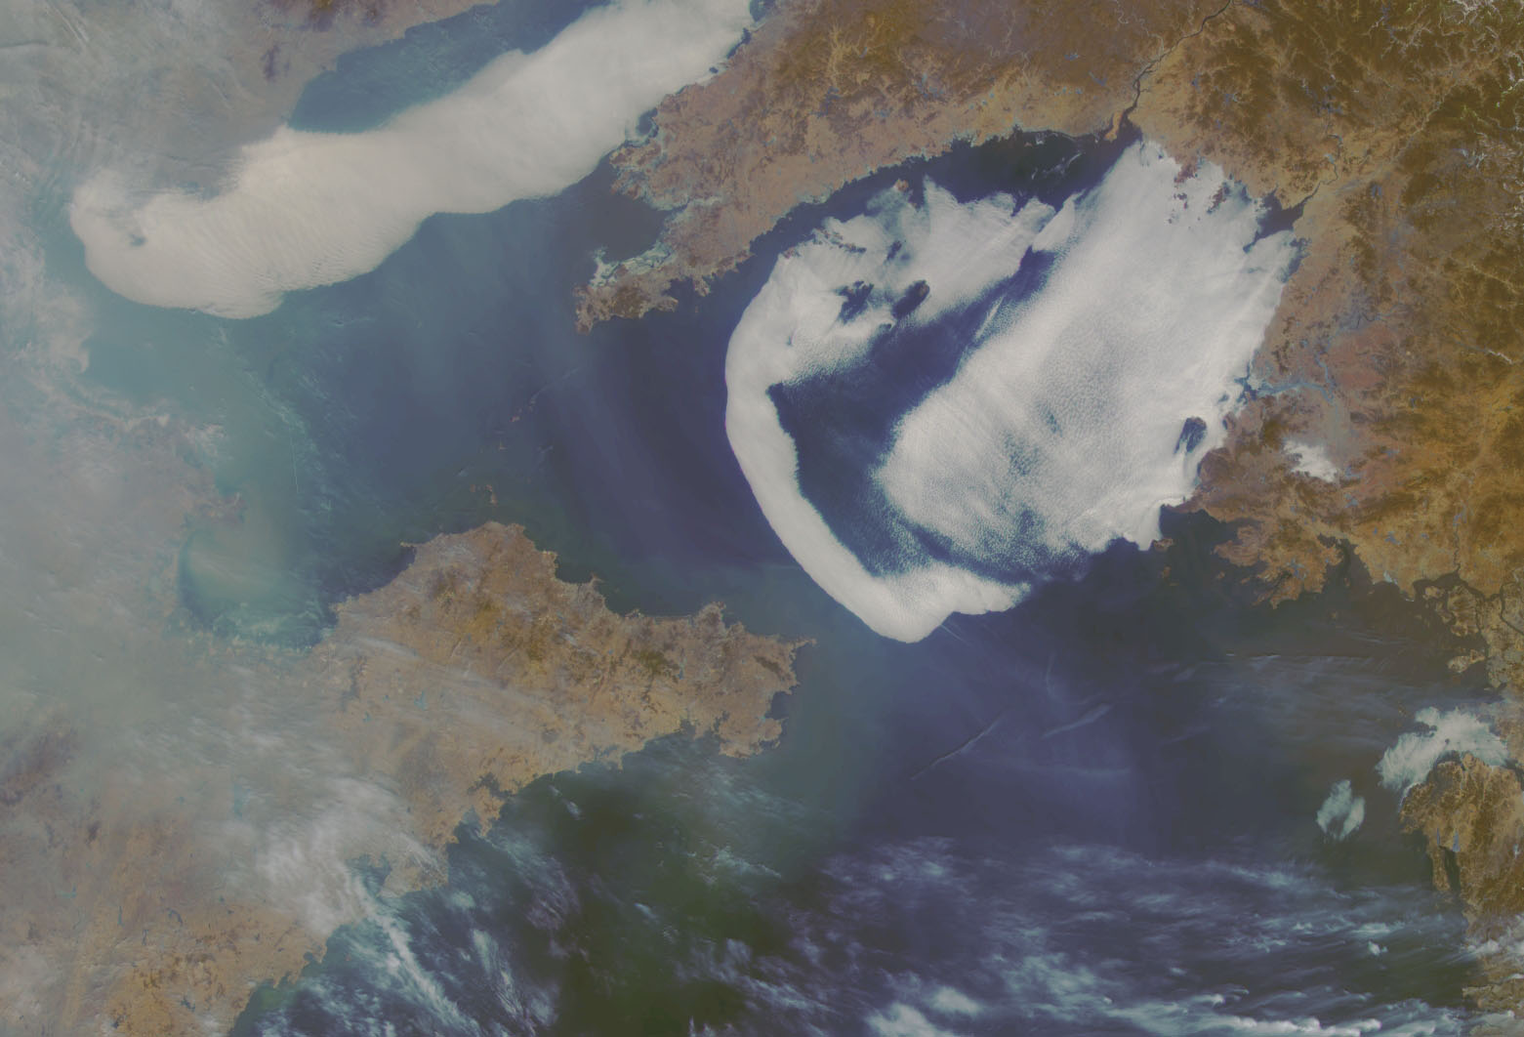
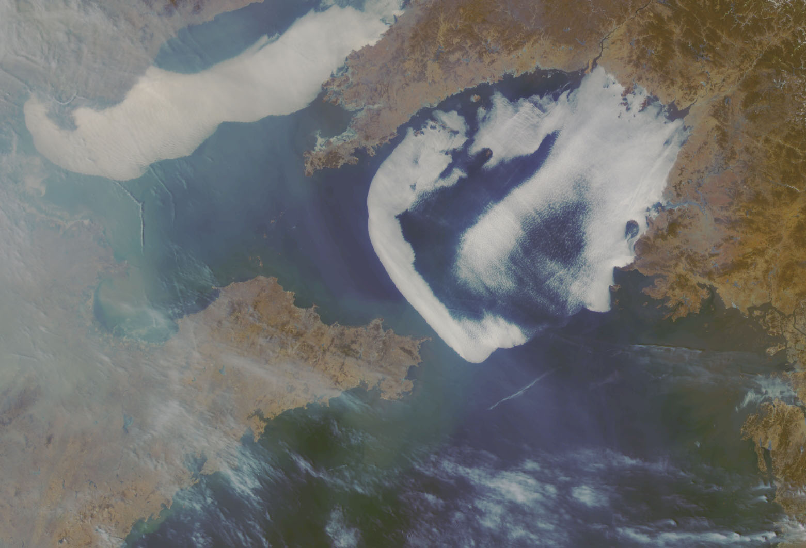
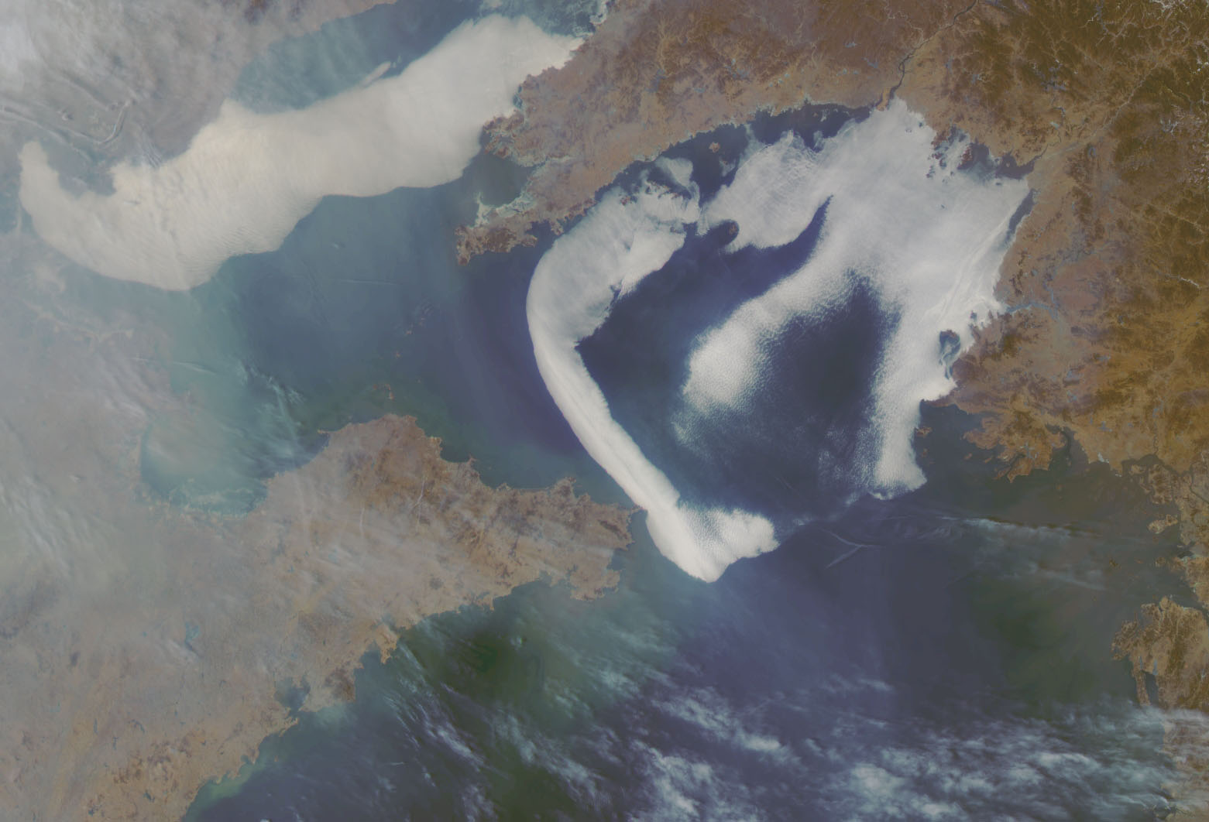
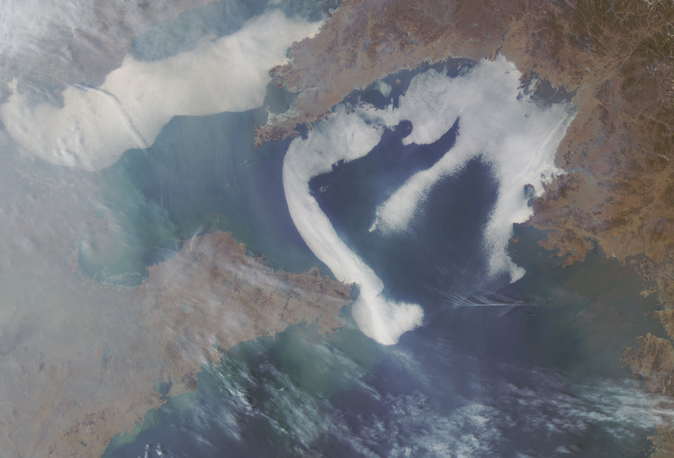
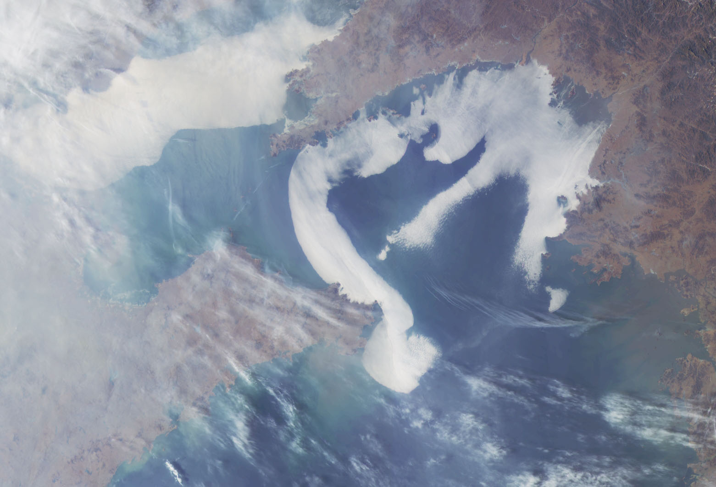
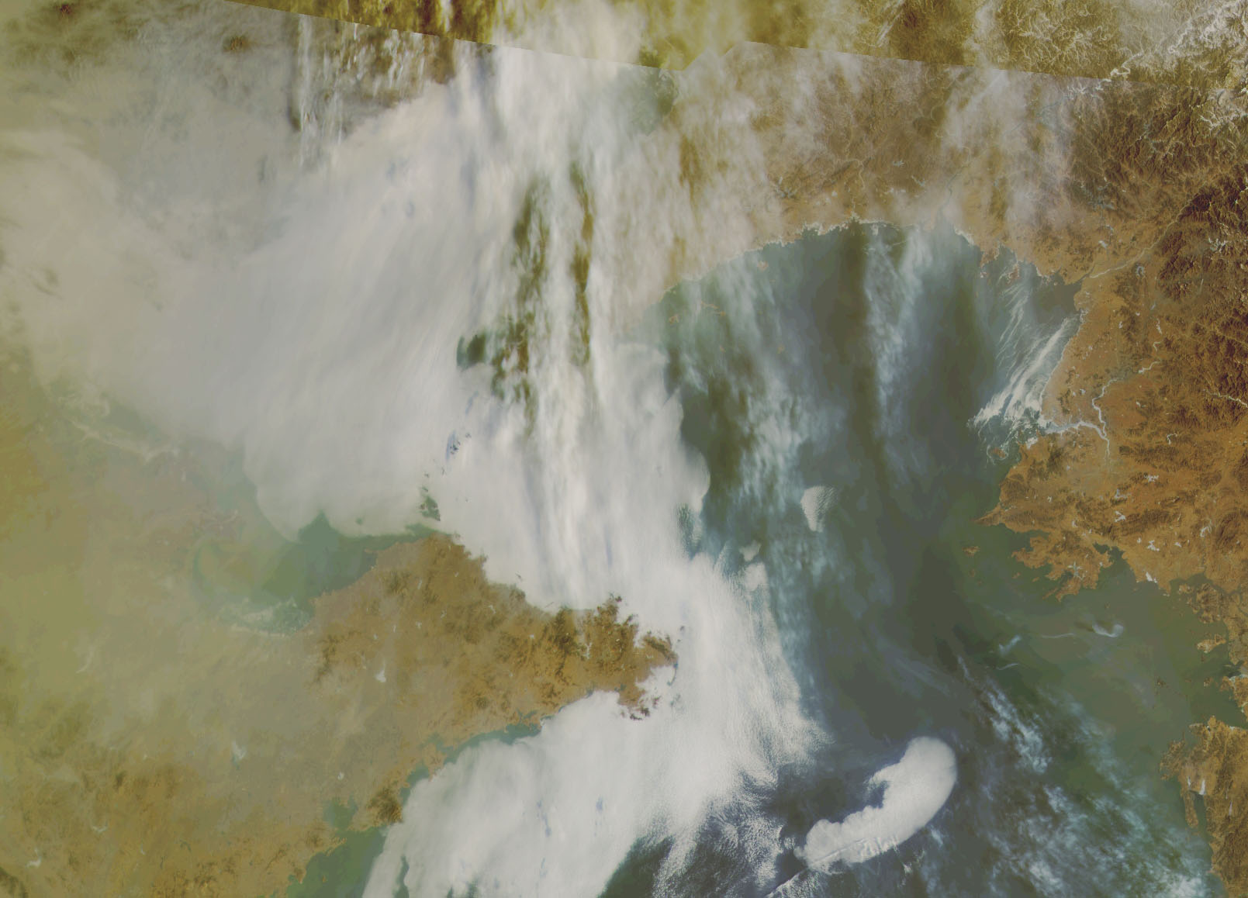
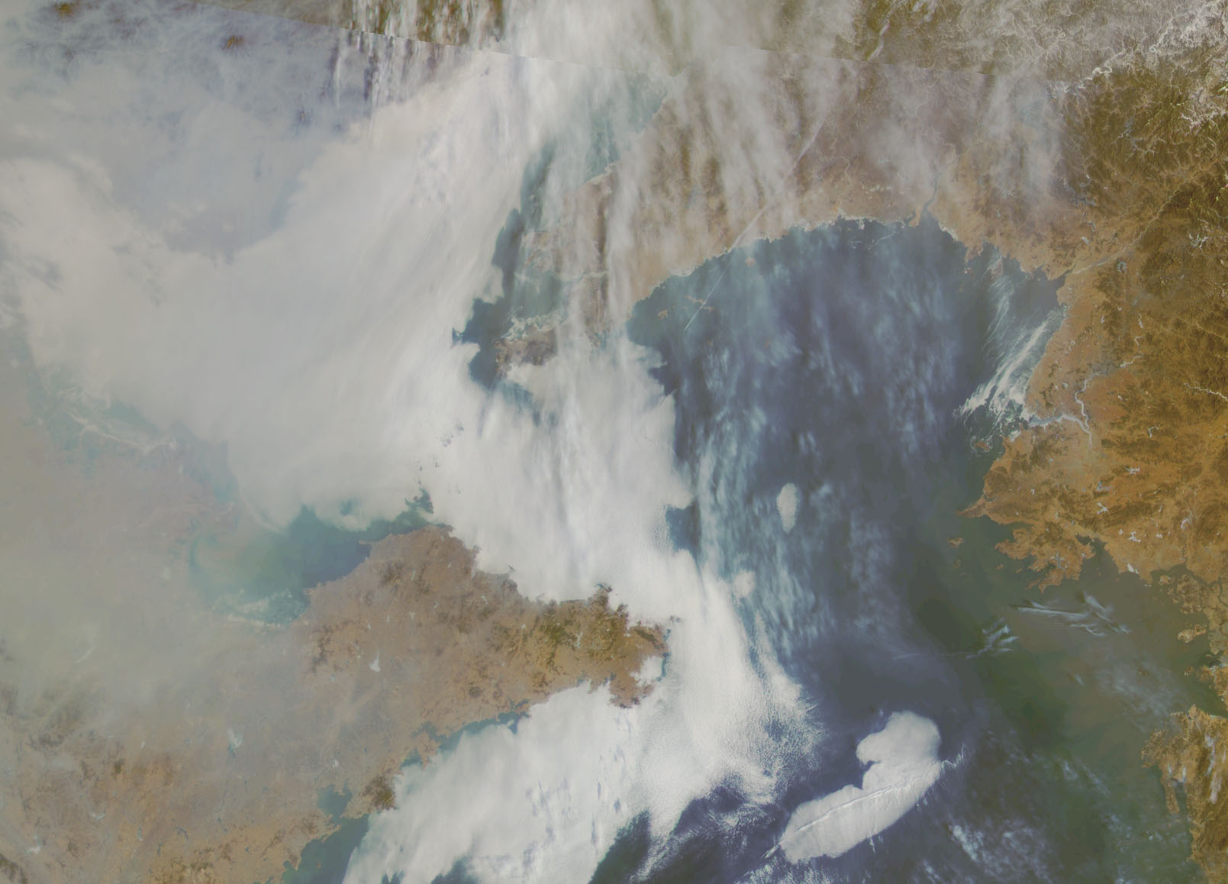
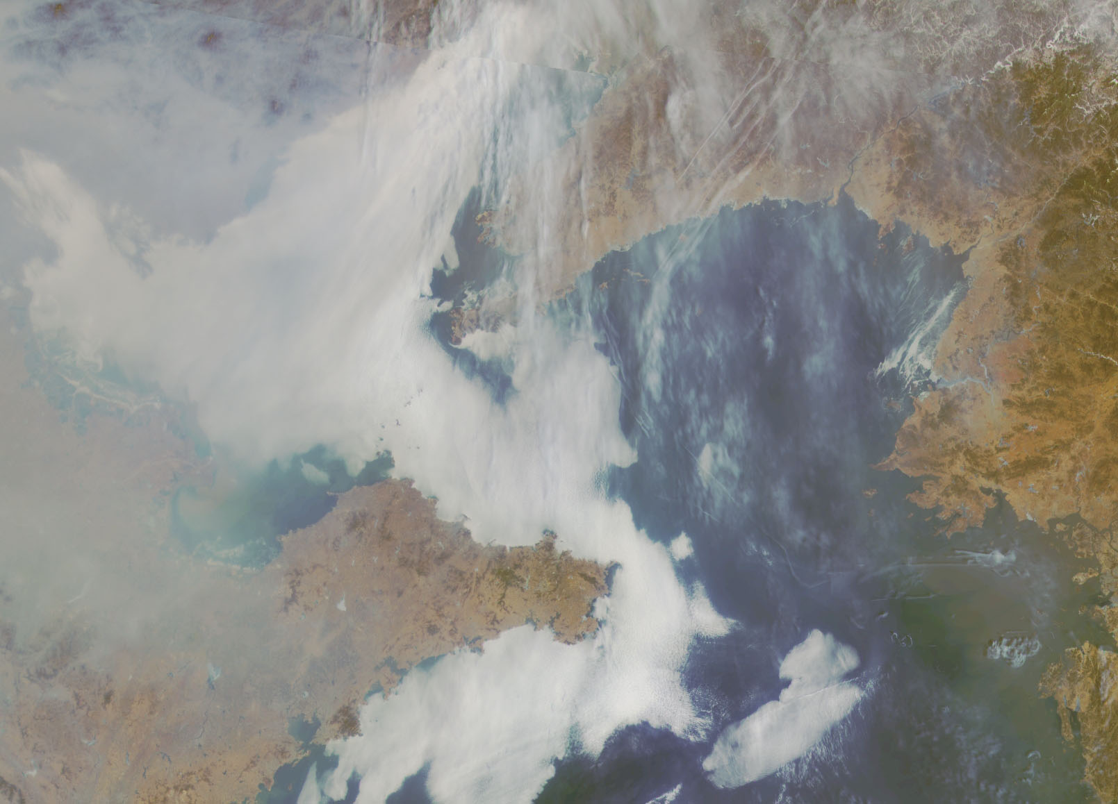
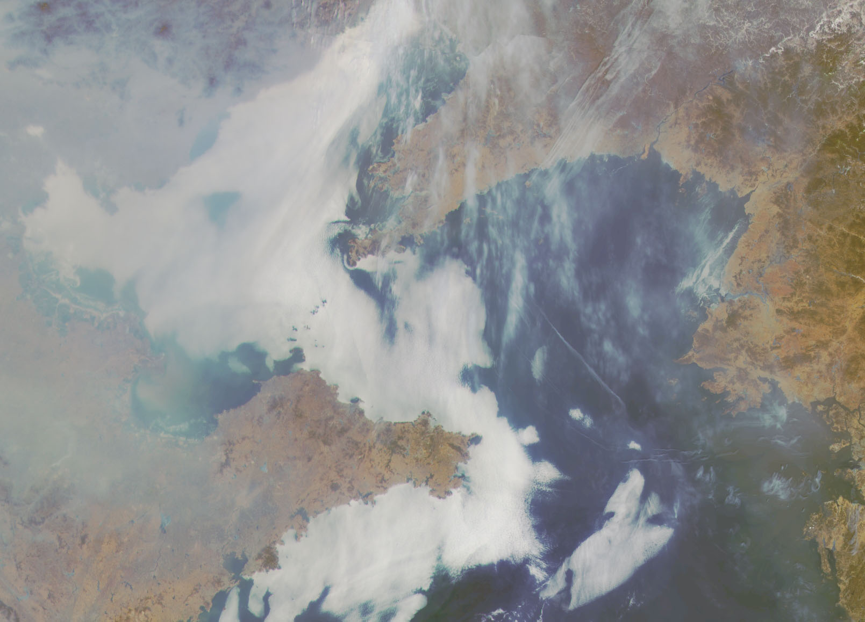
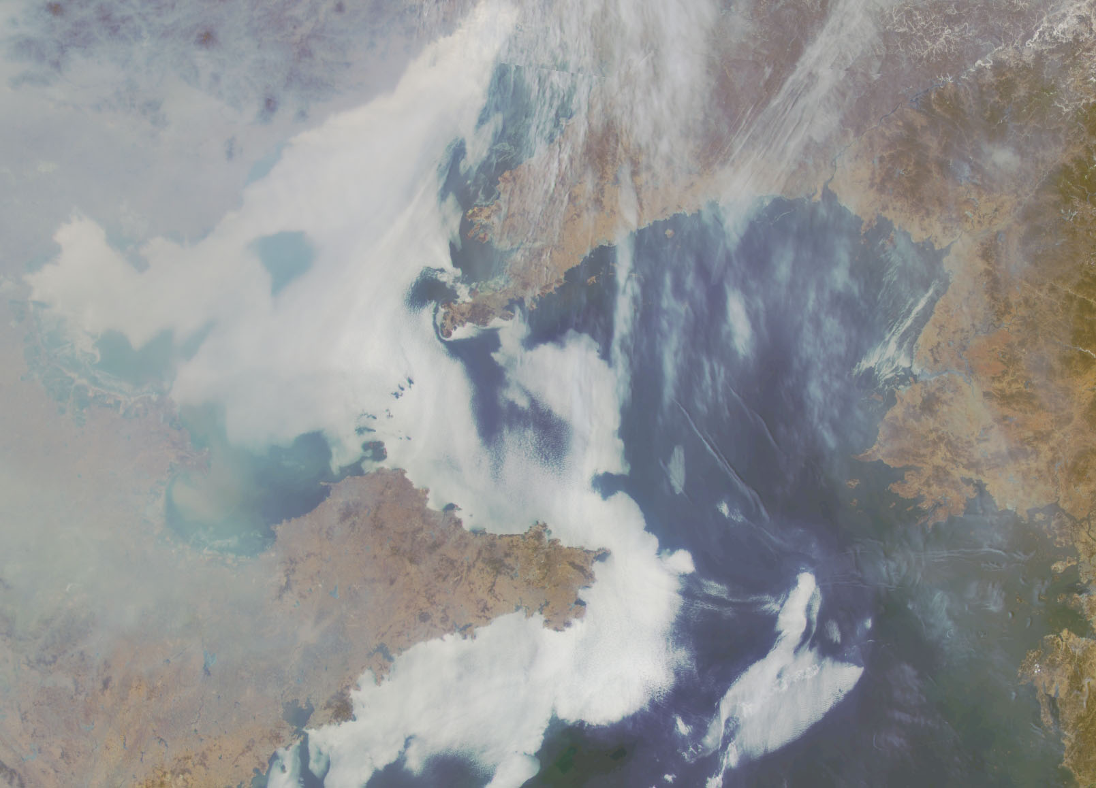
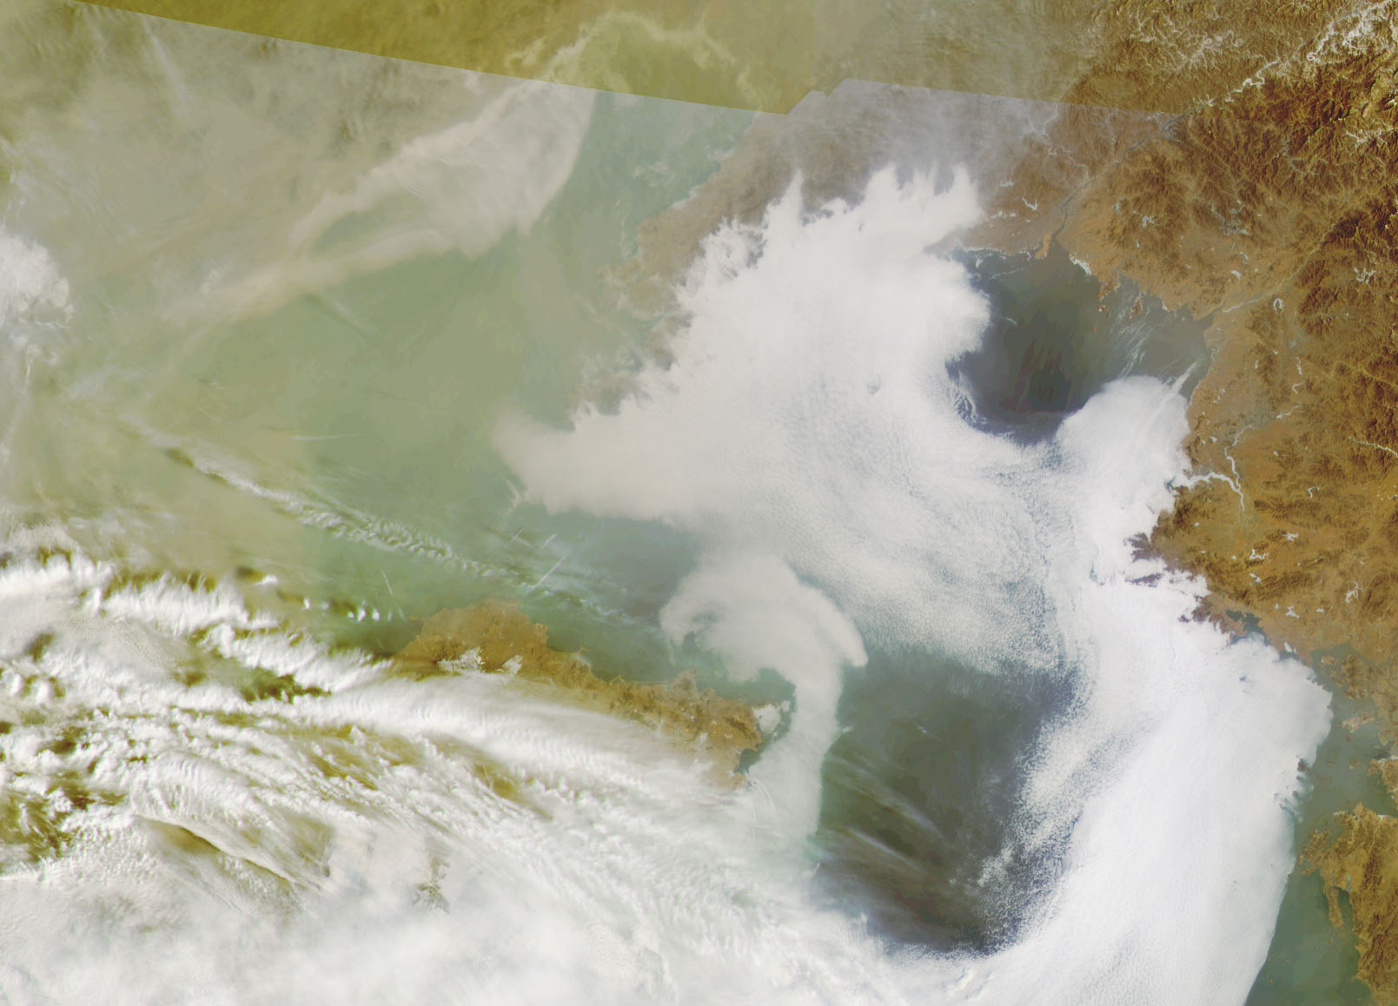
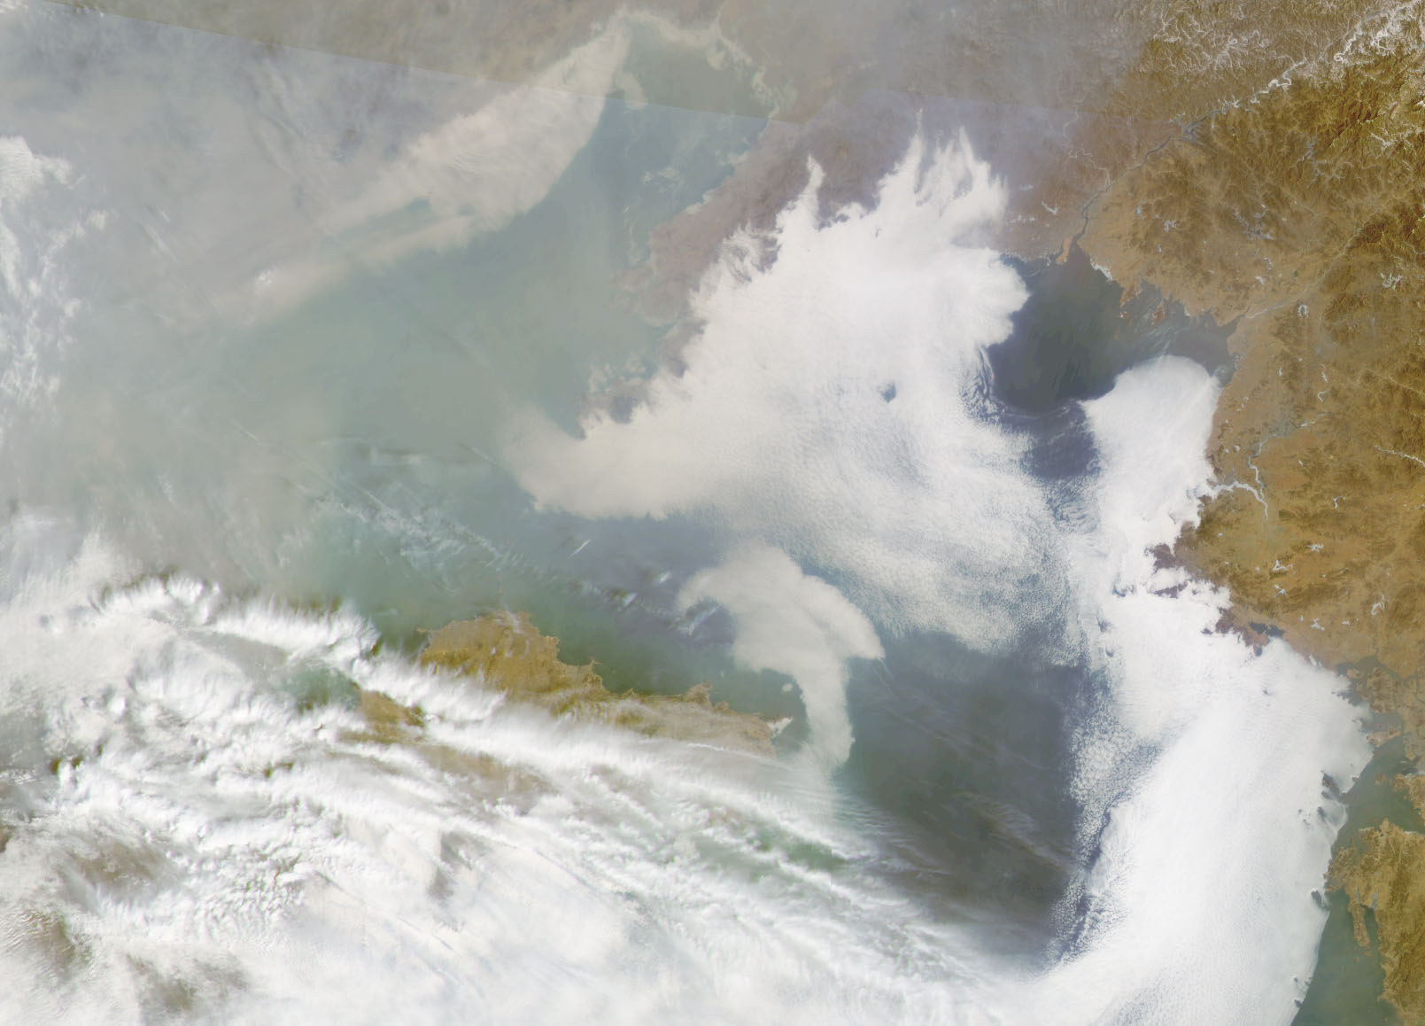
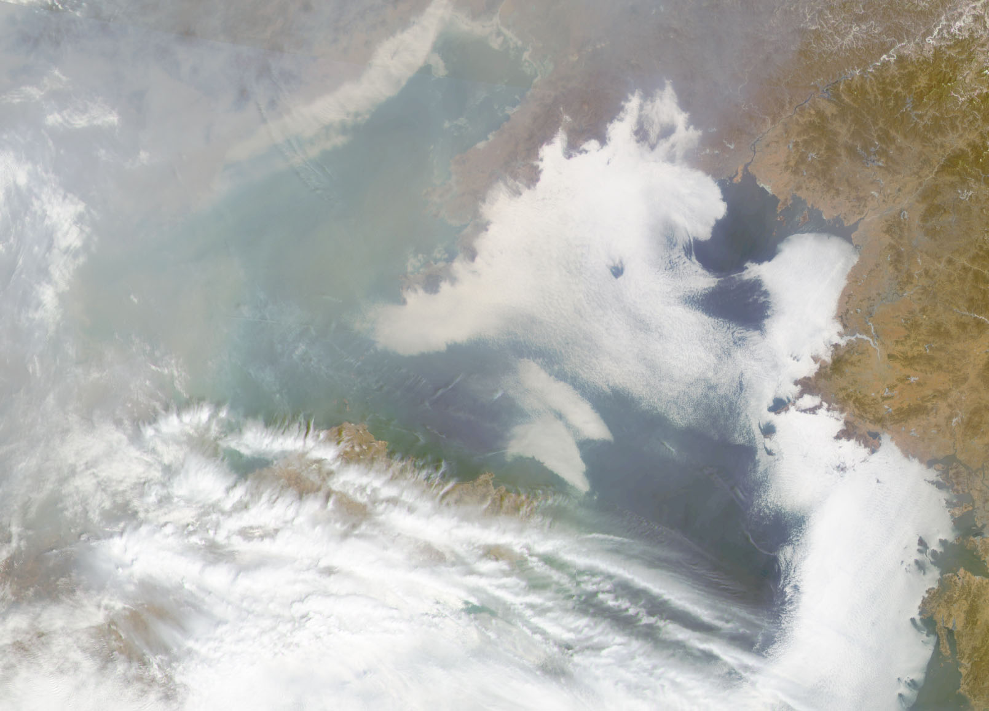
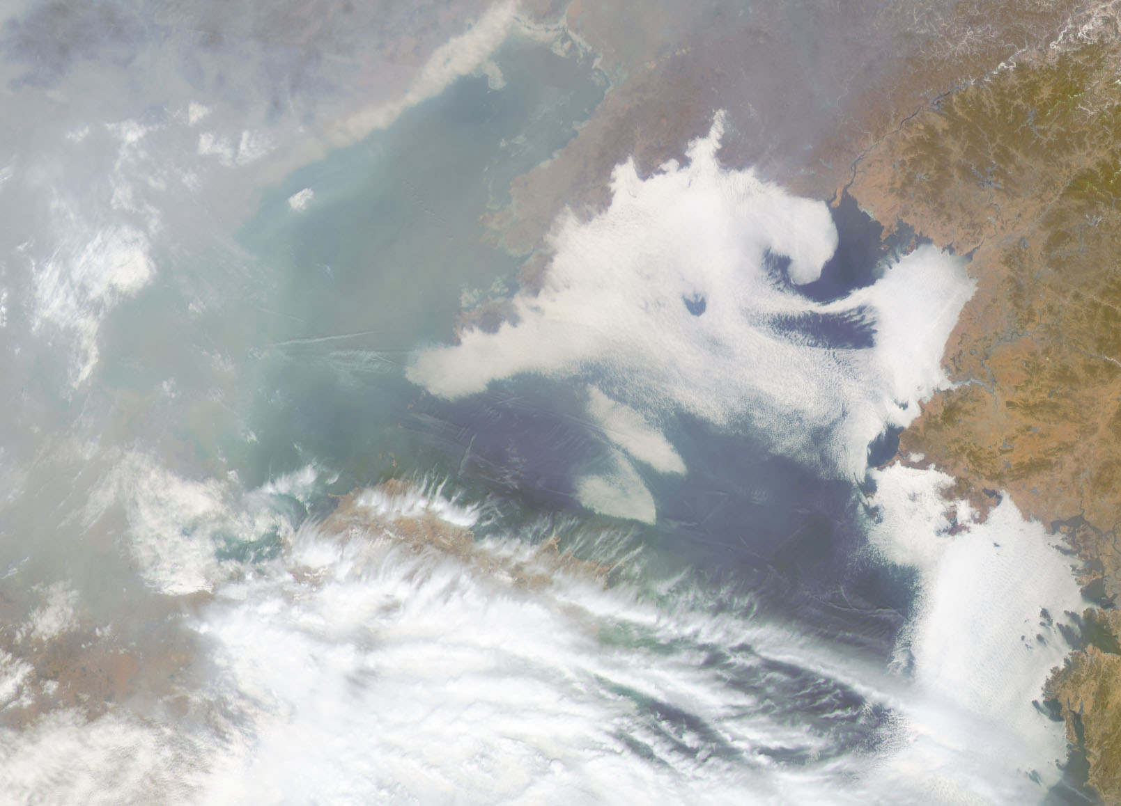
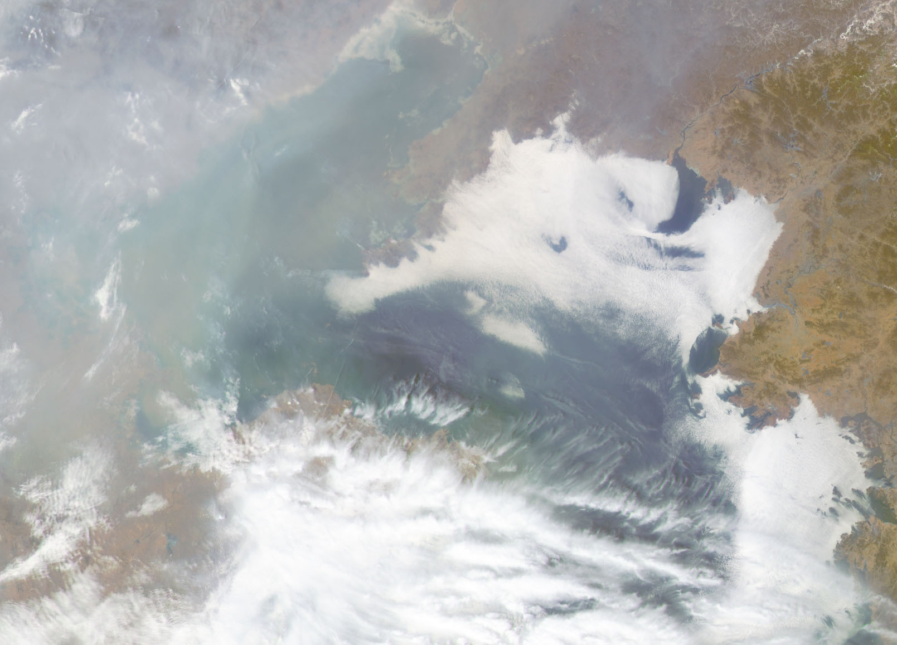
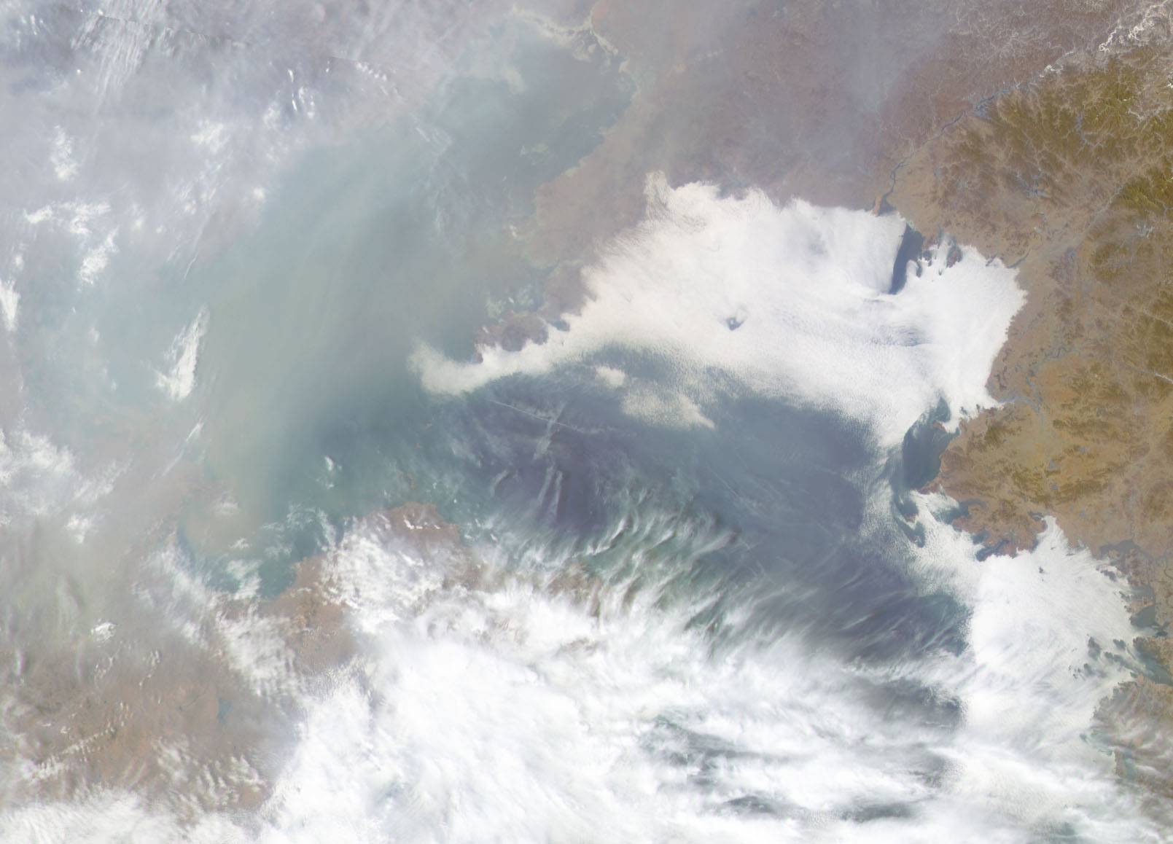
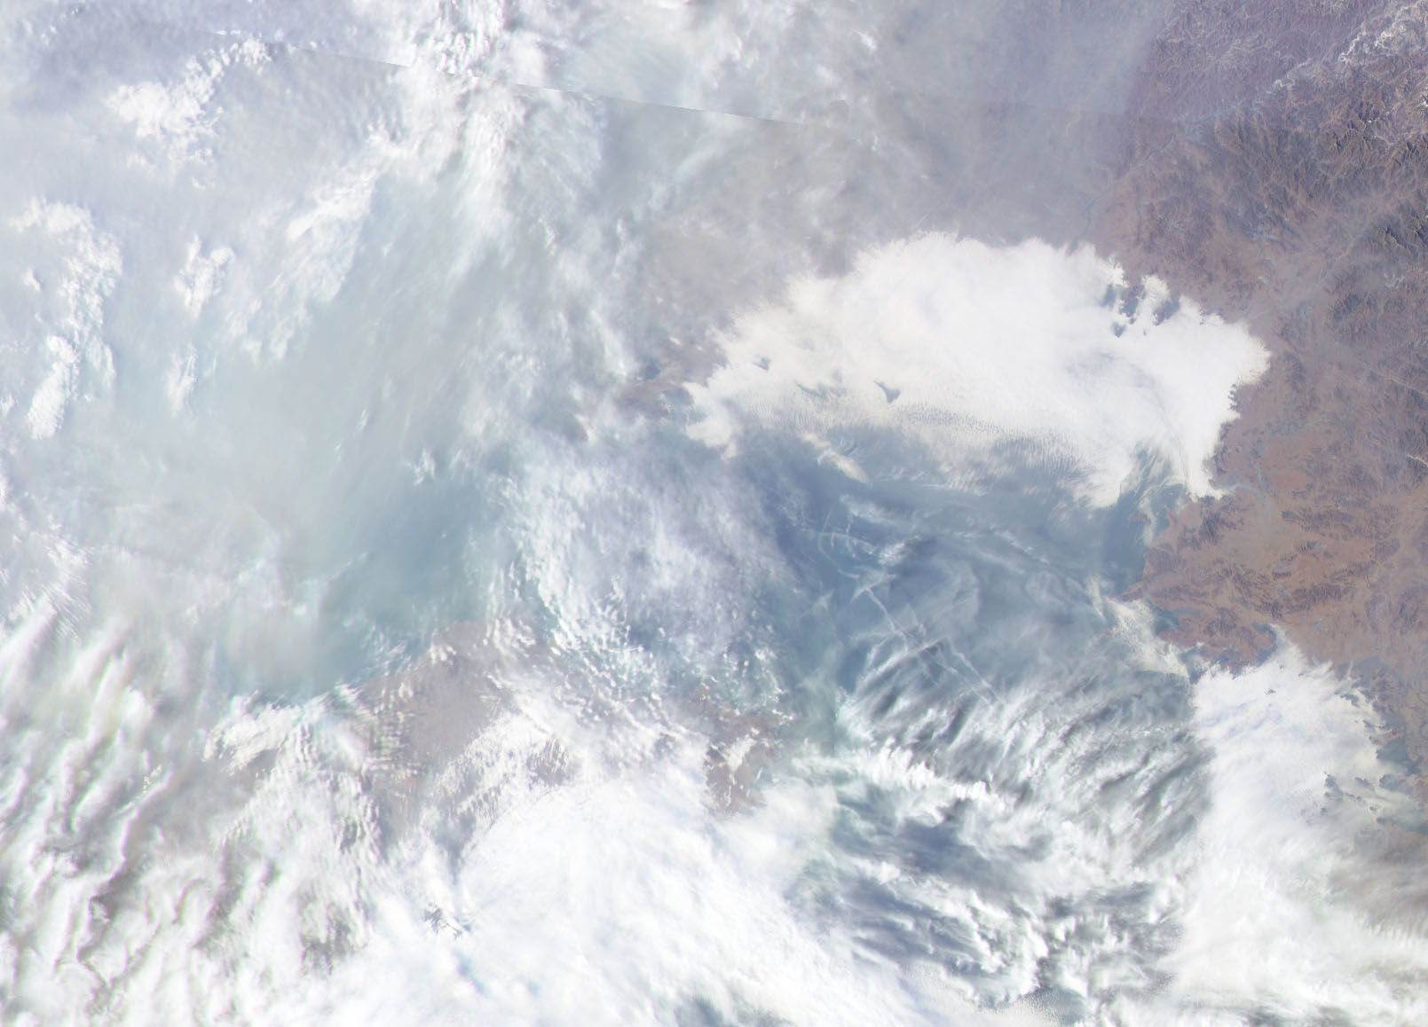
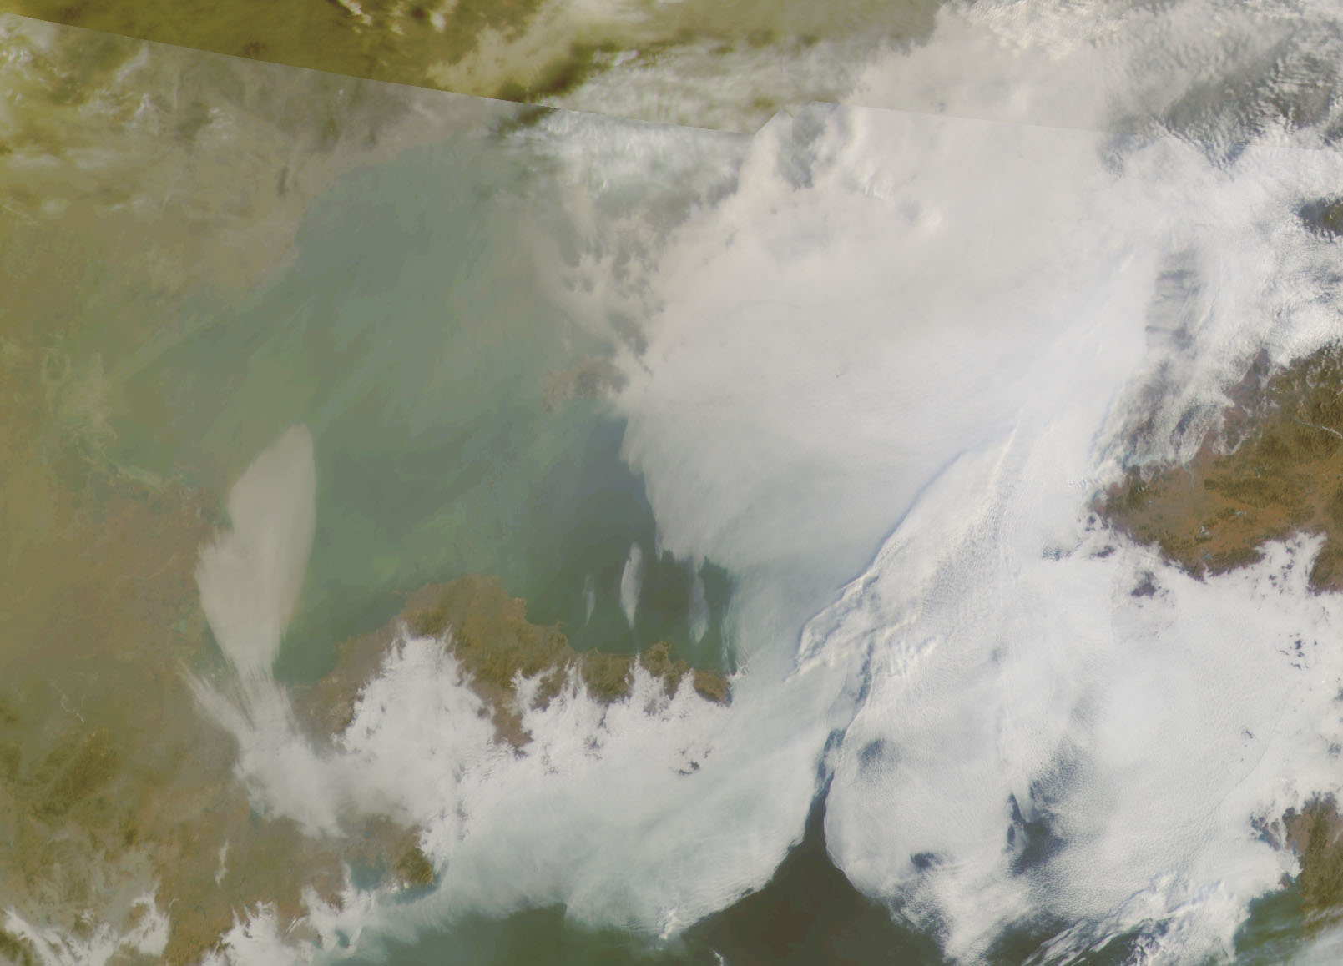
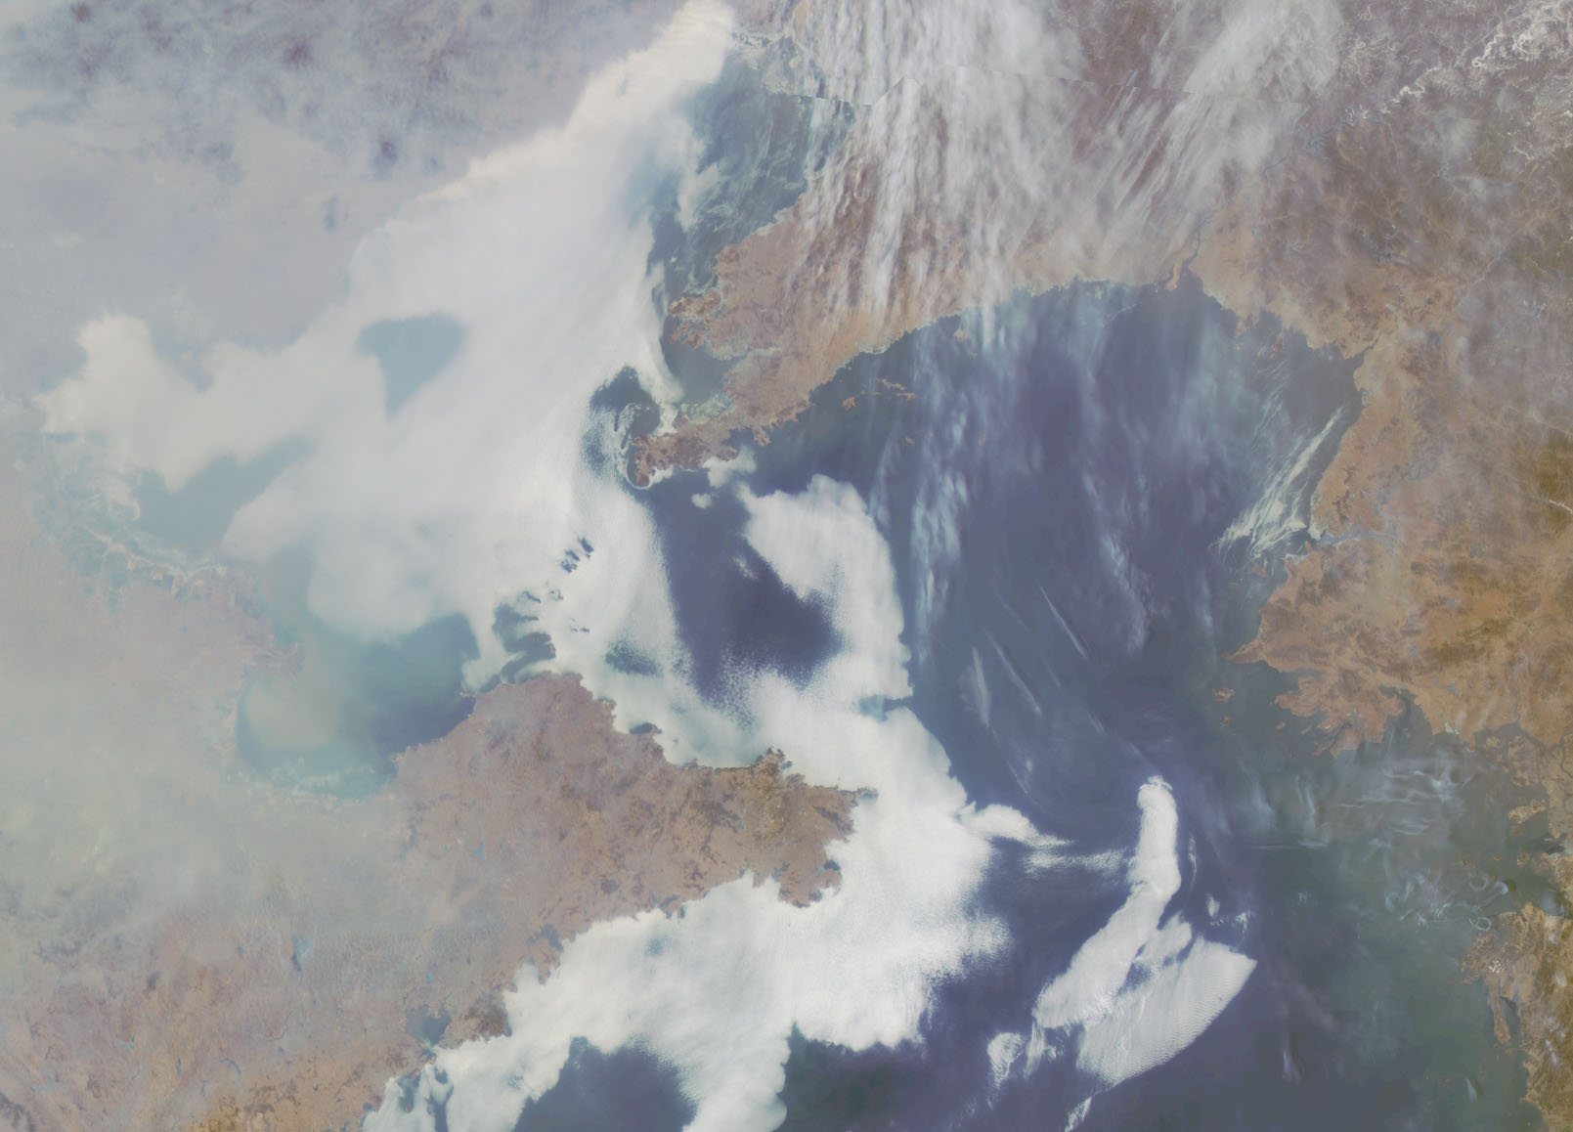
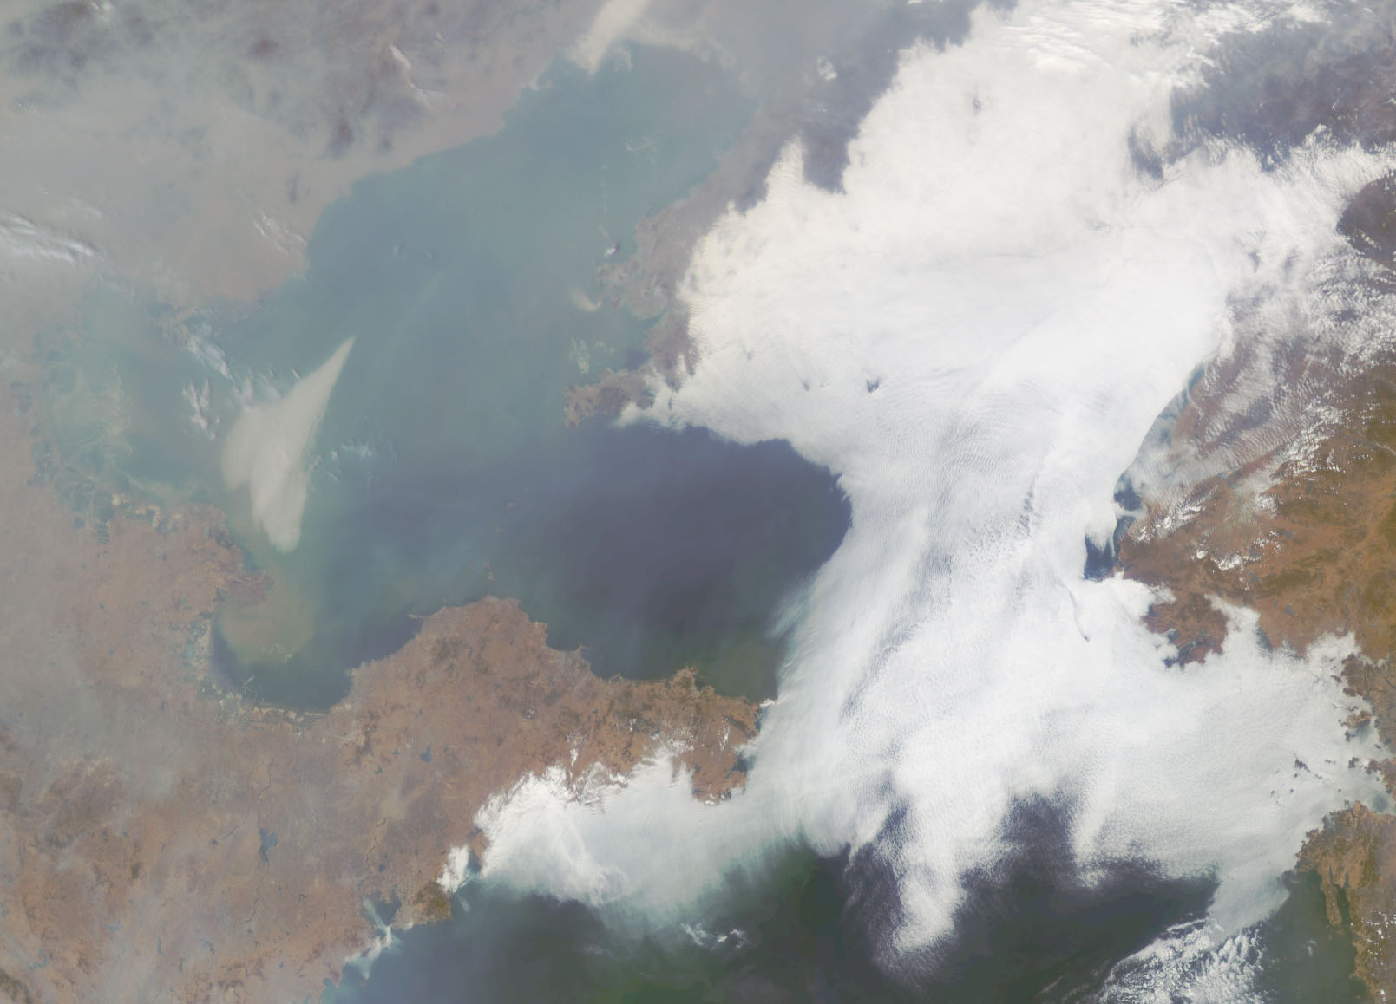
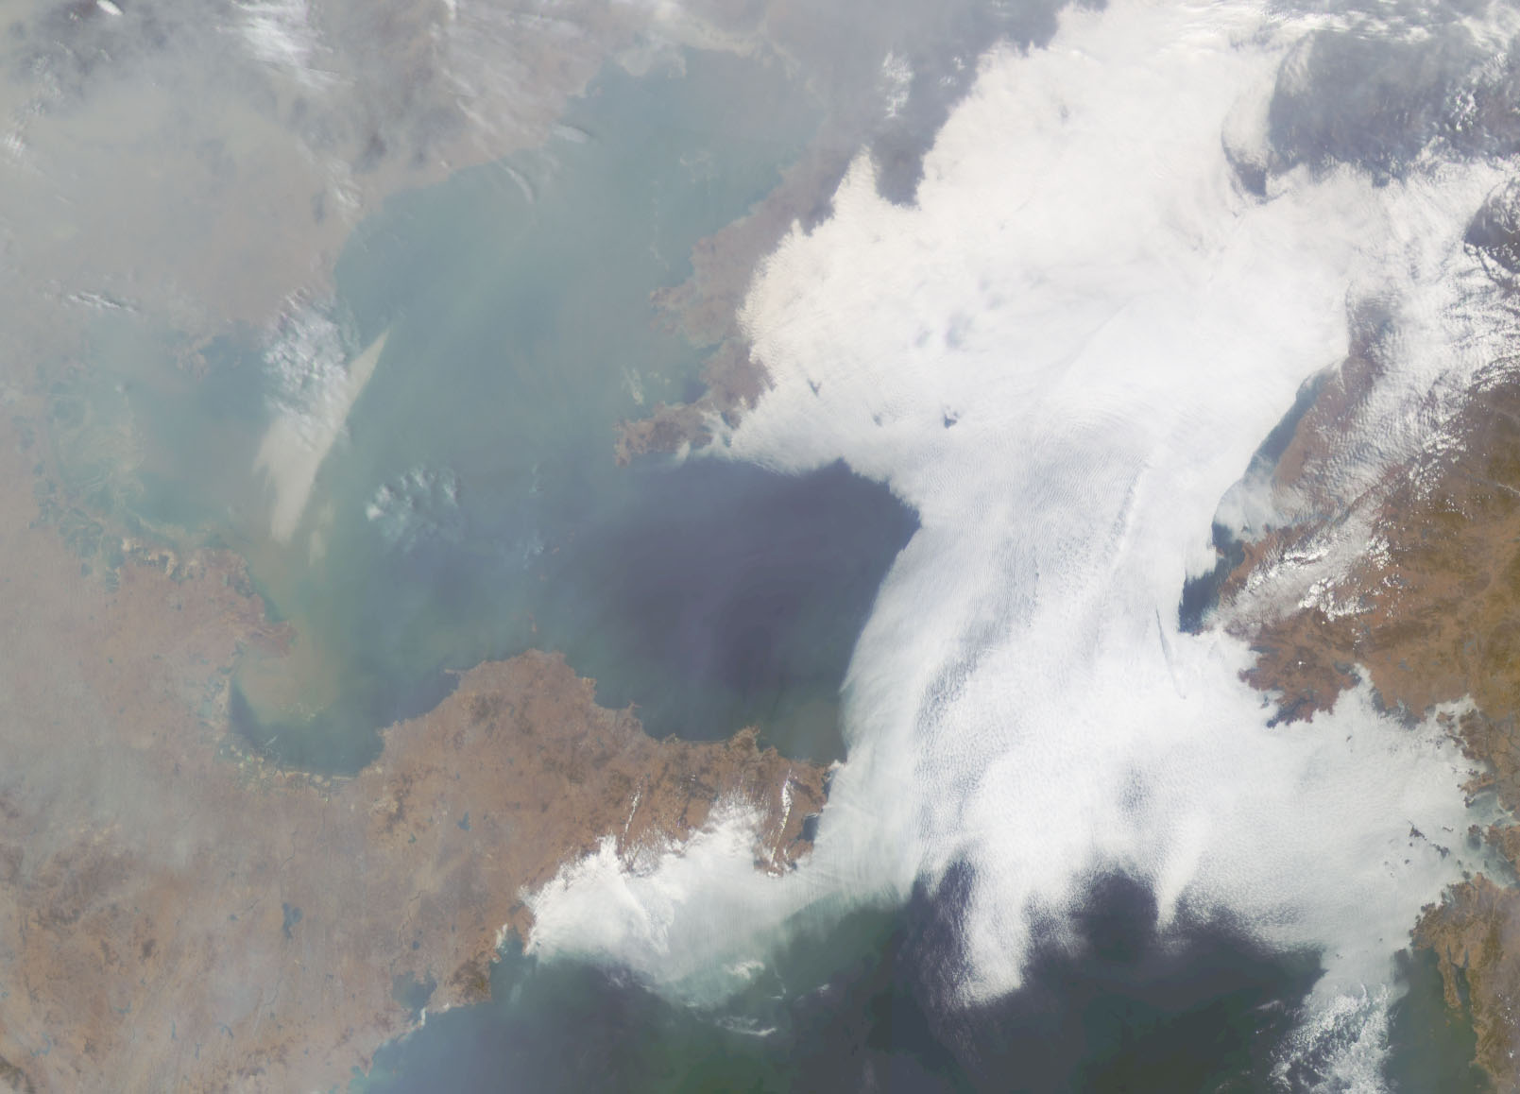
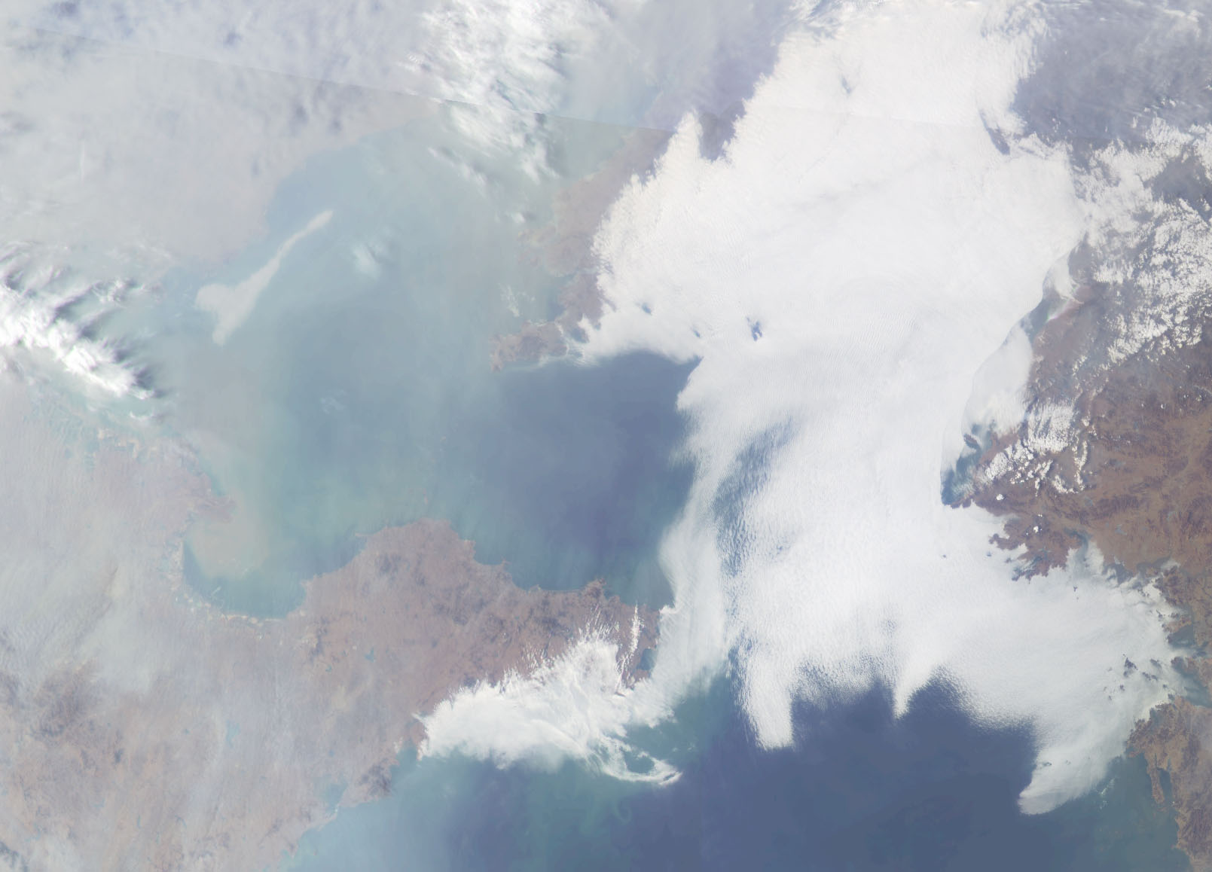
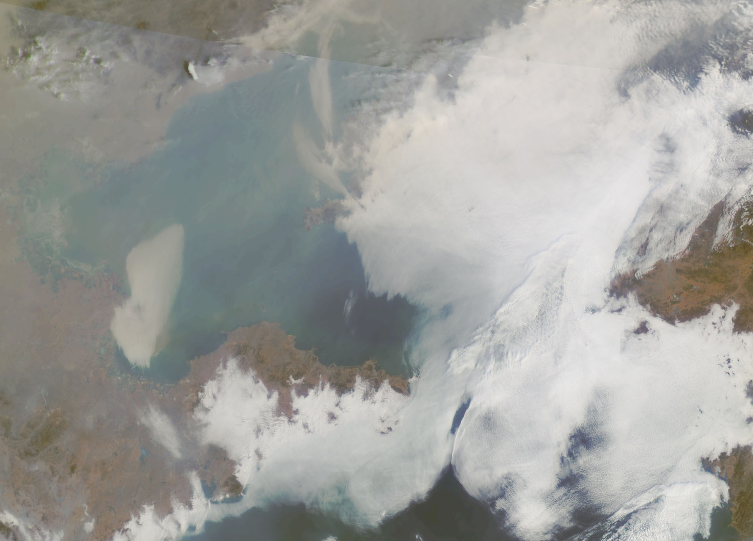
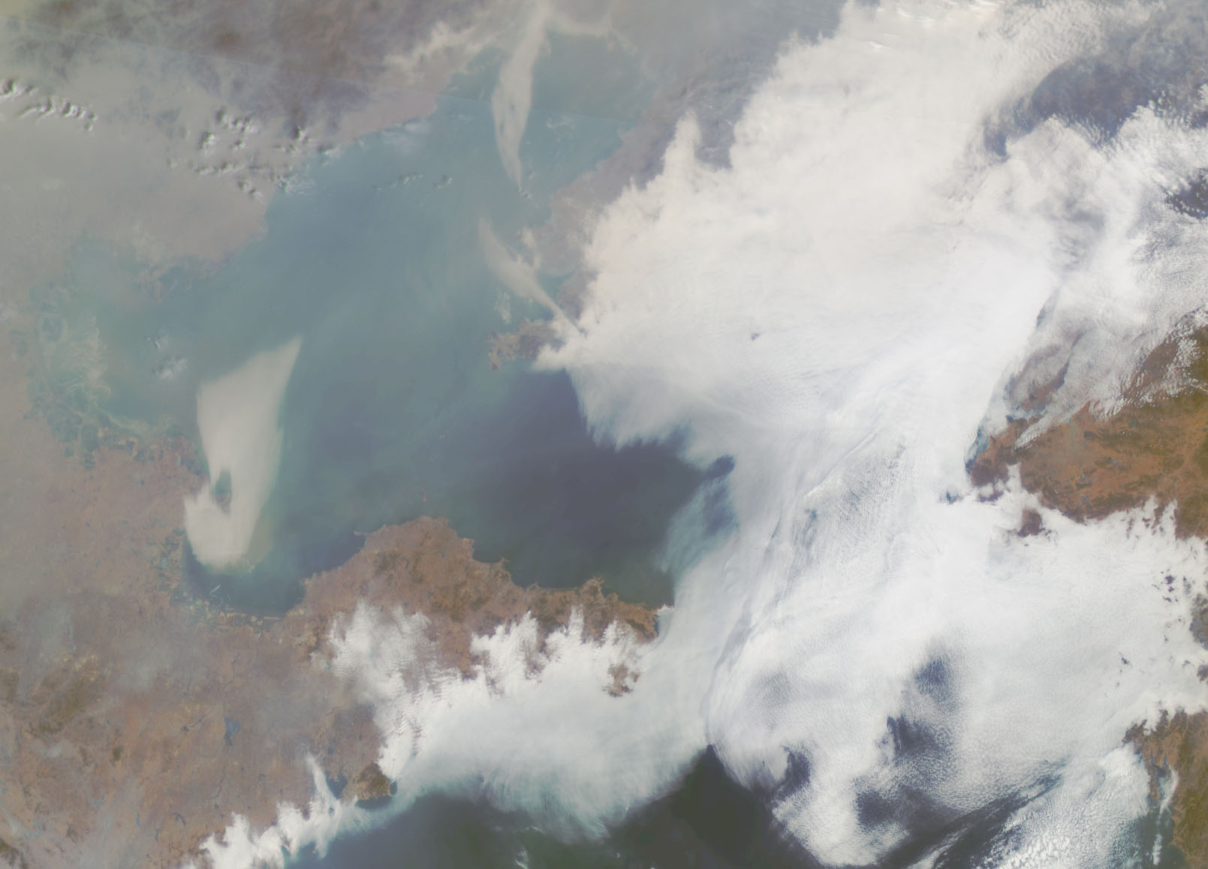
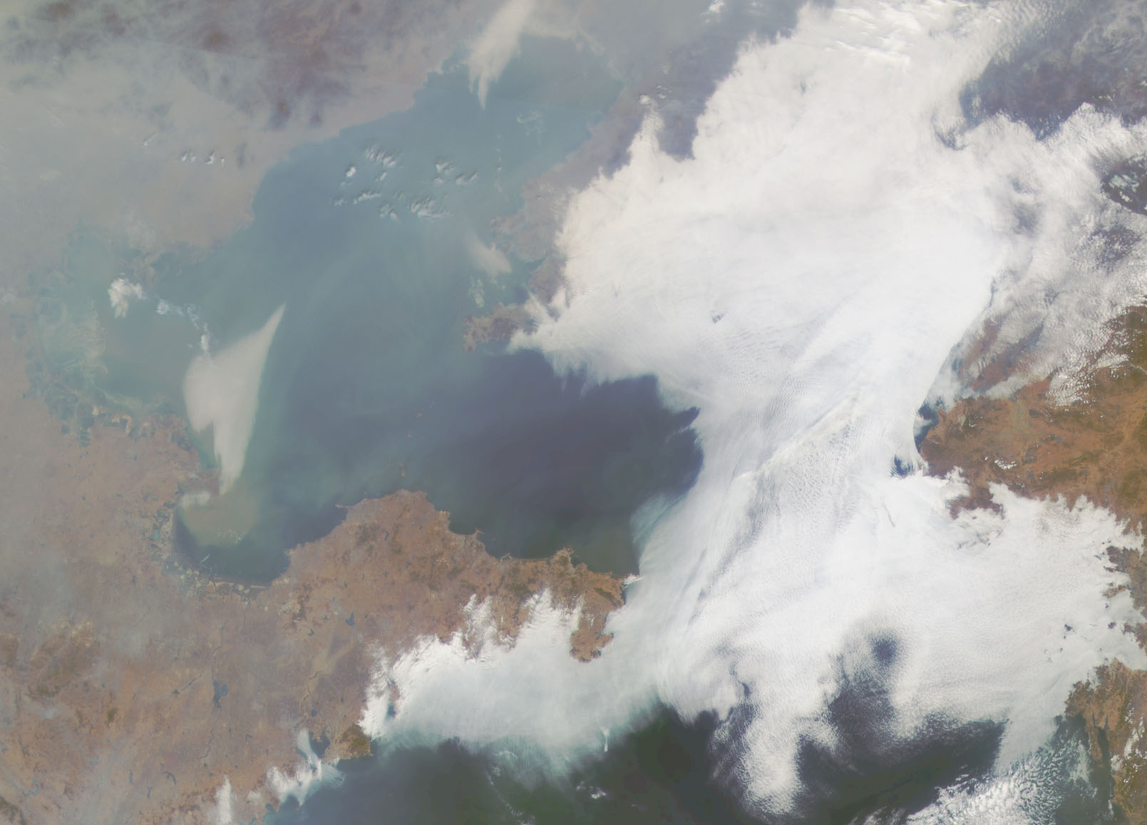
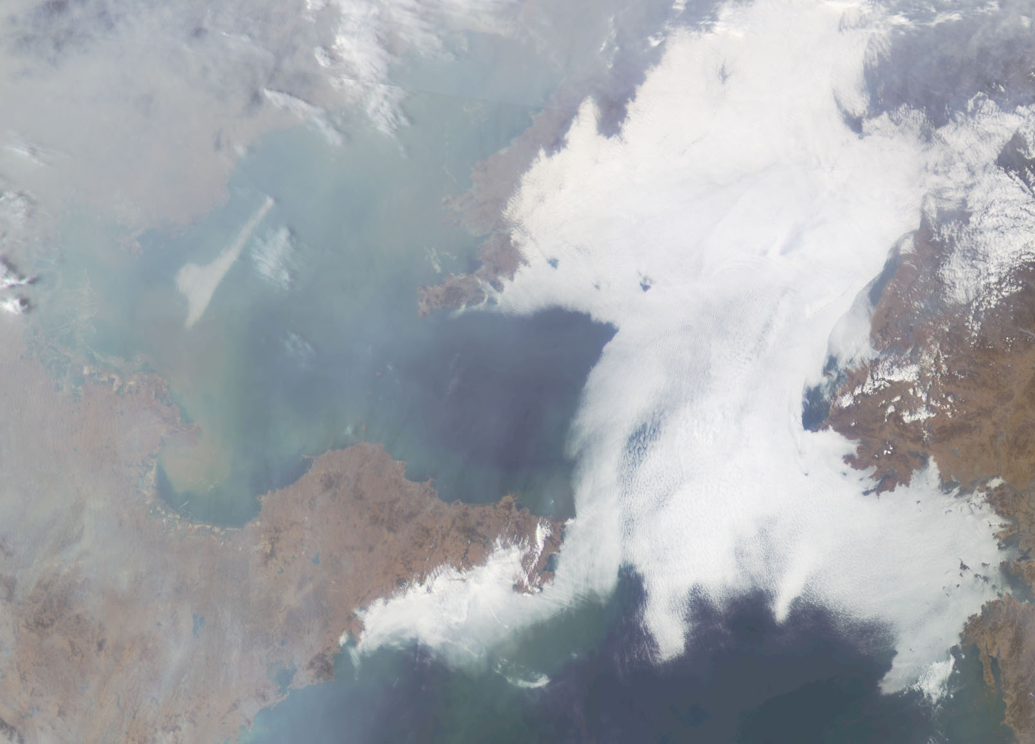
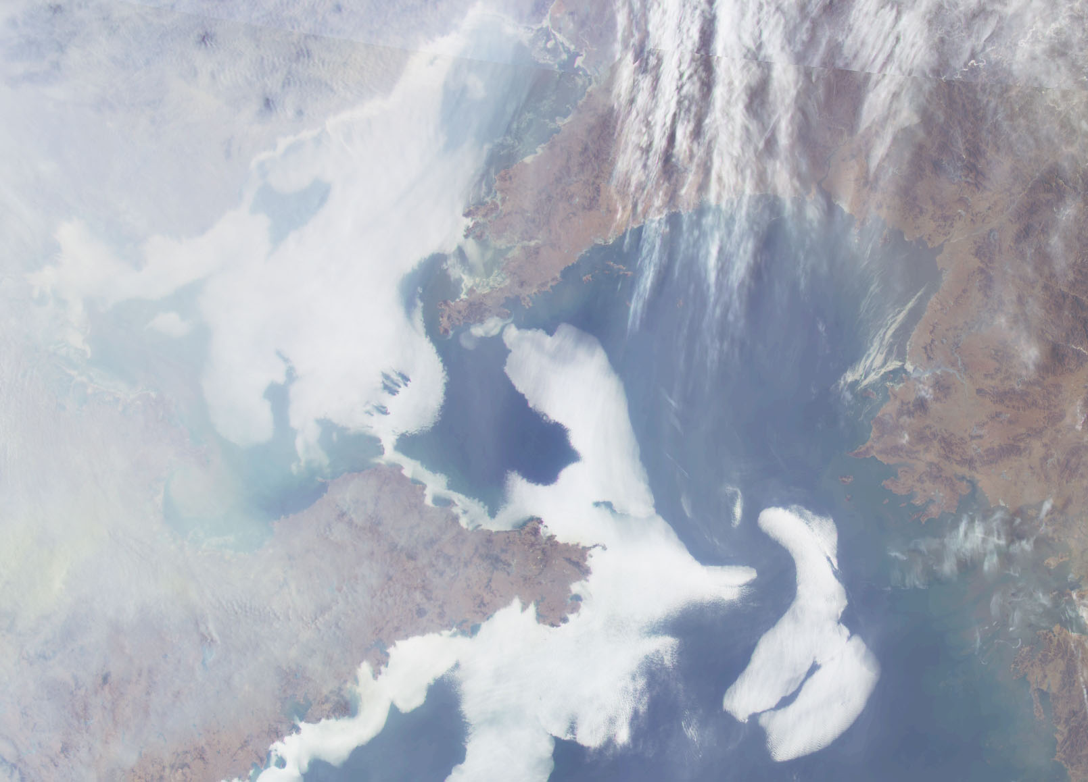
Sea Fog (19-23 Feb. 2011)
2011.02.19 00:15
2011.02.19 01:15
2011.02.19 02:15
2011.02.19 03:15
2011.02.19 04:15
2011.02.19 05:15
2011.02.19 07:15
2011.02.20 00:15
2011.02.20 01:15
2011.02.20 02:15
2011.02.20 03:15
2011.02.20 05:15
2011.02.20 06:15
2011.02.21 01:15
2011.02.21 03:15
2011.02.21 04:15
2011.02.21 05:15
2011.02.22 00:15
2011.02.22 01:15
2011.02.22 02:15
2011.02.22 03:15
2011.02.22 04:15
2011.02.22 05:15
2011.02.22 07:15
2011.02.23 00:15
2011.02.21 07:15
2011.02.23 04:15
2011.02.23 05:15
2011.02.23 07:15
2011.02.23 01:15
2011.02.23 02:15
2011.02.23 03:15
2011.02.23 06:15
2011.02.19 06:15
2011.02.20 04:15
2011.02.20 07:15
2011.02.21 00:15
2011.02.21 02:15
(UTC)

Slide 7
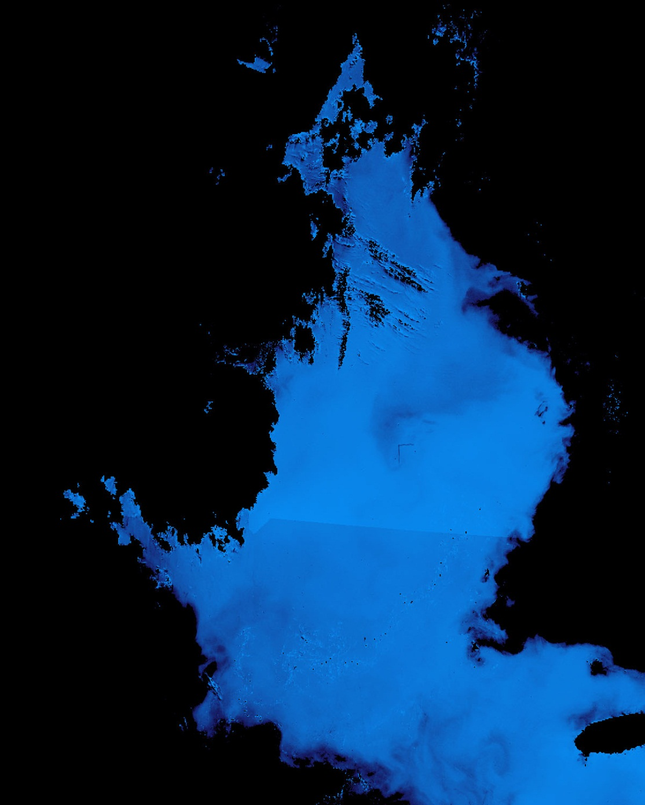
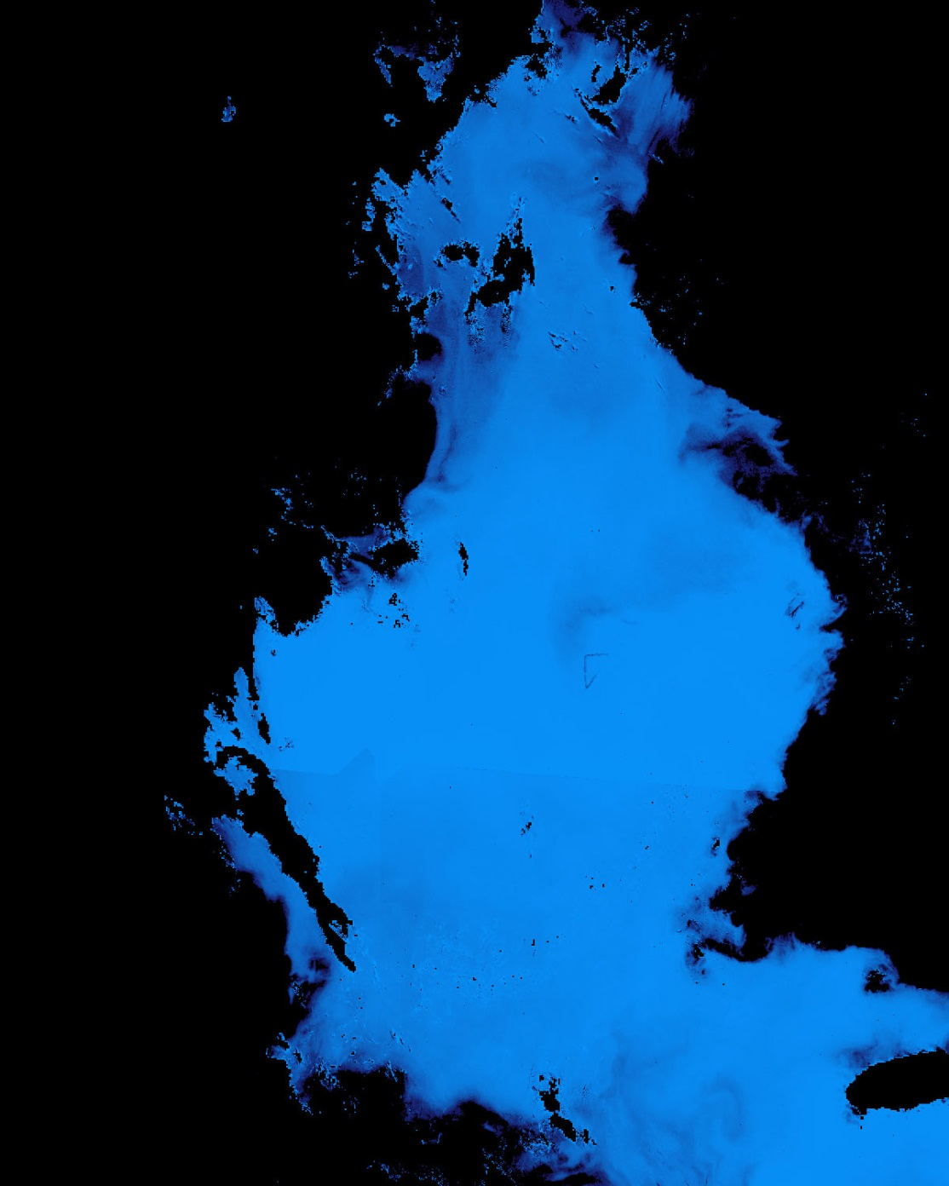
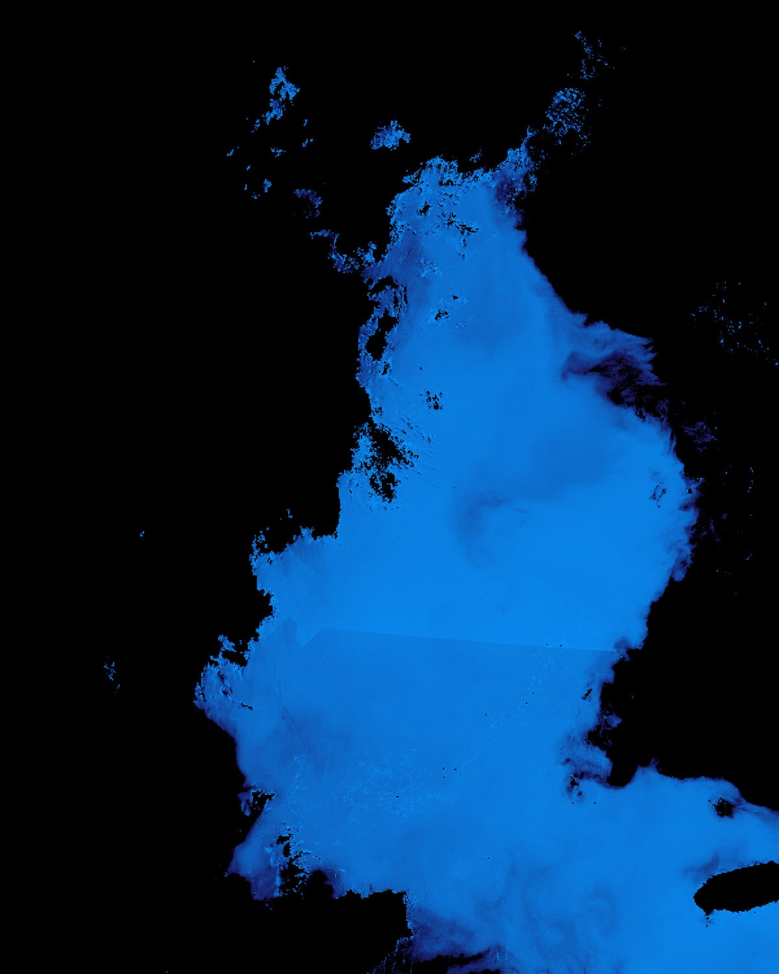





Ocean dumping site monitoring
2011.07.19
Ship velocity measurement
: 8~9 knot
Notes:
Not just track the spill, but also to maybe find the source.

Slide 8








Sea Ice (3-15 Jan 2011)
2011. 01. 06 03:16(UTC)
2011. 01. 07 03:16(UTC)
2011. 01. 11 03:16(UTC)
2011. 01. 12 03:16(UTC)
2011. 01. 14 03:16(UTC)
2011. 01. 15 03:16(UTC)
2011. 01. 03 03:16(UTT)
China
Korea
Acquisition by GOCI from 03 to 15 Jan 2011
As temperature dropping, area of sea ice widen and sea ice thicken
Notes:
Temperate latitude hi res ice

Slide 9


New science from SEVIRI: 15 min variability in TSS !!
Neukermans, G. 2012
Notes:
pinning Enhanced Visible and InfraRed Imager (SEVIRI).

Slide 10

New science enabled by better daily averaging
SEVIRI daily composite of 34 images
Quasi cloudfree
MODIS: 1 image
60% clouded
Neukermans, G. 2012

Slide 11


Sequential Ocean color from MODIS and NPP
Monitoring Bio-Optical Processes Using NPP-VIIRS And MODIS-Aqua Ocean Color Products
Arnone et al, 2013 Paper at SPIE - Baltimore May 2013
Uncoupling the
Advection
Bio-optical changes (growth decay and vertical migration)
Sensor processing
Deriving Currents under development using several methods .
Robert Arnone et al .
University of Southern Mississippi, Stennis Space Center, MS.

Slide 12






20: 16 S- NPP
21: 22 MODIS
22:27 S- NPP
A
A
C
C
B
Monterey
Bay
B
Southern California Chlorophyll Sequence within 111 minutes derived from S-NPP
and MODIS from June 25, 2012 from 20:16 – 22:27 GMT .
- Possible bio-optical changes from upwelling and advective changes along the coasts.
Notes:
Note upwelling and the eddy in the Bottom panels

Slide 13
Short Term Dynamics of a Harmful Algal Bloom in Monterey Bay
Curtiss O. Davis
College of Oceanic and Atmospheric Sciences, Oregon State University, Corvallis, OR 97331, USA
cdavis@coas.oregonstate.edu
541-737-5707
Special thanks to the COAST sponsor NOAA NESDIS and to Paul Bissett, Maria Kavanaugh, Ricardo Letelier, Bob Arnone, Z.-P. Lee, Heidi Sosik, Raphe Kudela and the entire COAST Monterey Bay Experiment Team
Notes:
SAMSON Hyperspectral Instrument 380-970

Slide 14






September 12, 2006 Time sequence of 710 nm:
Diurnal migration of the bloom?
0908
0938
1006
1124
1204
1238
images by Maria Kavanaugh

Slide 15



Bloom disappears on the 15th
9:11
9:34
Sept 15, 2006: No bloom
images by Maria Kavanaugh

Slide 16
Time series of color index in Taihu Lake over the day
Lee et al., 2012
Fig. 2. (a) Spatial distribution of C_{idx} of Taihu Lake on Dec. 16, 2011. Start from top left, clock wise: morning to afternoon.

Slide 17
Quantitative differences in dColor/dt over the day
Similar patterns over several dates
Percentage difference of hourly, lake-wide, Cª_{idx} [%]
Local time (o’clock)
b) Hourly change of lake-wide averaged C_{idx} relative to the daily mean for the seven days in 2011 used in this study.

Slide 18
Improved spectral resolution = improved bio-optical retrievals
Impact of spectral resolution on hyperspectral inverse model results (pigments, cdom, IOP’s)
John Moisan
Notes:
A hyperspectral inverse model was used to demonstrate the impact of different spectral resolution (number of wavebands) and different waveband widths (Full Width at Half Maximum) on the retrieval of 14 phytoplankton pigments and Inherent Optical Properties (DOM absorption, Detrital absorption and backscatter, and phytoplankton backscatter). Given high enough resolution all of the variables in the model can be retrieved. The study was a Monte Carlo experiment. The model was developed using results from Moisan et al. (2011) which used a global data set of phytoplankton absorption spectra to develop an inverse model algorithm that was able to retrieve pigment concentrations from absorption spectra. The ability to estimate phytoplankton pigments using pigment-specific absorption spectra is critical for using hyperspectral inverse models to retrieve phytoplankton pigment concentrations and other Inherent Optical Properties (IOPs). The results demonstrate the utility of hyperspectral observations in estimating phytoplankton pigment concentrations and note the sensitivity of these retrievals to changes in spectral fidelity and FWHM

Slide 19
Diurnal fluorescence. Heidi Sosik
Data from Shallenberg and Cullen (Shallenberg et al. 2008, JGR)
E_{d}, FLH and E_{d} versus FLH
Note difference between AM and PM

Slide 20

New science will require new validation tools
Stan Hooker
Notes:
Attenuation diminishing more rapidly in up more rapidly it UV than NIR?

Slide 21
New science enabled by the GEO-CAPE mission
Enhanced temporal resolution
Hyperspectral resolution
3. 250-350m nadir spatial resolution
4. Geostationary atmospheric measurements
5. Science enabled by the synergy of the above
What else?
Any modifications to the mission necessary to achieve these?

Slide 22
Extra slides

Slide 23

Jonsson et al, in prep: satellite chl interpolated along flowpaths
Notes:
This type of work is only as good as the circulation models and errors in position propagate over time.

Slide 24

Net community productivity (chl derived) in the Santa Barbara Channel (gC m² d⁻¹)
mg C m⁻² d⁻¹
Jonsson et al., in prep

