Slide 1
Geostationary Trace Gas and Aerosol
Sensor Optimization (GeoTASO)
ESTO IIP
21 May 2013
Jim Leitch, PI
jleitch@ball.com
303-939-5280

Slide 2
Outline and Team
NASA ESTO quad chart
Sensor overview
Project objectives
Sensor status
Expected sensor performance
Algorithm preparation
Plans
Ball Sensor Team:
  Tom Delker, Lead
  Bill Good, Airborne Lead
  Many supporting engineers and technicians
Co-Investigators
  Kelly Chance, Xiong Liu – Harvard/SAO
  Scott Janz, Ken Pickering, Nick Krotkov – NASA/GSFC
  Jun Wang – U Nebraska

Slide 3
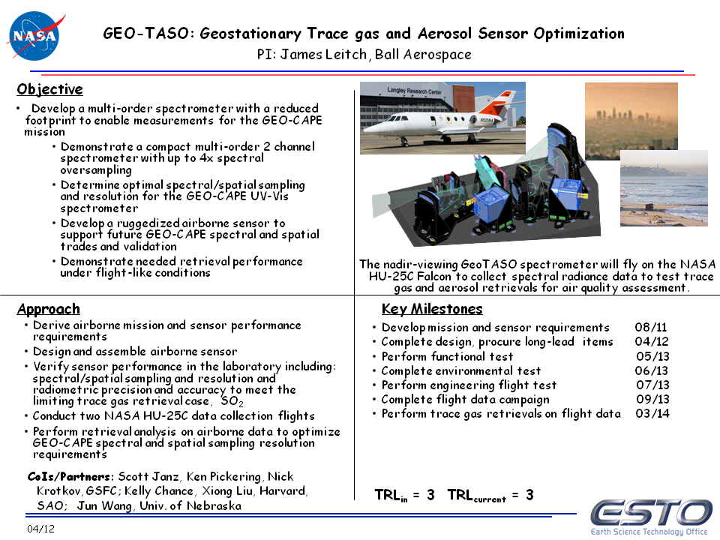

Slide 4
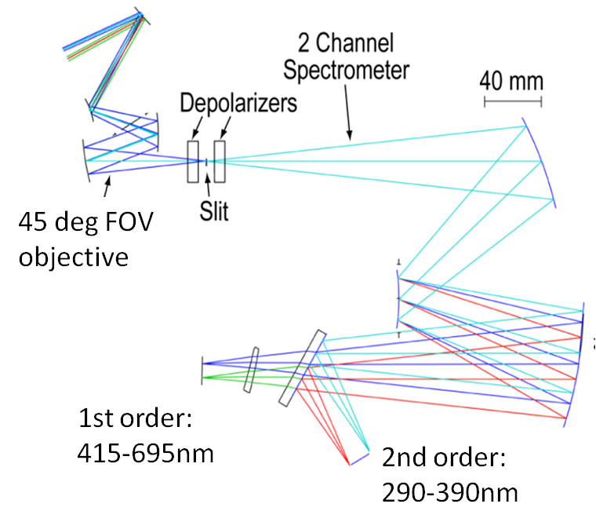
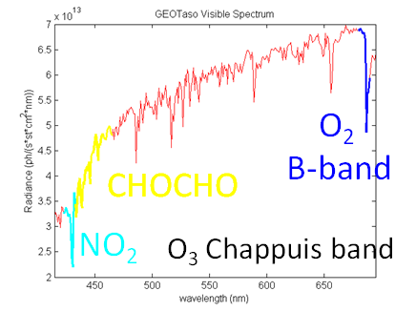
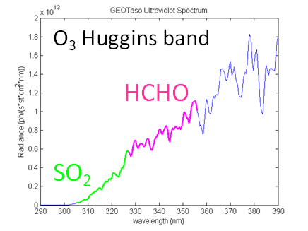
Sensor Concept Overview
Nadir-viewing wide-swath imaging spectrometer
Two channel spectrometer uses:
  1st order diffraction for Visible
  2nd order diffraction for UV
Low polarization sensitivity telescope (<3%) and electronic depolarizer for spectrometer
Field-swappable spectrometer slits to change spectral passband and sampling
Selectable view: wide nadir swath or zenith look with an optical fiber
Parameter | Value
Ground spot | 40 m x 80 m
Ground sample | 10 m x 50 m
Swath | 10 km

Slide 5
GeoTASO Advances Mission Readiness of GEO-CAPE UV-Vis Sensing
Hardware demonstration:
  Compact spectrometer
  Minimal blur depolarizer in a spectrometer
  Filtering scheme effectiveness
Sensor-algorithm system demonstration:
  Real scene data with variable spectral/spatial sampling and varying polarization sensitivity
  Effect on algorithm of spectral dispersion/filtering in spectrometer
Prediction/Validation:
  Component and system performance measurements inform TEMPO
  DISCOVER AQ contribution as “satellite analog” measurement from moderately high altitude overflights of DISCOVER-AQ test sites
  Flights with DISCOVER-AQ provide rich data set of measurements for comparison and validation of retrievals

Slide 6
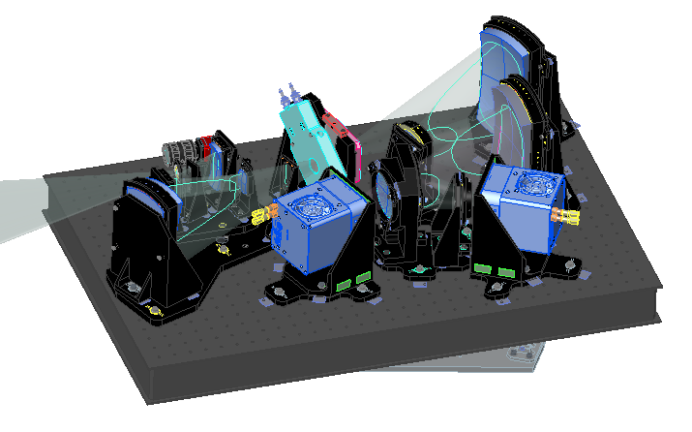
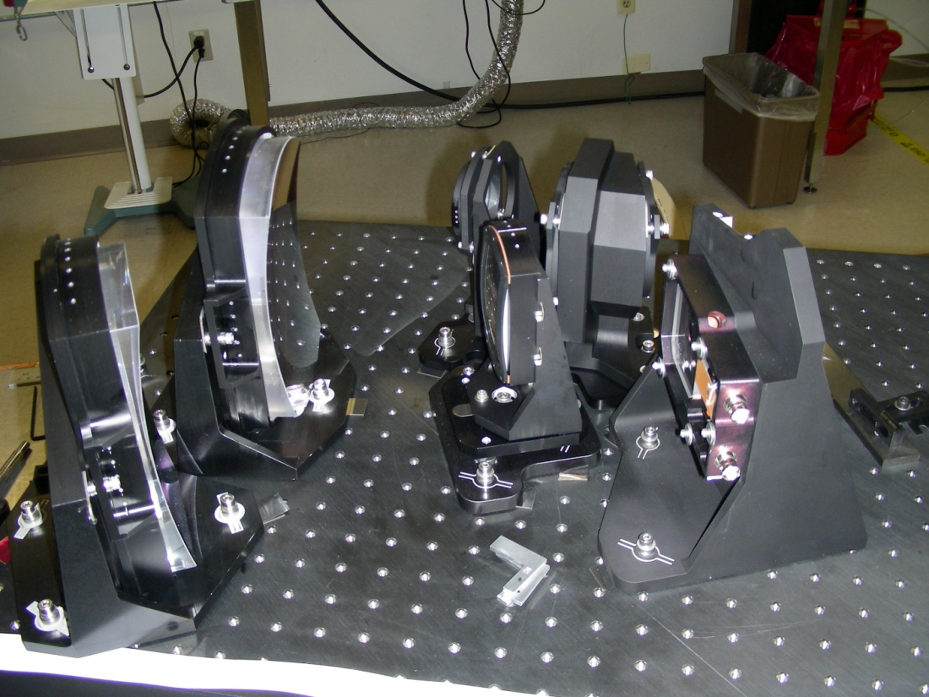
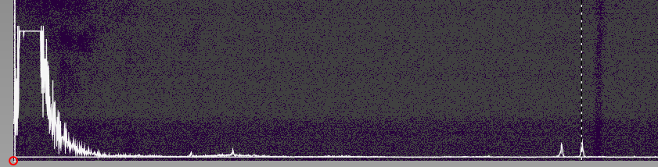
Sensor Status (1 of 2)
Telescope in alignment
  Built on separate baseplate
Spectrometer aligned:
  All optics in place
  Initial imaging measurements made
  Vertical alignment (flight configuration) verified
  Detector alignment underway
Grating ghost is < 1e-4 of signal

Slide 7
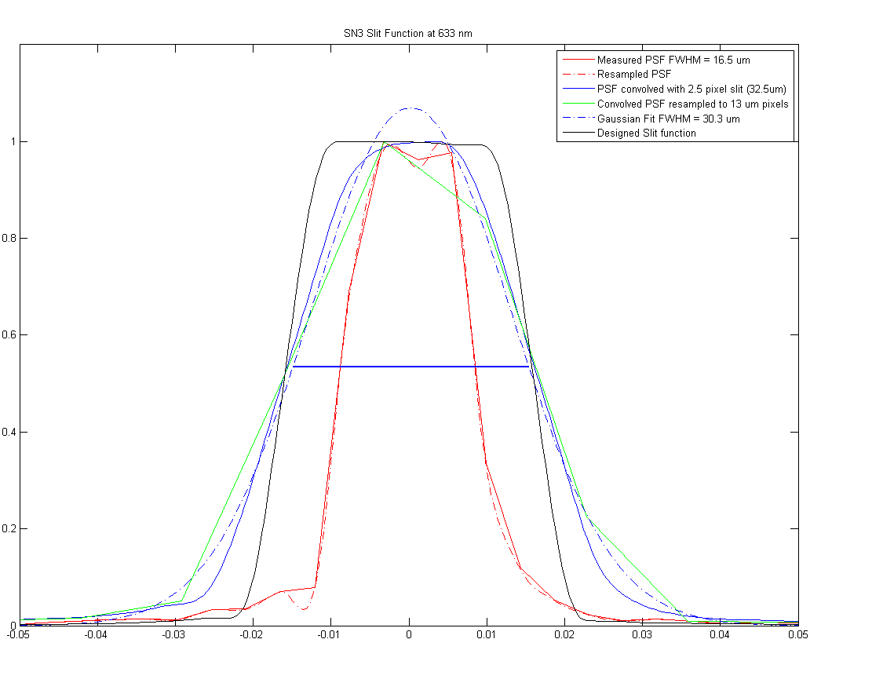
Sensor Status (2 of 2)
Imaging performance predicts
lineshape within specification
GeoTASO sensor in its thermally-stabilized
enclosure and mounting frame for the Falcon
GeoTASO sensor in the nadir well
with electronics racks
Lineshape asymmetry of <4%
Lineshape from imaging spot convolved with slit width to give passband shape
Completed preliminary engineering and airworthiness reviews with Langley flight team

Slide 8
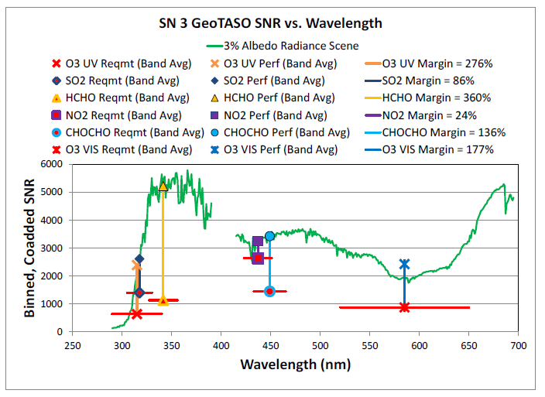
GeoTASO Predicted SNR
SNR predictions for 1 km square ground sample
Required SNRs shown as a band-averaged value (red lines)
Single sample SNRs are ~100x smaller (GSD: 40 m x 80 m)
NO2
NO2
SO2
CHOCHO
SO2
HCHO
CHOCHO
HCHO
O3
O3
O3
O3
3 samples/FWHM, SN03 grating, updated well and noise values,
0.6 mm flattening filter thickness

Slide 9
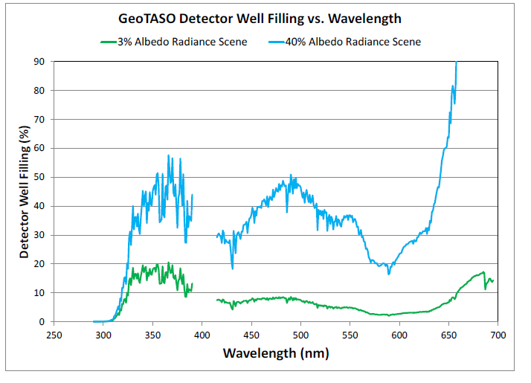
GeoTASO Predicted Saturation
Attenuation of visible channel from color filter glass in telescope
Adjustable amount of filtering using different filter thicknesses
Shorter integration times (in snapshot mode) can capture high signal scenes for cloud/aerosol studies in O2 B band
3 samples/FWHM, SN03 grating, updated well values,
0.6 mm filter thickness, 240 ms integration time

Slide 10
Algorithm Work
Aerosols (Jun Wang):
Development of a radiative transfer model (RTM) that includes modeling of trace gases, Rayleigh scattering, Aerosol Mie scattering, radiative transfer, etc.
Tests of aerosol retrieval algorithms using AERONET ground data measuring direct and diffuse solar radiance
Trace Gases (Kelly Chance, Xiong Liu):
Much preparation work for GeoTASO done using ACAM data from DISCOVER-AQ
Sensor Effects in data
  Fits of slit function and spectral shifts
  SNR characterization
  Empirical sensor radiometric calibration
Retrieval Studies:
  Derivation of reference spectrum to use in retrievals
  Finding best spectral fit windows
  Investigating direct retrievals of ozone profiles and trace gases

Slide 11
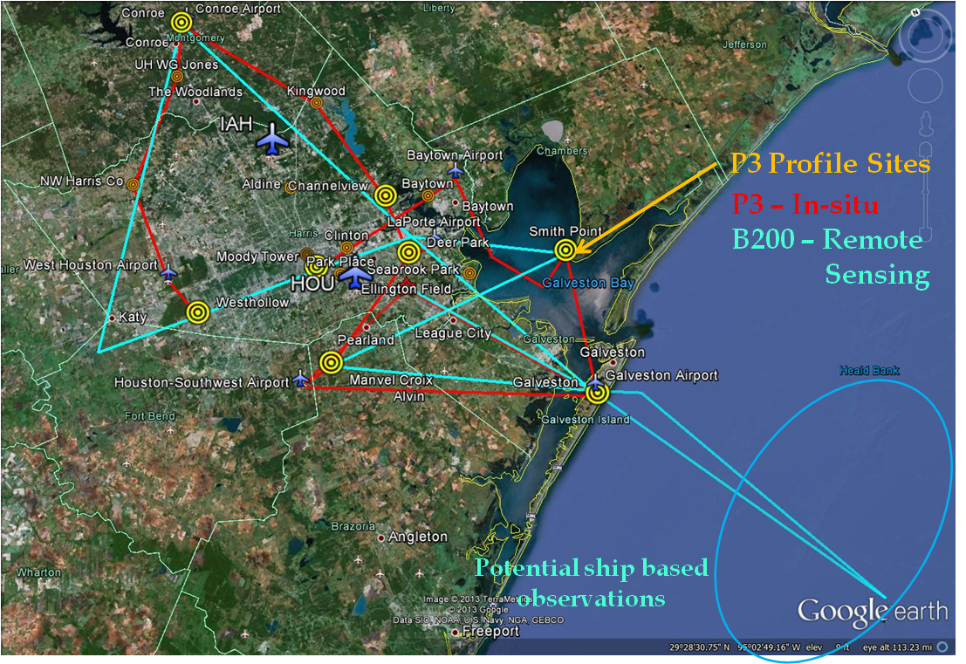
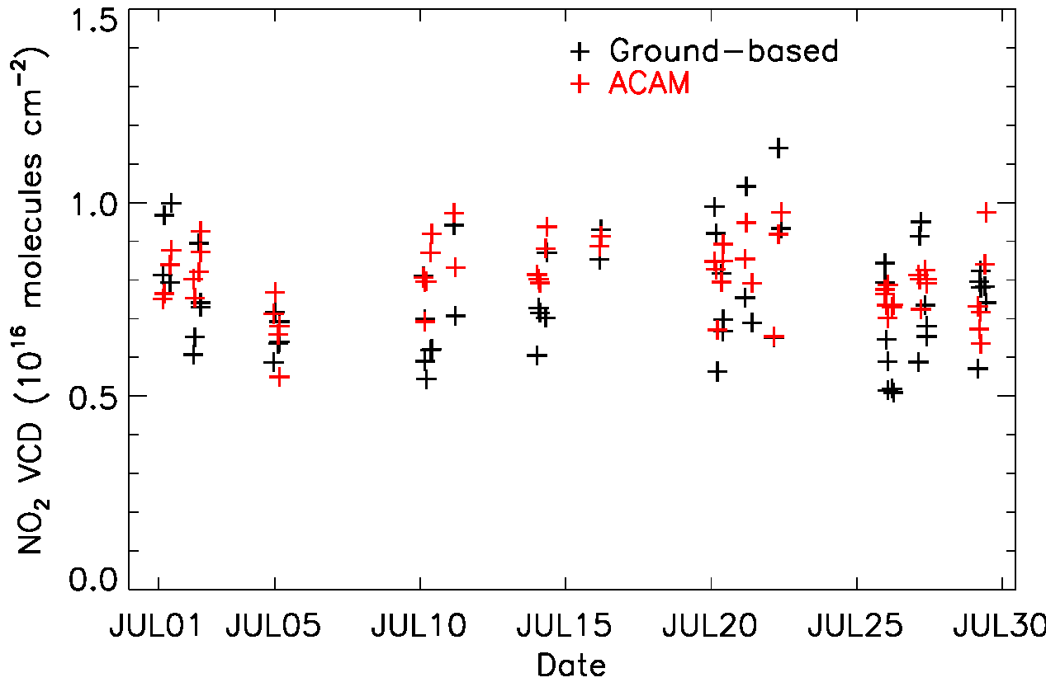
Plans
Sensor functional testing in late June
Sensor test flights at Langley in July
Calibration at Goddard (common cal to ACAM) after test flights
Data collection flights in September in conjunction with DISCOVER-AQ in Houston
Validation of retrieval performance using comparison with other DISCOVER-AQ measurements (ground-based and airborne)
B200 w/ACAM: 26 kft, 140 m/s
HU-25C w/GeoT: 40 kft, 230 m/s
Example of ACAM-based NO2 retrieval compared with Pandora

