Slide 1
Spatially resolving ocean color and sediment dispersion in river plumes, coastal systems, and continental shelf waters.
Dirk Aurin^{a,b,}, Antonio Manninoª, & Bryan Franzª
ªNASA Goddard Space Flight Center,
^{b} Science Systems and Applications, Inc.
Funded by the GEO-CAPE mission pre-formulation activity. Acknowledgements to M. Ondrusek of NOAA/NESDIS, X. Xiong and A. Angal of NASA/MCST, and G. Meister of the NASA/OBPG.

Slide 2
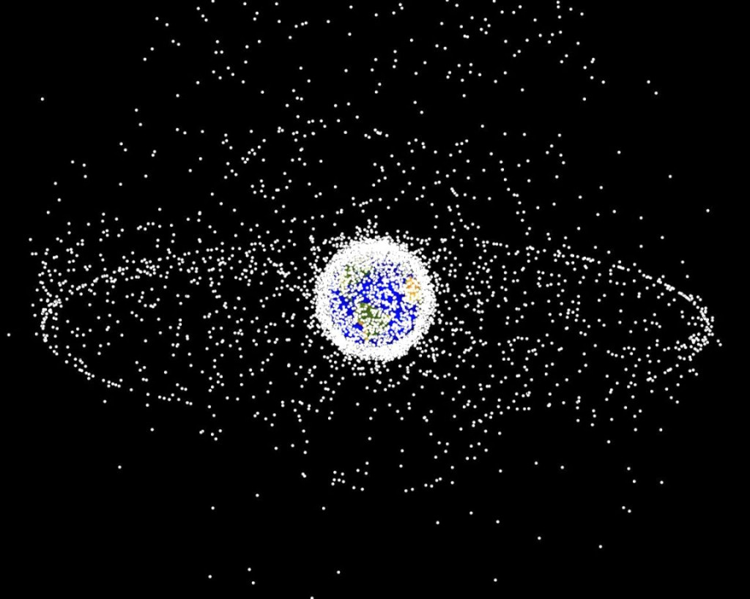
Stepping Out
705 km
LEO
36,000 km
GEO

Slide 3
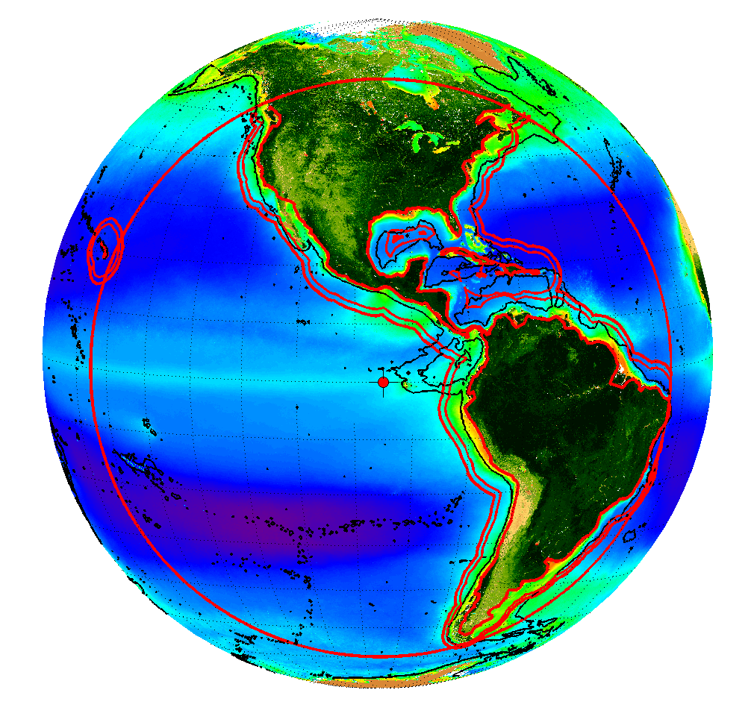
Possibility & Opportunity

Slide 4
What resolution is needed? Where do we need it? Why?

Slide 5
Specifically:
Ground Space Distance (GSD): Spatial resolution requirements in dynamic coastal and nearshore environments
GSD in quiescent waters (i.e. more relaxed spatial res. reqs reduce “stare interval” for telescope → higher temporal res.)

Slide 6
Specifically:
Scales of Variability (“patchiness”) near-, offshore
Proportion of Variability resolved at given GSD

Slide 7
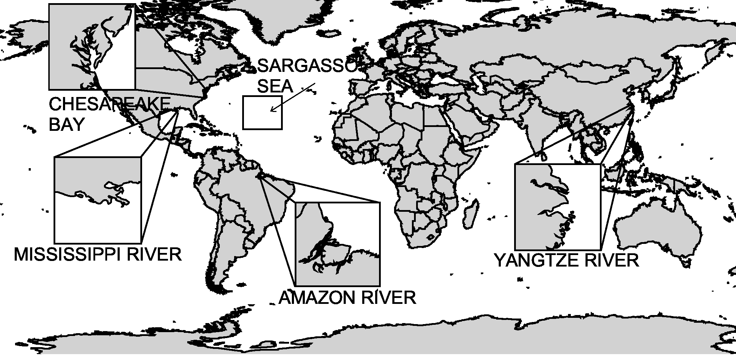
Approach
5 Regions of Study: 4 Plumes, 1 subtropical gyre
Wet Season & Dry 2008-2011 (3,000+ images)

Slide 8
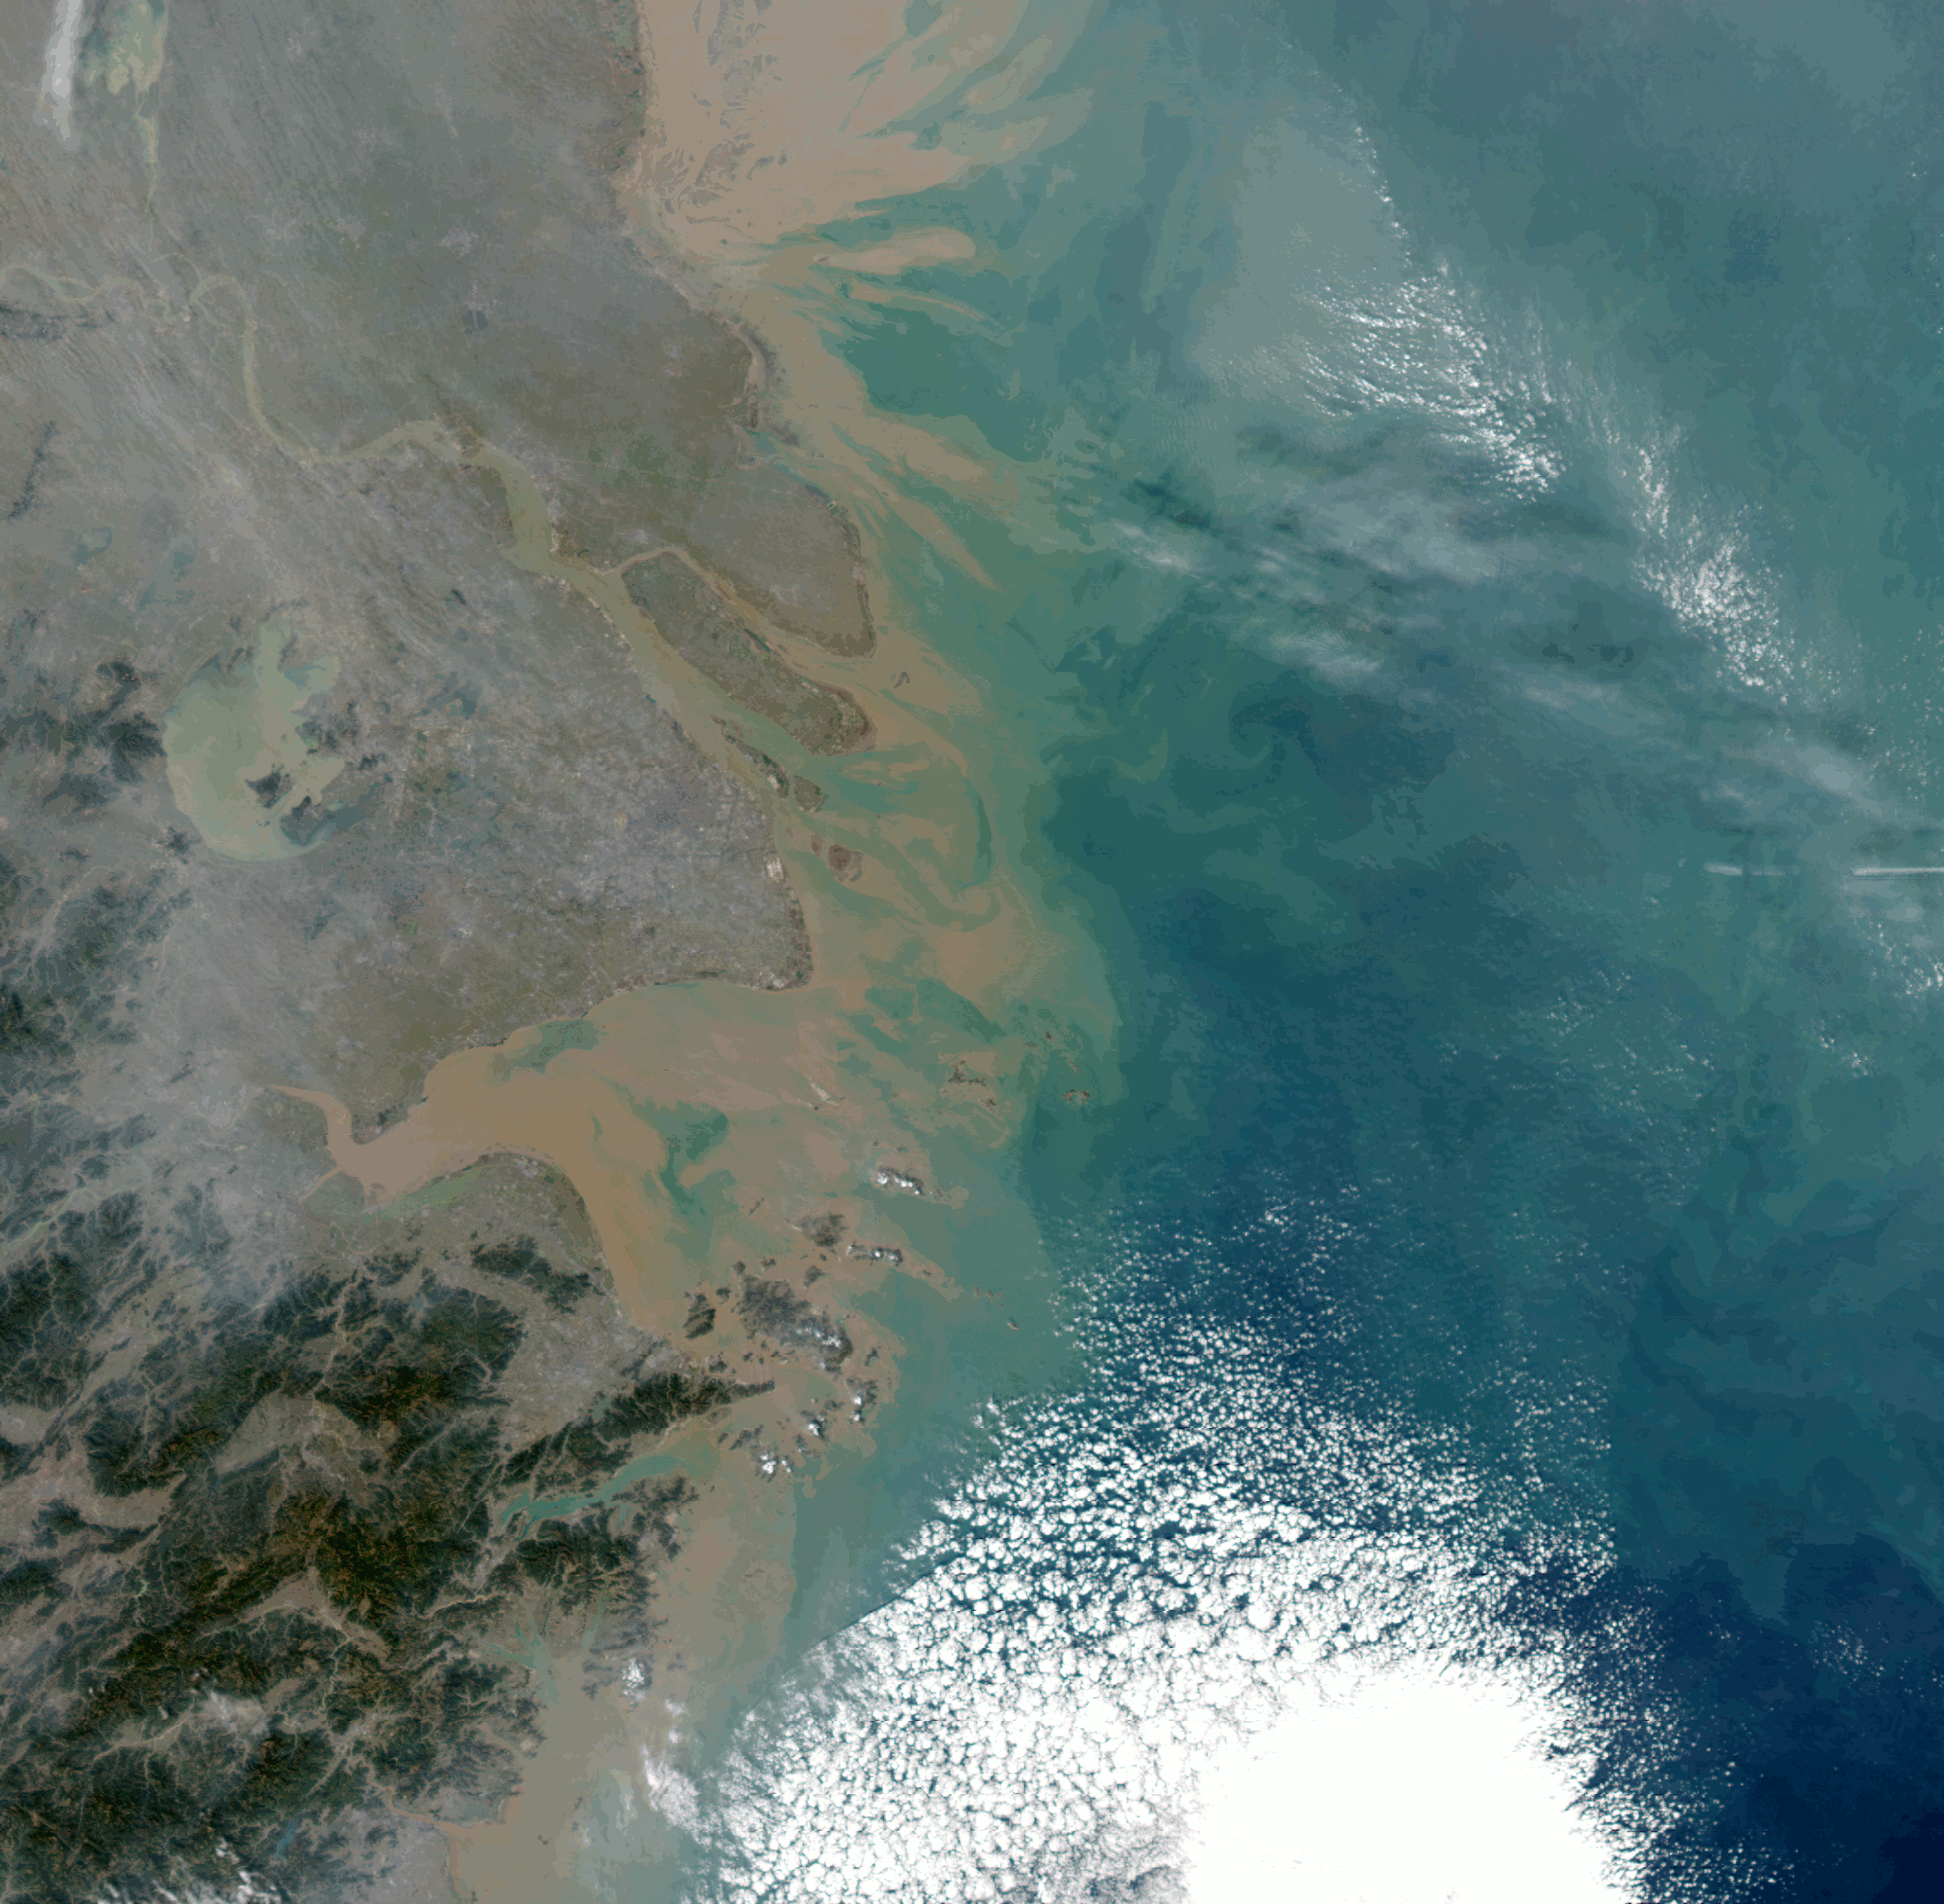
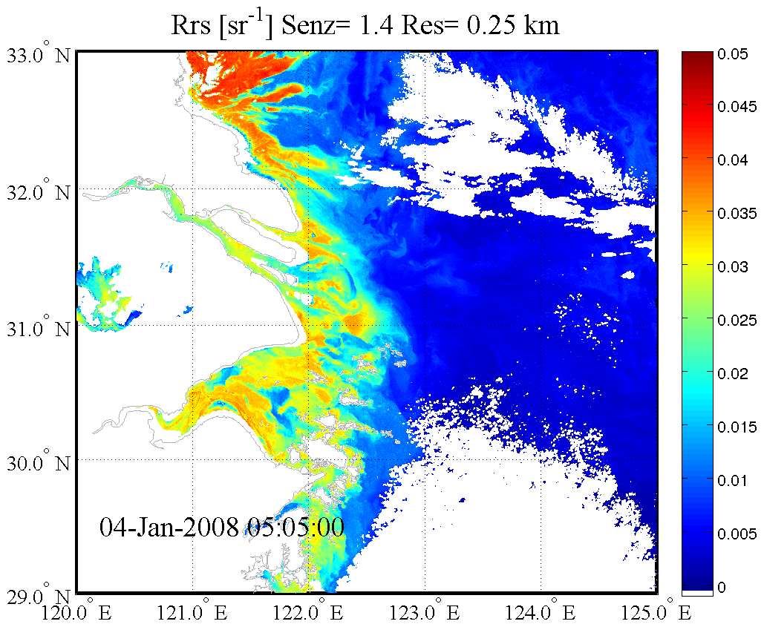
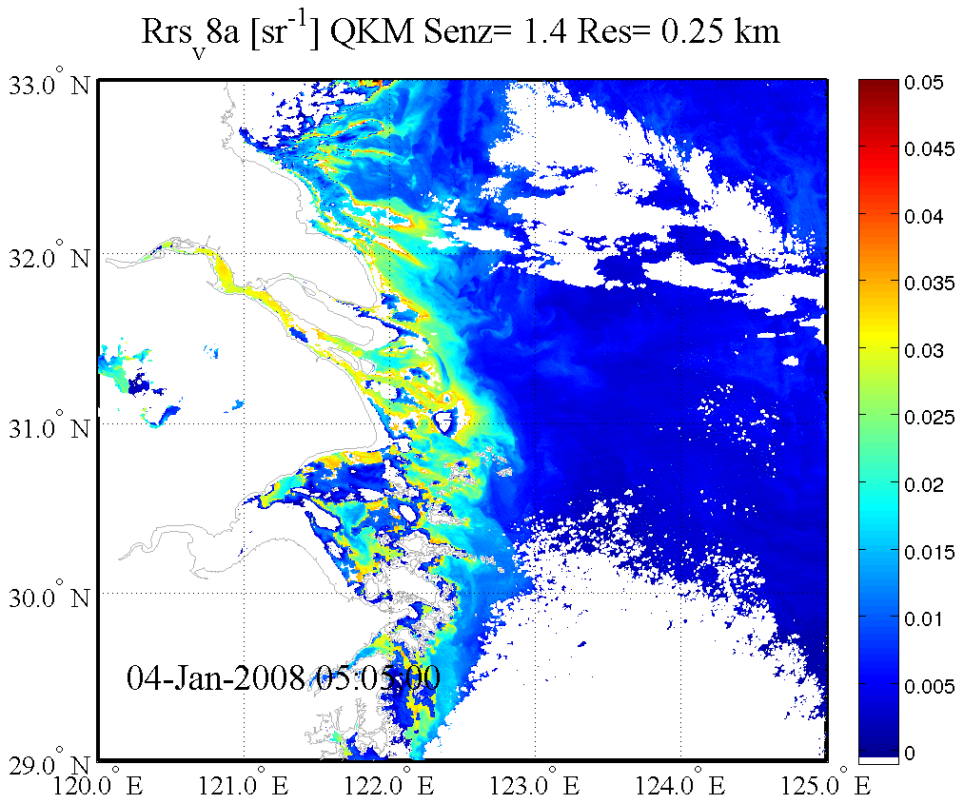
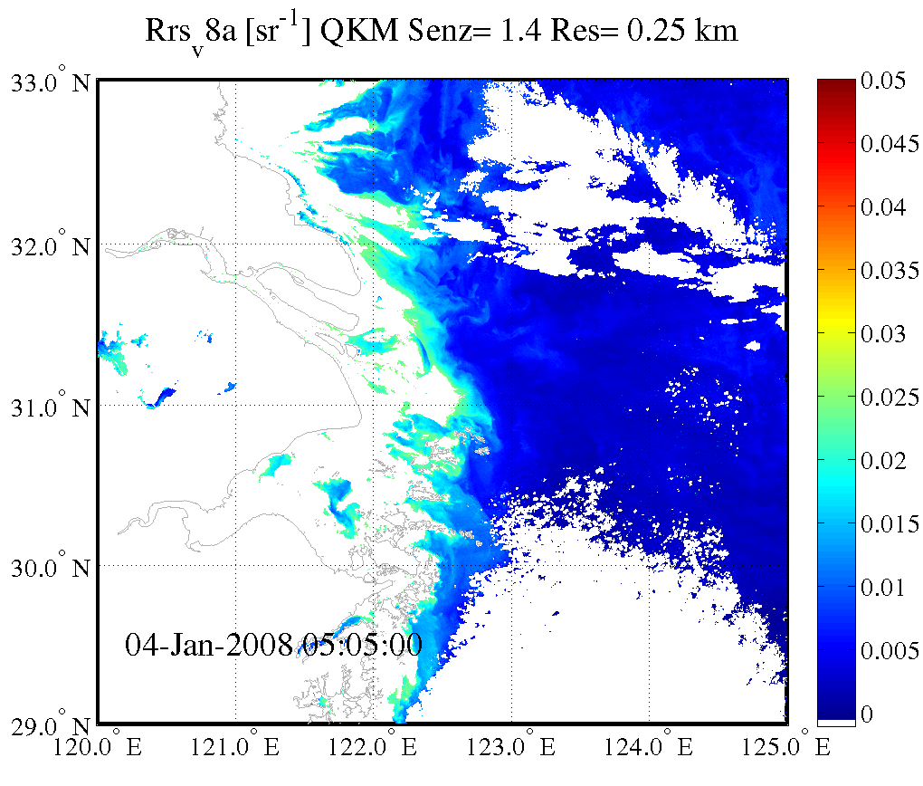

Slide 9
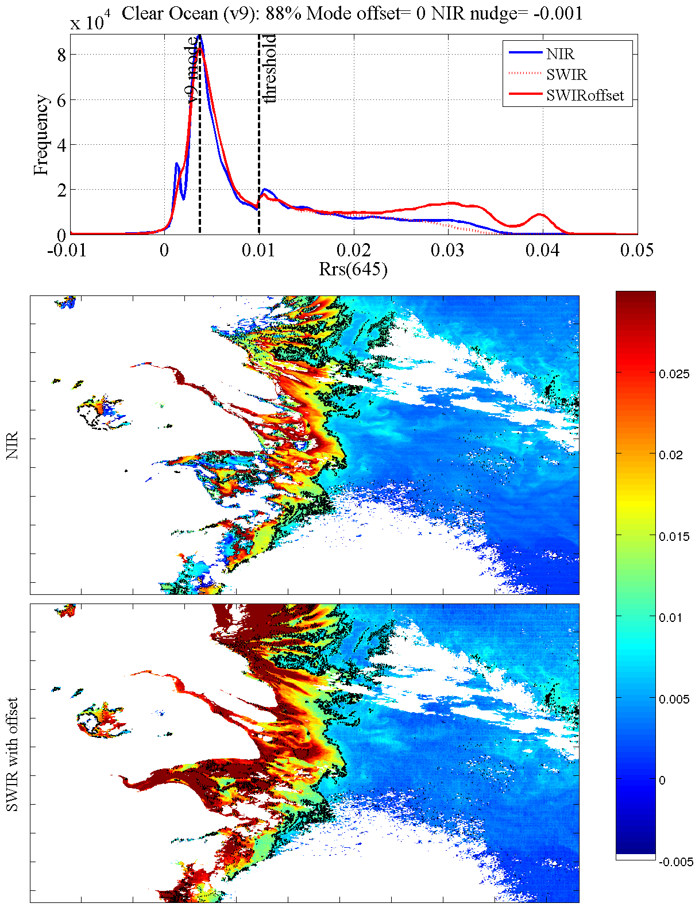
NIR-SWIR Merge
(See Poster: Murky Waters; Atmospheric Correction and MODIS Ocean Color Uncertainty in Extreme Environments.)

Slide 10
2 Methods for Quantifying Spatial Scales of Variability
1. Optimal GSD by Virtual Transect
Resolution requirements
2. Semivariance (γ)
Spatial scales of patchiness
Proportion of variability resolved at optimal GSD

Slide 11
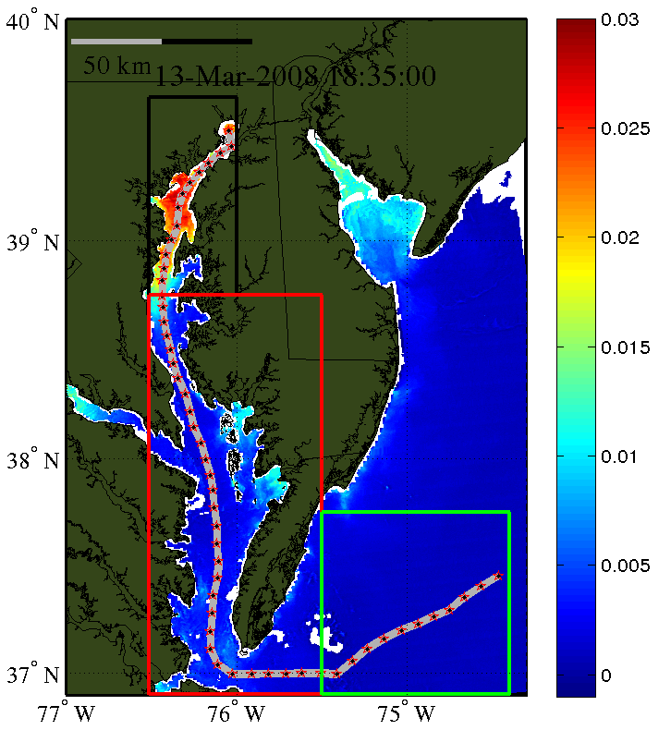
Method #1 Finding the optimal GSD: Interpixel variability around virtual stations
Finding the optimal resolution:
At each station, ask, “Is the interpixel variability greater than the noise?”
If “yes” then natural variability is detected, and using a larger pixel size will overlook variability at that scale.

Slide 12
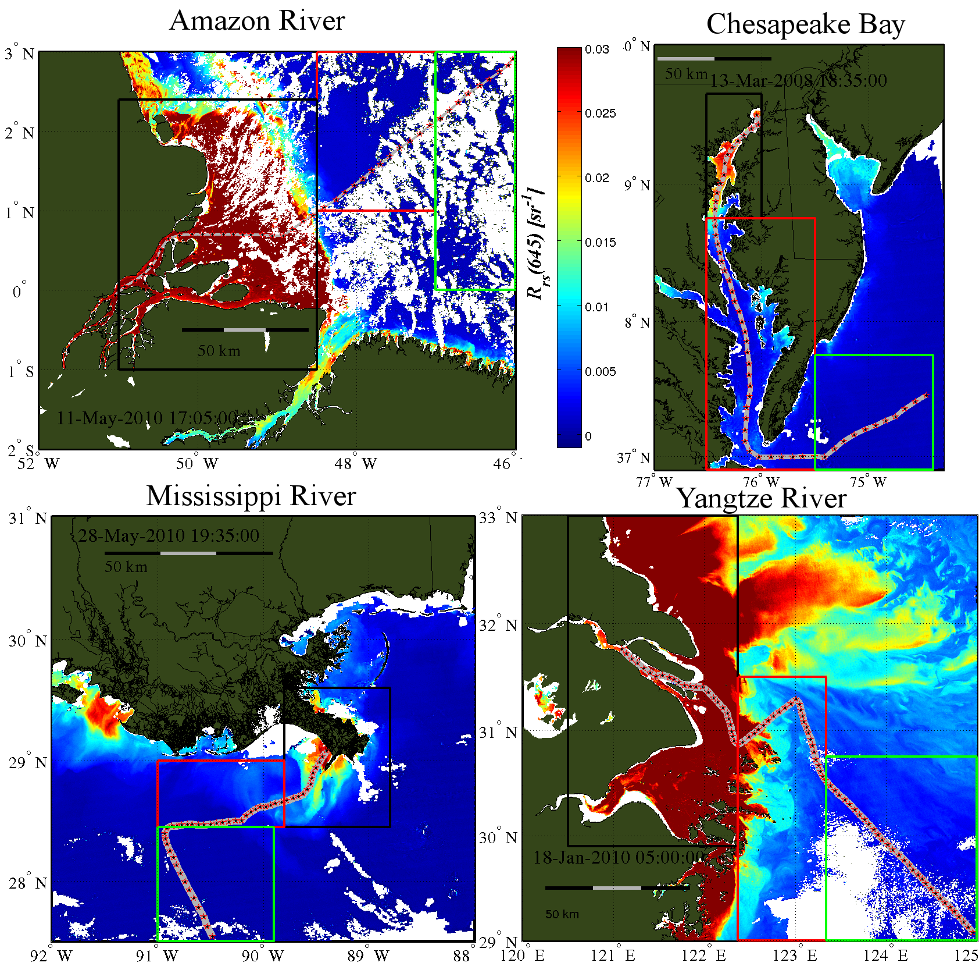

Slide 13
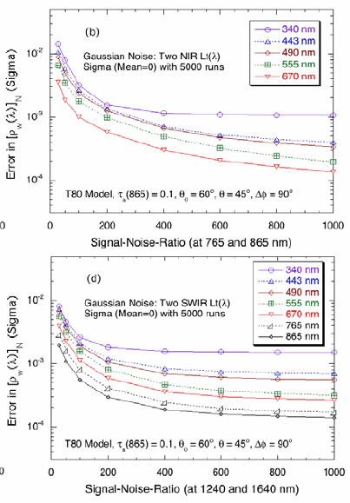
Calculating the Ocean Color Uncertainty
SNR
AC
PACE Mission Science Definition Team Report
NASA MODIS Characterization Support Team (MCST)
(See Poster: Murky Waters; Atmospheric Correction and MODIS Ocean Color Uncertainty in Extreme Environments.)
Evaluated on each pixel depending on whether SWIR or NIR bands used for atmospheric correction (more later)

Slide 14
Method #2 Finding scales of variability: Semivariograms
The semivariance function = half the squared difference of all pixel pairs in an image at distance h from each other in any direction, over all distances. The data can generally be fit to a spherical model:

Slide 15
Results

Slide 16
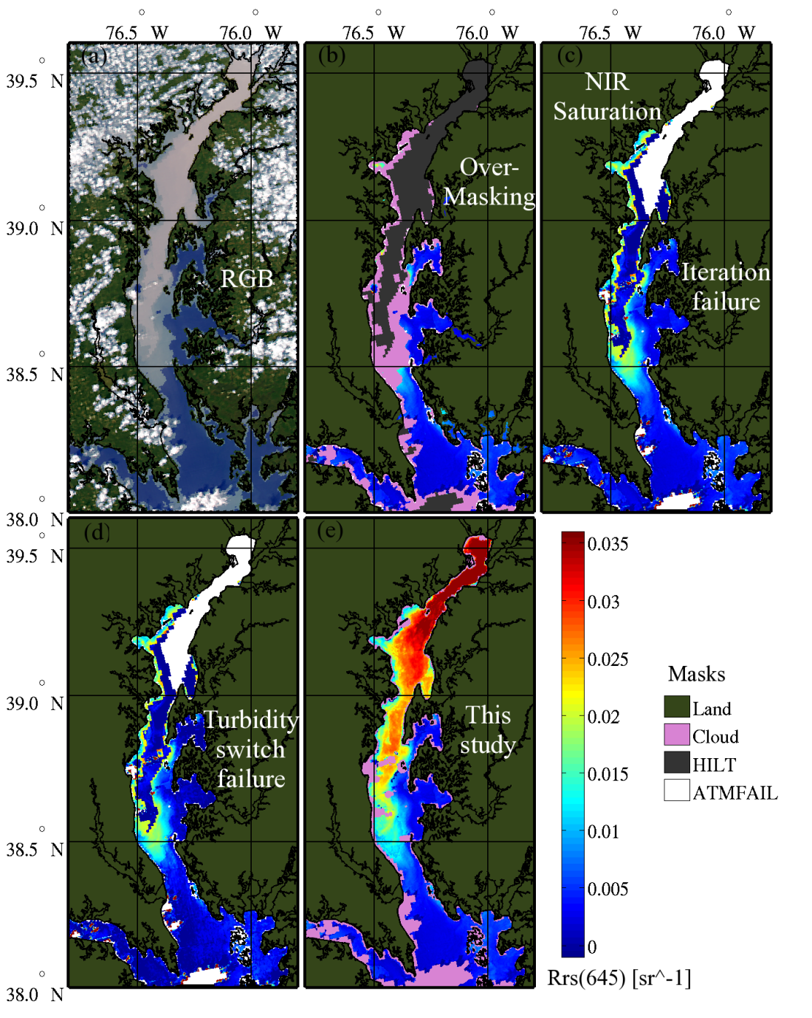
Example: Hurricane Irene and TS Lee;
Aug 27 – Sept 7, 2011 (Aqua 9/11/11 shown here)
Cloud ID
failure

Slide 17
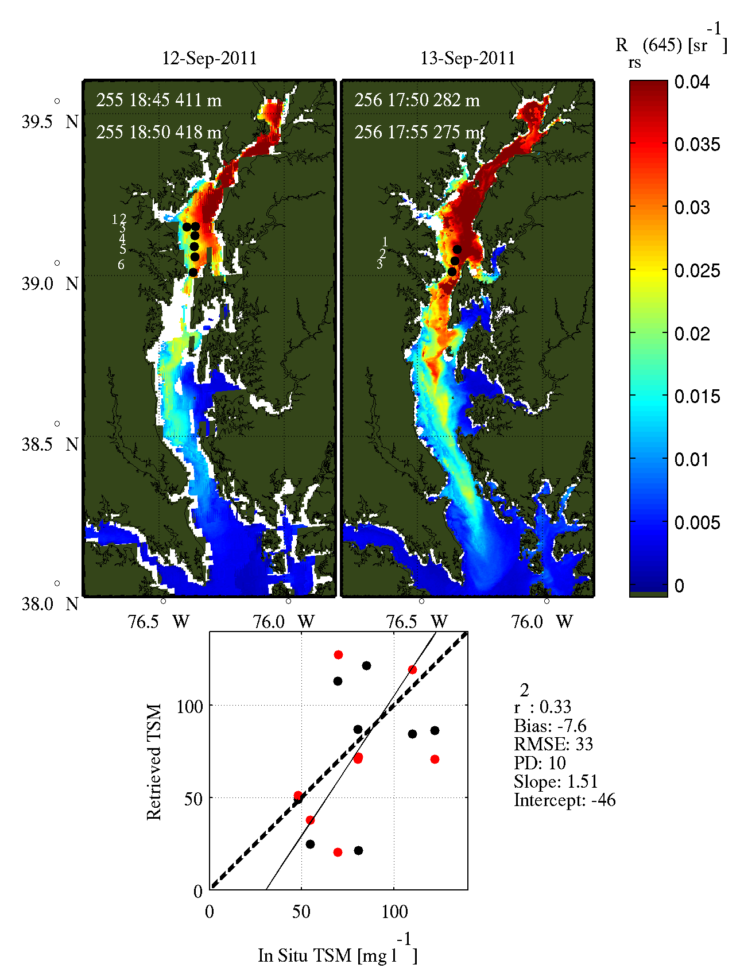
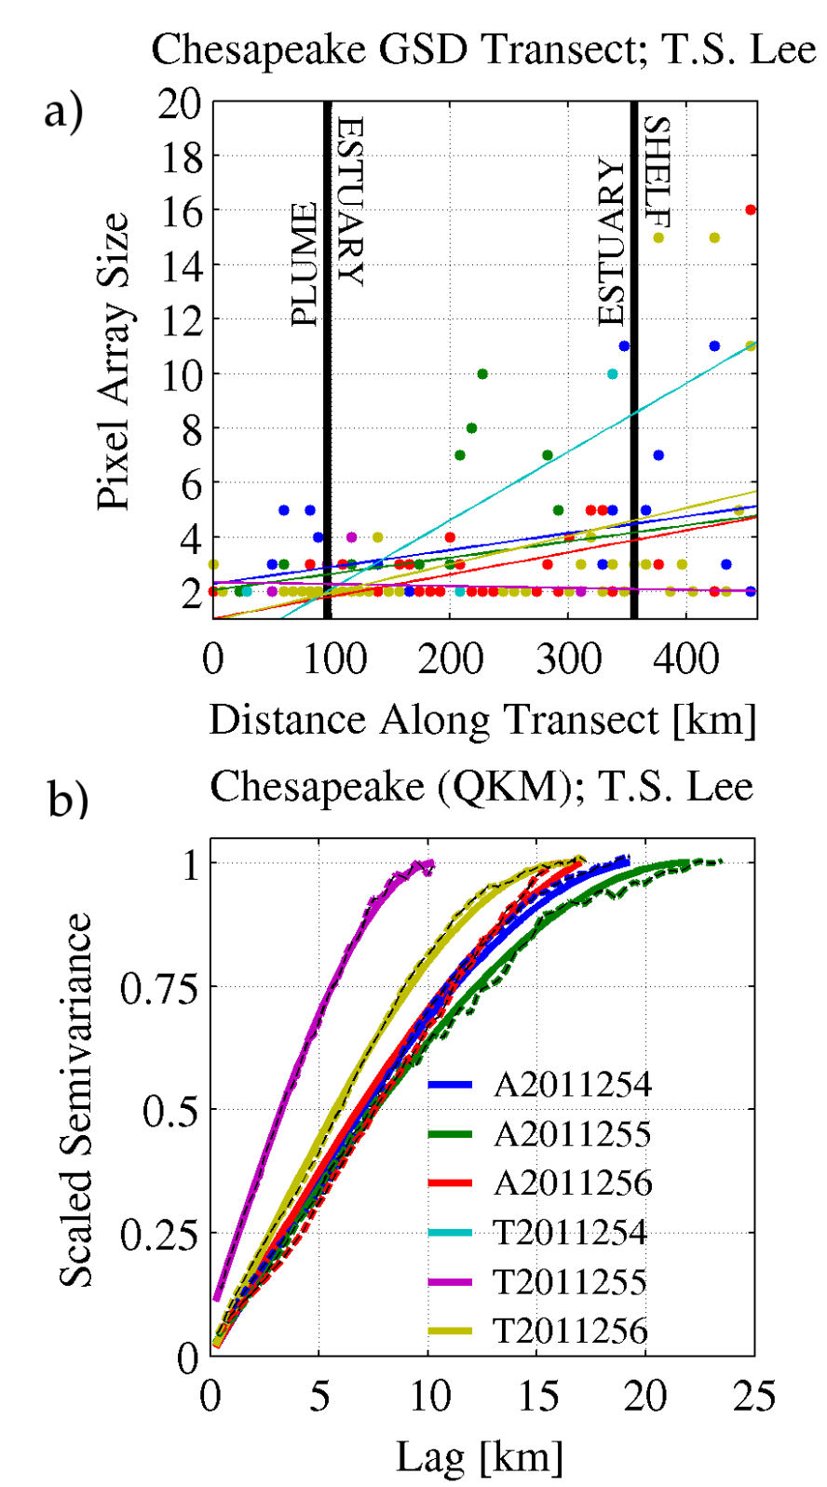

Slide 18
Results; Optimal GSD
Chesapeake: 630 Mississippi: 803 images

Slide 19
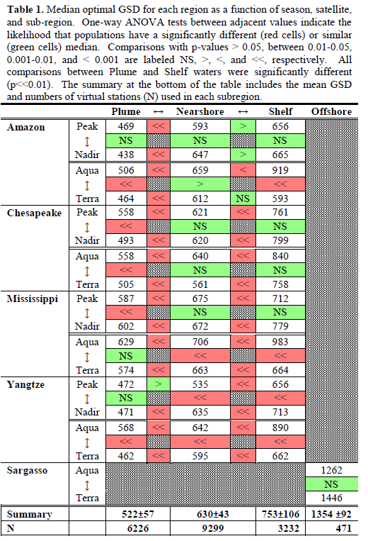
Results; Optimal GSD

Slide 20
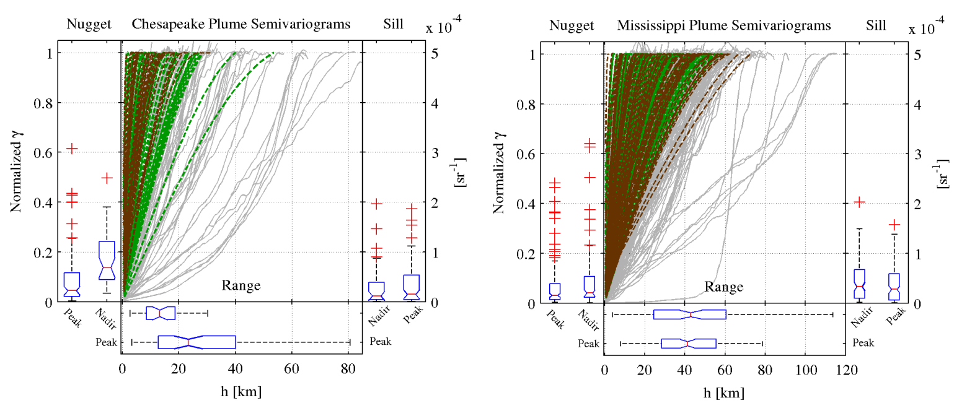
Results; Semivariance

Slide 21
Summary
Several years of high resolution (250 m) ocean color imagery from the most turbid and dynamic environments were custom-processed and analyzed for spatial variability.
Pixel-specific estimation of ocean color uncertainty is possible and useful.
Plumes more heterogeneous than nearshore, shelf, or offshore
Optimal GSD ↑ from ~500 m in plumes to ~1,400 m offshore
Patches ~20-90 km vs 180 km offshore
Plume patch size ↑ with river size
> 90% of variability generally resolved at 500 m GSD
Aurin, Dirk A., Mannino, A., Franz, B., "Spatially resolving ocean color and sediment dispersion in river plumes, coastal systems, and continental shelf waters. Remote Sensing of Environment." RSE-D-13-00194, in review.

Slide 22
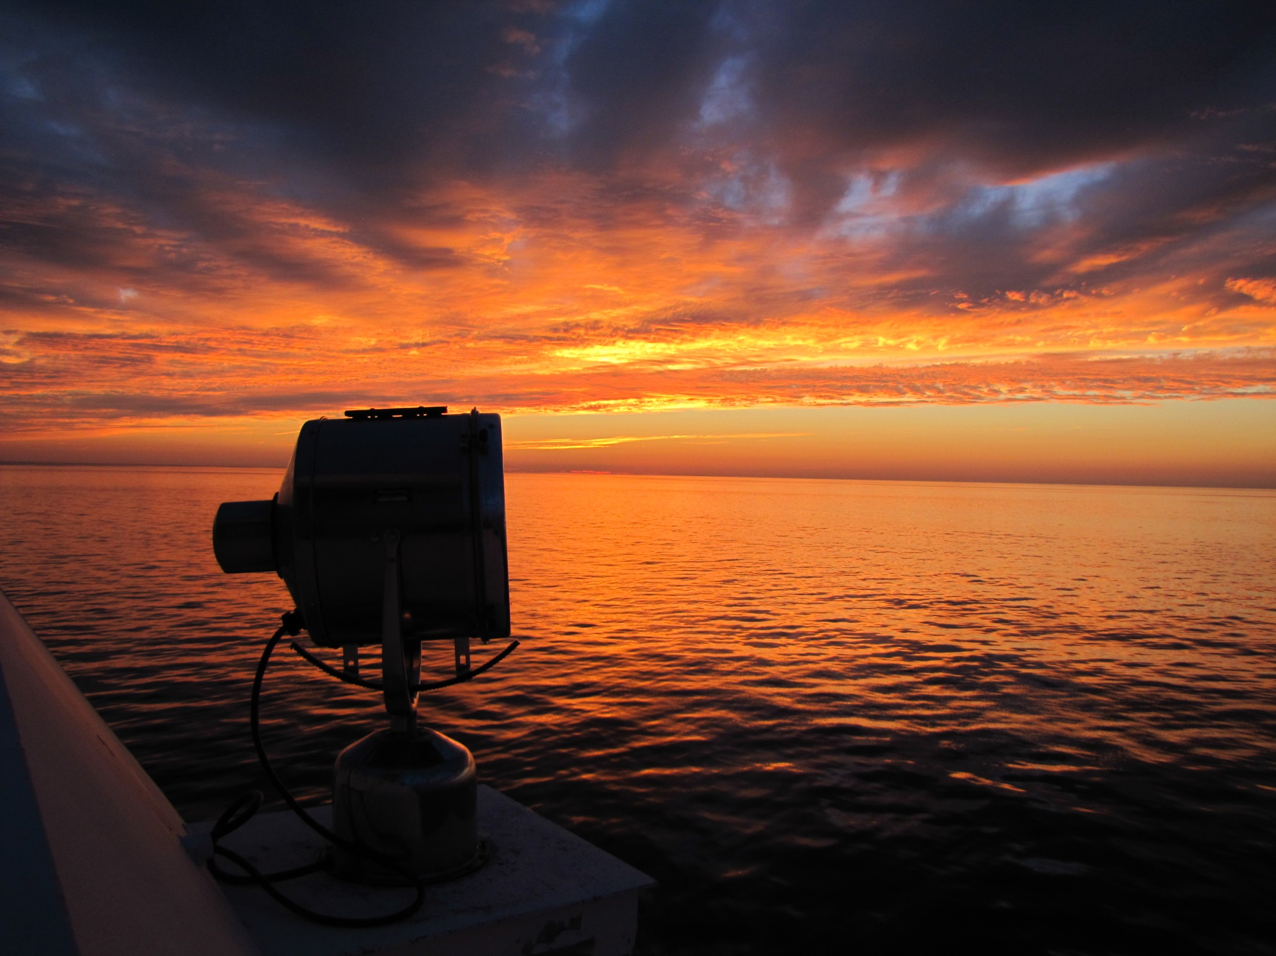

Slide 23
extras

Slide 24
Results; Optimal GSD
Sargasso: 1,100 images

Slide 25
Results; Optimal GSD
Mississippi: 803 images Yangtze: 757

Slide 26
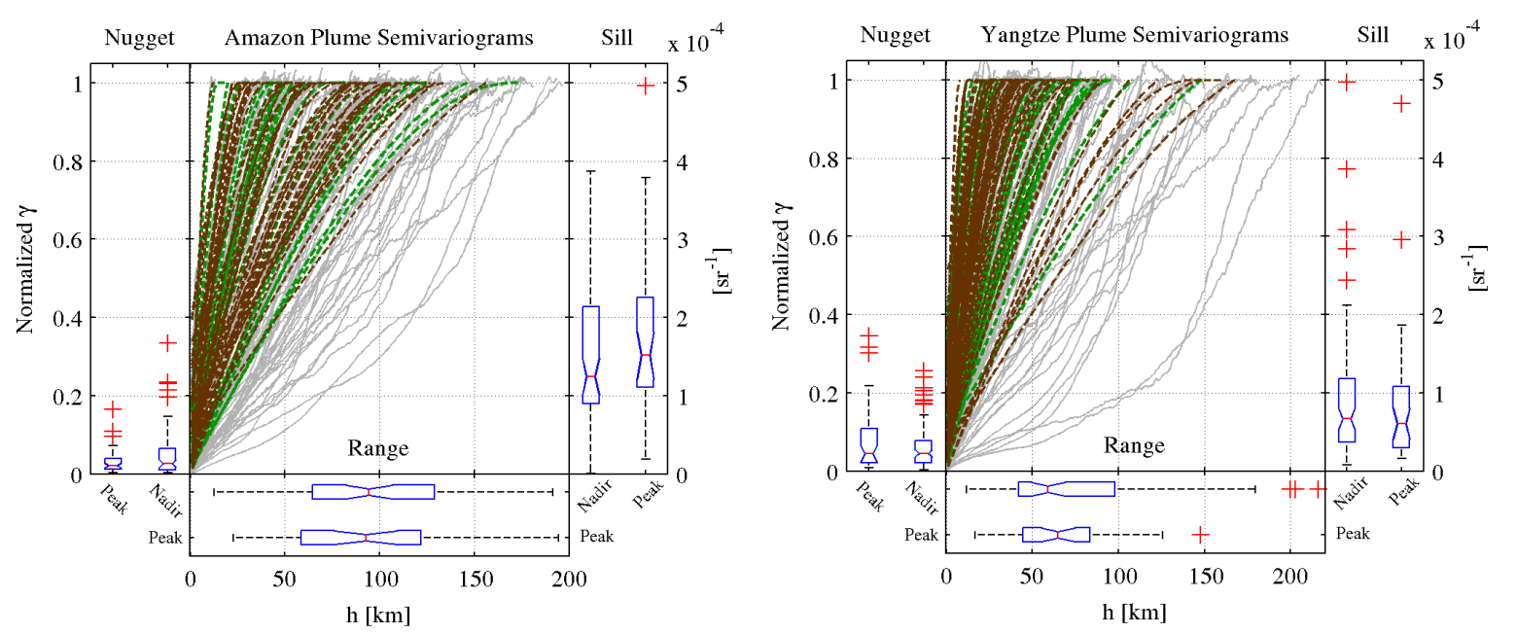
Results; Semivariance

Slide 27
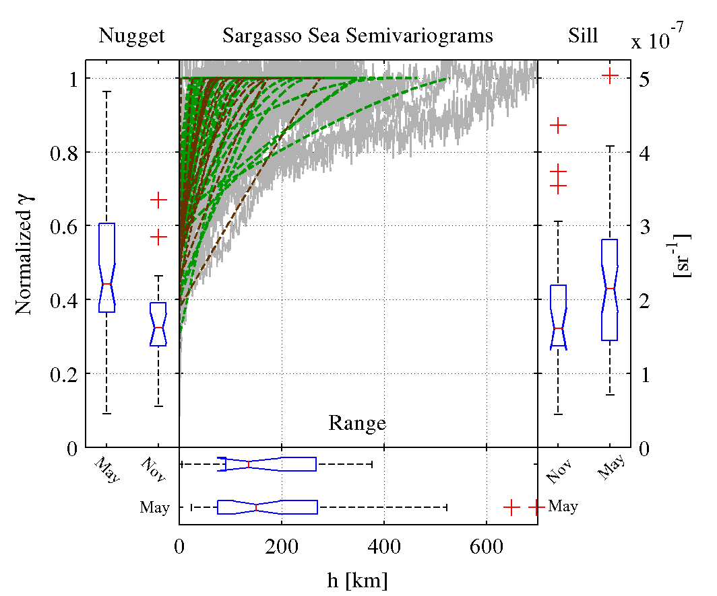
Results; Semivariance

Slide 28
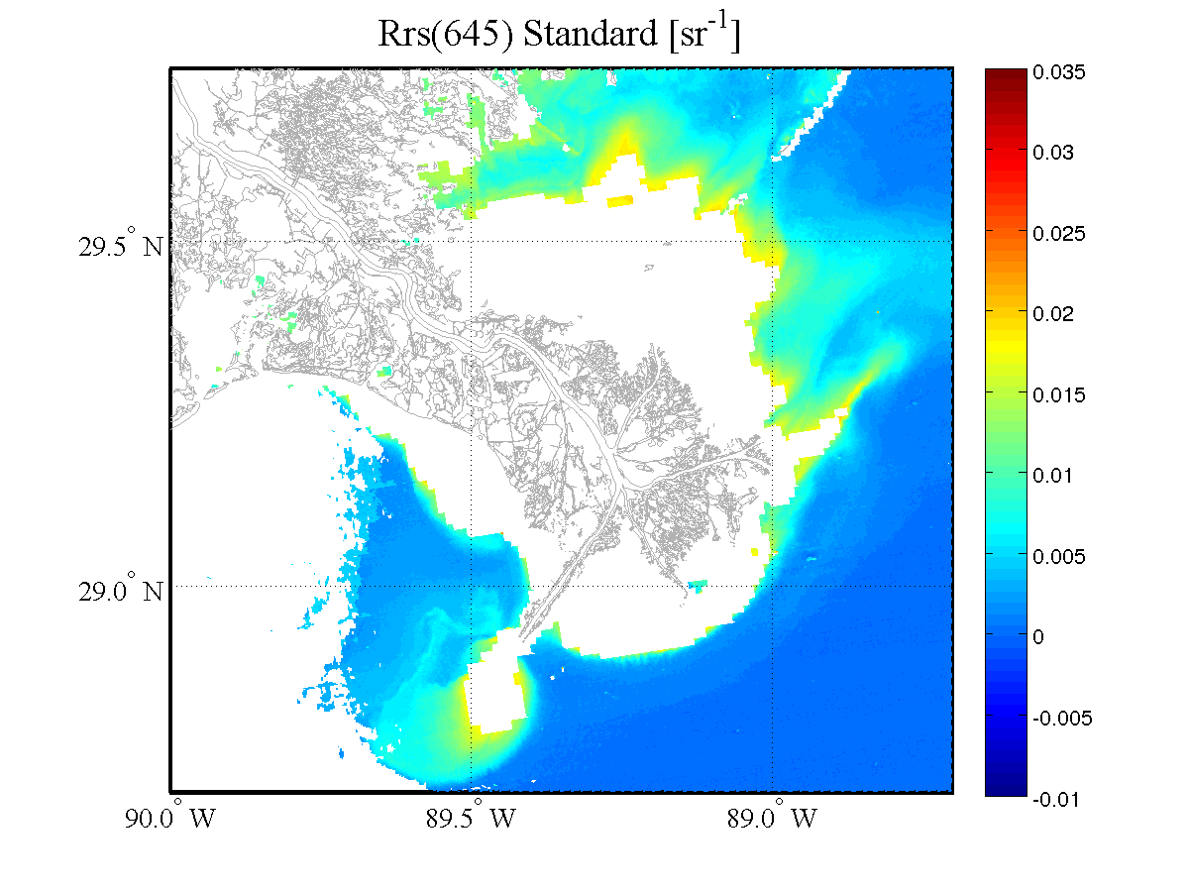

Slide 29
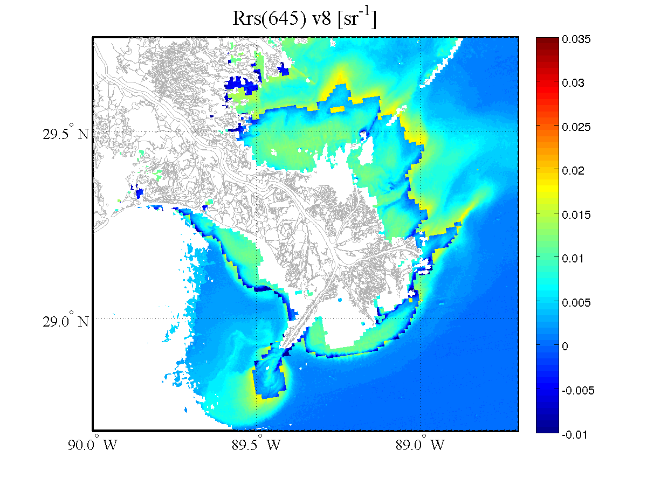

Slide 30
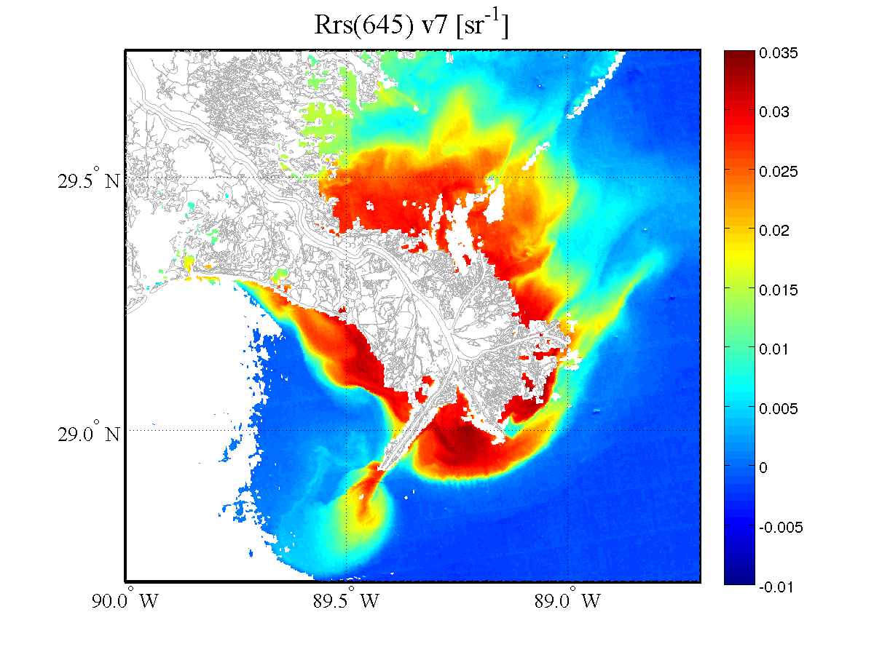

Slide 31
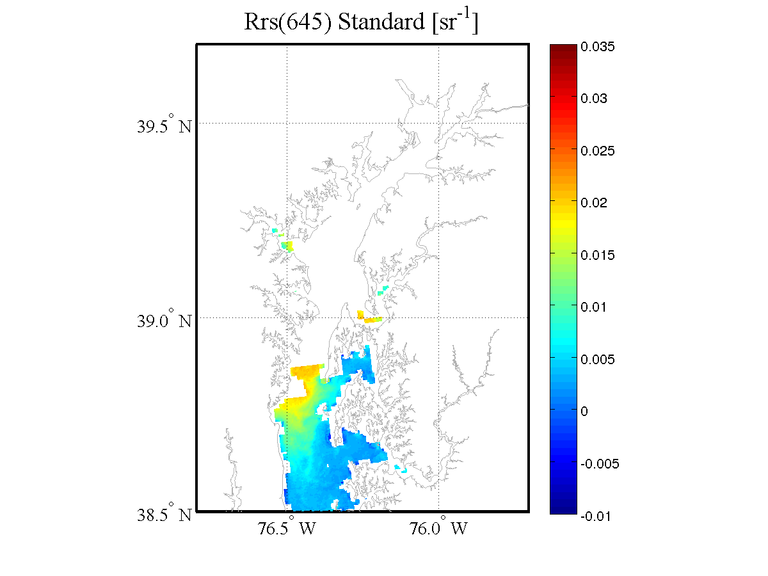

Slide 32
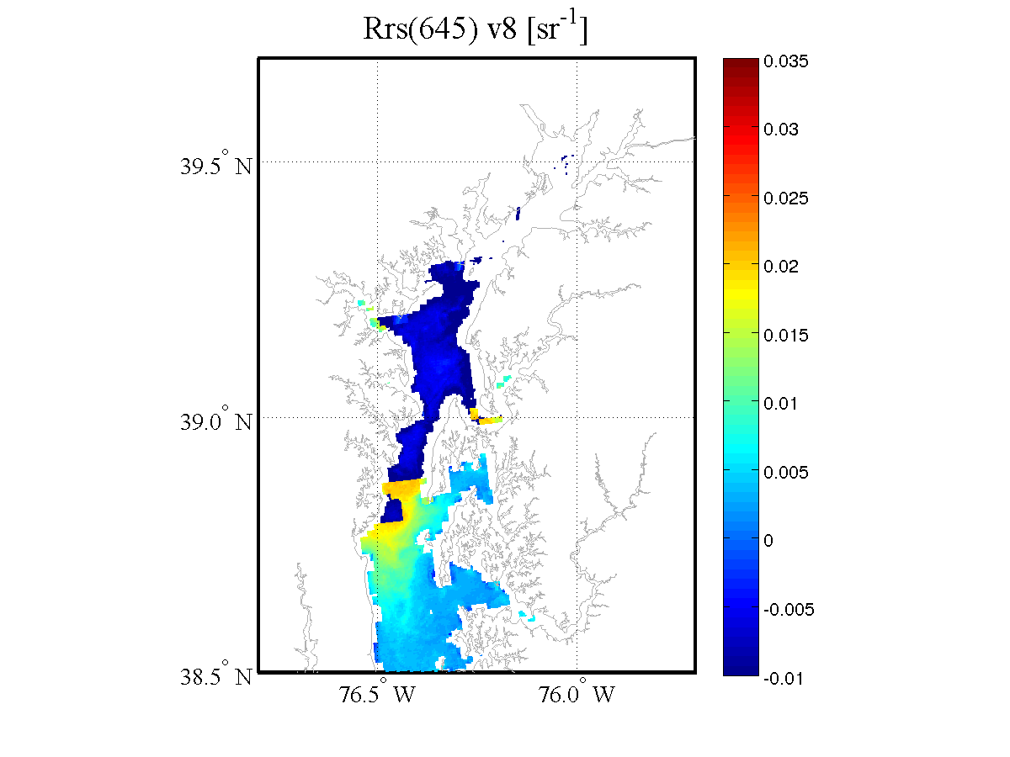

Slide 33
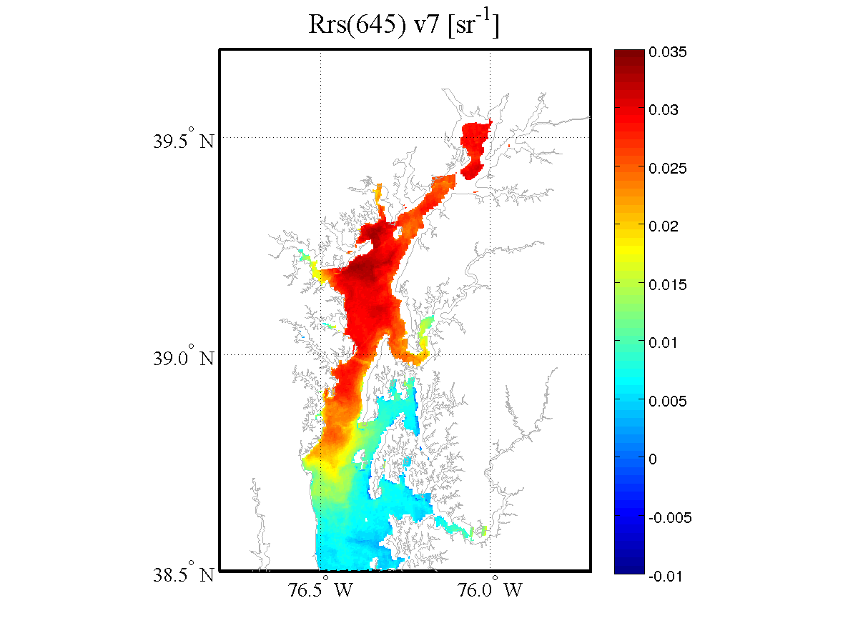

Slide 34
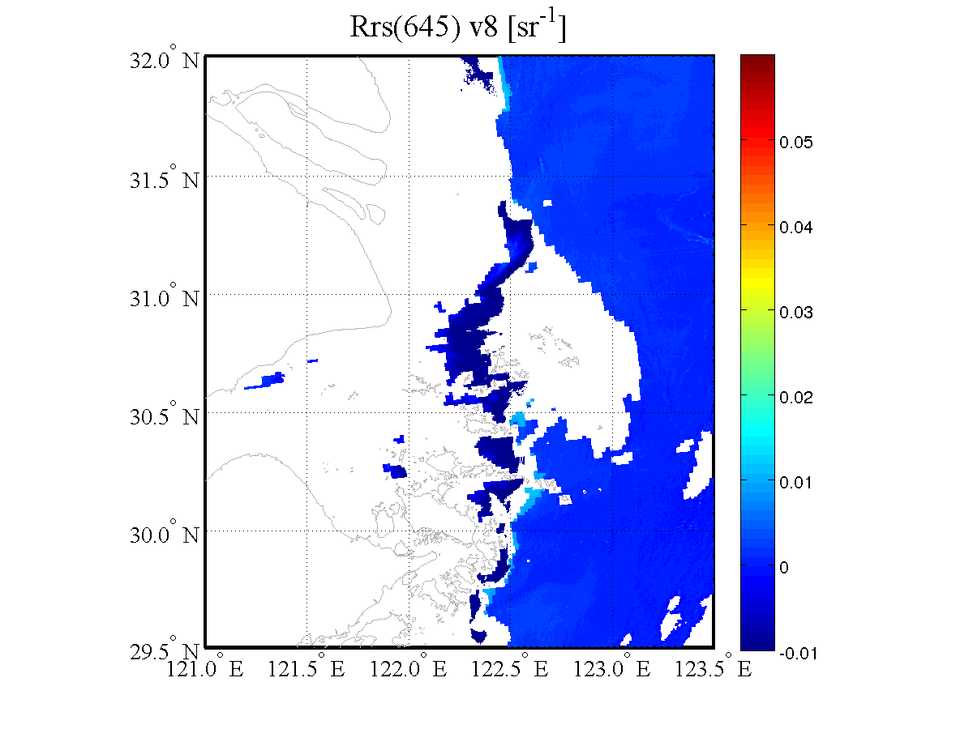

Slide 35
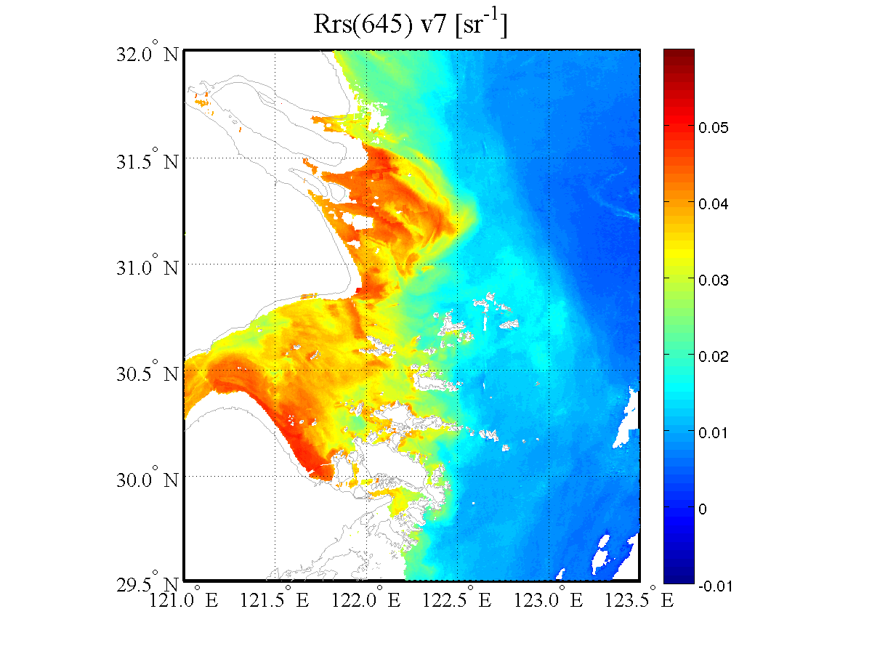

Slide 36
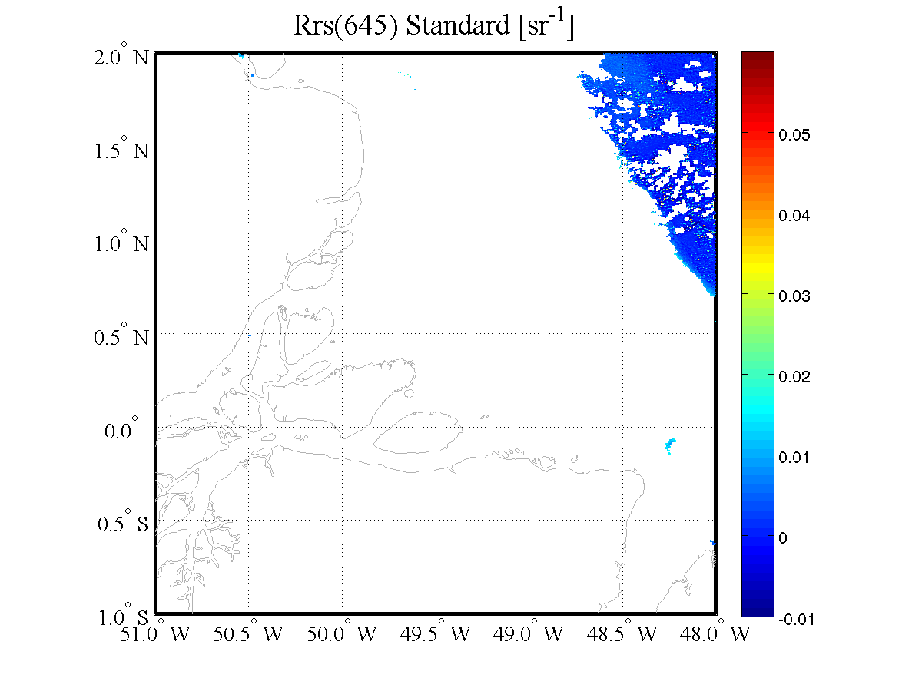

Slide 37
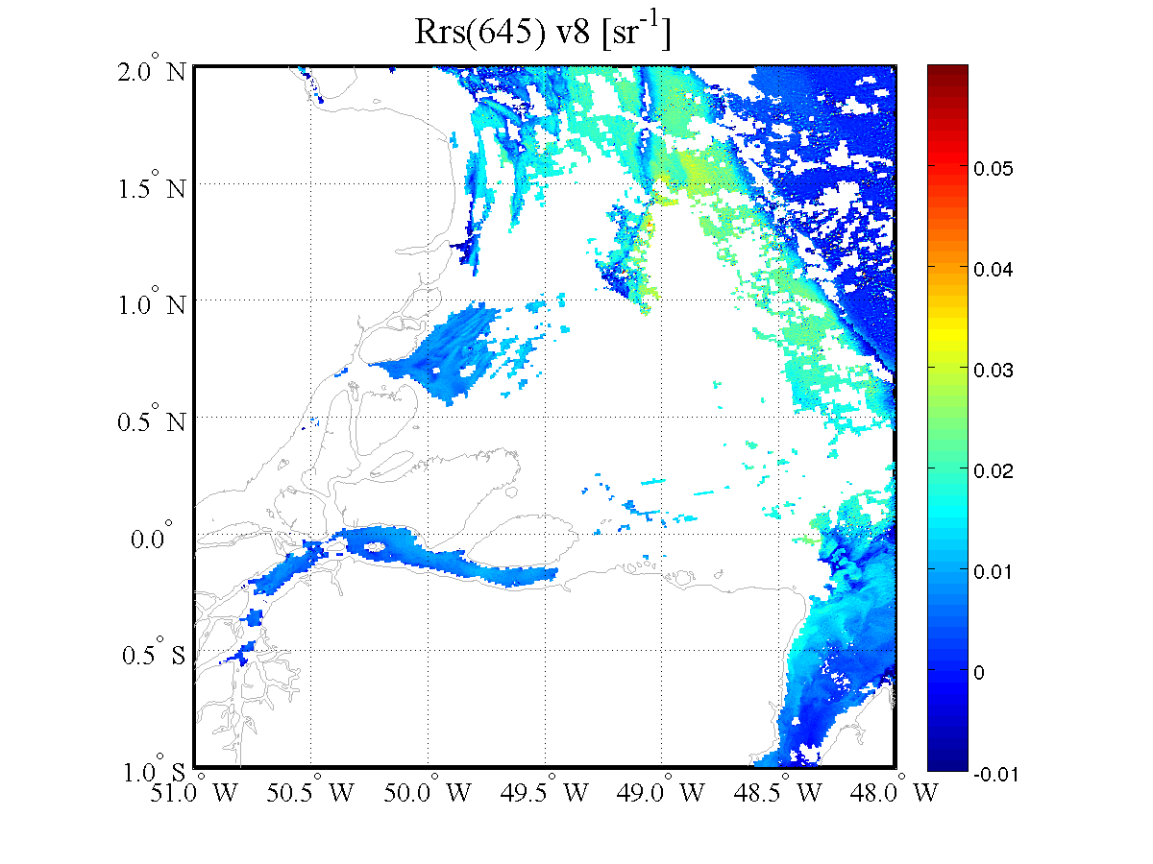

Slide 38
