Slide 1
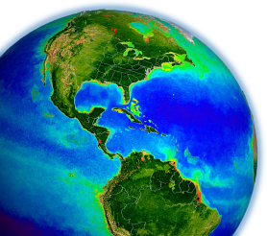
Atmospheric Correction Discussion
Bryan Franz
Zia Ahmad
NASA Ocean Biology
Processing Group
GEO-CAPE Meeting
21-23 May 2013
Notes:
Chuck retired

Slide 2
Some Questions
Is atmospheric correction of GEO any more challenging than for polar orbiters? In what way?
Given increased spectral resolution and increased spectral range (UV to NIR/SWIR), can we improve on the current atmospheric correction approach?
What other information can we use (in addition to
the OC sensor) to improve atmospheric correction?
Notes:
Sensitivity of diurnal variability to BRDF

Slide 3
Atmospheric Correction Basics
TOA
glint
whitecap
air
aerosol
water
gas
pol
L_{t}(λ) = [ TL_{g}(λ) + tL_{f}(λ) + L_{r}(λ) + L_{a}(λ) + t_{d}(λ) L_{w}(λ) ] t_{g}(λ) f_{p}(λ)
we want to retrieve L_{w}(λ)
other terms except aerosol can be estimated given only solar and view path geometry and ancillary data (wind, pressure, gas concentrations)
biggest effect is scattering by air molecules, contribution derived from pre-computed geometry-dependent and wind-dependent look-up tables (per sensor bandpass) based on radiative transfer simulations
aerosol contribution is estimated using measurements in longer wavelengths (NIR/SWIR), where water-leaving radiance is negligible or can be estimated. Spectral slope of retrieved L_{a} in NIR/SWIR is compared to a set of aerosol models, and best match model(s) are used to extrapolate to the visible wavelengths.

Slide 4
Approaches to Account for L_{w}(NIR) > 0
assign aerosols (ε) and/or water contributions (Rrs(NIR))
Hu et al. 2000
Ruddick et al. 2000
use shortwave infrared bands
Wang & Shi 2007
correct/model the non-negligible R_{rs}(NIR)
Moore et al. 1999 MERIS
Siegel et al. 2000 SeaWiFS (2000)
Stumpf et al. 2003 SeaWiFS (2002)
Bailey et al. 2010 SeaWiFS, MODIS, VIIRS, etc. (current)
Wang et al. 2012 GOCI
coupled ocean-atmosphere optimization
Chomko & Gordon 2001, Stamnes et al. 2003, Kuchinke et al. 2009,
Steinmetz et al. 2011

Slide 5
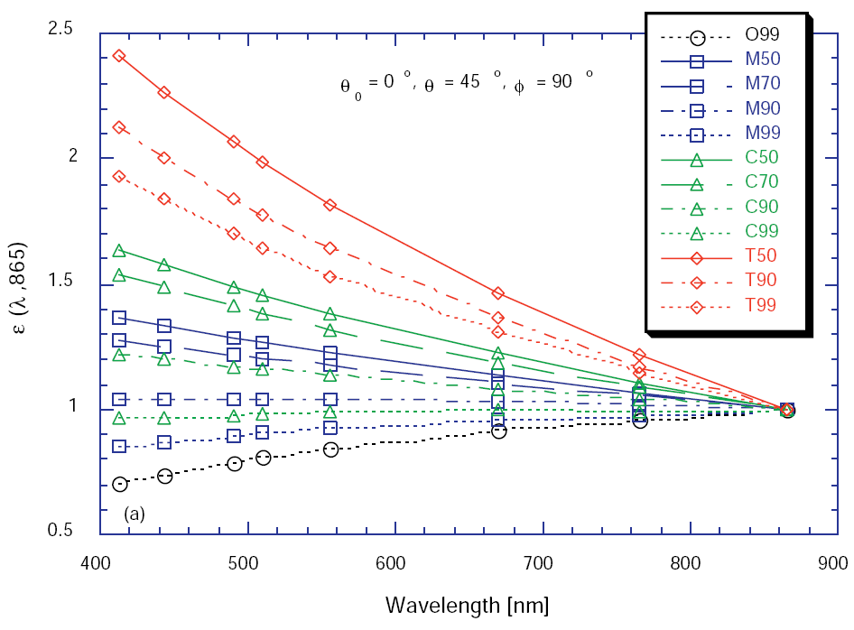
Aerosol Determination in Visible Wavelengths
Given retrieved aerosol reflectance at two λ,
and a set of aerosol models fn(θ,θ₀,φ).
π L
ρ =
F₀ · μ₀
ρ_{a}(748) & ρ_{a}(869)
model
ρ_{a}(NIR) ⇒ ρ_{as}(NIR)
ρ_{as}(748)
ε (748,869) =
ρ_{as}(869)
ρ_{as}(λ)
ε (λ,869) =
ρ_{as}(869)
Gordon & Wang 1994
ε (748,869)
Notes:
Models are non or weakly absorbing. Can’t distinguish absorbing aerosol from non-absorbing using NIR alone.

Slide 6
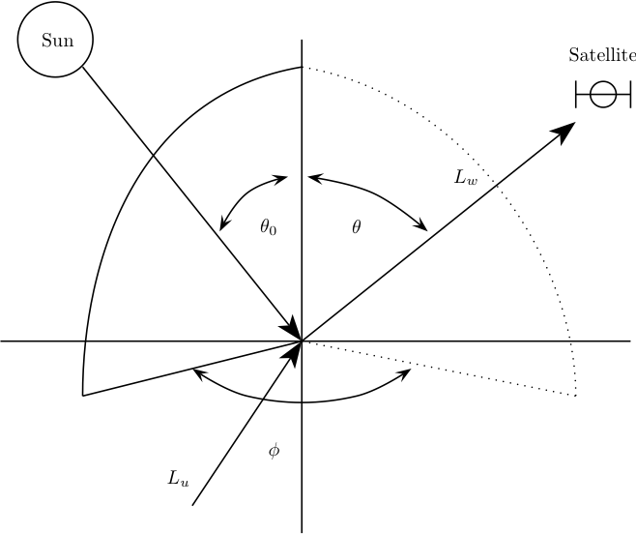
Atmospheric Correction Basics
TOA
gas
pol
glint
whitecap
air
aerosol
t_{d}(λ) L_{w}(λ) = L_{t}(λ) / t_{g}(λ) / f_{p}(λ) - TL_{g}(λ) - tL_{f}(λ) - L_{r}(λ) - L_{a}(λ)
brdf
Sun
nL_{w}(λ) = L_{w}(λ) f_{b}(λ) / t_{d0}(λ) μ₀ f₀
Sun
R_{rs}(λ) = nL_{w}(λ) / F₀(λ)
Morel f/Q = f (Chlorophyll)

Slide 7
Some Challenges for GEO
radiant path geometries
  wide range of solar zenith over the day
  high sensor view zenith at edge of footprint
  large airmass increases uncertainty
  bidirectional reflectance (BRDF
emphasis on coastal observations
Notes:
Polar orbiters see large airmass at high lats (cloudy)

Slide 8
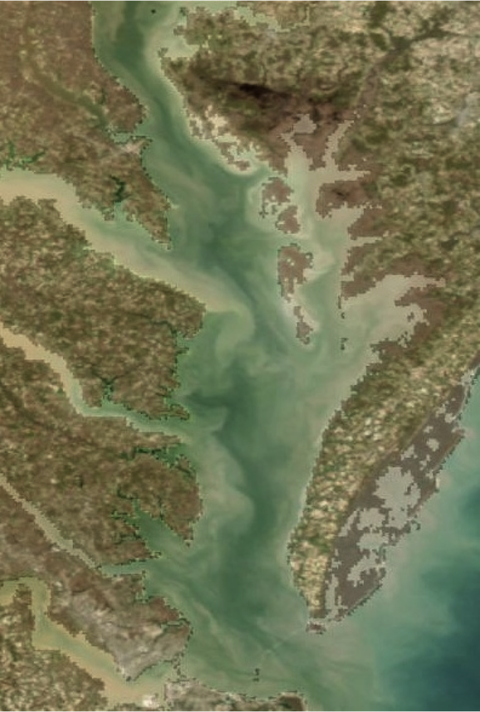
remote sensing of turbid, coastal waters is difficult
temporal & spatial variability
  higher sensor resolution (time/space)
  validity of ancillary data (wind)
straylight and adjacency effects
suspended sediments & CDOM
  complicates BRDF (f/Q) corrections
  complicates aerosol retrieval: Lw(NIR)
  complicates cloud detection
  saturation of observed radiances
non-maritime aerosols (dust, pollution)
  absorbing aerosols
anthropogenic emissions
NO₂ absorption

Slide 9
Atmospheric Correction for Trace Gases (NO₂ & O₃) and
Detection of Low Concentration of Mineral Dust over Ocean Using UV Channels of GEO-CAPE & PACE Sensors
Zia Ahmad
NASA/GSFC/Ocean Ecology Lab.
GEO-CAPE Team Meeting, May 21-23, 2013

Slide 10
Spectral Transmission
NO₂
O₃

Slide 11
NO₂ Correction
NO₂ Profile
Changes in TOA Refl. Due to NO₂
NO₂ Weighting Function
TOA Refl. After NO₂ Correction

Slide 12
NO₂ Correction (cont.)
RGB Image (April 11, 2005)
τ_{Aer} (869)
NO₂
Before NO₂ Correction
After NO₂ Correction
Frequency Dist.
Ahmad et al. (2007)

Slide 13
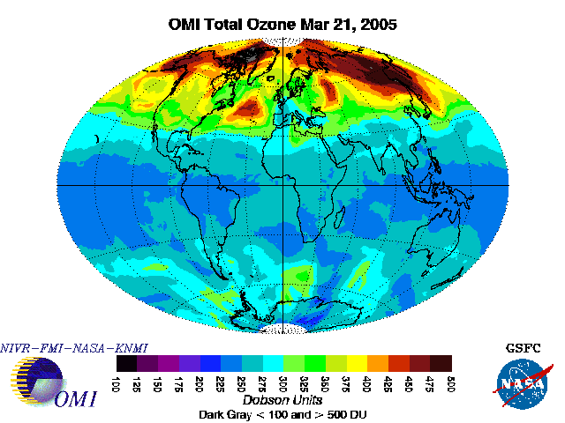
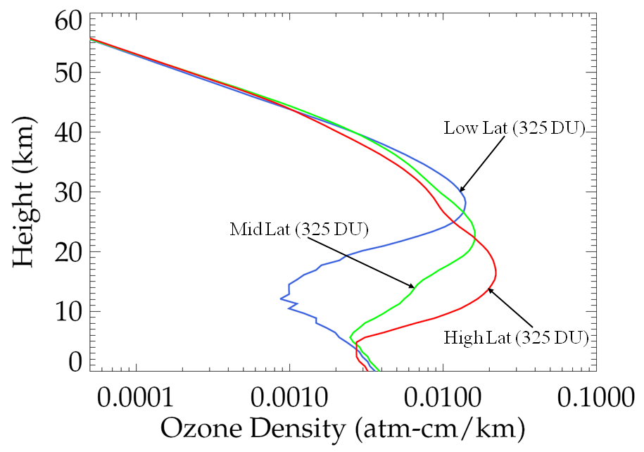
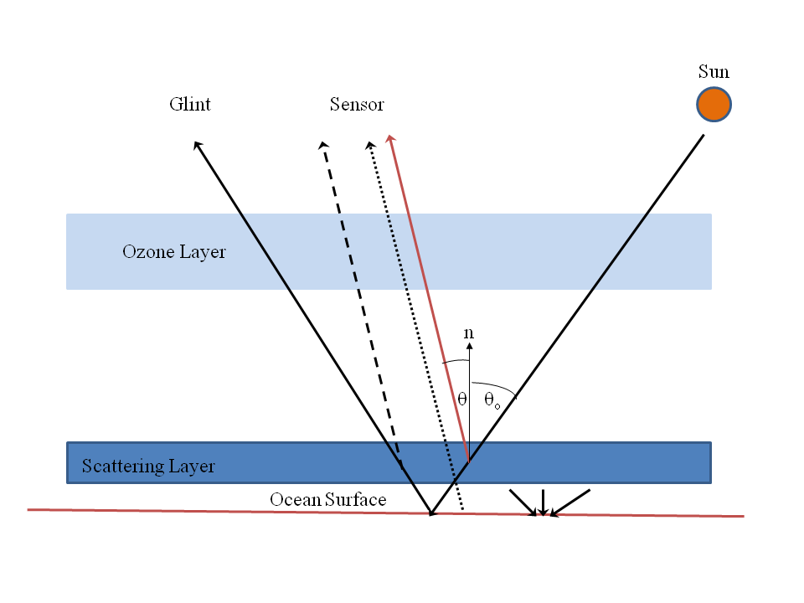
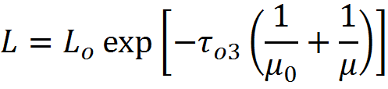


Ozone Correction

Slide 14
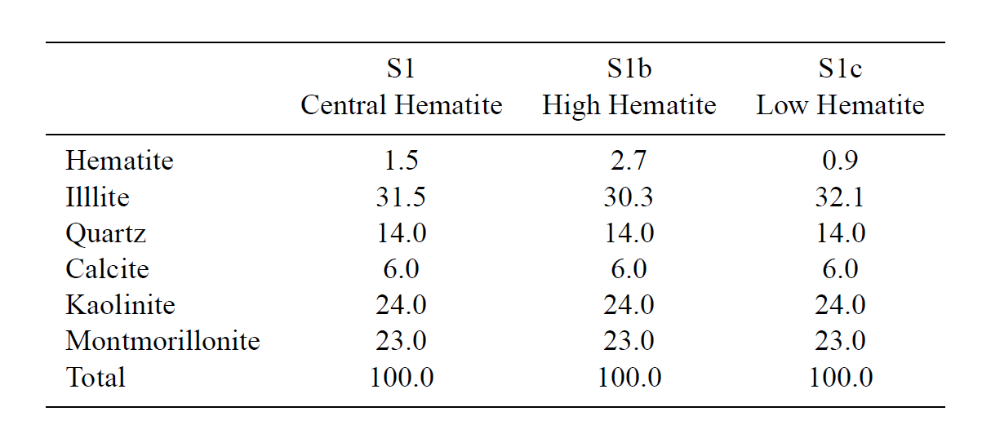

Major Constituents of Mineral Dust
Composition By Volume
, 2007

Slide 15
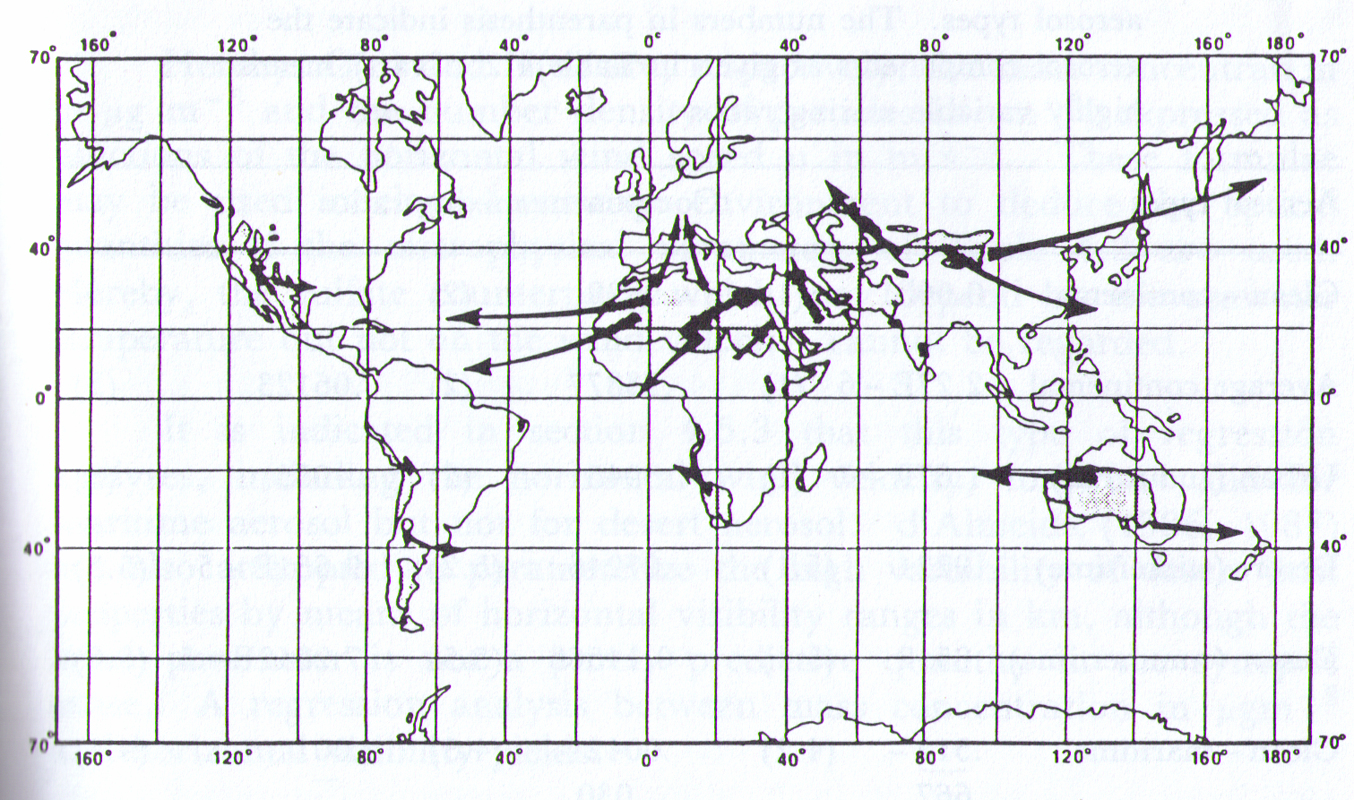
Sources and Transport of Mineral Dust
Reproduced from D’Almeida et al (1991)

Slide 16
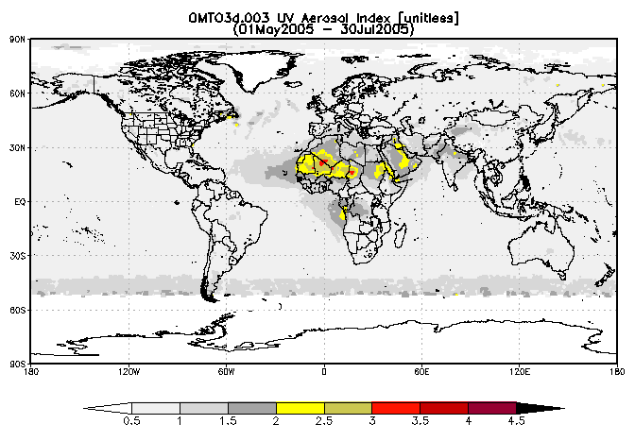
Detection of Mineral Dust From Space Using UV Aerosol Index From OMI Sensor
Cape Verde
Barbados

Slide 17
Ahmad-Fraser (AF) RT Code
The AF code (V3.0) is a vector code that accounts for all orders of scattering and polarization of the diffused radiation both in the atmosphere and the ocean.
It uses an iterative method, similar to one developed by Herman (1965), and solves the RT equation by numerically integrating over polar (θ) and azimuth (φ) angles and the optical thickness (τ)
The ocean atmosphere boundary can be either an optically flat surface or a rough surface characterized by Cox and Munk slope probability distribution.
Notes:
abc

Slide 18
Ocean-Atmosphere Model (This Study)
  Model atmosphere: Standard gas (air), and aerosols characterized by a bimodal log-normal distribution; Angstrom exponent (α) for absorbing aerosols = 0.403 α for non-absorbing aerosols = 0.79
  Ocean: water, phytoplankton, detritus material, and CDOM; Size distribution of the particulate matter (hydrosols) is described by power law (~ r⁻⁴); τ_{tot} (ocean) =10.
Notes:
abc

Slide 19
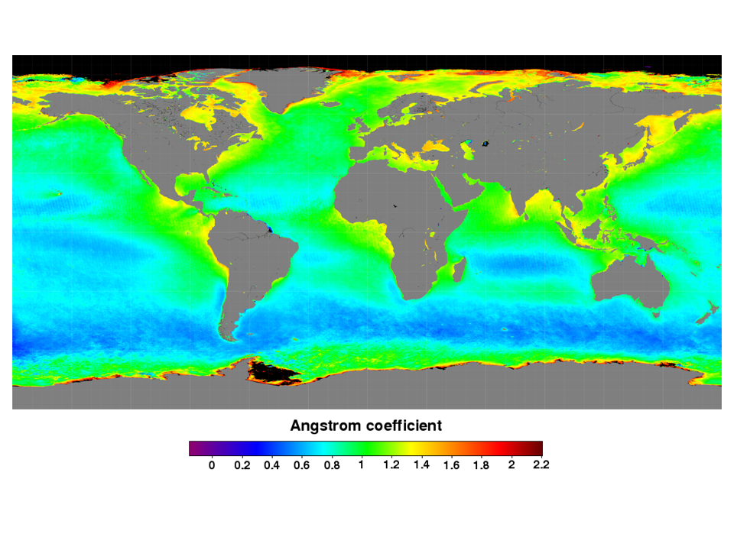
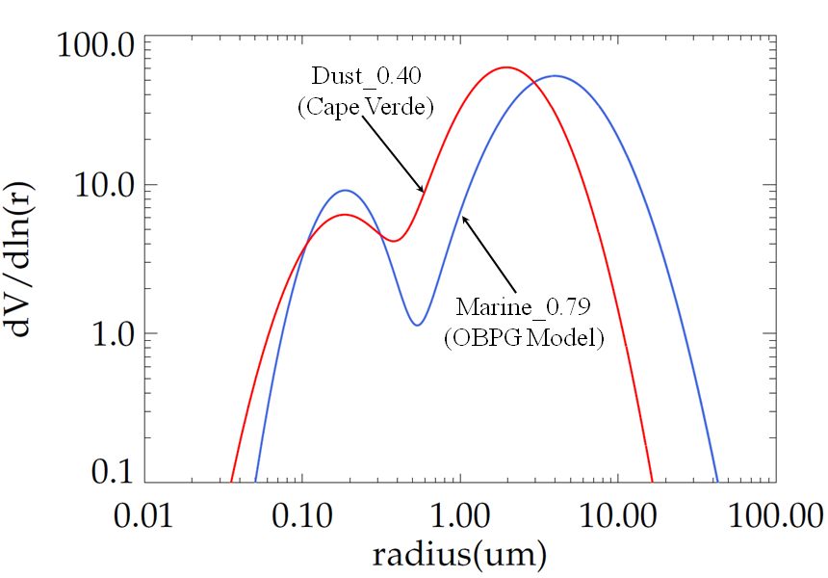
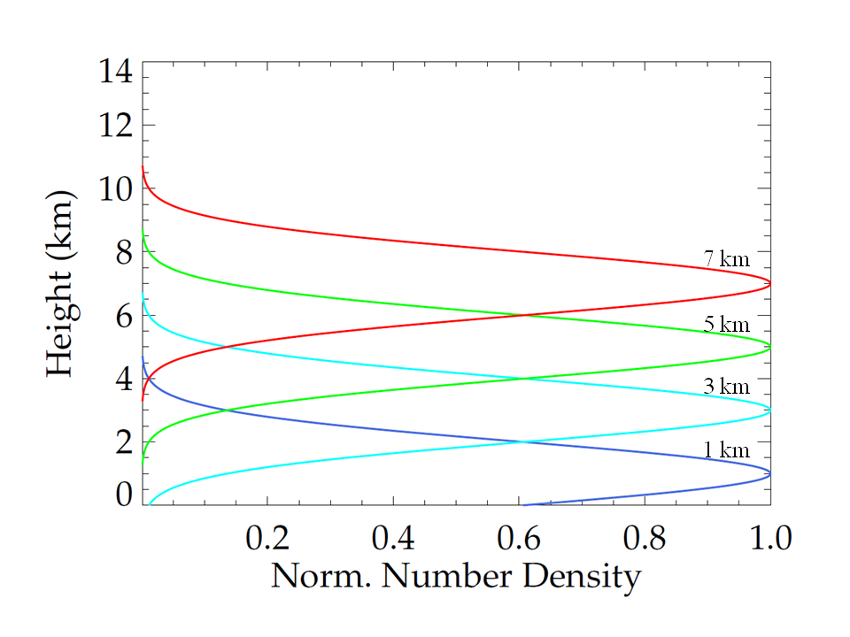
Aerosol Properties
Angstrom Coefficient
Aerosol Models
vertical Profile (Dust)
Parameter Dust Marine
r_{f} 0.184 0.187
σ_{f} 0.574 0.437
R_{c} 1.965 3.966
σ_{c} 0.595 0.672
V_{f} 0.090 0.100
V_{c} 0.910 0.900

Slide 20
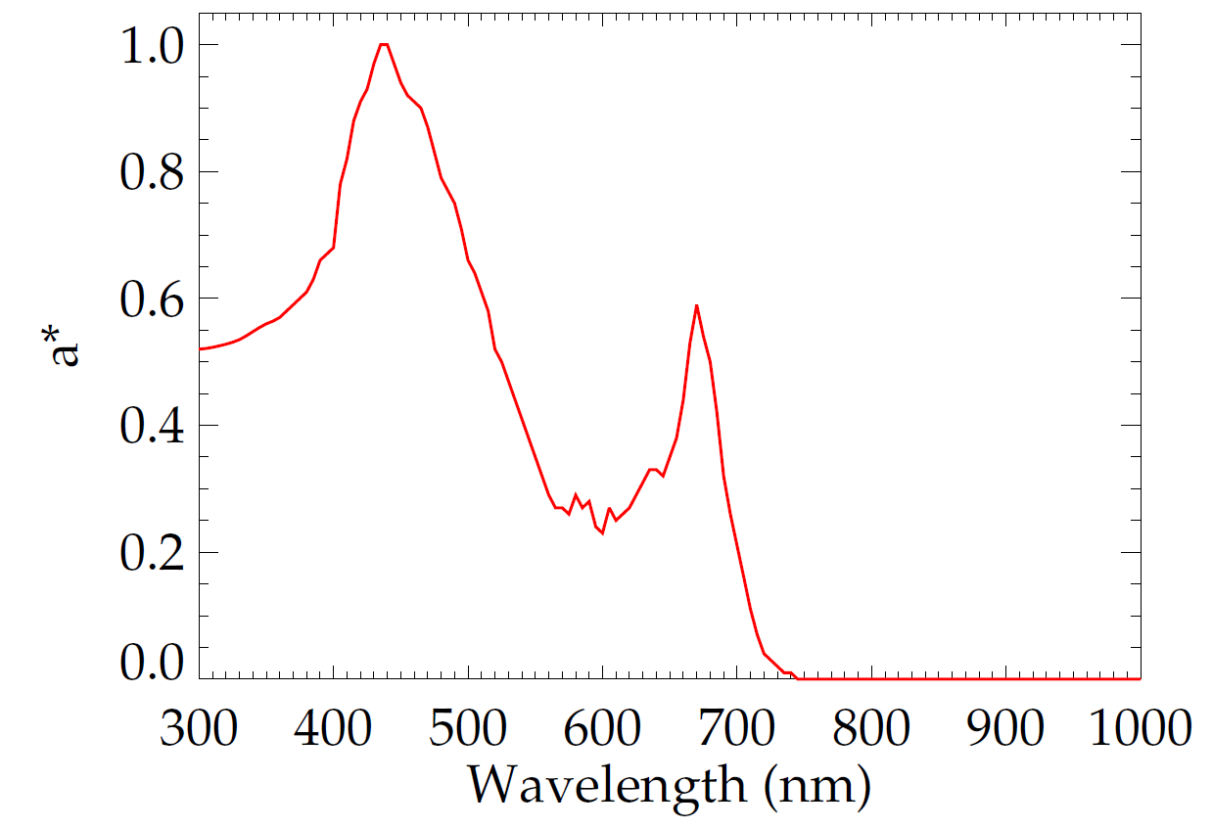
Normalized Chlorophyll Specific Absorption Coeff. (a*)
350-700 nm
Morel (JGR, 1988)
440 nm
< 350 nm
Mobley (extrapolated)
> 700 nm
Mobley (extrapolated)
Reproduced from Hydrolight

Slide 21
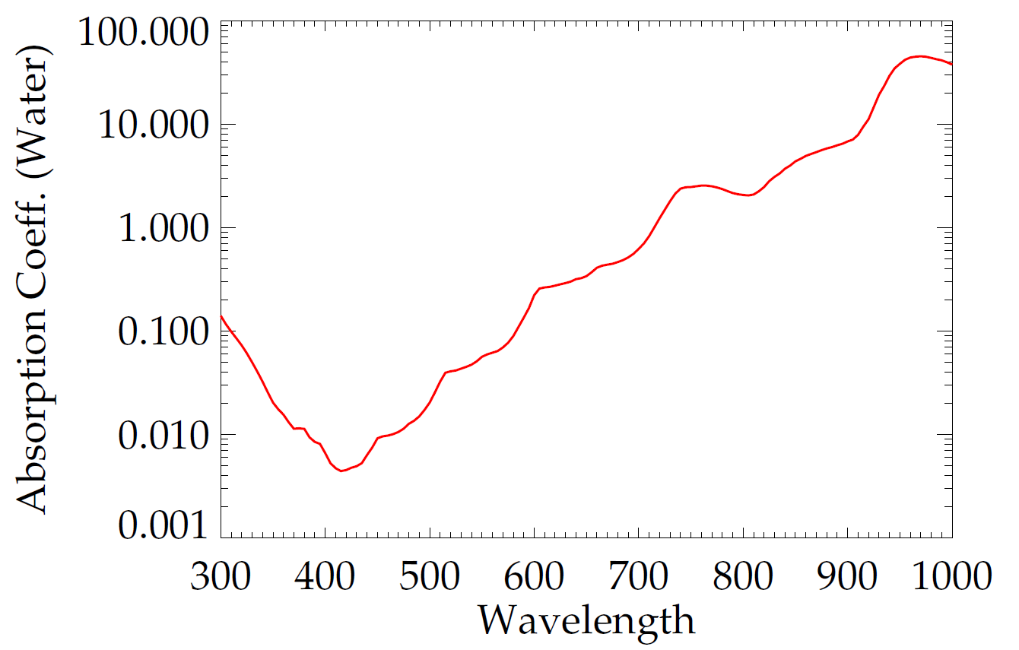
Absorption Coeff. of Water
300-340 nm
(SB --> SF)
SB: Smith & Baker
SF: Sogandares & Fry
PF: Pope & Fry
340-380 nm
(SF)
800 nm
(Segelstein)
725-800 nm
(SB)
380-725 nm
(PF)
Reproduced from Hydrolight

Slide 22
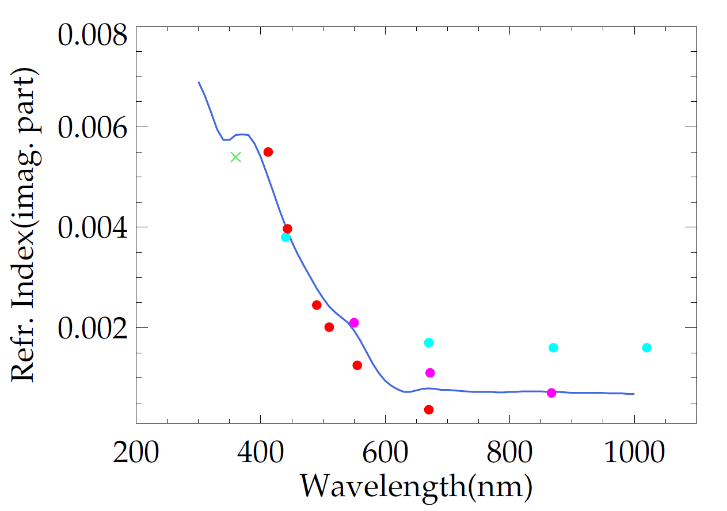
Spectral Dependence of Dust Refractive Index (n₂)
Red (solid circle): Cattrall et al.
Purple (solid circle): Kalashnikova et al.
Cyan (solid circle): AERONET
Green (cross): Sinyuk et al.
Ahmad
Ahmad et al. (2013, in preparation)

Slide 23
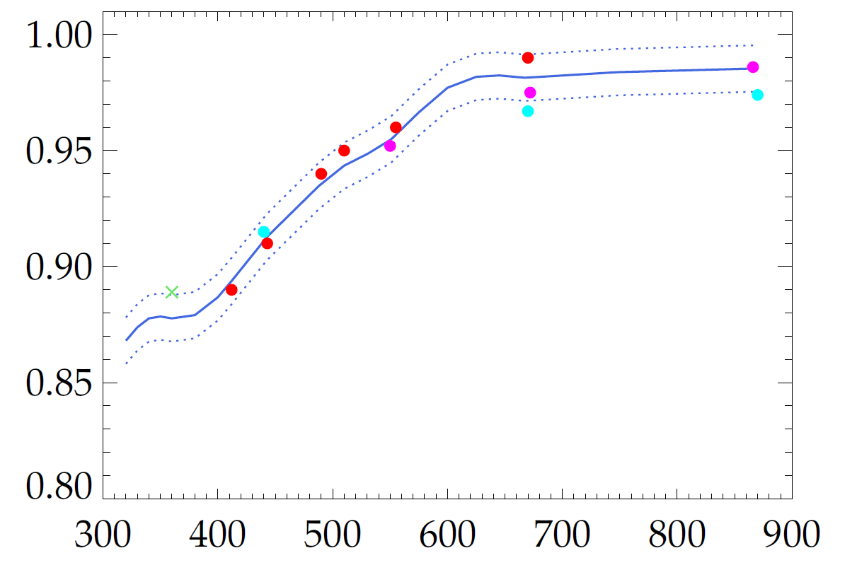
Spectral Dependence of Dust Single Scat. Albedo
Ahmad
Single Scattering Albedo
Red (solid circle): Cattrall et al.
Purple (solid circle): Kalashnikova et al.
Cyan (solid circle): AERONET
Green (cross): Sinyuk et al.
Wavelength (nm)
Ahmad et al. (2013, in prepration)

Slide 24
Lambert Equivalent Reflectivity (LER)
Lambertian Model Atmosphere
L_{λ}(R)
Sun
L_{tot} (λ) = L_{atm} (λ) + t L_{WL} (λ)
R
For a Lambertian Model atmosphere the TOA radiance L_{λ}(R) is given by:
L_{λ}(R) = L _{λ}(R _{λ} = 0) + R _{λ} T_{λ} /(1-S_{λ}R _{λ}) (1)
where,
λ = Wavelength
R _{λ} = Reflectivity of the lower boundary surface
T_{λ} = Related to the product of solar and sensor transmission
S_{λ} = Fraction of upwelling irradiance reflected to the base of the atmosphere
L _{λ}(R _{λ} = 0) Upwelling TOA radiance for R _{λ} = 0
Goal: Vary ‘R’ such that L_{tot}(λ) = L_{λ}(R)

Slide 25
Detection of Dust: LER & Aerosol Index (AI)
Both LER and AI are defined using Rayleigh model atmosphere. LER is the surface reflectivity value of a Rayleigh model atmosphere that would make L _{λ}(R _{λ})=L _{λ}(obs) and ΔLER is simply:
ΔLER = (R _{λ2} – R _{λ1}).
For AI, one first computes R _{λ1} by assuming that L _{λ1}(R _{λ1})=L _{λ1}(obs), and then predicts L _{λ2}(R _{λ1} , pred) by assuming that R _{λ2} = R _{λ1}
Mathematically AI is defined as:
AI = - 100*log₁₀[(L _{λ2}(obs)/ L _{λ2}(R _{λ1} , pred) )]

Slide 26
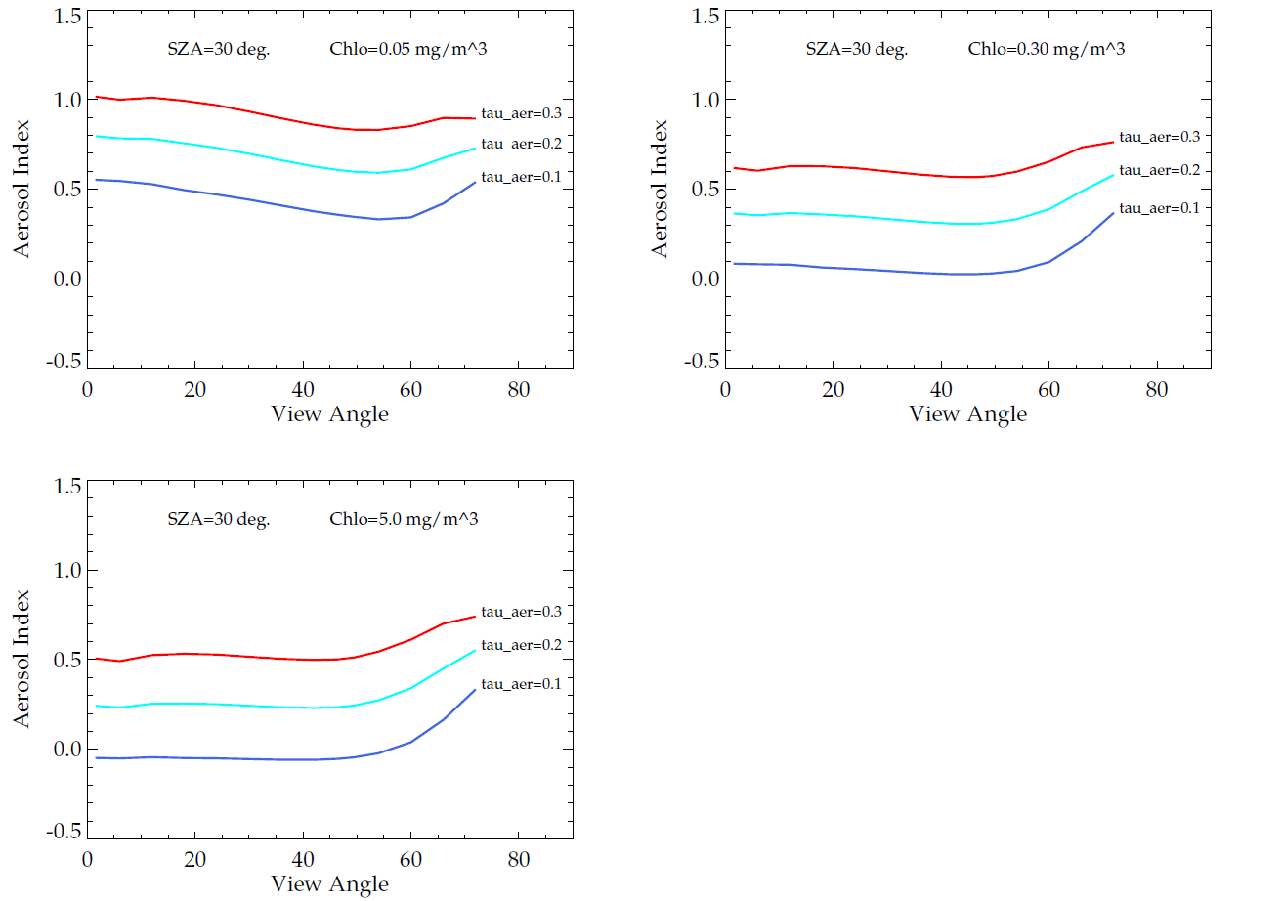
Aerosol Index (SZA=30º, Ht=3 km)
Chlo=0.05 mg/m³
Chlo=0.30 mg/m³
Chlo=5.0 mg/m³
AI shows very weak dependence on view angle (< 60º )
AI increases with dust optical thickness (τ)
Over open ocean where chlorophyll value is very small, AI ≈ 0.5. As chlorophyll value increases to 5.0 mg/m³, AI ≈ zero for τ=0.1
Ahmad et al. (2013, in preparation)

Slide 27
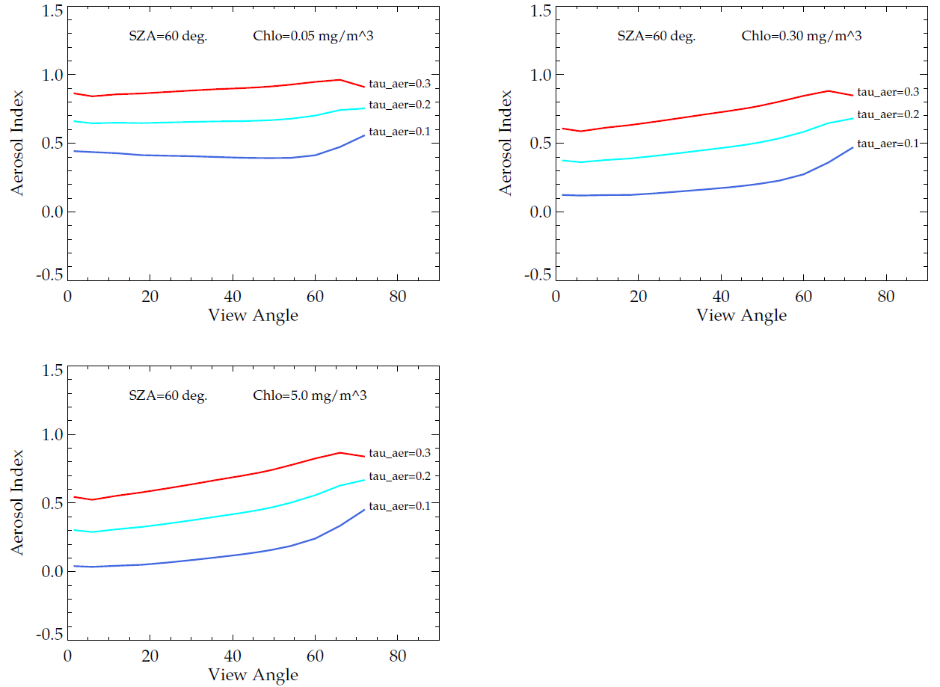
Aerosol Index (SZA=60º, Ht=3 km)
Chlo=0.05 mg/m³
Chlo=0.30 mg/m³
Chlo=5.0 mg/m³
Results are similar to SZA=30º, except that at large SZA and large chlorophyll value (5mg/m³), AI increases with view angle. This is due to an increase in optical path length which results in increased absorption at the shorter wavelength.
Ahmad et al. (2013, in preparation)

Slide 28
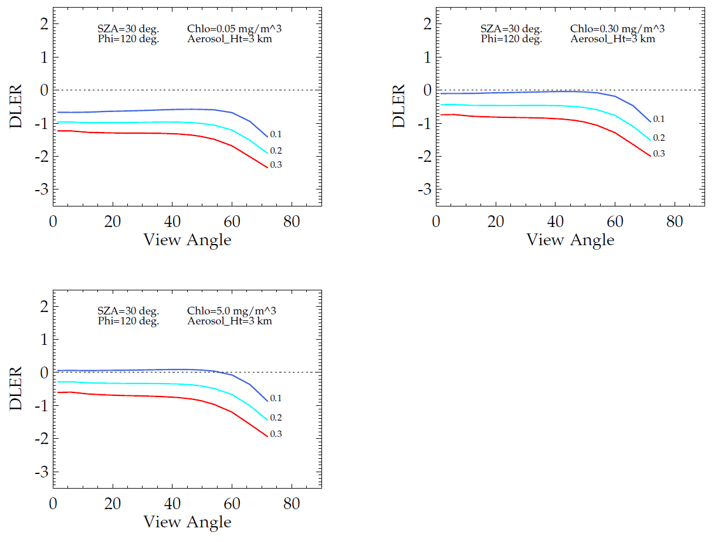
ΔLER (SZA=30º, Ht=3 km)
Chlo=0.05 mg/m³
Chlo=0.30 mg/m³
Chlo=5.0 mg/m³
For angles less than 60º, ΔLER is practically independent of view angle.
The magnitude of ΔLER increases with an increase in τ.
ΔLER is about -0.5 when chlorophyll is about 0.05 mg/m³, but it is practically zero for chlorophyll equal to 5.0 mg/m³. This can be explained as follows: when chlorophyll amount is very low, R₃₄₀ < R₃₈₀ due to stronger water absorption at 340 nm than at 380 nm.
ΔLER is more negative at large view angles.
Ahmad et al. (2013, in preparation)

Slide 29
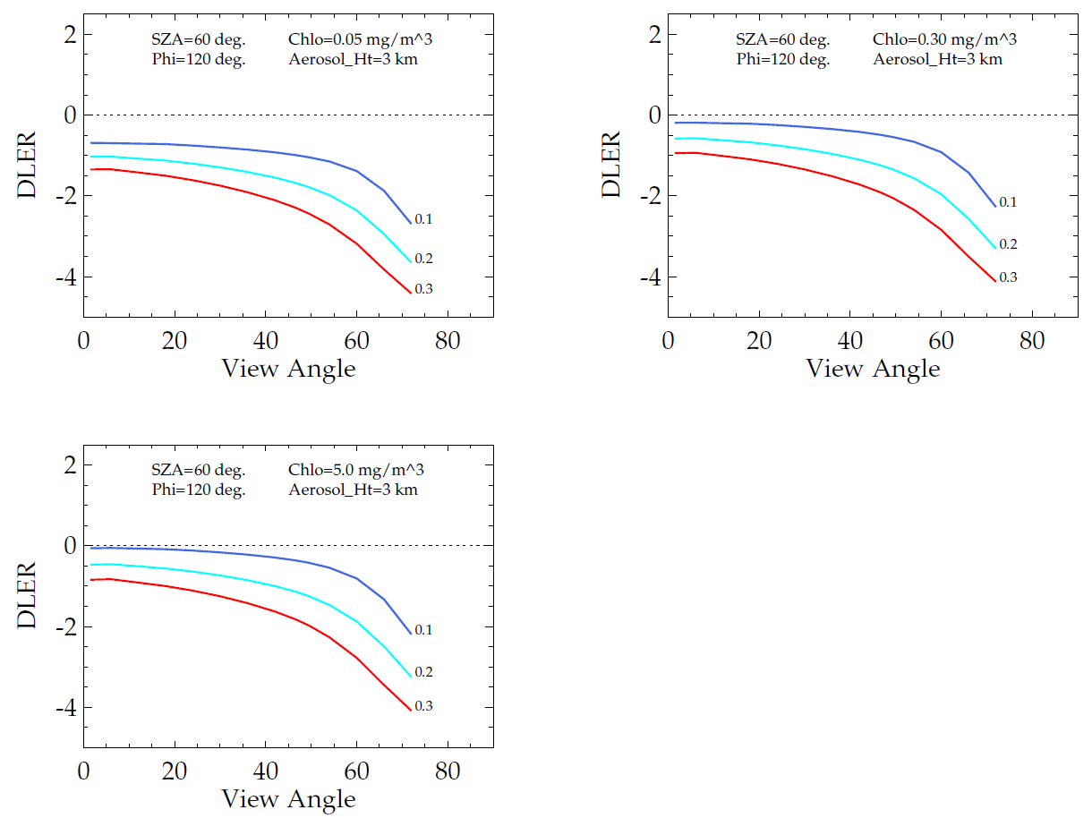
ΔLER (SZA=60º, Ht=3 km)
Chlo=0.05 mg/m³
Chlo=0.30 mg/m³
Chlo=5.0 mg/m³
The results for SZA=60º are similar to those for SZA=30º, except that ΔLER values at large view angles are more negative. This is due to increased in optical path length which results in increased absorption at 340 nm.
Ahmad et al. (2013, in preparation)

Slide 30
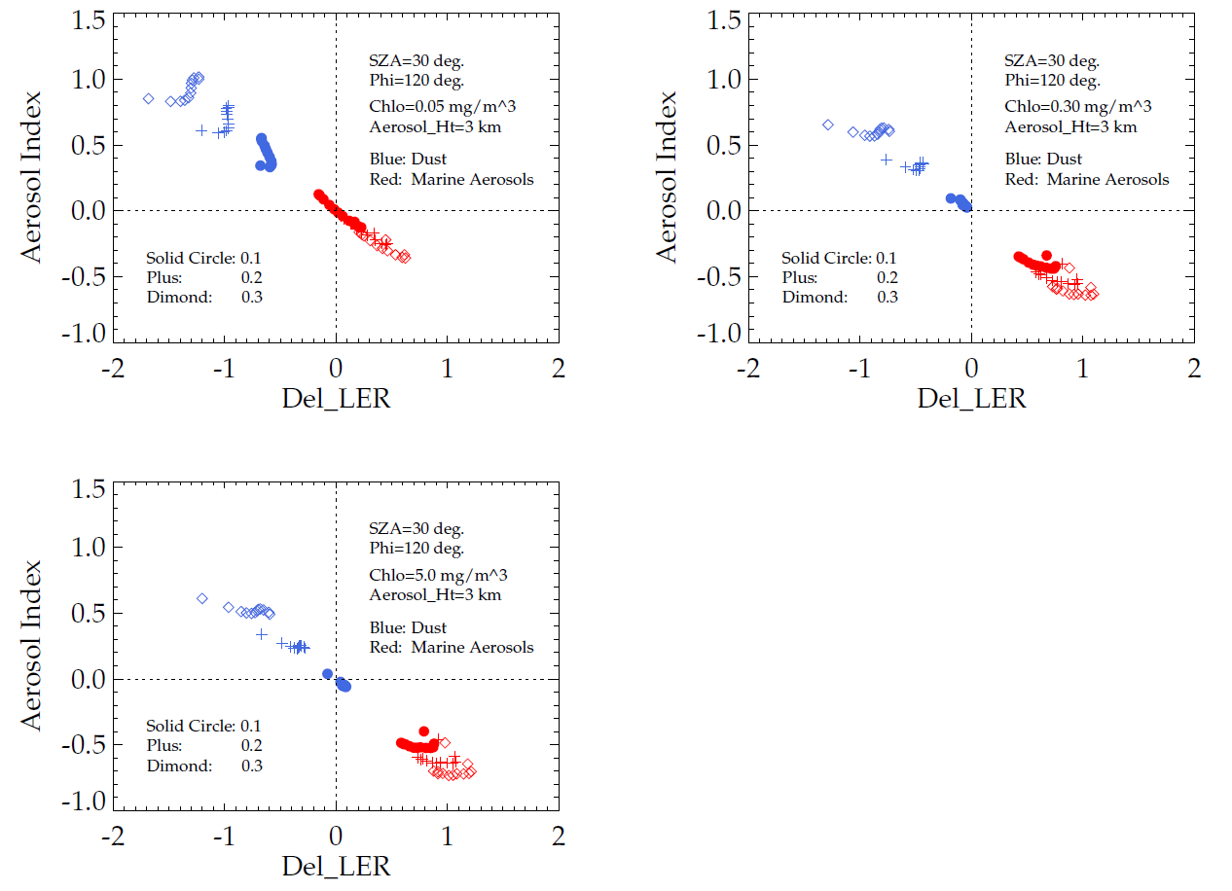
AI vs. ΔLER (SZA=30º, Ht=3 km)
Chlo=0.05 mg/m³
Chlo=0.30 mg/m³
Chlo=5.0 mg/m³
There is a clean separation between dust aerosols and Marine aerosols. Dust aerosols are practically confined in the 2nd quadrant and marine aerosols are in the 4th quadrant. This means that using ΔLER and AI we can detect small amount of dust aerosols over open ocean as well as coastal waters.
Ahmad et al. (2013, in preparation)

Slide 31
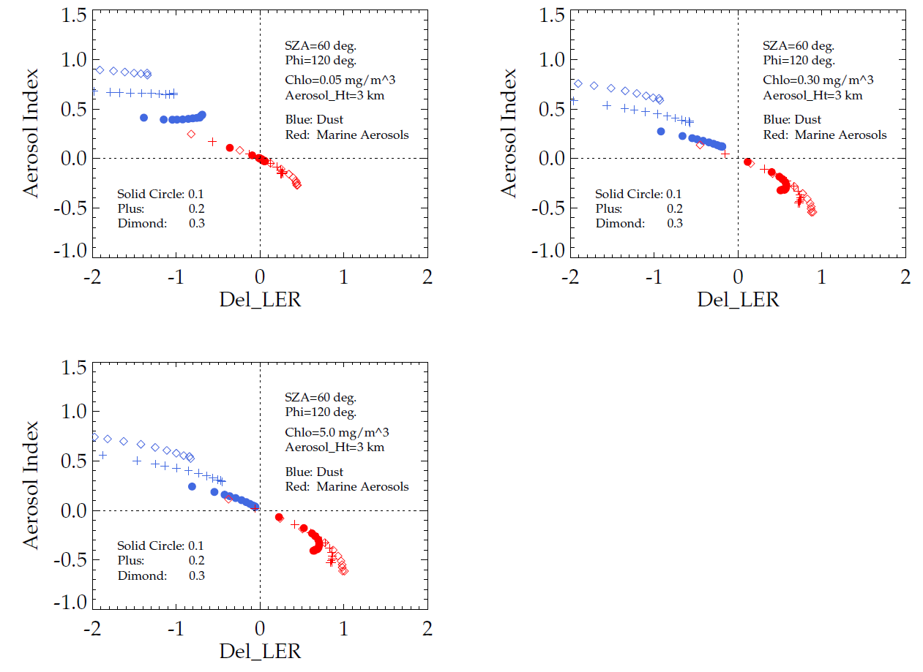
AI vs. ΔLER (SZA=60º, Ht=3 km)
Chlo=0.05 mg/m³
Chlo=0.30 mg/m³
Chlo=5.0 mg/m³
The results for SZA=60º are similar to those for SZA=30º, except that sometime marine aerosols appear as dust aerosols.
Ahmad et al. (2013, in preparation)

Slide 32
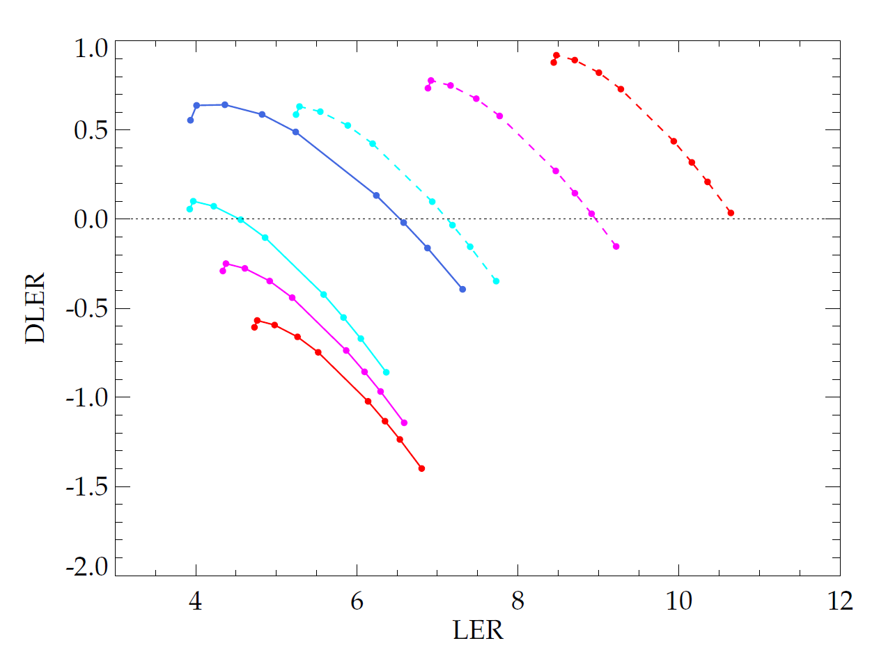
DLER(R₃₄₀-R₃₈₀) vs. LER(R₃₈₀)
SZA=30º
θ=0º (Nadir View)
Chl=2.0
Chl=0.5
(R₃₄₀-R₃₈₀)
Chl=0.1
Rayl.
τ=0.3
Chl=0.03
τ=0.2
τ=0.1
Non-absorbing aerosols (Marine_0.79)
Chl=2.0
Chl=0.5
τ=0.1
Chl=0.1
τ=0.2
Absorbing aerosols (Dust_0.40)
Chl=0.03
τ=0.3
(R₃₈₀ )
Ahmad et al. (2013, in preparation)

Slide 33
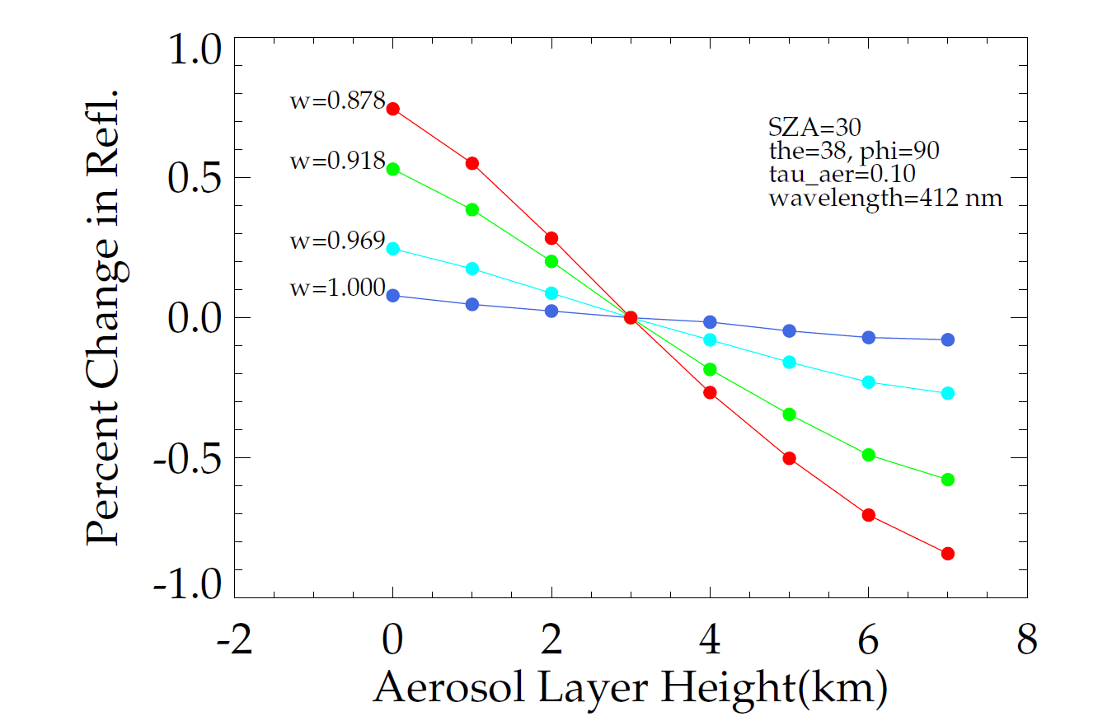
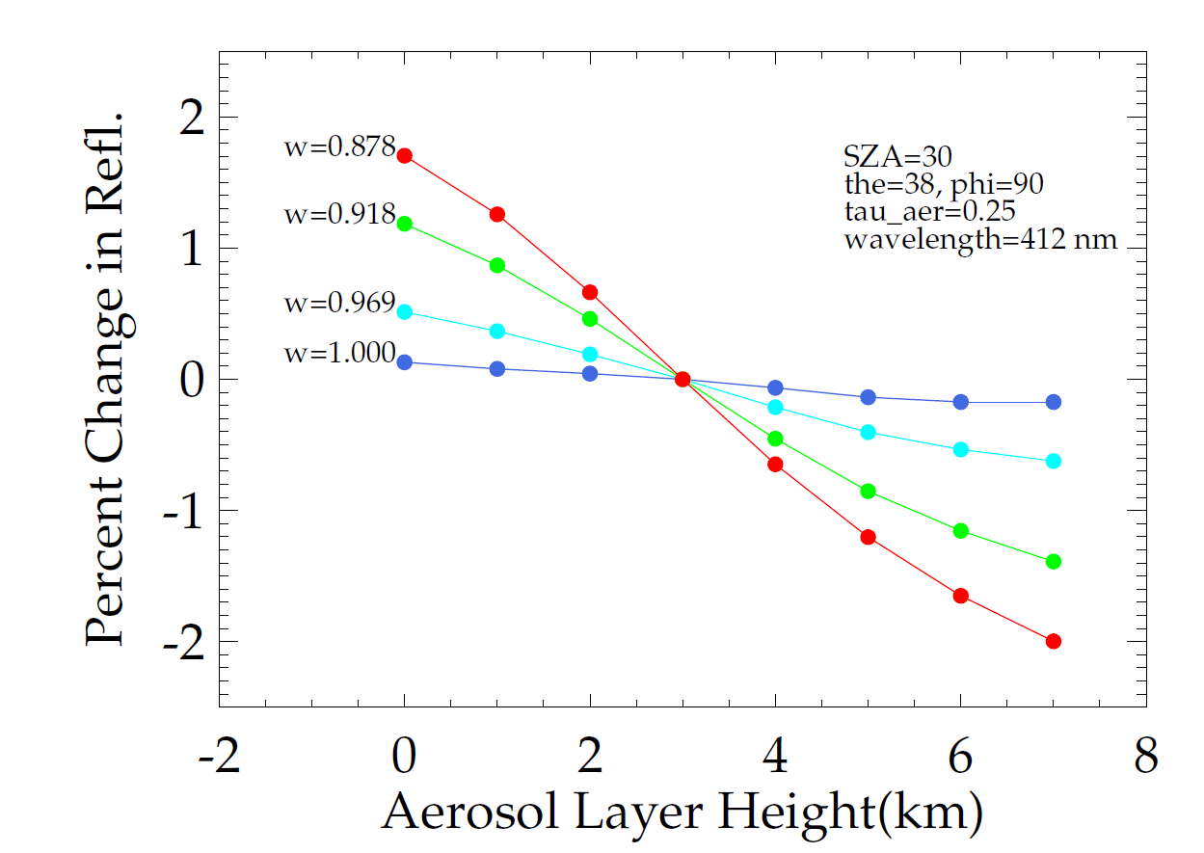
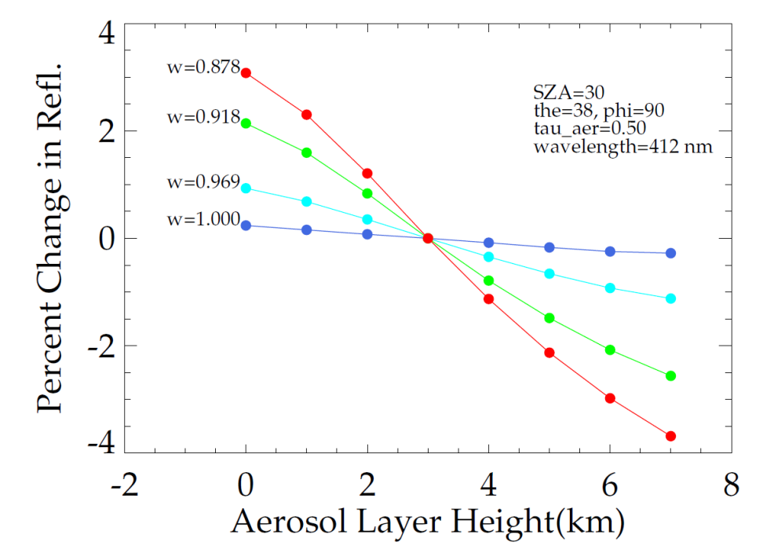
Change in TOA Reflectance with Aerosol Layer Height
Note: Based on our latest dust model, the SSA at 412nm is ~ 0.89. For τ_{aer}=0.25, an error of 1 km in aerosol layer height would change the TOA reflectance by ~ 0.7%. This will result in 7% change in water-leaving radiance. The error will increase with an increase in τ_{aer}.
Ahmad et al. (2013, in preparation)

Slide 34
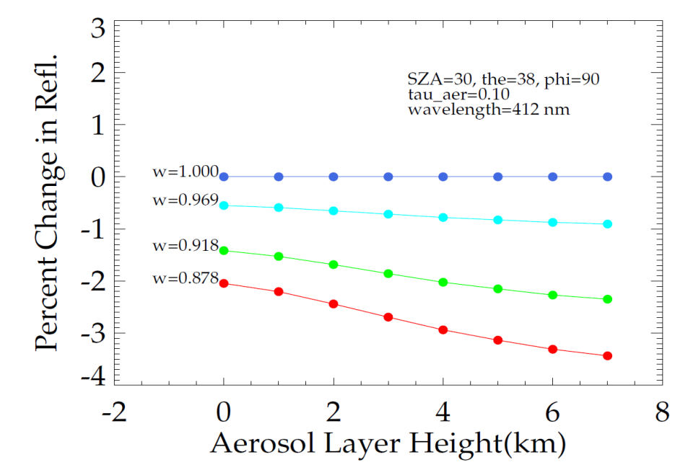
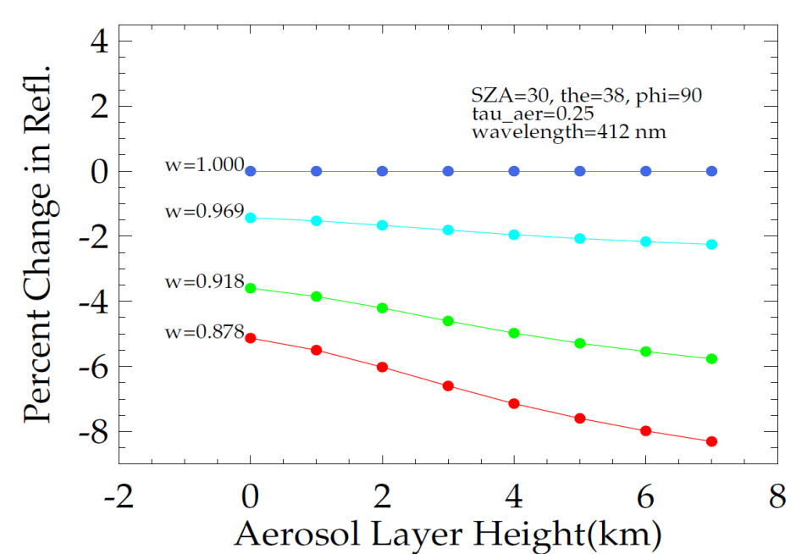
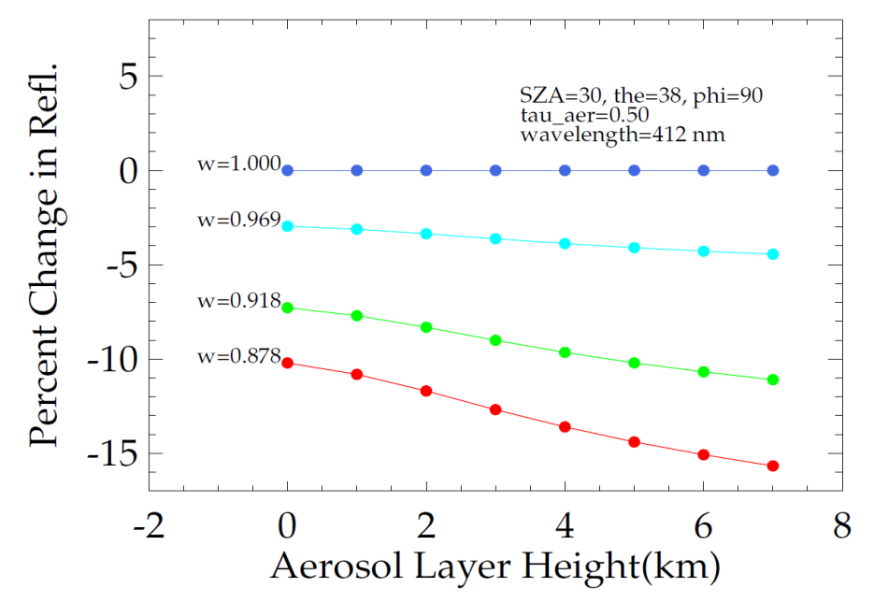
Change in TOA Reflectance with Aerosol Layer Height
These graphs show the effect of assigning wrong SSA to aerosols, although the aerosol layer-height is exactly known. Here, TOA reflectance for each aerosol model is normalized by the TOA reflectance of a non-absorbing aerosol model at exactly the same height. For example, for an aerosol layer at 3 km, and τ_{aer}=0.25, a change in SSA value from 0.878 to 0.918 would result in a change of ~2% in TOA reflectance . This is equivalent to a change of 20% in water-leaving radiance.
Ahmad et al. (2013, in preparation)

Slide 35
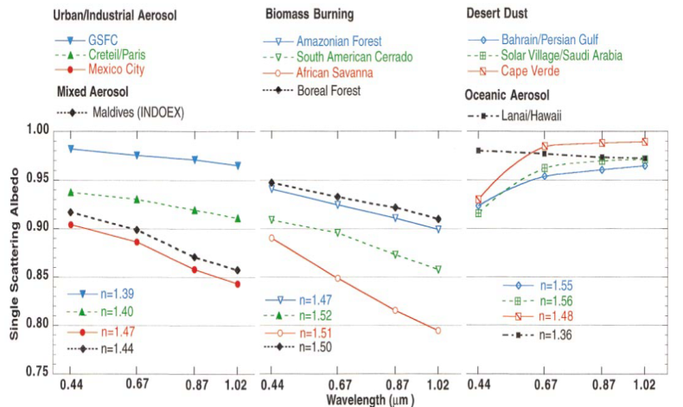
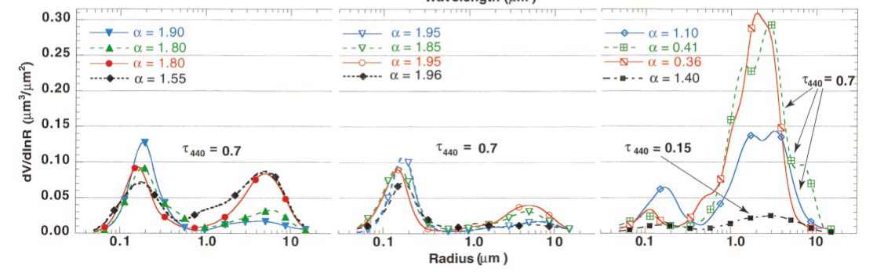
Requirements and Recommendations for Atm. Corr. (Absorbing Aerosols)
A priori knowledge of:
- Spectral dependence of refractive index
- Aerosol Layer Height
- Micro-physical properties of aerosols
Develop regional climatology of aerosol optical and microphysical properties
Investigate the possibility of using transport models like GOCART to identify aerosol constituents and their locations in the atmosphere.
Dubovik et al. (2002)

Slide 36
Backup Slides

Slide 37
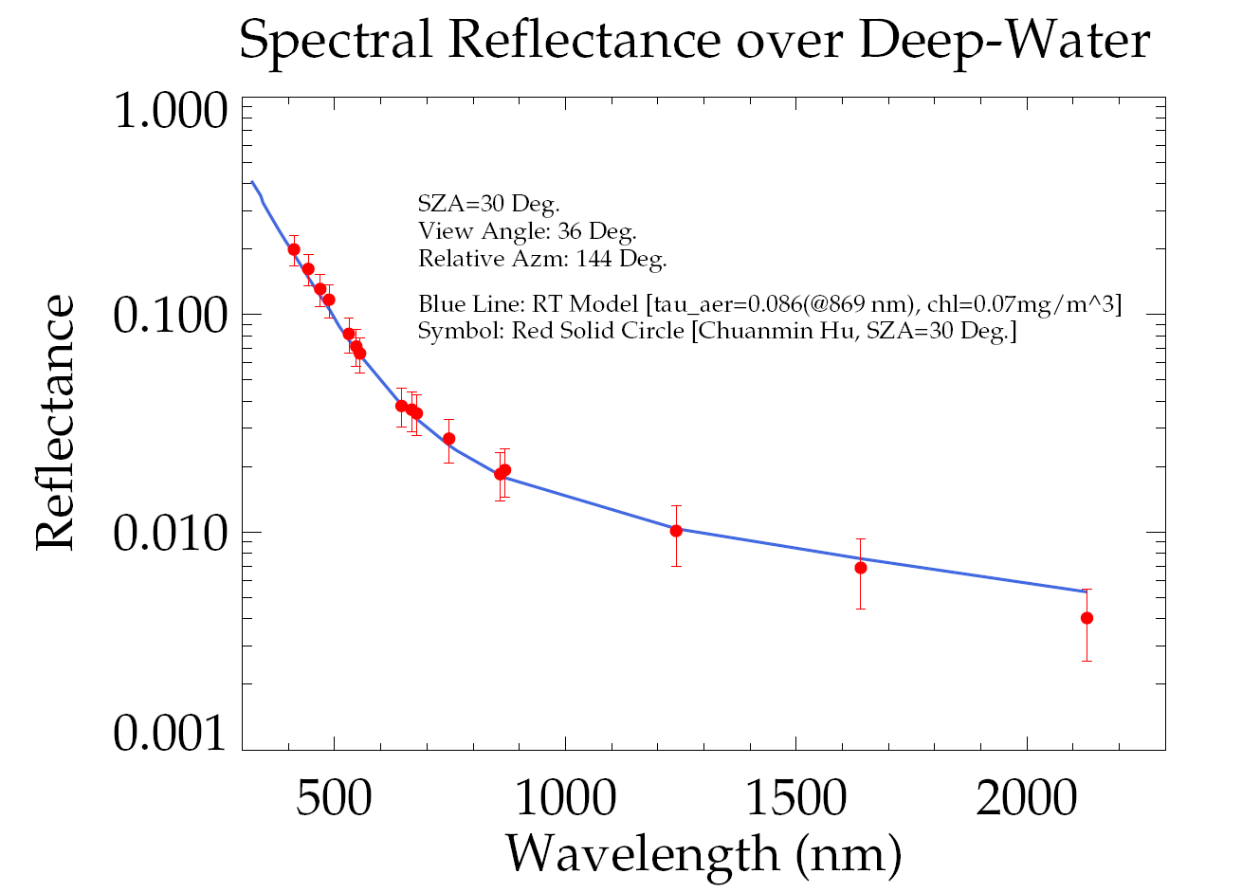

Slide 38
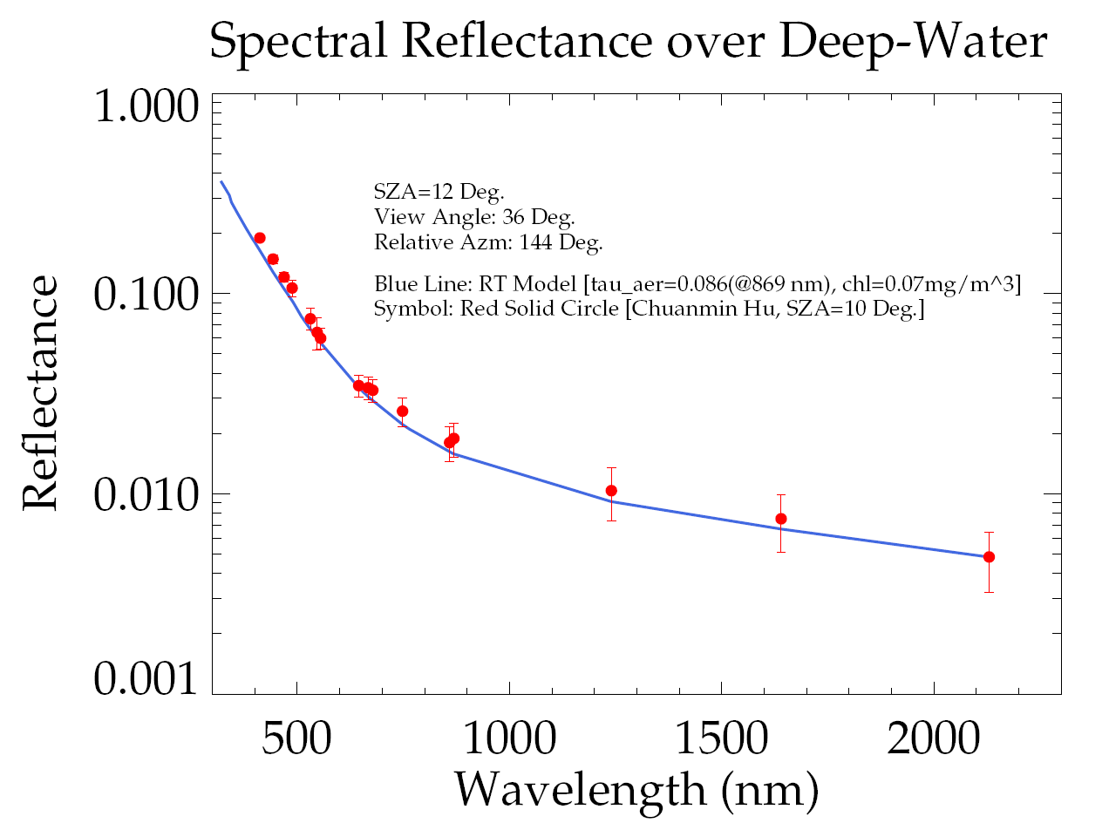

Slide 39
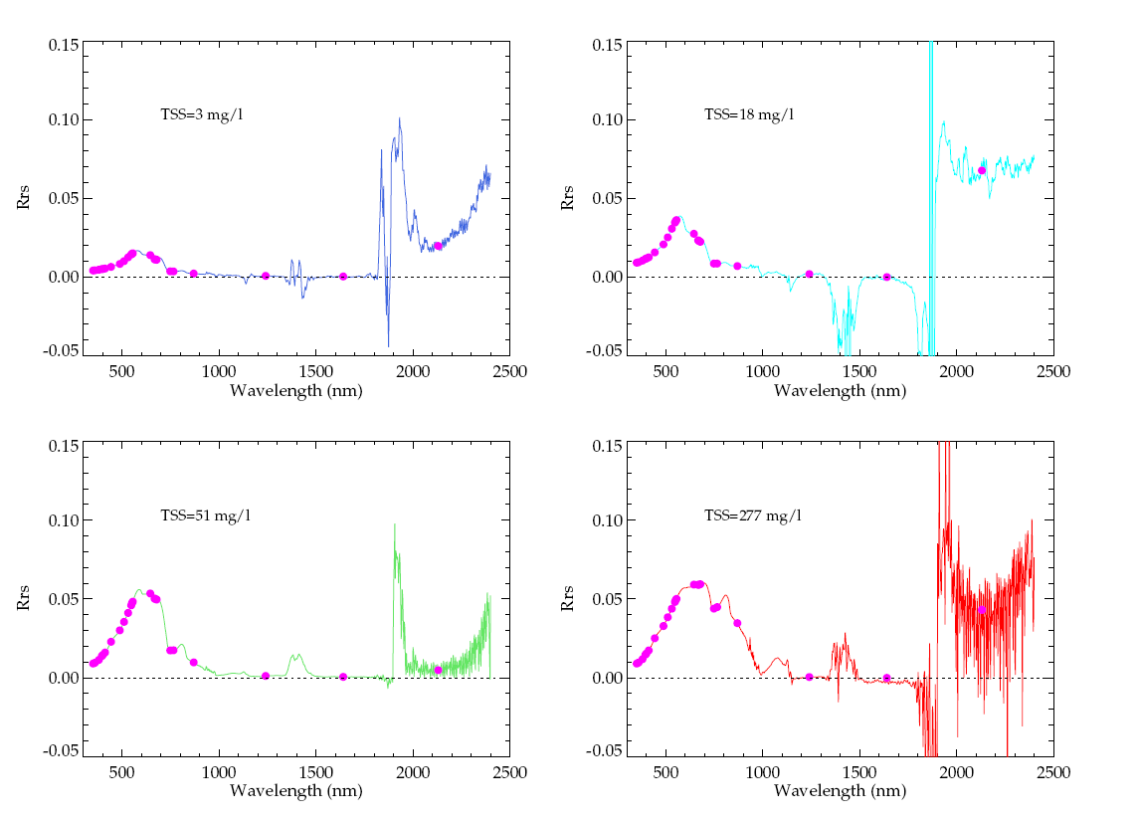

Slide 40
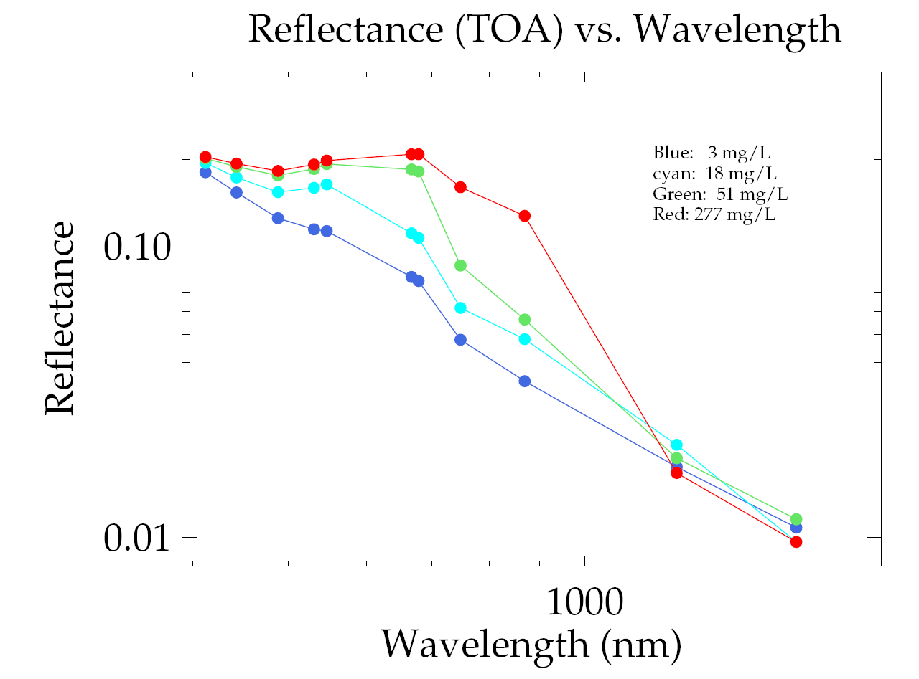

Slide 41
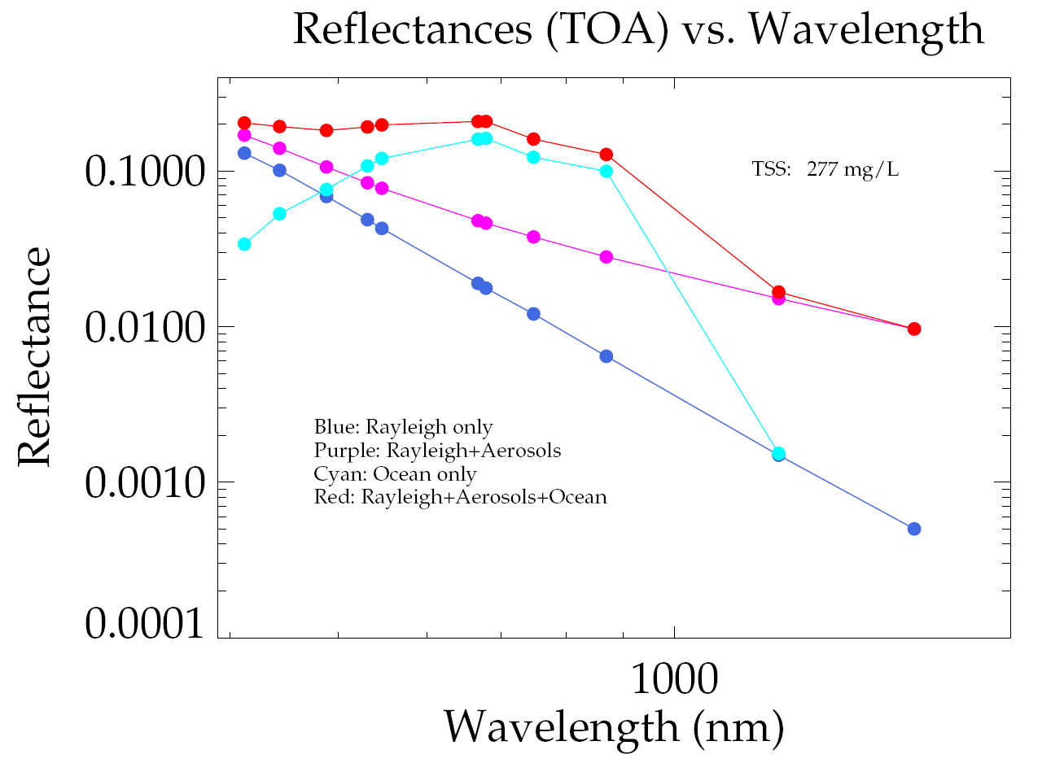

Slide 42
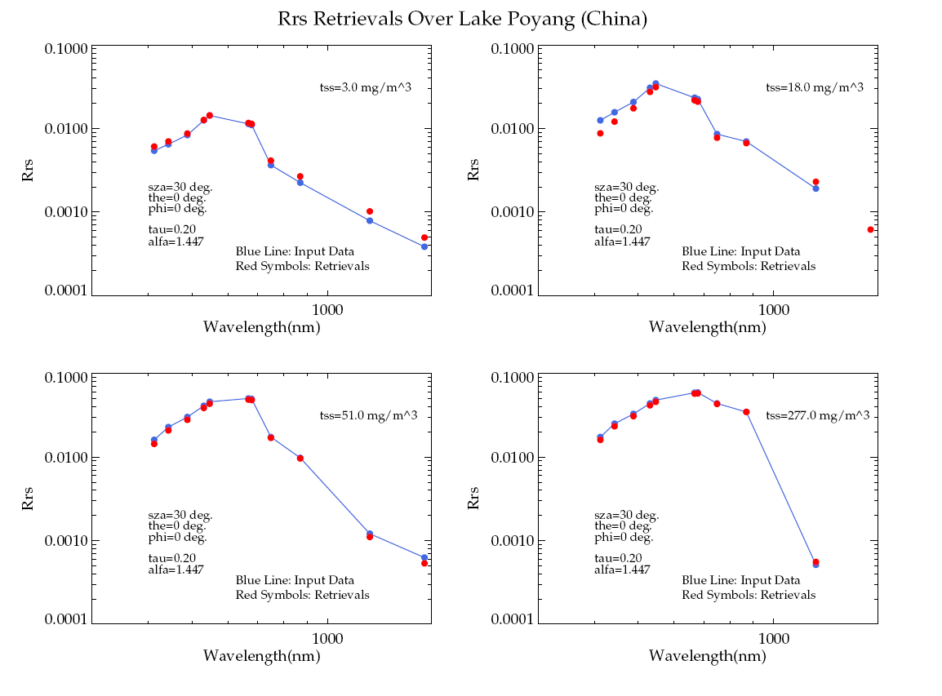

Slide 43
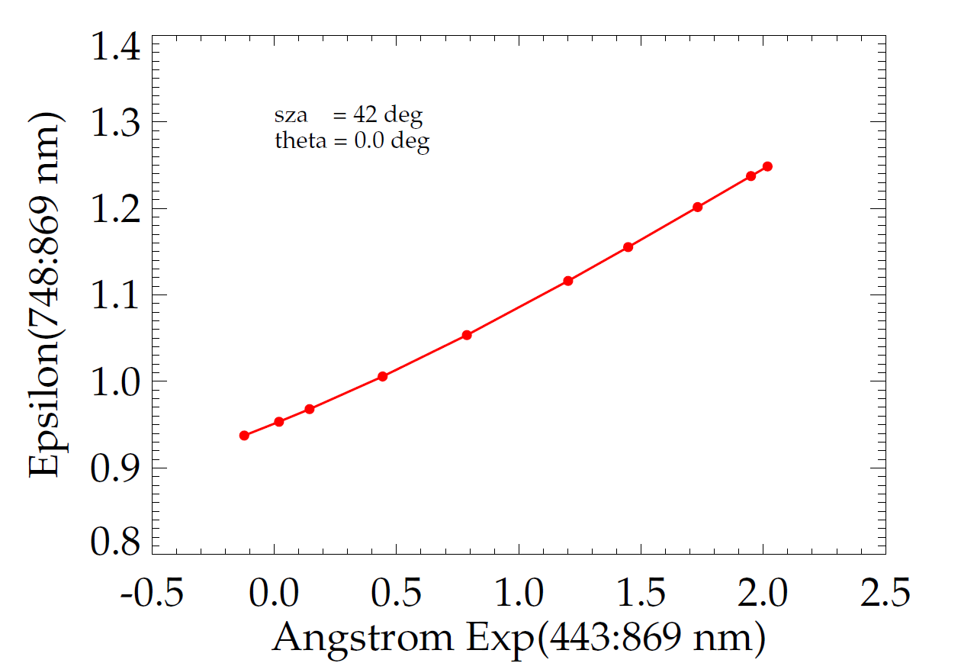
Epsilon vs. Angstrom Exponent

Slide 44
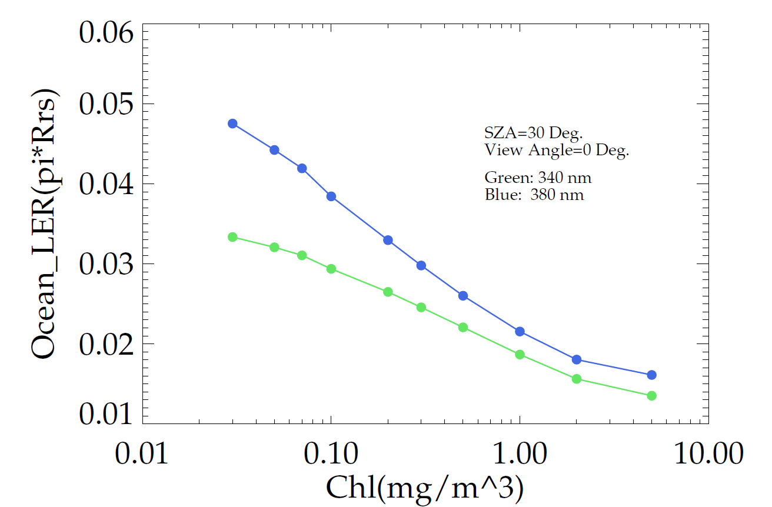
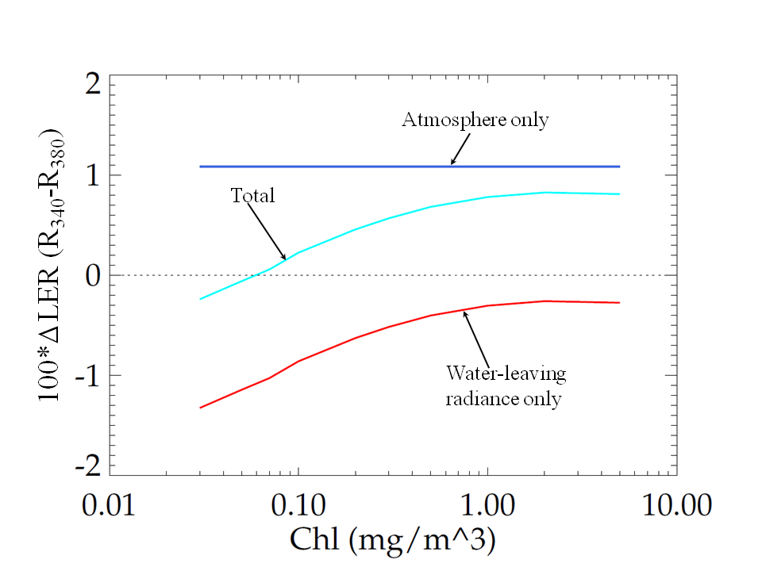
Ocean LER vs. Chlorophyll Con.
Ocean_LER vs. Chlorophyll Conc.
Δ LER (R340-R380) vs. Chlorophyll Conc.

Slide 45
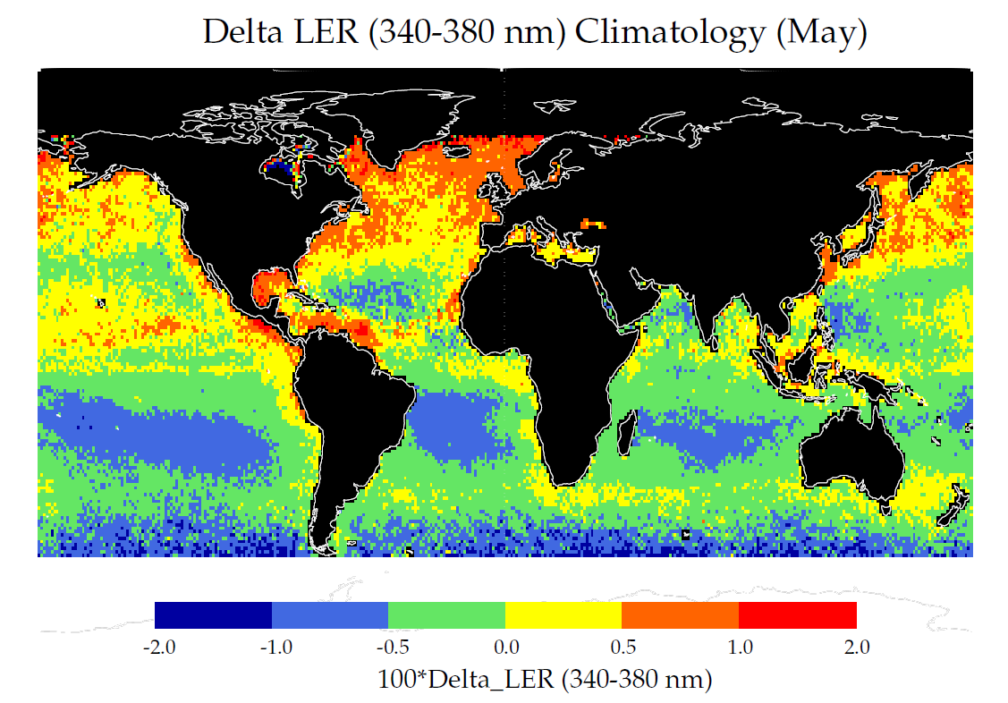
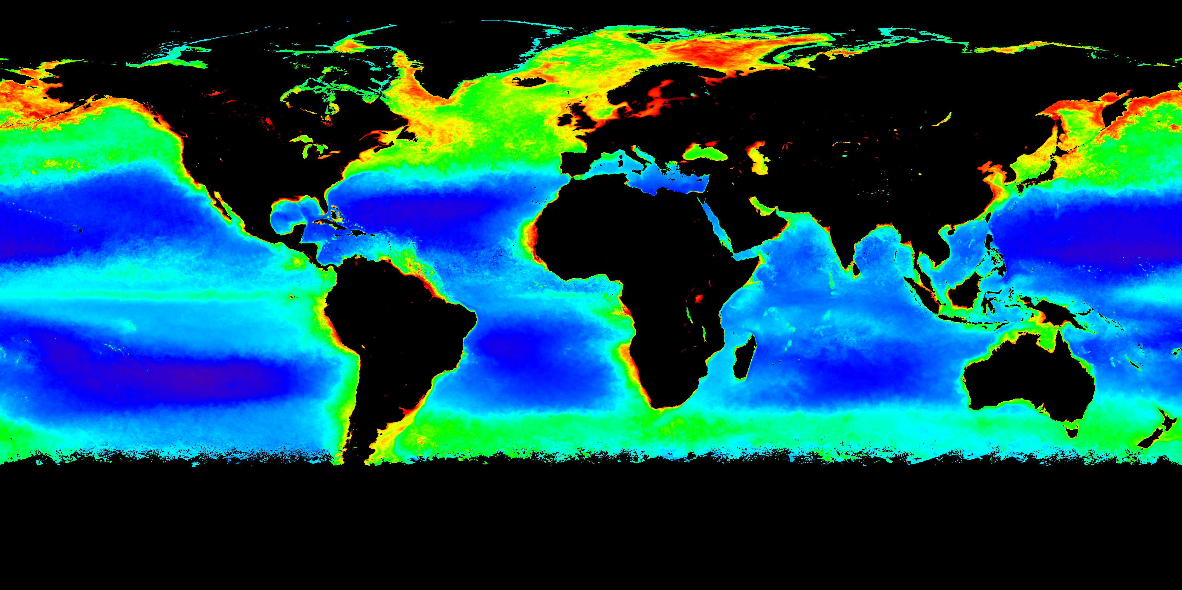
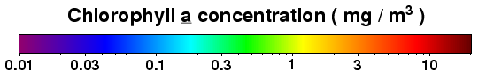
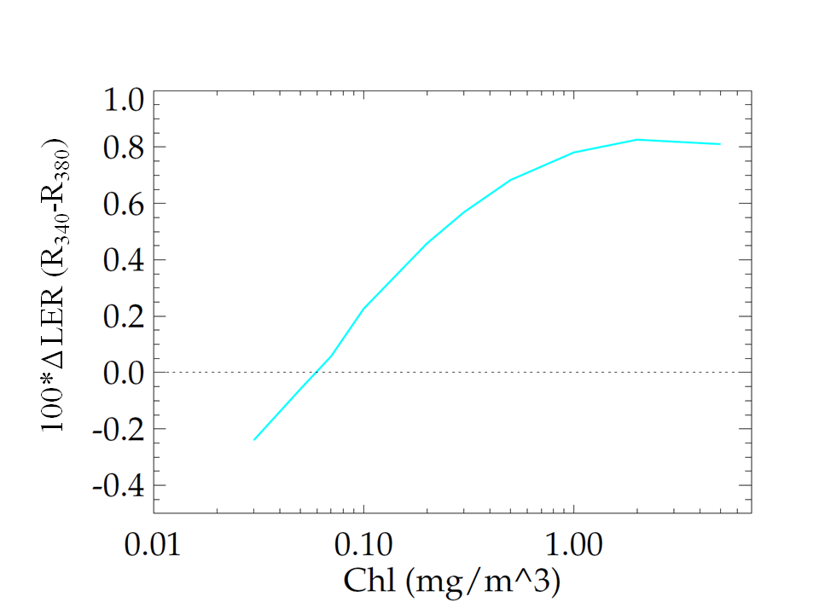
CDOM/Chlorophyll Signature in OMI/TOMS Minimum-Reflectivity Data Product (cont.)
MODIS/Aqua Chlorophyll Climatology (May)
Δ LER (R340-R380) vs. Chlorophyll Conc.
Δ LER (R340-R380) vs. Chlorophyll Conc.

Slide 46
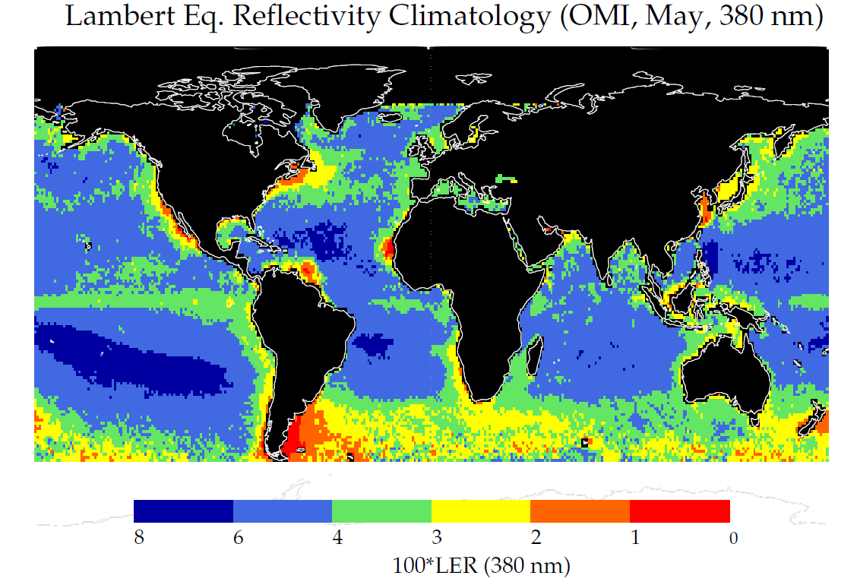
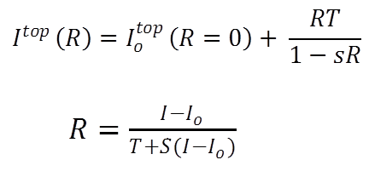
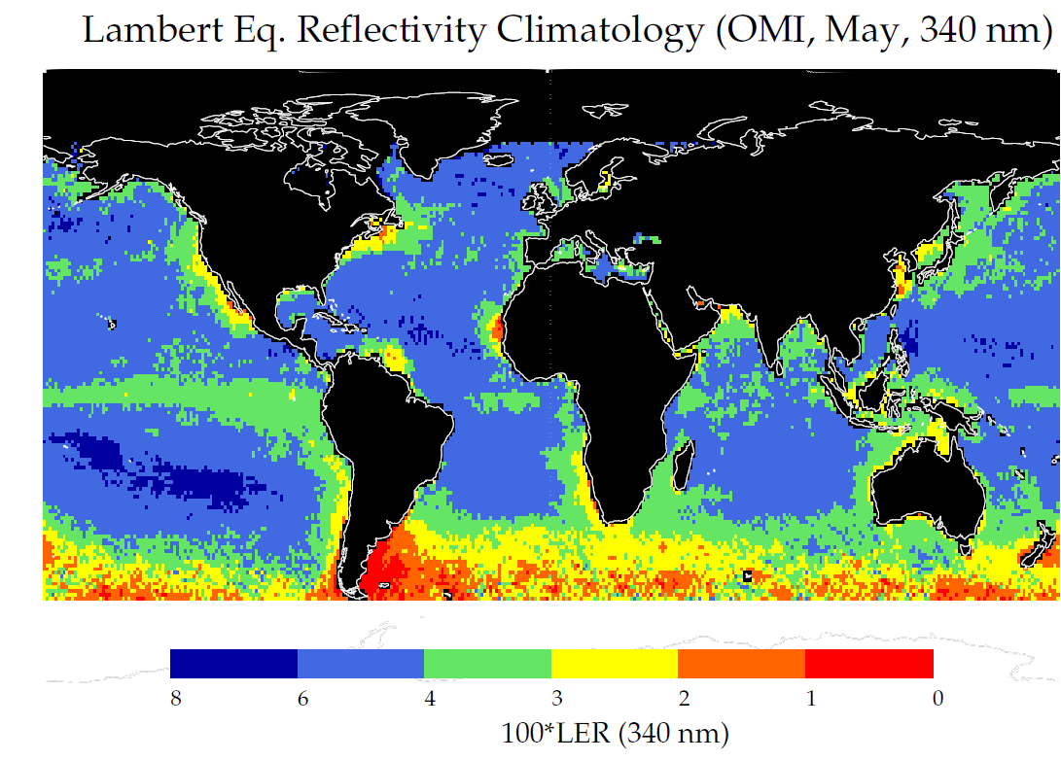
CDOM/Chlorophyll Signature in OMI’s Minimum-Reflectivity Data
MODIS/Aqua Chlorophyll Climatology (May)

Slide 47
NO₂

Slide 48
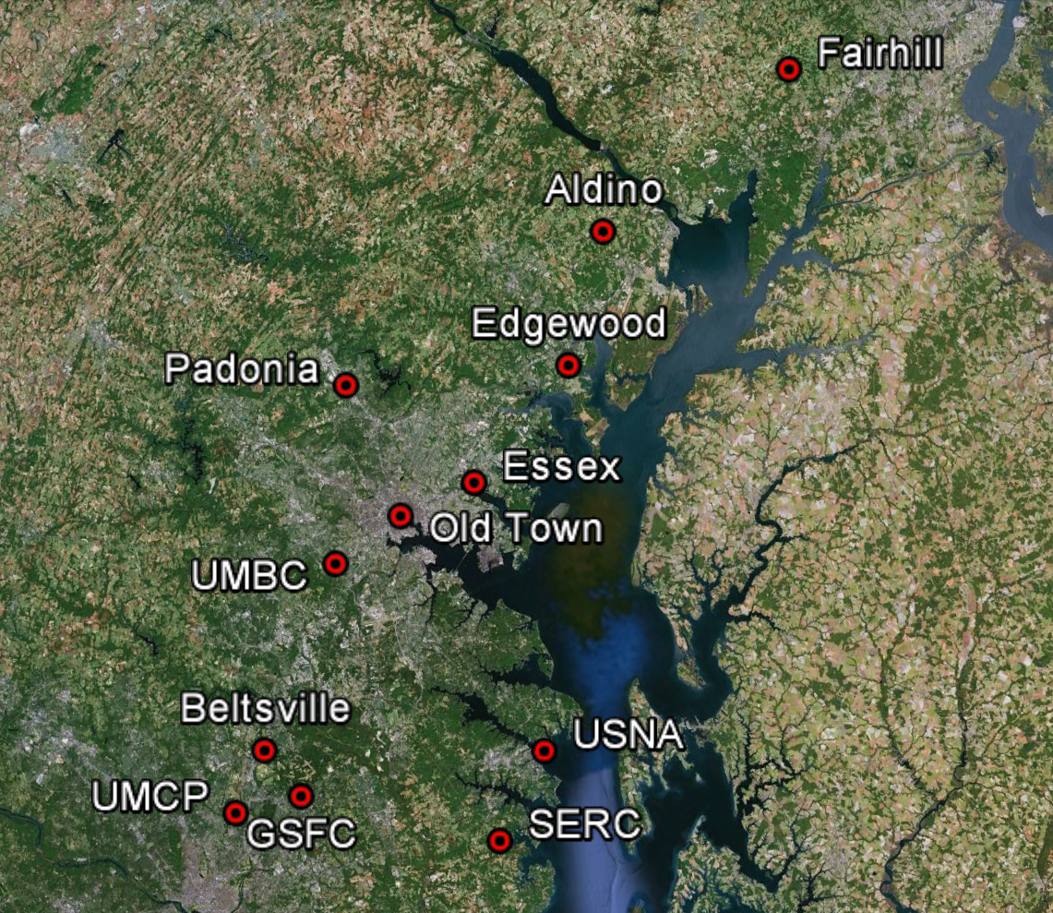
Spatial and temporal variability in TCNO₂ as observed by the Pandora network (circles) and OMI (squares) in the Washington DC/Chesapeake Bay area on July 18, 2011.

Slide 49

Diurnal variability in TCNO₂ as observed by Pandora (circles) and OMI (squares) in the coastal cities Seoul and Busan.

Slide 50
NO₂ variability over Washington DC/ Chesapeake Bay during NASA’s Discover-AQ and CBDOAQ campaigns (July 2011). Different Pandora sites are shown with different color (solid circles), and are grouped from rural (upper panel) to suburban-urban (lower panel). Measurements on Sundays are indicated by the shaded area.

Slide 51

Percent error (or change) in TOA reflectance (4A, 4B) and Rrs (4C, 4D), caused by a change of 1 DU in NO₂. NO₂ was assumed to be homogeneously distributed within a layer from 0 to 2 km (4A, 4C) and 0 to 3 km (4B, 4D). Results are shown here for a look angle of 36º and as a function of solar zenith angle (SZA= 1.5, 12, 30, 42, 60º) and wavelength (350-700 nm). Percent error is expressed as:100*(I_{(NO2 =0 DU)} -I_{(NO2 =1 DU)}) / I_{(NO2=0 DU)} Radiative transfer (RT) simulations were performed using two coupled RT programs, the atmospheric RT code by Ahmad and Fraser (1982) and the Hydrolight underwater RT code by Mobley (1988). Water composition was typical of complex coastal waters, with [chl-a]= 23 μgL⁻¹, [TSS]=20 μgL⁻¹ and a_{CDOM}= 2.1 m⁻¹ at 300 nm. Lw/L_{TOA} was 3% at 410 nm and SZA=30º.

Slide 52
Lw(NIR)

Slide 53
atmospheric correction basics
ρ_{t}(λ) = ρ_{w}(λ) + ρ_{g}(λ) + ρ_{f}(λ) + ρ_{r}(λ) + ρ_{a}(λ)
TOA water glint foam air aerosols
need ρ_{a}(λ) to get ρ_{w}(λ) and vice-versa

Slide 54
atmospheric correction basics
ρ_{t}(λ) = ρ_{w}(λ) + ρ_{g}(λ) + ρ_{f}(λ) + ρ_{r}(λ) + ρ_{a}(λ)
TOA water glint foam air aerosols
need ρ_{a}(λ) to get ρ_{w}(λ) and vice-versa
the “black pixel” assumption (pre-2000):
ρ_{a}(NIR) = ρ_{t}(NIR) - ρ_{g}(NIR) - ρ_{f}(NIR) - ρ_{r}(NIR) - ρ_{w}(NIR)
0

Slide 55
atmospheric correction basics
ρ_{t}(λ) = ρ_{w}(λ) + ρ_{g}(λ) + ρ_{f}(λ) + ρ_{r}(λ) + ρ_{a}(λ)
TOA water glint foam air aerosols
need ρ_{a}(λ) to get ρ_{w}(λ) and vice-versa
the “black pixel” assumption (pre-2000):
ρ_{a}(NIR) = ρ_{t}(NIR) - ρ_{g}(NIR) - ρ_{f}(NIR) - ρ_{r}(NIR) - ρ_{w}(NIR)
calculate aerosol ratios, ε :
ε(748,869)
ε(λ,869)
0
ρ_{a}(748)
≈
ρ_{a}(869)
ρ_{a}(λ)
≈
ε(748,869)
ρ_{a}(869)

Slide 56

atmospheric correction basics

Slide 57

Rrs(NIR) is not always negligible

Slide 58
approaches to account for R_{rs}(NIR) > 0 sr⁻¹
many approaches exist, here are a few examples:
assign aerosols (ε) and/or water contributions (Rrs(NIR))
e.g., Hu et al. 2000, Ruddick et al. 2000
use shortwave infrared bands
e.g., Wang & Shi 2007
correct/model the non-negligible R_{rs}(NIR)
Siegel et al. 2000 used in SeaWiFS Reprocessing 3 (2000)
Stumpf et al. 2003 used in SeaWiFS Reprocessing 4 (2002)
Lavender et al. 2005 MERIS
Bailey et al. 2010 used in SeaWiFS Reprocessing 2010
Wang et al. 2012 GOCI
use a coupled ocean-atmosphere optimization
e.g., Chomko & Gordon 2001, Stamnes et al. 2003, Kuchinke et al. 2009

Slide 59
Turbid Water Atmospheric Correction: ρ_{w}(NIR) ≠ 0
guess
ρ_{w}(670) = 0
model
ρ_{w}(NIR) = func ρ_{w}(670)
model
  1) convert ρ_{w}(670) to b_{b}/(a+b_{b})
  via Morel f/Q and retrieved Chl_{a}
  2) estimate a(670) = a_{w}(670) + a_{pg}(670)
  via NOMAD empirical relationship
  3) estimate b_{bp}(NIR) = b_{bp}(670) (λ/670)^{η}
  via Lee 2010
  4) assume a(NIR) = a_{w}(NIR)
  5) estimate ρ_{w}(NIR) from b_{b}/(a+b_{b})
  via Morel f/Q and retrieved Chl_{a}
correct
ρ'_{a}(NIR) = ρ_{a}(NIR) – t ρ_{w}(NIR)
retrieve
ρ^{i}_{w}(670)
test
|ρ_{w}^{i+1} (NIR) - ρ^{i}_{w}(NIR)|
< 2%
no
done

Slide 60
BRDF

Slide 61
Correcting BRDF with an IOP-centered system
θ_{S}
θ_{v}
L_{w}(Ω)
φ
water
Fact: For the same water body, water-leaving radiance changes with solar and sensor-viewing angles.
Objective: To correct this angular effect in order to make measurements comparable.

Slide 62
R_{rs}(Ω)
G(Ω)
{a&b_{b}}
G(0)
[R_{rs}]_{N}
Traditional approach is based on empirically derived Chl, then various uncertainties/bias are introduced.
With the newly developed IOP-centered system, the correction removes such biases.
The figure shows data flow.

Slide 63
Blue water case
Green water case
a(440) = 0.025 m⁻¹
Z_{eu} = 108 m
a(440) = 0.9 m⁻¹
Z_{eu} = 7.2 m
Rrs [sr⁻¹]
Rrs [sr⁻¹]
Wavelength [nm]
Wavelength [nm]
Two “extreme” waters (one blue, left, one green, right) to test the IOP-centered system.
The Chl-based system is not applicable to the green water.

Slide 64
φ = 90º
Blue water case
φ = 90º
412 nm, θ_{v} = 60º
550 nm, θ_{v} = 60º
φ = 180º
φ = 0º
φ = 180º
φ = 0º
L_{w}/L_{w}(0º) from R_{rs}
L_{w}/L_{w}(0º) from R_{rs}
412 nm
550 nm
L_{w}/L_{w}(0º) from NuRADs
L_{w}/L_{w}(0º) from NuRADs
Comparison of measured and Rrs-derived angular variation of water-leaving radiance of the blue water.
Top panel: Radius plot for a 60º view angle; bottom panel: scatter plot of all remote-sensing angles.

Slide 65
φ = 90º
Green water case
φ = 90º
440 nm, θ_{v} = 30º
550 nm, θ_{v} = 60º
φ = 180º
φ = 0º
φ = 180º
φ = 0º
Self-shadow
Self-shadow
L_{w}/L_{w}(0º) from R_{rs}
L_{w}/L_{w}(0º) from R_{rs}
440 nm
550 nm
L_{w}/L_{w}(0º) from NuRADs
L_{w}/L_{w}(0º) from NuRADs
Comparison of measured and Rrs-derived angular variation of water-leaving radiance of the green water.
Top panel: Radius plot for a 30º and 60º view angle; bottom panel: scatter plot of all remote-sensing angles. The grey points indicating the observations that under self-shading.

Slide 66
notes
How accurate do we need to know NO2 (diurnal variability)
Effect of BRDF (geometry, case 2)
Ozone (geometry, diurnal variability, 50DU=30%Chl)
Absorbing aerosols (aerosol height, type via transport models)
Rrs(UV) challenge

