Slide 1
TEMPO Requirement and Predicted Trace Gas Retrieval Performance
Xiong Liu¹, Kelly Chance¹, Brian Baker²
Dave Flittner³, Jay Al-Saadi³
Christopher Miller⁴, Rob Spurr⁵
TEMPO Team
¹ SAO ² BATC ³ NASA LaRC
⁴Harvard Univ. ⁵RT Solution Inc.
GEO-CAPE Team Meeting
May 21, 2013
TEMPO: It’s about time!

Slide 2
Outline
Introduction
Initial Determination of TEMPO SNR Requirement
Refinement of TEMPO SNR Requirement
Summary

Slide 3
Introduction
Spatial resolution: better than 8×4.5 km² over the center of the domain.
Flow down from TEMPO STM baseline measurement requirements to instrument requirements.
TEMPO STM is mostly taken from GEO-CAPE STM with some modifications.
Aerosol requirement mainly drives spatial resolution.

Slide 4
Initial Determination of SNR Requirements
Molecule | O₃ | SO₂ | NO₂ | H₂CHO | C₂H₂O₂
Fit Windows (nm) | 290-345 540-650 | 305-330 | 423-451 | 327-356 | 433-465
Use 1 “tough” atmospheric profile under highly ideal conditions
GSFC NY12 from K. Pickering in July
Surface albedo: 0.03 at all wavelengths
Clear-sky, no aerosols
Define worst viewing scenarios (different for different trace gases)
O₃, SO₂: SZA 50°, VZA 66.2° (Northwest Corner, 130°W, 50°N)
NO₂: SZA 70°, VZA 17.6° (95°W, 15°N)
H₂CO, C₂H₂O₂: SZA 50°, VZA 17.6° (95°W, 15°N)
Perform high-resolution calculation of radiances and weighting functions with VLIDORT: can be convolved to various spectral resolution and sampled at different spectral intervals.

Slide 5
Initial Determination of SNR Requirements
Estimate retrieval errors using the optimal estimation (accounting for other interferences but ignoring spectroscopic errors) vs. SNR & spectral resolution
Measurement: spectral resolution, spectral interval
Parameter: possible gases, Ring, surface albedo (up to 4th order)
Retrieval errors: use solution errors (smoothing + precision).
A priori error: climatological for O₃ profile but almost unconstrained for VCD
Measurement error (assumed or from instrument SNR model) → Iterative
Pre instrument configuration:
Need to vary different SNRs to determine the SNR requirement
SNR only includes shot noise, proportional to square root of radiance
Can be defined at a fixed radiance level (e.g., 6.4E12 photons/s/cm²/ nm/sr) and actual SNR at different wavelengths can be scaled accordingly.
Known instrument design (e.g., integration, co-adding, spatial resolution, spectral resolution and spectral samples)
Calculated according to instrument SNR model and actual radiance
Account for optical efficiency, include noises due to read-out, quantization, dark current, smearing, charge transfer efficiency
Cannot be defined with respect to a fixed radiance level

Slide 6
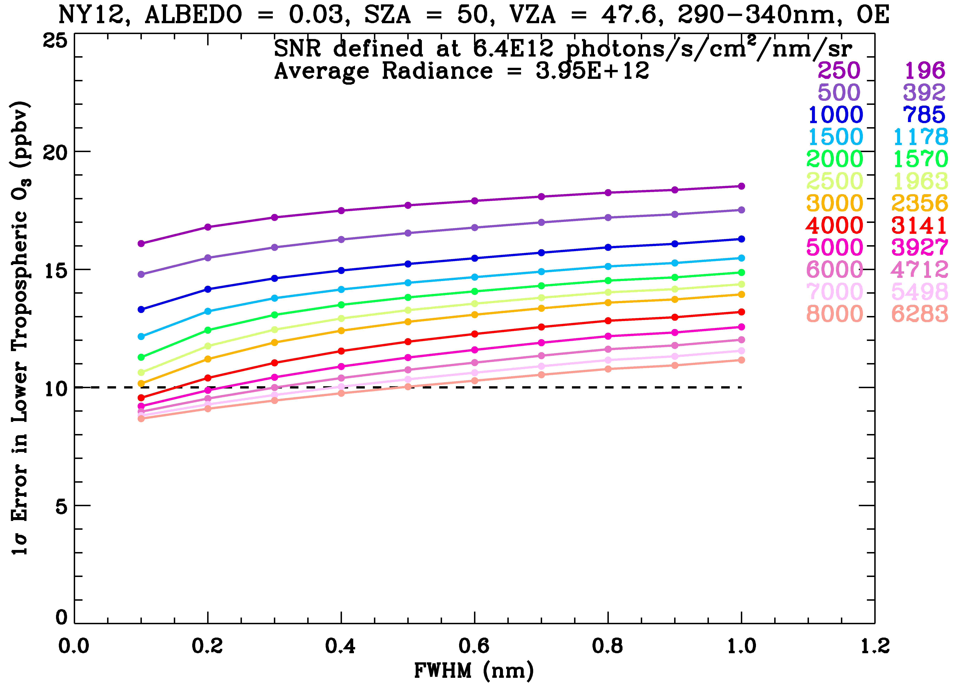
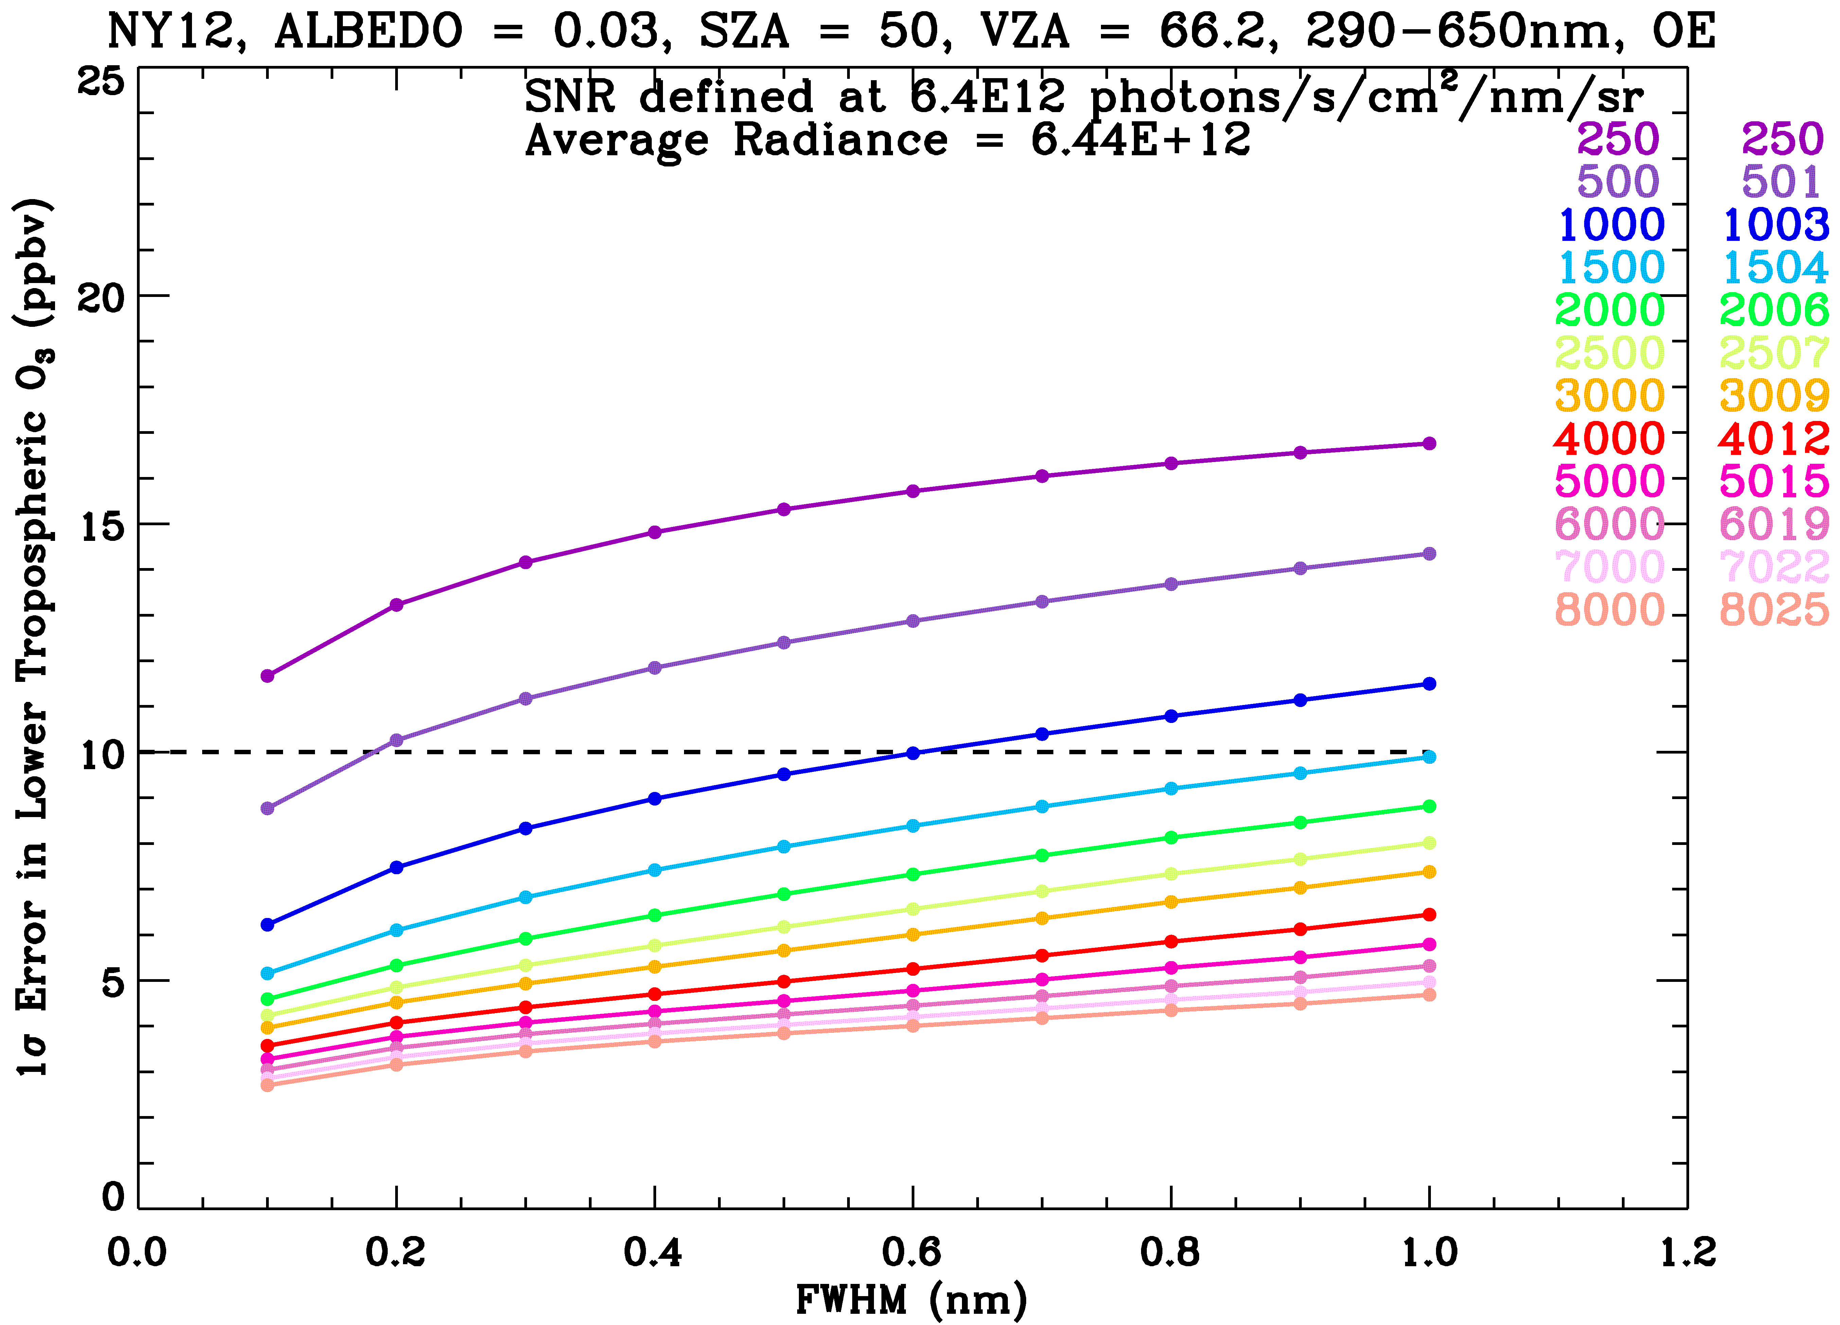
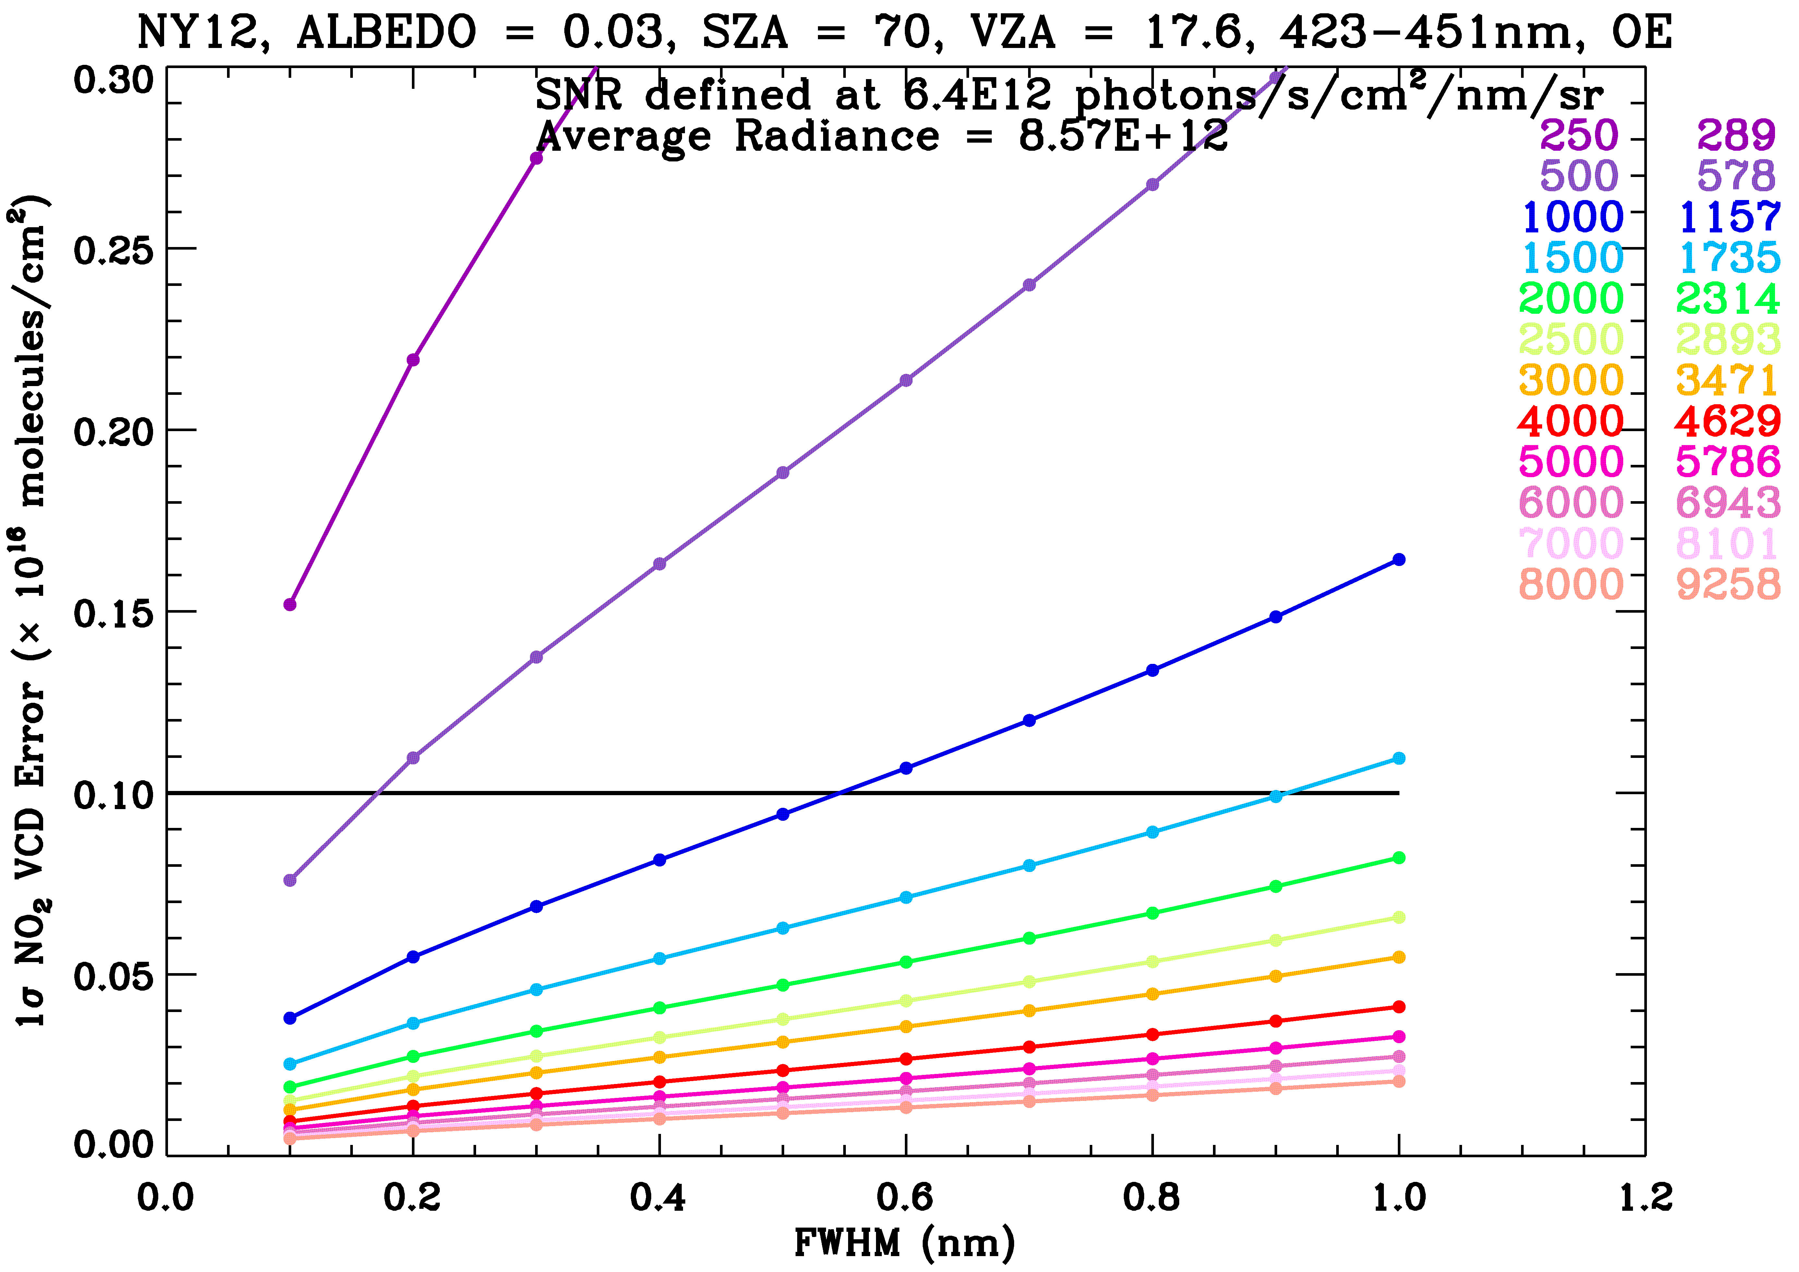
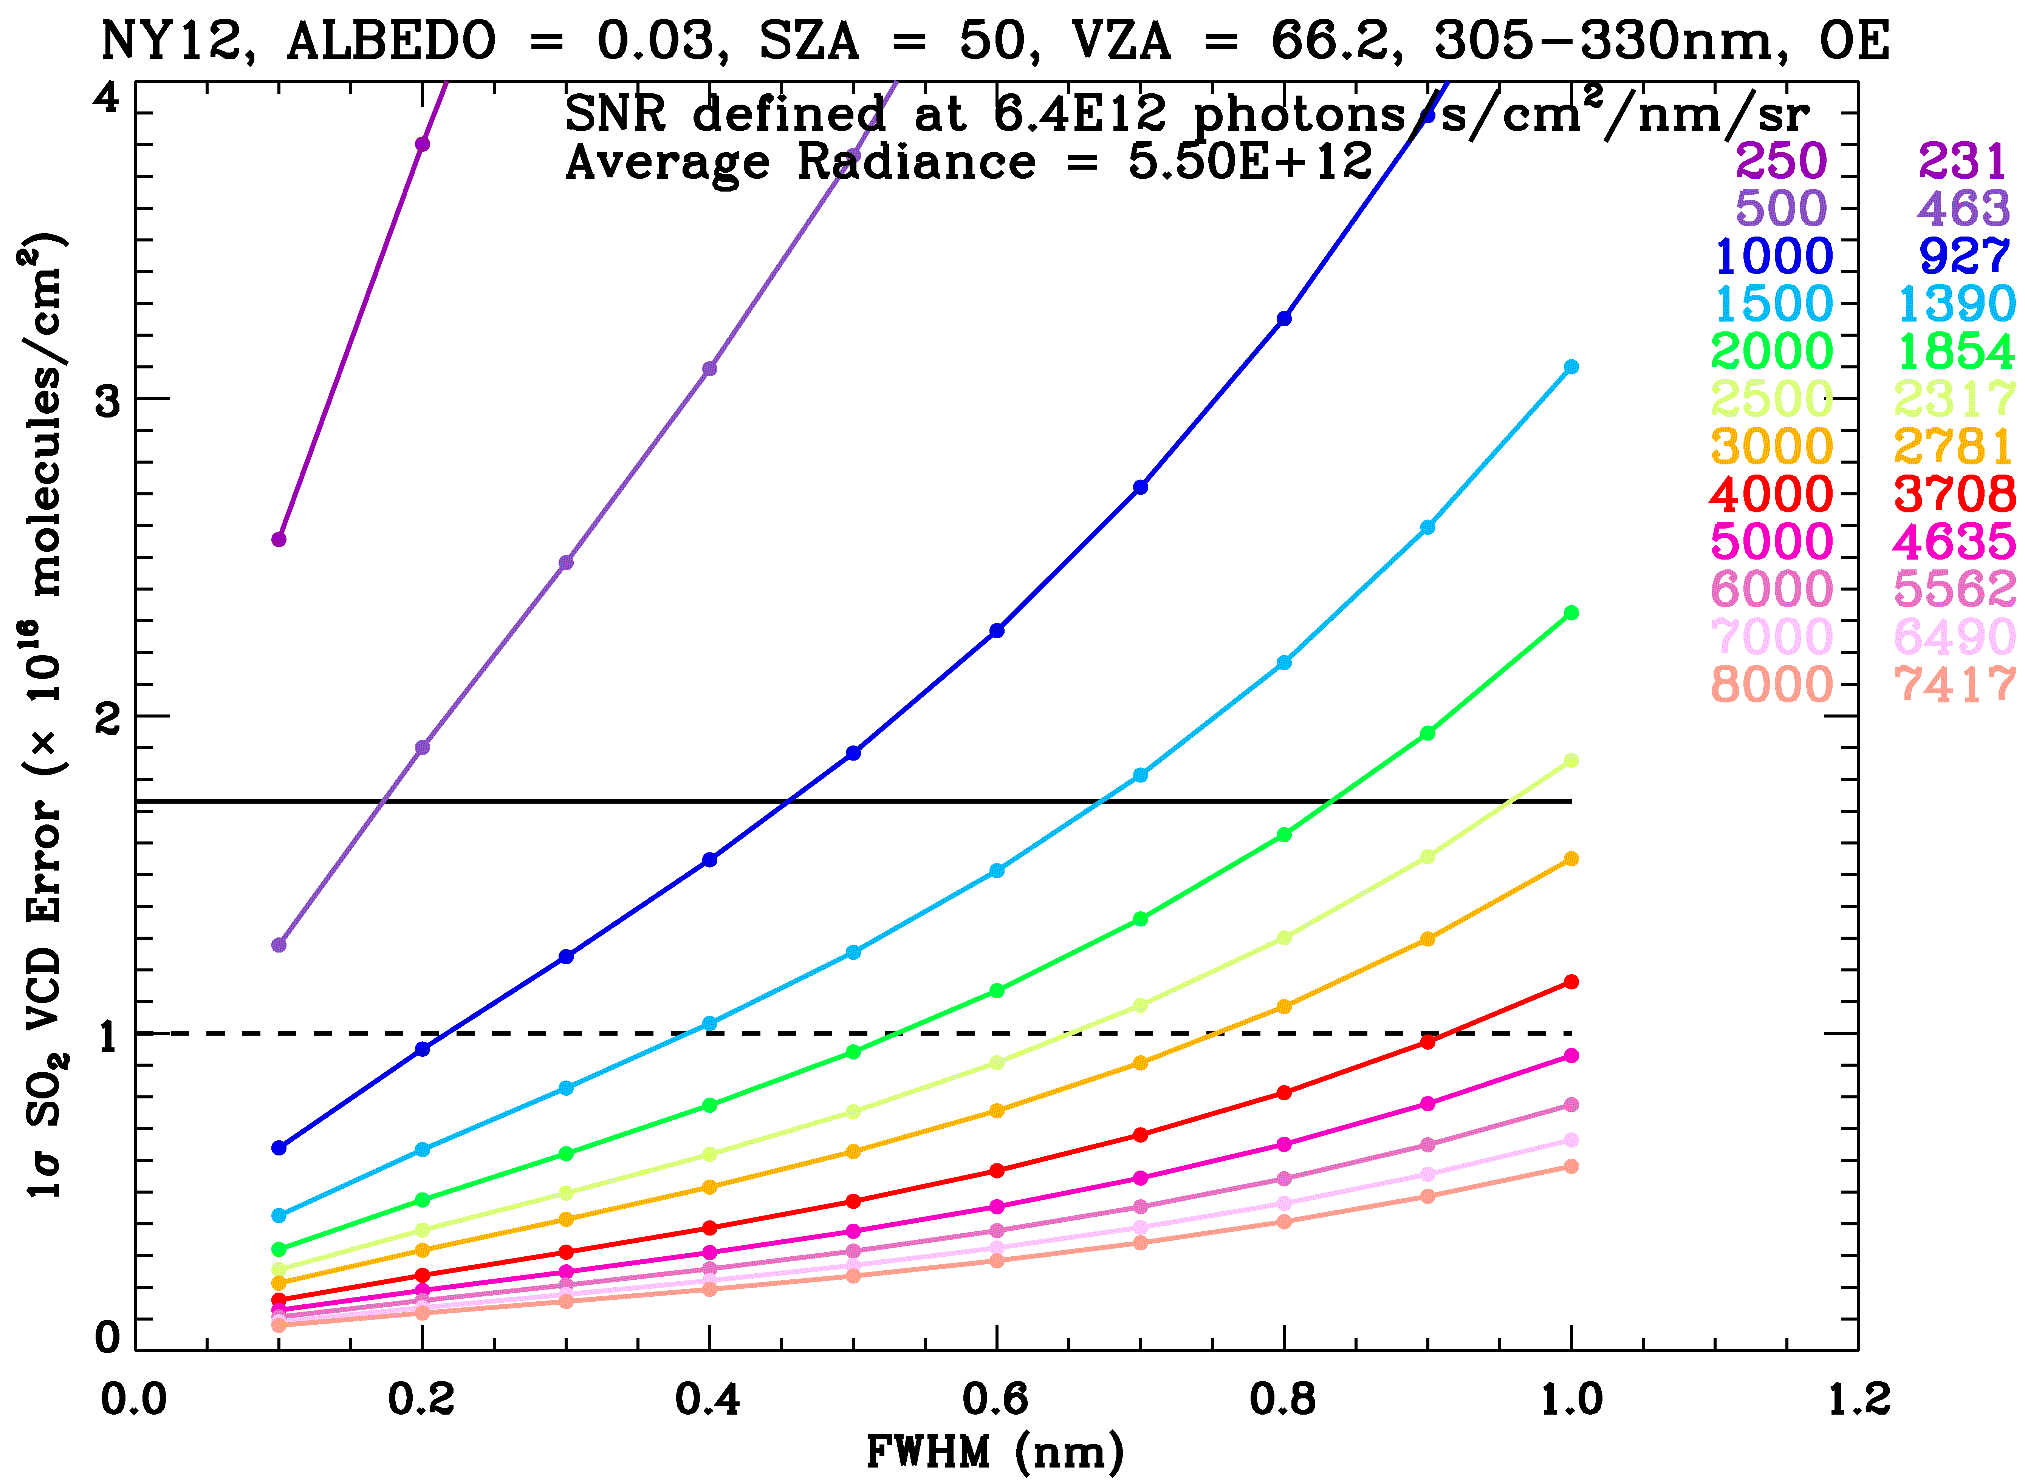
Initial Determination of SNR Requirements
0-2 km O₃, UV
0-2 km O₃, UV+Vis
NO₂
SO₂

Slide 7
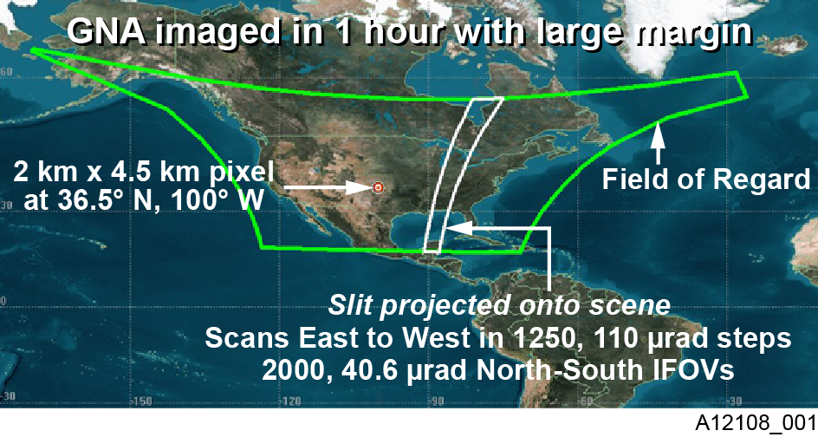
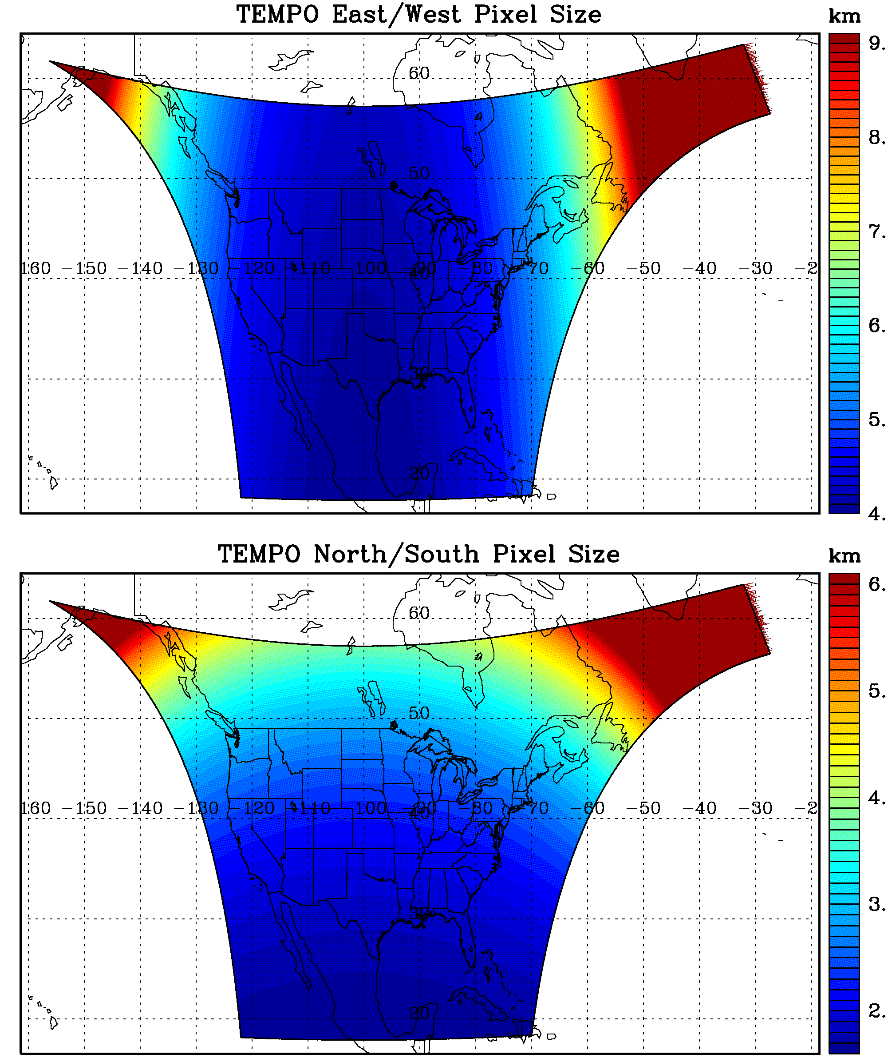
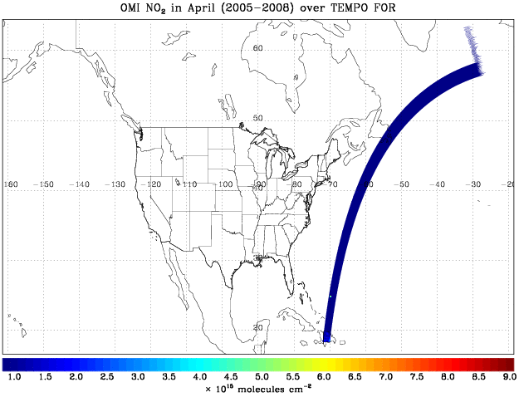
TEMPO Initial Design
Each pixel is a 2K element spectrum from ~290-690 nm (or ~290-490 nm, 530-750 nm) at ~0.6 nm FWHM

Slide 8
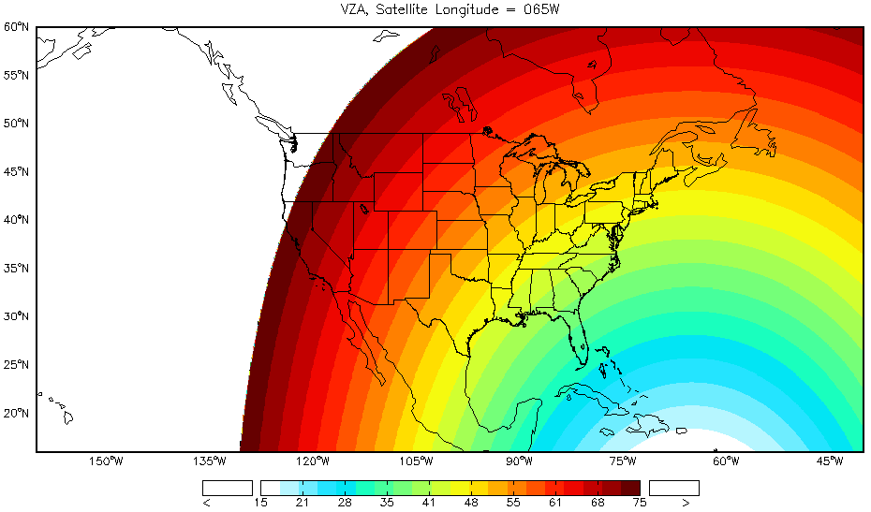
TEMPO Longitudinal Range
VZA change from satellite sitting from 65°W to 137°W
Large VZA to a certain extent can increase SNR and sensitivity for most spectral regions and gases except for O₃ and SO₂ retrievals using shorter UV
Acceptable longitude range: 85ºW-115ºW, and may be extendable if sacrificing some sensitivity and pixel size over corner regions

Slide 9
Refinement of Instrument SNR Requirements
Caveats in Initial Methodology
1 “tough” atmospheric profile, ideal conditions, “worst” viewing scenarios
Cannot address how trace gas retrieval performance varies with SZA, space, time, cloudiness, aerosol loading, terrain height, and so on
Input Refinement:
Hourly fields of GEOS-Chem model fields over TEMPO field of regard for 12 days (1 day/month) up to SZA 80° → ~90000 simulations
6 gases (O₃, NO₂, H₂CO, SO₂, C₂H₂O₂, H₂O), BrO, OClO, O₂, O₄
6 types of aerosols, water/ice clouds, pixel independent approximation
Kolemejier GOME surface albedo database with linear interpolation
Actual viewing geometry for a geostationary satellite at 100° W
RTM Calculation and Sensitivity Calculation
270-800 nm at 0.6 nm FWHM, every 0.2 nm
Include additional weighting functions wrt AOD, ASSA, COD, cloud fraction
State vector includes AOD, ASSA, COD, cloud fraction additionally
SNR model from initial design
Calculate errors due to 10 parameters (i.e., various radiance errors, polarization sensitivity, surface albedo, cloud and aerosol parameters, surface pressure)

Slide 10
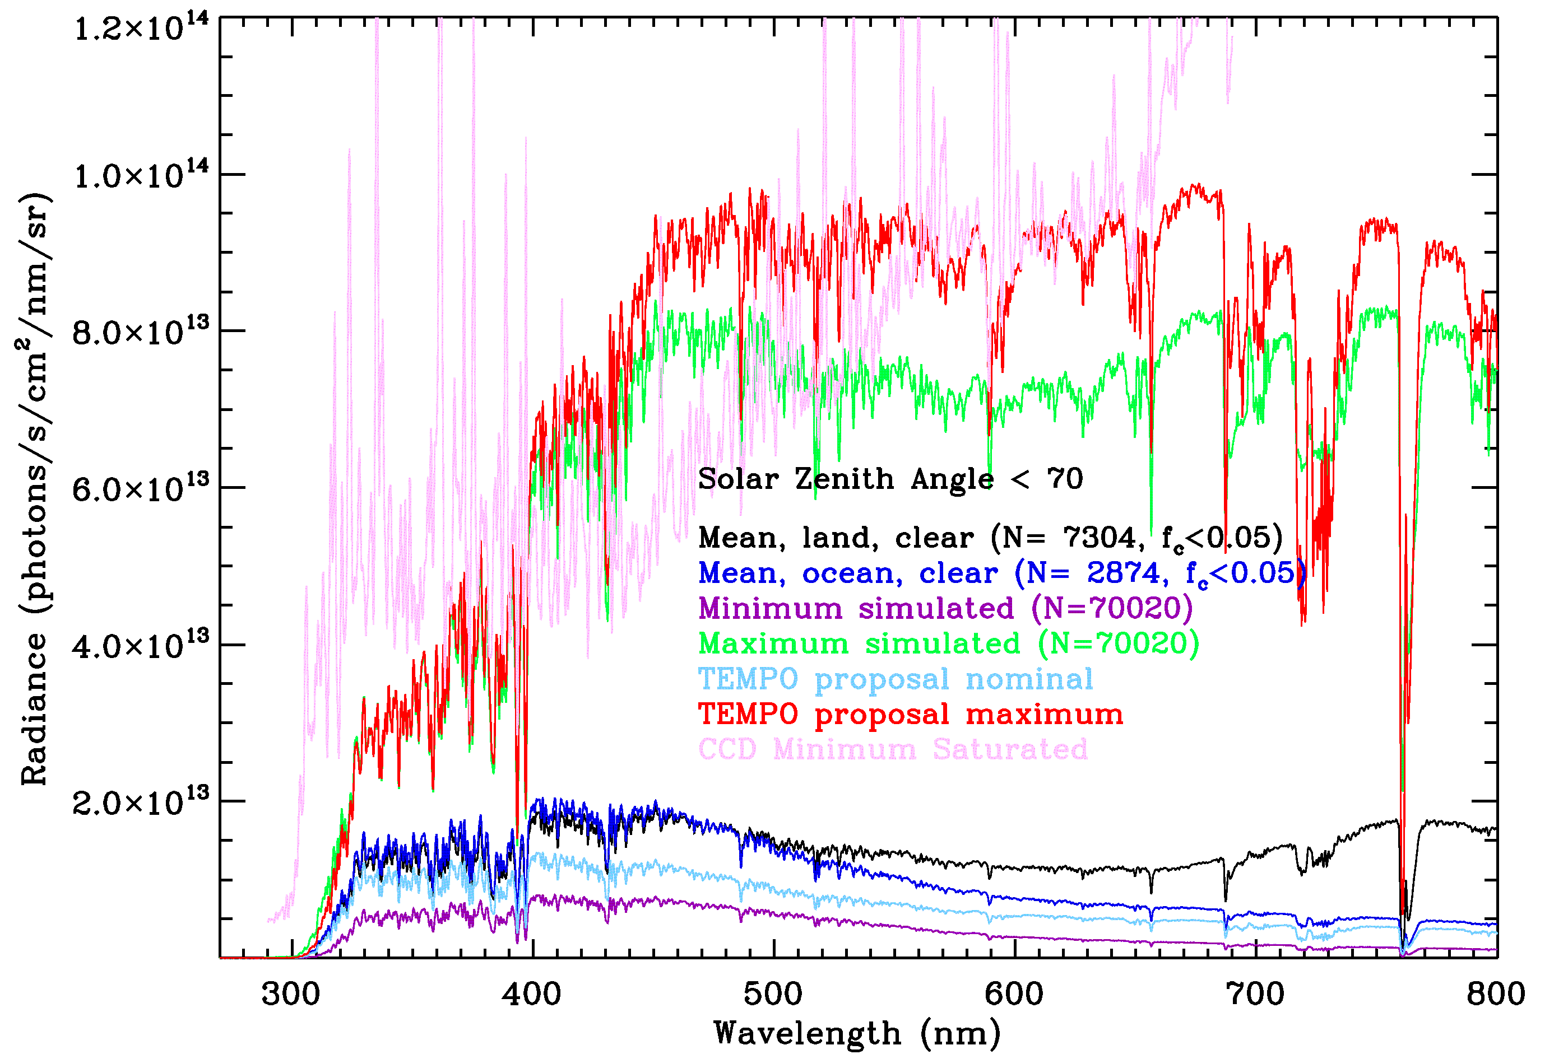
Determination of Nominal and Maximal Radiances
Nominal and maximum radiances are often needed for instrument design to determine the radiance and saturation level
Previously, nominal (clear-sky, 0.03 albedo), maximum (0.8 surface albedo)
Currently, nominal (mean land clear), maximum (maximum at each wavelength of all simulations)

Slide 11
Trace Gas Retrieval Performance
UV
UV+Vis.

Slide 12
Trace Gas Retrieval Performance
NO₂
H₂CO
SO₂
C₂H₂O₂

Slide 13
Trace Gas Retrieval Performance (Cloud fraction < 0.1)

Slide 14
Redefine The Requirements
Since not every retrieval can meet the requirement, “requirement met” is redefined using a threshold: e.g., 90%, 95%
Adjust SNR so that threshold retrieval errors increase to the requirement
The adjusted SNR is the required SNR
Using 90% as threshold

Slide 15
Redefine The Requirements
Using 95% as threshold
The refinement of TEMPO SNR requirement is on going and iterative
Understand retrievals with large errors
Understand retrieval variability with different parameters
Working with Ball to reduce dark current and readout noises and perform cost/performance trade studies

Slide 16
Summary
Efficiently and successfully defined the TEMPO SNR instrument requirement on first order using a simplified methodology
Developed an improved methodology to refine instrument SNR requirement and understand the retrieval variability for different conditions.
On-going and iterative refinement of TEMPO SNR requirement.
Acknowledgement
Funding from NASA on the TEMPO Project
TEMPO Science Team
GEO-CAPE Science Team

