Slide 1



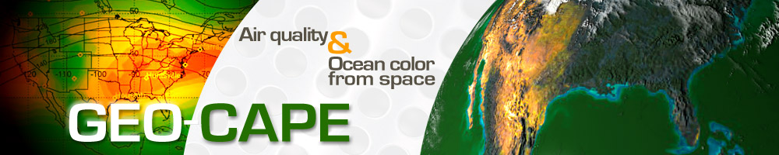
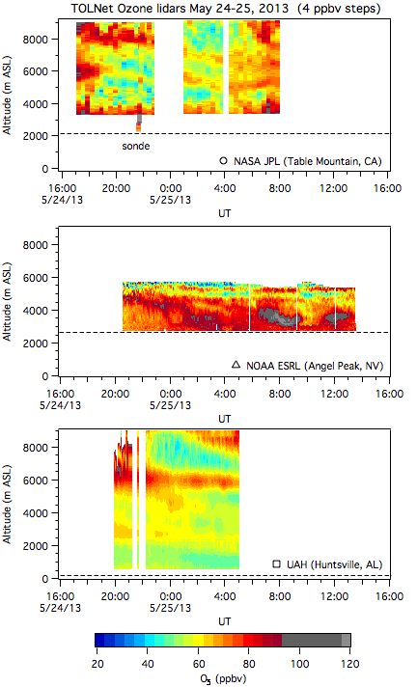
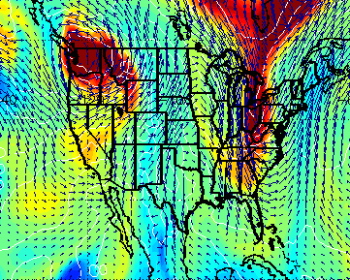
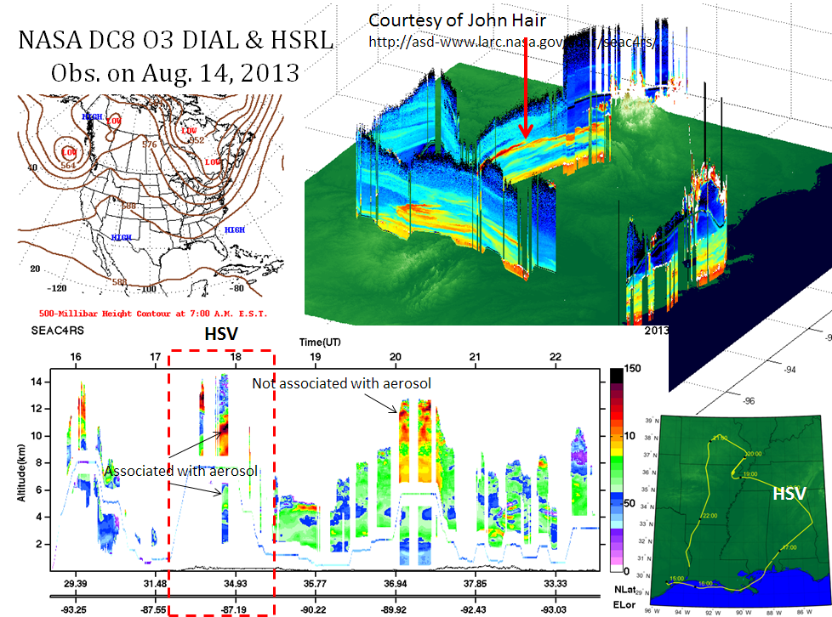
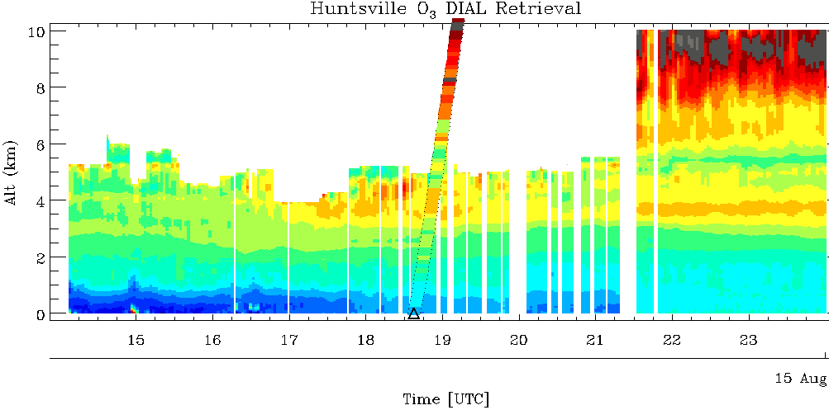
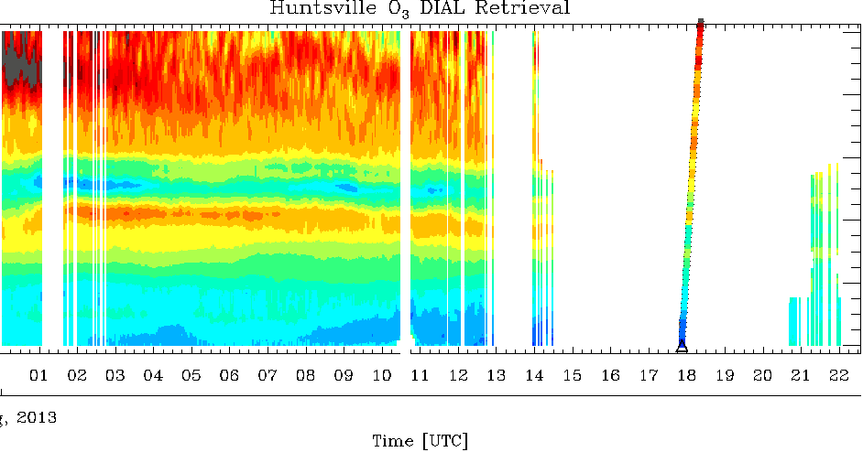

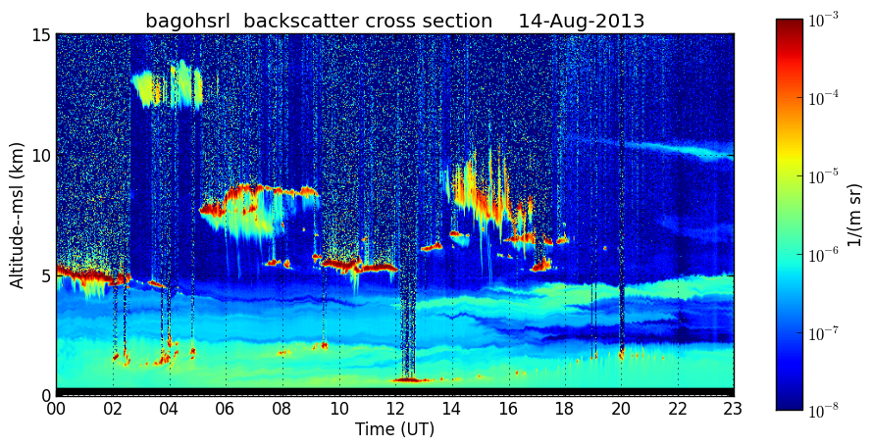
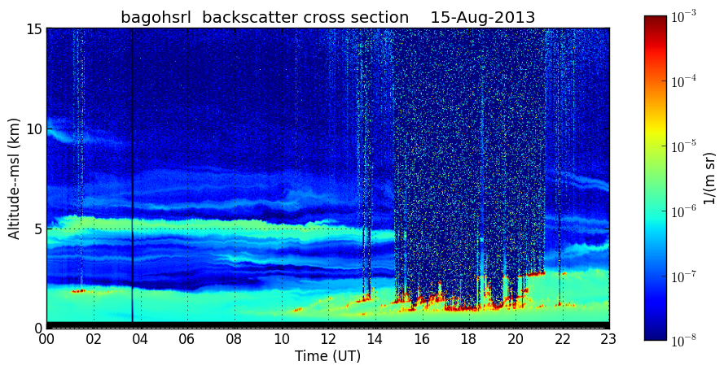
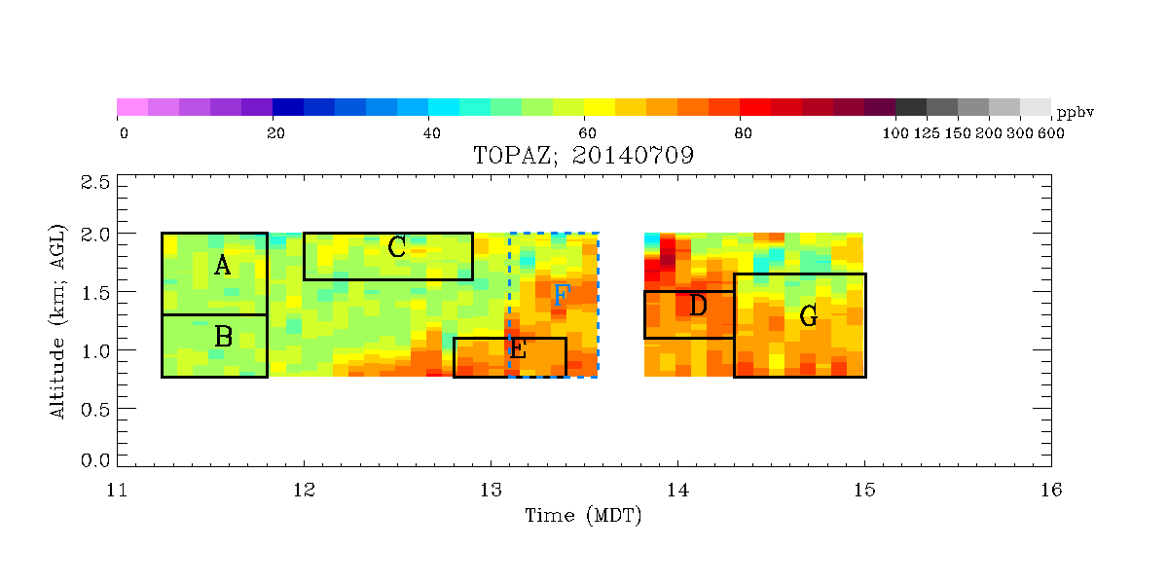
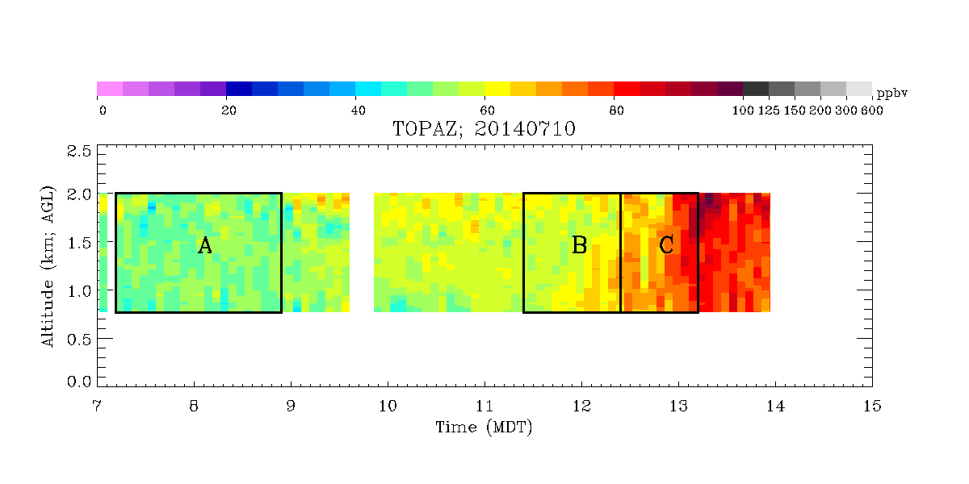
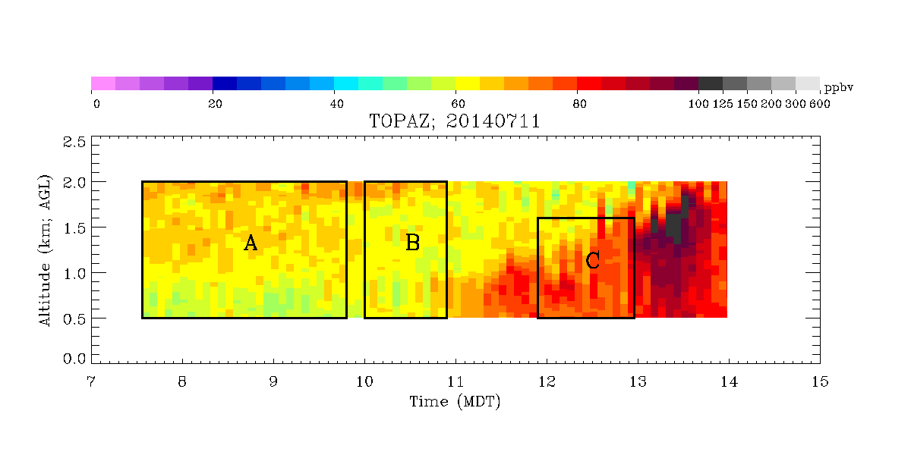
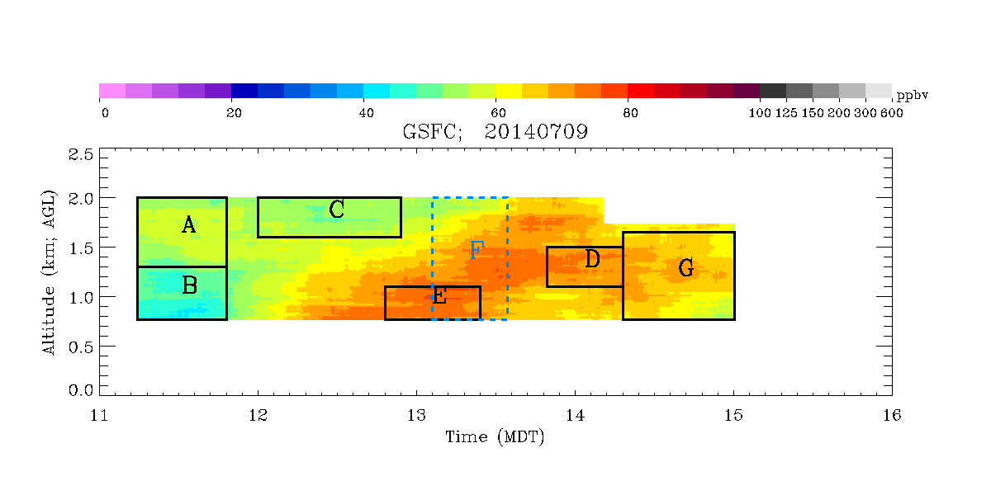
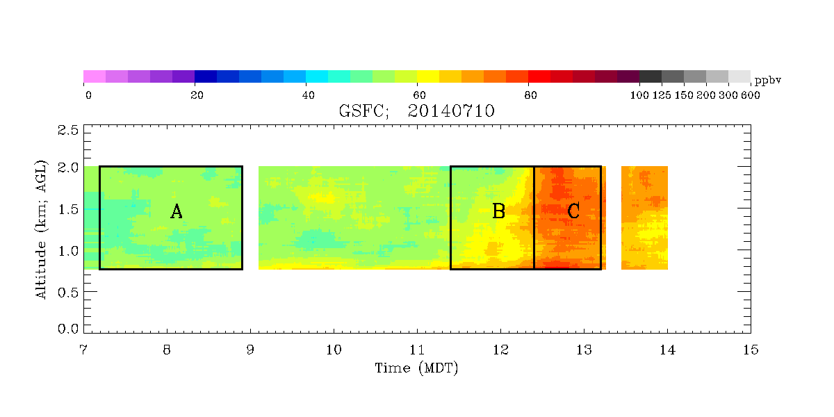
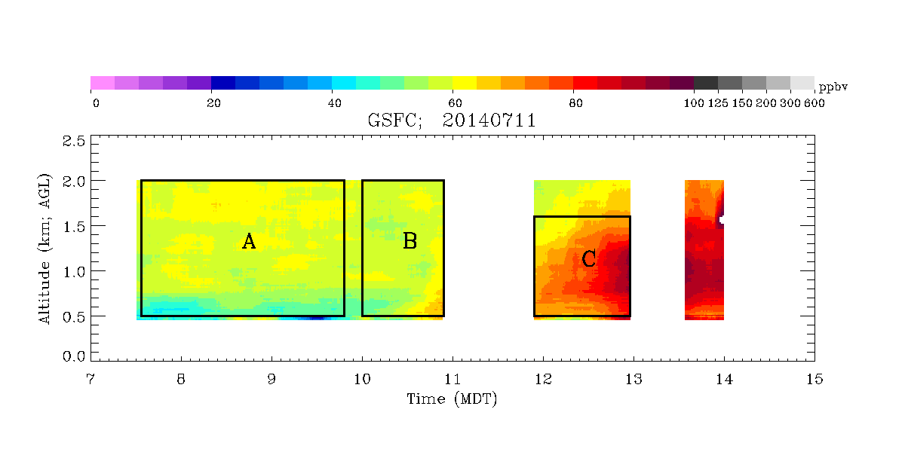
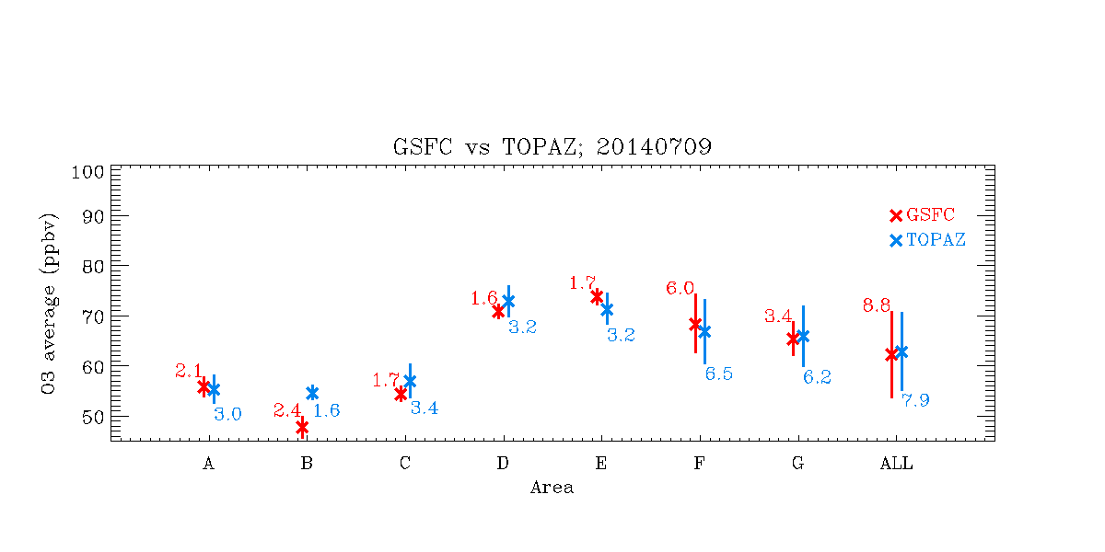
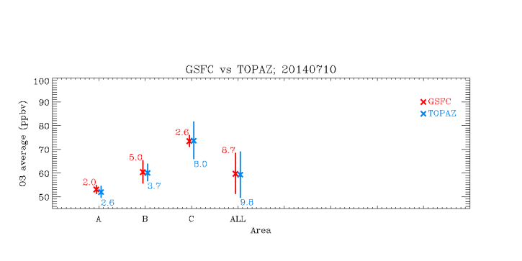
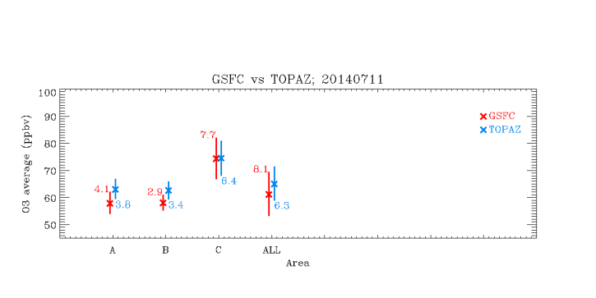
TOLNet – A Tropospheric Ozone Lidar Profiling Network for Satellite Validation and Process Studies
Michael J. Newchurch^{1*}, Shi Kuang¹, Lihua Wang¹, Thierry Leblanc², Raul J. Alvarez II³, Andrew O. Langford³, Christoph J. Senff^{3,4}, Steve Brown³, Bryan Johnson³, John F. Burris⁵, Thomas J. McGee⁵, John T. Sullivan^{5,6}, Russell J. DeYoung⁷, Johnathan Hair⁷, Jassim Al-Saadi⁷, Gao Chen⁷, Matthew Johnson⁸, Barry Lefer⁹, Brad Pierce¹⁰, Edwin Eloranta¹⁰
2015 GEO-CAPE Workshop
¹UAH, ²Caltech/JPL, ³NOAA/ESRL, ⁴CU, ⁵NASA/GSFC, ⁶ORAU, ⁷NASA/LaRC , ⁸NASA/ARC, ⁹NASA/HD, ¹⁰UW
Introduction
Measurements
NASA initiated an interagency ozone lidar observation network under the name TOLNet to promote cooperative multiple-station ozone-lidar observations to provide highly time-resolved (few minutes) tropospheric-ozone vertical profiles useful for air-quality studies, model evaluation, and satellite validation.
Motivation:
Prepare to make best use of next-generation satellite tropospheric ozone observations by advancing the understanding of following processes:
Synoptic processes such as STE, long-range pollution transport, and large-scale stagnation [timescale: days to several hours].
Mesoscale processes such as diurnal land/water boundary cycles, low-level jets, and orographic venting [timescale: hours].
Local scale processes including exchange between the boundary layer and the free troposphere, episodic precursor emissions, and convection [timescale: sub-hourly].
Objectives:
Provide coordinated high-resolution measurements of tropospheric ozone for air-quality/chemical/transport model improvement and satellite retrieval validation.
Exploit synergies with EVS-1 DISCOVER-AQ, EVI-1 TEMPO, GEO-CAPE studies, and existing routine observations to advance understanding of processes controlling regional air quality and chemistry.
Develop recommendations for lowering the cost and improving the robustness of ozone lidar systems.
310K (≈2 to 4 km ASL)
TMF
(Leblanc)
ESRL (Senff & Langford)
May 24, 2013 12UT RAQMS 310-K ozone
Brad Pierce (NOAA/NESDIS)
Figure 2. Multiple-station measurements of two stratospheric intrusions on May 24, 2013. (note the ESRL observation was made at Las Vegas.)
UAH
(Newchurch &
Kuang)
LaRC DIAL & HSRL
Due to smoke
Stations
UAH O3 Lidar
Due to smoke
Table 1. Summary of the TOLNet lidars.
Name | JPL TMO (Table Mountain tropospheric Ozone) DIAL | TOPAZ (Tunable Optical Profiler for Aerosol and oZone) lidar | RO₃QET (Rocket-city O3 Quality Evaluation in theTroposphere) lidar | GSFC TROPOZ (TROPospheric OZone) DIAL | LMOL (Langley Mobile Ozone Lidar)
Affiliation | NASA/JPL | NOAA/ESRL | UAH | NASA/GSFC | NASA/LaRC
Host location | Wrightwood, CA | Boulder, CO | Huntsville, AL | Greenbelt, MD | Hampton, VA
Set-up | Fixed-location | Mobile | Fixed-location | Mobile | Mobile
Transmitter type | Quadruple Nd:YAG pumped Raman laser | Quadruple Nd:YLF pumped Ce:LiCAF laser (tunable wavelength) | Quadruple Nd:YAG pumped Raman laser | Quadruple Nd:YAG pumped Raman laser | Quadruple Nd:YLF pumped Ce:LiCAF laser (tunable wavelength)
Wavelength (nm) | 289, 299 | Typically 287, 291, 294 | 283, 289, 299 | 289, 299 | Typically 285, 291 (527 for aerosol)
Receiver size (cm) | 91, 5, 5 | 50 | 40, 10, 2.5 | 41, 2.5, 2.5 | 40
Measurable range (km AGL) | 0.1-23 | 0-3 | 0.1-12 | 0.2-12 (day) 0.2-19 (night) | 0.1-4
Ozonesonde
Figure 3. Ozone enhancement associated with smoke transport measured by the ozone DIAL and HSRL on August 14, 2013.
UW-HSRL
Data Accuracy Assessment
Mean and 1-sigma
Mean and 1-sigma
Mean and 1-sigma
Measurements
NOAA/ESRL TOPAZ sample size = 30967
mean = 62.6 ppbv
std dev = 8.4 ppbv =13%
NASA/GSFC TROPOZ sample size = 158203
mean = 60.9 ppbv
std dev = 8.5 ppbv = 14%
Diff. of mean = 3%
Diff. of std dev = 1%
Figure 1. The effect of transport and mixing processes on the relationship between column and surface ozone observed with lidar during Discover-AQ/FRAPPE. In 66% of all cases observed at BAO, 1500 m AGL O₃ column and surface values agree within 10 ppbv, almost exclusively occurred after midday LT. For the remaining observations (34%), column O₃ mostly exceeds the surface values.
Figure4. TOLNet lidar intercomparison during DISCOVER-AQ campaign at BAO in July 2014.
Summary and Conclusions
A main objective of TOLNet is to provide high-resolution lidar data at multiple stations to modeling and satellite teams for validating and improving the fidelity of tropospheric ozone measurements by NASA’s next-generation geostationary instruments.
TOLNet lidars agree with ozonesonde free flights and tether flights, with CRDS on the BAO carriage, and with each other to within ~ 10% over a wide variety of conditions.
The TOLNet data are accessible at
http://www-air.larc.nasa.gov/missions/TOLNet/.
Senff et al.
http://nsstc.uah.edu/atmchem mike@nsstc.uah.edu Aug. 30-Sep. 2, 2015, Research Triangle Park, NC

