Slide 1
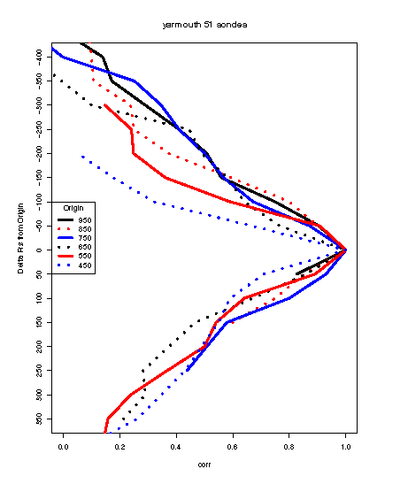
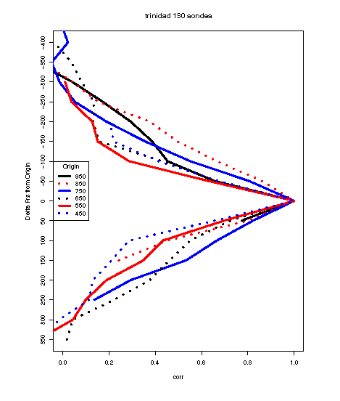
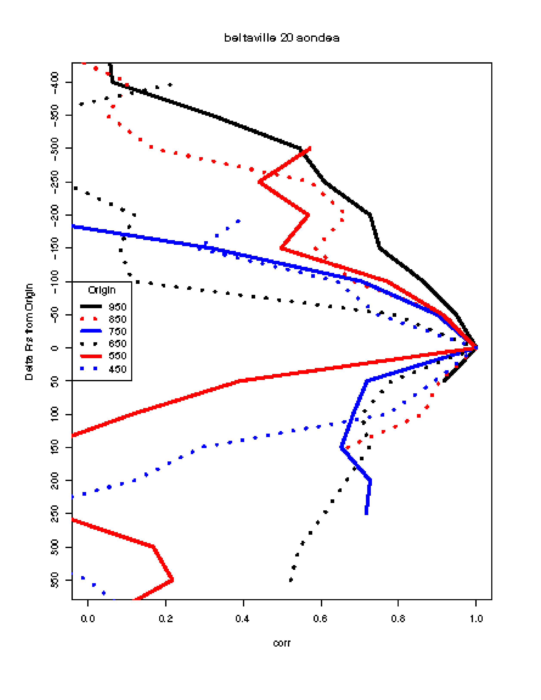
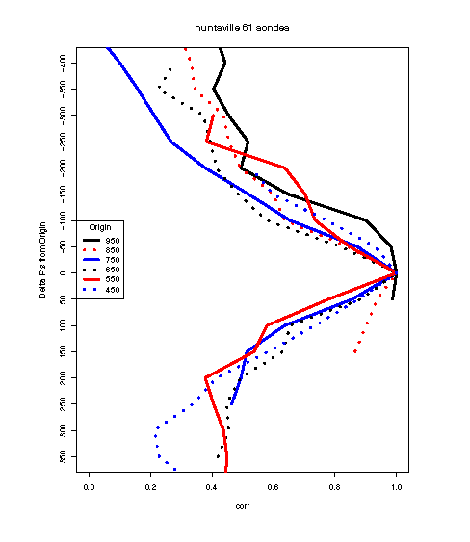
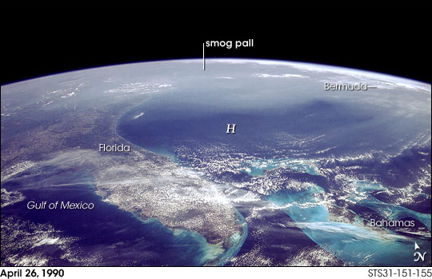
Systematic Vertical Correlation of O₃ and Optimal Estimation Provide Remarkably Accurate Methods for “Near-Surface” Ozone — Two Related Methodologies
Beltsville, MD
Eastern US
Yarmouth, NS
NE Atlantic Coast
Trinidad Head, CA
Pacific Coast
Huntsville, AL
Interior Southeast
Robert B Chatfield (NASA Ames), Xiong Liu (Harvard Smithsonian), Robert F Esswein (NASA Ames/BAER)
and the GEO-CAPE “Sensitivity” and “Variability” science definition teams
GEO-CAPE Workshop, 12 May 2011

Slide 2
Outline
“Near-surface” ozone: ignore surface variations irrelevant to ozone load for the day
Layering of lower tropospheric ozone…discouraging
Layer average ozone -> Surface estimation encouraging
Optimal Estimation: Vert. Resolution well described; Accuracy needs detailed work
Grounds for optimism in characterizing near-surface ozone — what are “exceptional events”?
“Just the Physics” vs our expectations for best estimation of accuracy — region by region..

Slide 3
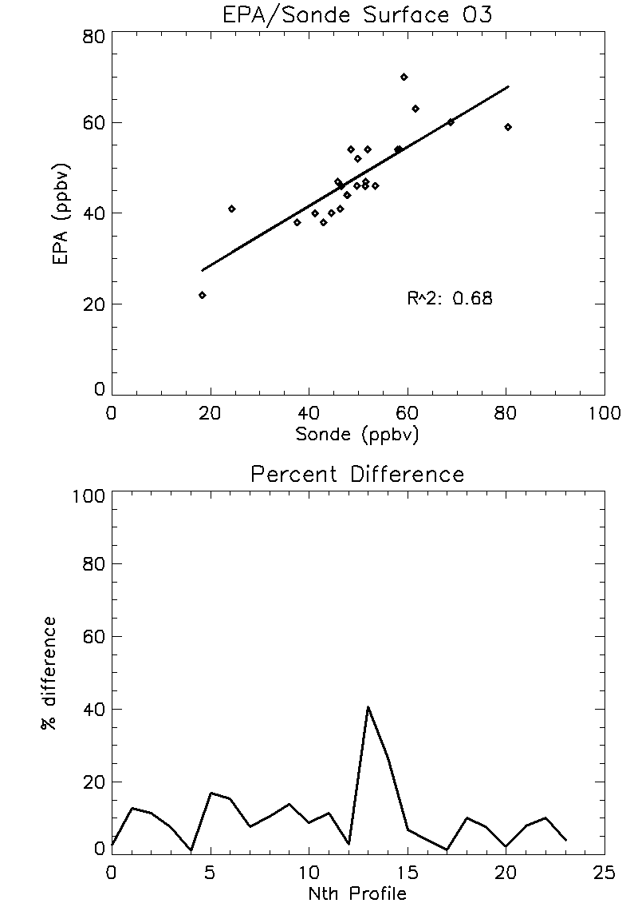
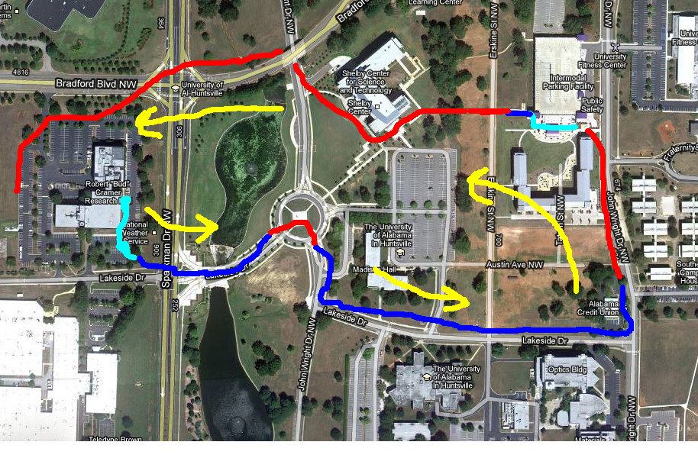
Horizontal Variability
Mike Newchurch
slide
Surface ozone of 24 sonde profiles compared with local EPA site: The variance in the surface ozone amounts at the ozonesonde/lidar site seen in the EPA HSV-Airport Rd. site (~10 km distant; Summer 2010) is about 75%. The other 25% is the HORIZONTAL variance.
UAHuntsville Campus Ozone
Measured with ozonesonde
1/28/2011
June 19
Inside
18-25 25-30 30-35 ppbv
Percent difference reaches ~30% for measurements away from buildings.

Slide 4
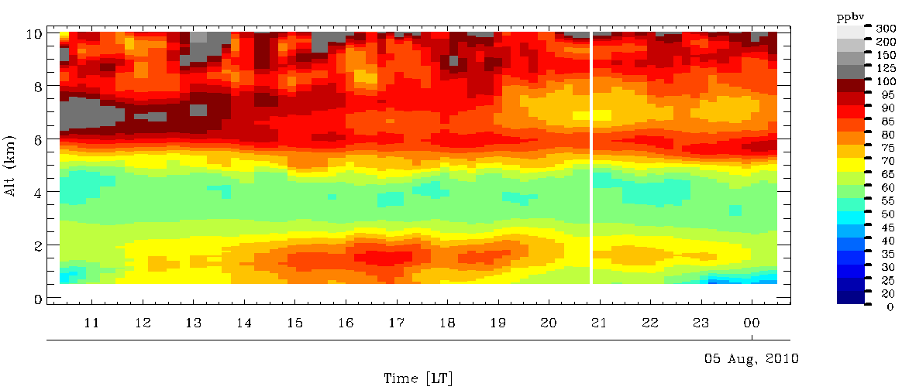
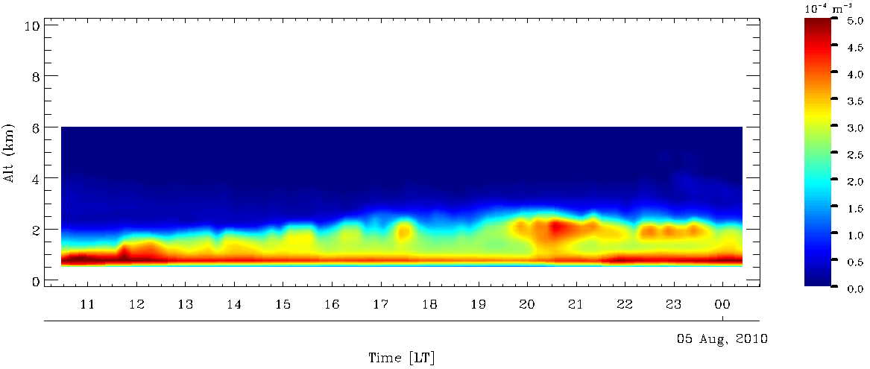
Different variation structures for ozone and aerosol suggest local photochemistry dominates the production
Ozone mixing ratio, August 4, 2010
O3 diurnal variation
Mike Newchurch
slide
Aerosol ext. coeff. at 291nm from O3 DIAL
The rapid aerosol variation in the PBL suggests the importance of a collocated aerosol measurement.
Notes:
Kuang: This slide is to demonstrate the aerosol is not necessarily correlated with ozone depending on their sources. I suggest using the previous one, slide 3, to emphasize lidar’s significance for satellite and skip this one.
Use either the previous slide or this one but not both? Needs a “so what” message. With a DIAL you’ll get the aerosol anyway, right?

Slide 5
Beltsville, MD
Eastern US
Analyses of variability from layer to layer of ozone … no averaging Black lines indicate variability near surface
Beltsville, MD
Eastern US

Slide 6
Satellites sense layer averages, and this aids surface O₃ estimation immensely
Red lines show correlation of layer average ozone with “near-surface” ozone (Sfc-950 hPa).
Thermal IR retrieval - green
UV+IR retrieval – red
UV+Vis nearly as good

Slide 8
SE USA: Low-Cloud exchange of pollution
Important effects persist for days, from one cloud system to another
Thickens the high-ozone layer
Raises ozone to a region more visible to the OMI sensor
depends on back scattered radiation

Slide 9
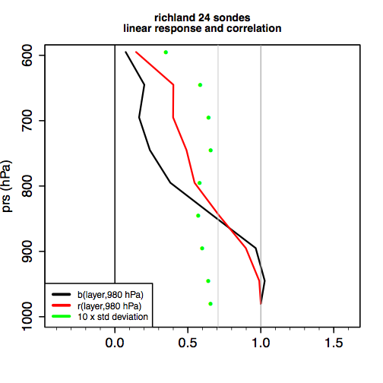
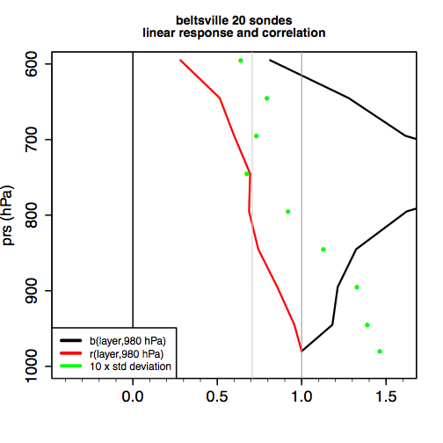
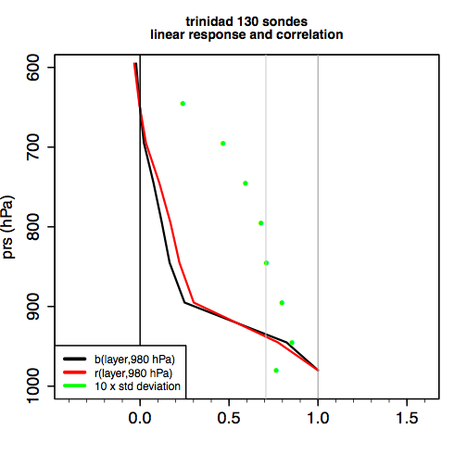
We may estimate various layer depths
East-Coast
West (NW) — ozone above lowest layers
Influenced by Asian, STE lamina

Slide 10
IR and UV Averaging Kernels
Mike Newchurch
slide

Slide 11
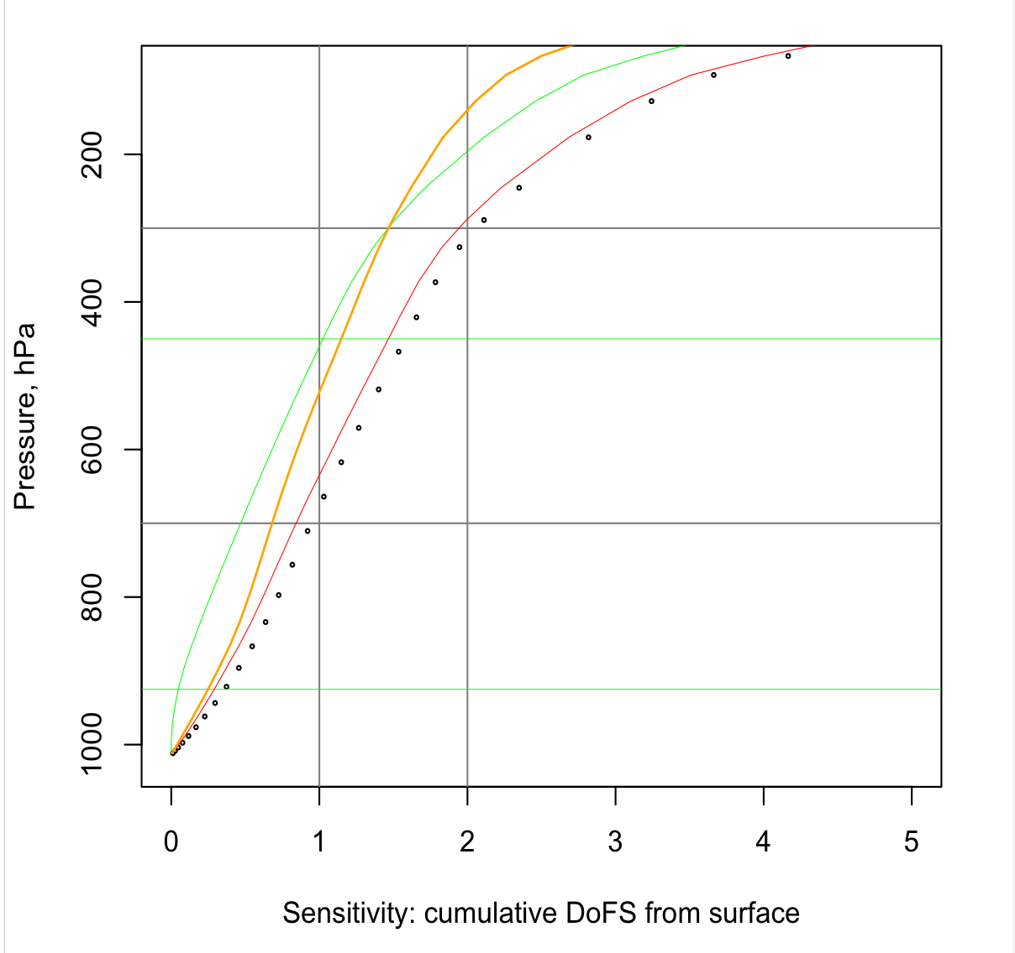
Current Natraj et al (2011) estimates of vertical resolution depend mostly on radiation/retrieval technique, not test profiles
Since we are primarily interested in near-surface ozone, we sum the Degrees of Freedom for Signal up, layer by layer, from the lowest layer.
Note the opposite virtues of UV+Vis (great in lowermost troposphere, then no more info)
and TIR (near-0 sensitivity to 925 hPa, but increasingly good up to 500 hPa.
UV+Vis
TIR
UV+TIR
UV+Vis+TIR

Slide 12
Current results suggest amazing accuracy for estimation of layers

Slide 13
Strong vertical Autocorrelation in Natraj test profiles Wide selection of possible profiles allows regional variation of tropospheric ozone to affect calculations! Correlation significantly greater than sonde-stations results
regression
1:1

Slide 14
Alternative Methods For Appropriate Accuracy Estimates
“Standard” Rodgers-style: Radiation and retrieval improve best estimate including geophysical correlation.
For every region and season of interest, perform sensitivity studies of radiative transfer / retrieval as in Natraj,
but use an adequate sample of ozone soundings. Existing knowledge initiates the retrieval “close to Nature.”
Sounding sets characteristic of the region provide the important “a priori covariance” matrix, give an appropriate first guess, and influence the solution. Remarkably good correlation of test profile and retrieval can occur.
Run as many different regional examples as possible, e.g., ~5–10 “regions.”
B. “Just the physics” solution: Bayesian estimation (improvement-of-our-knowledge philosophy) using an “uninformative prior.” Use “sample profiles” chosen to give minimal prior information. Test profiles can exhibit little vertical correlation, by design, and a priori and first-guess solutions are as uninformative as possible, but allow convergence. The solutions maximize information from the radiation pattern itself.
Secondly, add information about vertical autocorrelation (layer-average to surface regressions) and similar information.
This technique can use added information from any region in the continent.
Appealing to many, but formulation is intricate, some formulations may not even converge. (Hence the popularity of the Rodgers method.)

Slide 15
“Just-Physics” then statistics: B

Slide 16
Traditional Technique: A

Slide 17
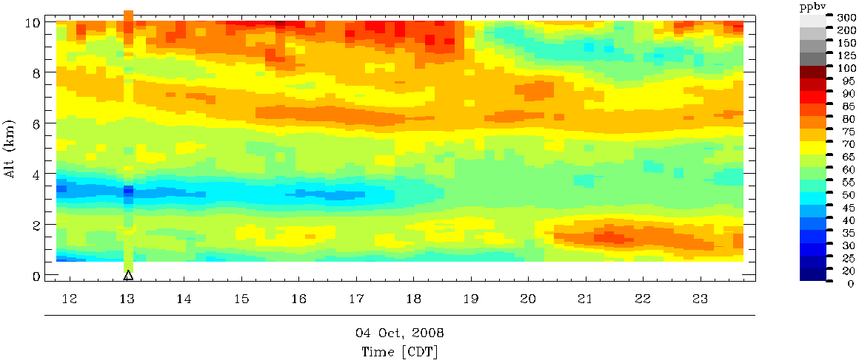
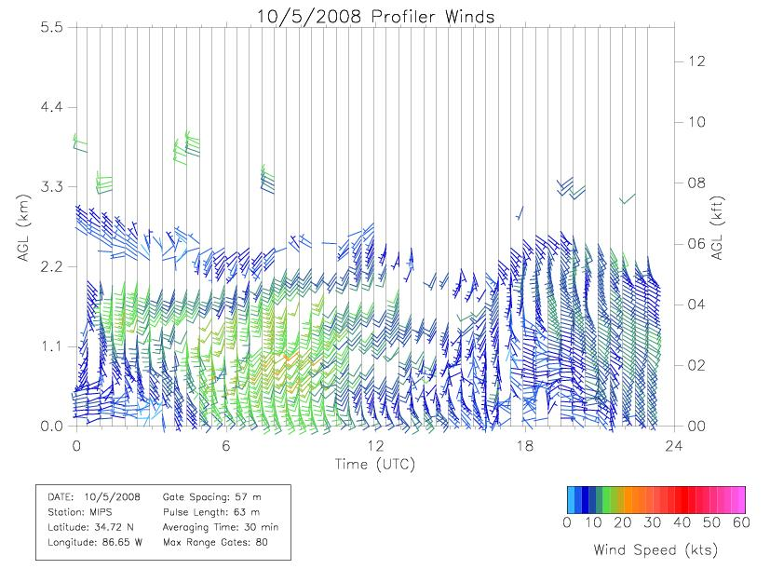
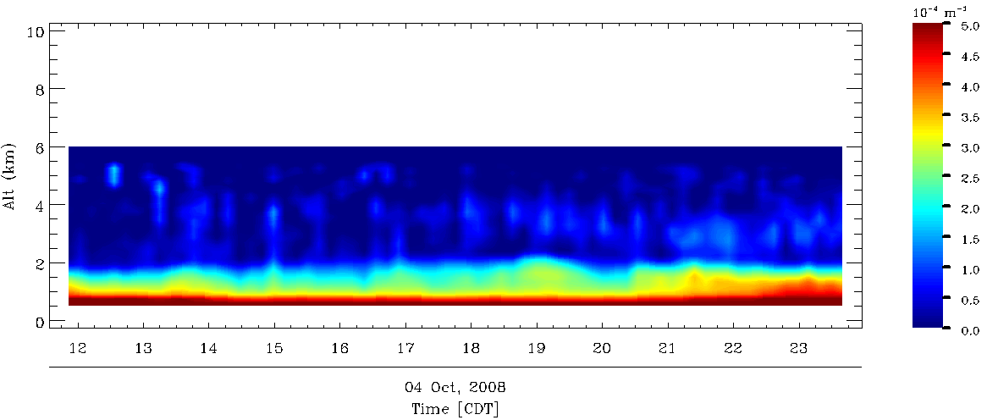
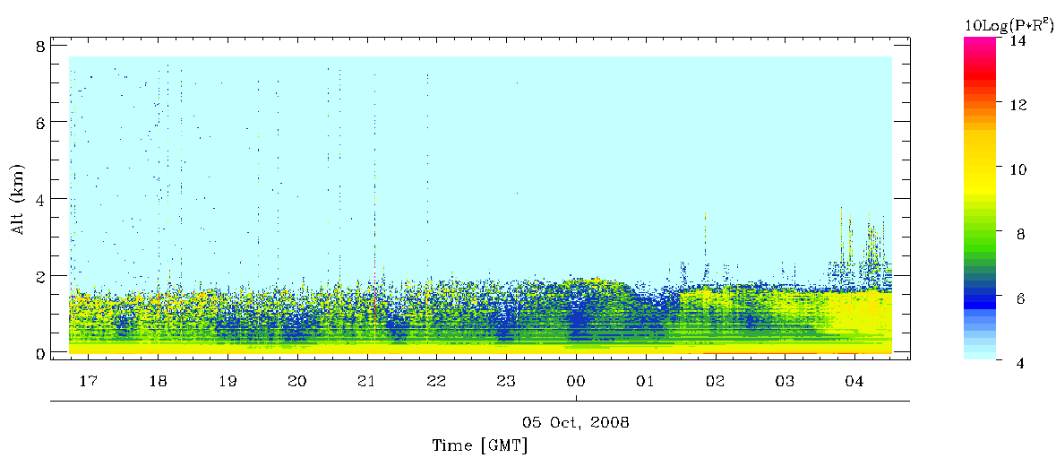
Nocturnal ozone enhancement associated with low-level jet
Lidar
Oct. 4, 2008
Co-located wind profiler
Low-level jet
Aerosol ext.coeff. at 291nm from O3 lidar
Mike Newchurch
slide
(a)
Positive correlation of ozone and aerosol due to transport
Co-located ceilometer backscatter
Kuang et al. submitted to Atmospheric Environment
Aerosol
Notes:
Kuang: Ozone and aerosol plums rise the same time as the LLJ. But the time range of the lidar data acquisition did not fully cover the LLJ. So added a dashed circle to label the LLJ.
What is the take home message here? According to your circles, most of the ozone action seems well in advance of the jet, 1-2 UTC. Aerosol really kicks up later, 3-5 UTC

Slide 18
Aerosol effects can aid or hinder retrieval
For a given incident frequency ν
Sun
Satellite
scattering N₂,O₂
Rayleigh ν
Higher altitude or absorbing aerosol degrade abilities
Situations with scattering aerosol gives more info on near-surface ozone: Rayleigh scattering of Chappuis, longer-wavelength light is amplified by aerosol scattering
Earth’s surface

Slide 19
FIN
Good reason for great optimism about that we can characterize regional near-surface ozone

