Slide 1
Summary of recent progress in GEO-CAPE aerosol related study
GEO-CAPE aerosol working group
Contributions from:
Shana Mattoo, Lorraine Remer, Yan Zhang, Qian Tan, Hongbin Yu, Jun Wang, Xiaoguang Xu, Shobha Kundragunta, Chuanyu Xu, Andrew Heidinger, Bradley Pierce, Nick Krotkov, Omar Torres, Kai Yang, Alexander Vassilkov
Reported by Mian Chin & Omar Torres
May 12, 2011 GEO-CAPE workshop, Boulder CO

Slide 2
FY11 GEO-CAPE aerosol studies
Clouds and aerosol:
  Availability of aerosol retrieval in cloudy environment from MODIS and GOES analysis (Remer, Mattoo)
  Seasonal variation of fractions of cloud-free and aerosol retrieval ability from GOES cloud and aerosol data (Hongbin Yu)
  Impact of sensor pixel resolution on aerosol retrieval accuracy and availability using MODIS data at GSFC (Jun Wang)
Aerosol diurnal variations:
  Diurnal variations of aerosol loading and particle size from AERONET (Yan Zhang, Hongbin Yu)
  Diurnal variations of column AOD and surface PM2.5 based on AERONET and EPA data (Qian Tan)
Aerosol effects on trace gas retrieval:
  SO₂ (Nick Krotkov, Omar Torres)

Slide 3
Availability of aerosol retrieval in cloudy environment from MODIS and GOES analysis
Shana Matto & Lorraine Remer (NASA GSFC)
Andrew Heidinger & Bradley Pierce (NOAA)
Questions to be addressed:
What is the availability of an aerosol retrieval in a cloudy environment?
How does that availability change with inherent pixel resolution?
What is the regional and seasonal availability of a retrieval, and how is that affected by pixel resolution?
What is the availability of an aerosol retrieval for a specific local area on a specific day under different cloud conditions, and how is that affected by pixel resolution?
Does frequent diurnal sampling significantly increase retrieval availability?
More details in Shana Mattoo et al.’s poster

Slide 4
Retrieval availability at different pixel resolution
Assumption: Product resolution at 8x8 km, and there is a “perfect” cloud mask to screen out clouds
Retrieval Definition: MODIS-like – Making aerosol retrieval when ~10% or more of the pixels in the grid box are cloud-free
Requirements:
8 km: 1 pixel clear/ 1 possible (100%)
4 km: 1 pixel clear/ 4 possible (25%)
2 km: 2 pixels clear/ 16 possible (12.5%)
1 km : 6 pixels clear/ 64 possible (9%)
8 km
For a 8x8 km product:
1 pixel at 8x8 km resolution
4 pixels at 4x4 km resolution
16 pixels at 2x2 km resolution
64 pixels at 1x1 km resolution

Slide 5
Examples of retrieval availability
Pixel size | Total pixel | Cloud-free | cloud | 8-km product
8 km | 1 | 0 | 1 | no
4 km | 4 | 1 | 3 | yes
2 km | 16 | 11 | 5 | yes
1 km | 64 | 57 | 7 | yes
8 km
Pixel size | Total pixel | Cloud-free | cloud | 8-km product
8 km | 1 | 0 | 1 | no
4 km | 4 | 0 | 4 | no
2 km | 16 | 2 | 14 | yes
1 km | 64 | 10 | 54 | yes
8 km

Slide 6
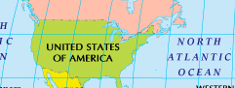
Seasonal statistics of retrieval availability
Start with MODIS L1B reflectance data at 0.5 km resolution
Apply standard MODIS aerosol cloud mask
Calculate cloud fraction and retrieval availability at 0.5, 1, 2, and 4 km
Calculate overall availability for full domain and sub-domains
Seasonal statistics calculated from 3 weeks of data per season, 1 week per each month of the season
Domain: 0-55°N, 139°W-13°W
Statistics for
Whole domain +
5 sub-domains +
4 1°×1° boxes
NW
NE
SW
SE
AO

Slide 7

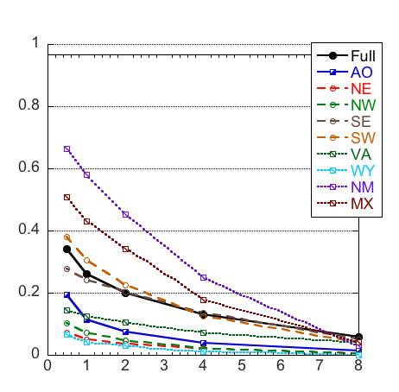
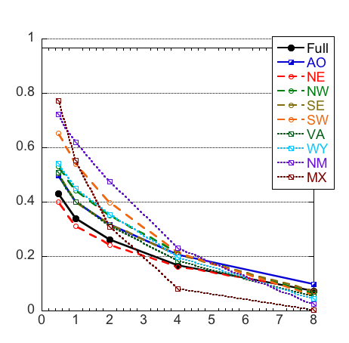
Domain statistics
Summer
Winter

Slide 8
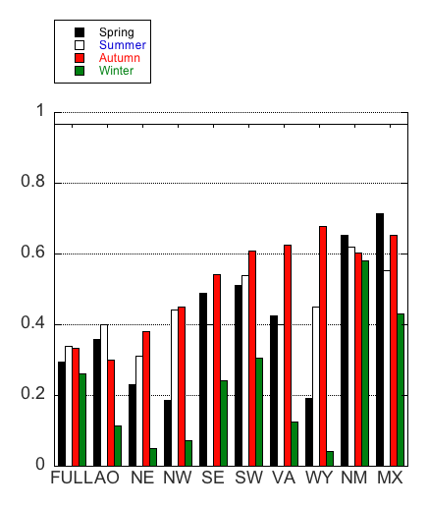
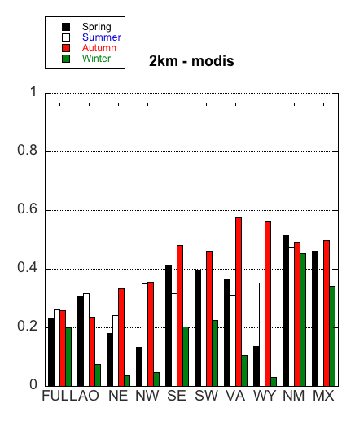
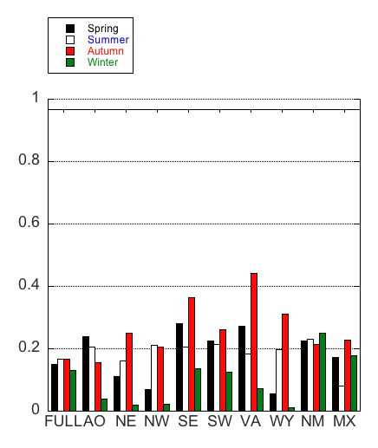
Seasonal statistics with different pixel resolution (full domain)
1-km MODIS
2-km MODIS
4-km MODIS
Fraction of aerosol retrieval
With a 0.5 km cloud mask, the annual average MODIS aerosol retrieval fraction (out of total pixel) in the full domain is about 40%, 30%, 25%, and 15%, respectively with 0.5, 1, 2, and 4 km pixel resolution.
There is a significant seasonal and regional variations of aerosol retrieval availability. Winter is the most difficult season; Autumn generally the easiest. Different regions have different seasonal characteristics.

Slide 9
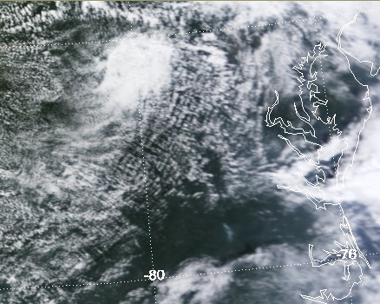
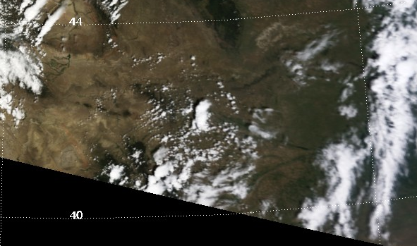
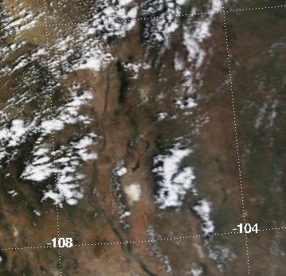
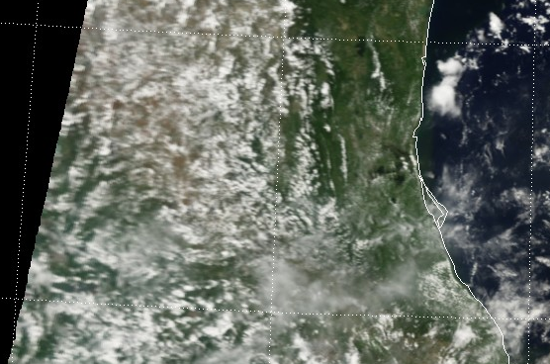
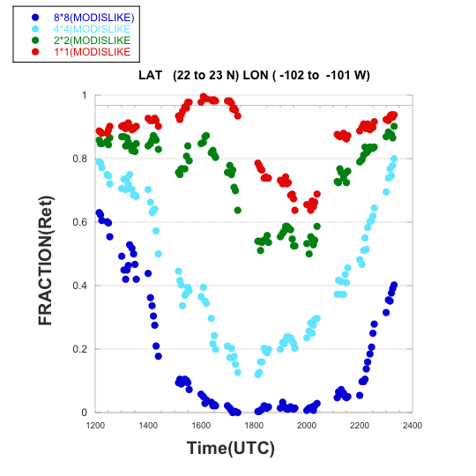
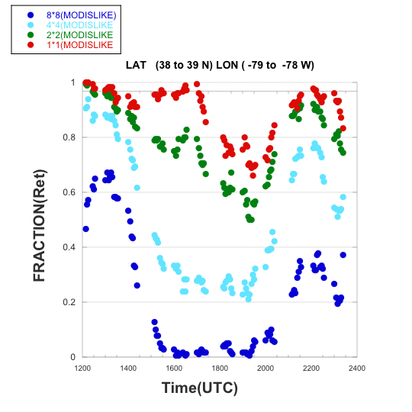
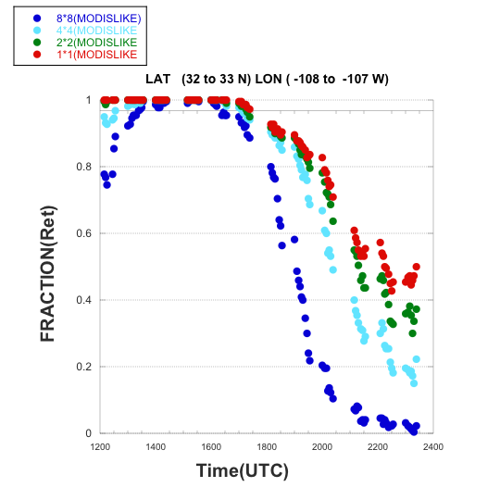
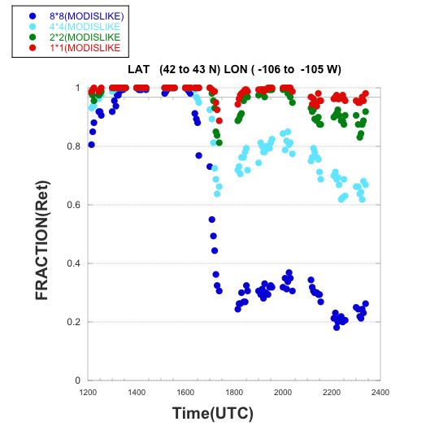
Diurnal variation of “cloud-free” fraction with different pixel size
Using a special GOES cloud mask product (from Brad Pierce and Andy Heidinger, NOAA), with1 km spatial resolution and 5 minutes time interval, 1-day, 8/12/2010, MOIDS-like retrieval criteria
Diurnal variation of CLOUD-FREE fraction from 1-day data of August 12, 2010
Virginia (VA)
Wyoming (WY)
New Mexico (NM)
Mexico (MX)
1-km
2-km
4-km
8-km
Terra
Aqua

Slide 10
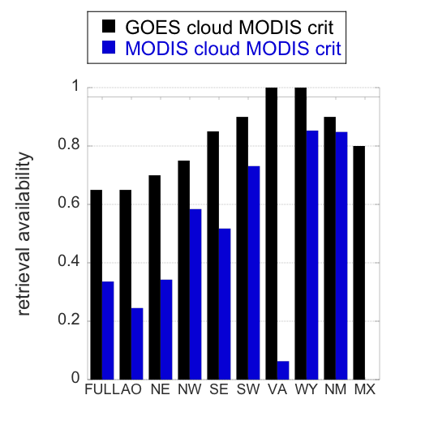
Cloud-free from different eyes – GOES vs. MODIS
Comparing retrieval availability at 1-km resolution for August 12, 2010:
GOES cloud mask at Terra overpass time (black)
Terra MODIS cloud mask (blue)
Note the differences in cloud masks between GOES and MODIS, especially at very cloudy location, VA and MX.
The GOES cloud mask is meant to find clouds, which is very different from the MODIS aerosol cloud mask that is meant to protect the aerosol retrieval
1-km resolution

Slide 11
Summary
MODIS seasonal analysis (with a 0.5 km cloud mask):
  Average MODIS aerosol retrieval availability in the NA domain is about 40%, 30%, 25%, and 15%, respectively with 0.5, 1, 2, and 4 km pixel resolution
  There is a significant seasonal and regional variations of aerosol retrieval availability. Winter is the most difficult and Autumn generally the easiest
Diurnal cycle:
  Cloudiness increases in afternoon in all domains
  The larger the pixel size, the larger the diurnal signal; MODIS-like retrieval availability at 1 and 2 km exhibit the least strong diurnal signal
  The temporal dimension allows at least some retrievals every day, but at 4 km and 8 km resolution those retrievals are reduced significantly especially in mid-day

Slide 12
Possibilities of Detecting Cloud-free Pixels and Retrieving Aerosols on Hourly Basis from
NOAA GOES-12 analysis
Hongbin Yu (NASA GSFC/UMD)
Shobha Kongragunta & Chuanyu Xu (NOAA NESDIS)
Questions to be addressed:
What is the possibility to have cloud-free atmosphere in individual hours?
What is the possibility to retrieve aerosol in individual hours?
How do these possibilities vary with location and season?
More details in Hongbin Yu et al.’s poster

Slide 13
Analysis of 1-year GOES-12 Aerosol/Smoke Product (GASP) data in 2009
Spatial resolution: 4 km
Measurement frequency: 30min
Cloud detection: using two Infrared (IR) channels (3.90 and 10.7 μm) at 4 km resolution
Aerosol retrieval: using mainly one visible channel at 0.52-0.72 μm in optimal conditions:
  cloud-free
  low surface reflectance
  appropriate scattering angle
  detectable aerosol signal, etc.

Slide 14
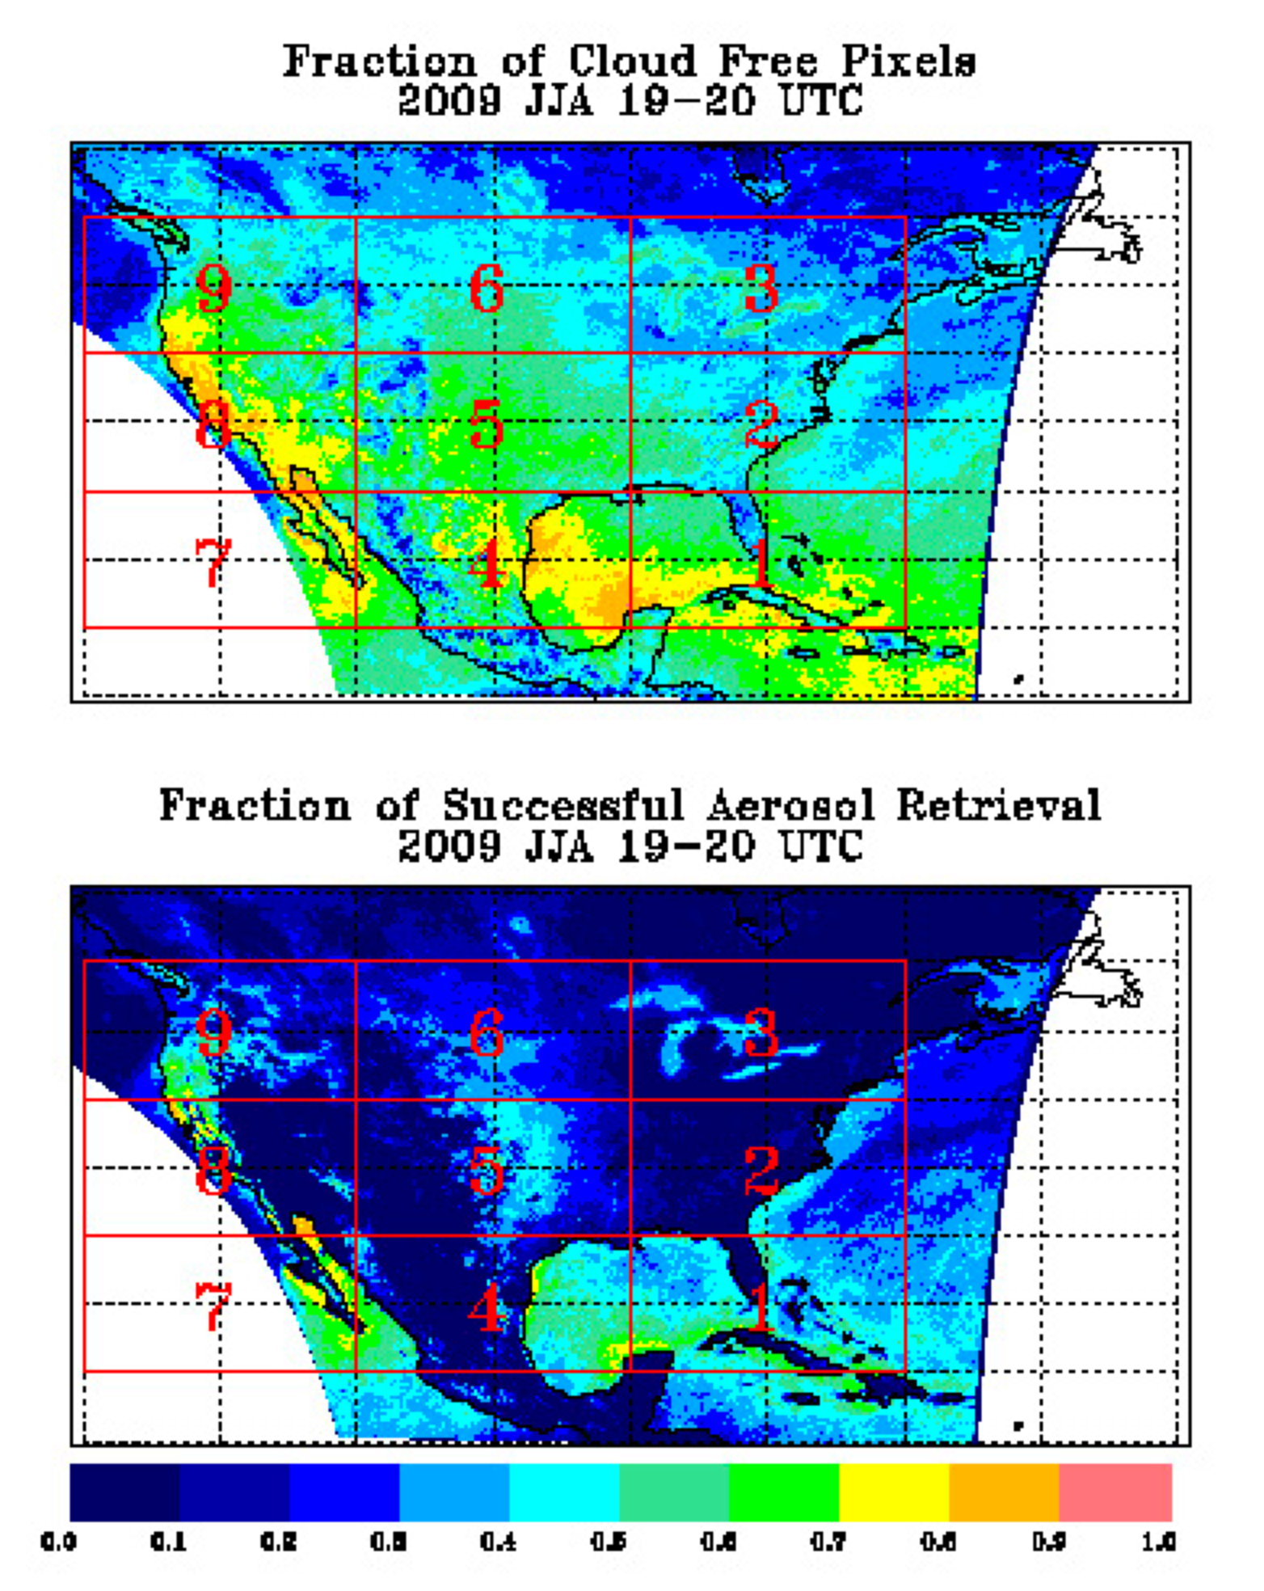
Seasonal statistics
Define 9 regions at 20° longitude x 10° latitude
Calculate in individual 4km grids two seasonal average fractions:
  Fclr: cloud-free fraction in each 1-hour interval (2 measurements per hour) over a season
  Faer: successful aerosol retrieval fraction based on GASP’s “normal criteria”
  Faer is always less than Fclr

Slide 15
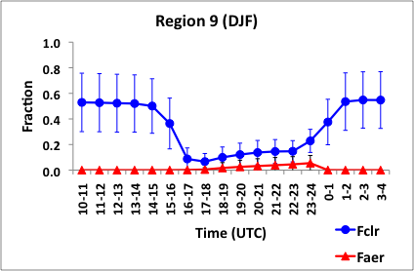
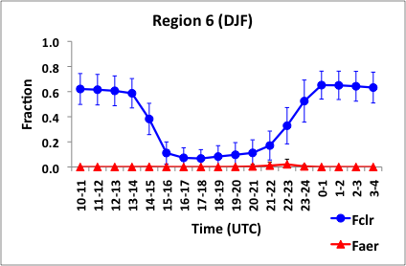
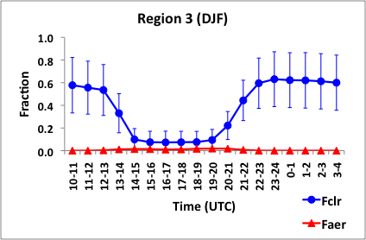
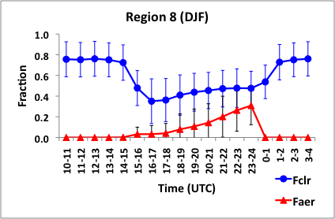
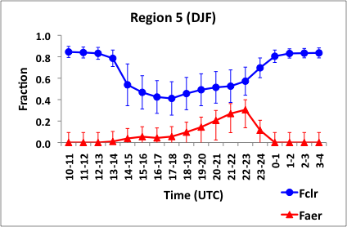
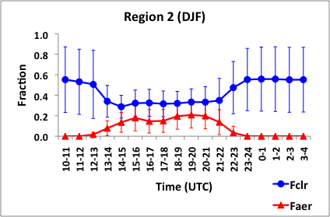
Winter (DJF)
110-130°W
90-110°W
70-90°W
9 NW
6 NC
3 NE
Terra
Aqua
40-50°N
8 SW
5 SC
2 SE
30-40°N
In winter, cloud-free fraction in northern US (40-50N) is only ~10% during the day and aerosol retrieval possibility is zero to less than 5%, due to surface snow/ice
In southern US (30-40N), cloud-free fraction is 30-50% during the day and aerosol retrieval fraction 20-30% in the afternoon. In SW and SC the aerosol retrieval probability is much lower in the morning than in the afternoon

Slide 16
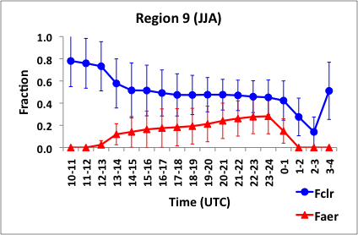
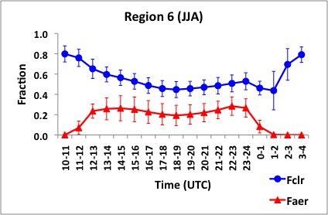
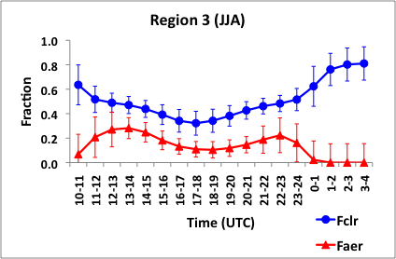
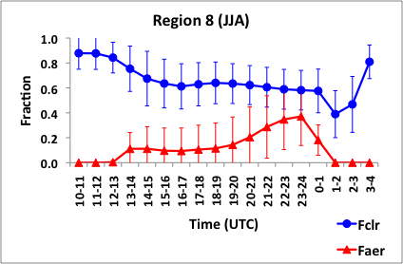
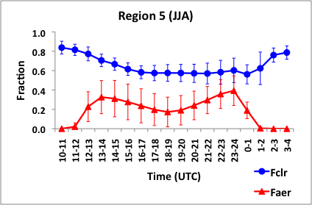
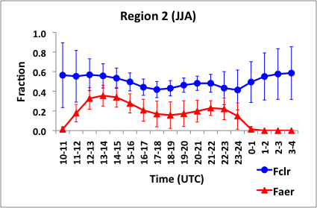
Summer (JJA)
110-130°W
90-110°W
70-90°W
9 NW
6 NC
3 NE
Terra
Aqua
40-50°N
8 SW
5 SC
2 SE
30-40°N
In summer, northern US (40-50N) has 40-50% cloud-free conditions and 10-30% possibility of retrieving aerosol.
Southern US (30-40N) has 50-60% cloud-free conditions and 20-40% aerosol retrieval except in the morning in SW (10%)

Slide 17
Summary
General characteristics from the statistical analysis of the 1-year GOES-12 cloud and aerosol data:
  Winter is the most difficult season to retrieve aerosols especially in the northern part of the U.S.
  The opportunity of aerosol retrieval in the southern US is better than in the northern US
  On day-to-day basis it would be very difficult to get diurnal variation cycles of aerosols. The diurnal cycle maybe best represented at seasonal and larger area average
Implications for GEO-CAPE:
  Aerosol retrieval availability could be significantly improved from GOES-12 with better cloud screening (1 km) and better surface characterization from UV technique

Slide 18
Impact of Satellite Pixel Resolution on The Aerosol Retrieval: DATA QUALITY and availability
Xiaoguang (Richard) Xu & Jun Wang (Univ. of Nebraska-Lincoln)
Question to be addressed:
How does the aerosol retrieval accuracy change with pixel resolution?
How does the aerosol retrieval availability change with pixel resolution?

Slide 19
Method
Terra MODIS, Mar – Nov, 2007, total 254 days, 1 km pixel size at nadir, 48 × 48 pixels centered at GSFC
Data quantities: reflectance, thermal radiance, and geometry
Aggregating 1-km data to 2, 3, 4, 6, 8, 12, 16 km pixel sizes
Applying cloud mask at the same resolution
Calculating confidence level (Q) of excluding cloud contamination (Q=1 means high confidence level)
Performing aerosol retrieval using SSA and phase function information from AERONET GSFC site for the same period of time

Slide 20
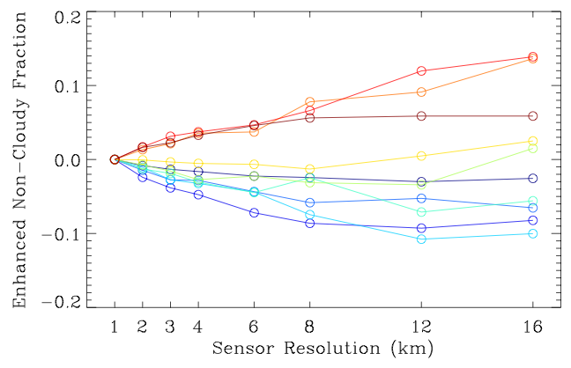


Cloud fraction: depending on cloud morphology
Change of cloud-free fraction relative to 1-km
Q=1
Category I
Most cloudy
Category II
Most clear
For large clouds (category I), increasing pixel size can lead to a decrease of cloud-free fraction over a region, thus decreasing aerosol retrieval availability
For small clouds (category II), increasing pixel size can lead to an increase of cloud-free fraction over a region, because the small clouds could “dissolve” in the scene. This will increase the pixel reflectivity, resulting in positive bias in aerosol retrieval due to contamination from “invisible” clouds

Slide 21
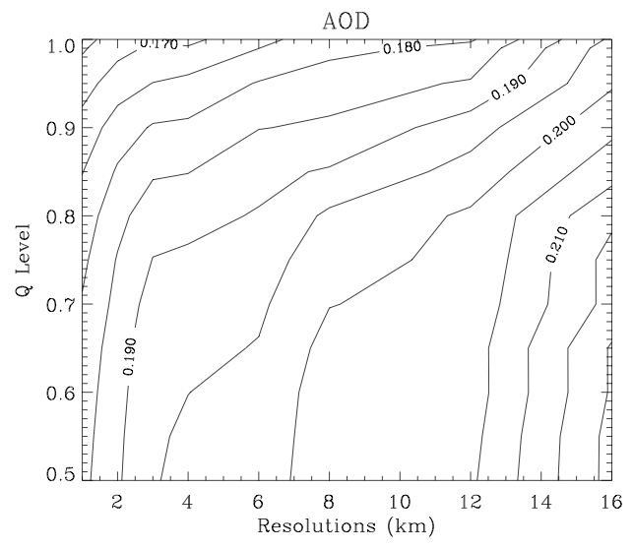
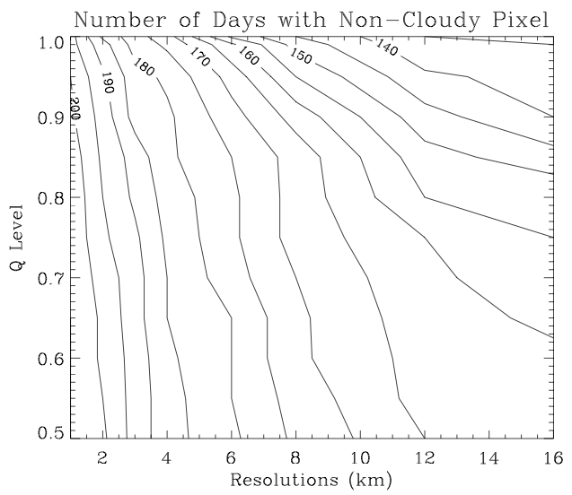
Aerosol retrieval quality and availability at GSFC
AOD
Number of cloud-free days
0.17
Cloud-free days decreases
140
AOD decreases
Confidence level Q
Confidence level Q
0.22
200
Pixel size (km)
Pixel size (km)
AOD increases
Cloud-free days decreases
For every 1 km coarser resolution, AOD increases by ~0.01 on average compared with AERONET
From 1km to 4km, AOD data bias increases by 10-15%
For every 1 km coarser resolution, the number of available AOD retrieval days decreases by 10-20%
From 1km to 4km, data availability decreases by 30-40%
Remember: at 1 km resolution, AOD could have already biased high by 20% !! (Koren et al., 2008)

Slide 22
Bottom lines regarding clouds and aerosols:
2-km pixel resolution is a minimum requirements for 8-km AOD product size. The difference in retrieval availability is much larger between 2 and 4 km than that between 1 and 2 km
Need a cloud screening capability at 1-km level to reduce cloud contamination in aerosol retrieval in order to meet the precision requirements
Diurnal variations requires temporal and/or spatial averaging

Slide 23
Aerosol effects on SO₂ retrievals
N. Krotkov, O. Torres, Kai Yang, A. Vassilkov (NASA GSFC)
Question to be addressed:
What is the error in SO₂ caused by the existence of aerosol?
How does the error associated with aerosol composition and vertical distributions?

Slide 24
Tropospheric trace gas retrievals
Aerosol affect trace gas retrieval through several different ways from multiple scattering and absorption
Trace gas vertical column (VC) is generally derived from satellite measurements as
VC = SCD/AFM
where SCD=slant column density retrieved from satellite measurements, AFM=air mass factor describing the actual light path through the atmosphere
The AMF depends on wavelength, surface albedo, solar zenith angle, clouds, vertical distribution of absorbing species, clouds, and aerosols
The quantification of aerosol effects requires knowledge of aerosol’s fundamental properties:
  Aerosol loading
  Particle shape
  Particle size distribution
  Refractive index

Slide 25
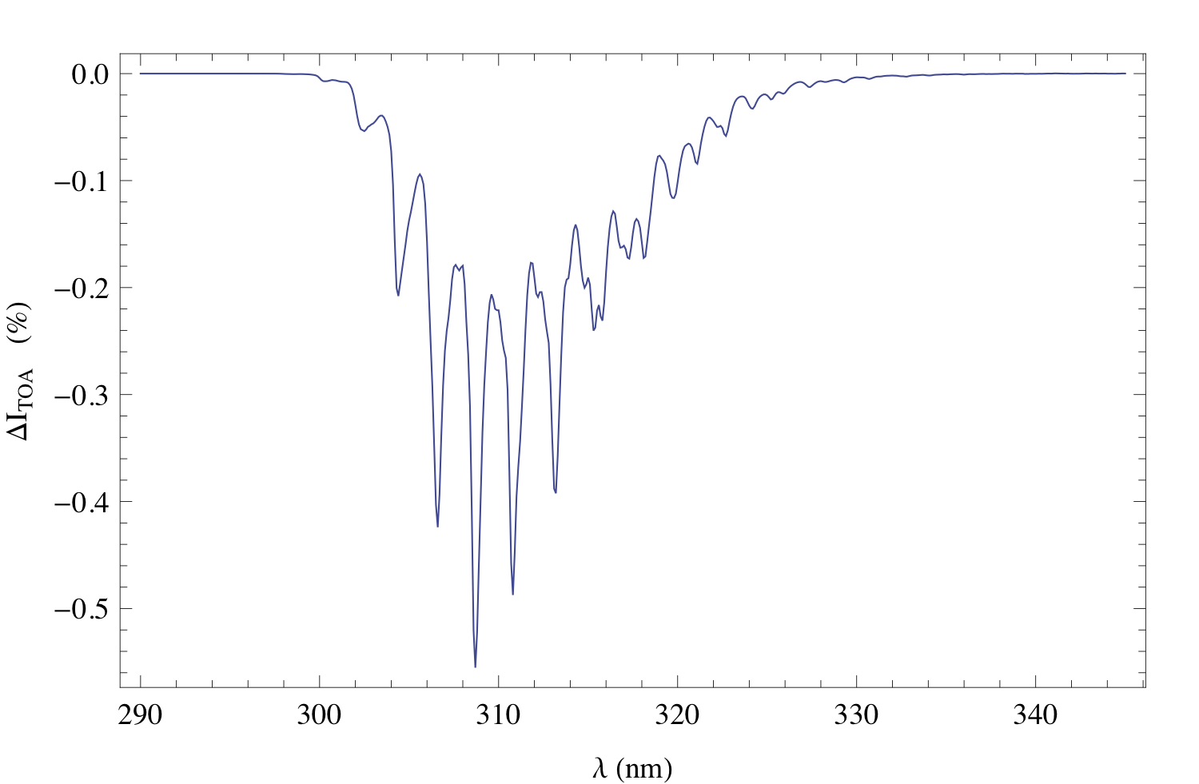
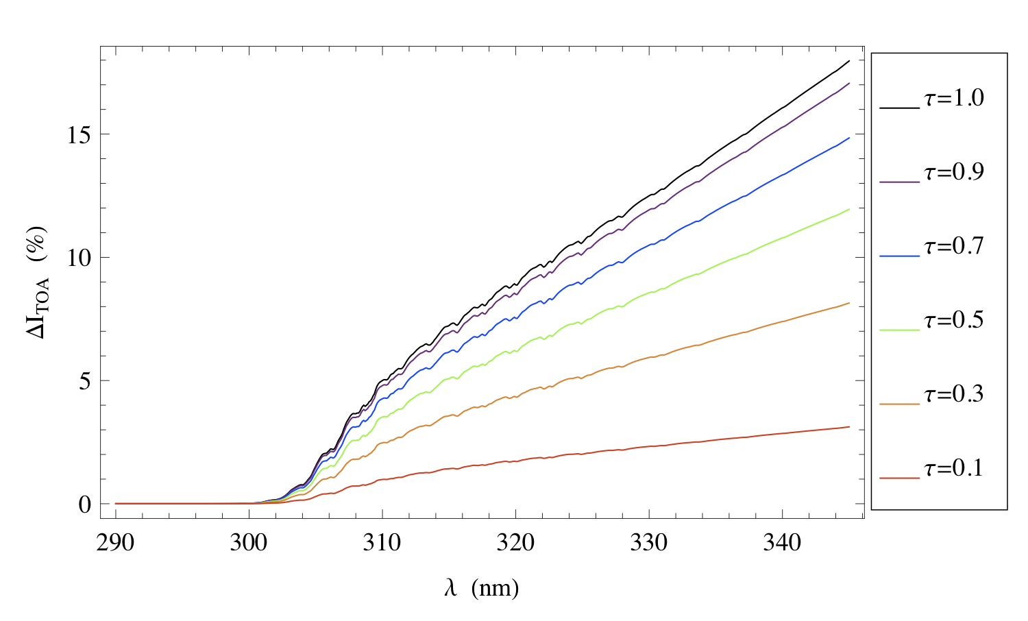
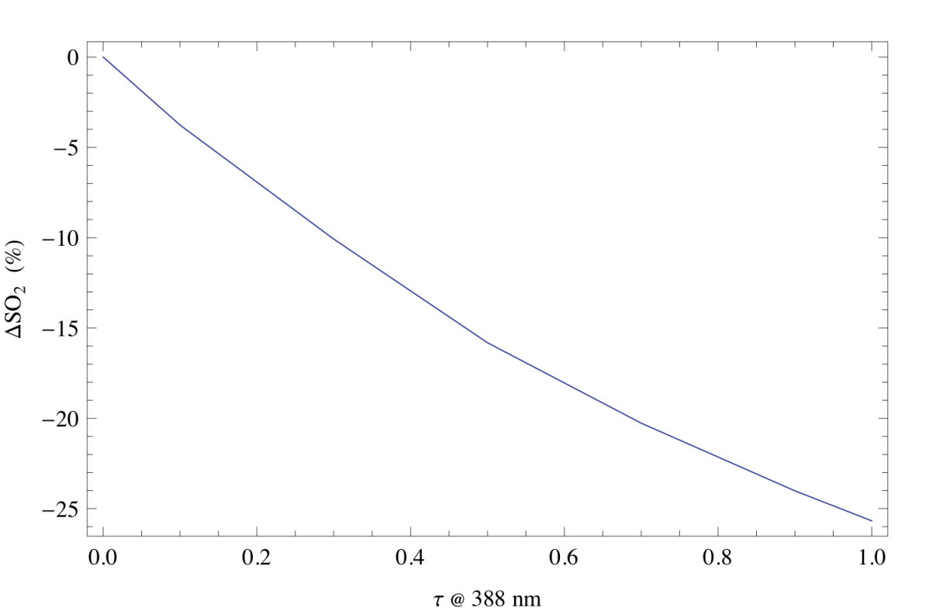
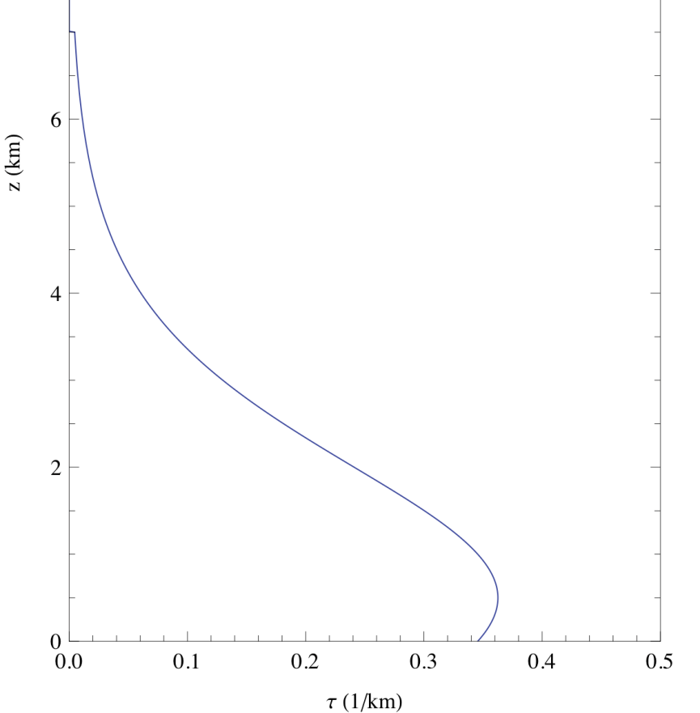
Aerosol effects on SO₂ retrieval
Net aerosol effect (%) on TOA measured spectra
SO2 spectrum
1Dobson Unit ( DU, =2.69 10¹⁶ molecules/cm²)
PBL SO₂ effect on TOA measured spectra (%)
Wavelength
Wavelength
Vertical shape for both SO₂ and aerosol
The larger the AOD, the larger the retrieval error
The resulting error depends on the vertical distributions of SO₂ and aerosols and aerosol refractive index
SO2 retrieval bias (%)
Aerosol Model: Smoke
O₃= 300 DU; SO₂= 1DU
AOD at 388 nm

Slide 26
Aerosol Daytime Variations over North and South Americas as Derived from Multiyear AERONET Measurements
Yan Zhang, Hongbin Yu, Alexander Smirnov, Tom Eck, Mian Chin, Lorraine Remer, Qian Tan, Robert Levy
Sites located in E. US, JJA
Question to be addressed:
What are the diurnal variations of AOD and size parameter in different locations over N and S America?
How representative is the aerosol radiative forcing estimated from LEO without considering the diurnal cycle?
Sites located in W. US, JJA
See Yan Zhang’s talk next

Slide 27
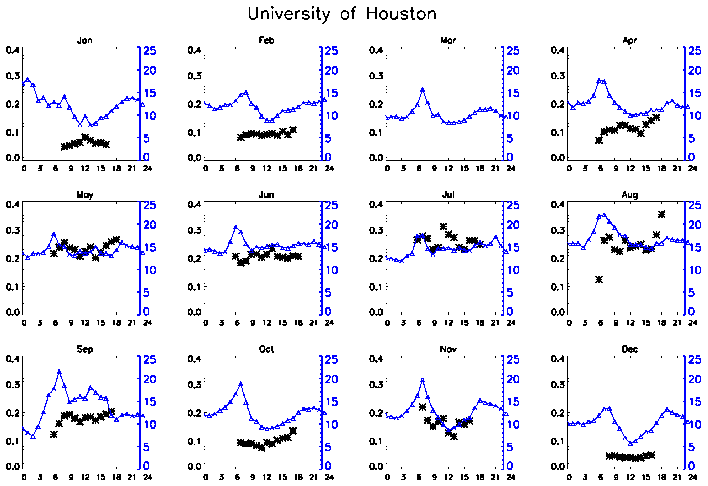
Diurnal Variability of AOD and PM2.5 Observed by Ground-based Networks (AERONET and EPA)
Qian Tan, Mian Chin, Tom Eck, & Hongbin Yu (NASA GSFC)
Jack Summers (EPA), Caterina Tassone (NOAA)
Question to be addressed:
What are the diurnal variations of column AOD and surface PM2.5?
What is the linkage between AOD and PM2.5 at different locations?
See Qian Tan’s talk next
Blue: PM2.5 (EPA) Black: AOD (AERONET)

