Slide 1

Update to the GEO-CAPE Community and Working Group
Jim Crawford
Principal Investigator
NASA LaRC
James.H.Crawford@nasa.gov
Mary Kleb
Project Manager
NASA LaRC
Mary.M.Kleb@nasa.gov
Ken Pickering
Project Scientist
NASA GSFC
Kenneth.E.Pickering@nasa.gov
Gao Chen
Data Manager
NASA LaRC
Gao.Chen@nasa.gov
Website: http://discover-aq/larc.nasa.gov

Slide 2
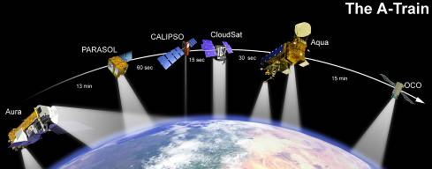
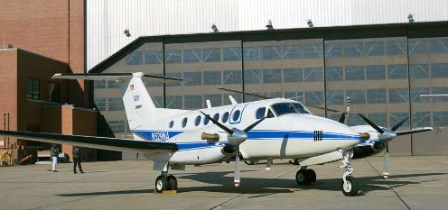
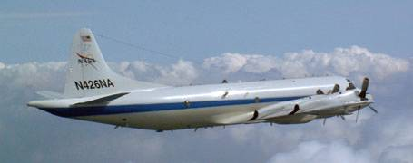
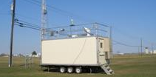
Investigation Overview
Deriving Information on Surface Conditions from Column
and VERtically Resolved Observations Relevant to Air Quality
A NASA Earth Venture campaign campaign intended to improve the interpretation of satellite observations to diagnose near-surface conditions relating to air quality
Objectives:
1. Relate column observations to surface conditions for aerosols and key trace gases O₃, NO₂, and CH₂O
2. Characterize differences in diurnal variation of surface and column observations for key trace gases and aerosols
3. Examine horizontal scales of variability affecting satellites and model calculations
NASA UC-12
NASA P-3B
Deployments and key collaborators
Maryland, July 2011 (EPA, MDE, UMd, and Howard U.)
California, January 2013 (EPA and CARB)
Texas, September 2013 (EPA, TCEQ, and U. of Houston)
TBD, Summer 2014
NATIVE, EPA AQS, and associated Ground sites

Slide 3
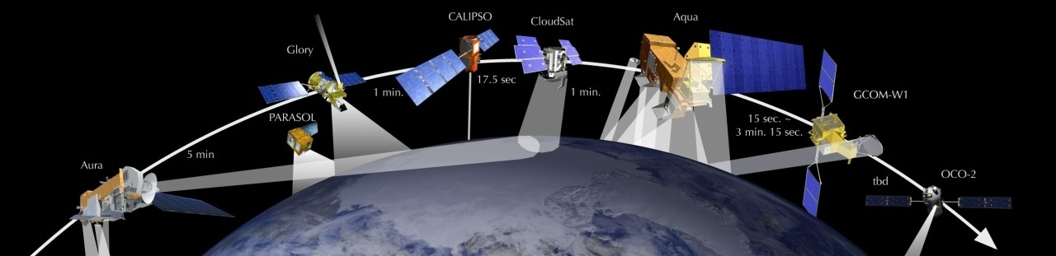
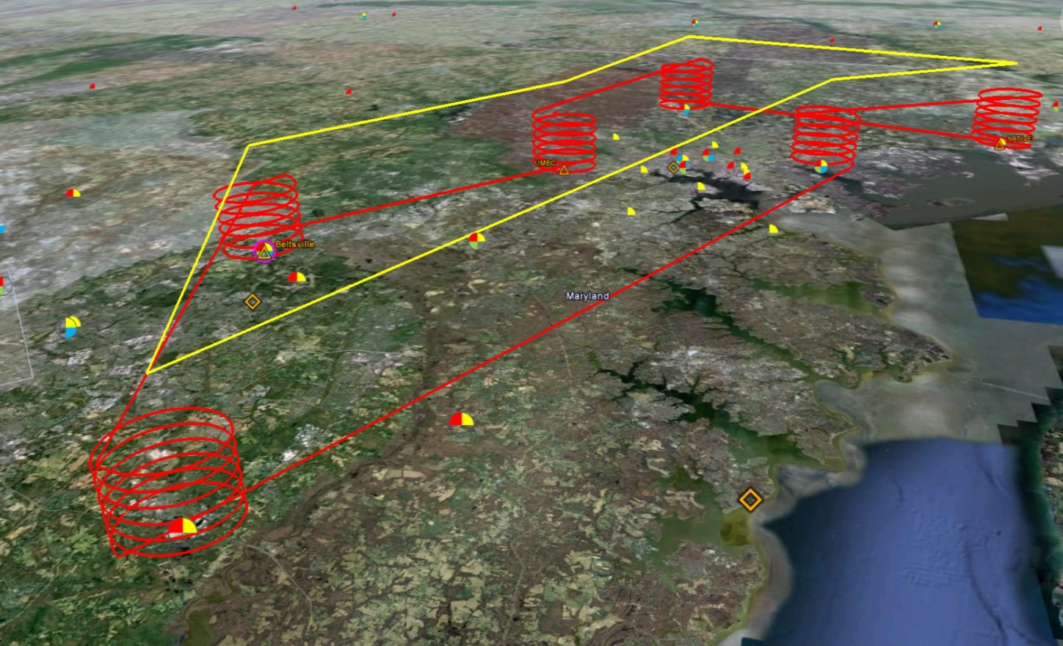
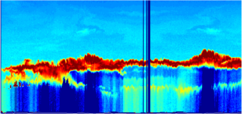

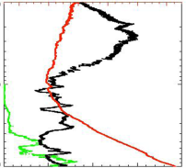
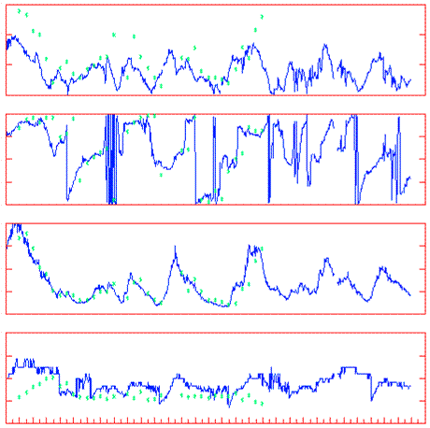
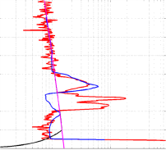
Deployment Strategy
Systematic and concurrent observation of column-integrated, surface, and vertically-resolved distributions of aerosols and trace gases relevant to air quality as they evolve throughout the day.
Three major observational components:
NASA UC-12 (Remote sensing)
Continuous mapping of aerosols with HSRL and trace gas columns with ACAM
NASA P-3B (in situ meas.)
In situ profiling of aerosols and trace gases over surface measurement sites
Ground sites
In situ trace gases and aerosols with AQS, NATIVE, and EPA
Remote sensing of trace gas and aerosol columns with Pandora and Aeronet
Ozonesondes
Aerosol lidar observations

Slide 4
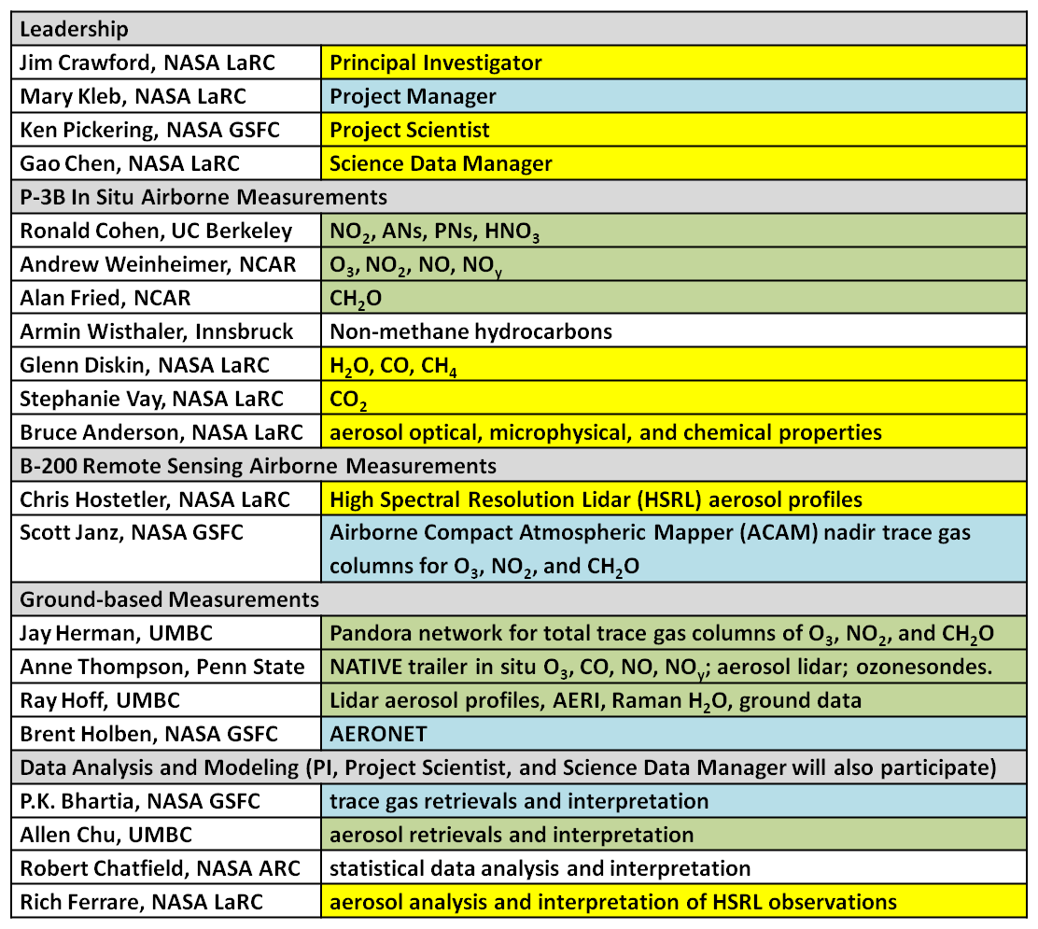
Science Team

Slide 5
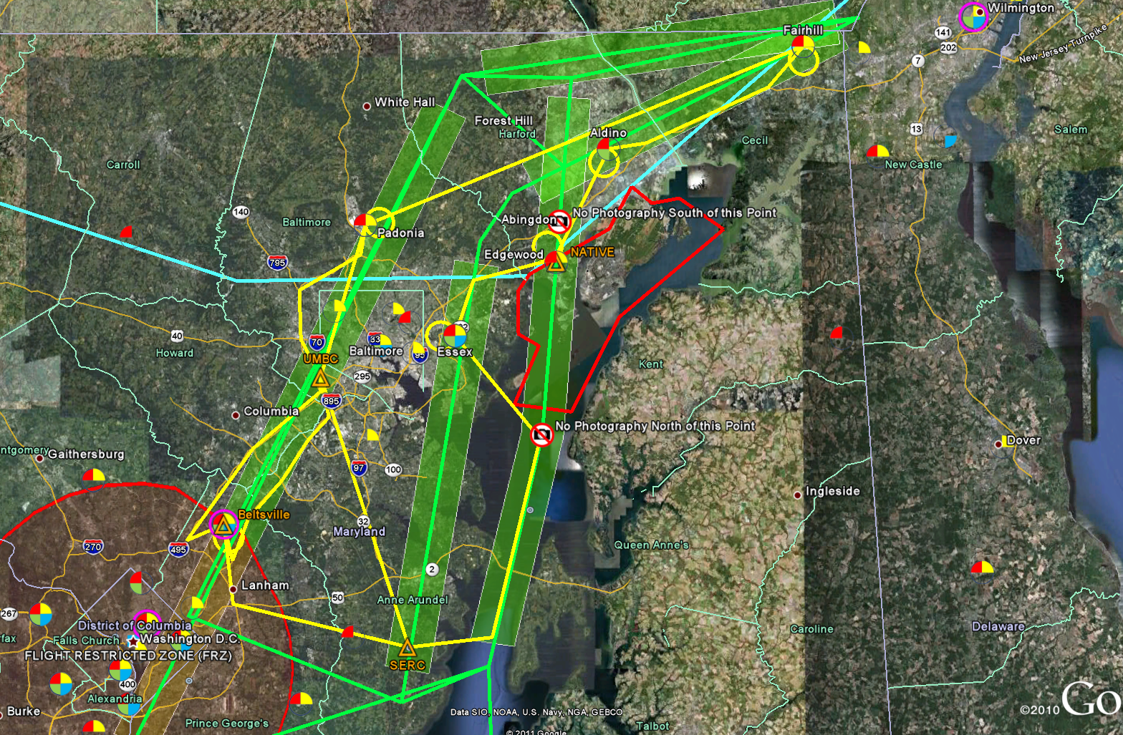
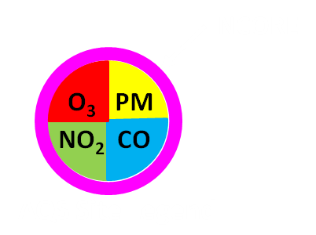
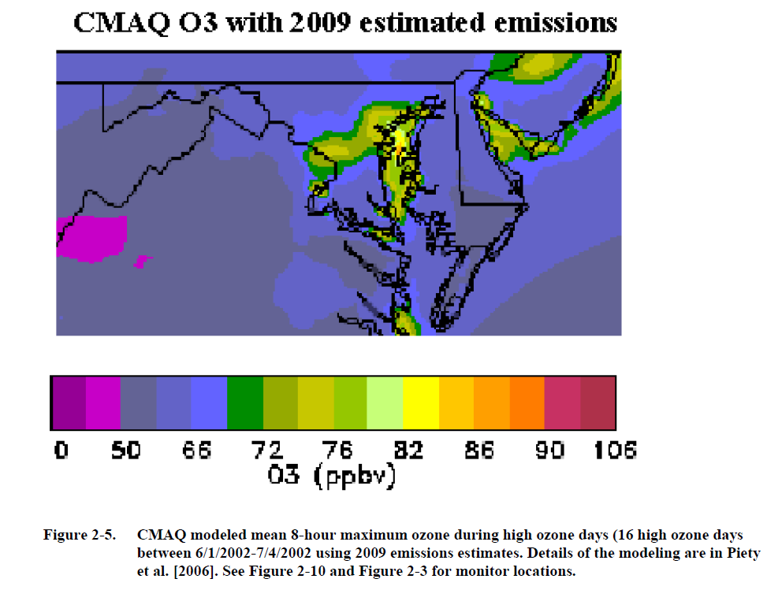
Baltimore-DC Flight Plan
Plan as of 2/8/11
Green Line: UC-12 flight path
Green Boxes: estimated ACAM swath
Yellow Line: P-3B flight path
Red line: R-4001 restricted area (cameras off during overflight)
Blue Line: ICAO FIR Boundary

Slide 6
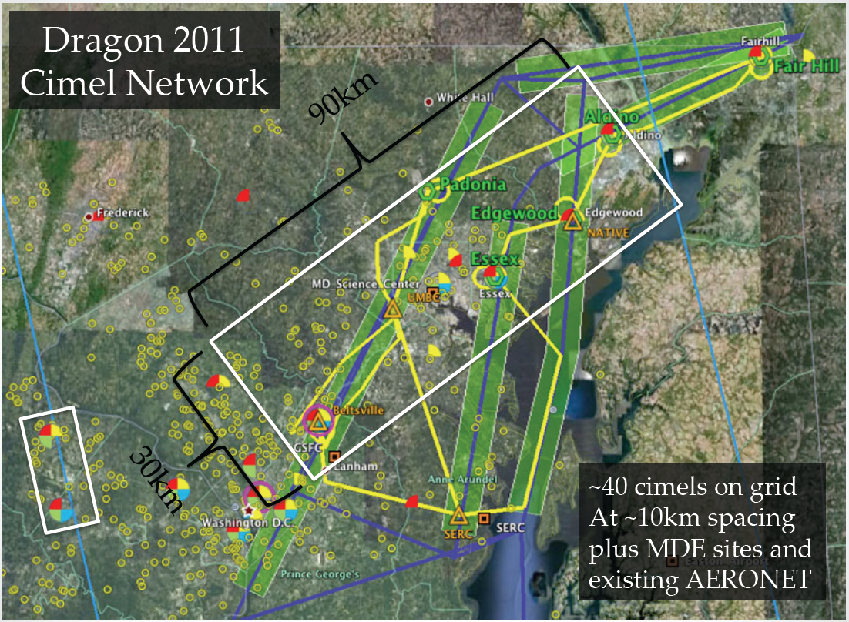
Additional Ground-Based
Observations (Aeronet)

Slide 7
Additional Ground-Based
Observations
Trace Gas and aerosol measurements
Fairhill: COMMIT Mobile Lab (Si Chee Tsay and Can Li)
Tethered Balloons (from surface to 1000 ft)
Edgewood: Rich Clark (Millersville University)
Beltsville: Everette Joseph (Howard University) and
Jose Fuentes (Penn State)
Remote Sensing
Edgewood: Leosphere Windcube and Sigma Space MPL
Beltsville: Vaisala Ceilometer

Slide 8
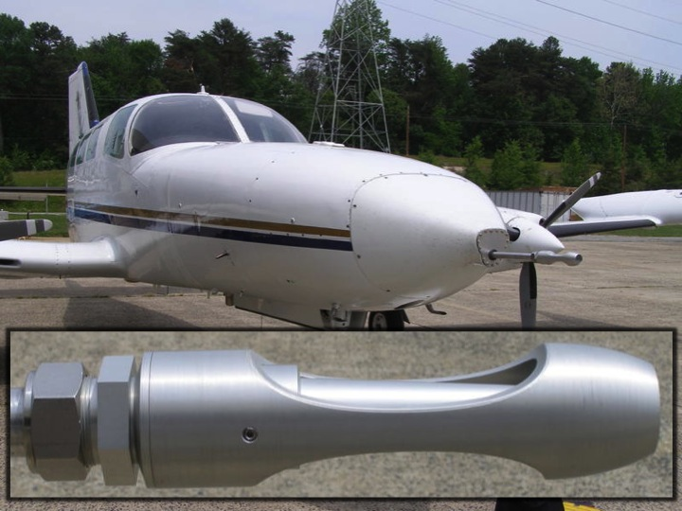
Additional Airborne Observations
University of Maryland (Russ Dickerson and Jeff Stehr)
Regional Atmospheric Measurement Modeling and Prediction Program: http://www.atmos.umd.edu/~RAMMPP/
Cessna 402b
In situ trace gas and aerosol payload - strong overlap with P-3B
Flights have already begun
Will provide valuable regional
context to DISCOVER-AQ

Slide 9
Schedule
SEAC₄RS
DC3
Data archived and available to the public four months after each deployment
Pandora spectrometers will remain in place after each campaign deployment
Extended gap after first deployment offers an opportunity to improve the observational strategy for later deployments

Slide 10
DISCOVER-AQ Baltimore-Washington Field Mission
Forecasting for Flight Planning
Team: Ken Pickering, Melanie Follette-Cook, Bryan Duncan - NASA
Clare Flynn, Chris Loughner - UMD, Greg Garner – PSU
Sources of forecast guidance:
Meteorology: NCEP North American Mesoscale Model (NAM)
UMD AOSC WRF
NASA GEOS-5 (0.25 x 0.13 deg)
NWS Sterling VA weather discussions; cloud forecasts
Sterling, VA, Wakefield VA, Dover, DE radars
Lidar-, ceilometer-, wind profiler-based boundary layer depths
Air Quality: - NOAA operational CMAQ ozone and experimental PM2.5 forecast guidance (Pius Lee and Rick Saylor, NOAA/ARL)
- CMAQ PM2.5 forecasts with NRT GOES fire emissions (Sundar Christopher, UAH)
- NASA GEOS-5 on-line tracers [GOCART aerosols, CO, CO₂, SO₂] (Arlindo da Silva, NASA/GSFC)

Slide 11
Types of Flight Conditions:
A wide variety of cloud conditions ranging from clear to 50% partial cloudiness (fair weather Cu OK; avoid stratus decks)
A variety of ozone and PM conditions (moderate to severe pollution)
Light (near stagnation) to moderate wind speed conditions
A mix of local pollution and transport from upwind source regions
(elevated pollution reservoir)
Chesapeake Bay breeze conditions
Before and after a thunderstorm passage
Sunrise (chemical evolution, low-level jet, subsequent BL growth)

Slide 12
Research and Analysis Activities
Statistical analysis – correlations between surface PM_{2.5} and AOD, surface and column NO₂, O₃, etc. Study extent to which boundary layer depth and mixing, humidity, emissions, and chemistry influence the correlation between surface and column observations.
Improvement of retrieval algorithms through insights obtained from the combination of ACAM, Pandora, aircraft, and surface data. Comparisons with MODIS, OMI, GOME-2, TES. Data available for testing GEO-CAPE algorithms.
Regional air quality modeling - WRF-Chem and CMAQ simulations (≤ 4 km horizontal resolution) will be evaluated using all available data from the field mission. Use model output to interpret observations. Compute scaling factors between surface and column values in model and compare with those derived from observations. Use transport feature information from the model to explain inconsistencies between surface and column observations.
Assess spatial and temporal variability of trace gases and aerosols in models and observations; important information for design of GEO-CAPE.

Slide 13
Overall Goals of Regional Modeling for DISCOVER-AQ
Unravel the details of factors controlling column amount versus surface quantities for trace gases and aerosols
- Evaluate WRF-Chem and CMAQ using all available
observations from field mission
- Compute scaling factors between surface and column values in model and compare with those derived from observations.
- Use information concerning transport features from the model to explain inconsistencies between surface and column observations.
- Use model output in spatial and temporal variability analyses in support of GEO-CAPE planning

Slide 14
Detailed List of Activities
Develop best possible set of emissions data for the study region from data sources such as CEMS, MARAMA, MDOT traffic counts, etc.
RACM2 (Bill Stockwell) chemical mechanism – will be in next CMAQ release. Need to get it into WRF-Chem also.
Evaluate WRF model boundary layer depths using sonde, lidar, aircraft, and ceilometer observations
Evaluation of chemical mechanisms and aerosol modules using surface, remotely sensed, and in-situ profile data.
How do scaling factors between surface and column quantities vary depending on boundary layer depth, transport, proximity to major sources, time of day, etc.

Slide 15
Detailed List of Activities
Examine spatial and temporal variations in surface and tropospheric column values in the models versus those derived from observations
Comparisons of model tropospheric column fields with satellite observations (OMI, GOME-2, MODIS, TES, etc.)
Fine-resolution (< 4 km) simulations to capture Chesapeake Bay Breeze

Slide 16
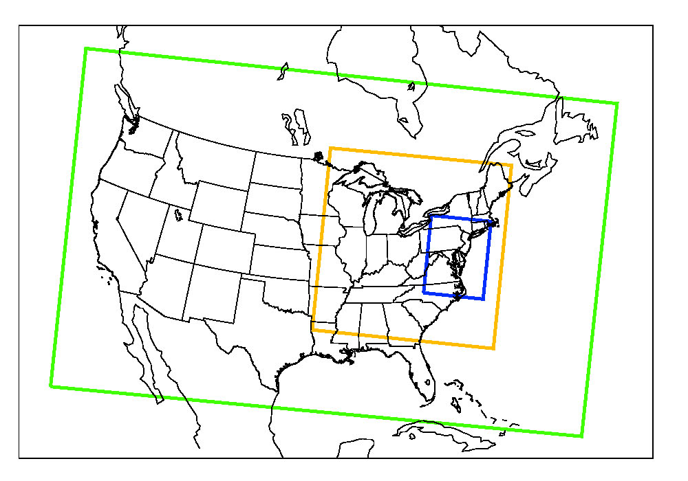
Weather Research & Forecasting
Model (WRF)
Advanced Research WRF (ARW) core V3.2
  32 levels in the vertical, up to 100 hPa
  Initial and boundary conditions based on NARR (GEOS-5 possible)
Online Chemistry Module – V3.2
  CBMZ chemical mechanism and MOSAIC aerosol parameterization including some aqueous reactions
4 km
12 km
36 km
  Initial and boundary conditions for trace gases and aerosols based on MOZART (NASA GMI possible)
  Anthropogenic emissions generated by (Sparse Matrix Operator Kernel Emissions (SMOKE) modeling system using annual emissions from US Regional Planning Offices and hourly Contiguous Emissions Monitoring data from the EPA
  Biogenic emissions from Biogenic Emissions Inventory System (BEIS) V3.12

Slide 17
MOSAIC 8-bin Aerosol Variables
8 aerosol mass size bins* (μg/kg dry air):
  SO₄, NH₄, NO₃, Cl, Na, organic carbon, black carbon, other inorganics , water
8 aerosol in cloud mass size bins* (μg/kg dry air):
  SO₄, NH₄, NO₃, Cl, Na, organic carbon, black carbon, and other inorganics
PM2.5 dry mass (μg/m³)
PM10 dry mass (μg/m³)
Backscatter coefficient
Single scattering albedo
Asymmetry parameter
Extinction coefficient
  All at 4 wavelengths (300, 400, 600, and 999 nm)
* Size bins range from 0.039 to 10 μm

Slide 18
Community Multiscale Air Quality Model (CMAQ)
Developed by EPA (Ching and Byun, 1999; Byun and Schere, 2006)
Applications:
By state air quality agencies for regulatory modeling as part of State Implementation Plan process
By EPA for national air quality assessments
By NOAA for operational air quality forecast guidance
Current version: 4.7.1 (June 2010)
Contains CB05 chemical mechanism; AE-5 aerosol module
WRF meteorological data processed by MCIP (Meteorology and Chemistry Interface Processor)
Emissions data sets developed using SMOKE

Slide 19
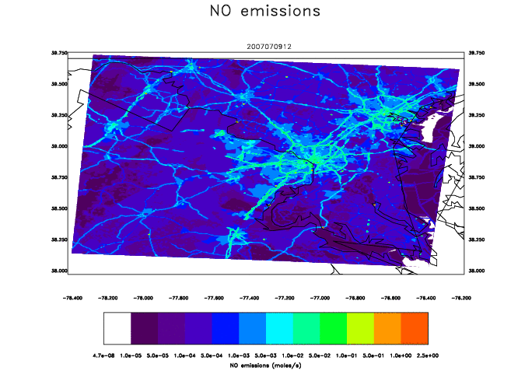
Emissions from SMOKE at 0.5-km resolution for Monday 8 AM

Slide 20
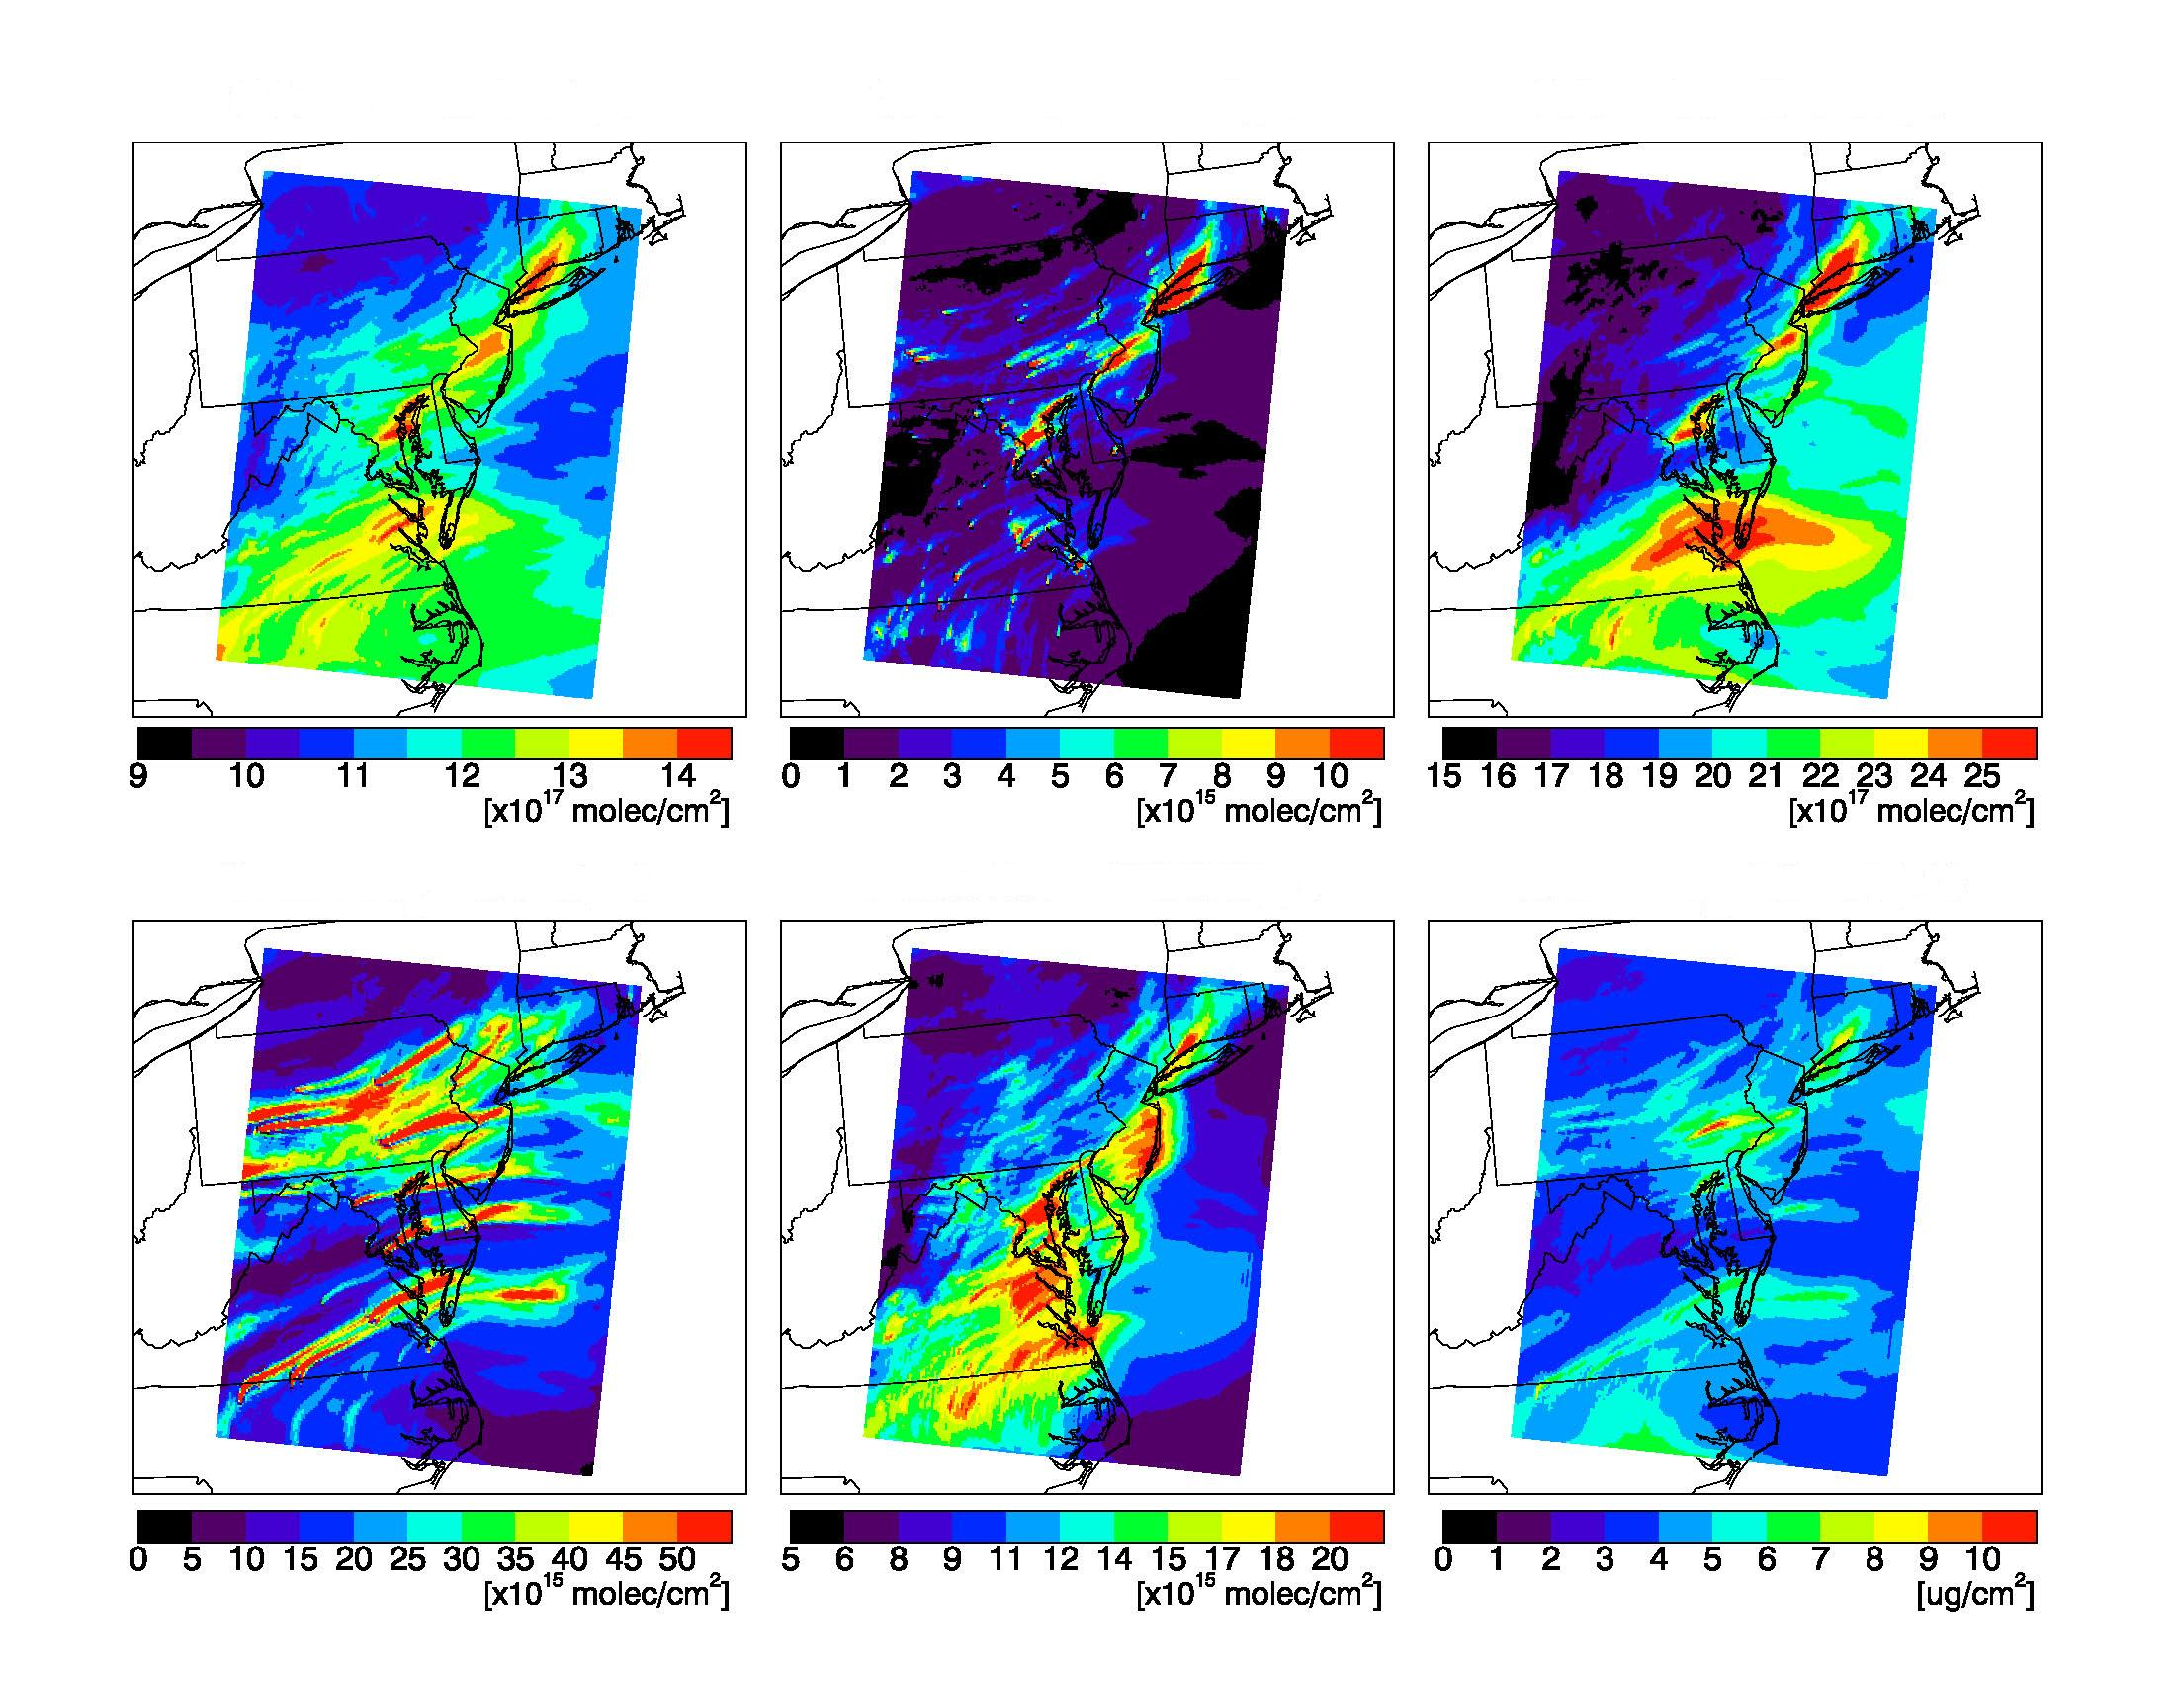
Trace Gas Species & Aerosols
July 9, 2007 – 18 UTC Trop Column (sfc – 200 hPa)
O₃
NO₂
CO
SO₂
HCHO
PM_{2.5}

Slide 21
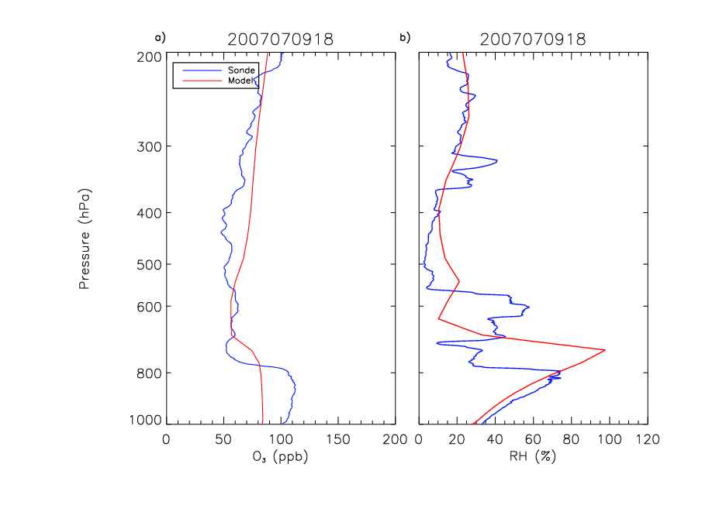
WRF-Chem (12-km res.) vs. Beltsville, MD Ozonesonde Profiles
Yegorova et al., JGR, subm., 2011

Slide 22
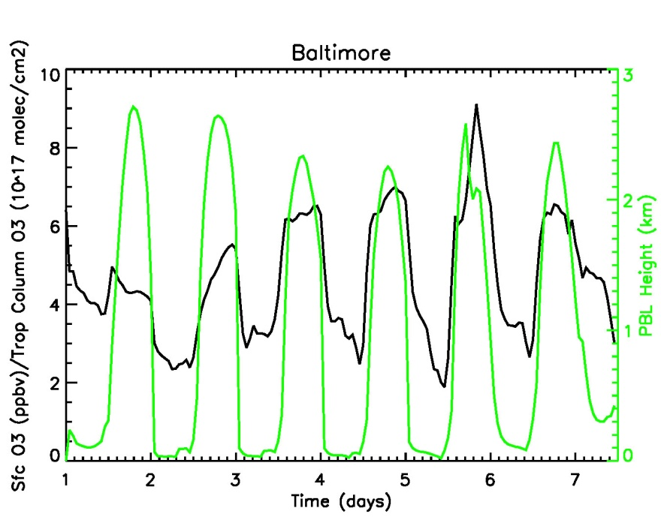
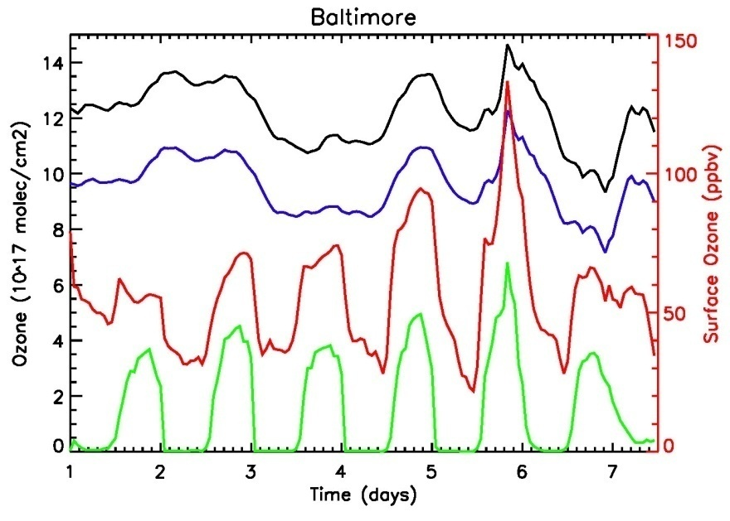
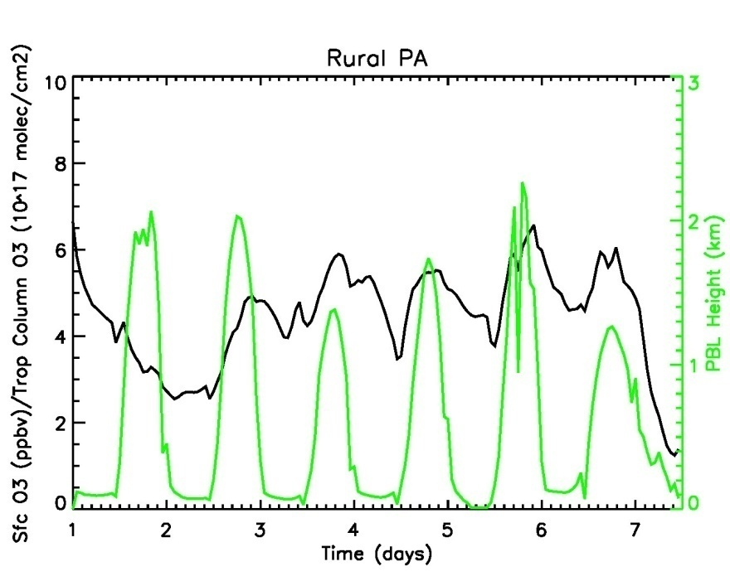
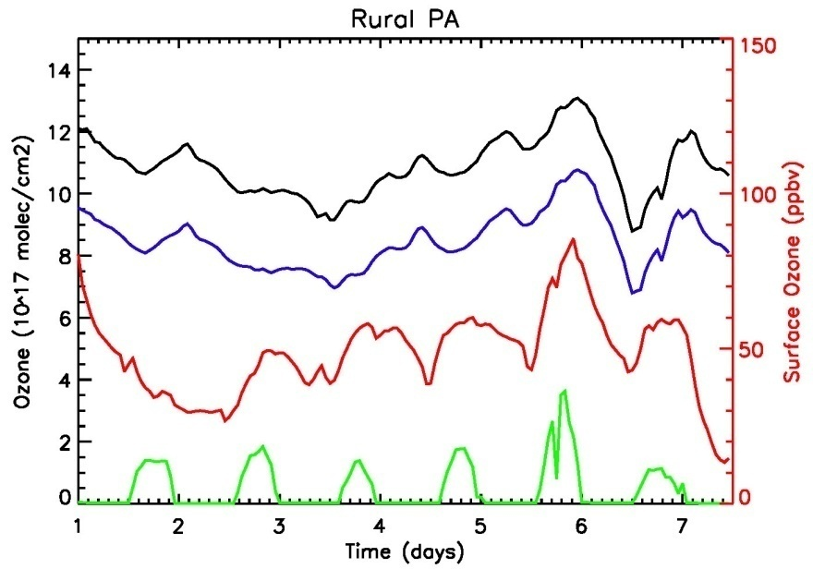
Trop. Column (sfc – 200 hPa)
ACAM Column (sfc – 330 hPa)
PBL Column
Surface mixing ratio
Sfc. O₃ (ppbv) / Trop Col. O₃ (10¹⁷ molec / cm²)
Trop Column = sfc – 200 hPa

Slide 23
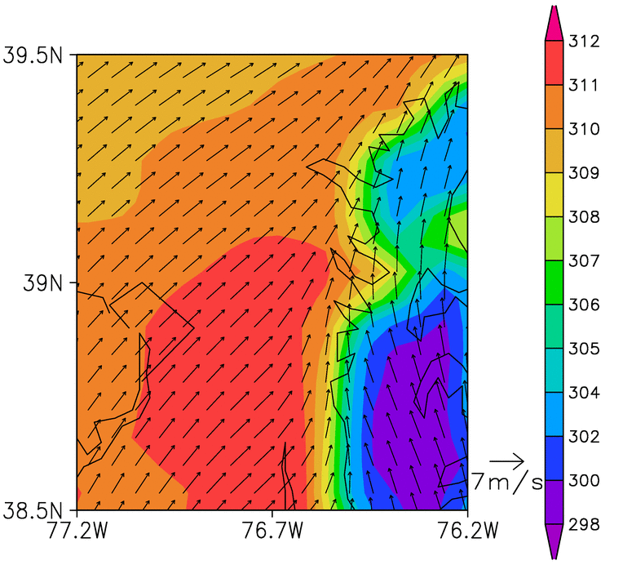
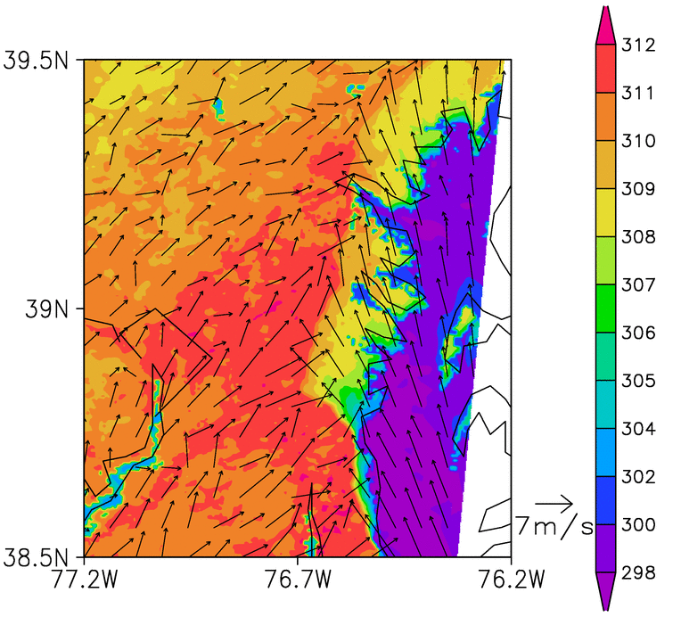
Loughner et al., 2011, Atmos. Environ, in press.
WRF-UCM 2-m temperature and 10-m wind speed at 2000 UTC (3pm EST) July 9, 2007. A stronger temperature gradient along the coastline of the Chesapeake Bay in the 0.5km domain results in a stronger Bay breeze.
13.5km
0.5km

Slide 24
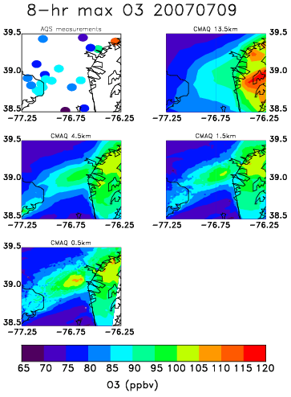
8-hr max O₃ concentrations on July 9, 2007 from measurements and the base case simulation. Less pollutants over the water in the higher resolution simulations due to a stronger bay breeze results in lower ozone concentrations over the water.
Convergence zone along western shore of bay leads to largest ozone values in that location
Loughner et al., 2011, in press

Slide 25
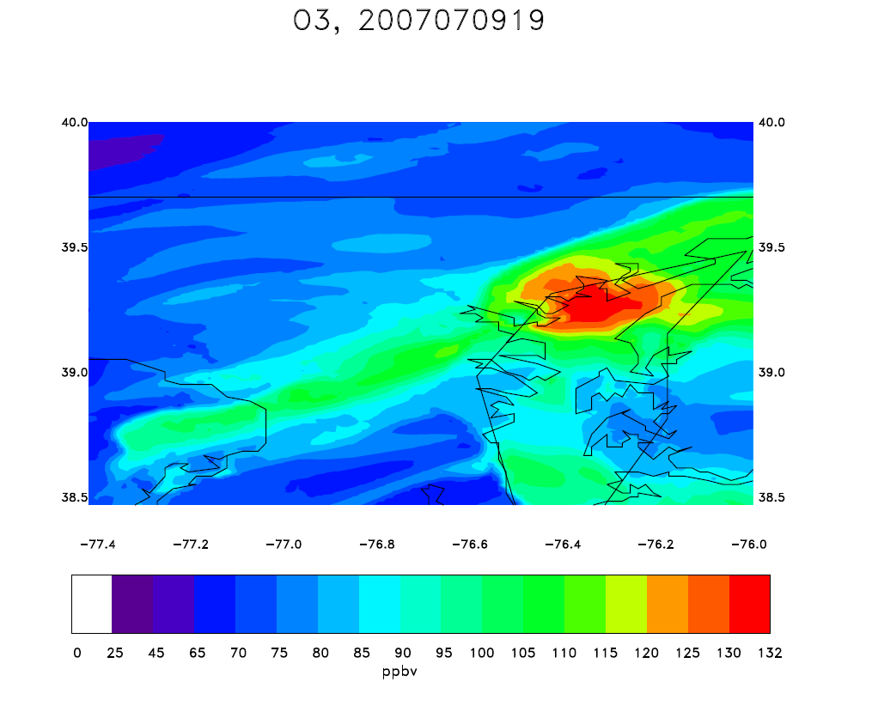
CMAQ 1.5-km simulation
Fair Hill *
* Aldino
* Essex
* Edgewood

Slide 26
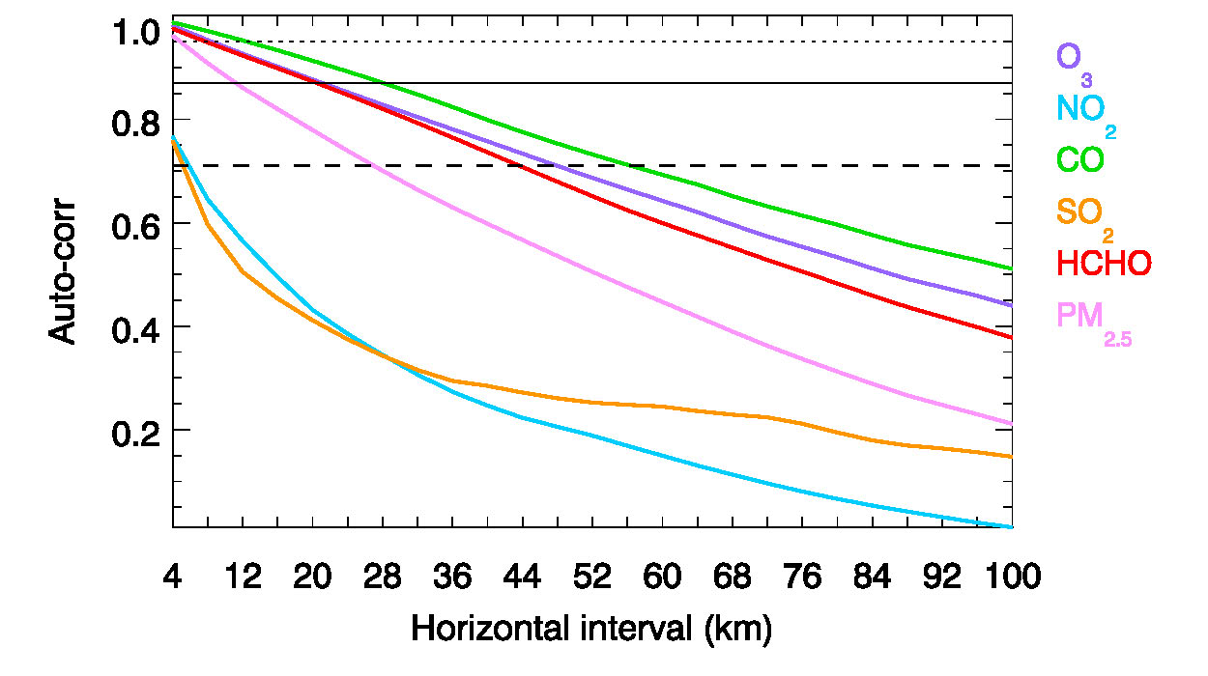
Spatial Variability in 4-km WRF-Chem Simulation
90% EV
75%
50%
Follette-Cook et al., 2011, in prep.

Slide 27
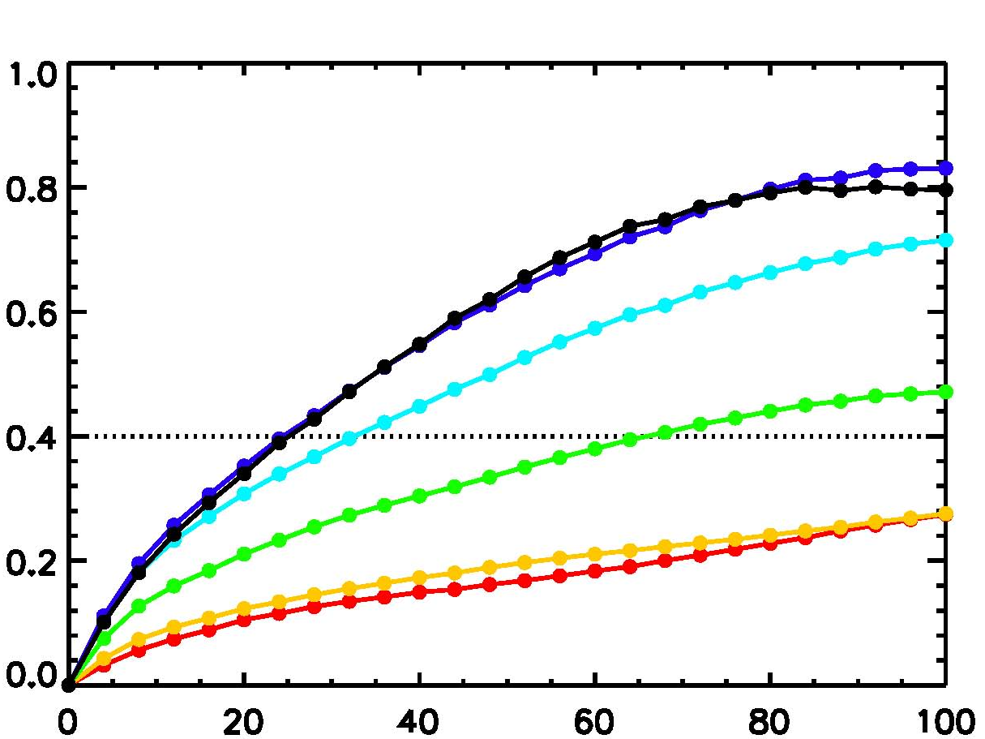
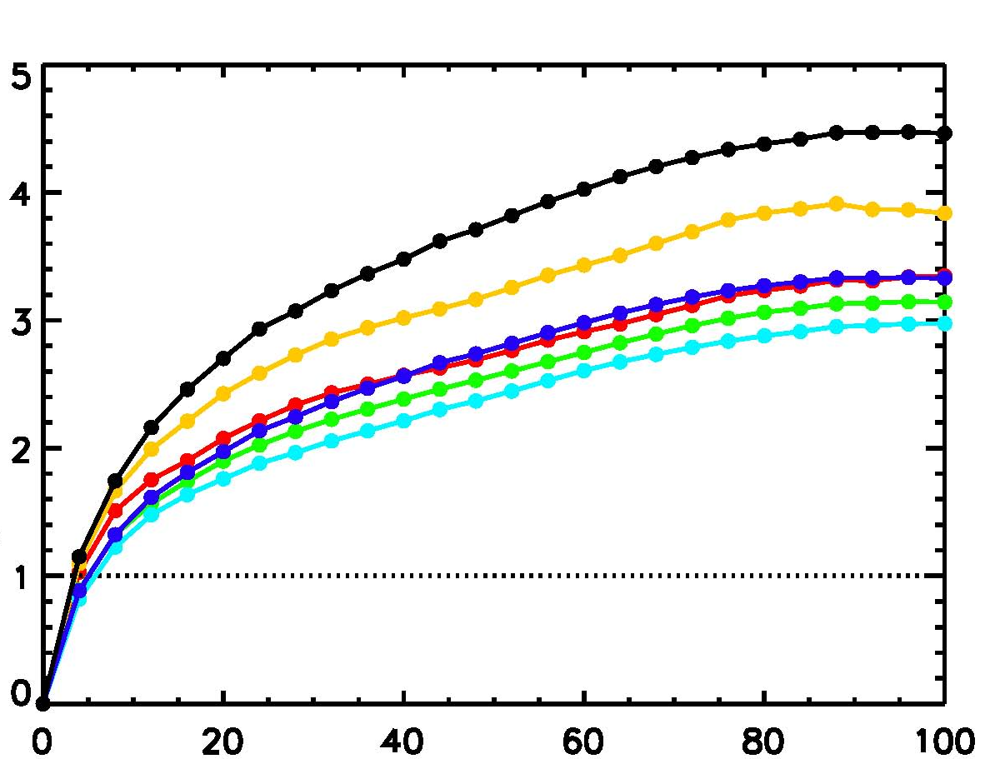
Change in Variability During Daylight Hours
Tropospheric Columns (sfc to 200 hPa)
O₃
NO₂
Average Difference (10¹⁷ molec/cm²)
Average Difference (10¹⁵ molec/cm²)
Distance (km)
7 AM 9 AM 11 AM 1 PM 3 PM 5 PM EST

Slide 28
Collaborative Post-mission Modeling Activities
Pius Lee/Rick Saylor (NOAA/ARL) – Evaluation of operational CMAQ O₃ forecasts and experimental PM_{2.5} forecasts
Maria Tzortziou (UMD/GSFC)– NASA New Investigator Program – Chesapeake Bay-focused research
Mian Chin (GSFC) – NASA Unified WRF containing GOCART aerosol
Arlindo da Silva (GSFC) – GEOS-5 GCM with GOCART aerosol and tracers
Ross Salawitch/Tim Canty (UMD) – MDE-sponsored CMAQ simulations
Russ Dickerson (UMD) – possible NASA AQAST activities
Xin-Zhang Liang (UMD) – black carbon studies using Climate-WRF
More collaborators welcome!

