Slide 1


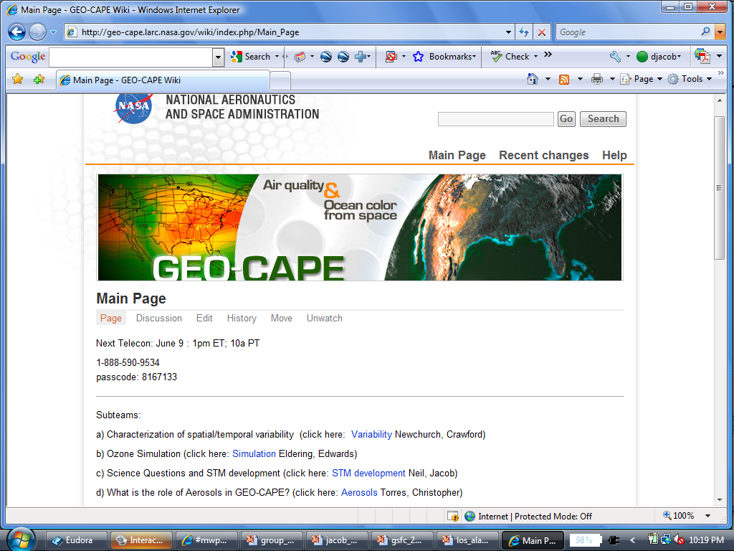
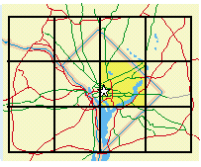
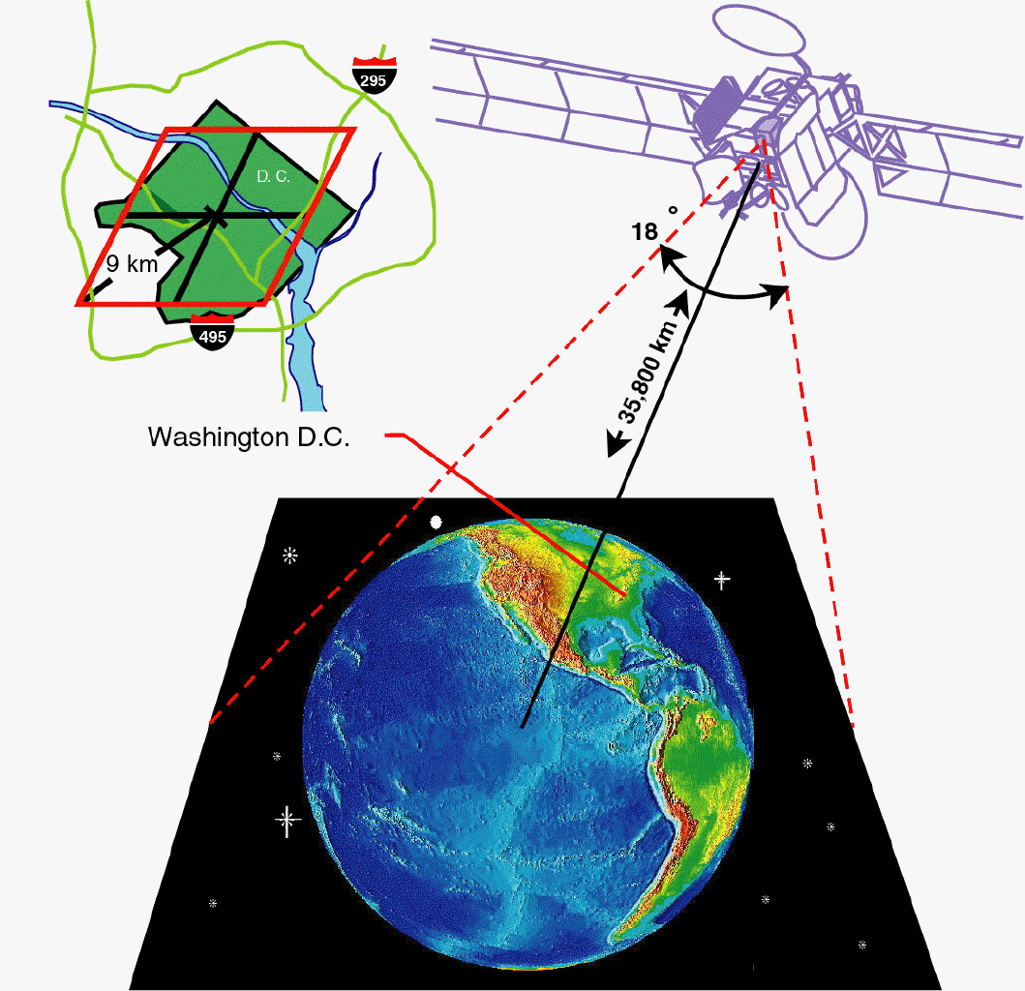


Multi-Spectral CO Measurements: From MOPITT to GEO-CAPE
David Edwards, Helen Worden, Merritt Deeter, Anne Boynard and the ACRESP & MOPITT Teams
NCAR, Boulder, CO
Ave Arellano
University of Arizona, Tucson, AZ
NCAR is sponsored by the National Science Foundation

Slide 2
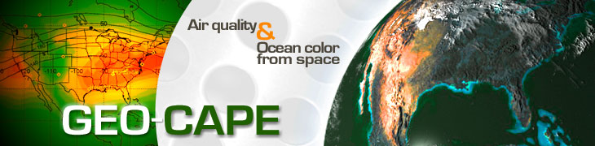
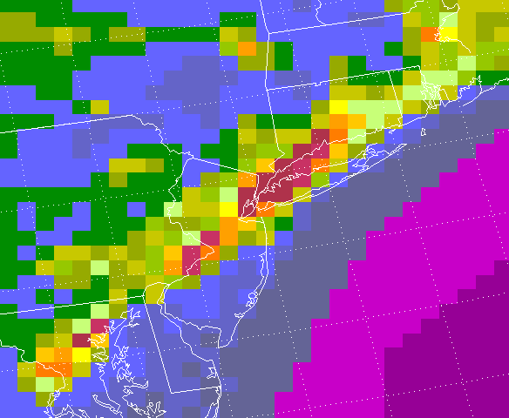
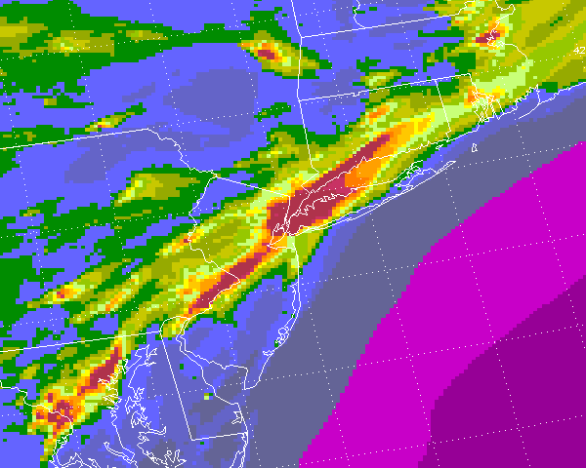
The Geostationary Coastal & Air Pollution Events (GEO-CAPE) mission is intended to build new remote sensing capability for atmospheric composition and coastal oceans science
Continuous geostationary observation allows high temporal monitoring to relate pollutant concentrations to their sources and transport, as well as provide data for air quality forecasts and coastal management decisions
Requirements includes a measurement of Carbon Monoxide (CO)
NE USA: Currently from LEO
Compared with the current capability of most LEO sensors, GEO-CAPE CO measurements would have the advantages of increased spatiotemporal resolution and sampling, and enhanced measurement sensitivity to the lowermost troposphere with a multispectral (TIR+NIR) retrieval
From GEO-CAPE

Slide 3
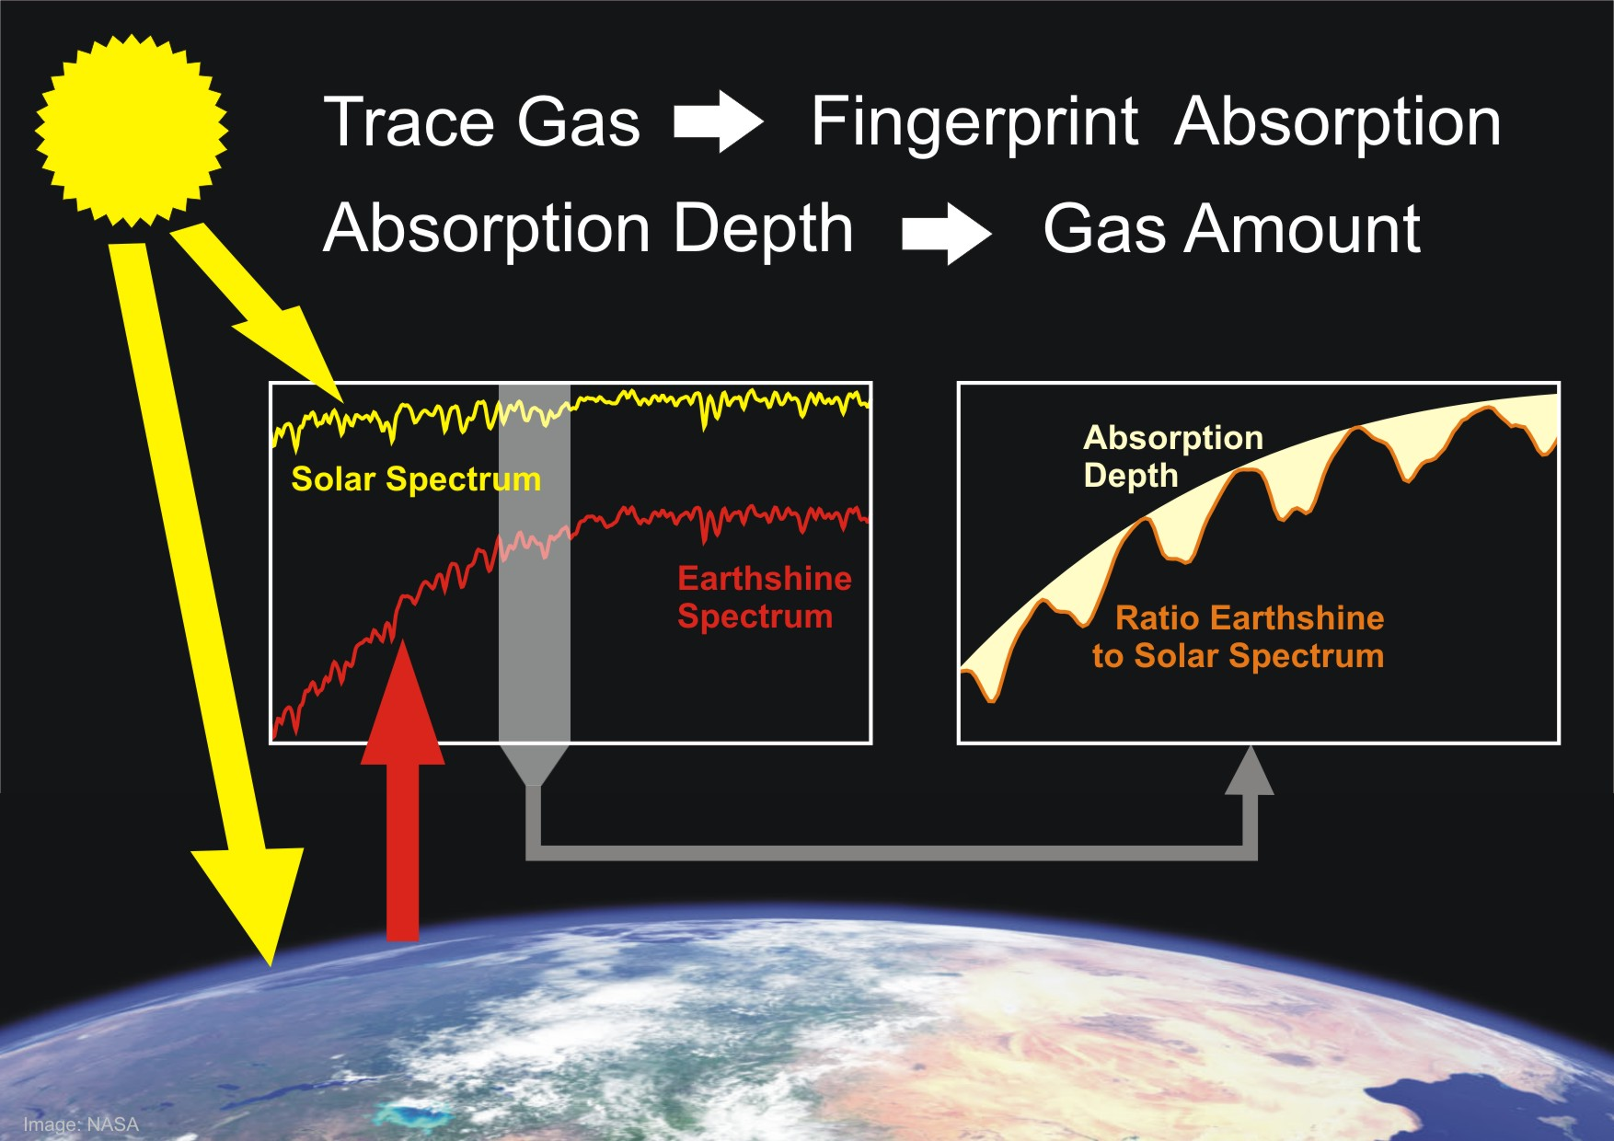
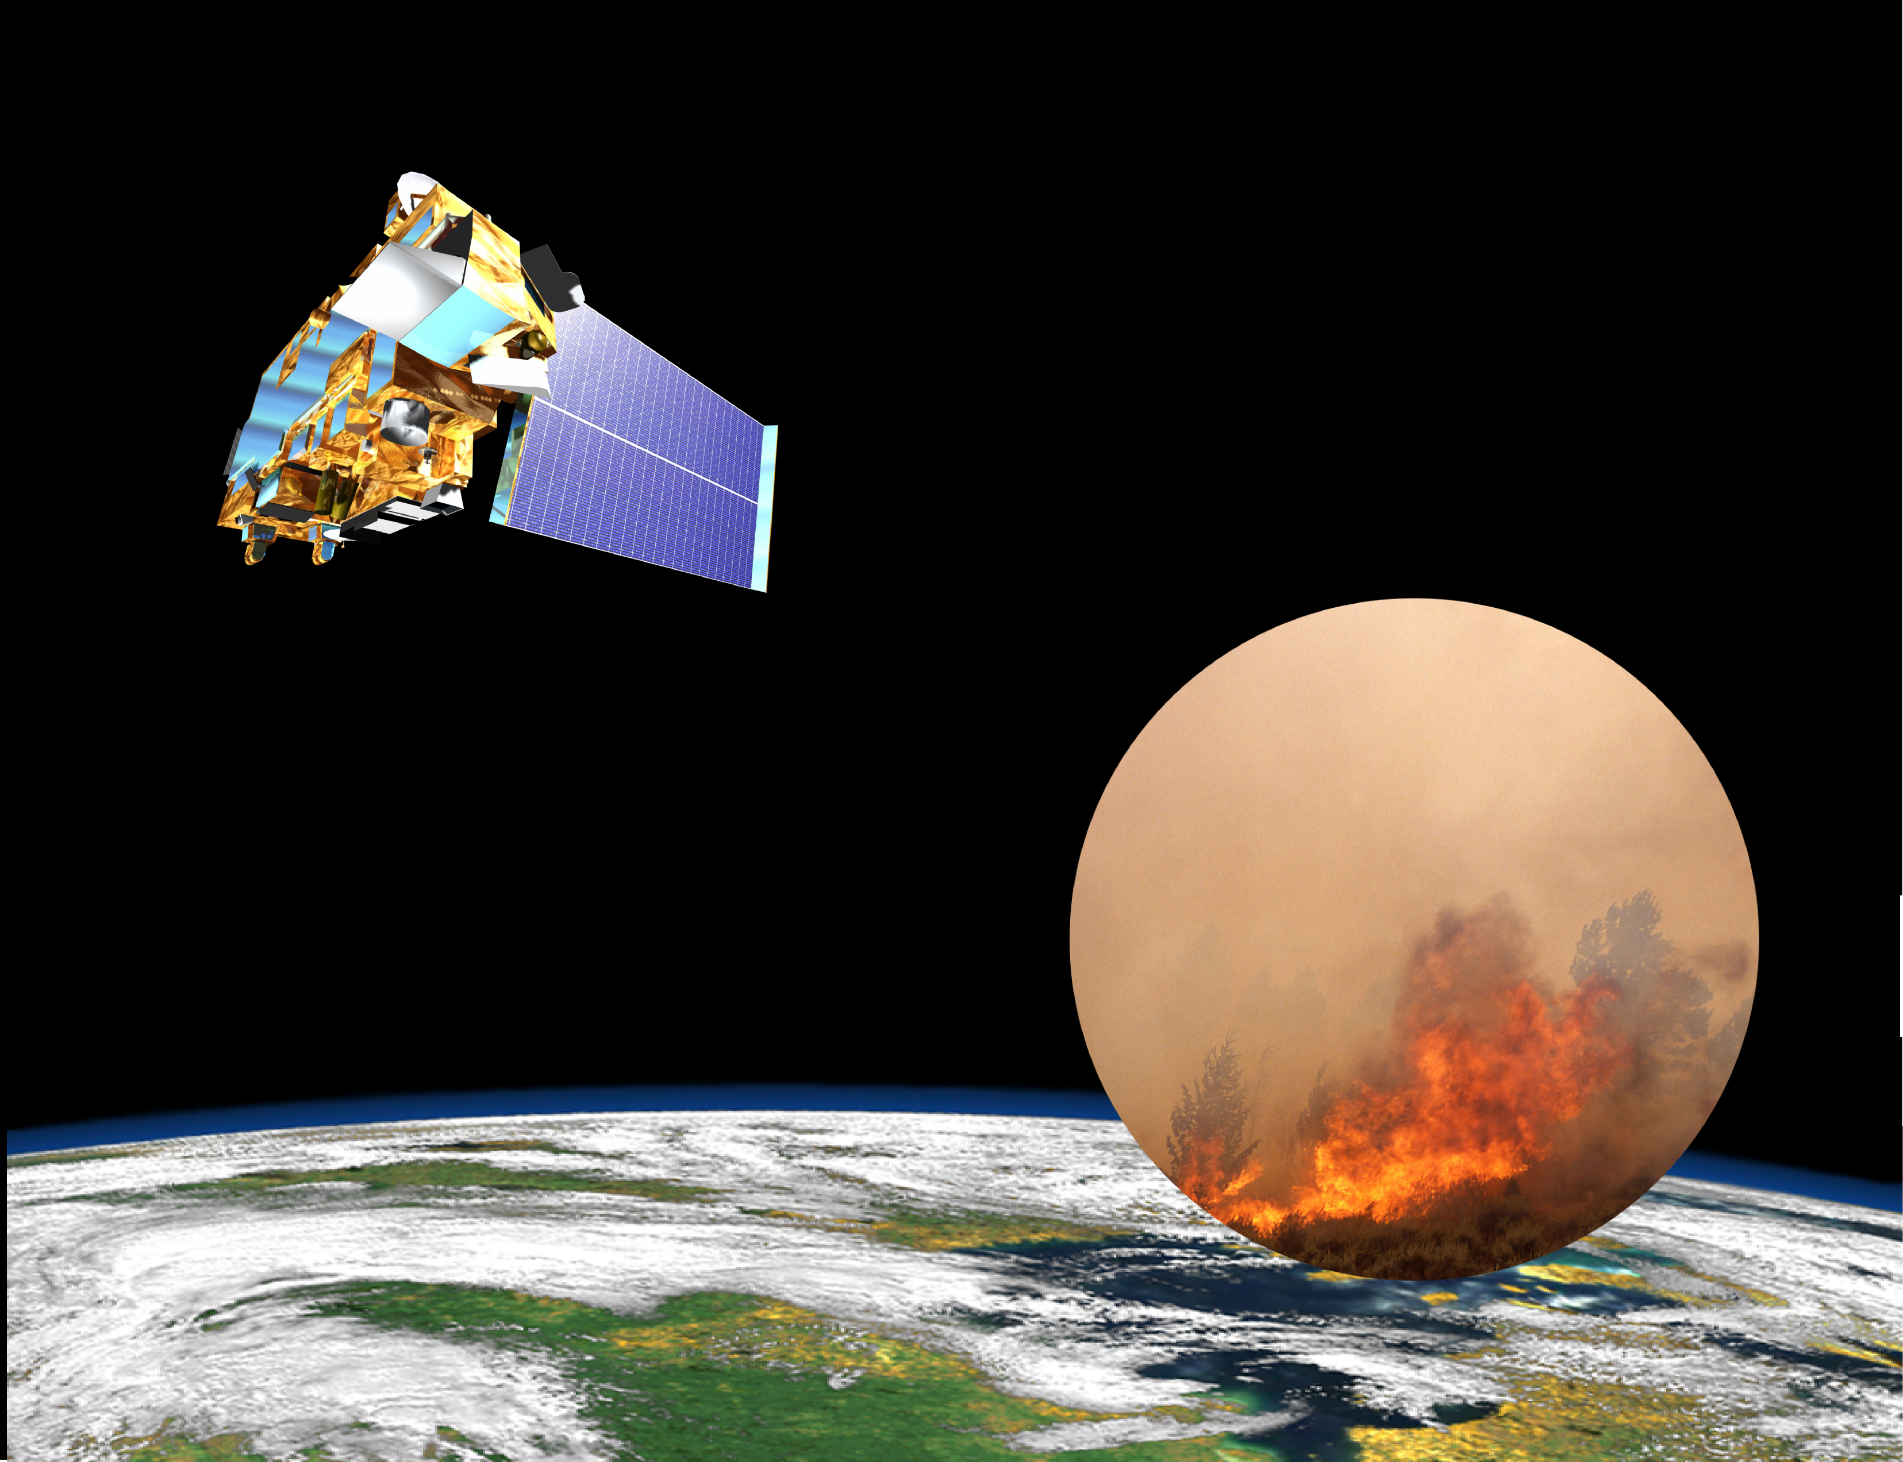
Provides column information
Provides FT profile information
TIR atmospheric emission
NIR solar reflection
TIR surface emission
CO Multi-Spectral Remote Sensing
DOAS UV Retrieval
Notes:
5/11/11
3

Slide 4
Are column measurements useful for AQ?
A true CO total column measurement is sensitive to the near-surface concentration, but is this useful for tracking surface AQ?
Unlike species such as NO₂, the medium lifetime of CO means that most of the column is contributed by transported CO in the free troposphere (FT)
Lowermost troposphere (LMT) below ~850 hPa accounts for ~ 30% column
Column measurements must also be of high precision to capture the variability of the LMT which is equivalent to ~ 10% of the total column
WRF-Chem CO statistics: 24km x 24km and 24 June-10 July 2008

Slide 5
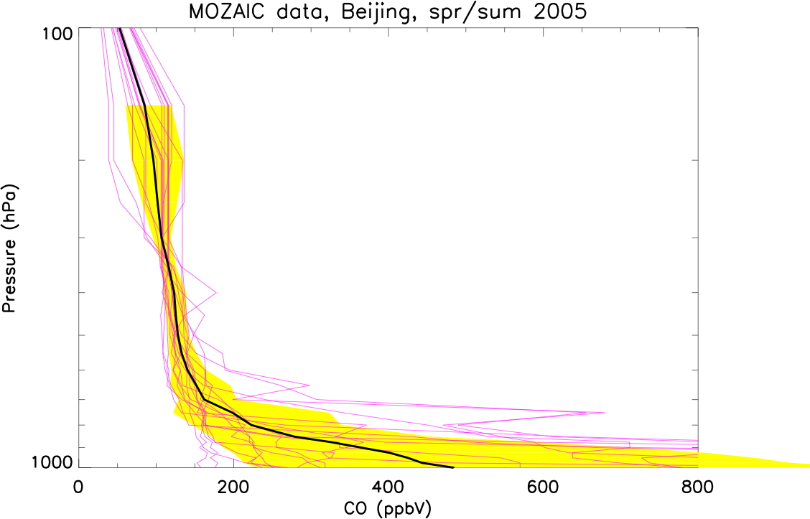
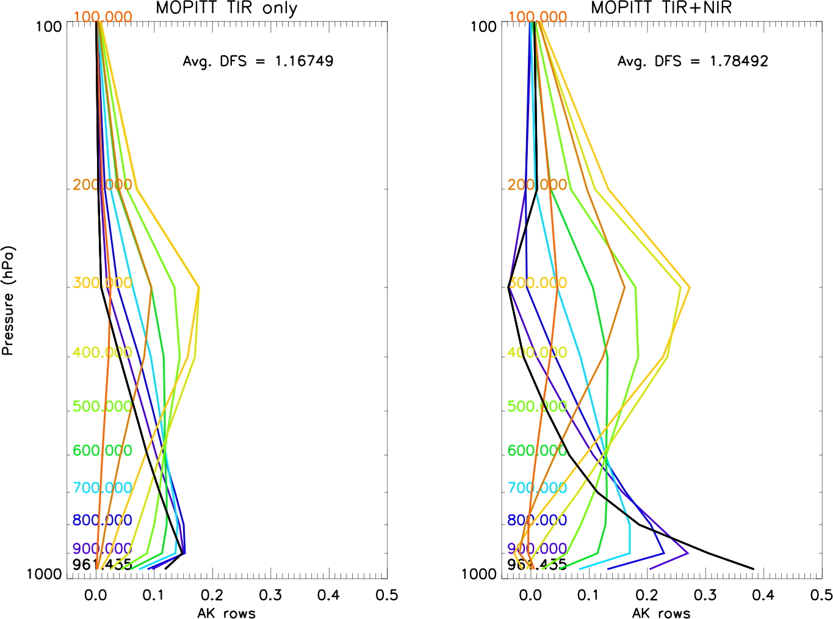
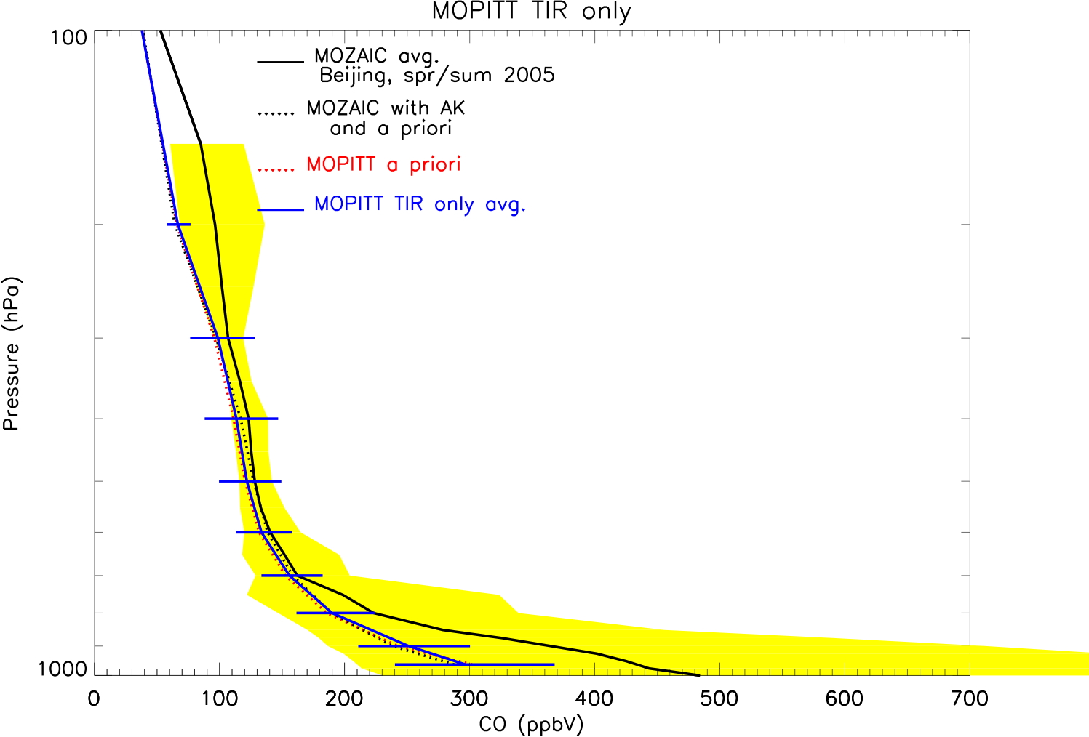
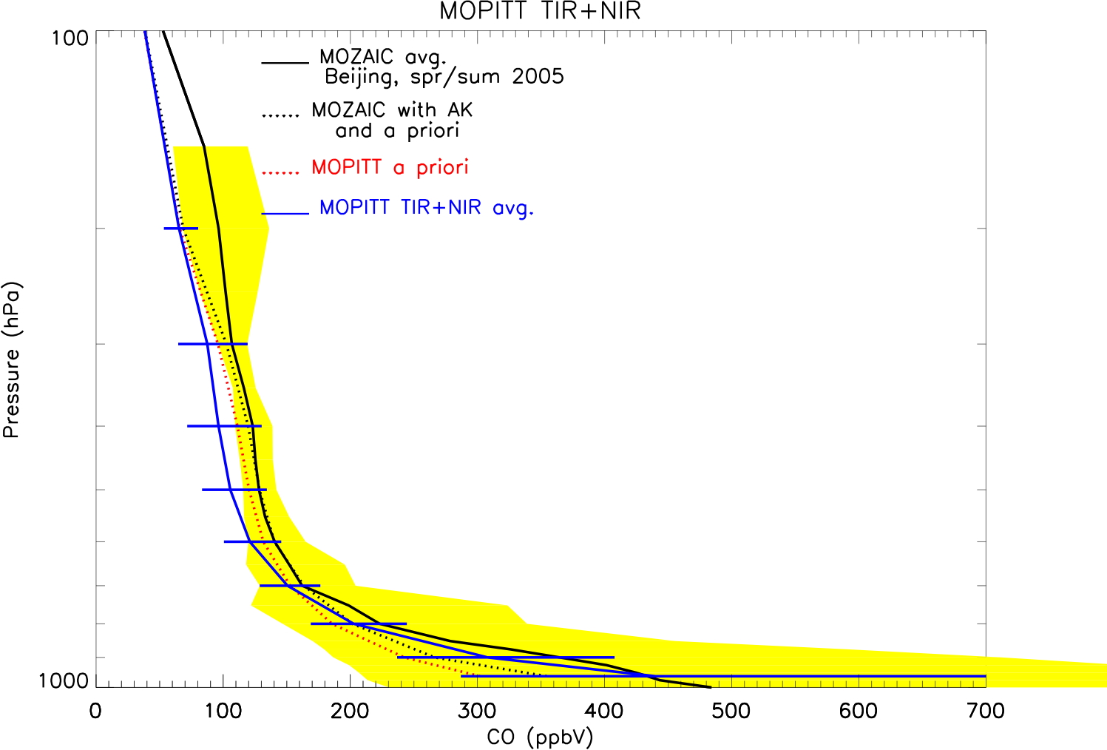
Beijing MOPITT V5-MOZAIC comparisons
N__{flights} = 18
TIR-only
AK
TIR+NIR
AK
MOZAIC avg.
MOZAIC std. dev.
Improved near-surface sensitivity
TIR_only
TIR+NIR
N__{MOP} = 576
coincidence =
200km, 24 hr.
Retrieval captures high CO and variability in the PBL

Slide 6
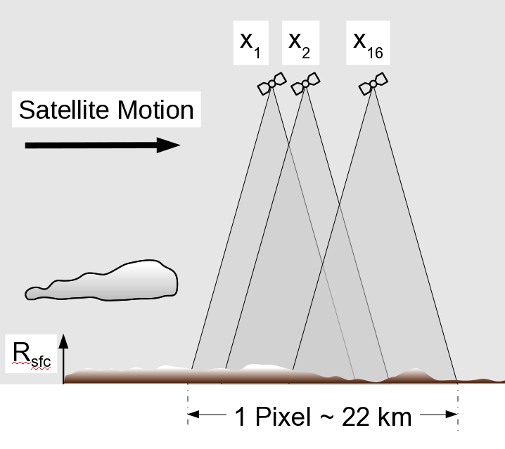
MOPITT ‘Geophysical’ Noise
Understanding of retrieval errors depends on the ability to quantify radiance errors
Find that MOPITT 'On-orbit' NIR radiance errors >> pre-launch instrumental errors
Main source of random errors for NIR radiances is geophysical
Each MOPITT 'pixel' is actually composed of 16 overlapping FOVs spaced ~ 170 m apart, a total shift of 2.7 km for one stare
Fine-scale variations in surface reflectance produce fluctuations in raw 'counts'
Geographical patterns consistent w/ MODIS-derived reflectance variability
From Deeter et al., sub. JGR, 2011
The MOPITT group is recommending some averaging or perhaps filtering of the data to compensate for the higher noise and retrieval error: the degree to which this is necessary will be application dependent
May limit MOPITT's applicability to high spatiotemporal AQ science, but the multispectral demonstration of improved vertical information stands
This is solely a MOPITT problem: Future instrumentation using gas correlation in either LEO or GEO should be able to account for this

Slide 7
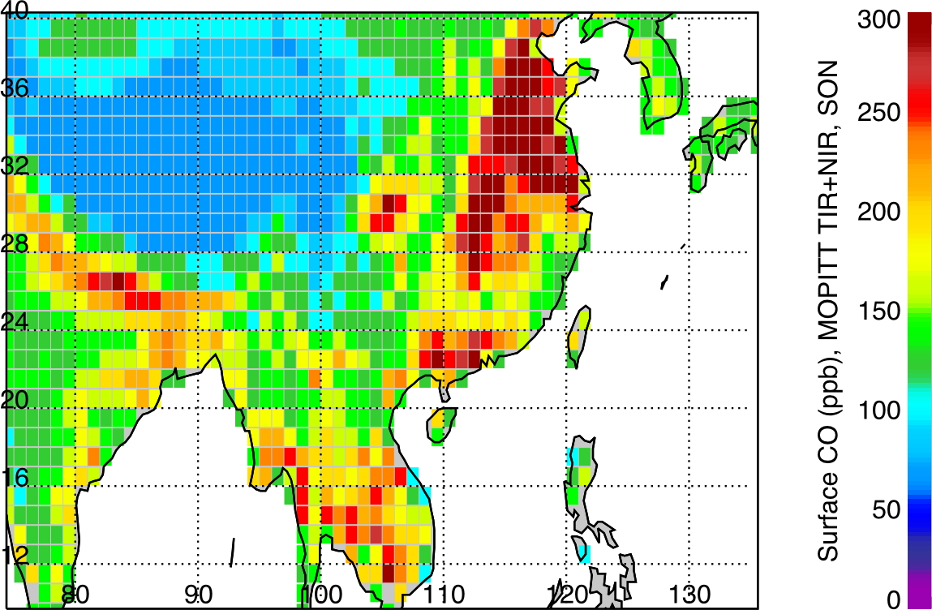
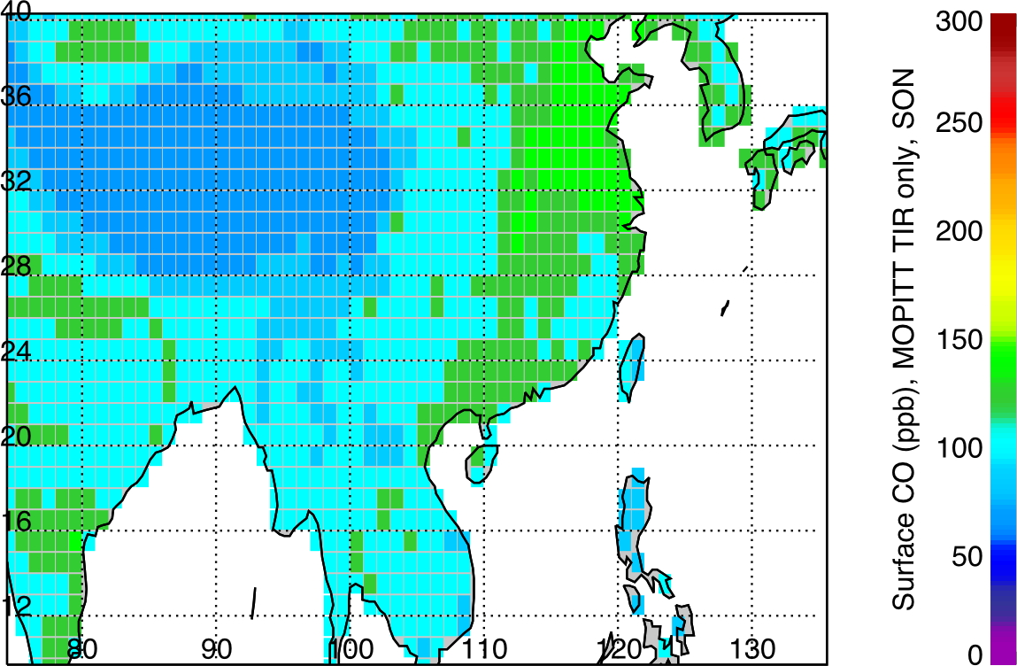
2005-2008 Sep-Nov Seasonal Average
MOPITT Surface CO Retrievals
From Worden et al., JGR, 2010
TIR+NIR with constant a priori
Beijing
TIR-only with constant a priori
Shanghai
Chengdu
Wuhan
Hong Kong

Slide 8
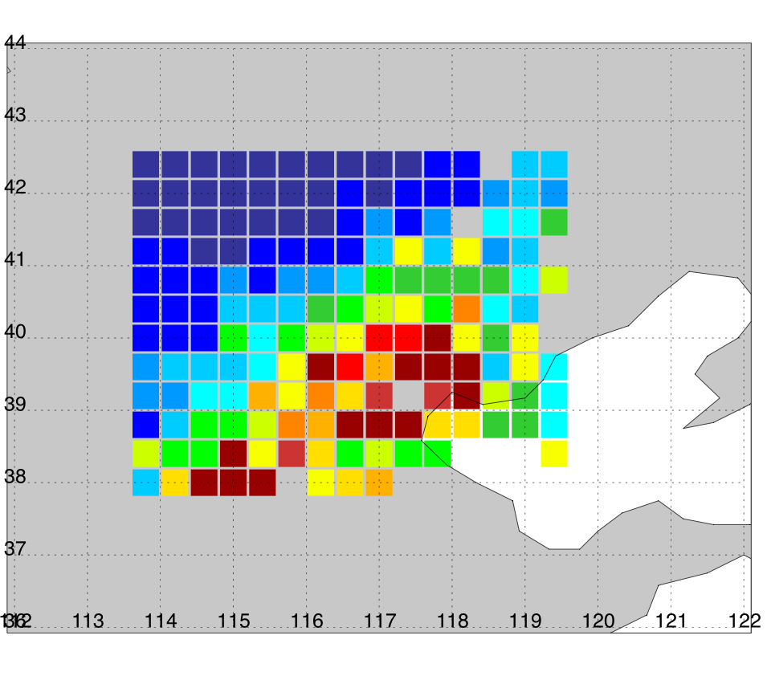
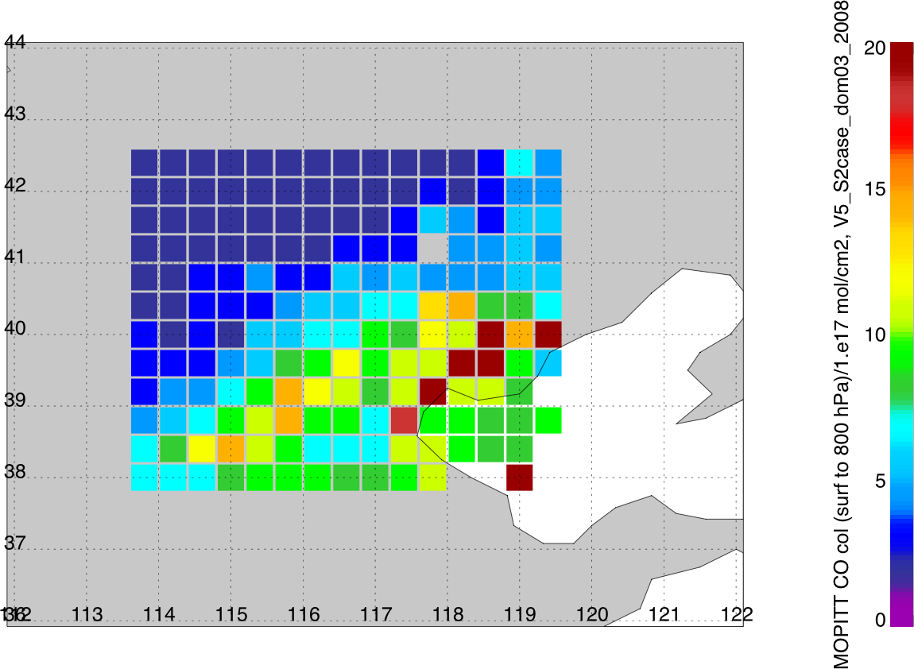
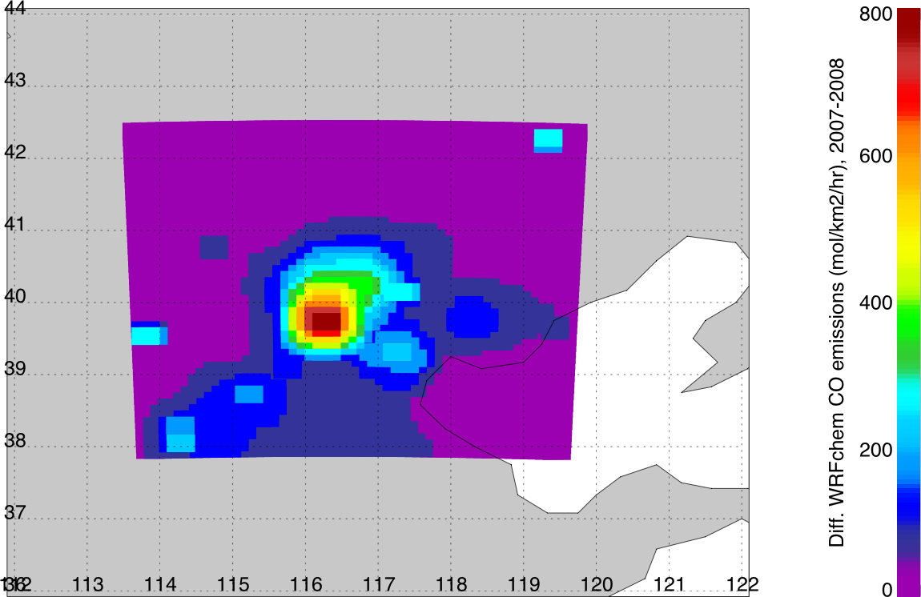
Beijing Olympics: Estimate of CO & CO2 reduction due to traffic restrictions
MOPITT sees
7.0 ± 1.2 Gg[CO]/day
reduction in CO comparing Augusts of 2007 and 2008 for Beijing
[39.5°-41°N,
115.5°-117.5°E]
MOPITT CO Column sfc-800 hPa
(molecules/cm²)/1.e17
Aug. 2007
Aug. 2008
Difference in WRF-chem CO
emissions (2007-2008)
Using WRF-chem for attribution of CO
difference due to emissions vs. meteorology:
8.4% reduction from meteorology in 2008
83% of reduction in CO from Beijing transport (box area) corresponding to 5.6 Gg[CO]/day
Assuming CO/CO₂ emission ratio = 0.1 for
China transportation sector (Streets et al.,
JGR, 2003, 2006), this is 56 Gg[CO₂]/day
Area with transportation emission differences
From Worden et al., prep. JGR, 2011

Slide 9
Are new LMT measurements useful for AQ?
Surface cf. PBL Concentrations usually track unless there is a high emission – leads to a strong CO gradient through the PBL
PBL cf. LMT During daytime, and when the PBL is higher, PBL and LMT CO are close, as they are when low-level transport is important
Surface
CO peaks at night after PBL collapse – but these peaks are not observed without NIR measurements
WRF-Chem 24km grid over Washington DC, June-10 July 2008
From Boynard et al., prep. JGR, 2011
Notes:
Make the Comment about O3: this peaks in the day because of photochemical sources

Slide 10
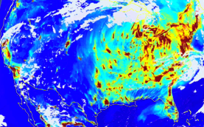
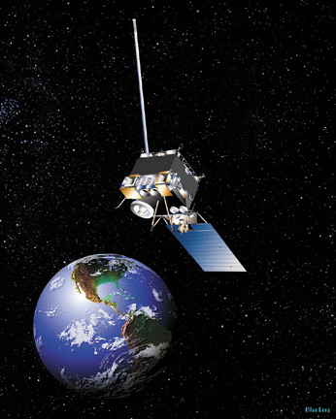
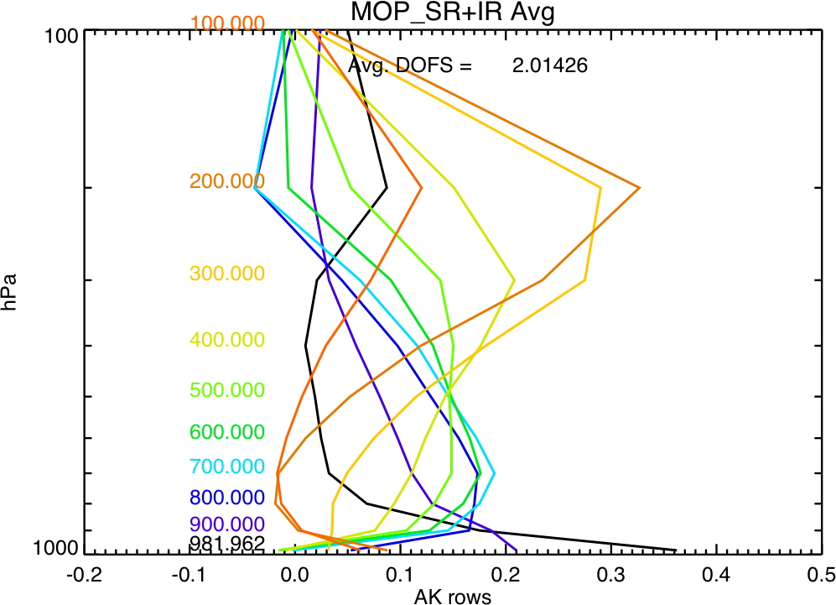
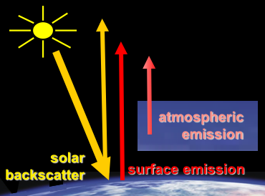

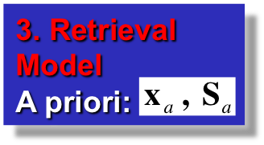
The OSSE Observation Simulator
2. The Forward Model
Simulated signal:
Measurement Sensitivity:
1. Nature Run Model Required state:
Instrument DescriptionNoise:
4. Retrieved Products:
Radiative Transfer
Notes:
We now have the basic OSSE frameworks
Learnt some things
Now we need to get more sophisticated and focus in on new developments for the various OSSE modules
Necessary to get to the point where OSSEs can truly be used as a component of tradeoff studies
Start with the Observation Simulator

Slide 11
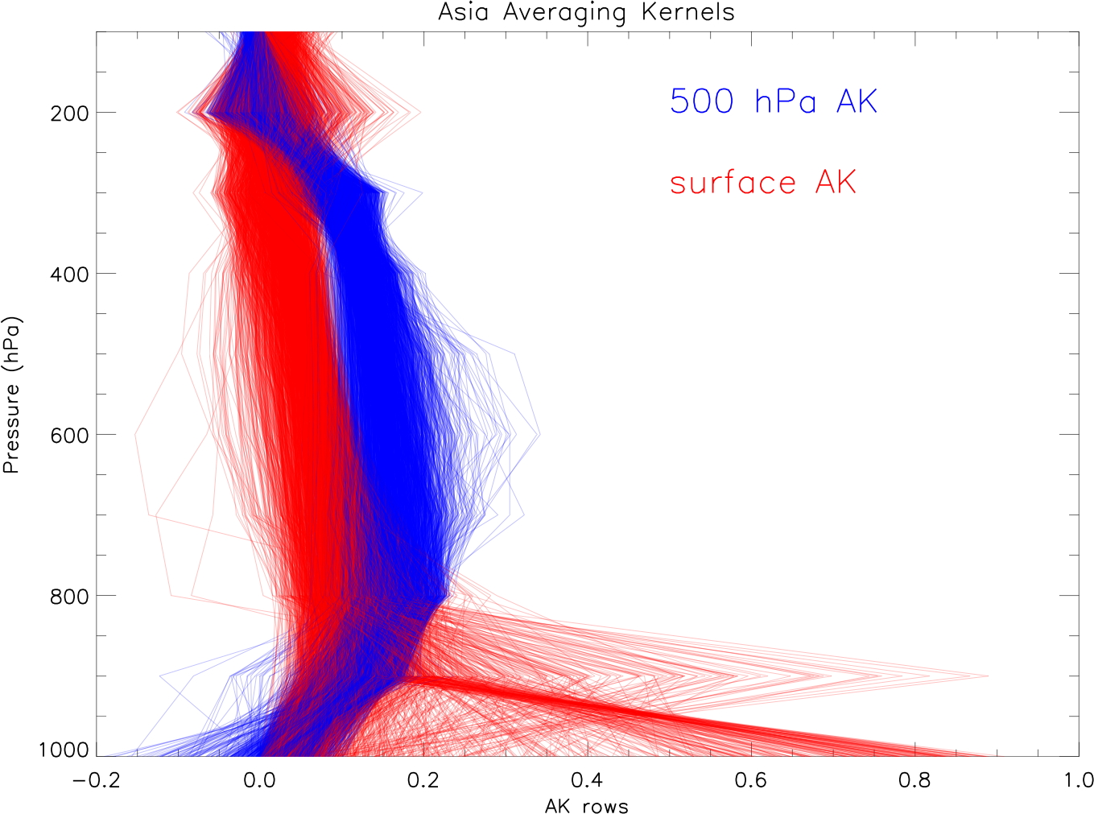
Retrieval Averaging Kernels
OSSEs provide a means to generalize on the conclusions of limited retrieval case-studies
Observation Simulator measurement & retrieval characteristics are represented by the Averaging Kernel (AK) and retrieval error
However, running the full Observation Simulator in the OSSE is expensive and very involved
OSSEs have been simplified by assuming all observations can be represented with a few AK cases and these are used to sample the Nature Run model everywhere/all day
But AKs vary a lot….
Spread in MOPITT AKs for surface & 500 hPa CO retrievals
Depend on surface characteristics, temperatures, clouds, aerosol loadings, trace gas loadings, viewing and solar angles
Realistic OSSEs need to account for this
Notes:
Major limitation of the OSSEs to-date
Likely to make a difference
Because AK differences depend on surface characterization, might expect geographical biases
Again, we can use heritage measurements to tell us how important this is
Go back to slide 8: Perhaps we can short-circuit this calculation loop

Slide 12
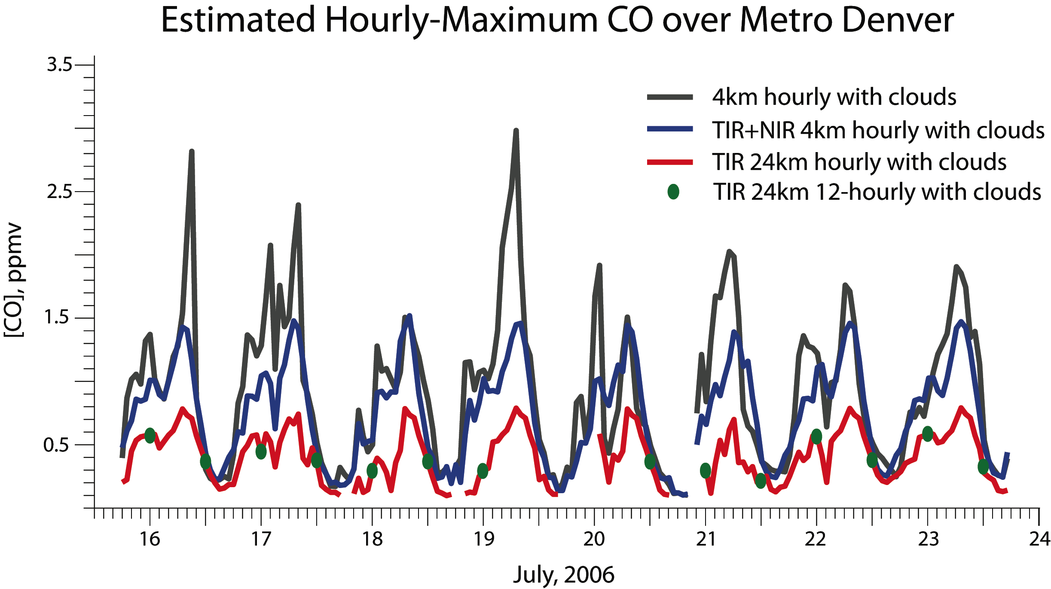
Hourly-Maximum CO over Metro Denver for different Observation Simulators
Grey Baseline: Surface CO 4-km hourly shows peak around 7-am local time (rush-hour emissions) and a smaller peak during the night (PBL collapse)
Blue - Corresponding to expected GEO-CAPE: A multispectral (TIR+NIR) CO retrieval (5% allowable cloud/pixel) follows baseline nearly continuously with vertical dilution due to finite AK width in the LMT
Red: A 24-km pixel TIR-only retrieval sensitive primarily to the FT results in lower CO than baseline due to vertical sensitivity and horizontal dilution of pollution events. Frequent cloud data gaps mean trend is not obvious
Green - Corresponding to current MOPITT: The 24-km 12-hourly sampling fails to capture the diurnal cycle

Slide 13
Future OSSE Studies (trace-gas-centric)
Regional Scale: Develop modeling/DA at the regional scale for OSSEs to determine measurement spatiotemporal resolution requirements and investigate horizontal/vertical/temporal scale inter-dependence: Nature Run: 4-km hourly CONUS WRF/Chem run with evolving cloud fields; Control Run: Ensemble WRF-Chem/DART simulation; Perturbation Runs: Assimilation of Observation Simulator sampling Nature Run with progressively coarser spatiotemporal resolution
Correlations: Determine how GEO-CAPE CO measurements can improve knowledge and forecasts of ozone, aerosol type and surface PM through ozone-CO and AOD-CO correlations in a DA system
Active chemistry: Determine how the ensemble of GEO-CAPE ozone, CO, NO2, and HCHO measurements can constrain ozone production and transport to improve knowledge and forecasts of ozone air quality
Integrated observing system: Investigate the relative contributions of GEO-CAPE, other LEO satellite, suborbital and surface observations in driving a chemical weather forecast
Nighttime measurements: Determine importance of nighttime TIR-only data in improving an AQ forecast – implications for instrumentation payload
Boundary conditions: Importance of observations over the neighboring oceans, how far out these need to go and at what spatiotemporal resolution to constrain boundary inflow/outflow
Notes:
Once some of the OSSE module developments have taken place, there are many studies waiting to be performed
Probably an equivalent list for the aerosol and coastal oceans groups
Important to recognize that OSSEs are just one component of tradeoff studies
For example, underlying physics plays a dominant roll in defining measurement sensitivities and these may look much the same in OSSEs for different technologies

