Slide 1
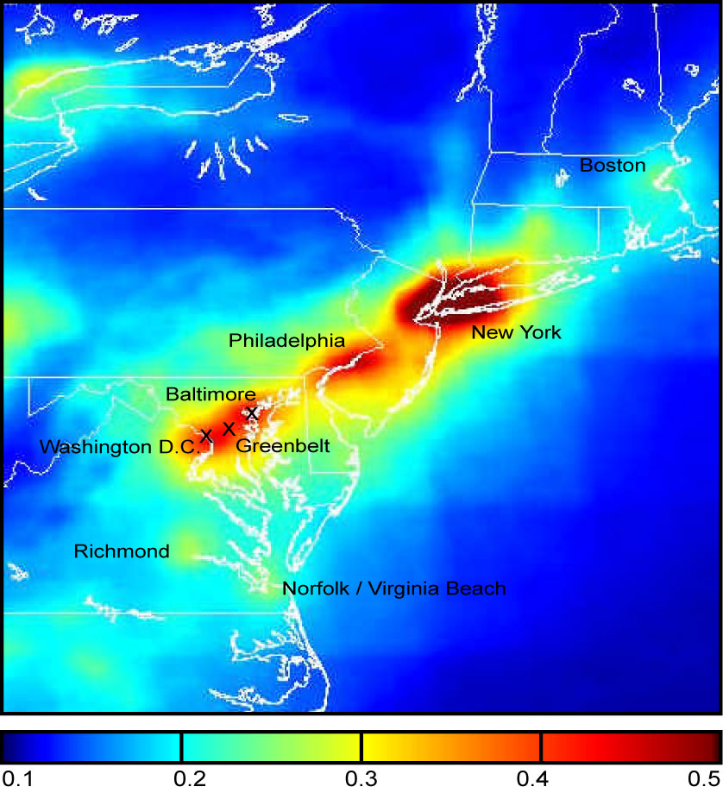
Effect of NO₂ on Geostationary Satellite Chlorophyll Retrieval In Coastal Water:
False Diurnal Variation
Jay Herman & Maria Tzortziou
Annual Average NO2 Climatology from OMI

Slide 2
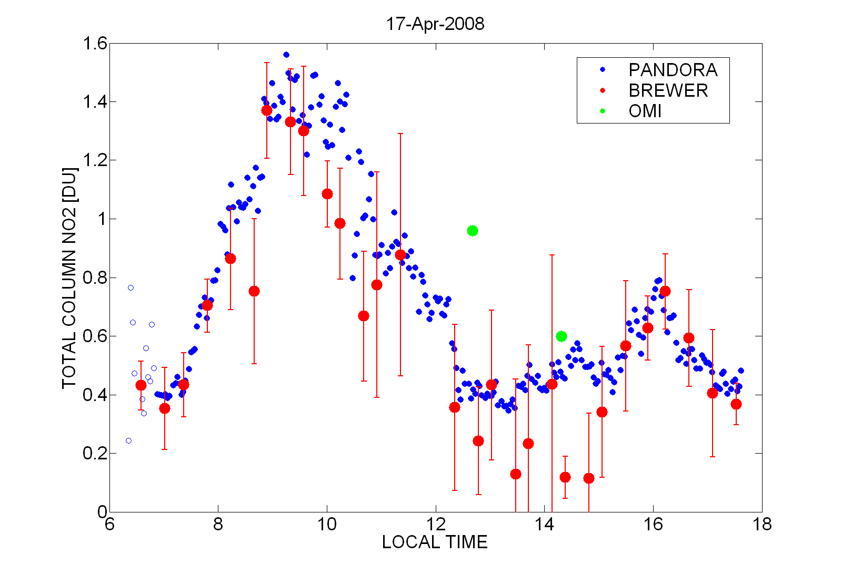
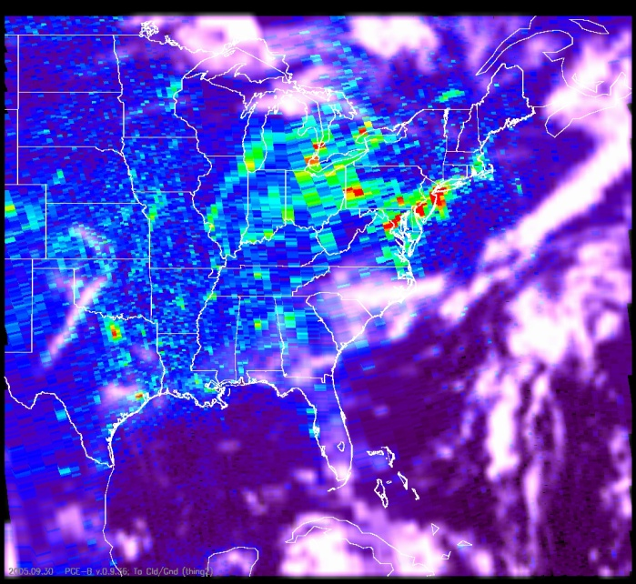
Examples of NO₂ Diurnal Variation
OMI
OMI observed pixel NO₂ variability for Sept. 30, 2005 over eastern and central US with clouds. Areas covered with clouds have no current NO2 information.

Slide 4
Input to Radiative Transfer Equation
Measured Reflectivity of Chesapeake Bay
[Tzortziou et al., 2007]
Including Chlorophyll and CDOM

Slide 5
The Effect of NO₂ Altitude Distribution
0–2 km
0–4 km
0–3 km
Use 0 - 3 km Case
In following slides

Slide 6
Output from Radiative Transfer Equation
490 nm
443 nm
Reflectivity Change per DU of NO2
dR/R = -0.01*(3.84243 + 0.08821*exp(SzaEff/14.91337)) Wvl=490 nm
dR/R = -0.01*(7.42119 + 0.40409*dexp(SzaEff/18.29943)) Wvl=443 nm

Slide 7
Retrieval Error per DU of NO₂
Chlorophyll Blue/Green Ratio From MODIS Website
data a0,a1,a2,a3,a4/ 0.3660,-3.0670, 1.9300, 0.6490,-1.5320/
x = log10( ratio(i))
x2 = x*x; x3 = x2*x; x4 = x3*x
Ca(i) = 10**( a0 + a1*x + a2*x2 + a3*x3 + a4*x4 )
P = Ca = A R ^{–N}
dP/P = -N dR/R * [NO₂]
The Power Coefficient N is the key to the magnitude of the NO₂ false diurnal variation effect on retrieved chlorophyll values

Slide 8
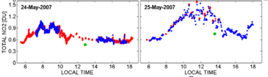
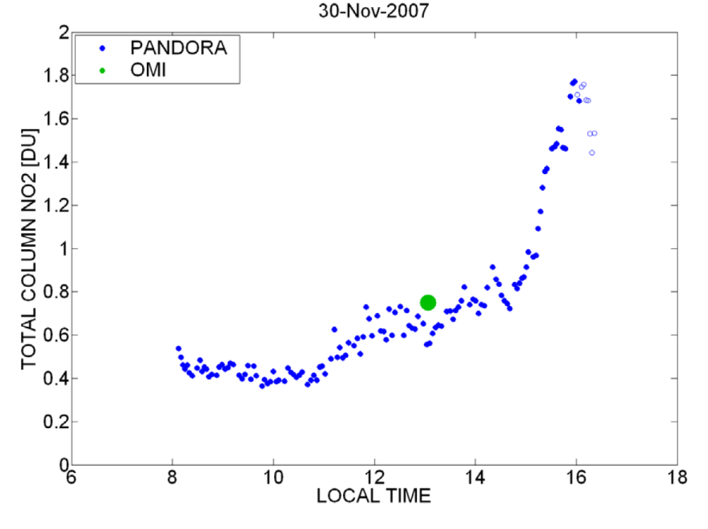
Measured NO₂ Amounts vs Time of Day
Case 2
Case 1
Case 3

Slide 9
Case 1: An Example of False Diurnal Variation in Chlorophyll

Slide 10
Case 2: An Example of False Diurnal Variation in Chlorophyll

Slide 11
Case 3: An Example of False Diurnal Variation in Chlorophyll

Slide 12
Case 1,2,3: An Example of False Diurnal Variation in Acdom
Since Acdom, depends R490,
the percent error per DU of NO2
is reduced compared to retrievals
based on R443

Slide 13
Summary
NO₂ can be highly variable throughout the day.
Using an incorrect assumed value of NO₂ affects the retrieved water leaving radiance nLw and can be interpreted incorrectly as chlorophyll absorption.
Chlorophyll retrievals errors can be over 50% based on using an assumed NO₂ amount from another instrument or climatology.
NO₂ should be measured at the same time that coastal ocean water leaving radiances are measured.

