Slide 1
Satellite and Above-Boundary Layer Observations for Air Quality Management Workshop
Jim Szykman (ORD/NERL), Scott Jackson (Region 8) and Terry Keating (OAR), U.S. EPA
Center Green Bldg. 1 UCAR's Campus
Boulder, CO
9-10 May 2011

Slide 2
EPA Working Group on Satellite Observations for Air Quality Management
Objectives:
To improve communication across the different EPA groups interested in satellite observations related to air quality management
To better articulate EPA’s interests and commitment to using satellite observations
To provide a focal point for communication with NASA and NOAA, with a focus on Geostationary Coastal and Air Pollution Events (GEO-CAPE) and other satellite missions within the NRC Decadal Survey
EPA-GEO Committee (original convener)
Terry Keating (OAR/OPAR), Venkatesh Rao and Rich Scheffe (OAR/OAQPS)
Bryan Bloomer (NCER), Rob Pinder (NERL/ASMD), George Pouliot (NERL/ASMD), Jim Szykman (NERL/ESD), Tim Watkins (ACE-NERL/HEASD), Darrell Winner (NCER)
Vance Fong (Region 9), Scott Jackson (Region 8), Mark Sather (Region 6)
Office of Air and Radiation
Office of Research and Development
Regional Offices

Slide 3
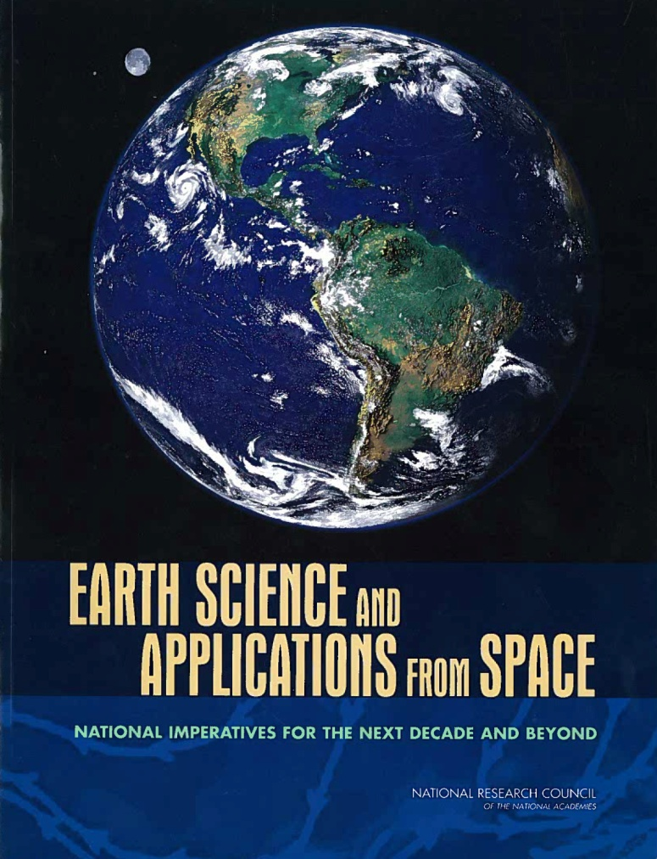
Factors limiting advancement of Earth Science research to applications
2007 Decadal Survey
Inexperience in identifying requirements of applied users of the data and information.
Limited knowledge of how managers, policy and decision makers, and the public obtain and use data and information.
Capacity of institutions and organizations to apply new types of data and information to traditional and ongoing processes and ways of doing business.
Notes:
3

Slide 4
Workshop Series on Satellite and Above-Boundary Layer Observations for Air Quality Management
A series of 3 community workshops to:
Engage a broader air quality management community: States, Academics, Private Sector Stakeholders
Create an opportunity for two-way communication between Air Quality and Satellite Communities
Create an process to better understand the suitability of satellite observations for air quality management applications, traceability to current and future stream of satellite observations.
Begin a longer-term process that we hope will continue as new missions like GEO-CAPE develop and come to fruition.
1st Workshop - May 9-10, 2011, 2nd - Fall 2011, 3rd Early 2012

Slide 5
Develop, Capture and Apply lessons from current Earth Observing System (EOS) data to the future
The Air Quality Community is starting to embrace the use of observations from EOS instruments.
As the AQ Community begins to build the infrastructure and capacity to use this information, it is based on the current suite of EOS instruments and datasets – the community needs to understand a path forward for data continuity (When will AQ missions like GEO-CAPE, and other relevant Decadal Survey missions launch)
The AQ Community consists of a wide spectrum of users with different needs and different capabilities to access and use the data.
Lessons can be learned from the current applications of EOS data products regarding data availability, data coverage, data formats, data accessibility, and data quality. These lessons can be applied to future missions.

Slide 6
Workshop Overview
Major Air Quality Management Challenges
Tightening Ozone and Fine Particle Standards

Slide 7
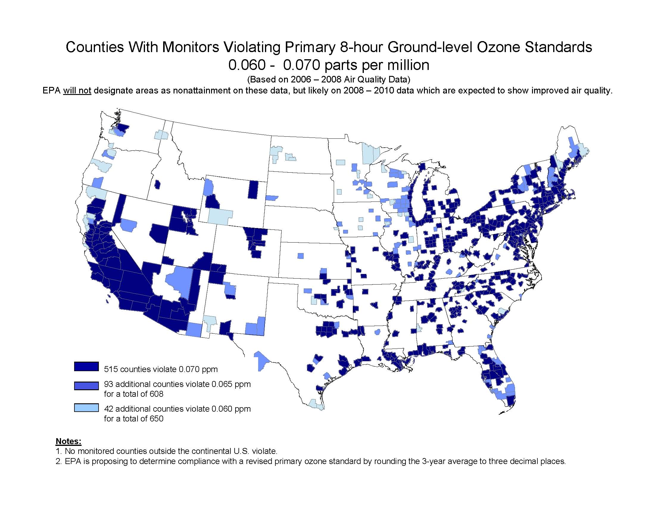
Approaching Natural Background
New Sources: Oil & Gas Development
Increasing International Transport
Impact of Climate Change
Cite: http://www.epa.gov/air/ozonepollution/actions.html

Slide 8
Workshop Overview
Major Air Quality Management Challenges
Tightening Ozone and Fine Particle Standards
Climate Change – Air Quality Linkages

Slide 9
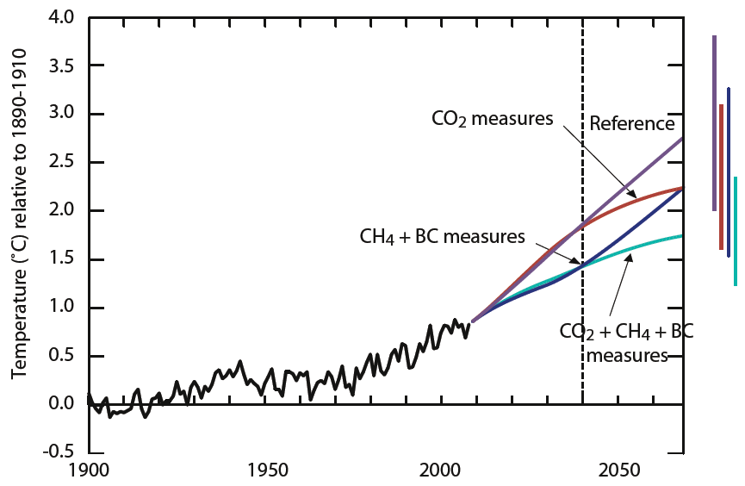
Short-term and long-term
benefits from controlling
both greenhouse gases
and short-lived climate
forcers
Source: UN Environment Programme: Towards an Action Plan
for Near-term Climate Protection and Clean Air Benefits (2011)

Slide 10
Workshop Overview
Major Air Quality Management Challenges
Tightening Ozone and Fine Particle Standards
Climate Change – Air Quality Linkages
Multi-Pollutant Assessment and Control Policies
State of the Art Practices in Air Quality Management
Attainment Designation and Exceptional Event Analysis
State Implementation Plan Development
Air Quality Forecasting
Emissions Inventory Development
Examples of Applications of Satellite Observations to Air Quality Management Issues (in conjunction with AQAST)
Discussion of Needs and Opportunities

Slide 11
Common Supporting Analyses Using Observations
Characterizing Air Quality Spatial Distribution & Temporal Trends
Understanding Conditions that Lead to Non Attainment
Evaluating Exceptional Events (Strat Intrusion, Dust, Fires)
Quantifying Exposure and Health Risk
Defining Boundary Conditions for Local Scale Analysis

Slide 12
Common Supporting Analyses Using Observations
Characterizing Air Quality Spatial Distribution & Temporal Trends
Evaluating Air Quality Models
Meteorological Fields
Chemical Fields
Transport and Transformation Processes

Slide 13
Common Supporting Analyses Using Observations
Characterizing Air Quality Spatial Distribution & Temporal Trends
Evaluating Air Quality Models
Estimating Emissions and Source Attribution
Identifying and Quantifying Sources
Updating Periodic Bottom Up Inventories
Detecting Impacts of Control Policies
Attributing Concentrations to Sources (Local/Regional/Global, Sectors)

Slide 14
Common Supporting Analyses Using Observations
Characterizing Air Quality Spatial Distribution & Temporal Trends
Evaluating Air Quality Models
Estimating Emissions and Source Attribution
Forecasting & Near Real Time Information
Informing Local Forecasts
Responding to Events

Slide 15
Suitability Matrix
AQM Application | Satellite Instruments, Data Products, Analysis Tools
 | Data Product A | Data Product B | Data Product C | Data Product D
Air Quality Spatial & Temporal Analysis
e.g., Attainment Design Conditions
Air Quality Model Evaluation
Emissions Inventory & Source Attirbution
e.g., Fire Activity and Emissions
e.g., Trends and Control Effectiveness
Forecasting & Public Information
Relevance of Parameter
Detection Limit
Accuracy
Temporal/Spatial Resolution
Ease of Use

Slide 16
How Can You Help Us Help You
What will the data products from GEOCAPE look like?
Putting simulated data in the hands of air quality analysts.
Communicating potential value to Air Quality Agency management (national, state, local).
Creating a demand for the mission

Slide 17
Next Steps
Continued Coordination with NASA Air Quality Applied Science Team (AQAST)
Coordination with the GOES-R AQ Proving Ground
Web-Based Resources for AQ Community
Continued Outreach to AQ Management Community
Fall and Winter Workshops

