Slide 1
Lessons learned from OMI observations of point source SO₂ pollution and suggestions for GEO-CAPE requirements
N. Krotkov (NASA/GSFC)
V. Fioletov, C. McLinden (Environment Canada)
K. Yang (Univ. of Maryland)

Slide 2
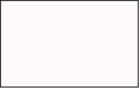

Lesson 1: Averaging OMI pixels allows detection of weak sources with enhanced ground resolution
SO₂ signal may be not detectable in a single OMI pixel. This rectangular “pixel” is light pink
However, it is possible to see the source and even to determine its exact location by averaging a large number of individual satellite pixels.
In this plot, a pixel is light pink if it covers the source (x) and it is white otherwise.
x

Slide 3
We used SO₂ Emissions source inventory (for 2006)
(thanks to Mike Moran et al., Environment Canada)
Top 100 emission sources for the US
Top 20 Canadian emission sources
Sources located within several km were combined into one
The largest “combined” source is about 300 kT per year
The largest single US source is about 200 kT per year
The oil sands site emissions are about 120 kT per year

Slide 4
We used OMI PBL SO₂ data to examine average spatial patterns from the top pollution point sources
OMI daily SO₂ data do not show any obvious pollution signals except for exceptionally strong sources (e.g., Norilsk, Russia and Ilo, Peru smelters, China)
We applied:
Data filtering:
  by Cross-track position (10-50)
  by cloud fraction (<0.2)
  by solar zenith angle (<60)
  by SO₂ values (to remove outliers and volcanic SO₂)
Spatial smoothing
Local bias correction
No AirMass Factor adjustment [ Lee et al 2009] - this will be implemented in Level 3 SO2 data due to release in May

Slide 5
Mean total column SO₂ and NO₂ values for 2 sites (Mildred Lake and Fort Chipwyan) as a function of the distance between the site and the pixel centre
We found that point sources of SO₂ in the US produce elevated SO₂ values over a relatively small area: within 20km
-- Mildred Lake
-- Fort Chipwyan
The whiskers show the 5th and 95th percentiles, the box edges represent the 25th and 75th percentiles, the center is drawn at the median value.

Slide 6
SO₂ from OMI, average for 2005-2010
For each grid point of a 2x2 km grid, all overpasses centered within a 12 km from that point were averaged
60 km
60 km
OMI smallest
pixel size

Slide 7
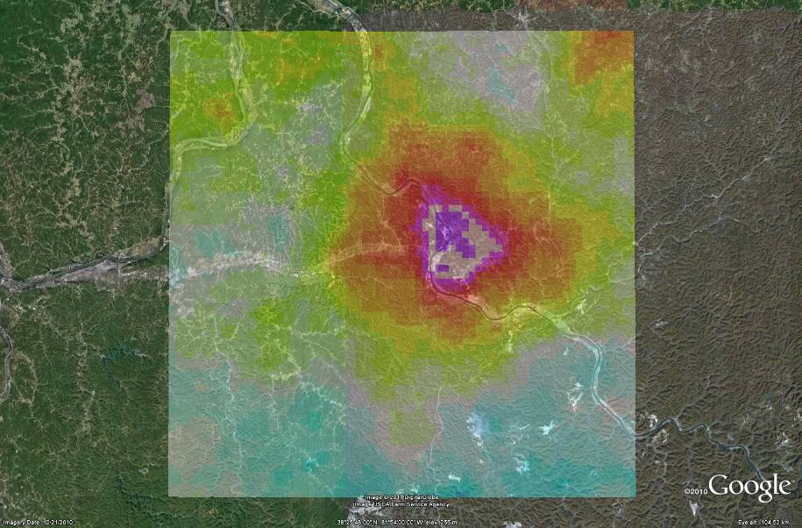
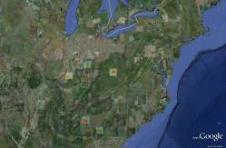
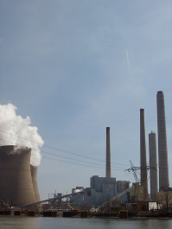
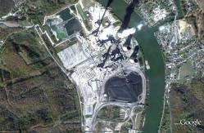
SO₂ Source #10 (John Amos power plant, 2900 MW, ~110 kT/year of SO₂)

Slide 8
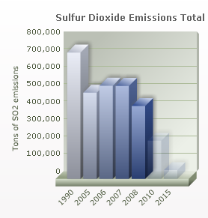
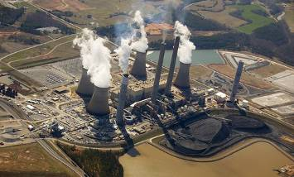
US Source #1.Bowen Coal Power Plant, Georgia (3500 MW),
SO₂ emissions: 170 kT in 2006
2005-2007
2008-2010
“In 2008, the mammoth construction program yielded the first scrubbers, sophisticated equipment that will reduce our overall systems emissions by as much as 90 percent”
Georgia Power website

Slide 9
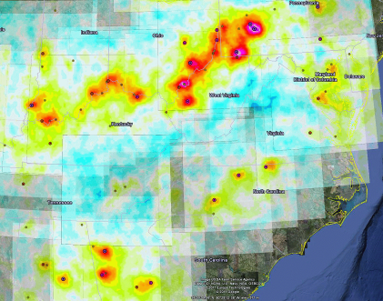
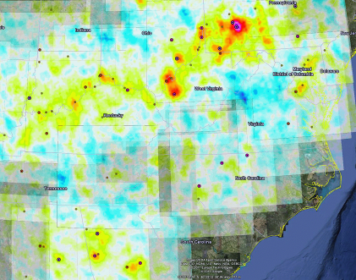
OMI data show a substantial decline in mean SO₂ values over Western US between 2005-2007 and 2008-2010
2005-2007
2008-2010

Slide 10
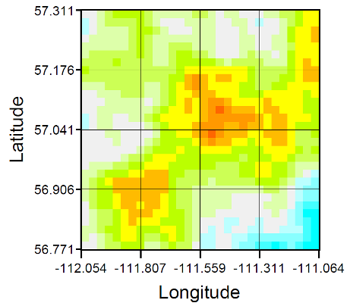
Lesson 2: Important SO₂ targets outside CONUS
Mildred Lake, Alberta, Canada. Oil Sands.
Mean OMI SO₂ for May-August
2005-2007
2008-2010

Slide 11
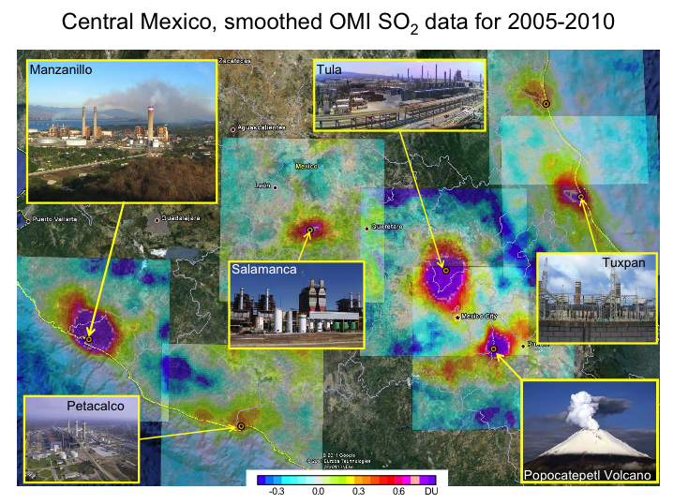

Slide 12
Annual SO₂ emissions vs. and estimates from a fit of mean OMI SO₂ by 2D Gaussian function (2005-2007 data)
Lesson 3: It appears that OMI SO₂ data can be used to monitor sources that emit more than 80 kT per year
Fit
where
R=0.78
for sources<150kT/year
R=0.88 for all sources
Since , a is the total number of molecules.
If is in DU, i.e. in 2.69·10²⁶ mol·km⁻² , and σ_{x},σ_{y} are in km, then a is in 2.69·10²⁶ mol.
Y = 0.0056 X
Mean OMI SO2 Fit Residuals

Slide 13
Suggestions for GEO-CAPE measurement requirements:
High spatial resolution (a few km) is required for emission monitoring.
Increase SO₂ measurement precision requirement: ~0.1 DU ~ 10¹⁵ molecules / cm²
Plan for frequent measurements of selected regions: (~100/day )
Staring mode of observations including targets in Canada
(e.g., Oil Sands), Mexico and S. America (Peruvian smelters, degassing volcanoes )

