Slide 1
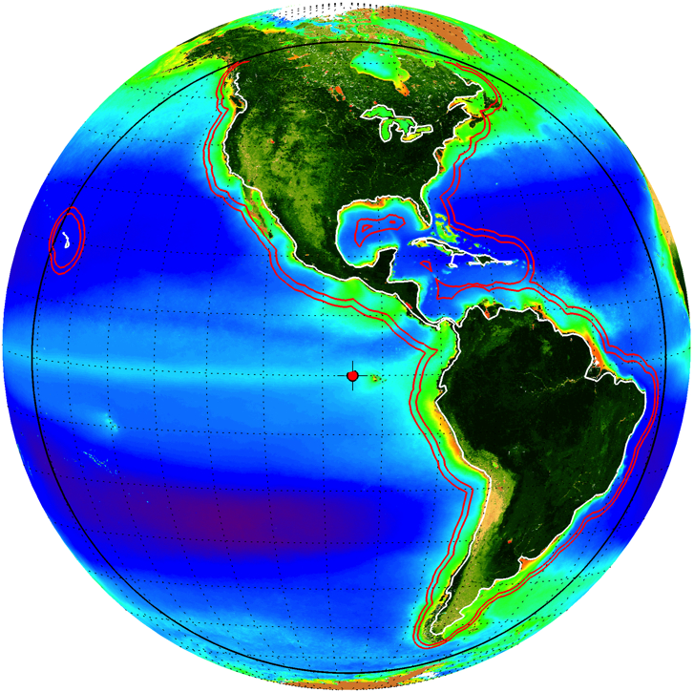
Recommendations on future science and engineering studies for Ocean Color
Ocean Science Working Group
Antonio Mannino
NASA GSFC

Slide 2
FY15 Ocean Science Priorities
Priority | Notes | Suggested GEO-CAPE Ocean Tasks
High |  | Plan for Korean Field Campaign
High |  | Apply existing/new observations of high temporal, high spatial or high spectral resolution data sets that have a rich set of associated obs. Short-term dynamics of physical, biogeochemical and bio-optical processes. Definition of spatial scales of features for GEO-CAPE time-space domain. Algorithm development for coastal ocean products including non-standard products that are mission critical/highly desirable. e.g. diurnal PAR and NPP Interdisciplinary atmosphere/ocean studies Exchange across land-sea interface Linkages with DISCOVER AQ, GOCI cruises, etc. Define the BRDF of coastal particles with varying solar angles Exchange processes between coastal and offshore waters, through mixing, advection, transport and diffusion along fronts and plumes.
High |  | Retrieval and viewing enhancements for GEO-CAPE OC science 1. Development of atmospheric correction methodology/code, LUTs, etc. for geo a. to account for combination of geo sensor viewing angles & variability in diurnal & seasonal solar geometry (solar zenith angle and earth’s orbit), b. for retrieval of ocean Rrs in the UV as well as VIS-NIR. 2. BRDF – studies leading to BRDF correction of Rrs at relevant solar angles 3. Refinement of sea-state and surface reflectance models for use at varying solar zenith angles and geostationary view angles.

Slide 3
FY15 Ocean Science Priorities
Priority | Notes | Suggested GEO-CAPE Ocean Tasks
High | focus on imaging time. | High spatial resolution analysis of cloud cover (sub-km) to aid in the intelligent scheduling of imaging to maximize data and science content.
High | Changed from medium high to high. Note the addition of #4, deemed highly relevant by the SWG | GOCI, high latitude polar orbiters (SeaWiFS, MODIS, MERIS, VIIRS; including same-day orbital overlap), SEVIRI, and HICO data analysis as well as simulated GEO-CAPE data Short-term dynamics Analysis of spatial resolution requirements Algorithm development for coastal ocean products Investigate temporal variability at the northern limits of the GEO-CAPE domain using PO satellite data
High/Med |  | 2 day data synthesis meeting
Low | FY 16 likely be a high priority for field campaign | Atmospheric Property Requirements for Atmospheric Corrections: Aerosol, NO2, O3, water vapor detection and retrieval requirements. What spatial and temporal resolution is needed for NO2 and ozone? How can we detect and correct for absorbing aerosols?
Low | Revisit this topic after results FY12-14 are completed. | Impacts of remote sensing reflectance (Rrs) errors on inherent optical properties (IOP) retrievals: How much reflectance error can we tolerate to discern diurnal changes in IOPs?

Slide 4
FY16 Ocean Science Priorities
KORUS-OC Field Campaign
See white paper for science objectives and priorities
Other studies if funding permits
Compute expected SNR for high solar zenith angles and sensor view angles conditions.
Determine adequacy of this SNR for detection of diurnal variability beyond a certain level (5%)?
FY17 and beyond
Science studies per prioritization in previous slides
GEO-CAPE “suborbital simulated datasets” - such as Aerostate or Airplane observations (hyperspectral, diurnal, appropriate GSD)

Slide 5
FY16 Ocean Color Engineering Priorities
Complete filter wheel breadboard assembly and functional testing
Note - funding to complete this approved in FY15
Cost estimation of GEO-CAPE coastal ecosystem mission
host fees for GEO-CAPE OC sensor (FR and spectrometer)
project mngmt, SE, SMA, ground sys., & mission ops for hosted payload
Continuation of scheduling study
Compute annual cycle of scene coverage statistics from automatic scheduler of FR and spectrometer to account for RSIs (and open ocean) and real cloud cover distribution for multiple cloud thresholds.
Optimize spectrometer iFOV “strips”observations (minimize scan time) to observe 100km inland to 400km offshore.
Develop demo data for end-users
Mature low TRL/highest risk technologies
Build and test focal plane assembly (detector, filters and enclosure) that is sensor agnostic to reduce GEO-CAPE mission risk and to promote EVI/M success.

Slide 6
Post-FY16 Ocean Color Engineering Priorities
Mature high risk technologies
Explore enhanced spatial resolution approaches through spatial sub-sampling and overlapping iFOVs
Roll camera landmark feedback software development
INR/Geolocation solutions: landmarks from OC sensor and/or roll camera, star camera readings, beacons on the ground
Fast steering mirror or scan mirror used for jitter correction
 |  | O | O | O |  | X | X | X
 |  | O | O | O |  | X | X | X
 |  | O | O | O |  | X | X | X
 |  | B | B | B |  | Y | Y | Y
 |  | B | B | B |  | Y | Y | Y
 |  | B | B | B |  | Y | Y | Y
 |  | C | C | C |  | Z | Z | Z
 |  | C | C | C |  | Z | Z | Z
 |  | C | C | C |  | Z | Z | Z
GSD = 375 x 375 m
Spatial sub-sample =
125 x 125m

Slide 7
FY16 Oceans SWG Activities
Complete STM white paper / NASA Tech Memo in 2015
Prepare EOS article (publication by summer 2016)
White paper to DS on coastal ecosystem dynamics (diurnal)
Translate applications info. into Applications Traceability Matrix
Develop applications fact sheets
Bring in other disciplines
Atmospheric engaged
Terrestrial (Schaaf joined; ask Fred Huemmrich?)
Phys ocean. (J. Wilkin ?)
Expand product suite
Phys. Oce. (surface vector currents)
Continuous aerosol AOD across land-ocean
Fused daily land albedo; diurnal vegetation stress; LAI; wildfires
Expand SWIR band set
2.13 um (currently baseline) - continuous land-ocean aerosol properties
1.38 um for cirrus cloud detection

Slide 8
FY16 Oceans SWG Activities
Continue outreach to scientific communities
Tout diurnal measurements from space to advertise (not “GEO-CAPE”)
CERF 2015; Ocean Sciences 2016; Ocean Optics 2016, Fall AGU 2016
Outreach to coastal managers and end-users
Go to PR folks to help us hone a message
Develop theme to sell mission
Coastal Health & Hazards or Coastal Health & Services
CHI - coastal health index is a function of (e.g.):
Water quality,
Presence/level HABs,
biodiversity,
habitat loss,
CHI
Population

Slide 9
Ocean Health Index
Example of ecological index
The Ocean Health Index measured Ecological Integrity as the relative condition of assessed species in a given location. This was calculated as the weighted sum of the International Union for Conservation of Nature’s (IUCN) assessments of species. Weights used were based on the level of extinction risk following Butchart et al. 2007: EX (extinct) = 0.0, CR (critically endangered) = 0.2, EN (endangered) = 0.5, VU (vulnerable) = 0.7, NT (not threatened) = 0.9, and LC (least concern) = 0.99. For primarily coastal goals, the spatial average of these per-pixel scores was based on a
3nmi buffer; for goals derived from all ocean waters, the spatial average was computed for the entire EEZ.
Ecological Integrity refers to the ability of an ecosystem to support and maintain ecological processes and a diverse community of organisms; is a Resilience measure used in calculating scores for five of the Goals. The Goals that it influences are Food Provision (Fishing), Artisanal Fishing Opportunity, Natural Products, Sense of Place (Iconic Species), and Biodiversity (all subgoals except Species).
http://www.oceanhealthindex.org/Components/Ecological_Integrity/
Andreasen, J. 2001. Considerations for the development of a terrestrial index of ecological integrity. Ecological Indicators 1, 21–35.

Slide 10
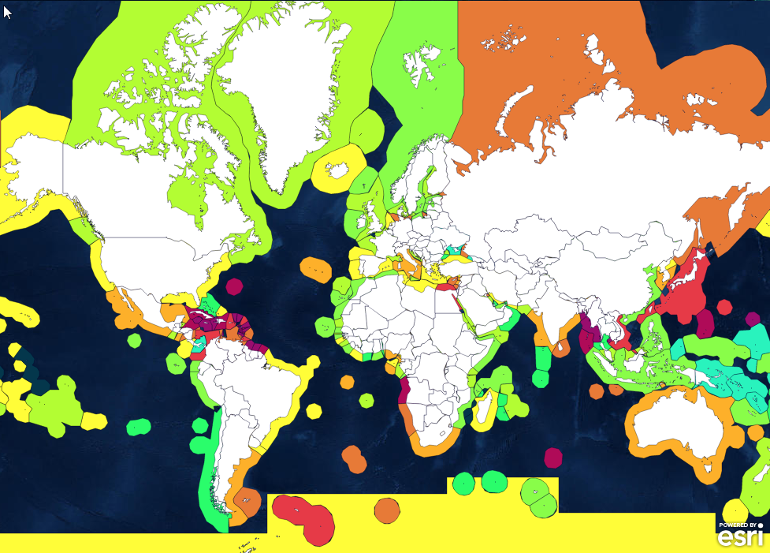
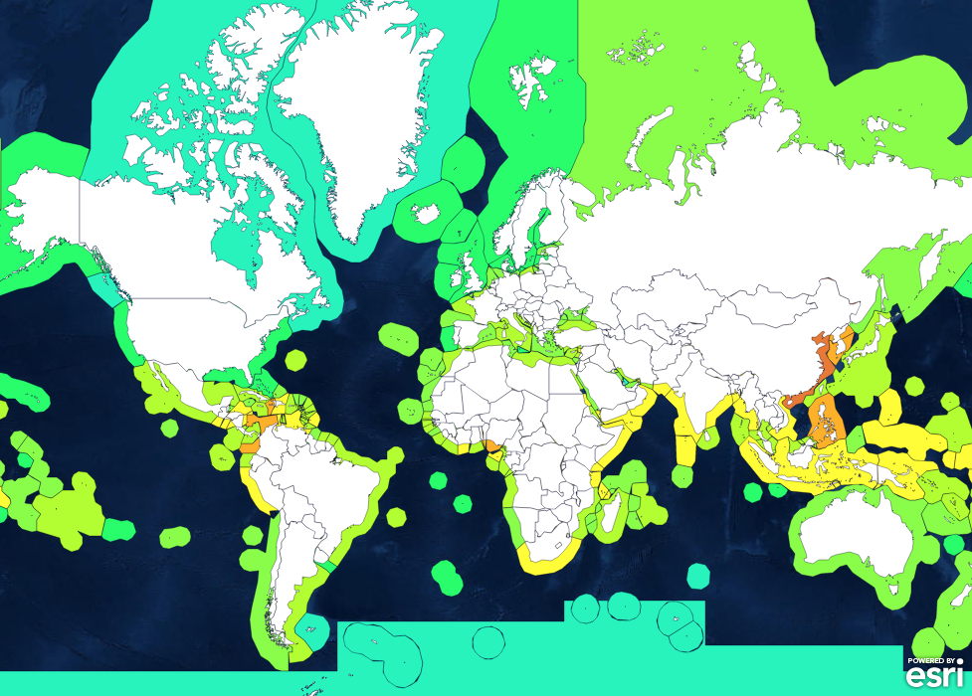
FY16 GEO-CAPE Ocean SWG Activities
Food Provision
Clean Waters
http://www.oceanhealthindex.org/

Slide 11
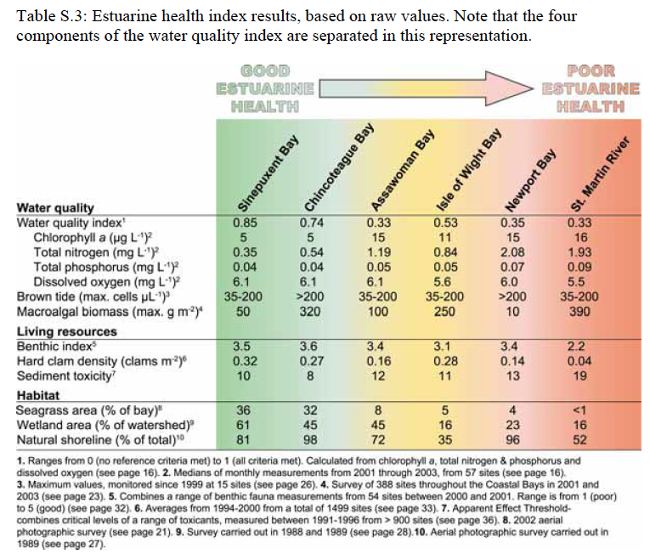
Coastal Bays Ecosystem Health Index
Maryland DNR
Carruthers, Dennison, Wazniack and Hall. Coastal Bays Ecosystem Health Index: Bringing it all together.

Slide 12
Data rate costs
2011 Hosted Payload RFI:
$1.8M/yr on average for full 36MHz transponder (30 Mbps)
IDL sensor data rates 10 to 36 Mbps (375m FR and 250m COEDI).

Slide 13
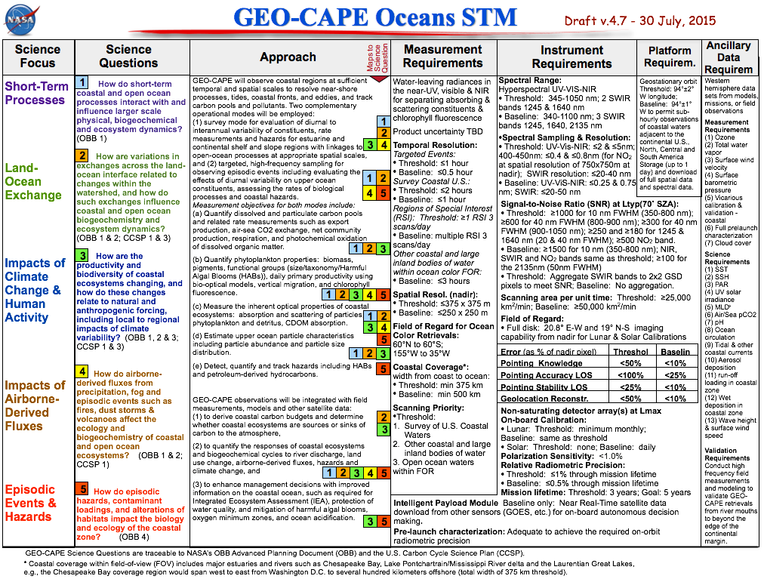

Slide 14
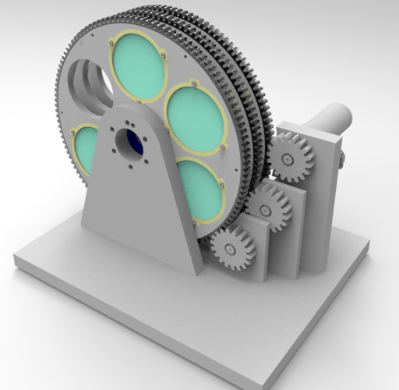
Filter Wheel Breadboard Mechanism
50 filters into 10 wheels with 5 filters each. Each wheel has an open spot
Each wheel is independently actuated but their positions are coordinated via computer
Design should be modular, expandable and use commercial solutions if practical
Not considered a high precision optical mechanism however the transition speed is fast
Filter replicas made of glass are preferred
Prototype “proof of concept” model is intended to operate in a shirt sleeve environment at STP conditions
Index: 60° in 0.2 seconds, still for 2.0 seconds
Life: 3 years operating 17 hours/24 hours
Courtesy of Walt Smith
Filter: 82 mm x 6 mm; 72 g;
94 mm radius
Wheel: 290 mm x 10 mm; 0.82 kg

Slide 15
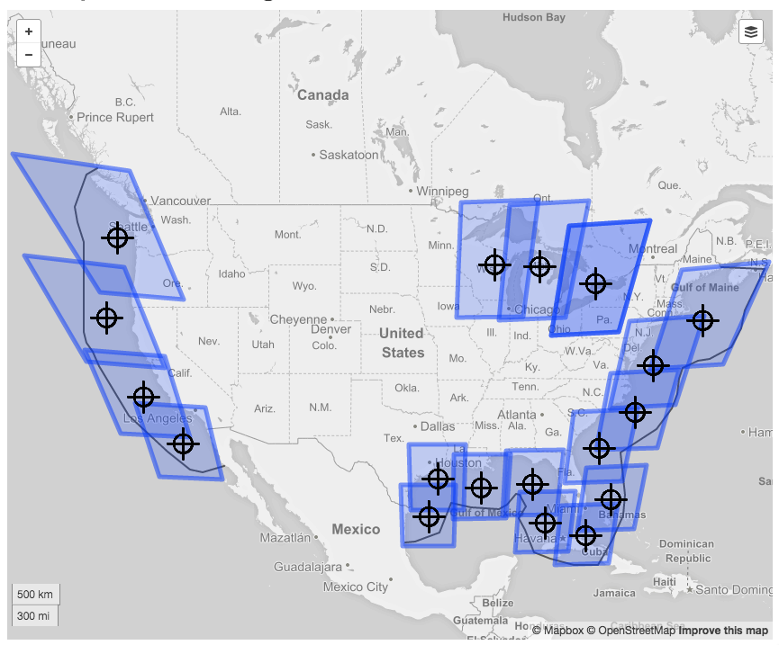
Strawman 18 Coastal/Lakes Survey Scenes Using FR
~45min to scan
CONUS coastal
waters
Source: GSFC analysis via GUI Editor, assuming spherical Earth – Satellite at 95W

Slide 16
COEDI - 375m GSD, 500km coverage
# Scenes: 43
Min. GSD: 399 m
Max GSD: 687 m
Courtesy of Jeremy Frank et al.
16

