Slide 1
Tropospheric Ozone Profiling Using Simulated GEO-CAPE Measurements
Geo-cape COMMUNITY WORKSHOP
MAY 12 2011
Vijay Natraj¹, Xiong Liu², Susan Kulawik¹, Kelly Chance², Robert Chatfield³, David P. Edwards⁴, Annmarie Eldering¹, Gene Francis⁴, Thomas Kurosu², Kenneth Pickering⁵, Robert Spurr⁶, Helen Worden⁴, Omar Torres⁵
1- Jet Propulsion Laboratory, California Institute of Technology, 4800 Oak Grove Drive, Pasadena, CA 91109, USA
2- Harvard-Smithsonian Center for Astrophysics, 60 Garden Street, Cambridge, MA 02138, USA
3- NASA Ames Research Center, Moffett Field, CA 94035, USA
4- National Center for Atmospheric Research, PO Box 3000, Boulder, CO 80307, USA
5- NASA Goddard Space Flight Center, Greenbelt, MD 20771, USA
6- RT Solutions, Inc., 9 Channing Street, Cambridge, MA 02138, USA

Slide 2
Goals
Rationale: Measurement requirements in GEO-CAPE STM go beyond current demonstrated capability
Focus: Assess sensitivity (to amounts and vertical distribution) of trace gas retrievals to wavelength set used
Can needed vertical sensitivity be achieved with new combinations of wavelengths?
Method: Radiative transfer simulations and Jacobian analysis (focus on ozone)
Notes:
These are the group’s goals, as they were in September.

Slide 3
VLIDORT – Part 1
Notes:
These are the inputs

Slide 4
VLIDORT – Part 2
Notes:
These are the outputs

Slide 5
Outline of Results
Spectral regions used
O₃, T, H₂O profiles
DFS summary
Details for high and low sensitivity cases
First look at results with aerosols
Conclusions

Slide 6
Spectral Regions
UVQ denotes polarized radiation
Notes:
Here is an overview of the spectral regions used and the key characteristics. For starters, we used spectral resolutions on order of the current best instrument. We believe that reasonable improvements in engineering could result in significant noise improvements relative to OMI and TES, and that is the basis of the noise estimates used in these calcs.

Slide 7
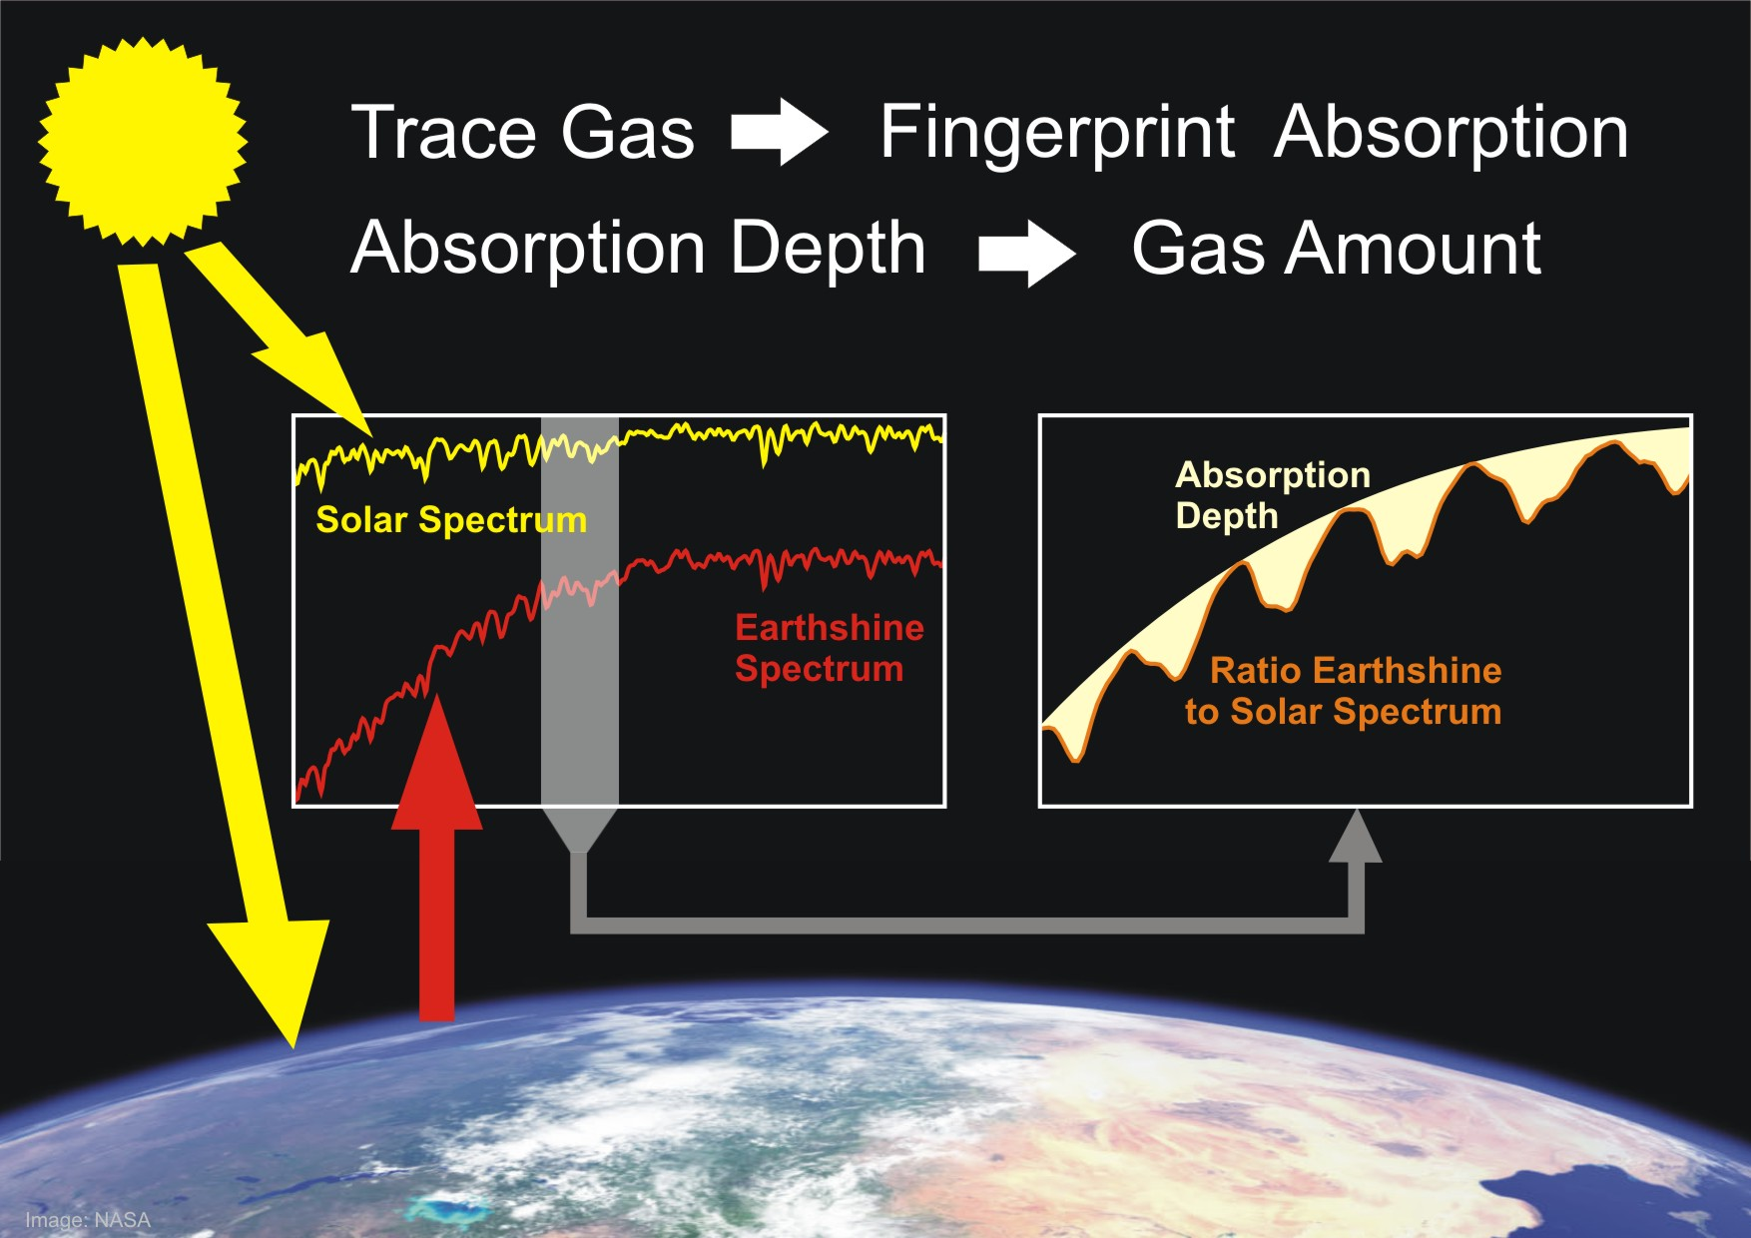
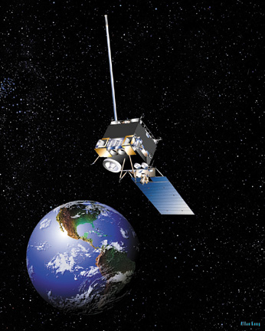
TIR: Provides Free Troposphere profile information
VIS: Provides column information
UV: Provides partial column information
atmospheric emission
solar backscatter
surface emission
O₃ Multi-Spectral Remote Sensing
DOAS UV Retrieval
Notes:
Of course it is not as simple as this picture shows – each technique has vertical information, but with very different characteristics. This is just meant to remind ourselves of the variety of approaches that can be considered
6/24/11
7

Slide 8
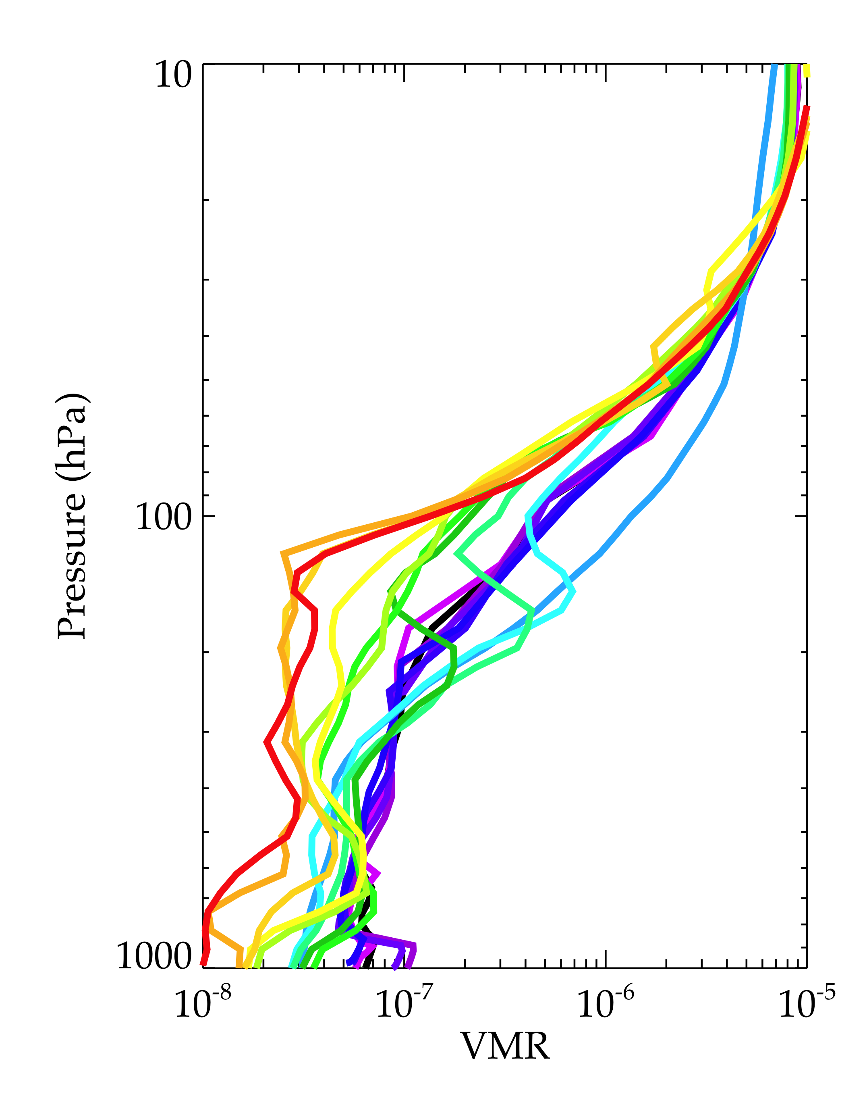
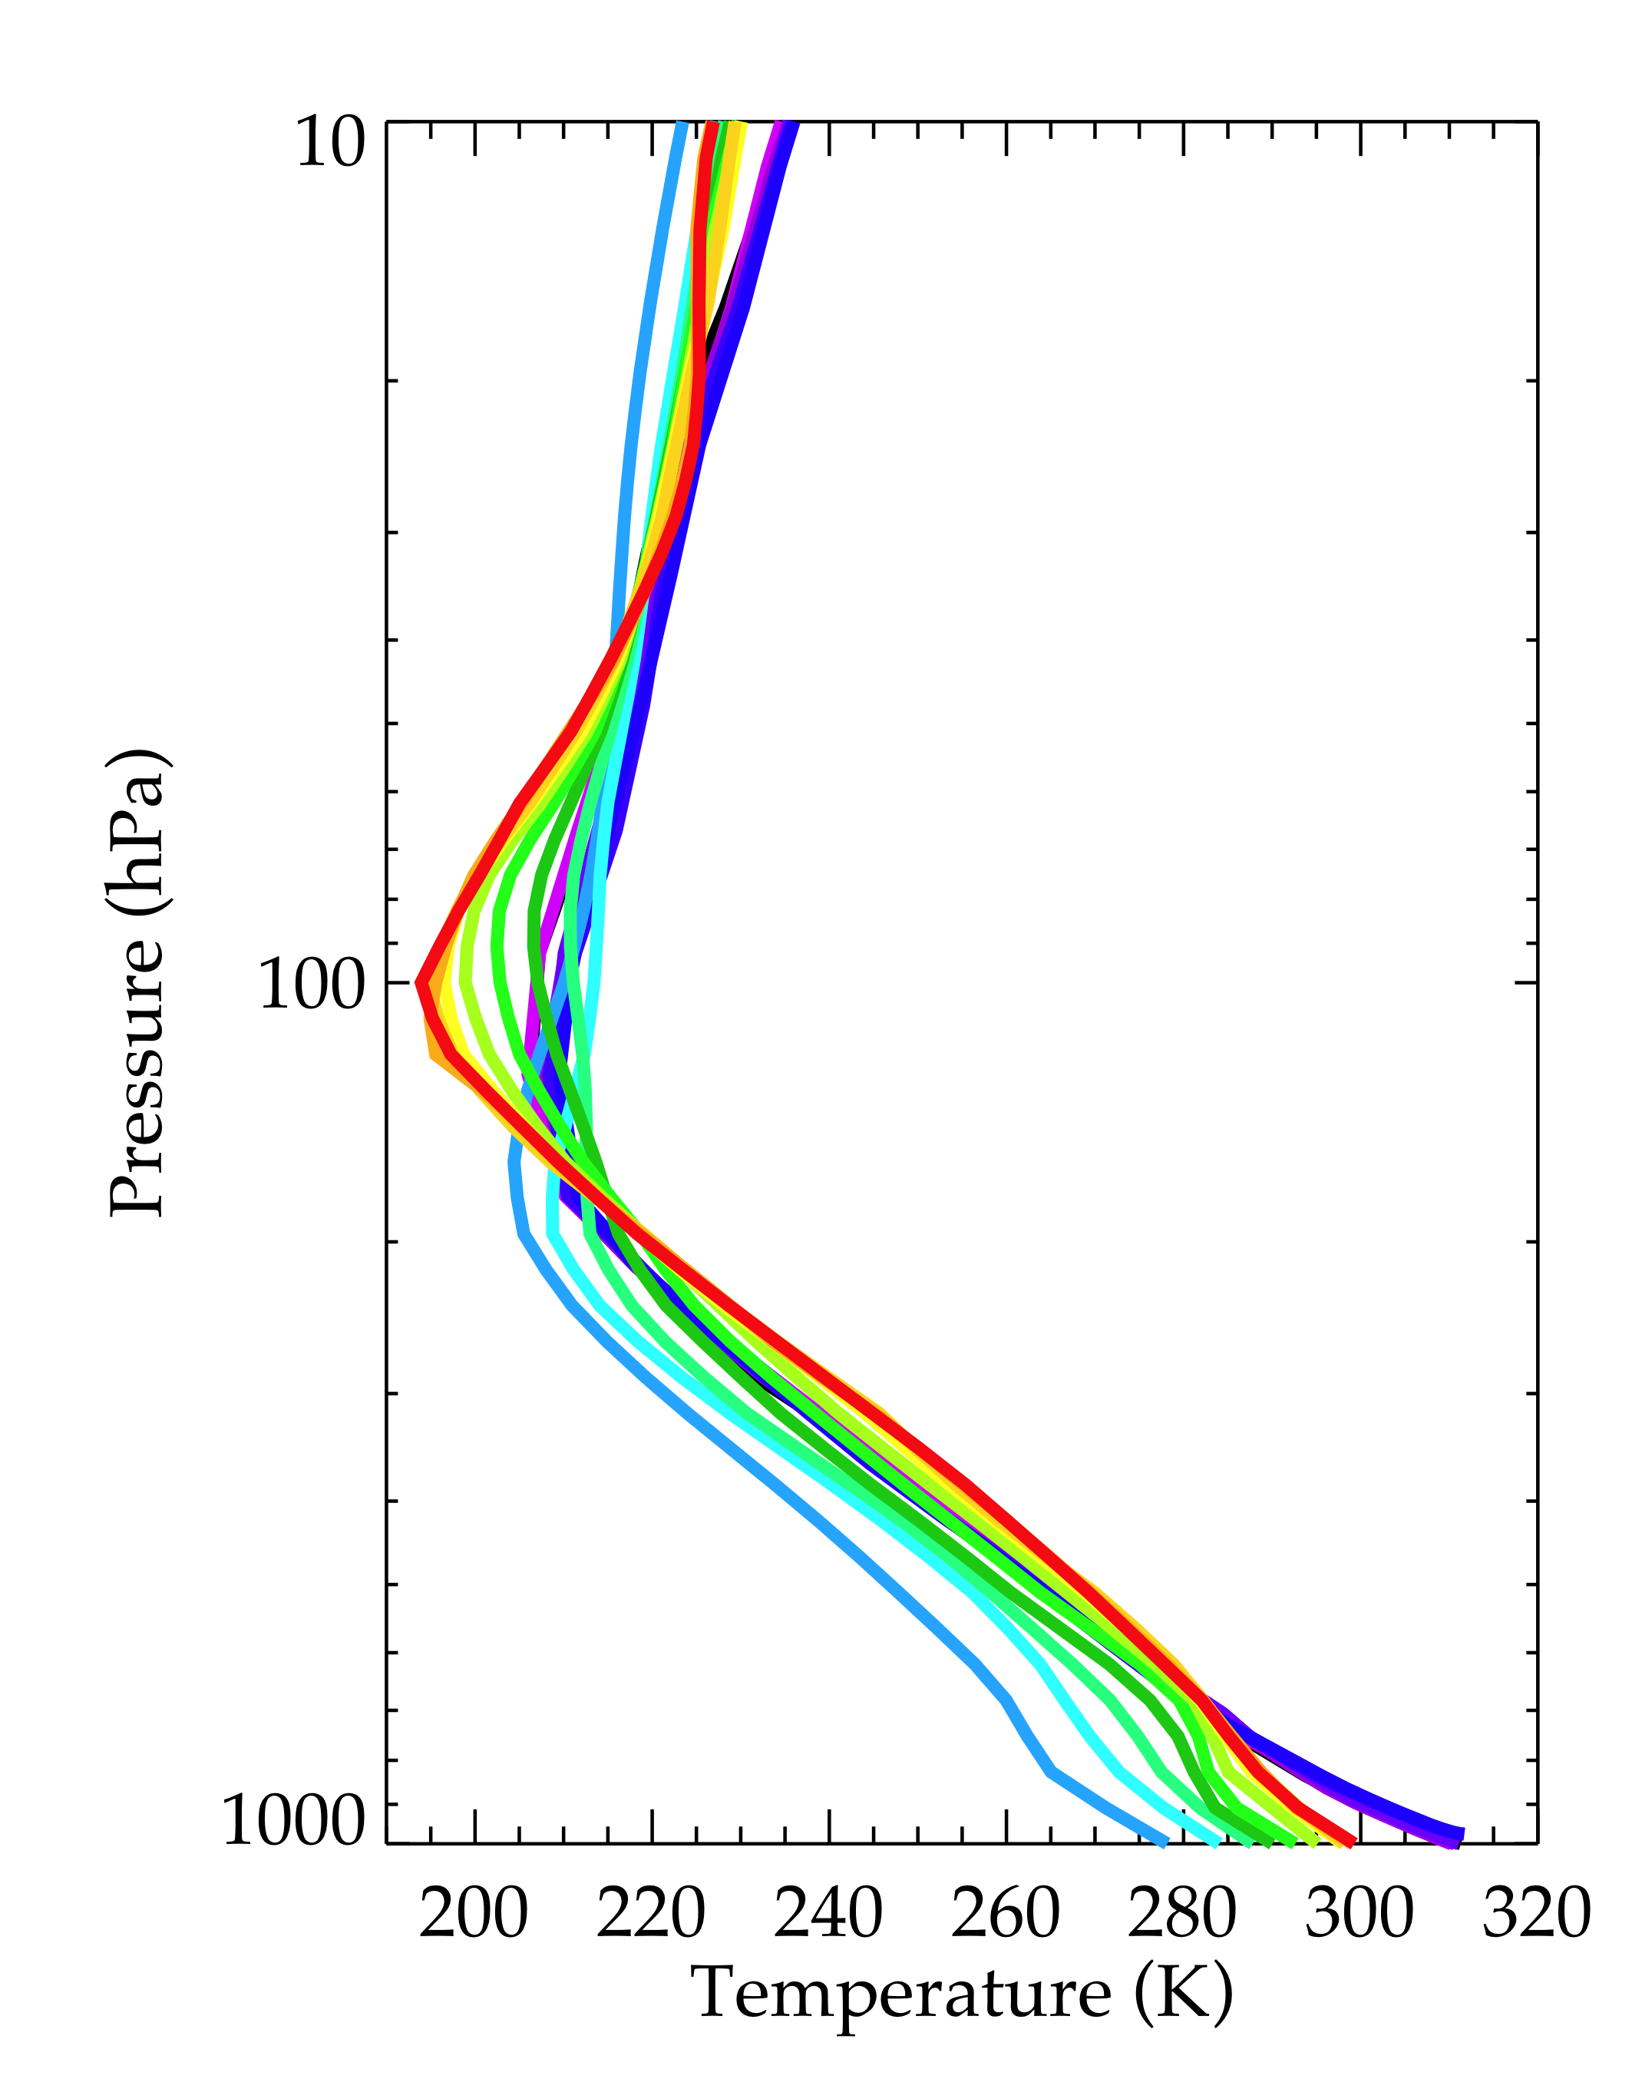
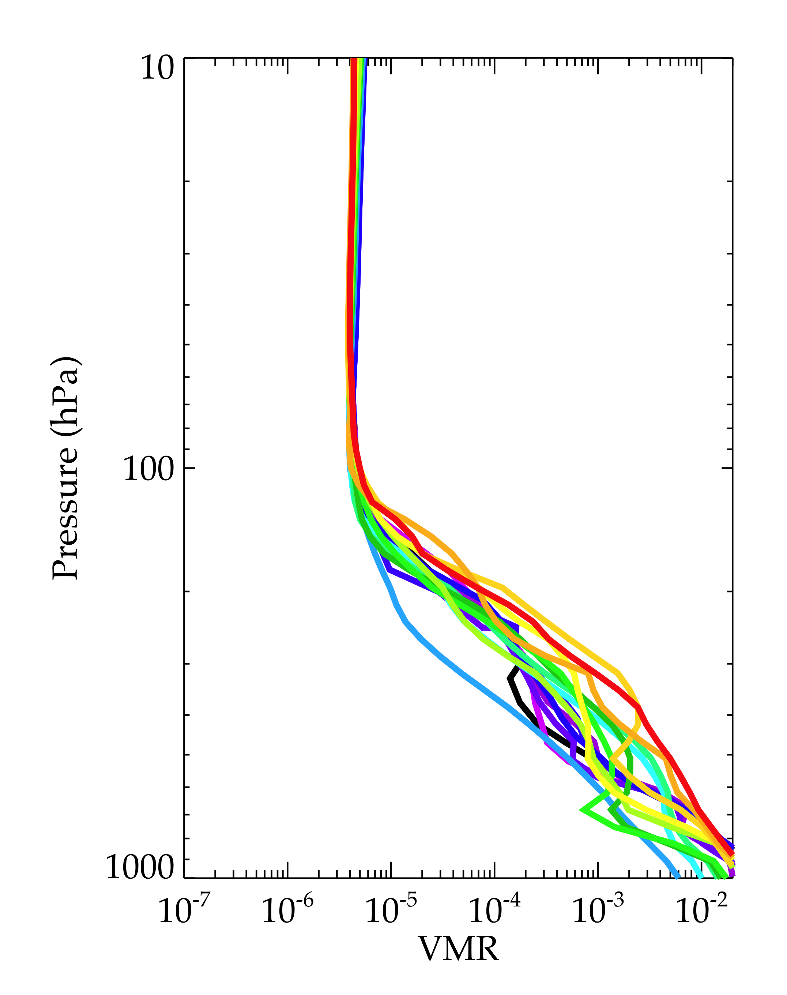
Profile Characteristics
Ozone
Temperature
Water
Notes:
Ozone – wide range of LMT ozone concentrations, polluted to clean.
Water and temperature – none of the profiles are particularly dry, there is a pretty good range of surface temperatures.

Slide 9
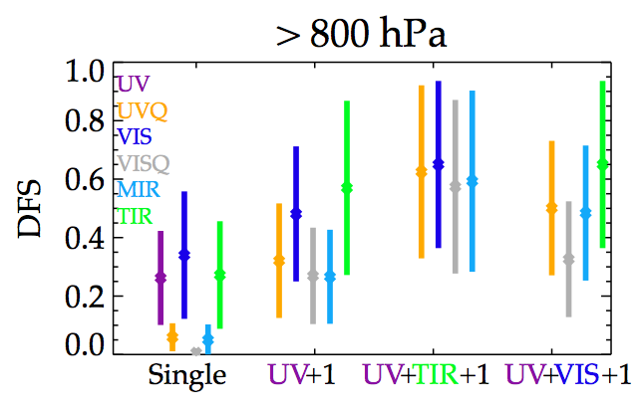
DFS
Clearly, there is a group that provides an improvement of sensitivity in the lowest layers
Note: use of Lambertian surface may underestimate power of polarized measurements.
Notes:
We can show that same information graphically, and that highlights the grouping of performance. The left hand data are single spectral regions, the center are UV plus another region, and the rightmost are UV + thermal plus something else.
There are a group that perform substantially better in the >800 region, with a wide range of performance over the 16 cases.

Slide 10
Polluted atmosphere, single band
This profile showed strong sensitivity, it is a polluted atmosphere with an enhanced ozone layer of 80-100 ppbv below 900 hPa
Notes:
Now we will look at sets of averaging kernels for the case with the highest DFS in the >800 and >900 layers, and then the lowest DFS case.
Here are plots for single spectral regions. We see the high sensitivity of VIS near the surface, but the overall higher sensitivity of TIR and UV. The MIR has low sensitivity throughout.

Slide 11
Polluted atmosphere, joint bands
Use of TIR really lets you separate lower layers above and beyond UV+VIS
Notes:
For this case, the UV+TIR and UV+VIS+TIR have remarkable sensitivity near the surface.

Slide 12
Nominal atmosphere, single bands
This atmosphere features high sza, low temperature and thermal contrast, small a priori variability (clean).
Notes:
In a contrasting case, for single spectral regions, there is little sensitivity in the lower troposphere.

Slide 13
Nominal atmosphere, joint bands
Less dramatic change, but there is increased sensitivity in lower layers
Notes:
Combinations of bands have increased sensitivity, but it isn’t very impressive.

Slide 14
Reduction in Errors
polluted
Clean background
Notes:
For those two cases. We can look at the DFS and error (why was TES A priori error so low – did we use the correct location???)

Slide 15
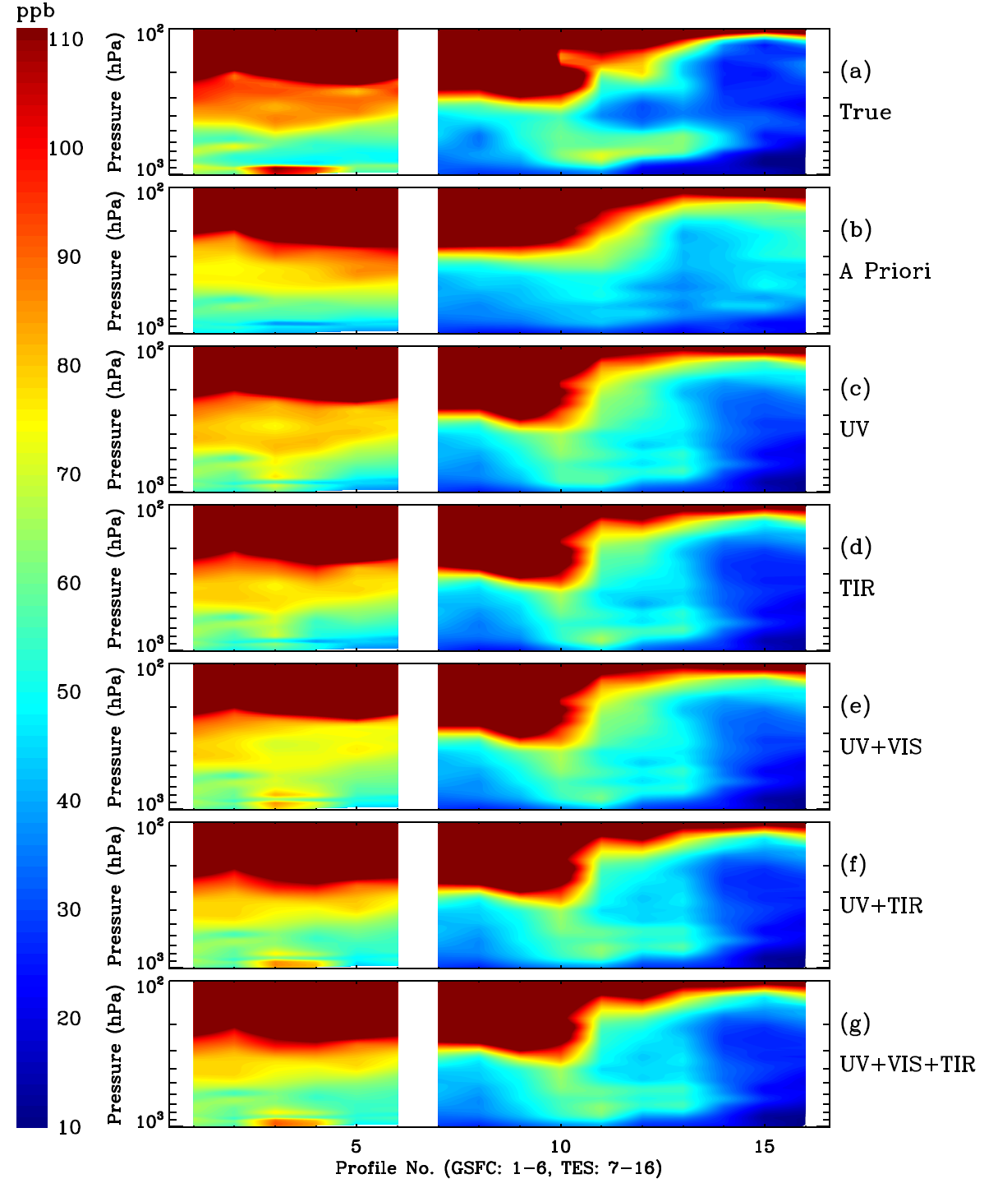
Another Perspective

Slide 16
Aerosols: Profiles and Properties
5 aerosol types: black carbon, organic carbon, coarse seasalt, fine seasalt, sulfate
AOD profiles at 300 nm, 400nm, 600 nm and 999 nm (Courtesy: Ken Pickering)
MODIS total column AOD at 550 nm (Courtesy: Omar Torres)
RH profiles (Courtesy: Melanie Follette-Cook)
Only lowest 26 layers have aerosols => no stratospheric aerosols
Single scattering properties

Slide 17
Aerosols: First Results
Clear Sky
Aerosols
Notes:
Increase in LMT DFS for VIS with aerosols

Slide 18
Conclusions
Multi-spectral retrievals (UV+VIS, UV+TIR, UV+VIS+TIR) improve sensitivity to the variability in near-surface O₃ by a factor of 2-2.7 over those from UV or TIR alone.
Multi-spectral retrievals provide the largest benefit when there is enhanced O₃ near the surface.
Combining all 3 wavelengths (UV+VIS+TIR) provides the greatest sensitivity below 850 hPa, with a 36% improvement over UV+VIS and a 17% improvement over UV+TIR.
The impacts of clouds and aerosols are being assessed.

Slide 19
Conclusions
To link our results to the STM, OSSEs needed to quantify impact of different observation scenarios
We will characterize sensitivity and errors as a function of thermal contrast, SZA, VZA, ozone concentrations, surface characteristics, aerosol amounts, etc.
This tool will allow our work to be directly used for OSSE studies.

Slide 20
Backup Slides

Slide 21
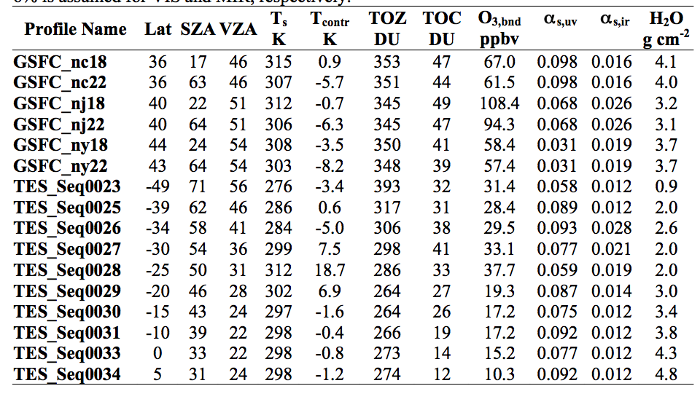
Key Characteristics
Notes:
Here are more details of each. Tcontr = thermal contrast
Note the wide range of trop DUs.
(thermal contrast – Tsurf – T layer above)

Slide 22
Other inputs
A priori error: McPeters climatology [McPeters et al., 2007]
A priori covariance Matrix: correlation length of 6 km
State vector: ozone at each layer, water vapor at each layer (except for UV), 1 surface albedo/emissivity for each spectral region.
A priori error for H2O: 20% at each layer
A priori error for surface albedo/emissivity: 0.05
Notes:
Here are more details of the inputs. This is a pretty reasonable setup for the retrieval – no tricks were used to improve performance.

Slide 23
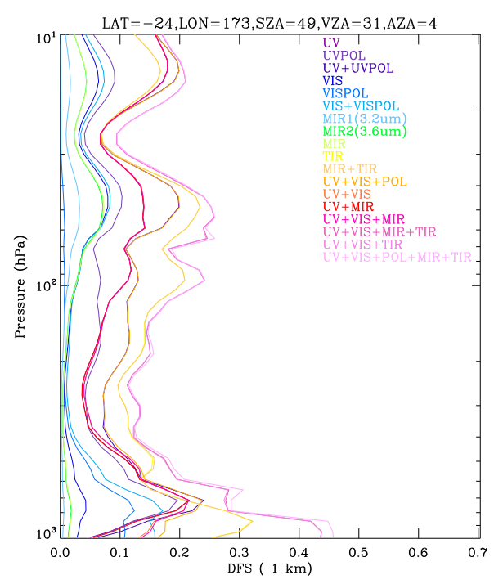
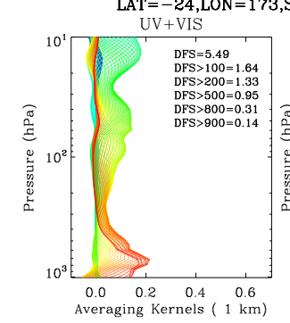
Example Analysis
Detailed analysis performed for each of the 16 profiles. We began by looking at every possible combination of the wavelength regions.
DFS – degrees of freedom for signal – how much information comes from the measurement (as opposed to the a priori)
Notes:
Here are just some snapshots – for each case, we looked over averaging kernels, the summed degrees of freedom, and the reduction in the estimated error. This was performed for a very wide set of spectral regions and combinations.

Slide 24
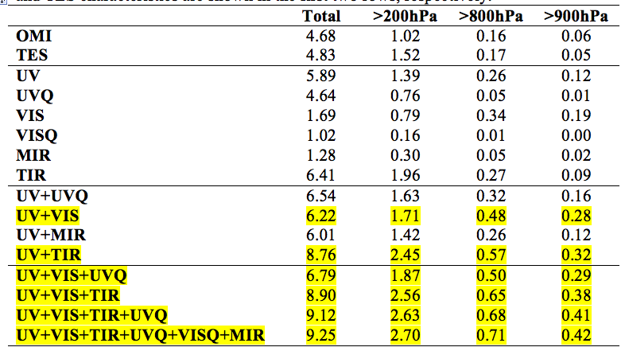
A summary of the DFS for ozone: all possible combos
Notes:
One way to look at the results is to calculate the degrees of freedom in different atmospheric layers, and average over all 16 profiles. Here we use the total column, less than 20 hPa (think of this as troposphere, and then two layers close to the surface – 800 hPa to surface and 900hPa to surface.
On this table, we have used yellow to highlight any combination that has DFS greater than 0.4 for the less than 800 hPa. The bottom three rows of the table also have more than 0.35 DFS in the layer below 900 hPa.
(note to self = we later use UV_VIS_TIR, but don’t bother with other cases because they are small additions for a whole new band)

Slide 25
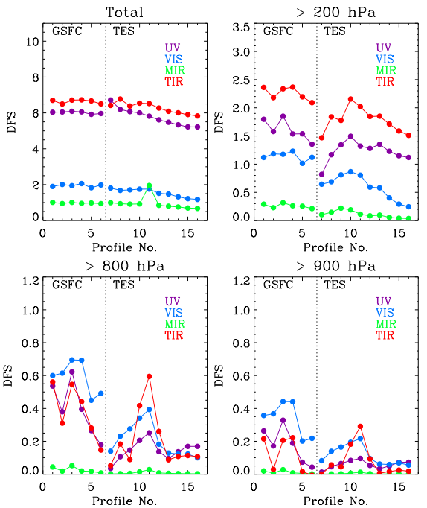
Single
Limited DFS in lower layers
Notes:
To see the details of the 16 cases. We plot the DFS as a function of profile. On this page we just have the single spectral regions. The > 800hPa has a wide range of values, but >900 still has a lot of variability.
Update this

Slide 26
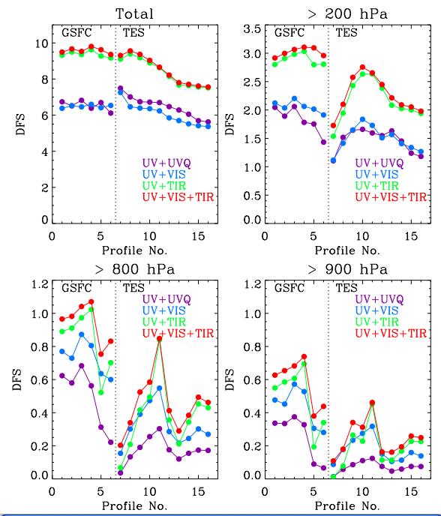
Combined
Significant increase in sensitivity in lowest layers
Notes:
Now a similar plot, but for the 4 ‘most likely cases’. Two groups of performance for Total and > 200, when we look at the lowest layers we see the advantage of the combined wavelength regions.
UV+UVQ doesn’t stack up in the lowest layers – looks like the real questions are about adding VIS and/or IR.
update

Slide 27
Vertical Details
Notes:
Now looking at the vertical details of the performance. These are averages over all profiles. See the differentiation of the DFS in lowest layers. In terms of error reduction, the same cases that had high DFS have the largest reduction in error. Note that the estimated errors are in the 10-20 percent range for the best cases.

Slide 28
Increase noise by factor of 3

