Slide 1
Interdisciplinary Science: DISCOVER-AQ and Beyond
Maria Tzortziou
Carolyn Jordan

Slide 2
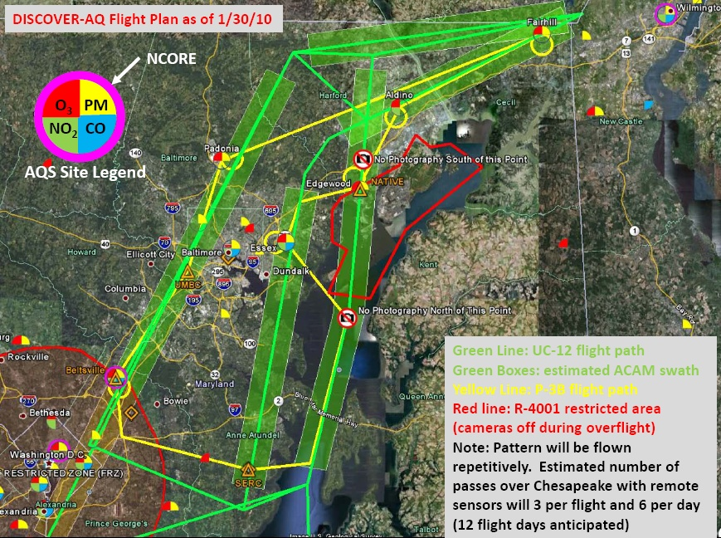
Interdisciplinary Science from GeoCAPE
Detailed, integrated observations in the atmosphere-ocean system are critically needed for understanding processes, feedbacks, interactions between the atmosphere and ocean components of the Earth System.
The Discover-AQ detailed aircraft flights provide a great opportunity for integrated observations and coordinated measurements of air-quality/ atmospheric composition and ocean biological, biogeochemical and optical properties over the Chesapeake Bay estuary.

Slide 3
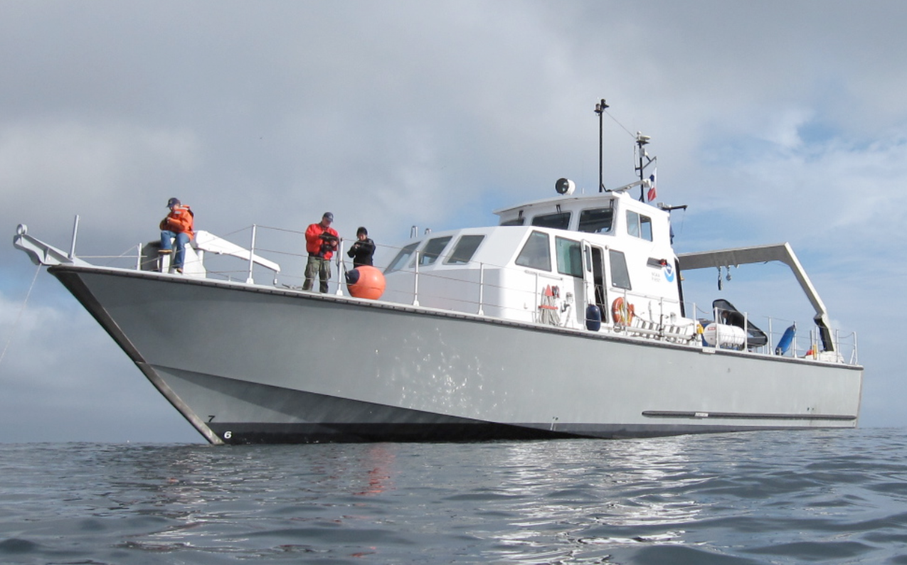
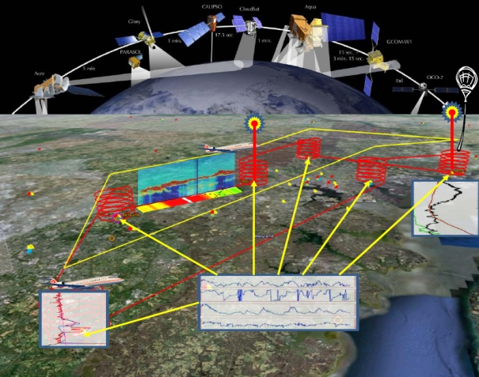
Interdisciplinary Science from GeoCAPE
Ship-based measurements during July 2011
More than 15 people participating with measurements on the ship
Additional people involved in data processing, analysis, interpretation
NOAA Vessel SRVx - National Marine Sanctuary Test and Evaluation Vessel R8501

Slide 4
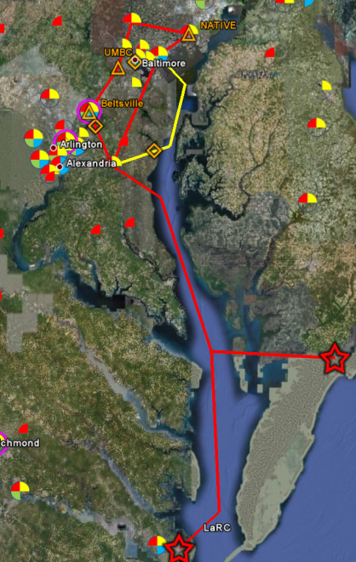
Interdisciplinary Science from GeoCAPE
Objectives of oceanographic campaign:
❖ Study small scale and short-term dynamics in biogeochemical variables
❖ Focus on carbon sources and fluxes
● Primary productivity rates and stocks
● Land-ocean carbon dynamics (overlaps with previous objective)
❖ Algorithm development for coastal ocean products
❖ Emphasis on linkages with DISCOVER AQ measurements of tropospheric air quality and atmospheric composition
● More accurate atmospheric corrections of water-leaving radiances
through imporved knowledge of spatial and diurnal atmospheric variability
(aerosols, NO2, Ozone, water vapor, etc)
● Applications of ACAM aircraft observations to ocean color studies
- 500m spatial resolution & 7km swat width
- 2 spectrometers: 305-520 nm (0.8nm res) & 480-900nm (1.6nm res)
● High Spectral Resolution Lidar (HSRL)
- Validation of HSRL in-water beam attenuation retrievals
- Highly relevant for ACE ocean ecosystem mission component.
● Optical closure analysis (in the ocean-atmosphere system)
❖ Air-sea exchange
● CO2 exchange
● Marine primary biogenic aerosols (intact algae)
● Measurements of trace gases

Slide 5
Interdisciplinary Science from GeoCAPE
Chesapeake Bay Campaign – July 2011 (12 flights over 1 month in July)
Sampling: 9-10 cruises over a 12-day period (match with flights when possible)
Spatial: | 3 days: stationary - measurements at one location - upper bay main stem (flight day) - mid-bay main stem (non-flight day) - lower bay main stem (non-flight day) 4 days: follow water mass (drogue w/ GPS tracking) - upper bay main stem (flight day) - Potomac River plume (non-flight day) - Marsh ebb tide (flight day) - Bloom or lower-bay main stem (flight/non-flight day) 3 days: additional transects - upper bay main stem cross-bay transect (flight day) - upper bay near-shore to center bay transect (flight day) - mid- to lower bay main stem meridional transect (non-flight day)
Temporal: | 6 to 10 discrete stations during each day
Vertical: | 3 depths (surface, 10% and 1% light depth)
Total Samples: | Maximum: (3*10+4*6+3*6)*3=216 samples
Total stations: | Maximum: (3*10+4*6+3*6)=75 stations (unique station profiles)

Slide 6
Interdisciplinary Science from GeoCAPE
Measured Parameters
Water Inherent Optical Properties (IOPs): Total in-water absorption, a, scattering, b, attenuation, c, backscattering, bb, (ac-9, ac-s, VSF3, ECO triplet, CTD) – surface measurements and in-water profiles More Optical Parameters: Fluorometric Chlorophyll-a Chl-a, phytoplankton absorption spectra, aph, non-algal particulate absorption spectra, ad, colored dissolved organic matter absorption spectra, aCDOM, CDOM fluorescence Excitation Emission Matrices, EEMs
Radiometry: Surface Down-welling Irradiance, Es, Upwelling Radiance, Lu, Down-welling Irradiance, Ed, Water-leaving radiance, Lw, Remote Sensing Reflectance, Rrs, Normalized water leaving radiance, nLw, exact nLw, Q, Fo, %LL, Photosynthetically active radiation, PAR, Diffuse attenuation coefficient, Kd, KdPAR, KLu, Zeu, Kbio, OCnVn, etc. (C-Ops; 19-band UV-NIR sensor; 10nm FWHM) – profiles Ed, Lu, Es - HyperPro (UV-NIR; 3nm FWHM). NIR hand-held above-water radiometer/ 350 to 880 nm 512 channels (15 days).
Biogeochemical variables: Particulate Organic carbon and nitrogen, POC/PN, Dissolved Organic Carbon DOC, Total Dissolved Nitrogen, TDN, Suspended Particulate Matter, SPM; HPLC pigments (no cost); Phytoplankton cell count sample collection;
Primary Productivity incubations
Phytoplankton cell counts – non-acidified Lugol’s
O2 and partial pressure CO2 pCO2, Dissolved Inorganic Carbon DIC, Total Alkalinity TA, pH
Measurements of aerosols/trace gases: AOD – Microtops instruments Total Column NO₂, O₃, SO₂, H₂O, HCHO, BrO - Pandora measurements Surface O₃, CO, SO₂, NOx, HCHO– In-situ sensors on the ship Aerosols - Targeting diurnal variability; Analysis for water-soluble inorganic ions; Organic analysis; Detailed information on submicron size distributions. Trace Gases - Samples of CH4, N2O, and CO2 in the atmosphere and in the surface water. Maybe also CO measurements; Calculation of fluxes to assess the role of the upper Chesapeake as a net source/sink for these compounds as well as their diurnal variability.
Detailed, coupled observations of atmospheric and in-water parameters, resulting in a dataset that could allow us to start addressing some interdisciplinary questions

Slide 7
GEO-CAPE Atmospheric Measurements

Slide 8
GEO-CAPE
Ocean
Measurements
Chl-a
CDOM
Pigments
Functional Groups
Euphotic Depth
PAR

Slide 9
One Goal of GEO-CAPE:
Provide information on natural and anthropogenic
precursors of O₃ and aerosols [NRC, 2007].
Key Precursors of O₃ and aerosols:
VOCs & NO_{x}
VOCs:
Oxygenated: CH₃OH, CH₃CHO, (CH₃)₂CHO
Halogenated: CH₃Br, CH₂Br₂, CHBr₃
Hydrocarbons: C₅H₈, C₁₀H₁₆

Slide 10
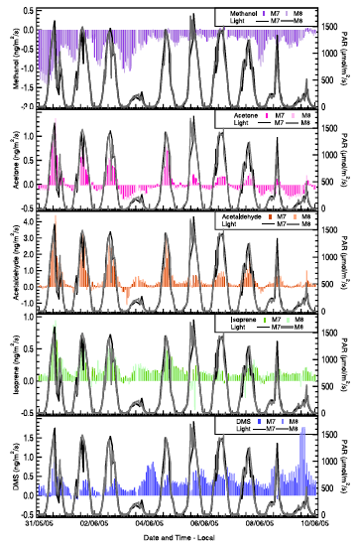
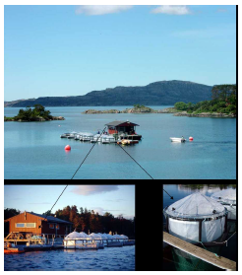
Diurnal Variability
in Seawater
What are the controls?
Biological: phytoplankton?
bacteria?
Abiotic: photolysis of CDOM?
Sinha et al., ACP, 2007.

Slide 11
Atmospheric Global Significance of Seawater…
Methanol: Globally undersaturated in oceans
Oceans provide 20% of the global sink
Loss processes in seawater? unknown
Acetone: Highly uncertain global budget
33% of the global source, or
56% of the global sink, or
minor source
Produced by solar irradiation of CDOM
by microbial metabolism
Acetaldehyde: Produced by solar irradiation of CDOM
Oceans provide 27% of global source
2nd largest, after hydrocarbon oxidation

Slide 12
Atmospheric Global Significance of Seawater…
Acetaldehyde: Produced by solar irradiation of CDOM
Millet et al., 2010 estimated global sources
128 Tg yr-1 oxidation of hydrocarbons
57 Tg yr-1 ocean emissions
23 Tg yr-1 terrestrial biosphere
Estimated ocean emissions based on
satellite maps of CDOM & solar irradiation
Biological marine source likely as well

Slide 13
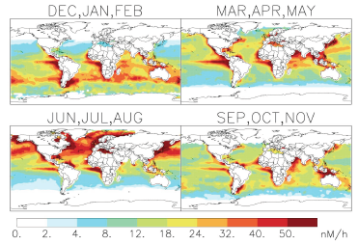
Photoproduction of Acetaldehyde in Ocean Mixed Layer
Millet et al., ACP, 2010

Slide 14
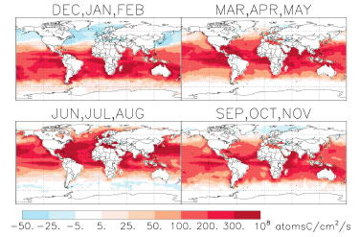
Seasonal Air/Sea Flux of Acetaldehyde
Millet et al., ACP, 2010

Slide 15
Diverse Sources/Sinks of Halogenated VOCs
CH₃Cl: Net global source ≤ 12%
Biological removal in seawater
Seasonally variable sink (0% winter, 30% summer)
CH₃Br: Net global sink
Chemical and biological removal in seawater
Diurnally varying biological sink, midday maximum
Both: Source of halogen radicals to stratosphere
Large non-marine sources
Produced by algae & phytoplankton
with production rates variable throughout lifecycle
factors controlling production not well known
Not well correlated with Chl a
Peak in regions of picophytoplankton
Spatial/temporal variability of degradation suggest
different organisms are responsible,
but details not well understood
Addition of toluene greatly inhibits biological degradation

Slide 16
Diverse Sources/Sinks of Halogenated VOCs
CH₂Br₂ & CHBr₃:
Oceans provide the largest source
Produced by macroalgae and microalgae
Largest sources in coastal waters
contributing 70-90% to the total global emissions
Short-lived compounds
Source of halogen radicals for tropospheric O₃ depletion
Deep convection can transport to the stratosphere
Minimal degradation in seawater
Undersaturations due to vertical mixing in water column
or to transport of air masses with elevated concentrations
Sufficient supply in tropical open oceans to account for 20-35%
of excess Br in stratosphere not due to by CH₃Br and halogens
But, it is not known how much of these gases are transported to
stratosphere

Slide 17
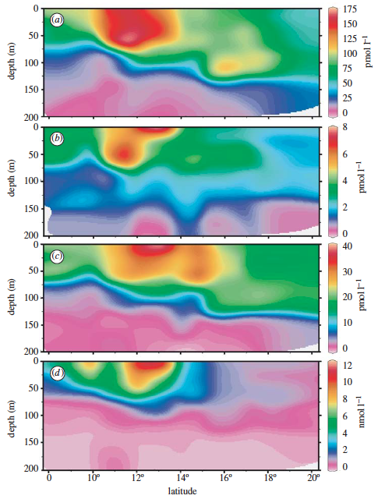
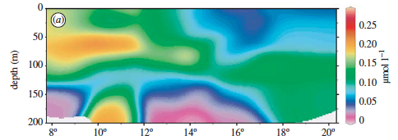
Halogenated Compounds & Pigments
CH₃Cl with Chlorophyll a
CH₃Br
CH₃I
DMS
Smythe-Wright et al., Philos. Trans. R. Soc., Ser. A, 2005

Slide 18
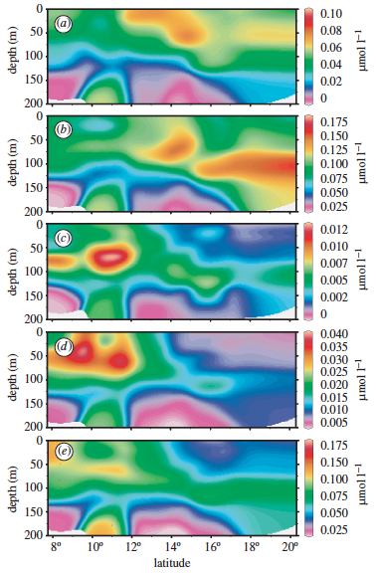
Halogenated Compounds & Pigments
zeaxanthin
divinyl chl a
peridinin
fucoxanthin
19 hexanoyl-
fucoxanthin
Notes:
Smythe-Wright et al., Philos. Trans. R. Soc., Ser. A, 2005

Slide 19
Pigments & Taxonomy

Slide 20
PHYSAT: Phytoplankton Identification using remotely sensed nLw
Alvain et al., Global Biogeochem Cyc, 2008

Slide 21
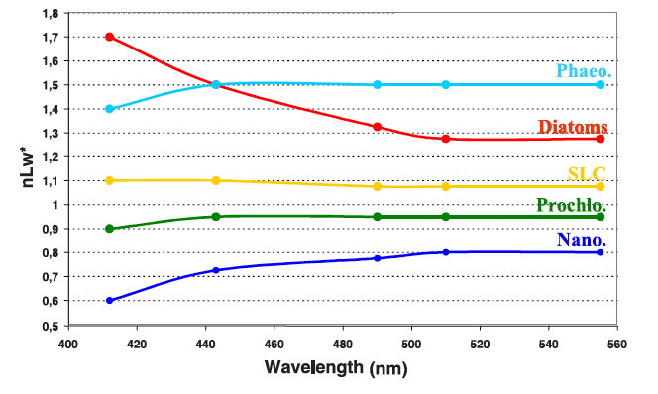
Mean nLw* Spectra for PHYSAT groups
Alvain et al., Global Biogeochem Cyc, 2008

Slide 22
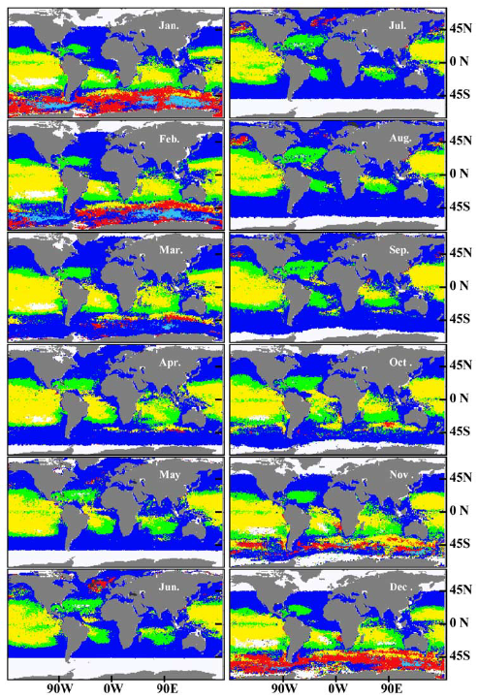
PHYSAT
Monthly Climatology
-of the dominant
phytoplankton group
Nanoeucaryotes
Prochlorococcus
Synechococcus
Diatoms
Phaeocystis-like
-based on 1998-2006 SeaWiFS
Alvain et al., Global Biogeochem Cyc, 2008

Slide 23
Isoprene & Clouds
Meskhidze & Nenes [2006]
Cloud droplet number concentration double
Cloud droplet effective radius (R_{eff}) reduced 30%
Reduced short-wave radiation at TOA by 15 W m⁻²
Chl a had greatest influence on Reff of all parameters evaluated
Attributed cloud properties to phytoplankton bloom
Proposed marine biogenic isoprene as the source of SOA
Marine Isoprene Emissions: 0.1 – 1.9 Tg C yr⁻¹
Terrestrial Isoprene Emissions: 400-750 Tg C yr⁻¹
Arnold et al. [2009]
Over remote oceans, terrestrial sources provide 0.1 pptv isoprene
Marine isoprene emissions can support tens of pptv
Oxidation of marine isoprene in these regions provides source of radicals
But, contribution to marine OA < 1%

Slide 24
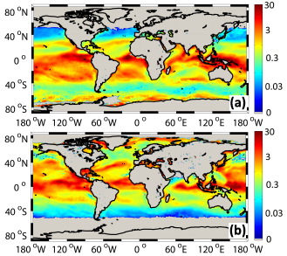
Marine Isoprene SOA % Contribution to Total Submicron Marine Aerosol: Jan/Jul 2001
Gantt et al., ACP, 2009

Slide 25
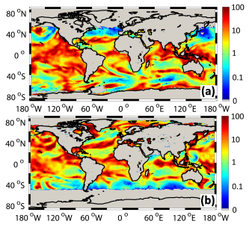
Daily Max. Marine Isoprene SOA % Contribution to Total Corresponding Submicron Marine Aerosol: 1 Jan/ 1 Jul 2001
Gantt et al., ACP, 2009

Slide 26
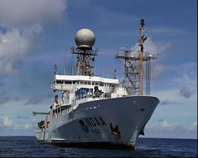
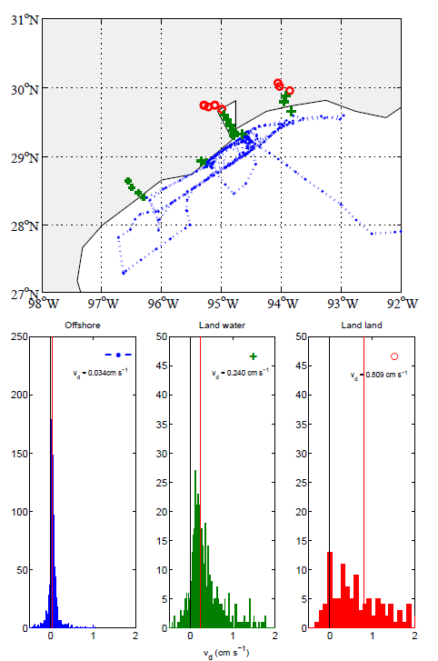
Helmig et al. - Variables Controlling Ozone Deposition to Ocean Water
1/3 of Atmospheric Ozone lost to Ocean Surface.
Oceanic Ozone Deposition Fluxes show High Variability.
Physical Variables determining Ozone Uptake include Winds, Wave Motion, Temperature.
Physical Variables can only explain a Fraction of the Ozone Flux.
Chemical Enhancement from Ozone Reaction with Chemical Species in Ocean Microlayer
Not 100% sure yet what Chemical Reactants are. Candidates: I⁻, Unsaturated Organics, Halogens?
50% of Variability in Ozone Flux can be explained by in-situ Ocean Chlorophyll/ Satellite Ocean Color Observations.
Cruise Tracks
Ozone Deposition Results
Open Ocean
Near Land
Ship
Channels

