Slide 1
Aerosol Daytime Variations over North and South America as Derived from Multiyear AERONET Measurements
Yan Zhang1, Hongbin Yu2, Alexander Smirnov1, Tom Eck1, Mian Chin3, Lorraine Remer3, Qian Tan1, Robert Levy4
1 GESTAR/USRA, 2 ESSIC, 3 NASA/GSFC, 4 SSAI
May 12, 2011

Slide 2
Aerosol can have a large daytime variation
Important for studies of
climate forcing
air quality
satellite data validation
Relatively under-explored over large regions
polar orbiting satellites have no capability (one daytime visit)
geo satellites have large uncertainties
Our objective:
document aerosol daytime variations in GEO-CAPE viewing areas with high quality, multi-year measurements from AERONET
give suggestions to GEO-CAPE requirements aspect with aerosol s

Slide 3

AERONET Data Processing
Instantaneous measurements from 54 AERONET sites (after 1997) with more than two year active measurement period.
Daily mean:
$AOD_{day}=\frac{\sum_{i=1}^{n}{{AOD_{hr}}_{i}}}{n},$ for days with more than five hourly measurements
Hourly mean:
$AOD_{hr}=\frac{\sum_{i=1}^{n}{{AOD}_{i}}}{n},$
We use departure (percentage) from daily mean instead of absolute value to present aerosol day time variation
Hourly departure :
$$AOD_{dpt}_{i}= {(AOD}_{hr}−AOD_day)/AOD_day$$
*100%
Daytime variation :
$AO{D_dpt}_{season}=\frac{\sum_{i=1}^{n}{{AOD_{dpt}}_{i}}}{n},$ for seasons DJF, MAM, JJA, and SON.

Slide 4
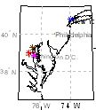
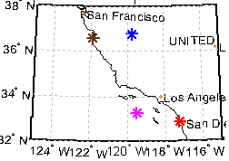
US: Northeast and West Coast (pollution aerosols) show opposite AOD daytime variations
Northeastern US (JJA)
West Coast US (JJA)
Northeast: Increasing AOD over a day likely associated with strong afternoon photochemical activity
West Coast: AOD maximum in morning, decreases during day
- associated with mesoscale circulations

Slide 5
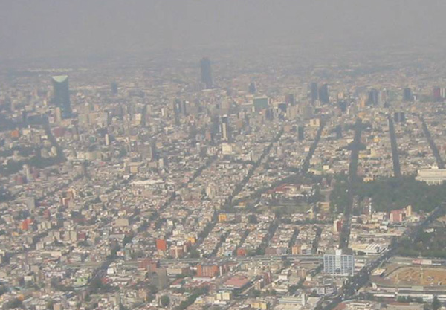
AE
AOD
Rapid morning increase of AOD due to local emission.
Small afternoon AOD change due to basin ventilation by terrain-induced wind.
AE shows 15%~25% changes; noontime peaks could be related to strong photochemistry that produces small particles.

Slide 6
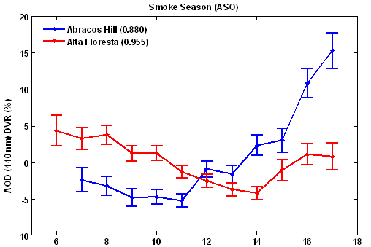
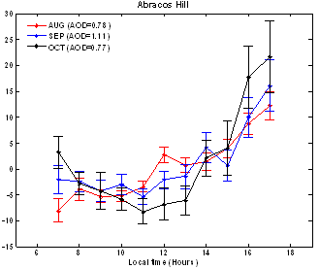
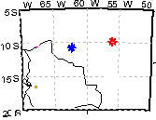
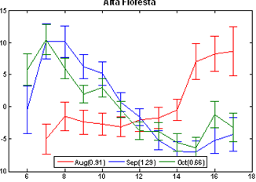
Two forest sites in South America (smoke aerosols) with differing AOD daytime variations
Abracos Hill
Alta Floresta
Abracos Hill
Alta Floresta
Abracos Hill: AOD increases during day; late afternoon maximum consistent with observed peak fire activities
Alta Floresta: AOD has morning maximum, decreases during day

Slide 7
Lanai Island (Marine aerosols), Hawaii: AOD increases during day presumably associated with sea breeze
AE
Lanai
AOD
Large AE variation could result from: 1) large uncertainties in low AOD regime; 2) photochemistry produces fine-mode sulfate aerosol at the noon.

Slide 8
AOD and AE variations show wide range depending on location and/or season
(AOD)
(AE)
Northeast US has large AOD (> 0.3) and AE (> 1.6), but small DVRs
West Coast US shows small AOD (<0.3) and AE (0.8~1.2), but AE DVR are large
Middle US has small AOD & DVR
South America shows large AOD (> 0.3) over Amazon region
Notes:
Colors indicated magnitude of AOD or AE.
- Size of Triangle presents AOD or AE DVR. DVR is an index to present departure range (Max – Min departure).
- Direction of triangle is morning or afternoon when AOD/AE maximum appears.

Slide 9
Conclusions
There are a wide range of AOD and AE variations depending on location and/or season
AOD changes could be increasing or decreasing, but they are non-linear.
To capture observed AOD variations we see, at least three successful aerosol retrievals from geo satellites are needed (morning, noon, and afternoon).
Both comprehensive datasets and regional simulations are needed to better understand the observed complex daytime variations. In particular, simultaneous measurements of aerosol and precursors from GEO-CAPE would provide better insight

